Slide 1
Transient Explorer’s
Progress Report
John Bartholow
PRTI, January, 2017

Slide 2
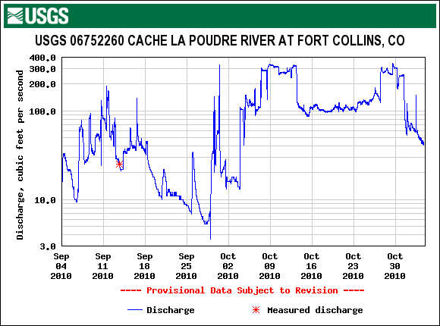
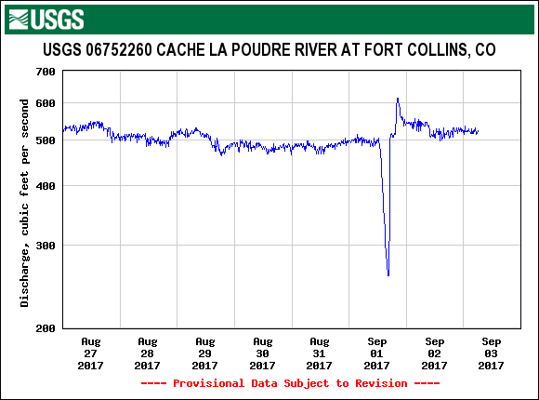
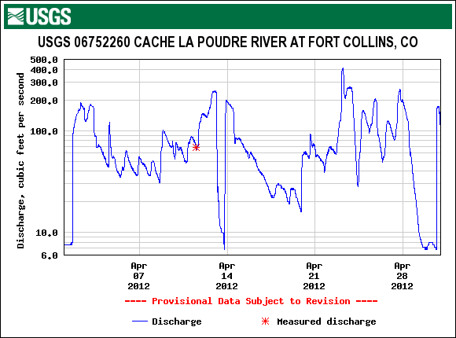
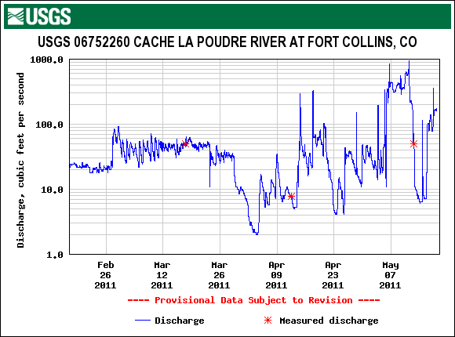
Why?
Documented Abrupt Flow Events
Note logarithmic scales

Slide 3
Initial Goals
Understand the likely causes of flow fluctuations that are Transient:
  Abrupt – begin and end rather suddenly
  Short-lived
  Represent a large percentage or absolute flow change
  Occur in the Poudre, primarily through the Fort Collins reach
Understand how transients may impact aquatic organisms, public safety, sediment management and/or water temperature (positively or negatively)

Slide 4
And Also…
Brainstorm promising opportunities for further exploration that might:
  Reduce the magnitude / frequency / length of river / or avoid certain times of the year of large transients
  Opportunities could include:
    Structural changes
    Operational changes
  All directed toward a healthier working river and acceptable to all parties

Slide 5
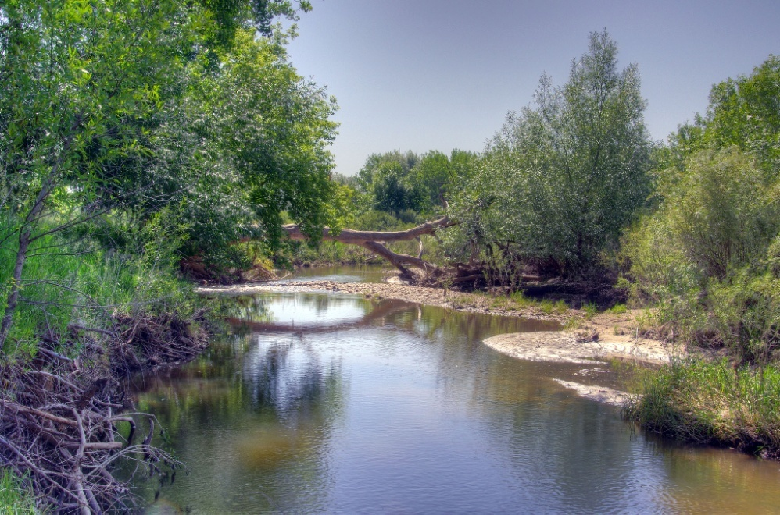
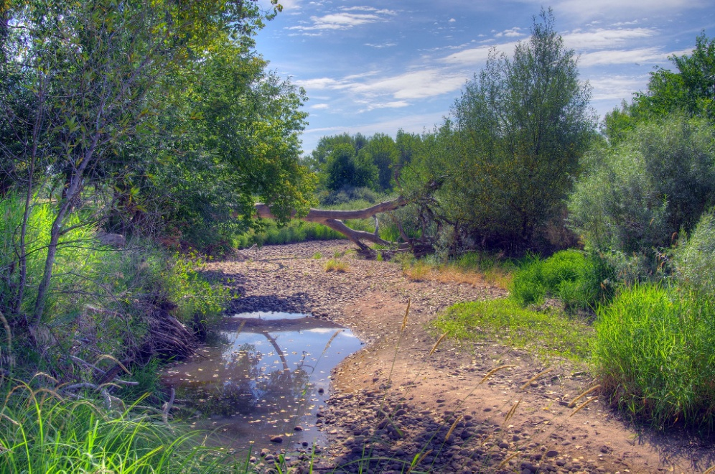
Abrupt Flow Plunges
Can dewater channels (especially side channels) leading to fish stranding if long lasting

Slide 6
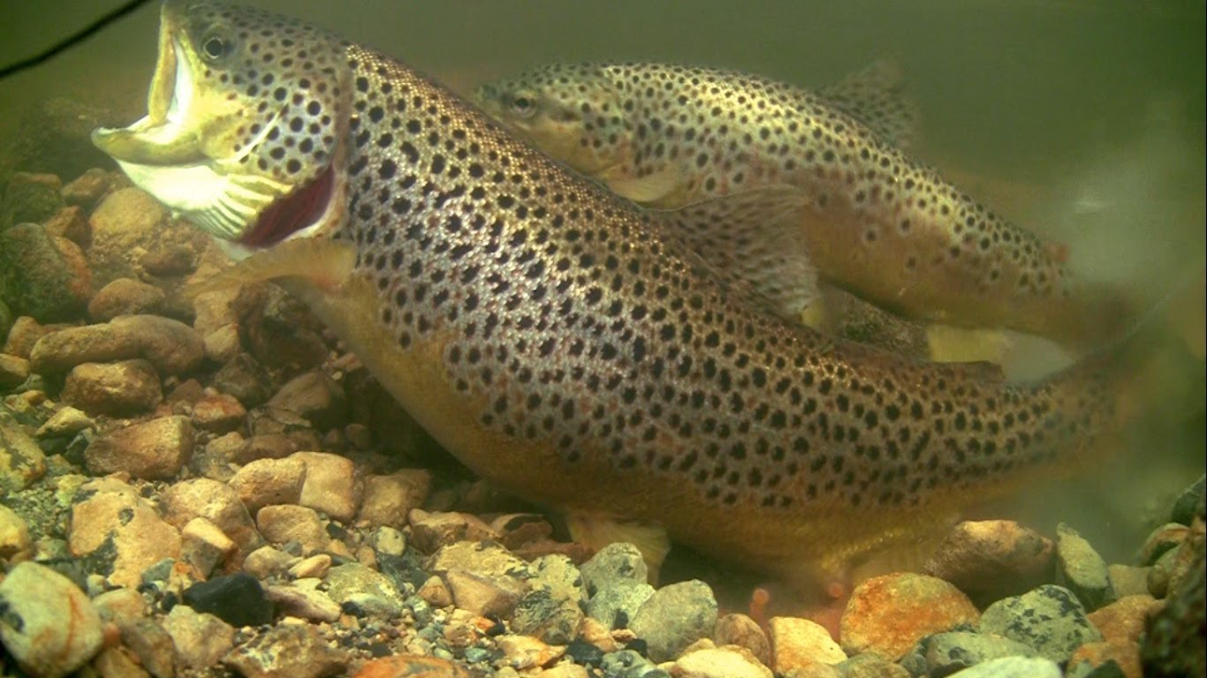
Abrupt Flow Spikes
Can disrupt brown trout spawning in October

Slide 7
Biological ‘Guidance’
Scientific literature is scarce and incomplete:
  Especially for warm water species
Stranding is worse when:
  Water is cold (< 40-44°F)
  Substrate is coarse and gradients low
  Ramping rate (rate of change) is greater than ~1/3 to 1/2 foot per hour in a low flow range
    Example: At McMurry Bridge, a 100 cfs change = 0.36 feet when flows are low
Abrupt fluctuations are associated with higher energetic costs, lower growth rates, reduced spawning and rearing success

Slide 8
Recreation and Safety
Both abrupt flow increases and decreases can affect quality and safety of river-based recreation
There is no way for public to anticipate sudden changes
  Flows that are safe for a young child for tubing at 10 am could become unsafe by noon

Slide 9
Data Used
November 2015 through October 2016, i.e., WY 2016
  Telemetry was added to many diversion points for 2016
  15-minute data only
    No QA/QC; obvious data gaps and bad values
  Inflows (Mainstem, North Fork & Hansen Supply Canal)
  Many, but not all, diversions

Slide 10
Data Used, cont.
Top of main focus
Note
Bottom of focus

Slide 11
Starting Point – Gage Data
Logarithmic scale use to highlight differences
Only part of year shown here
Primary Focus

Slide 12
Approach
Calculated the maximum positive or negative flow changes within 24-hours following each 15-minute data point
  Absolute, i.e., maximum – minimum cfs, & vice-versa
  Percentage (Relative) change in cfs
  Each may have utility in exploring impacts
Sampled largest transient events to identify major contributing factors

Slide 13
Selected Findings – 1
Large transients, both absolute and percentage, occur year-round
But mostly occur during the irrigation season, June through October
For example, these are absolute “spikes” from May through October

Slide 14
Selected Findings – 2
Some events are straightforward resulting from day-to-day operations
For example a canal headgate must be cleared or tended
Here it is likely that Larimer-Weld diversion was stopped to increase river depth to float debris off its trash rack
500 cfs

Slide 15
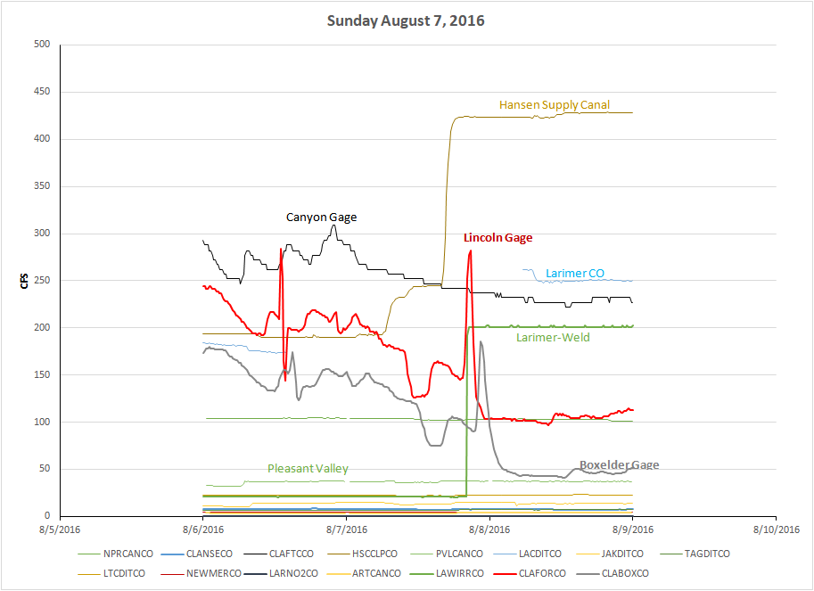
Selected Findings – 3
Some events are more complex timing or coordination issues
Commissioner prefers to see “bumps” rather than “holes”
Appears that water is sent from Horsetooth to Larimer-Weld but there is a delay in capturing that water

Slide 16
Selected Findings – 4
Transients often observed Thursday to Monday
Shown is a common ‘shut-down’ pattern – small Thursday drops followed by larger Friday drops
Hansen Supply Canal ramping off in stages

Slide 17
Selected Findings – 5
Diurnal fluctuations during peak snowmelt can be large but are rarely abrupt
Here we see ±400 cfs variation from a high daily mean flow

Slide 18
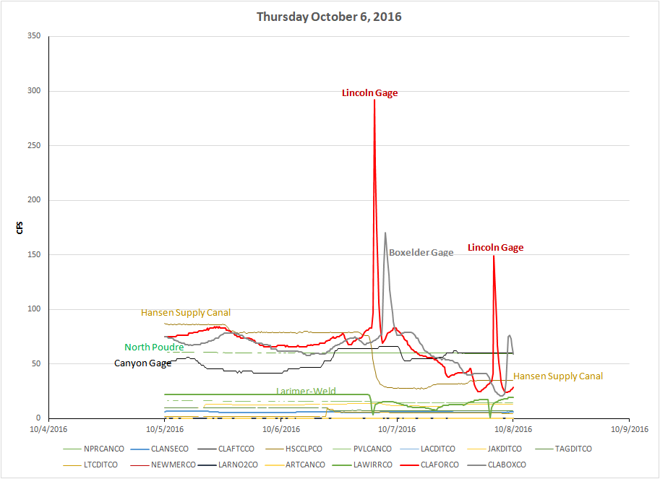
Selected Findings – 6
Often no obvious explanation for magnitude of transients
Could be rainfall, ice, bad or misleading gage data, …

Slide 19
Looking Ahead
There may be fewer large transients in the future
  C‑BT deliveries to the Poudre will likely decline as downstream agricultural deliveries convert to upstream municipal withdrawals
But if less water is in the river, there may be more large percentage flow changes from river operations
  Less “buffering” capacity
Time will tell

Slide 20
Brainstorming
Opportunities
Operational
Structural
Information
(& data)

Slide 21
Operational Opportunities - 1
  Meet with large diverters to better understand their operations, explore possibilities, and brainstorm incentives for all parties
Potential operational examples:
  Tweak the ‘normal’ Hansen ramping rate guidelines
  Use more but smaller step changes when large flow changes are scheduled and automated receipt of water is, or becomes, possible

Slide 22
Operational Opportunities - 2
If a weekly water users coordination conference should come to pass to discuss multiple objectives, keep transient issues in mind
If new water development projects are built, explore possibilities to further minimize detrimental transients without injecting any new ones

Slide 23
Structural Opportunities
Continue to look for funds to automate diversion headgates and maximize working-river coordination
Continue to support Flows Initiative and fish passage retrofit since base flows help buffer large percentage flow changes and likely mitigate stranding
Support redesign of large capacity headgates to minimize needs to abruptly “flush” debris from diversion pools

Slide 24
Information Needs - 1
Continue to explore adding more real-time measurements to diversions
  Though many have been added recently, many remain
  Priorities are largest diversions and municipal intakes & outfalls
  Data will benefit multiple objectives such as the Flow Augmentation Initiative
Support local scientific studies that may shed light on the biological implications of abrupt flow fluctuations, e.g., fish movement

Slide 25
Information Needs - 2
For "educational" purposes only, consider Smartphone app to display real-time flow data with warnings on likely flow changes along the river
  OWF oversee development with grant from Fort Collins
  App could present other geo-referenced data
  Must consider any liability issues

Slide 26
Caveats
Existing operations system has been established over almost 150 years
  Few incentives to change operations or infrastructure
  Some reasons not to change:
    Transit loss, expense, extra responsibilities, possible benefits of flow spikes

Slide 27
Data Limitation?
Additional years of more complete data may reveal other issues and opportunities
Index = [∑(abs(Q(i)-Q(i-1))] / [∑((Q(i)+Q(i-1))/2)]
Bob Milhous, personal communication, 2017
Notes:
FLASHINESS INDEX EQUATIONS
RB Index = [∑(abs(Q(i)-Q(i-1))] / [∑((Q(i)+Q(i-1))/2)]
Flashiness Index = ∑[(abs(Q(i)-Q(i-1)) / ((Q(i)+Q(i-1))/2)]/Ndays
TQmean= ∑(N days Q ≥ Qave)/Ndays
RBI is the Richards-Baker Flashiness Index

Slide 28
Progress Report Summary
Identified at least some mechanisms causing large transient flow events
  Identified several potential opportunities
    Operational
    Structural
    Information needs
    Ranging from easy and inexpensive to harder, long-term and expensive
  More work to do!

Slide 29
Many Thanks To Many Advisors and Helpers:
Scott Hummer, Ken Kehmeier, Bob Milhous,
Steve Malers, Andy Pineda, Jen Shanahan,
Luke Shawcross, Mark Simpson, Kristin Swaim,
Reagan Waskom, and Brad Wind

Slide 30


