Slide 1
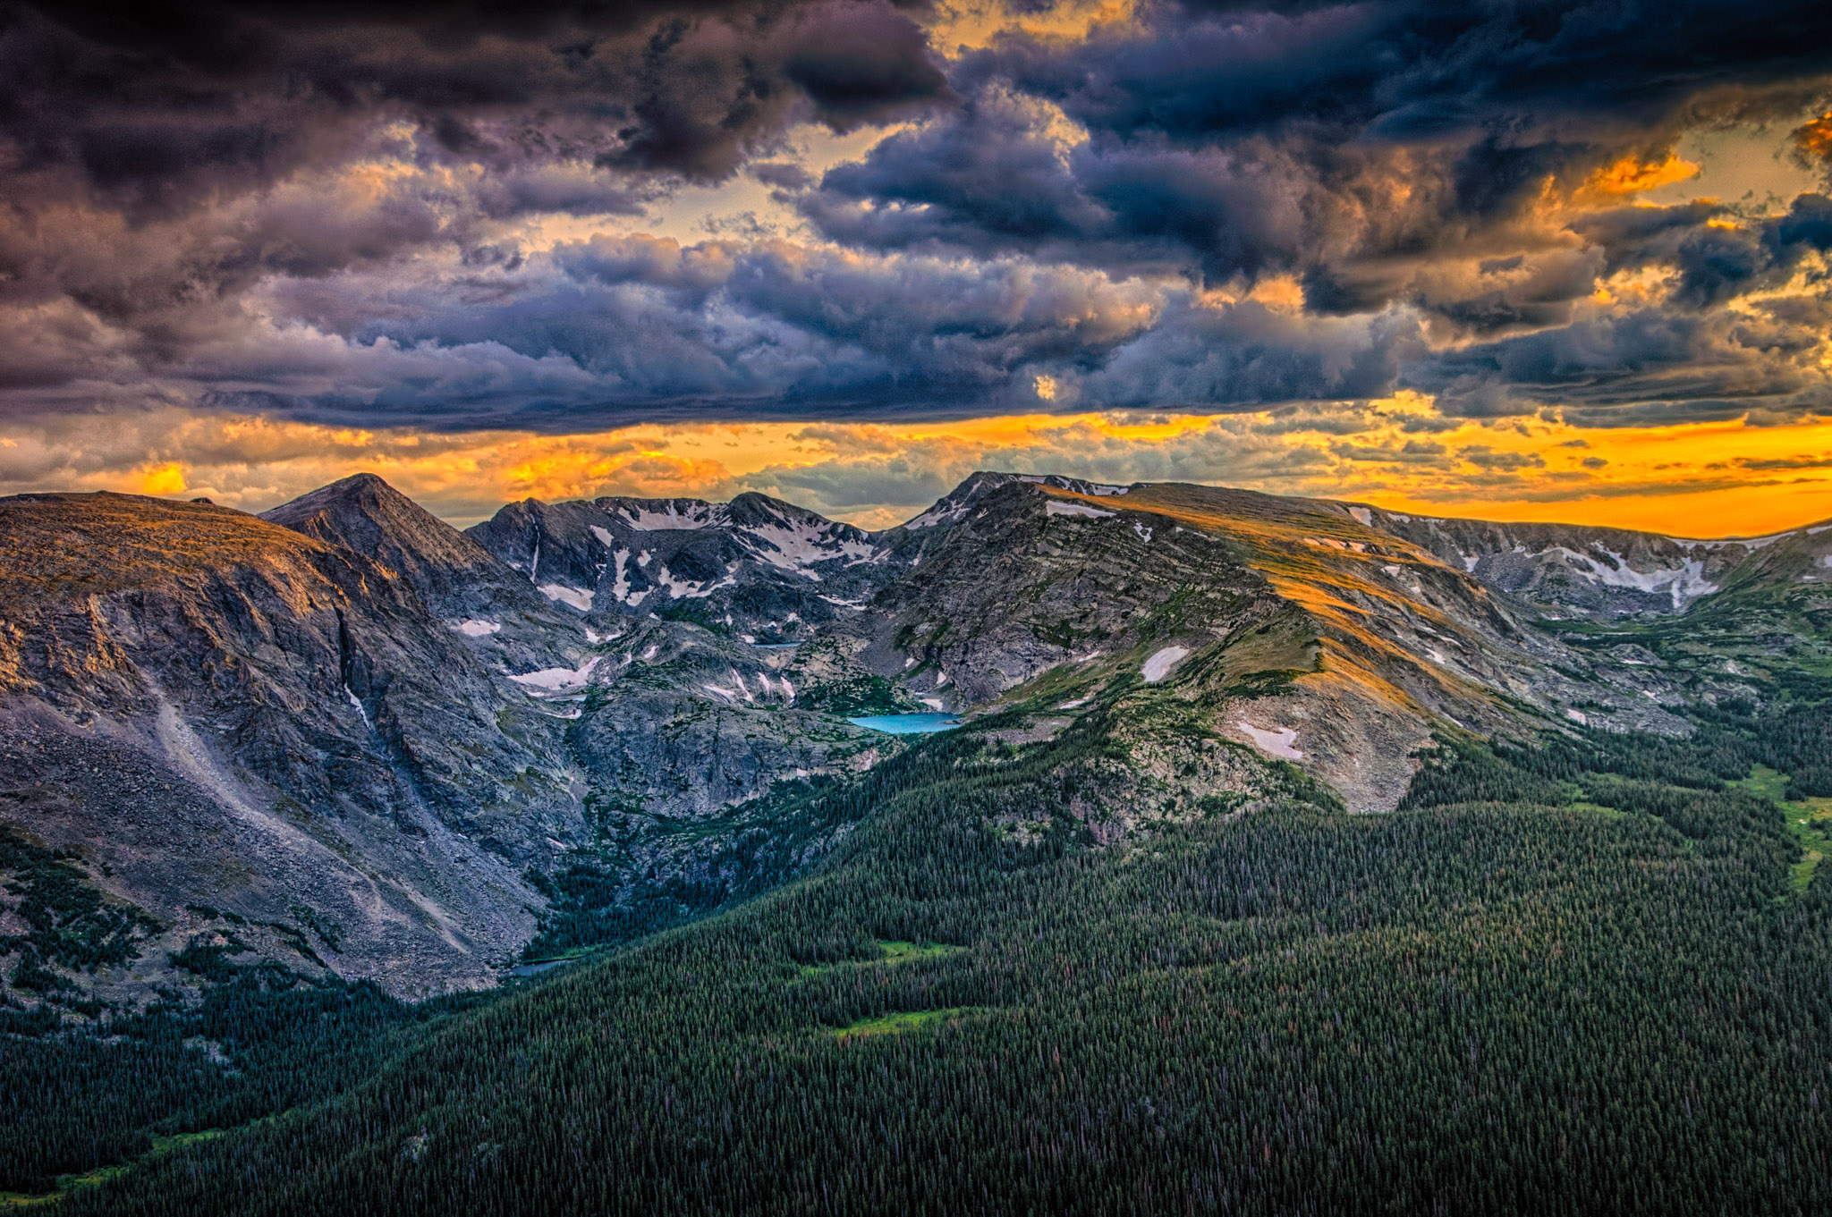
& the Colorado Water Plan
Rebecca Mitchell,
Director, Colorado Water Conservation Board Rebecca.Mitchell@state.co.us
Notes:
Talk about History of the agency
Mission
The Colorado Water Conservation Board's mission is to conserve, develop, protect and manage Colorado's water for present and future generations.
Overview
The Colorado Water Conservation Board (CWCB) represents each major water basin in the state, the Denver Metro Area, and other state agencies in our joint effort to use water wisely and protect our water for future generations.
The CWCB was created over 80 years ago and today it remains Colorado's most comprehensive water information resource. The agency works on a broad range of programs and provides technical and financial assistance to support the Colorado Water Plan.
Governed by a 15-member Board, the CWCB's responsibilities include protecting Colorado's streams and lakes, flood mitigation, watershed protection, stream restoration, drought planning, water supply planning, and water project financing. The CWCB also works to protect the state's water apportionments in collaboration with other western states and federal agencies.
Each CWCB program is directed by the agency's Strategic Framework, as well as through Statutory Authorities and Responsibilities. Reviewed annually by the Board, the Strategic Plan also contains a Board Member Work Plan, which guides the Board's actions and helps implement the authorities and objectives of the CWCB.
Funding and Budget
The CWCB is almost fully self-funded. The majority of the funding appropriations for the CWCB comes from the CWCB Construction Fund (referred to as "Cash Funds").

Slide 2
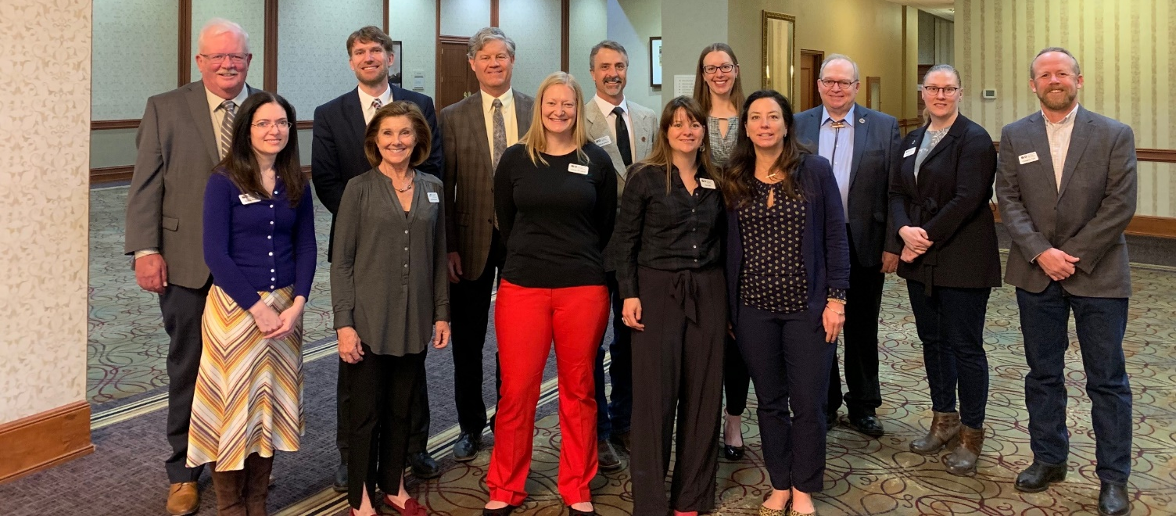
What WE DO
Board of Directors representing each Basin
Staff of nearly 50
Interbasin Compact Committee
Nine Basin Roundtables
MISSION:
To Conserve, Develop, Protect and Manage Colorado’s Water
for Present and Future Generations.
Notes:
Law politics and policy

Slide 3
Our Focus
Supply
Ecosystem health
Industries
Hazards
Interstate
Notes:
Supply
Wise and thoughtful water supply planning and management is critical to ensure a secure future for the state. Our state’s water supply consists of both surface water and groundwater sources, and these supplies are dependent upon complex interactions among geography, weather, and laws and regulations—all of which influence how much water is available for beneficial uses.
The CWCB envisions a Colorado that balances municipal, industrial, agricultural, environmental and recreational water needs and promotes cooperation among all water uses. The vision is supported by many water supply goals, which, when evaluated together, support the development of more balanced water supply strategies.
Supply Planning
Demand Mgmt
Land use and water planning
Urban water efficiency
ATM’s
Weather modification
Storage and reuse
Ecosystem health
Colorado’s mountain watersheds have a strong influence on the quality and quantity of water. Healthy watersheds provide ecosystem services that benefit ecological processes, local and state economies, and social stability. Approximately 80 percent of Colorado’s population relies on forested watersheds to deliver municipal water supplies. Ecosystem health management strategies are efforts that protect and restore our natural ecosystem services, wildlife, and diverse plant communities.
watershed health
ISF
Salinity
Wand scenic
Endangered
Industries
Water is a critical resource for nature and people, as well as a common economic commodity. Used in almost every industry—Colorado water is an essential input for agriculture, food, and beverage production; as a part of the industrial processes in many manufacturing and industrial operations; and a critical input in energy generation. Companies have unique water footprints, requiring different amounts and types of water at different parts of their supply chains.
Ag, Energy, rec, tourism
Hazards
Coloradans are familiar with the threats and impacts of natural disasters, including droughts, wildfires, floods, and tornadoes. In the past decade, Colorado experienced a flood in 2013 that resulted in nearly $4 billion in damages; wildfires in 2010, 2012, 2013, and 2018 that destroyed over 1,250 homes; a tornado that left a scar through multiple communities in 2008; and many others. While these natural hazards have and will continue to impact Colorado communities, they ultimately push our state toward more thoughtful, resilient management plans.
The Colorado Resiliency Framework (2015) defines the structure through which the State will support local agencies and community groups on their path toward resiliency. The Colorado Water Conservation Board (CWCB) works closely with the Colorado Resiliency Office (CRO) and the Colorado Division of Homeland Security and Emergency Management (DHSEM) to plan for, respond to, and rebuild from natural hazard events. For a complete list of hazards that can impact Colorado, you can reference the State's Natural Hazard Mitigation Plan
Climate, drought, flood
Seven major watersheds originate in Colorado, sending water downstream to nineteen other states. As a result, Colorado is a party to nine Interstate Compacts and an international treaty with Mexico. Partnering with our downstream neighbors is an important part of managing water in Colorado.
Interstate Compacts
Interstate compacts, which are agreements between two or more states, govern specific interactions among those states and require consent by the U.S. Congress.
The State of Colorado is party to the following interstate compacts and equitable apportionment decrees:
Arkansas River Basin
Arkansas River Compact of 1948
The compact protects all water uses in existence in 1949 and apportions the benefits of John Martin Reservoir between Colorado and Kansas.
History of the Arkansas River Compact
Colorado River Basin
Colorado River Compact and Upper Colorado River Compact
These compacts allow Colorado to use up to 3.85 million acre feet (MAF), provided the Upper Basin does not cause the flow at Lee Ferry, Ariz., to fall below 75 MAF, based on a 10-year running average (7.5 MAF/year). To learn more, see the Coordinated Long Range Operating Criteria. Learn about Compact Administration in this presentation.
La Plata River Compact
This compact apportions the waters of the La Plata River between Colorado and New Mexico, by allowing the unrestricted right to use waters by both states between December 1 and February 15, and allocating specific flows and deliveries between February 16 and November 30.
Animas-La Plata Compact
This compact provides agreements that allow for the operation of the Animas-La Plata Project.
History of the Colorado River Basin Compacts
North Platte River & Laramie River Basins
North Platte River Decree
The North Platte Decree limits Colorado’s use of North Platte River water.
Laramie River Decree
The Laramie River Decree limits Colorado’s diversions to 49,375 AF/year in the Laramie River Basin.
Republican River Basin
Republican River Compact
Colorado’s consumptive uses are limited to 54,000 AF, plus all uses from Frenchman and Red Willow Creeks.
Rio Grande River Basin
Rio Grande Compact
The compact establishes Colorado’s obligation to ensure deliveries of water at the New Mexico state line and New Mexico’s obligation to assure deliveries of water at the Elephant Butte Reservoir, with some allowance for credit and debit accounts.
Costilla Creek Compact
The compact establishes uses, allocations and administration of the waters of Costilla Creek in Colorado and New Mexico.
South Platte River Basin
South Platte River Compact
The compact establishes Colorado’s and Nebraska’s rights to use water in Lodgepole Creek and the South Platte River.
In addition, the Director of the Colorado Water Conservation Board (CWCB) is a voting member of the Arkansas River Compact Administration, and CWCB staff provide engineering and legal advice to the Administration. Staff members also are designated representatives to the Engineering and Legal Committees of the Upper Colorado River Commission.

Slide 4
DNR-other agencies
CPW
CDPHE
SEO
AG
Notes:
CWCB is not a regulatory agency….
Law politics policy

Slide 5
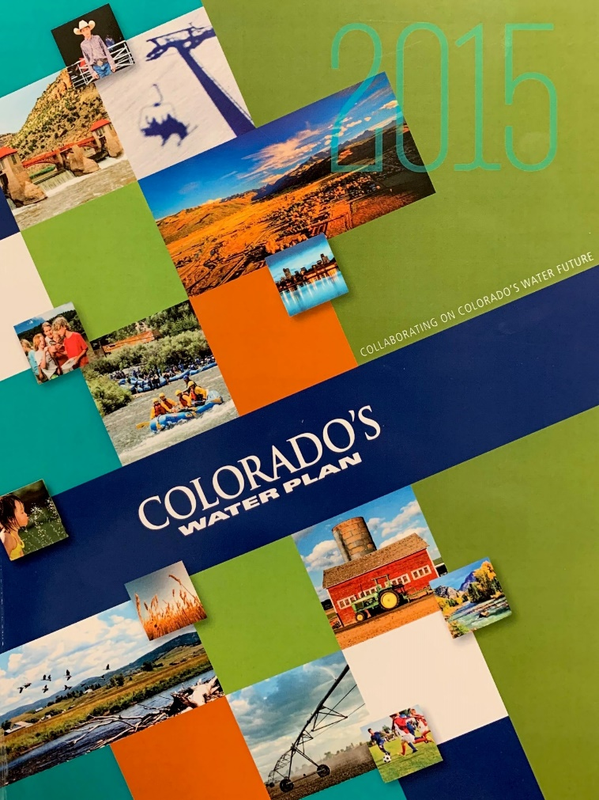
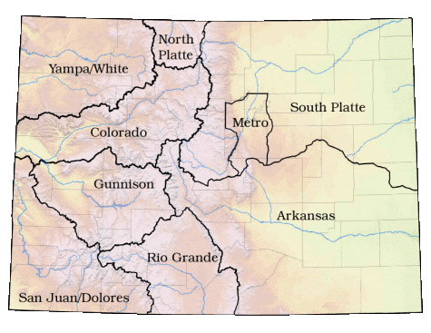
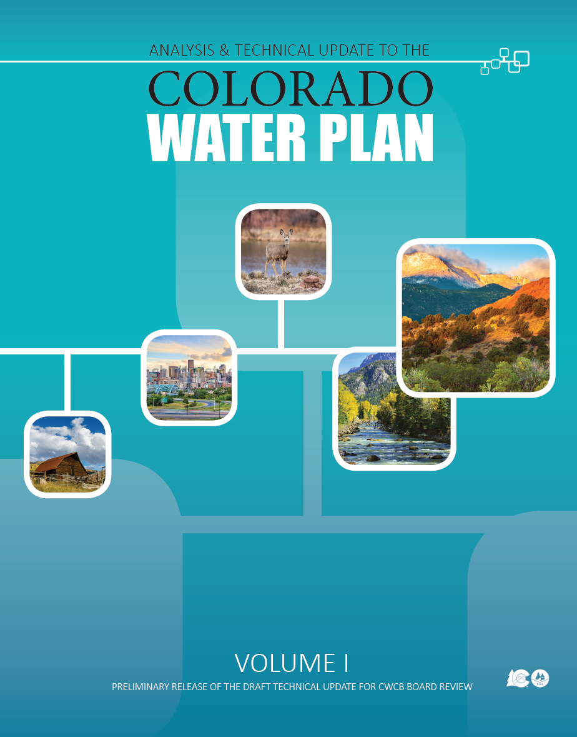
Colorado’s Water Plan

Slide 6
WATER PLAN PROCESS
65% Progress

Slide 7
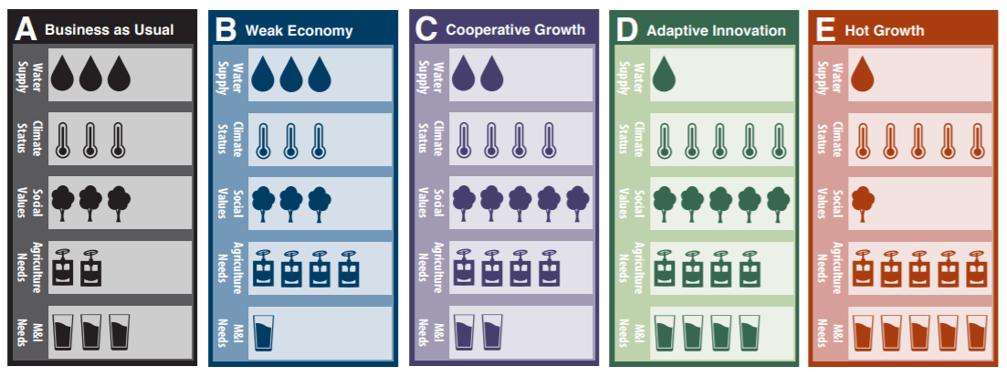
SCENARIO PLANNING
NO CHANGE MODERATE SIGNIFICANT
CHANGE CHANGE

Slide 8
WATER PLAN GOALS

Slide 9
Funding
Grants
Loans
Referendum DD
Notes:
Agriculture
Conservation & Land Use
Engagement & Innovation
Environment & Recreation
Water Storage & Supply

Slide 10
THANK YOU
Rebecca Mitchell,
Director, Colorado Water Conservation Board Rebecca.Mitchell@state.co.us

