Slide 1
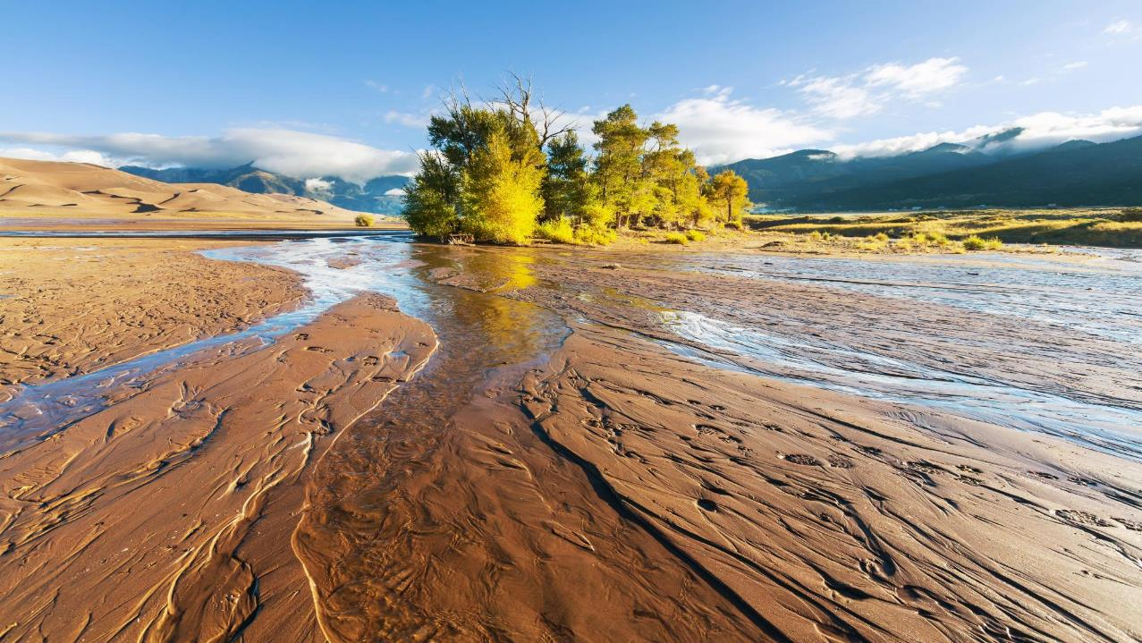
Environmental Aspects of Water Policy & Politics
GRAD592 - Interdisciplinary Water Resources Seminar Series
Nicole Rowan, Clean Water Program Manager
Colorado Department of Public Health and Environment
nicole.rowan@state.co.us

Slide 2
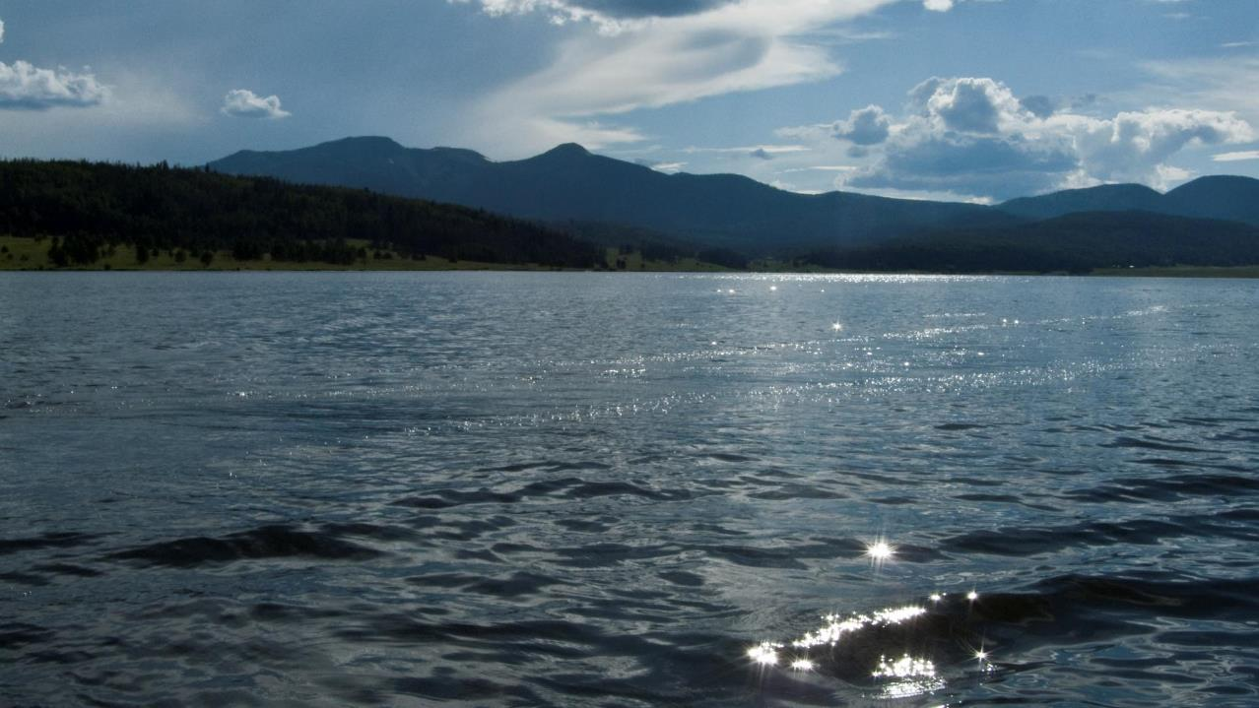
Water Quality Control Division Mission:
Regulatory agency
  Safe Drinking Water Act
  Clean Water Act
  Colorado’s Water Quality Control Act
Staff to Water Quality Control Commission
Protect and restore water quality for public health and the environment in Colorado

Slide 3
History of federal Clean Water Act and Colorado Water Quality Control Act
Federal Clean Water Act
Colorado Water Quality Control Act
1899 Rivers and Harbors Act
1948 Federal Water Pollution Control Act (FWPCA)
1965 Water Quality Act
1970 EPA Established
1972 FWPCA Amendments or Clean Water Act
1977 Clean Water Act
1987 Water Quality Act
1966 Colorado Water Pollution Control Act
1973 Colorado Water Quality Control Act
1985 Colorado Water Quality Control Act Amendments
1989 Colorado Water Quality Control Act Amendments
Several amendments since 1989

Slide 4
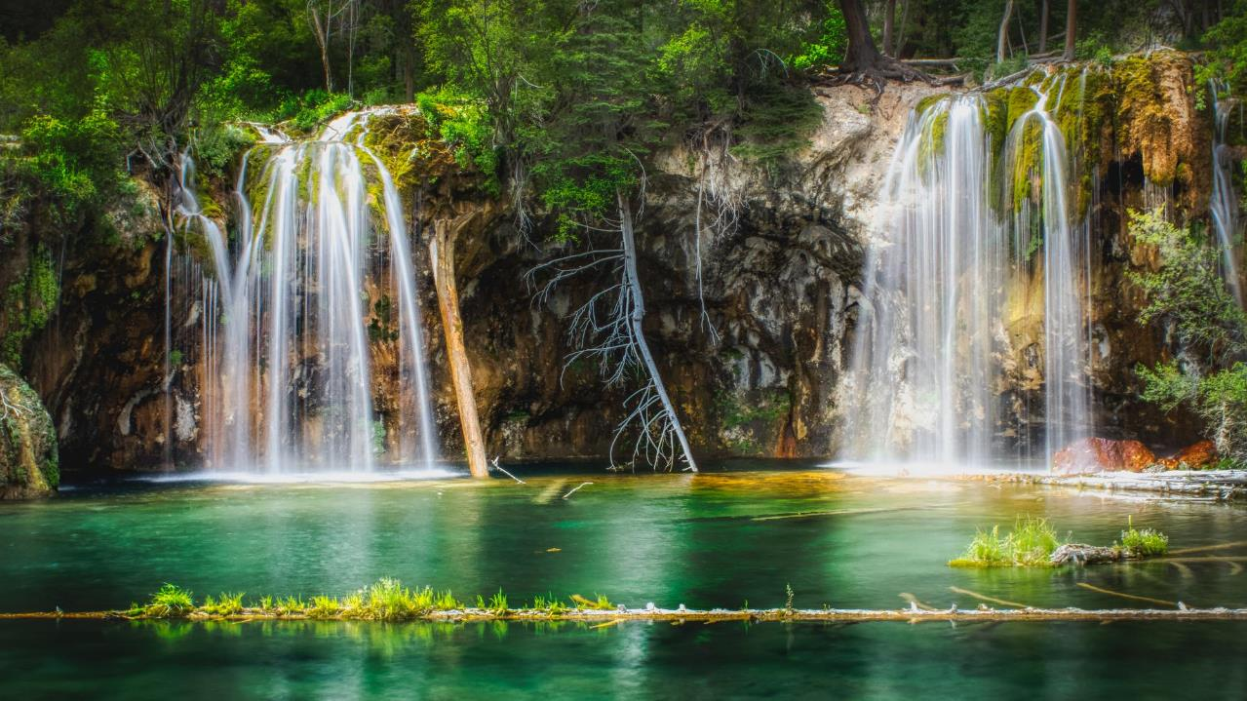
Clean Water Act Goal
Prevent, reduce, and eliminate pollution in the nation's water in order to "restore and maintain the chemical, physical, and biological integrity of the Nation's waters”. [33 U.S.C. § 1251(a)]

Slide 5
WQCD’s Permits

Slide 6
Penalties
($, per day, per violation)

Slide 7
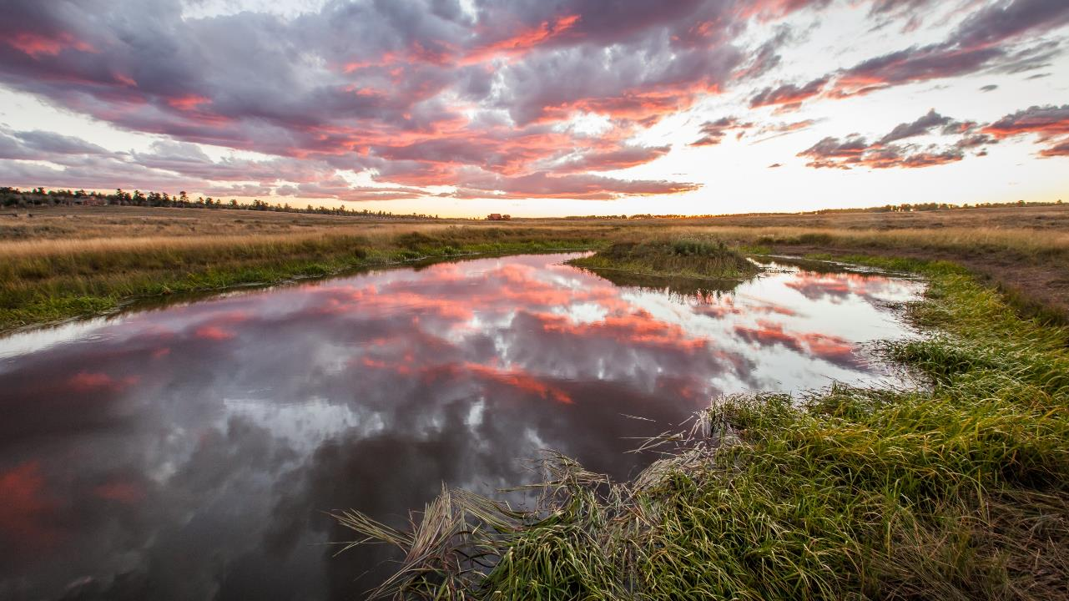
Case Study: Waters of the United States
The term ‘‘navigable waters’’ means the waters of the United States, including the territorial seas. [33 U.S.C. § 1362(7)]

Slide 8
WOTUS History
Since 1970s the Environmental Protection Agency and U.S. Army Corps of Engineers have defined WOTUS in regulation and policy
Three supreme court decisions – 2006 case (Rapanos) results in 2008 policy that is in effect in Colorado today
2015 Obama Rule
2020 Trump Rule

Slide 9
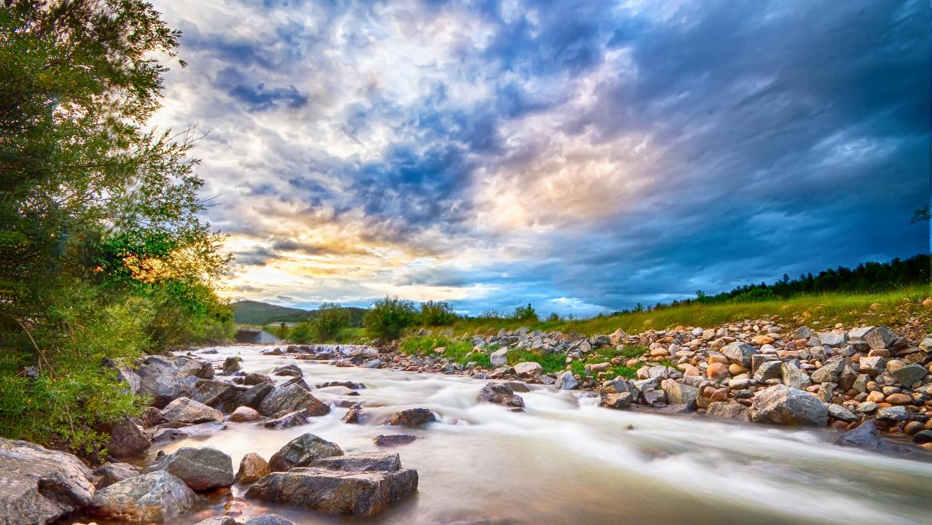
State Waters
"State waters" means any and all surface and subsurface waters which are contained in or flow in or through this state, but does not include waters in sewage systems, waters in treatment works of disposal systems, waters in potable water distribution systems, and all water withdrawn for use until use and treatment have been completed. [C.R.S. 25-8-103(19)]

Slide 10
State Waters

Slide 11
State Waters that are WOTUS under
2008 guidance
2008 WOTUS Guidance

Slide 12
State Waters that are WOTUS under
2008 guidance and 2020 Navigable Waters Protection Rule
2020 Navigable Waters Protection Rule

Slide 13
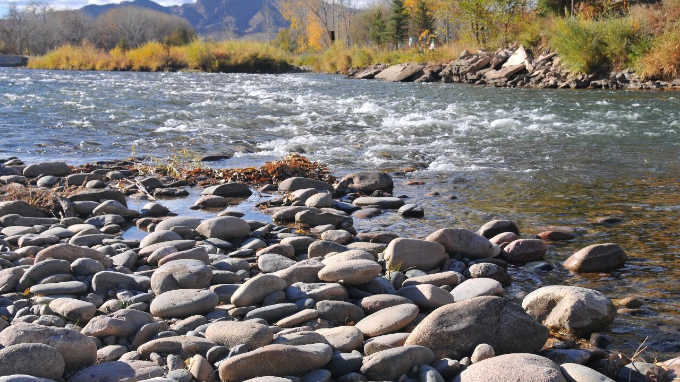
2020 Navigable Waters Protection Rule - District Court of Colorado
Rule finalized and published in federal register on April 21, 2020
Colorado filed complaint on May 22, 2020
Colorado filed motion for preliminary injunction to stay the implementation of the rule on May 28, 2020
June 19, 2020 Judge Martinez granted Colorado’s request for a stay

Slide 14
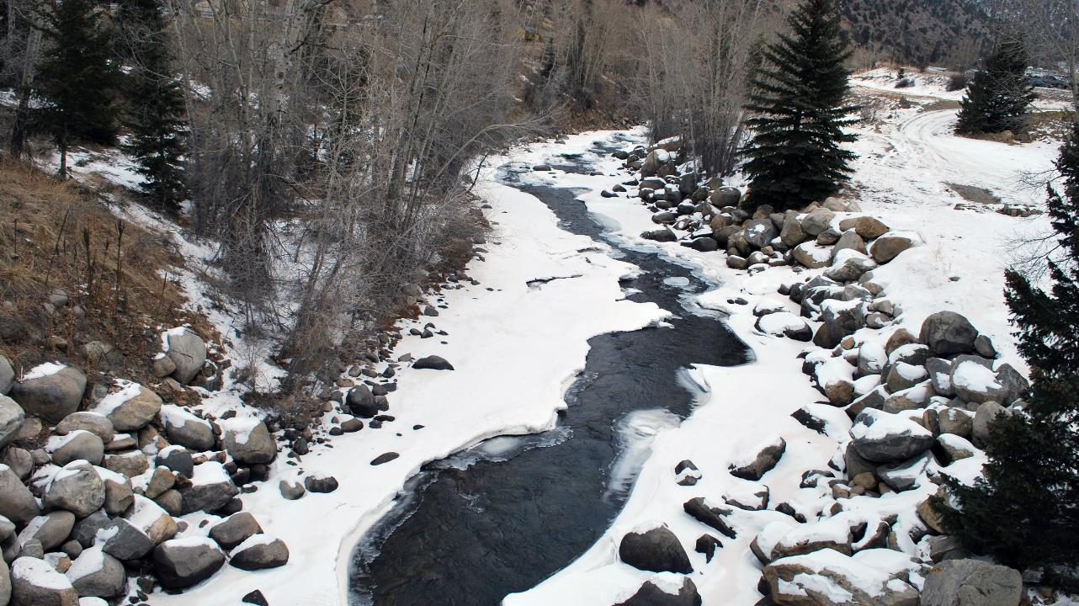
2020 Navigable Waters Protection Rule - 10th Circuit Court of Appeals
June 23, 2020 Department of Justice (DOJ) filed notice of intent to appeal district court decision
DOJ’s opening brief, July 9, 2020
State’s response brief, August 7, 2020
DOJ’s reply brief, August 14, 2020
Oral Arguments, November 18, 2020

Slide 15
2020 Colorado Legislative Session
“Gap” Waters
Amend Colorado Water Quality control Act to allow dredge and fill
Colorado permit program for “gap” waters
Funding

Slide 16
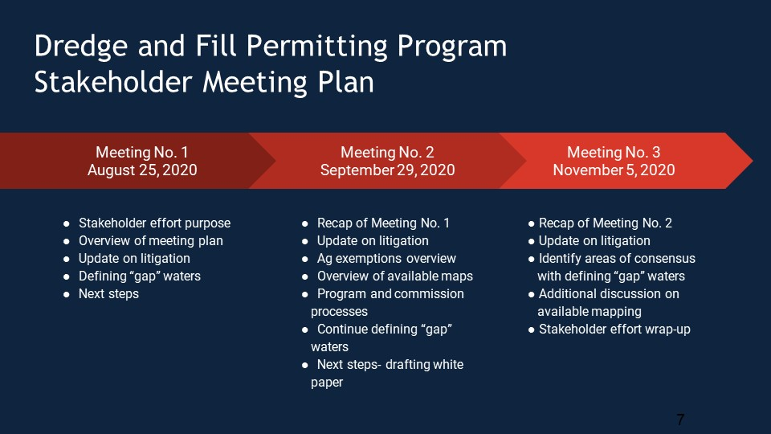

Slide 17
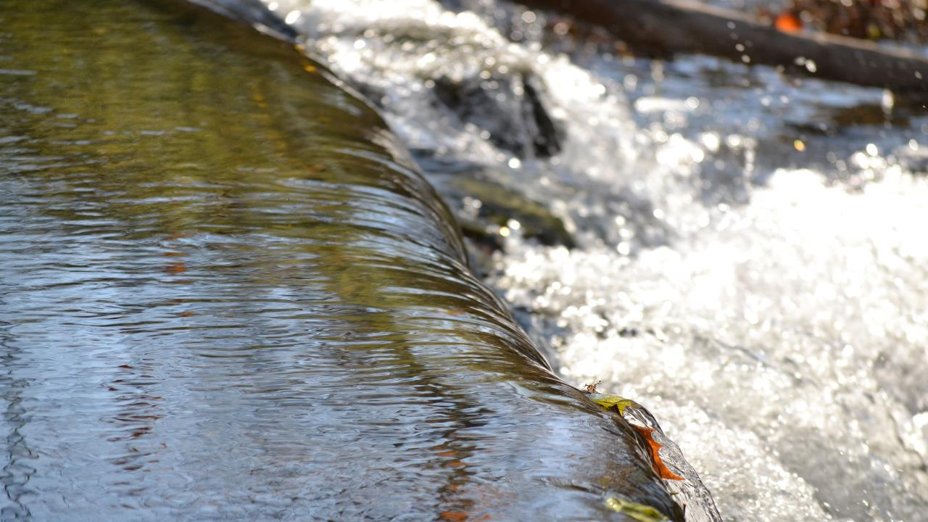
THANK YOU!
Nicole Rowan, Clean Water Program Manager
Colorado Department of Public Health and Environment
nicole.rowan@state.co.us

