Slide 1
Recreational Water Law and Policy:
Water, Wetlands, Waterfowl
Greg Kernohan, Director
Ducks Unlimited, Inc.
Western Water Law, Policy and Institutions
October 12, 2020

Slide 2
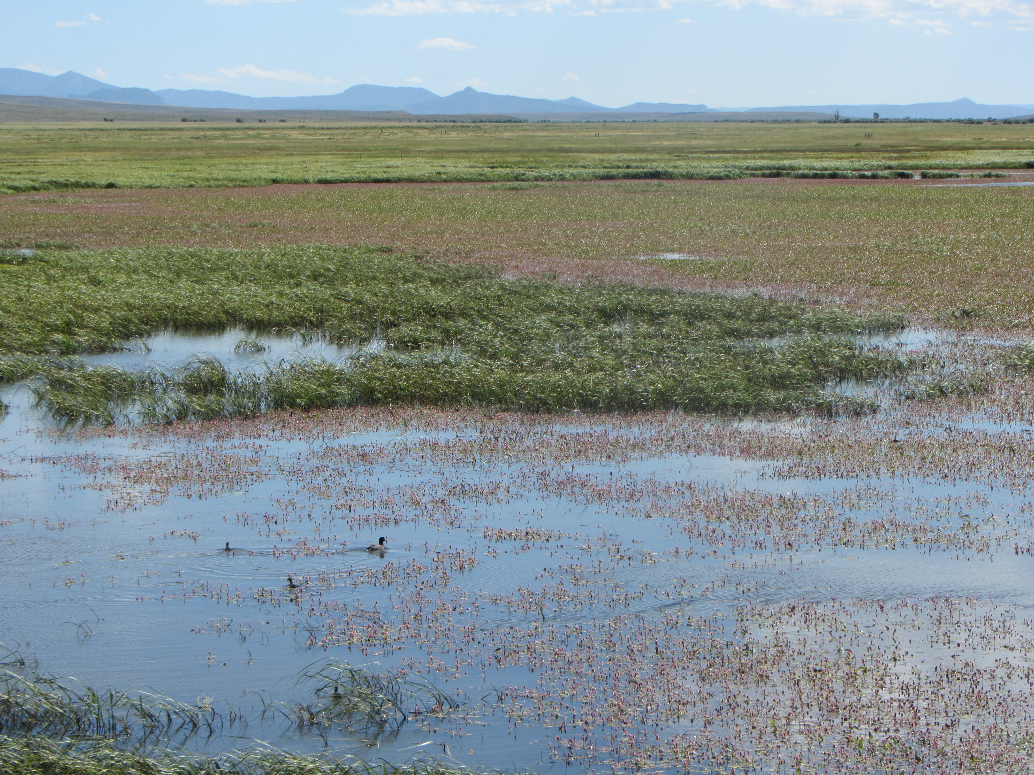
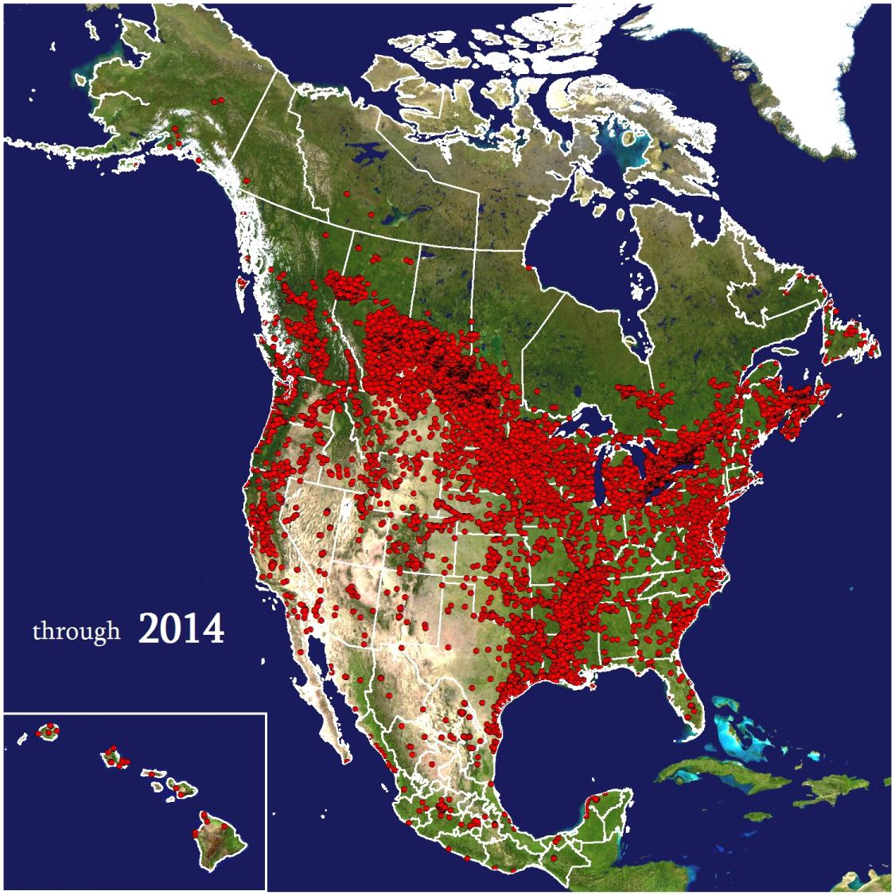
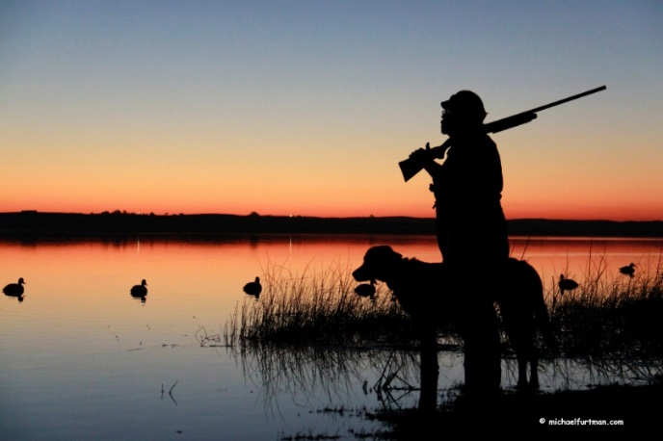
Wetland Conservation Organization
Notes:
Since 1937 Ducks Unlimited has conserved over 13.5 million acres of habitat across North America with the goal of sustaining North American waterfowl populations. We achieve these goals through direct habitat conservation that involves protecting lands through conservation easements, restoration projects (often using public finding to do so), and management of wetlands. We also provide technical assistance so that people can improve the qualities of their land.
We have over 20,000 completed projects in North America but the first 46 years of the company were spent doing restoration work solely in Canada.

Slide 3
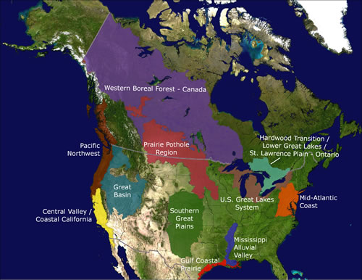
Focused Conservation

Slide 4
Loss of Breeding Birds – 30%
"The numbers of ducks and geese are larger than they've ever been, and that's not an accident," says Rosenberg. "It's because hunters who primarily want to see healthy waterfowl populations for recreational hunting have raised their voices.“ Journal of Science, September 2019

Slide 5
Transformational Change

Slide 6
Politics of Water
The attitude of Coloradans toward Roosevelt and Pinchot clearly illustrated the divergence of opinion that existed in the state over the conservation issue. For while the two men were accorded widespread contempt in the Colorado backwoods, they also commanded a large following all across the state. Roosevelt’s support came primarily from urban centers, plains cities such as Denver, Colorado Springs, and Pueblo and Western Slope settlements like Delta and Montrose, areas dependent on the preservation of mountain watersheds for irrigation and water supplies (1897).
Source: Hobbs, Justice Gregory J. Colorado Water Law: An Historical Overview. 1997
Notes:
100 years later, the U.S. Supreme court relied in the pledges made through the National Forest Organic Act that created national forests for these purposes to reject the notion that the National Forest reservations were intended to federal instream flow rights.
Water time progresses very slowly.
In fact, it wasn’t until 1979 that the court upheld the constitutionality of the state to enforce minimum streamflows and lake levels, but in accordance with the priority system….therefore very few instream flows actually provide these benefits.

Slide 7
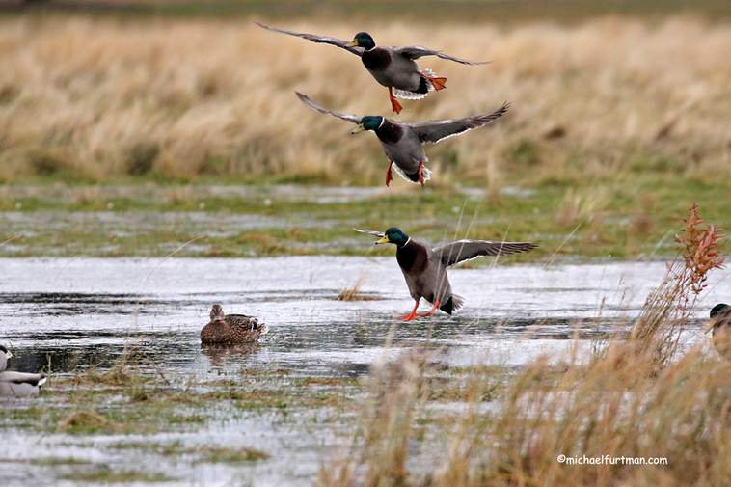
Private Property Right
“Running water in its natural course is “the property of the public”
However, the “right to it’s use…will be regarded and protected as property”
Provides the right to divert and use water and may be conveyed and transferred like any other private property right.

Slide 8
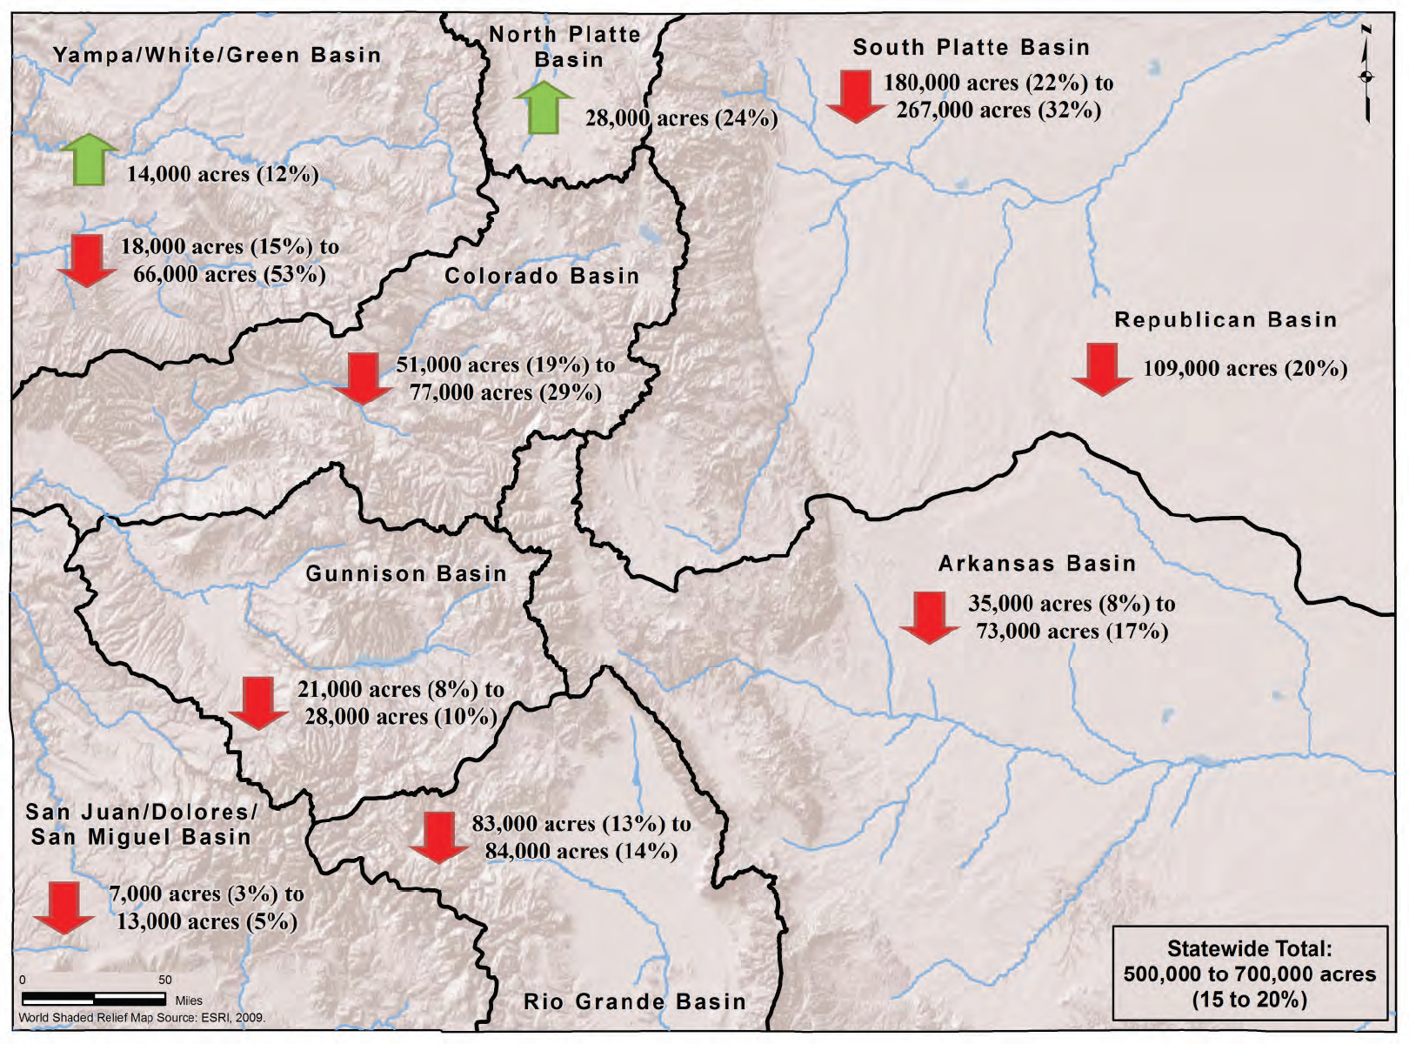

Slide 9
Piggybacking on Laws
Colorado does not provide protections for wetlands
Irrigation Water Rights to Irrigate Wetland Plants
Purchase Water Rights and Change the Right to Wildlife, Recreation
Innovative Water Trades
Innovative Partnerships
Notes:
Irrigation Water – can use irrigation water to grow green vegetation. Requires flooding an impoundment and releasing water every 72 hours.
Purchase water rights – expensive, very prohibitive cost of acquisition, change in water court
Innovative Water Trades – we’ll talk about this in some detail
Innovative partnerships – talk in detail

Slide 10
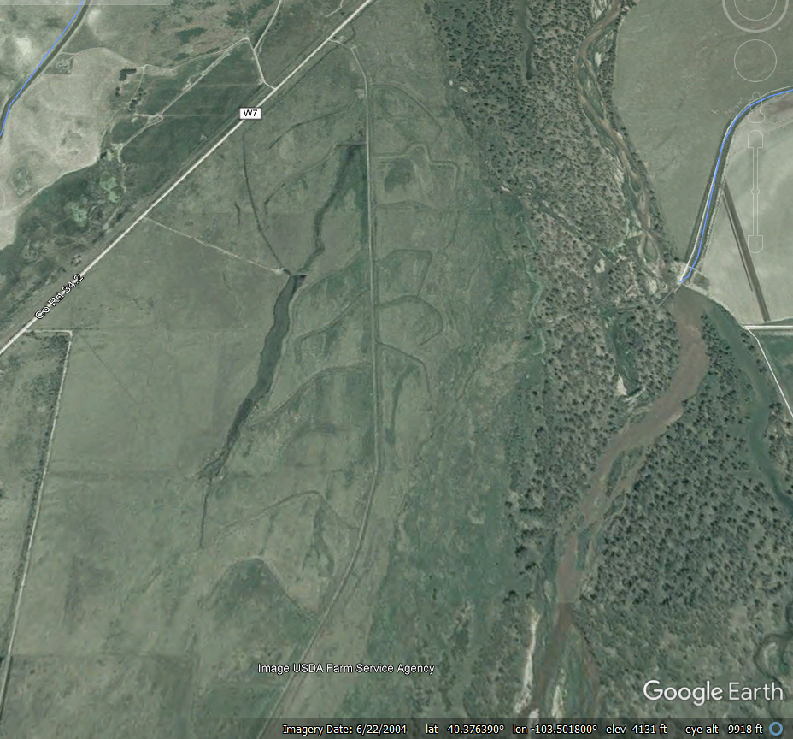
Irrigated Wetlands
Elliott SWA
Purchased Land and Water
Constructed Several Levees
Flood Water Using Union Mutual Ditch Co. Water
Water fills wetlands and is drained every 72 hours

Slide 11
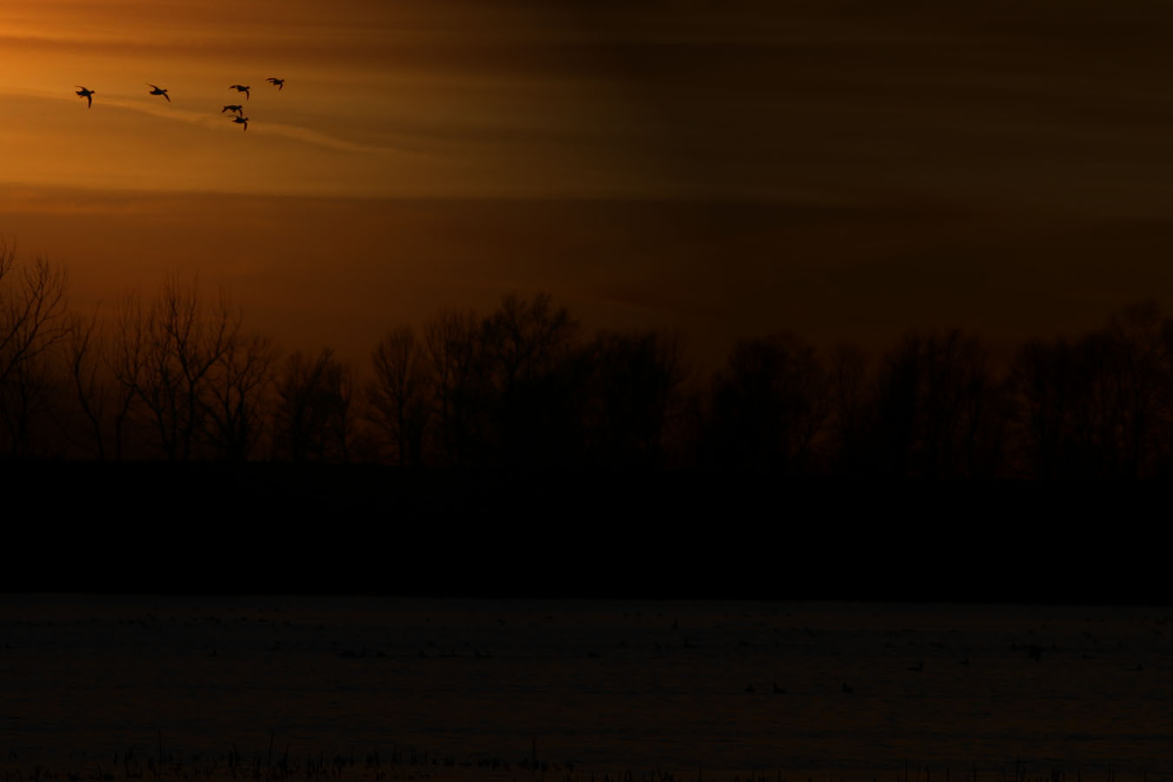
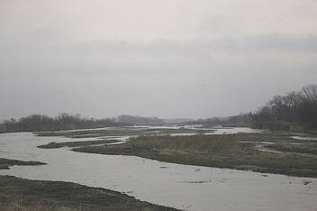
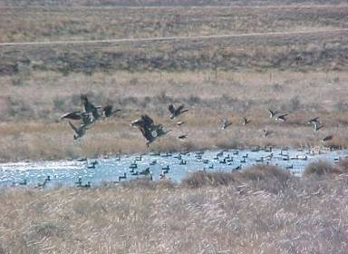
Aquifer Recharge
Winter/Spring
Wetland
recharge
basin
River

Slide 12
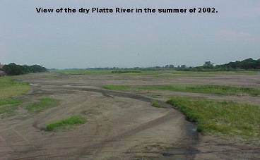
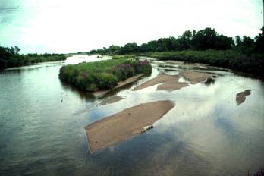
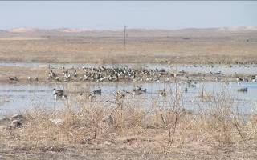
River Augmentation
Summer/Fall
Wetland
recharge
basin
River

Slide 13
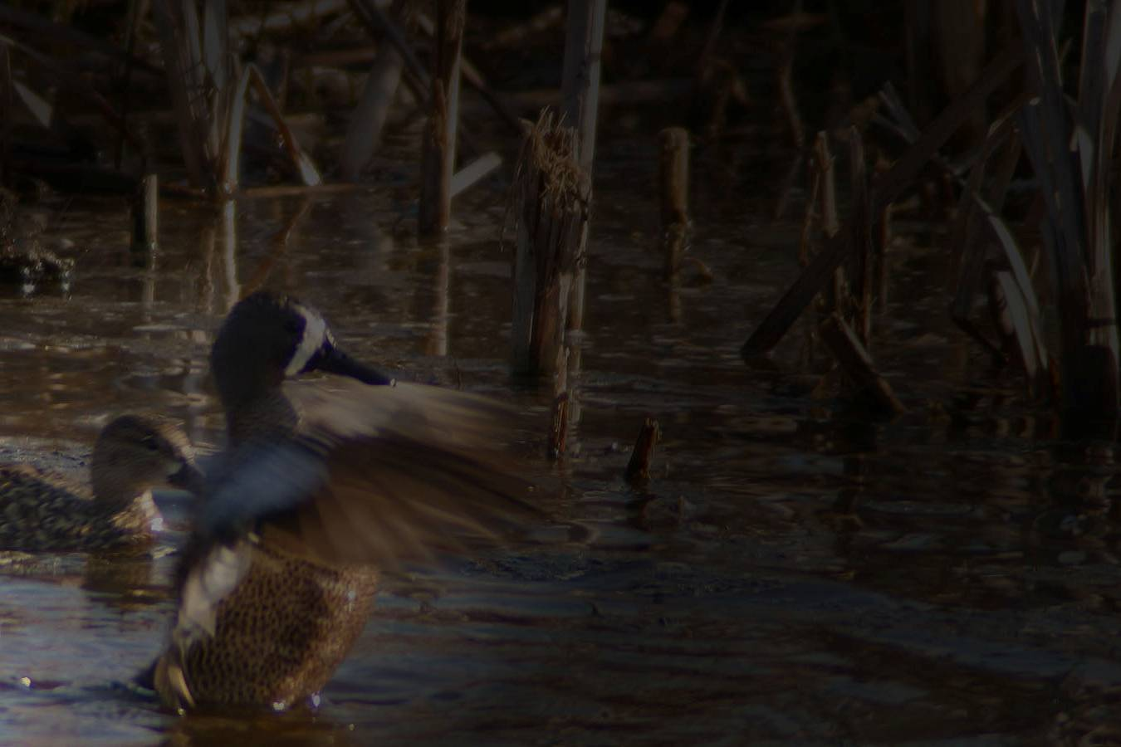
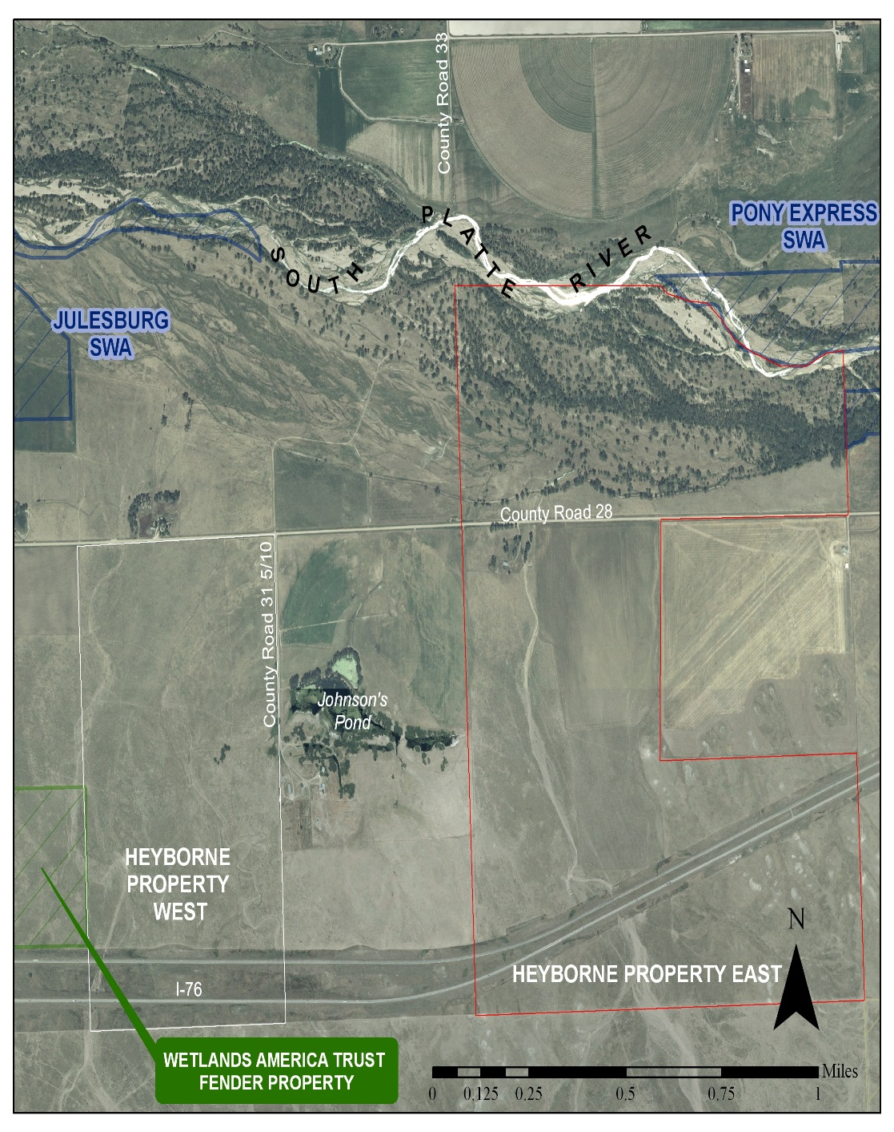
South Platte River Ranch
Property Description
Riparian Corridor
Warm-water sloughs
Dryland Crops
Native Prairie
NO WATER RIGHTS!

Slide 14
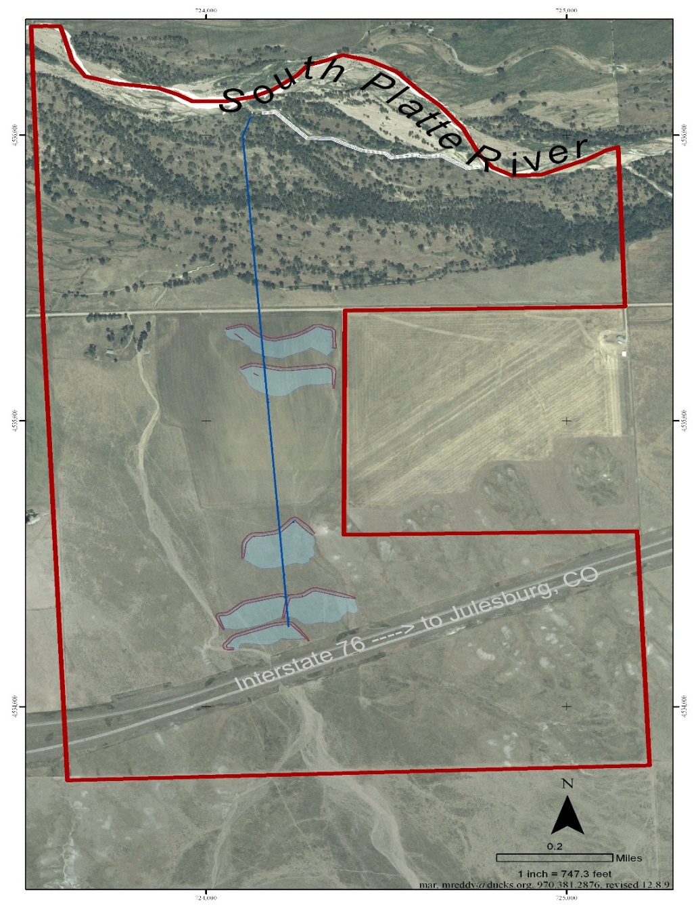
South Platte River Ranch
Project Summary
NEW WATER RIGHTS
40 Acres of Wetlands
1.5 Miles Pipeline
3,000 GPM Pump
70 acre-feet minimum river flows

Slide 15
Politics of Wetland Water
Laws, Policy, and Institutions are only one element of the politics of water
The complex nature of Colorado’s Private Property Water Rights makes it difficult to navigate and finalize deals
Landowners, Water/Irrigation Districts, Grant Makers, State Engineer
RELATIONSHIPS MATTER
Reputation, Success, Feeling that loss was avoided (WIN Scenarios)
MONEY MATTERS

Slide 16
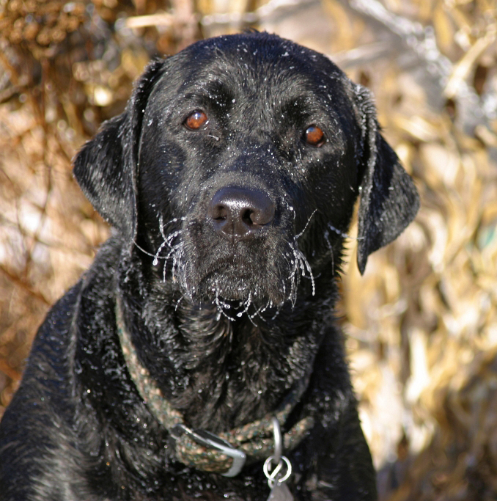
Thank You!
Greg Kernohan
970-481-7793
gkernohan@ducks.org

