Slide 1
Lake Powell & The Fture of West Slope Water
Colorado River District
Zane Kessler, Director of Gov’t Relations Andy Mueller, General Manager
Notes:
- Welcome, Introduction
- Thank [Russ]
- Bringing together familiar and new faces
- Shared concern and priorities

Slide 2
To lead in the protection, conservation, use, and development of the water resources of the Colorado River basin.

Slide 3
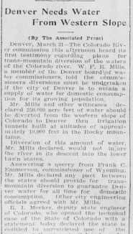
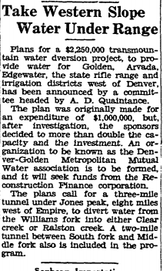
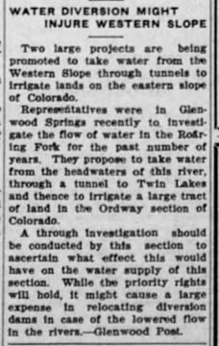
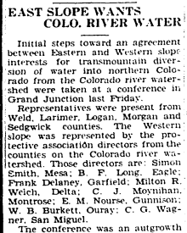
Archival news stories courtesy Colorado Historic Newspapers Collection

Slide 4
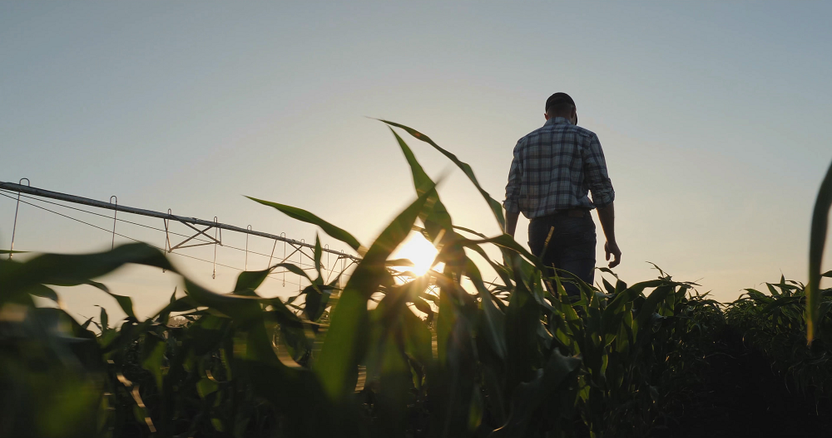
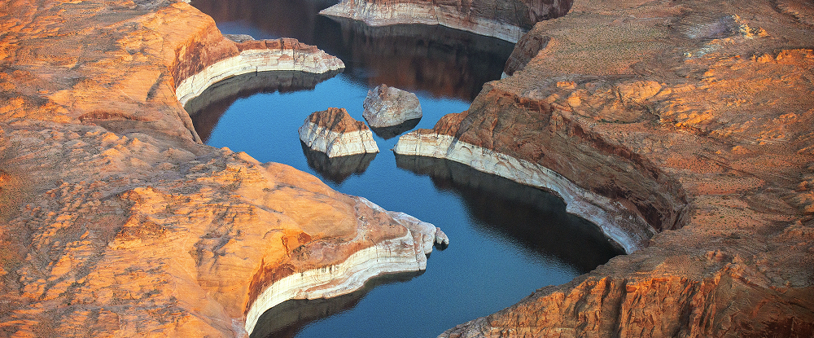
Intrastate
Interstate
Notes:
- Mission – “To lead in the protection, conservation, use, and development of the water resources of the Colorado River basin for the welfare of the District, and to safeguard for Colorado all waters of the Colorado River to which the state is entitled.”
- Dual mission

Slide 5
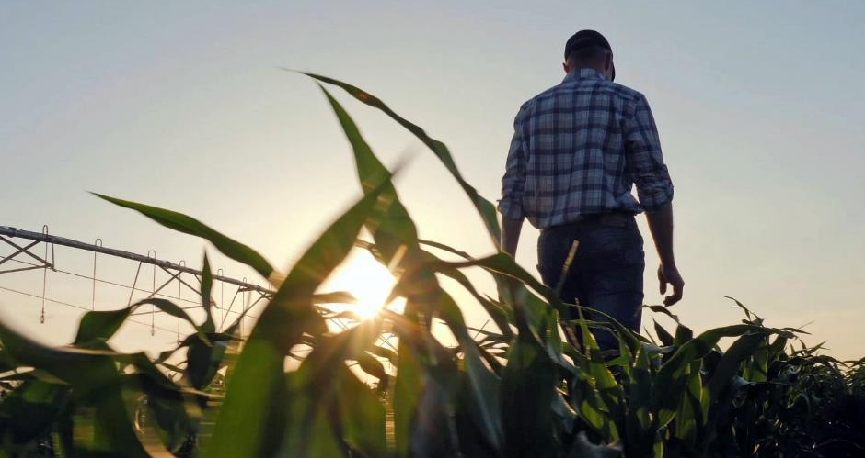
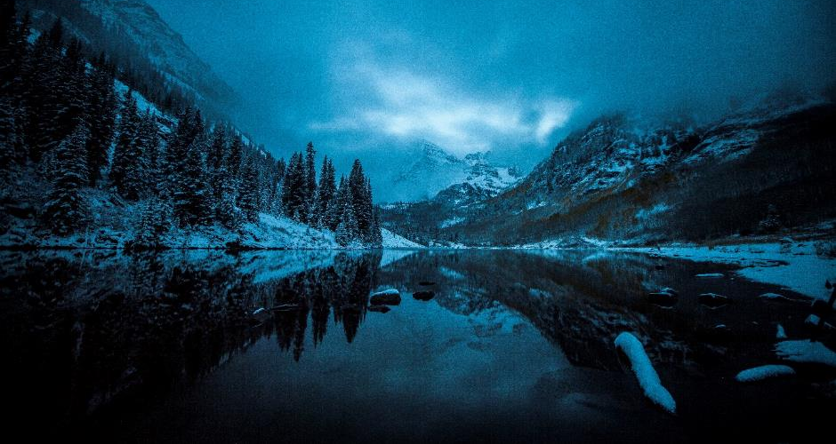
Securing legal protections to keep water on the West Slope
Keeping water flowing to farms and ranches
Ensuring adequate drinking water supplies
Maintaining healthy rivers

Slide 6
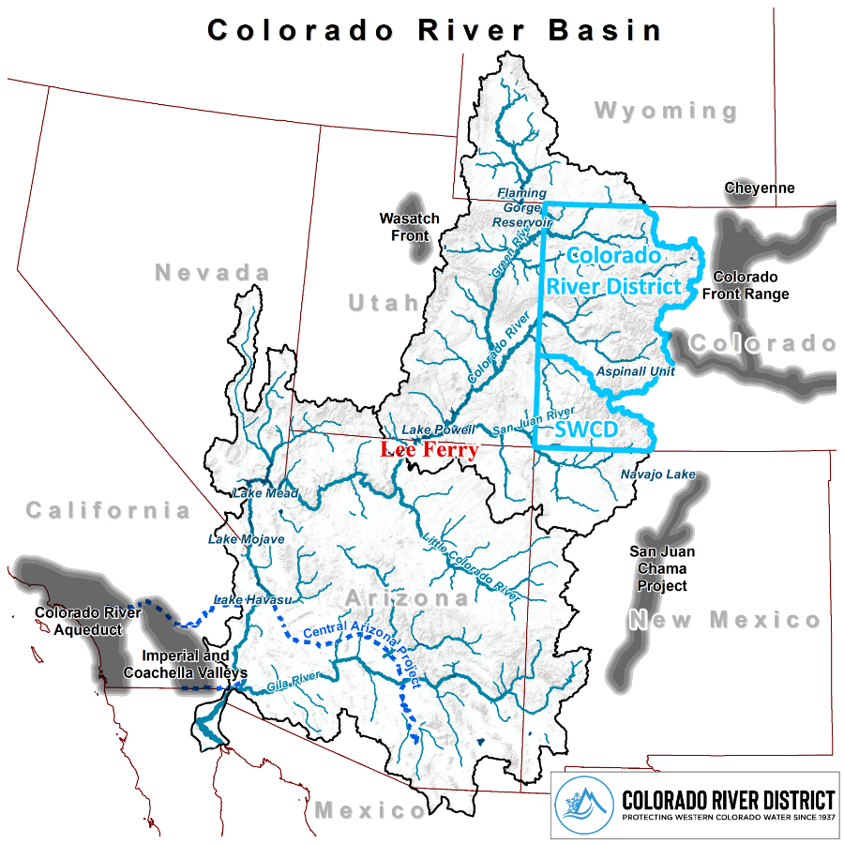
The Colorado River Basin
Notes:
- A look at the basin
- Our fifteen-county district
- 65% of the natural flow, plus Southwest = 70%
Seven states,
gray areas = population relying on trans-basin diversion (Front Range, Salt Lake, Los Angeles/San Diego)
- Lees Ferry was the split of the calculated flows (17 million af)

Slide 7
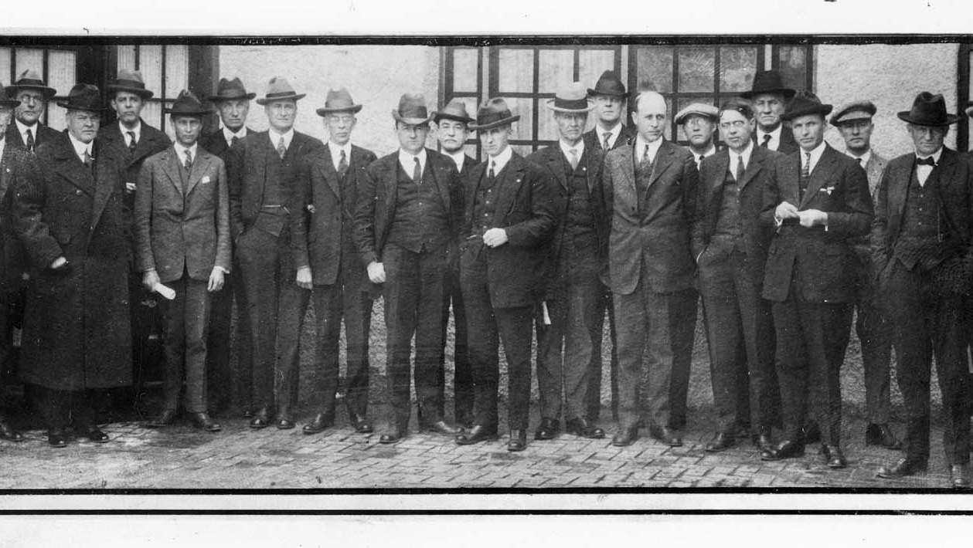
1922 Colorado
River Compact
Notes:
-Problems in Lake Powell and Lake Mead are our problems
- same system, thanks to these guys
- Prior appropriation would have shut us out (blame southern CA)
- 1922 Compact established separate development
- Foundational law of the river which also includes numerous compacts, federal laws, an international treaty, court decisions and decrees, contracts, and regulatory guidelines
- All this supports basin with 40 million people

Slide 8
The Colorado River mainstem: on paper
Lower Basin
Upper Basin
7.5 million acre feet
Art. III(a) Compact allocation
7.5 million acre feet
Art. III(a)Compact allocation
1 million acre feet
Art. III(B)Tributary use
1.5 million acre feet
Art. III (c)To Mexico
acre foot = 325,851 gallons
Notes:
UB Non-Depletion Obligation of 75 MAF / 10

Slide 9
The Colorado River mainstem: actual use
Lower Basin
Upper Basin
7.5 million acre feet
Mainstem Uses
4.0 - 4.5 MAF Compact allocation
1 -1.5 MAF
Reservoir Evaporation
2.0 – 2.5 MAF
Tributaries
acre foot = 325,851 gallons
Notes:
UB Non-Depletion Obligation of 75 MAF / 10

Slide 10
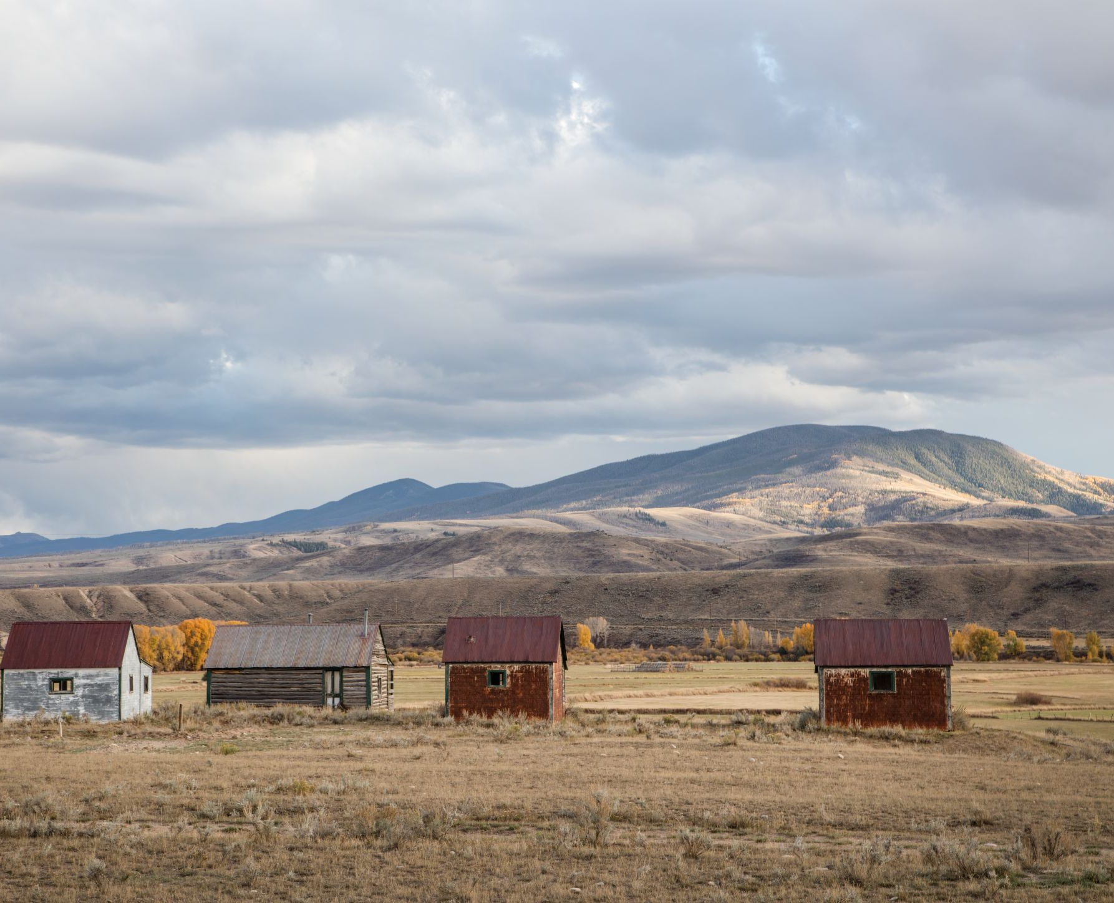
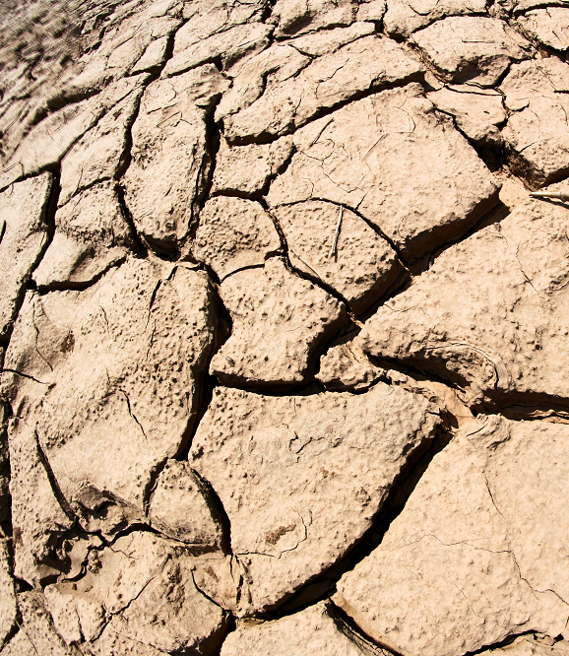
Multi-Decadal Drought Continues
Notes:
- SLOW DOWN
- System not recovering
- yes highly variable, but exceptional drought
multi-decadal drought worst in 1200 yrs according to tree rings
We are bound by the hydrology, we know what that looks like
Living with Less-
- Water users in the UB have been living on the front lines of climate change. Taking water cuts for 20 years, while continuing to meet our Compact obligations.

Slide 11
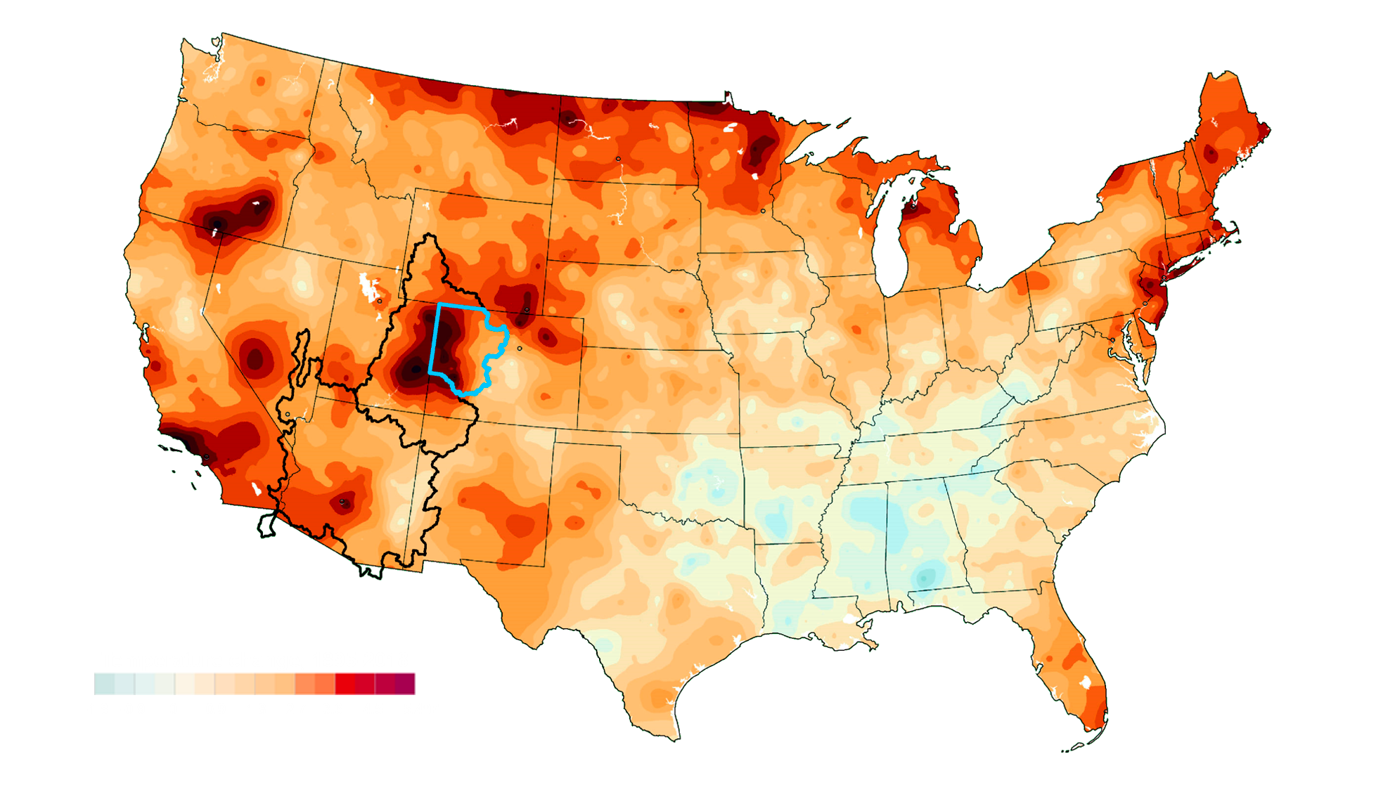
Temperature data generated by NOAA
Temperature graphic courtesy the Washington Post

Slide 12
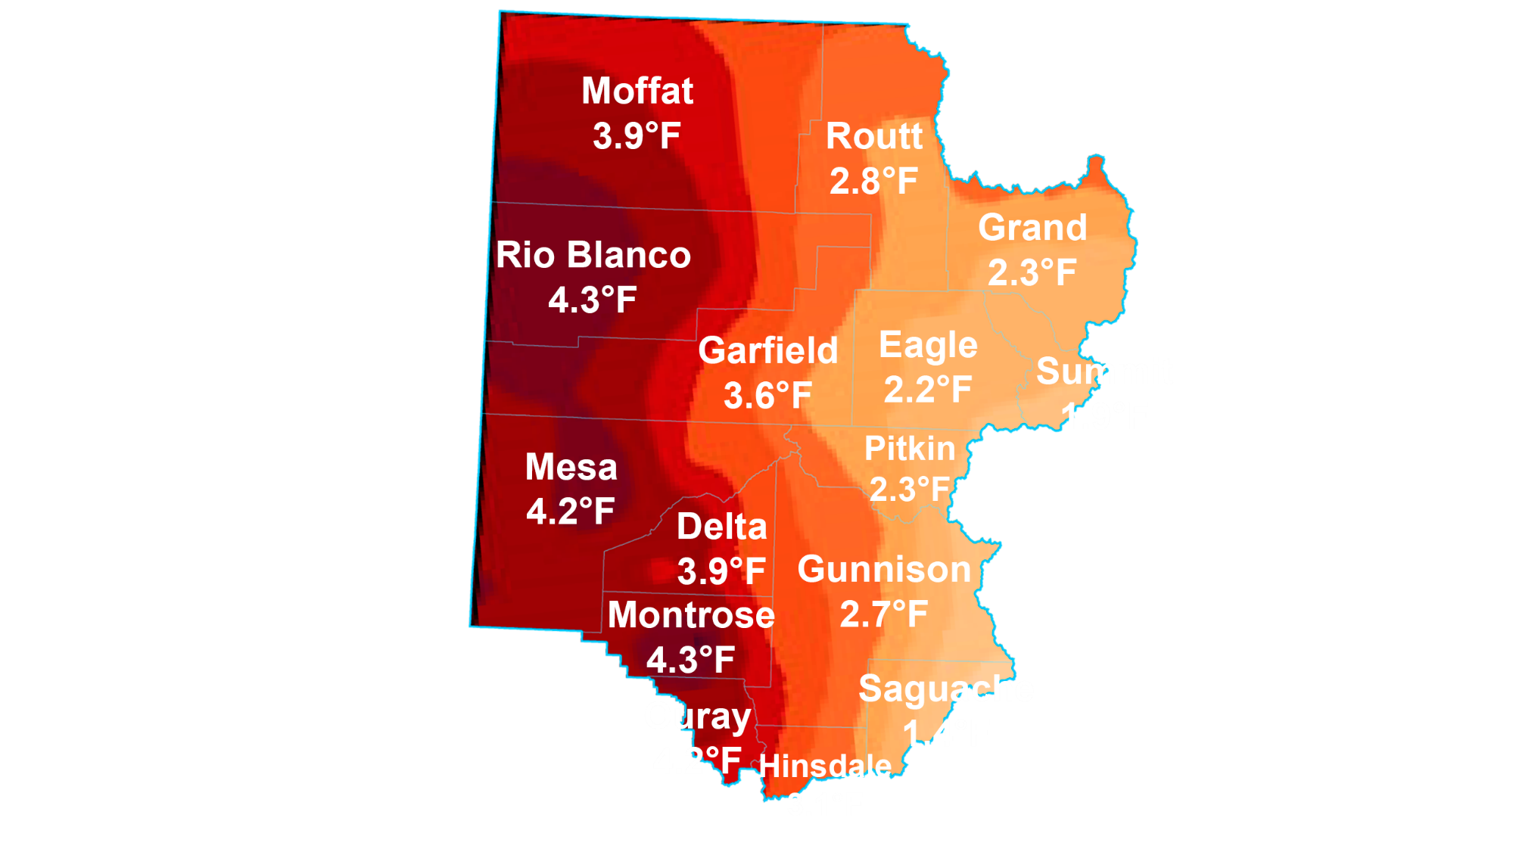
Temperature data generated by NOAA
Temperature graphic courtesy the Washington Post

Slide 13
For every 1 degree Fahrenheit rise in average temperature, streamflow is reduced between 3% to 9%.
Data:
Changing climate drives future streamflow declines and challenges in meeting water demand across the southwestern United States
(Olivia L.Miller; et al, Journal of Hydrology, vol. 11, May, 2021)
Colorado River flow dwindles as warming-driven loss of reflective snow energizes evaporation ( P. C. D. Milly, K. A. Dunne, Science 2020)
Notes:
- Temperature increases vary from 1.8 to 4 degrees above average
- early, hot summers,
- natural shortages review
- Last year, 89% average snowpack only equaled 32% inflow into Lake Powell

Slide 14
Soil Moisture
November 15th, 2020
November 15th, 2021
% of Average
> 500%
300-500%
200-300%
150-200%
130-150%
110-130%
100-110%
90-100%
70-90%
50-70%
30-50%
0-30%
Prepared by NOAA, Colorado Basin River Forecast Center
Salt Lake City, Utah, www.cbrfc.noaa.gov
Notes:
- 2021 looks cheerful by comparison
Snowpack must meet soil deficit first
- Last year, 89% average snowpack only equaled 32% inflow into Lake Powell
- This year 94% snowpack and only 60% of average runoff

Slide 15
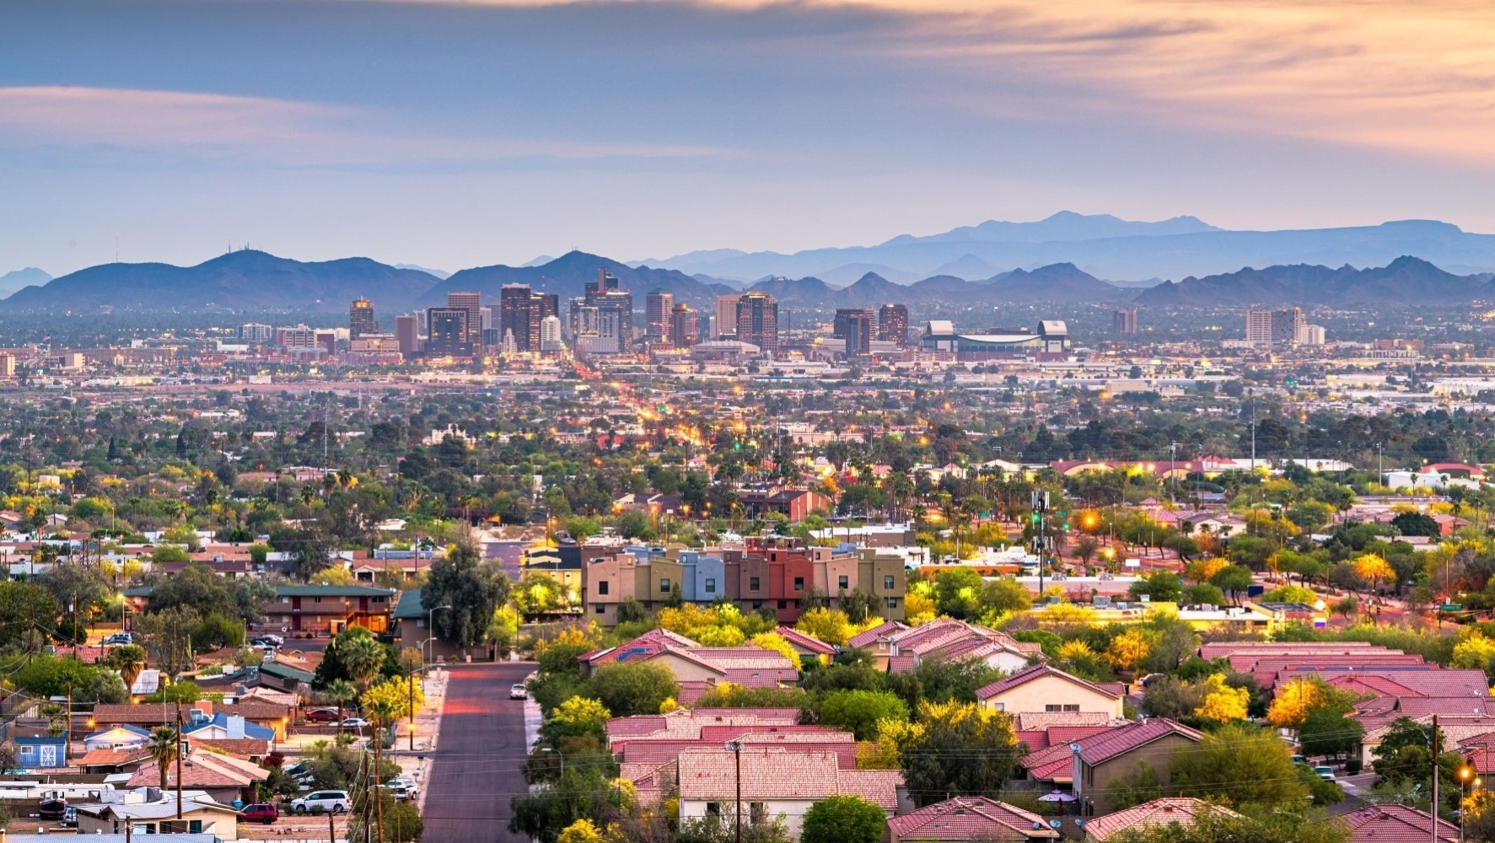
Population Growth
State of Colorado: 9 million by 2050
Colorado River Basin: 76 million by 2060
Source: Colorado State Demographer,
U.S. Census Bureau (2020)
Colorado River Basin data from U.S. Bureau of Reclamation
Colorado River Basin Water Supply and Demand Study (2012)
Notes:
-Another stressor- everyone wants to live where it’s sunny
Current Colorado population: 5.5 million
Current Colorado Basin population: 40+ million
Keep in mind, river district population is barely 500,000- CRD unites that voice

Slide 16
Provisional Natural Flows for the Colorado River at Lee’s Ferry (USGS gauge 09380000) Water Years 1906-2021
Total Average
2012-2021
Average
1922 Compact Allocation
Notes:
- Founders over-estimated flows
- discuss graph (what do these numbers mean x and y axis)

Slide 17
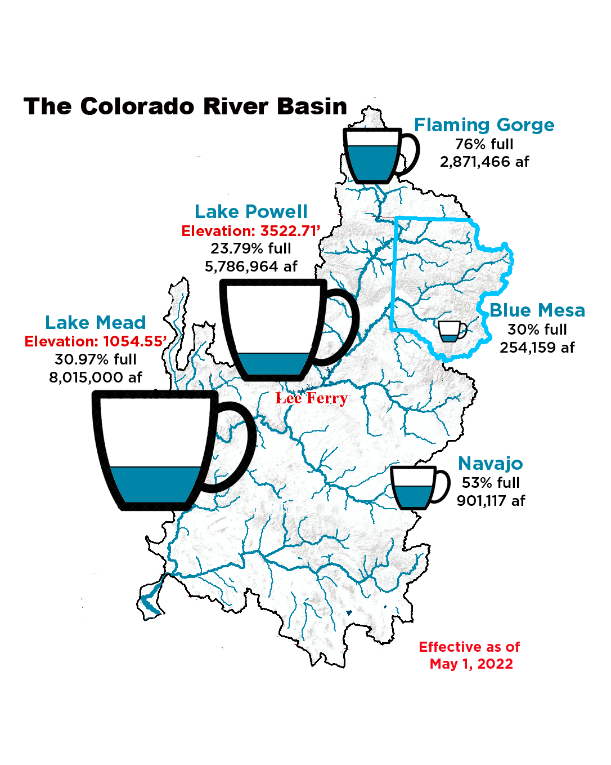
Notes:
- -over delivered to the lower basin over the last ten years, with about 90 million over ten currently on our credit, (changing soon)
-guidelines and negotiations have gotten us here. (Walk through the various levels of each reservoir).
Mexico is also owed about 1.5 million acre-feet. In wet years, from the Lower basin
In dry it’s a fifty-fifty split, bringing our obligation up closer to 8.23 million.
But there would be surplus still in the system if the Lower Basin had not been allowed to continue their overuse, supreme court reference
We are not willing to face curtailment, or reduce our uses even further to meet the compact obligation while the lower basin continues to leave the tap running.

Slide 18
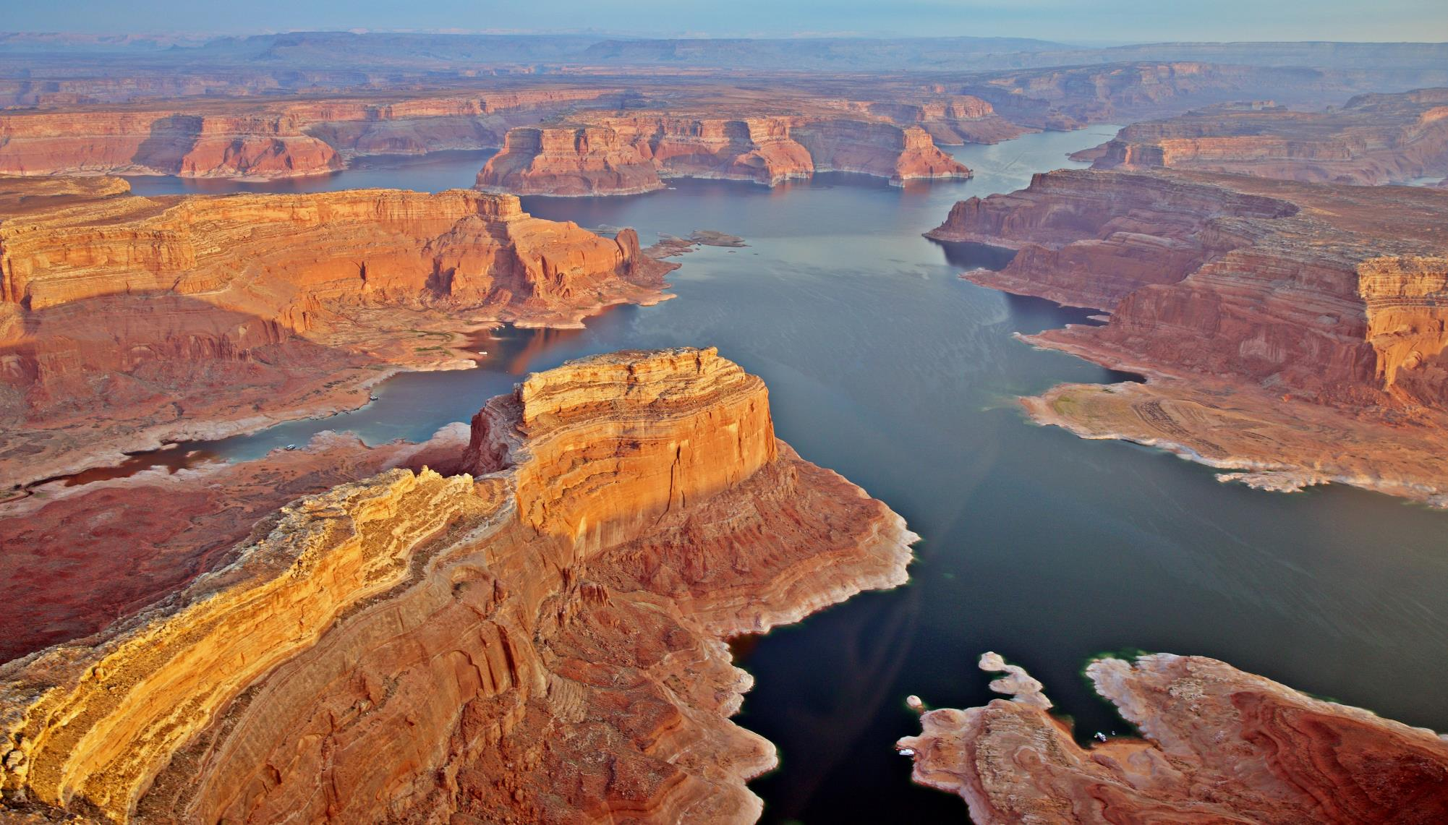
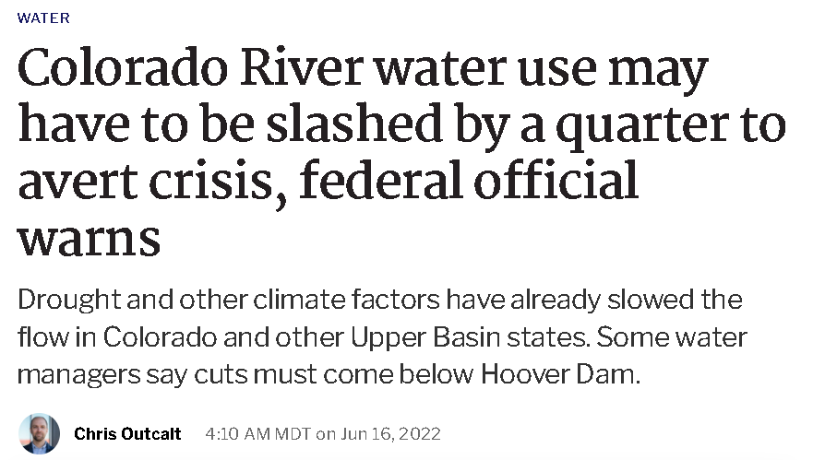
Notes:
- Headlines, discuss
recently dropped below 3525 target elevation established to protect power generation
BoR Drought Response Plan 2022. 7 maf release from Powell, extra 500k from Flaming Gorge

Slide 19
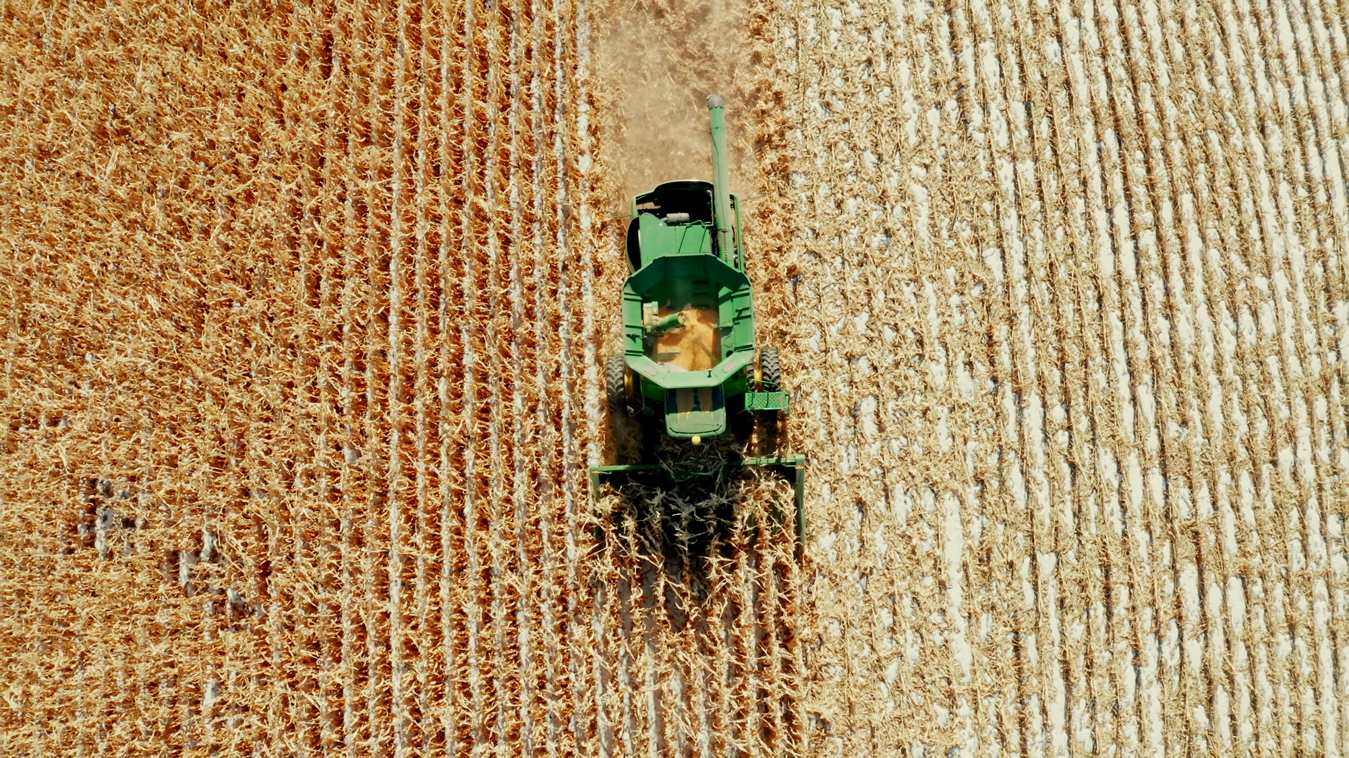
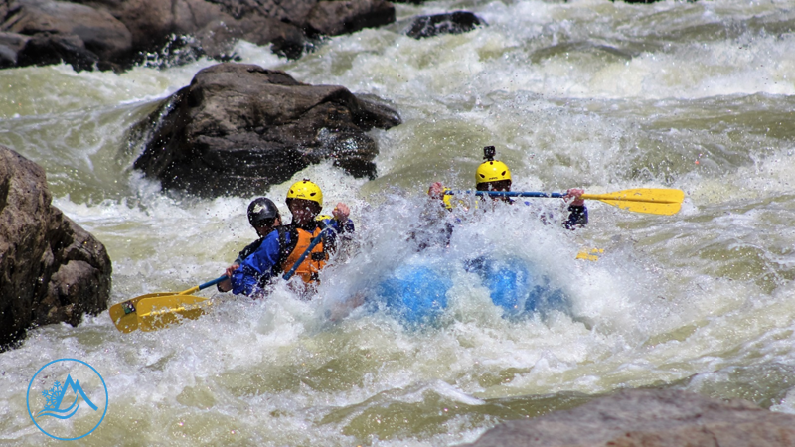
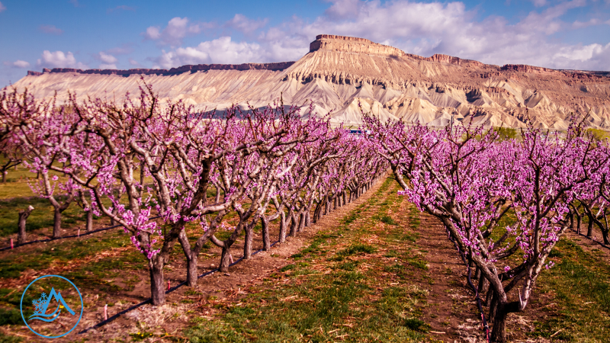
High-impact projects and investments for West Slope water
$4.2 million annually

Slide 20
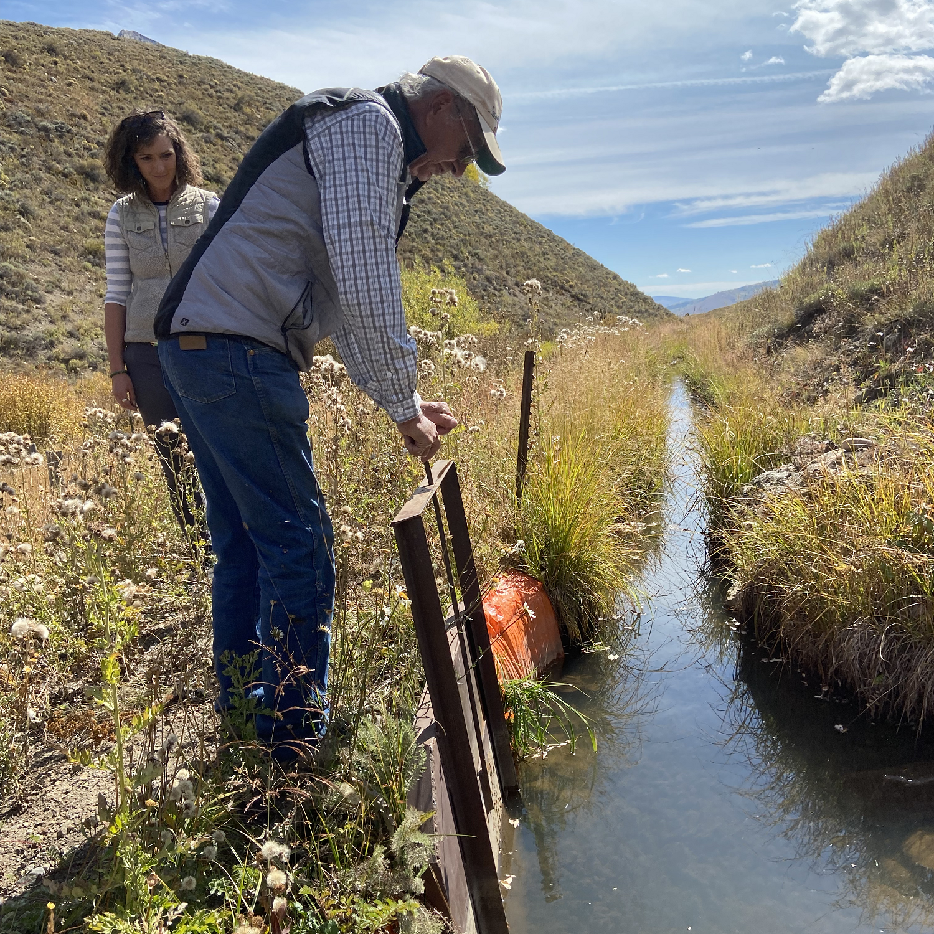
Moving Forward
Interstate
Interim Guidelines Renegotiation
Federal Policy-Making
Across the Divide
State Policy-Making
Front Range Conservation Outreach
Western Slope
Innovative Local Partnerships
Infrastructure Funding
Forest, Watershed, and Soil Health
Notes:
- Mission adapting riff
- Interim guideline re-negotiation -were agreed upon in 2007, expiring in 2026. We’re at the table so that West Slope water isn’t ON the table.
- We, along with the SWCD are doing a lot modeling to look at how these operations will affect the rivers and our communities.
- We want to make sure that the data and the understanding is at such a level that our representatives understand what they are getting themselves into as they balance our needs with those of the other states involved.

