Slide 1
Keys to Depolarizing and
Elevating our Conversations
Martín Carcasson
Director of the Center for Public Deliberation
Professor, Department of Communication Studies
Dedicated to enhancing local democracy through improved public communication and community problem solving
EMAIL: mcarcas@colostate.edu
Twitter: @mcarcasson CPD website: cpd.colostate.edu

Slide 2
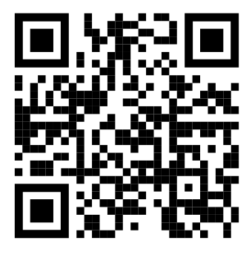
Martin will be using Poll Everywhere for some audience interaction
You can use the QR code below
Or go to Pollev.com and enter csucpd210
Or download the free Poll Everywhere App
It will ask for your name, but you can “skip”

Slide 3
Notes:
Poll Title: Do not modify the notes in this section to avoid tampering with the Poll Everywhere activity. More info at polleverywhere.com/support Which statements best describe your view of the current quality of public discussion and debate? (choose up to three) https://www.polleverywhere.com/multiple_choice_polls/oooLT1TsKAz1BmuYdMgG6?display_state=instructions&activity_state=opened&state=opened&flow=Engagement&onscreen=persist

Slide 4
Notes:
Poll Title: Do not modify the notes in this section to avoid tampering with the Poll Everywhere activity. More info at polleverywhere.com/support Which statements best describe your view of the current quality of public discussion and debate? (choose up to three) https://www.polleverywhere.com/multiple_choice_polls/oooLT1TsKAz1BmuYdMgG6?display_state=chart&activity_state=opened&state=opened&flow=Engagement&onscreen=persist

Slide 5
Notes:
Poll Title: Do not modify the notes in this section to avoid tampering with the Poll Everywhere activity. More info at polleverywhere.com/support Which statements best describe your view of the current quality of public discussion and debate? (choose up to three) https://www.polleverywhere.com/multiple_choice_polls/oooLT1TsKAz1BmuYdMgG6?display_state=chart&activity_state=closed&state=closed&flow=Engagement&onscreen=persist

Slide 6
CPD Projects, 2006-2022
Civic mission of schools
Grade configuration of Poudre School District schools
Statewide dropout rate
Colorado Health Care Reform
Student housing
Improving higher education
Childhood obesity
Bicycle safety
Diversity Dialogues at CSU Diversity Conference
STEM education in K-12
Arts Engagement Summit
CSU/Old Town collaborative project
School budgeting issues/school closures
Medical Marijuana
Regional visioning process
Water and growth issues
Poverty in Larimer County
PSD Student Think Tank facilitator group
K-12 school improvement
Improving higher education through student-faculty reciprocity
Politics of food
Issues surrounding aging
Early childhood education
Politics of food
Issues surrounding aging
Early childhood education
On campus stadium proposal
Senior transportation
Campus smoking
School safety
Bullying
Mental health
Nature in the City
Larimer County Landfill/Wasteshed
Diversity and Inclusion in Fort Collins
CSU Innovation and Economic Prosperity
CSU parking and affordable housing
Backyard wood burning
Housing affordability
Fort Collins City Plan
K12 substance abuse
City sales tax proposals
Data and democracy
Housing and health equity
Intergenerational dialogues
Decarbonization of electricity/Platte River
CSU Strategic plan

Slide 7
Overview: Two Key Questions
Why are we so polarized?
What can we do about it?

Slide 8
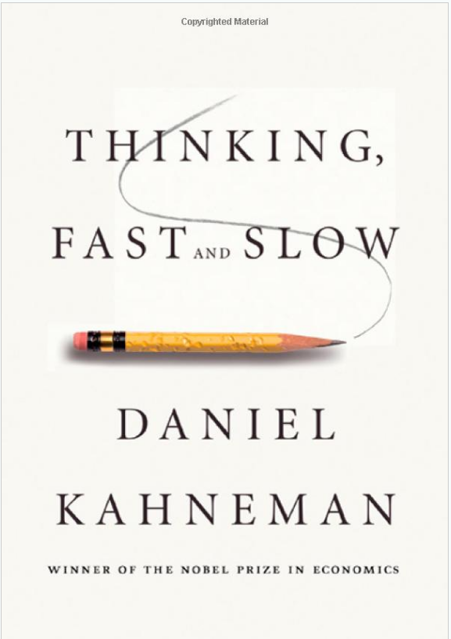
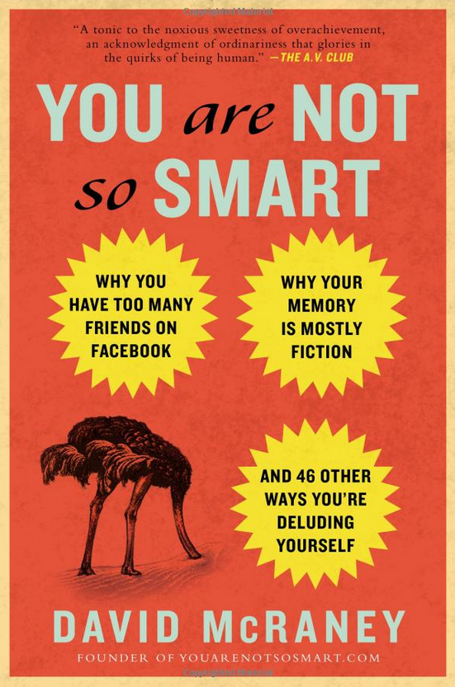
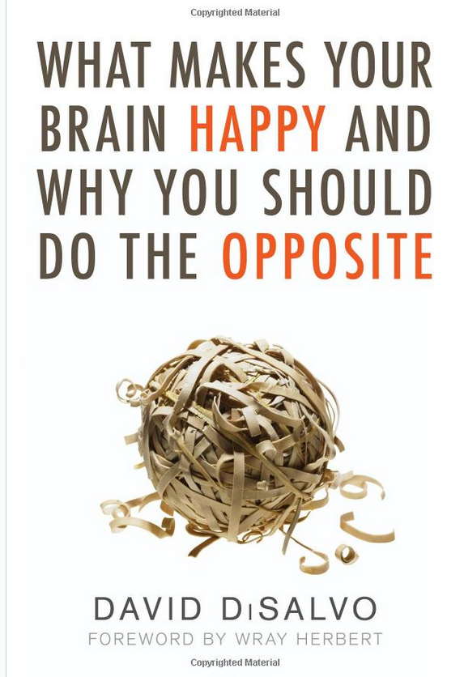
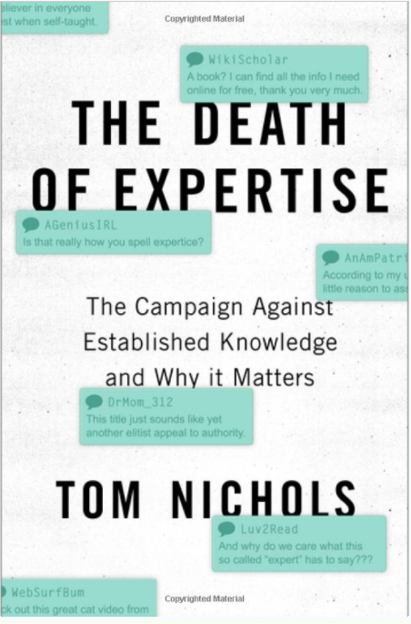
So what are we learning about social psychology and brain science that’s relevant to deliberative engagement?

Slide 9
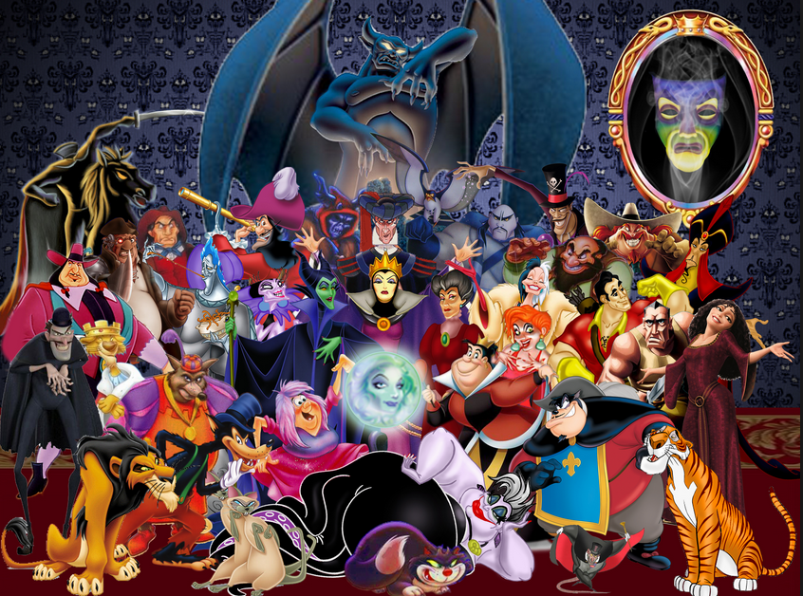
What Are We Learning from Brain Science and Social Psychology?
The Problematic
We crave certainty and consistency
We are suckers for the good v. evil narrative

Slide 10
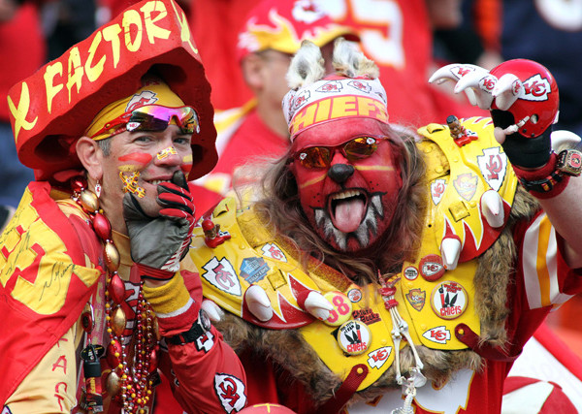
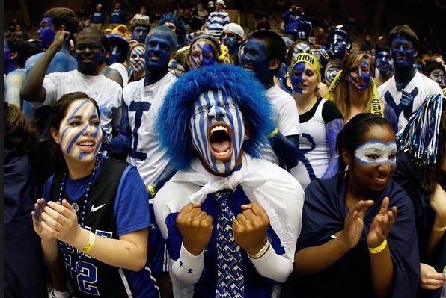
What We Are Learning from Brain Science and Social Psychology?
The Problematic
We crave certainty and consistency
We are suckers for the good v. evil narrative
We are “groupish” (prefer to gather with like-minded)

Slide 11
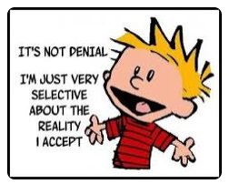
What We Are Learning from Brain Science and Social Psychology?
The Problematic
We crave certainty and consistency
We are suckers for the good v. evil narrative
We are “groupish” (prefer to gather with like-minded)
We filter & cherry pick evidence to support our views

Slide 12
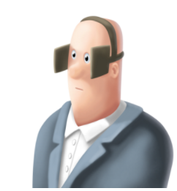
What We Are Learning from Brain Science and Social Psychology?
Stages of motivated reasoning
What and who we expose ourselves to | selective exposure / echo chambers/ filter or media bubbles

Slide 13
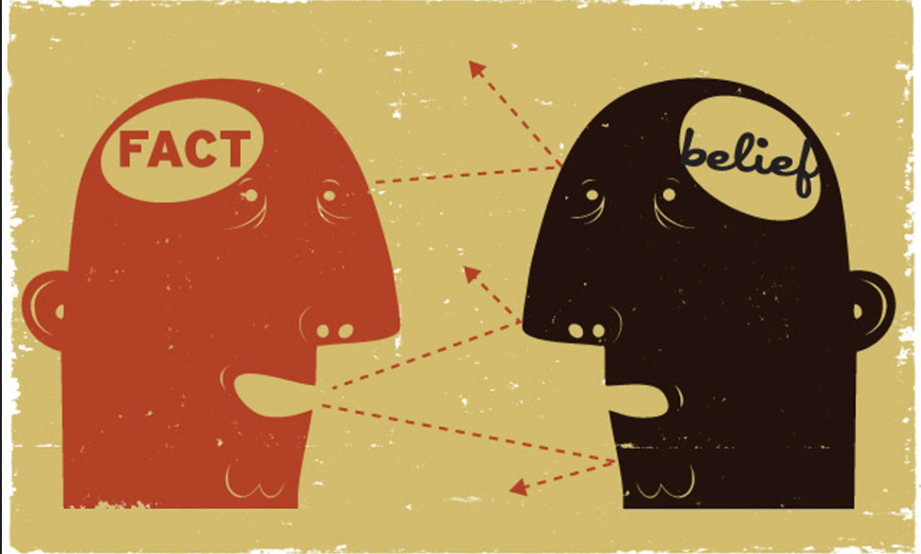
What We Are Learning from Brain Science and Social Psychology?
Stages of motivated reasoning
What and who we expose ourselves to | selective exposure / echo chambers/ filter or media bubbles
How we interpret new evidence | confirmation bias, backfire effect, cognitive dissonance

Slide 14
How we interpret new evidence
“when we want to believe something, we ask ourselves, ‘Can I believe it?’ Then…we search for supporting evidence, and if we find even a single piece of pseudo-evidence, we can stop thinking.… In contrast, when we don’t want to believe something, we ask ourselves, ‘Must I believe it?’ Then we search for contrary evidence, and if we find a single reason to doubt the claim, we can dismiss it“
Jonathan Haidt and Tom Gilovich

Slide 15
What We Are Learning from Brain Science and Social Psychology?
Stages of motivated reasoning
What and who we expose ourselves to | selective exposure / echo chambers/ filter or media bubbles
How we interpret new evidence | confirmation bias, backfire effect, cognitive dissonance

Slide 16
What We Are Learning from Brain Science and Social Psychology?
Stages of motivated reasoning
What and who we expose ourselves to | selective exposure / echo chambers/ filter or media bubbles
How we interpret new evidence | confirmation bias, backfire effect, cognitive dissonance
How we make attributions and tell stories | egoism, illusory correlation, negativity bias

Slide 17
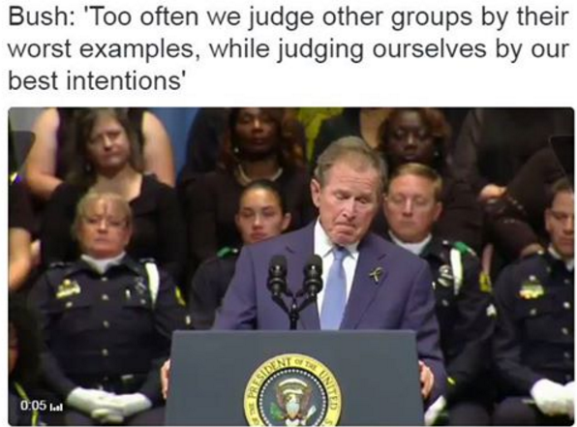

Slide 18
What We Are Learning from Brain Science and Social Psychology?
Stages of motivated reasoning
What and who we expose ourselves to | selective exposure / echo chambers/ filter or media bubbles
How we interpret new evidence | confirmation bias, backfire effect, cognitive dissonance
How we make attributions and tell stories | egoism, illusory correlation, negativity bias
How we make decisions | heuristics, self-serving bias, social proof

Slide 19
What We Are Learning from Brain Science and Social Psychology?
Stages of motivated reasoning
What and who we expose ourselves to | selective exposure / echo chambers/ filter or media bubbles
How we interpret new evidence | confirmation bias, backfire effect, cognitive dissonance
How we make attributions and tell stories | egoism, illusory correlation, negativity bias
How we make decisions | heuristics, self-serving bias, social proof
What we remember | availability bias

Slide 20
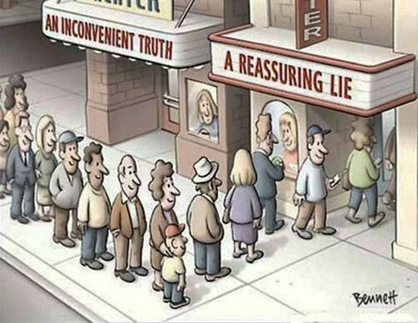
What We Are Learning from Brain Science
The Problematic
We crave certainty and consistency
We are suckers for the good v. evil narrative
We strongly prefer to gather with the like minded
We filter & cherry pick evidence to support our views
We avoid values dilemmas, tensions, and tough choices

Slide 21
The Vicious Cycle of Exaggerated Polarization
Individually developed subconscious biases

Slide 22
The Vicious Cycle of Exaggerated Polarization
Individually developed subconscious biases
Negative interaction effects

Slide 23
Negative Interaction Effects
Kathryn Shultz – Being Wrong
First step: Ignorance assumption
Second step: Idiot assumption
Third Step: Evil assumption

Slide 24
The Vicious Cycle of Exaggerated Polarization
Individually developed subconscious biases
Negative interaction effects
The
Russell
effect

Slide 26
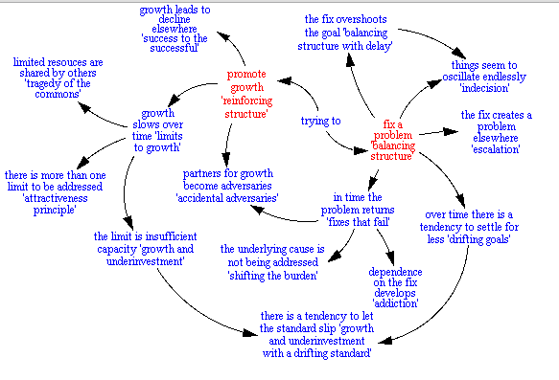
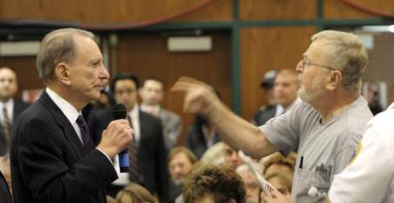
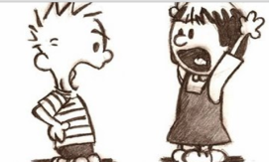
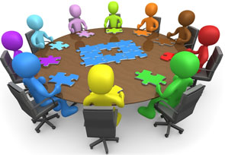
Overview: Three Key Arguments
#1 – The Basic Reality
Most of the key problems we face are best understood through a wicked problems lens
#2 – The Bad News
Human nature and many of our primary institutions and processes are woefully ill-suited to address wicked problems
#3 – The Hopeful News
Once we realize #1 and #2, we can build capacity for the kinds of conversations, processes, and institutions that cultivate the wisdom so critical to addressing wicked problems, particularly at the local level

Slide 27
The Vicious Cycle of Exaggerated Polarization
Individually developed subconscious biases
Negative interaction effects
The
Russell
effect

Slide 28
The Vicious Cycle of Exaggerated Polarization
Individually developed subconscious biases
Negative interaction effects
The
Russell
effect
Impact of the internet

Slide 29
The Vicious Cycle of Exaggerated Polarization
Individually developed subconscious biases
Negative interaction effects
Overly
adversarial
political system
The
Russell
effect
Impact of the internet

Slide 30
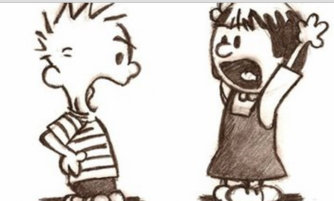
Drawbacks of an Overly-Adversarial Political System
Plays into flaws of human nature
Often focuses on “winning” vs. solving problems
Zero-sum game incentivizes “bad” communication, strategic research, and problematizes implementation
Often focuses on blaming (them) vs. taking accountability (us)
Relies on narrow value frames (thus avoids tensions)
Attracts/privileges organized, entrenched voices
Negative side effects like polarization, cynicism, and apathy (which then cause even worse communication)
Assumes a narrow role for citizens (citizens as voters, consumers, or spectators)

Slide 31
Consider our Typical Public Processes
Our two-party system
Campaigns, referenda, and elections
“Town halls”
Interest groups and lobbyists
Political debates
Congressional deliberations and legislative debate
Social media political engagement
Citizen comment and public hearings
Expert panels
Letters to the editors
Emails and email campaigns to policymakers

Slide 32
Key Problems with our Typical Public Processes
Engage too late in the process when issues are simply framed as “yes” or “no” and teams are already set
Primarily provide opportunities for individual or group expression
Caters to entrenched and organized voices
Little to no effective interaction or learning/refinement of opinion

Slide 33
The Vicious Cycle of Exaggerated Polarization
Individually developed subconscious biases
Media focus on conflict
Negative interaction effects
Overly
adversarial
political system
The
Russell
effect
Impact of the internet

Slide 34
The Vicious Cycle of Exaggerated Polarization
Individually developed subconscious biases
Media focus on conflict
Negative interaction effects
Implications of hyper-polarization:
Anecdote wars / “Gotcha” politics
The “Outrage Industrial Complex”
Meanspiritedness / contempt
Assumption of negative motives
Conspiracy theories
Drowning out of legitimate concerns
Overly
adversarial
political system
The
Russell
effect
Impact of the internet

Slide 35
Overview: Two Key Questions
Why are we so angry?
What can we do about it?

Slide 36
Key Steps for Depolarizing and Elevating our Conversations
Adopt a Wicked Problems Mindset
Change the Way We Engage

Slide 37
Wicked problems inherently involve competing underlying values, paradoxes, and tradeoffs that cannot be resolved by science.

Slide 38
Key Deliberative Responses
Balancing (the long-term focus)
Re-calibrating (short term corrections)
Transcending (short term ideal)

Slide 39
FOOD AS A WICKED PROBLEM
WE WANT OUR FOOD TO BE:
Inexpensive
Fresh
Nutritious
Safe
Long lasting
Delicious
Convenient
(Accessible, Easy to prepare)
Ethically grown
(labor/animal welfare)
Our choice
Supportive of a local economy
Supportive of a agriculture community
Grown and delivered in a environmentally responsible manner
Supportive of efforts to reduce hunger locally and globally

Slide 40
HEALTH CARE AS A WICKED PROBLEM
High Quality
Accessible
Low cost

Slide 41
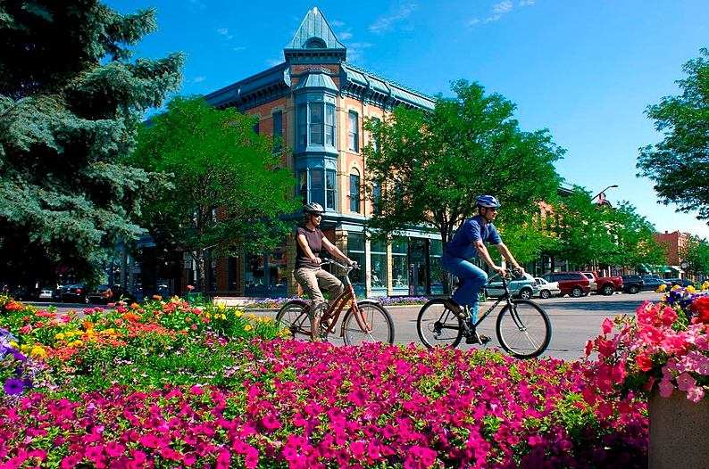
Competing Values in Downtown Fort Collins
Aesthetics/Beauty
Compassion
Diversity/Inclusivity
Economic health/vitality
Effective use of public resources
Equality
Excitement/fun
Family
Individual freedom
Individual responsibility
Individual rights
Justice/Fairness
Public health/ environment
Respect for law
Respect for others
Safety

Slide 42
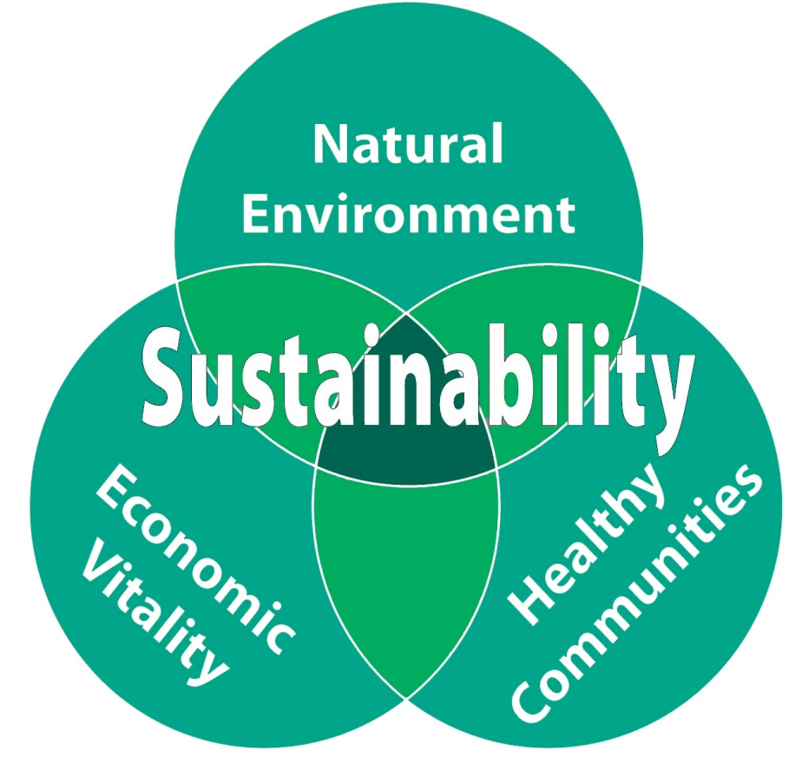
Capitalism or Sustainability as a Wicked Problem
The “Triple Bottom Line” of
Profit (economics, also tied to jobs and taxes)
People (social justice, equality, fairness)
Planet (environment)

Slide 43
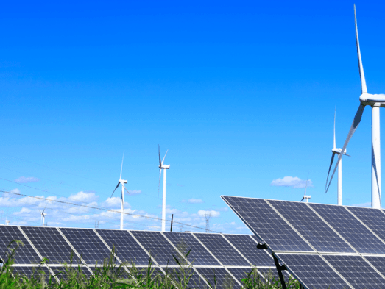
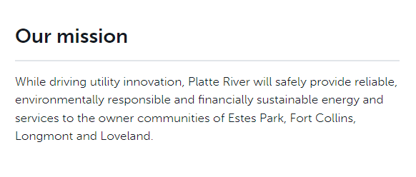
Power generation as a Wicked Problem
Financially sustainable
Reliability
Environmentally responsible

Slide 44
COVID 19 and our community response as a wicked problem
Freedom/Liberty
(Concern about government or expert overreach)
Individual
Responsibility
Economic
vitality
Mental health
Public health
Family
Employee
safety
Need for connection
Empathy
Concern for the most vulnerable
Supporting small businesses

Slide 45
American Values as a Wicked Problem
1. Justice
2. Security/Safety
3. Equality
4. Freedom for us
5. Freedom for future generations

Slide 46
Inherent Democratic Tensions
Freedom and Equality
Our Freedom and Freedom of Future generations
Freedom and Security
Justice is a tension within itself (justice as the ideal between too much and too little credit or punishment)
Some others
Short term and long term
Individual rights and community good
Unity and diversity
Cooperation and competition
Structure and agency (or opportunity and individual responsibility)
Flexibility/Innovation and Consistency/Tradition
Best use of resources (money, time, people)

Slide 47
Wicked problems inherently involve competing underlying values, paradoxes, and tradeoffs that cannot be resolved by science. They call for ongoing high quality communication, creativity, and broad collaborative action to manage well.
.

Slide 48
The Wicked Problems Mindset
Presume wicked problems, not wicked people
Become more comfortable with uncertainty

Slide 49
Traditional v. Facilitative Leadership
Traditional
Strong opinion
Charisma
Public speaking skills
Mobilization of the like-minded
Facilitative
Strong on process
Trust and respect
Facilitation skills
Collaboration between broad perspectives

Slide 50
The Wicked Problems Mindset
Presume wicked problems, not wicked people
Become more comfortable with uncertainty
Focus on elevating the conversation not just winning the argument
Put your energy toward identifying, engaging, and negotiating inherent tensions
Work toward creating a learning community

Slide 51
Key Steps for Depolarizing and Elevating our Conversations
Adopt a Wicked Problems Mindset
Change the Way We Engage

Slide 52
What We Are Learning from Brain Science
The Problematic
We crave certainty and consistency
We are suckers for the good v. evil narrative
We strongly prefer to gather with the like minded
We filter & cherry pick evidence to support our views
We avoid values dilemmas, tensions, and tough choices

Slide 53
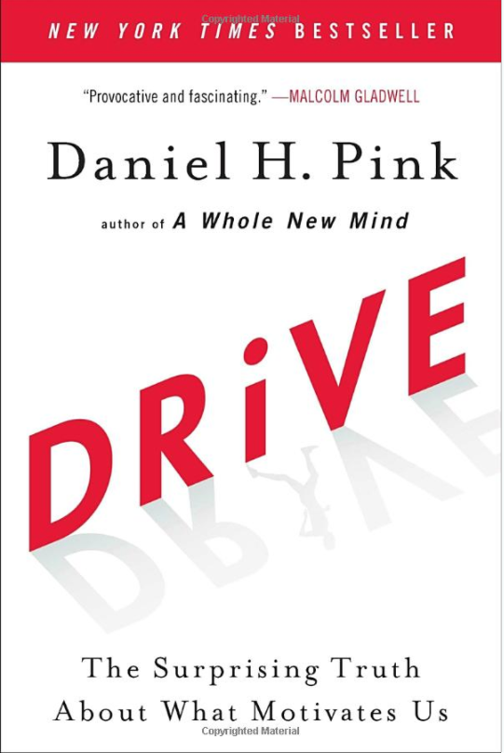
What We Are Learning from Social Psychology and Brain Science
The Good
We are inherently social and seek purpose and community

Slide 54
What Are We Learning from Brain Science and Social Psychology?
The Good
We are inherently social and seek purpose and community
We are inherently empathetic
We are inherently pragmatic and creative

Slide 55
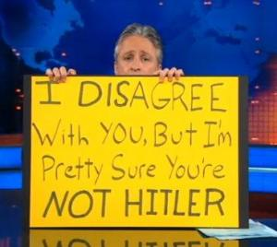
What Are We Learning from Brain Science and Social Psychology?
The Good
We are inherently social and seek purpose and community
We are inherently empathetic
We are inherently pragmatic and creative
We can overcome our bad tendencies and build better habits

Slide 56
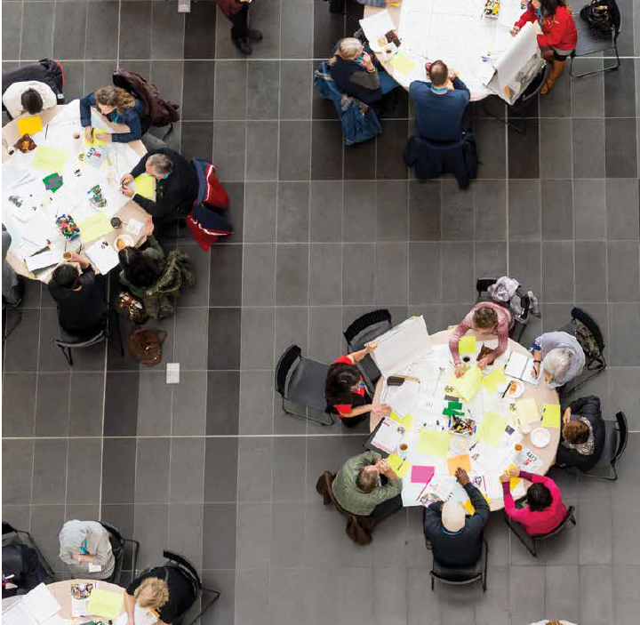
What We Are Learning from Social Psychology and Brain Science
Bottom line: The most powerful thing to help people overcome their biases and tackle wicked problems well is genuine conversation with people they respect.

Slide 57
What is Deliberative Engagement?
Deliberative democracy
Community problem-solving
Collaborative problem-solving
Participatory decision-making
Slow democracy
Strong democracy
Multi-stakeholder dispute resolution
Public participation
Democratic governance
Collaborative governance
Organic or community politics
Consensus building or seeking processes
Organic politics

Slide 58
Key Components of Deliberative Engagement
Overall deliberative framing
Wicked problem, multiple approaches, broad range of actors, starting discussion “upstream” (before polarization)
Discussion guides/backgrounder
Base of information, something to react to, framed for deliberation, not persuasion
Small, diverse, representative groups
Processes designed for interaction and learning
Small group facilitators

Slide 59
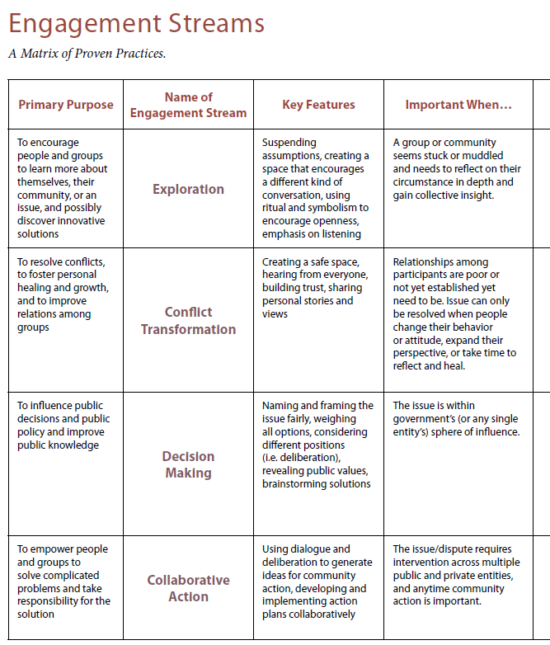
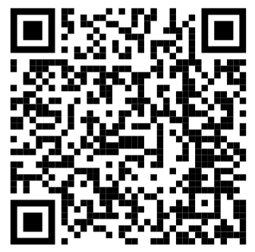
National Coalition for Dialogue and Deliberation www.ncdd.org

Slide 60
The Four Key Shifts of Deliberative Engagement
From wicked people
→ to wicked problems
From adversaries
to collaborators
From inciting the worst of human nature
to bringing out the
best of human nature
From facts as cherry picked ammunition or “fake news”
to facts as tools for
addressing problems
together

Slide 61
Sam Kaner, Facilitator’s Guide to Participatory Decision-Making

Slide 62
The Vicious Cycle of Exaggerated Polarization
Individually developed subconscious biases
Media focus on conflict
Negative interaction effects
Overly
adversarial
political system
The
Russell
effect
Impact of the internet

Slide 63
The Virtuous Cycle of Authentic Engagement
Opportunity for authentic
engagement
(primary at local level)
Potential for collaboration and co-creation
Development
of mutual
understanding
Greater refinement
of opinions
(i.e. learning)
Building of trust and respect

