Slide 1
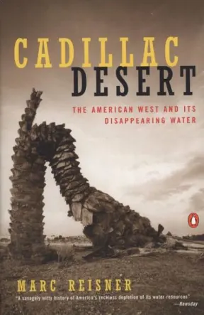
Cadillac Desert
Book Report
October 12, 2022
Claire Bouchard
Community Foundation of Northern Colorado

Slide 2
Why You May Want to Read this Book

Slide 3
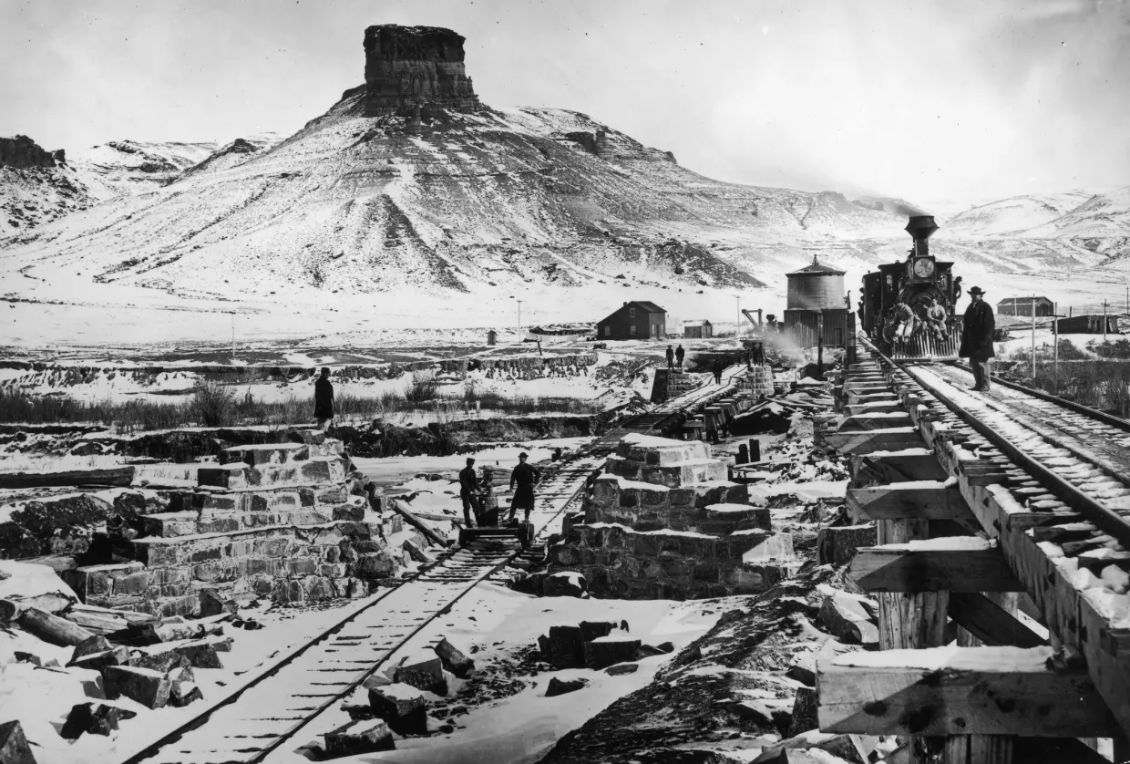

Slide 4
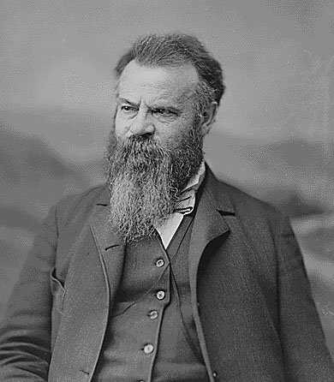
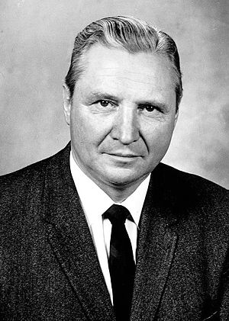
John Wesley Powell
William Mulholland
Floyd Dominy

Slide 5
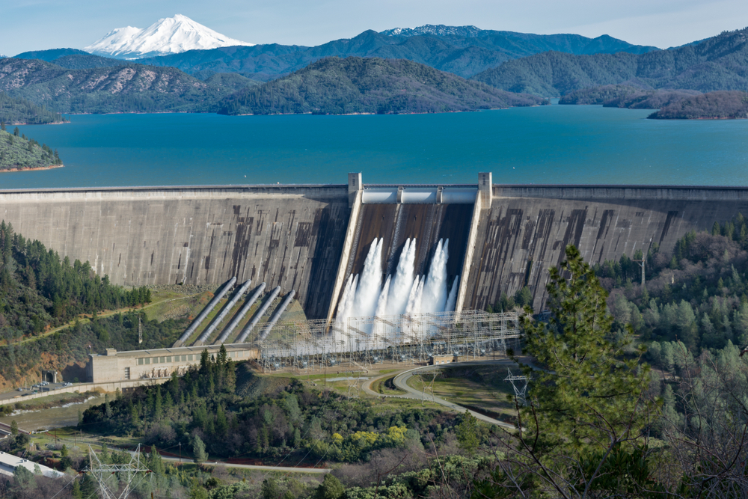

Slide 7
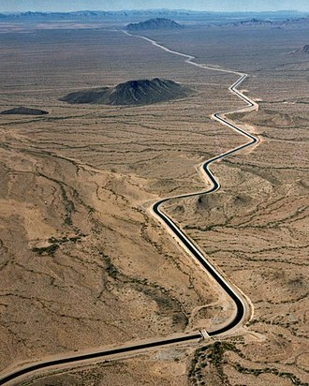

Slide 8
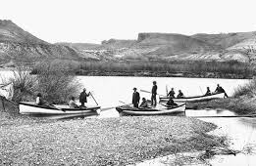
Powell’s Epic Trip

Slide 12
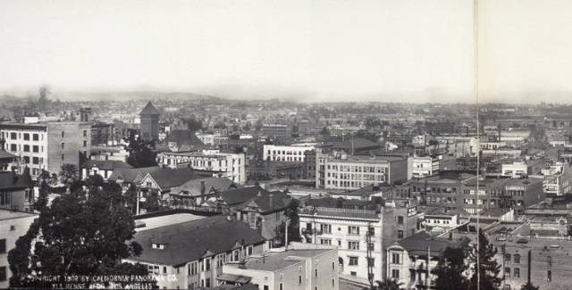
Los Angeles: unnatural growth and development

Slide 13
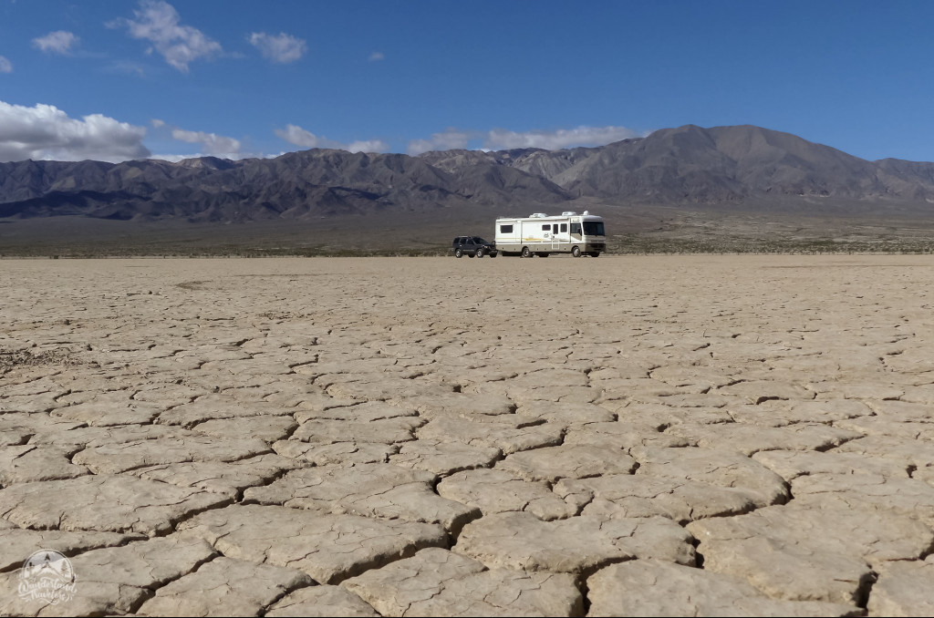

Slide 16
Cadillac Desert & 2022 WLL Class Reflections
Urgency
Preservation
Collaboration
Social Justice

