Slide 1
Project Permitting Basics
John A. Kolanz
jkolanz@nocoattorneys.com
970- 663-7300

Slide 2
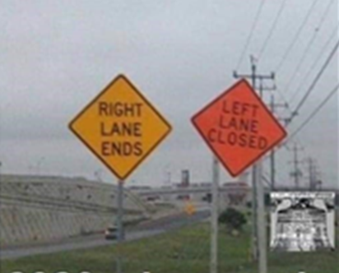
Considerations
Time Consuming and Expensive Process–
What Will You Get For Your Time And Money
Can It Be Permitted?
Permitting Intensity Varies Based on the Underlying Project
Size
Location
Proponent

Slide 3
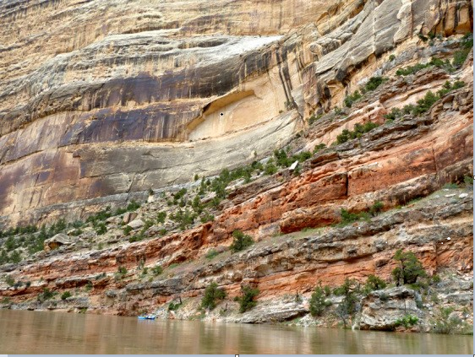
Finish Project
Start Project

Slide 4
Types of Permits/Authorizations
Federal
State
Local
Public

Slide 5
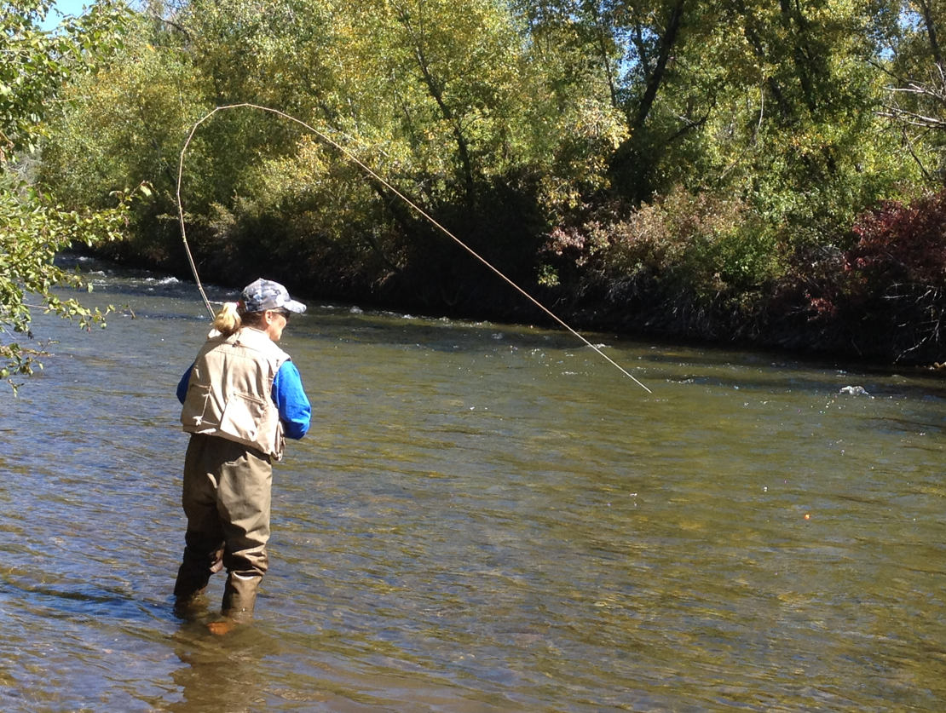
Federal
Typically drive the permitting process
Is there a federal hook? Usually there is.
Clean Water Act Section 404 – Army Corps of Engineers
Federal Land Management Agency
Federal Money

Slide 6
Federal
National Environmental Policy Act
CATEX
Environmental Assessment – Finding of No Significant Impact
Environmental Impact Statement – required for major federal actions significantly affecting the quality of the human environment.
Lead Agency has primary NEPA compliance responsibility
Trump Administration rule to reduce NEPA review burdens
Biden Administration rulemakings
§ 4331. Congressional declaration of national environmental policy
(a) The Congress, recognizing the profound impact of man’s activity on the interrelations of all components of the natural environment, particularly the profound influences of population growth, high-density urbanization, industrial expansion, resource exploitation, and new and expanding technological advances and recognizing further the critical importance of restoring and maintaining environmental quality to the overall welfare and development of man, declares that it is the continuing policy of the Federal Government, in cooperation with State and local governments, and other concerned public and private organizations, to use all practicable means and measures, including financial and technical assistance, in a manner calculated to foster and promote the general welfare, to create and maintain conditions under which man and nature can exist in productive harmony, and fulfill the social, economic, and other requirements of present and future generations of Americans.

Slide 7
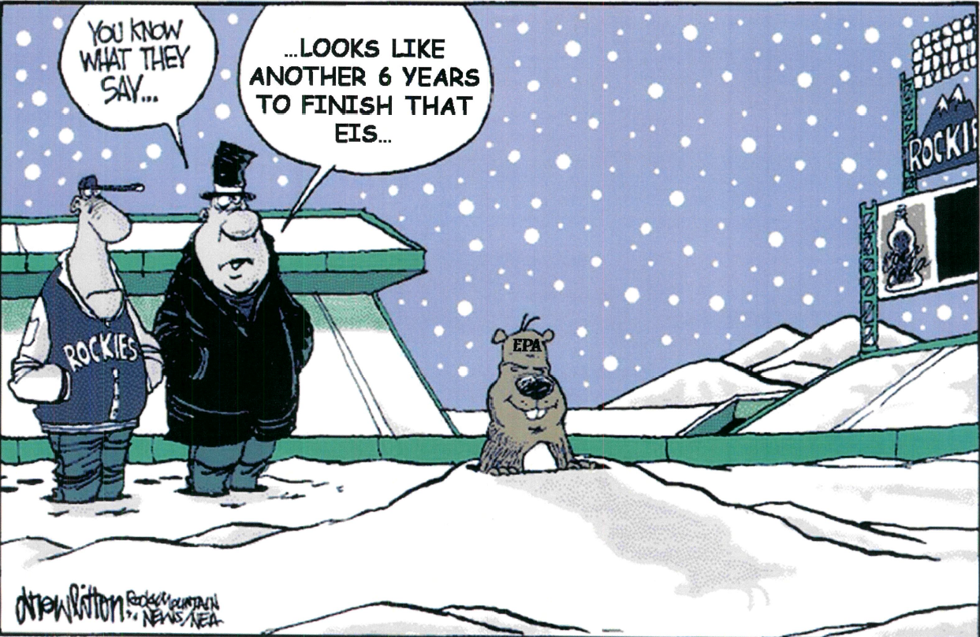

Slide 8
Clean Water Act
Section 404 regulates the placement of “dredged or fill material” into waters of the United States.
Corps is often the lead agency for water infrastructure projects
Permitting program run by Corps of Engineers with oversight by the United States Environmental Protection Agency (“EPA”)
Larger water projects that require 404 authorization typically need an individual permit.
Requires an intensive (substantive) alternatives analysis. Corps can only permit the Least Environmentally Damaging Practicable Alternative.

Slide 9
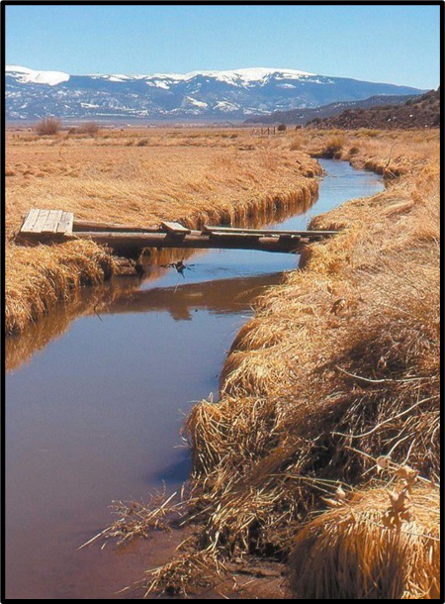
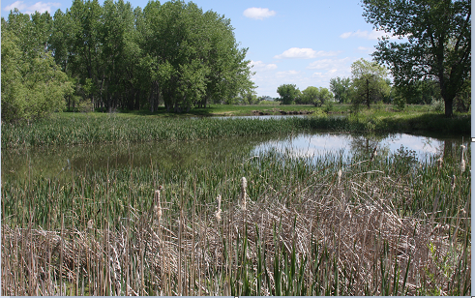
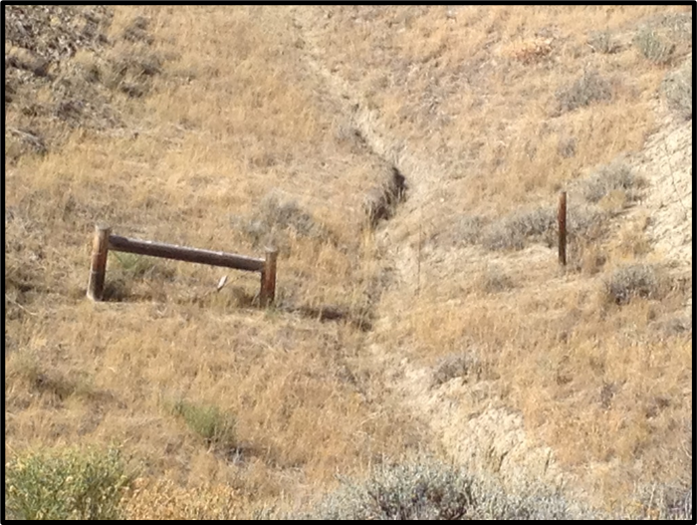
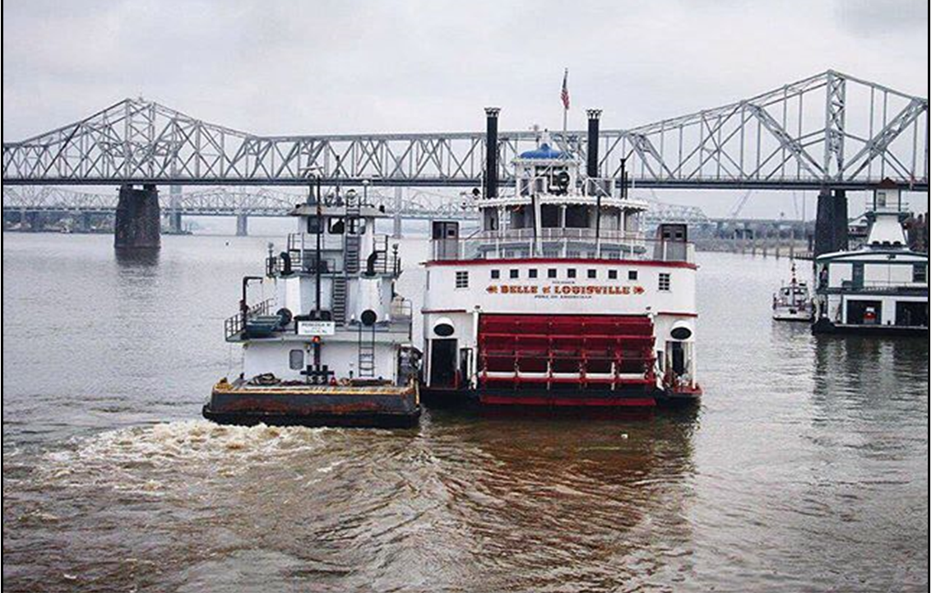
Clean Water Act
Is it a WOTUS?
Does it qualify for a permitting exemption?
Can it be covered by a Nationwide Permit?
Discretionary Authority
Is it the LEDPA?
Avoid, Minimize, Mitigate

Slide 10
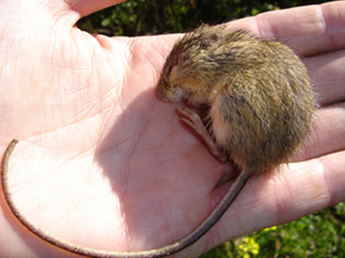
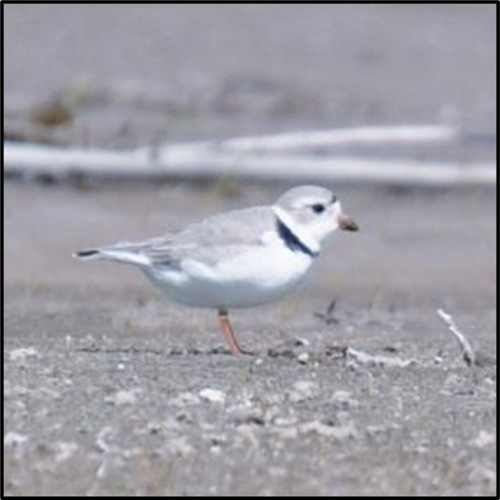
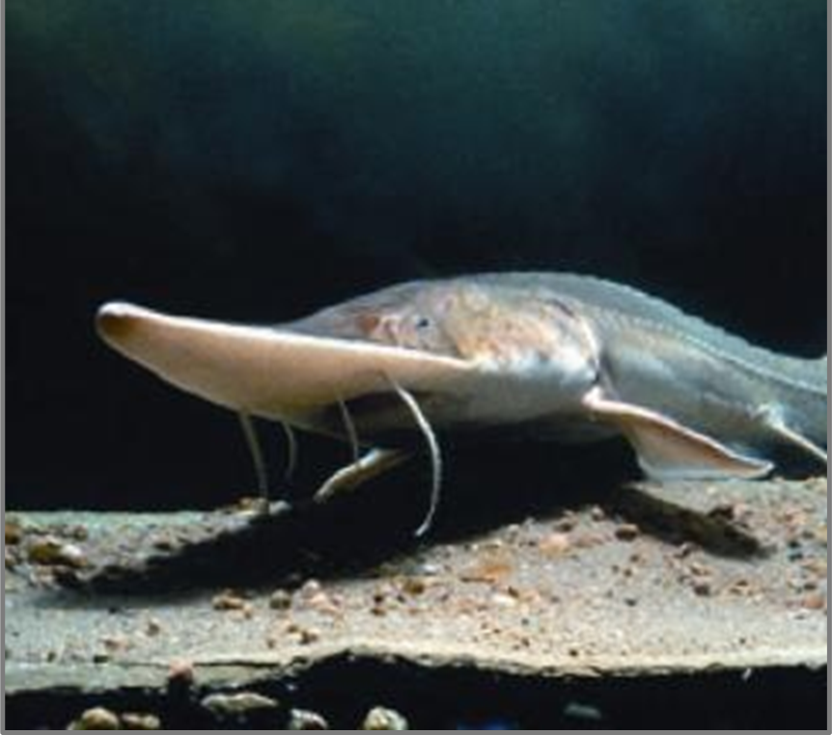
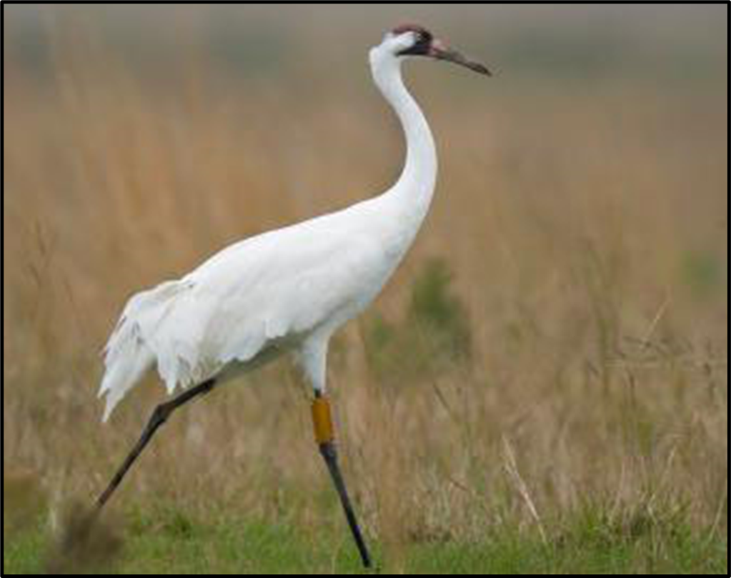
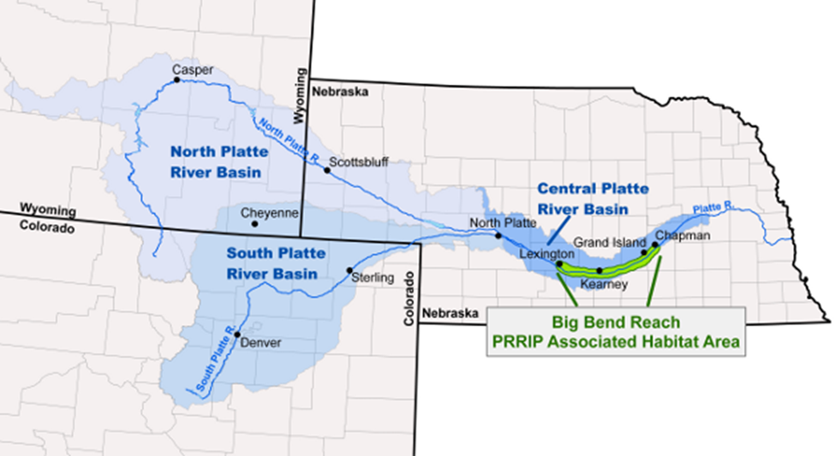
Ancillary Federal Requirements
Endangered Species Act
The Take Prohibition is the primary functional element of the Act. Once listed, the Act prohibits anyone from “taking” the species except under limited circumstances. This applies on both public and private lands.
Section 7 -- requires federal agencies to consult with the United States Fish and Wildlife Service to ensure that actions they authorize or fund are not likely to jeopardize the continued existence of any listed species or destroy or adversely modify its critical habitat.

Slide 11
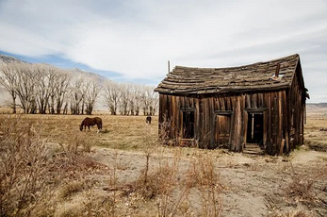
Ancillary Federal Requirements
National Historic Preservation Act
Section 106 -- Federal agency must consider the effects of the projects it authorizes or funds on districts, sites, structures, objects, or other cultural resources listed or eligible for listing on the National Register of Historic Places.
Consultation with the State Historic Preservation Officer, Indian Tribes, local governments, the project proponent, and other interested parties to determine whether such properties will be affected
Procedural but can add time and costs.

Slide 12
Ancillary Federal Requirements
Fish and Wildlife Coordination Act
Requires a federal permitting agency for a project diverting or impounding water from any stream to consult with USFWS and the state fish and wildlife agency for the state in which the project is located.
Satisfied by State Fish and Wildlife Mitigation Plan

Slide 13
State
CWA Section 401 Water Quality Certification
Applies to projects requiring a CWA Section 404 IP, or other federal permit authorizing a discharge into state waters.
State can certify, certify with conditions, or deny.
Subject of federal regulatory battles.

Slide 14
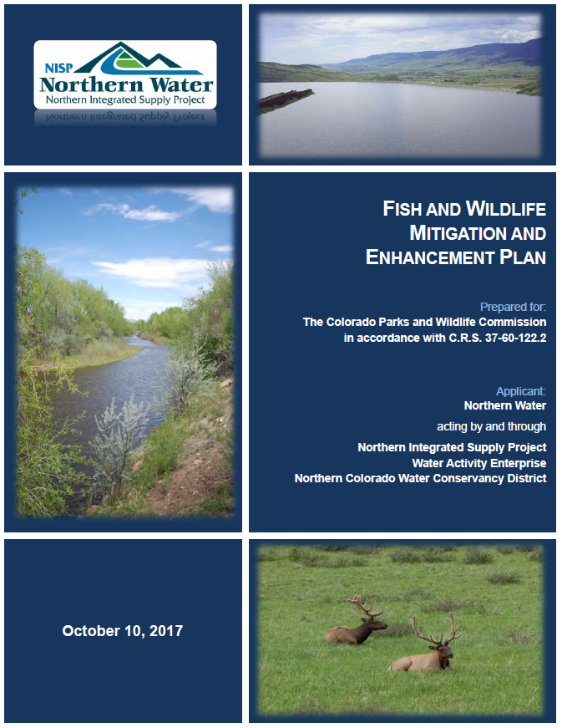
State
C.R.S. 37-60-122.2 Fish and Wildlife Mitigation Plan
Proponents of storage projects requiring an application for a permit, license, or other federal approval must submit a proposed Fish and Wildlife Mitigation Plan to the Colorado Parks and Wildlife Commission.
The plan that eventually results from this requirement becomes the official state position on mitigation for the project.

Slide 15
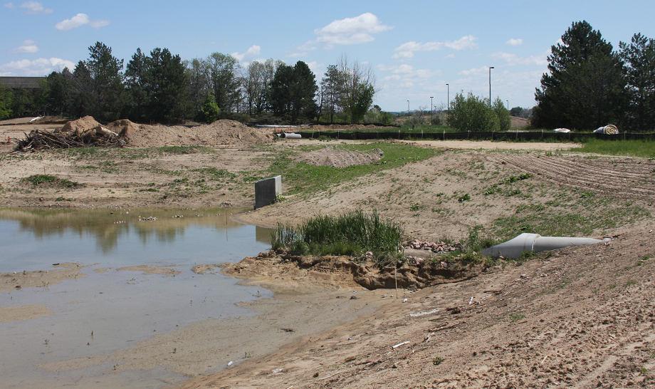
State
Air Pollution Emission Notice to the Colorado Air Pollution Control Division and implementation of a Fugitive Dust Control Plan.
Application of best management practices to account for raptors and other migratory birds.
Colorado Discharge Permit System coverage for stormwater discharges associated with construction activities.

Slide 16
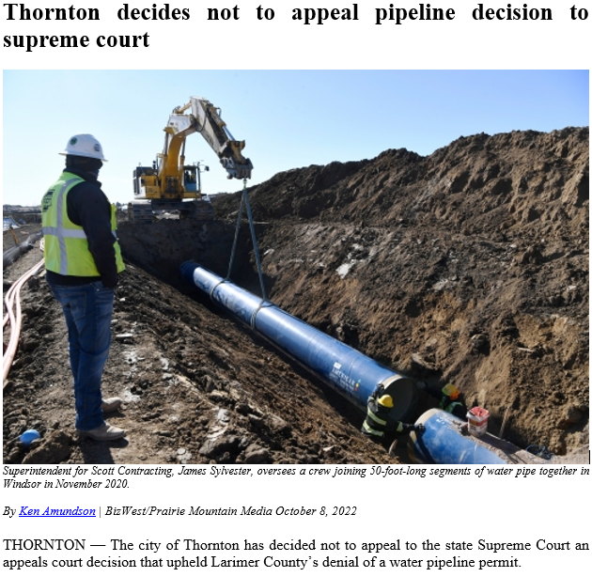
Local
House Bill 1041
Enacted in 1974, authorizes counties and municipalities to identify, designate, and regulate areas and activities of state interest through a local permitting process.
An entity proposing development in an area of State Interest or conducting an activity of State Interest must obtain a permit from local government.

Slide 17
Is there a better way?
Storage
… Colorado must also develop additional storage to meet growing needs and face the changing climate. … In addition, water managers will need to be more agile in responding to changing conditions, so that storage can be more rapidly added to Colorado’s water portfolio while maintaining strong environmental health. To do this, we must address a broken permitting system that currently produces uncertainty and fosters mistrust among all stakeholders.
--Colorado Water Plan
Our dilemma is that we hate change and love it at the same time; what we really want is for things to remain the same but get better. -- Sydney J. Harris

