Slide 1
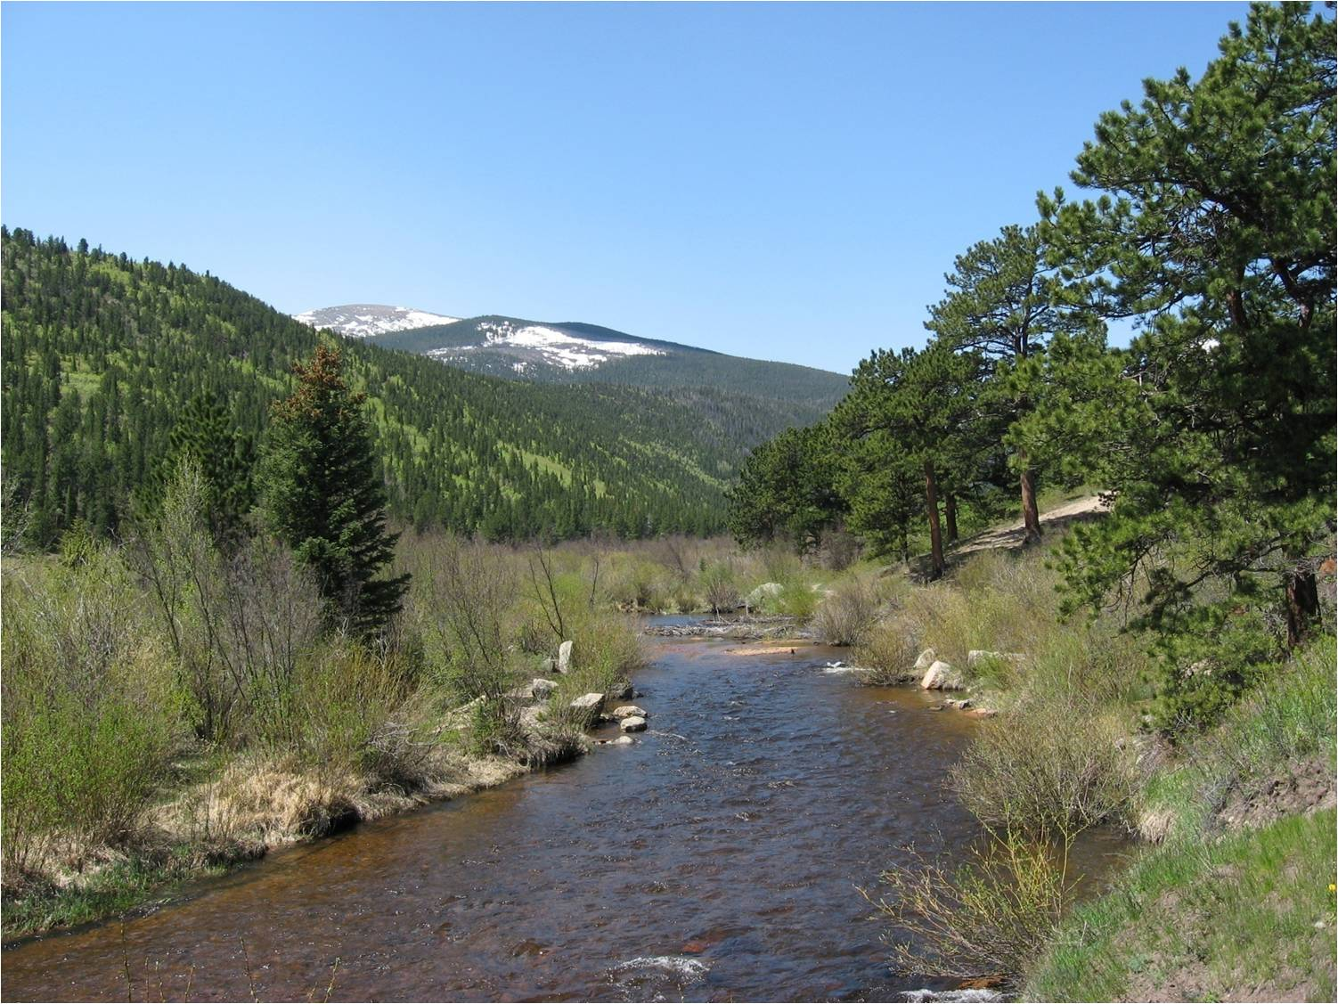
Colorado Division of Water Resources
Water Literate Leaders of Northern Colorado
October 12, 2022
Michael Hein, Assistant Division Engineer
Mark Simpson, Poudre Water Commissioner
Jean Lever, Thompson Water Commissioner

Slide 2
https://dnr.colorado.gov

Slide 3
The position of Water Commissioner was created by the Legislature in 1879
The office of State Hydraulic Engineer was created by the Legislature in 1881
State Engineer’s Office became part of the Department of Natural Resources in 1969
State Engineer and Director of Division of Water Resources is Appointed by the Governor
State Engineer’s Office includes 260 employees
https://dwr.colorado.gov

Slide 4
Division of Water Resources Mission
Provide competent and dependable distribution of water in accordance with statutes, decrees and interstate compacts.
Ensure public safety through safe dams and properly permitted and constructed water wells.
Maintain and provide accurate and timely information concerning water.
Promote stewardship of all human, fiscal and natural resources.
Serve the public through the generation of creative solutions to problems.
Help the public understand complex water issues.
Promote stability in the use of the state's limited water resources.
Apply modern technology to its greatest advantage.
Notes:
9 Compacts between Colorado and surrounding states
3 U.S. Supreme Court Decrees
2 Interstate Agreements
South Platte River Compact (Entered April 27, 1923)
Applies in Lower Section of the South Platte (Water Dist. 64)
Regulation trigger is 120 cfs at state line between April 1 and October 15
If not 120 cfs at state line all un-augmented diversions junior to June 14, 1897 are curtailed
Colorado has full use of all flows between October 16 and March 31
Laramie River Agreement with Wyoming (April 28, 1957)
49,375 acre-feet allocation to Colorado per calendar year
19,875 acre-feet for Transmountain Users in Colorado
29,500 acre-feet for Meadowland Users in the Laramie River Valley
Sand Creek Agreement with Wyoming (Amended August 7, 1997)
Wyoming may reopen Amendment if water administration procedures fail to satisfy 50.68 cfs of senior Wyoming water rights
Wyoming gives notice to Colorado when irrigation demand equals 40 cfs
Once Colorado delivers 40 cfs for 7 days, delivery is reduced to 35 cfs

Slide 5
Division of Water Resources Roles and Responsibilities
Water Administration
Surface & Underground
Water Court Participation
Interstate Compacts and Decrees
Flow Measurement (Hydrographic Program)
Well Metering
Public Safety
Dam Safety
Well Construction & Inspection
Well Permitting
Public Data & Information
Notes:
9 Compacts between Colorado and surrounding states
3 U.S. Supreme Court Decrees
2 Interstate Agreements
South Platte River Compact (Entered April 27, 1923)
Applies in Lower Section of the South Platte (Water Dist. 64)
Regulation trigger is 120 cfs at state line between April 1 and October 15
If not 120 cfs at state line all un-augmented diversions junior to June 14, 1897 are curtailed
Colorado has full use of all flows between October 16 and March 31
Laramie River Agreement with Wyoming (April 28, 1957)
49,375 acre-feet allocation to Colorado per calendar year
19,875 acre-feet for Transmountain Users in Colorado
29,500 acre-feet for Meadowland Users in the Laramie River Valley
Sand Creek Agreement with Wyoming (Amended August 7, 1997)
Wyoming may reopen Amendment if water administration procedures fail to satisfy 50.68 cfs of senior Wyoming water rights
Wyoming gives notice to Colorado when irrigation demand equals 40 cfs
Once Colorado delivers 40 cfs for 7 days, delivery is reduced to 35 cfs

Slide 6
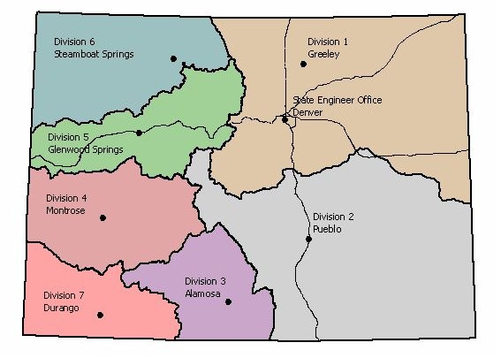
DWR Water Divisions & Offices

Slide 7
Division 1 Water Districts Map

Slide 8
Key Water Measurement Terms
cfs – a cubic foot of water past a fixed point in one second (second-foot)
Acre-foot – one acre covered one foot in depth (1 cfs for 1 day equals approximately 2 acre-feet) – Average suburban family uses about ½ acre-foot of water per year
Flume or Weir – specially shaped devices installed in a ditch to measure flow

Slide 9
South Platte Basin Hydrology
USGS estimates total basin native flows to average about 1,400,000 acre-feet annually
Transmountain water imports average about 400,000 acre-feet annually
Total annual surface water diversions average about 4,000,000 acre-feet annually

Slide 10
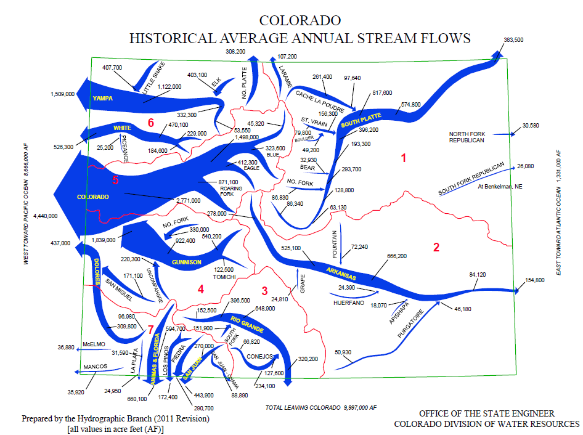

Slide 11
TRANSMOUNTAIN DIVERSIONS
OFFICE OF THE STATE ENGINEER
1
6
2
RIVER
3
STEAMBOAT
SPRINGS
4
YAMPA
5
RIVER
6
PLATTE
7
TO COLORADO RIVER BASIN
30. SARVIS DITCH
31. STILLWATER DITCH
32. DOME DITCH
30
8
SOUTH
32
31
GREELEY
TO SOUTH PLATTE BASIN
1. WILSON SUPPLY DITCH
2. DEADMAN DITCH
3. LARAMIE POUDRE TUNNEL
4. SKYLINE DITCH
5. CAMERON PASS DITCH
6. MICHIGAN DITCH
7. GRAND RIVER DITCH
8. ALVA B. ADAMS TUNNEL
9. MOFFAT WATER TUNNEL
10. BERTHOUD PASS DITCH
11. VIDLER TUNNEL
12. HAROLD D. ROBERTS TUNNEL
13. BOREAS PASS DITCH
14. HOOSIER PASS TUNNEL
9
1
5
10
DENVER
16
11
19
17
15
COLORADO RIVER
GLENWOOD
SPRINGS
18
20
12
GRAND
JUNCTION
13
21
14
4
2
DELTA
RIVER
GUNNISON
22
TO ARKANSAS BASIN
15. COLUMBINE DITCH
16. EWING DITCH
17. WURTZ DITCH
18. HOMESTAKE TUNNEL
19. CHARLES H. BOUSTEAD TUNNEL
20. BUSK-IVANHOE TUNNEL
21. TWIN LAKES TUNNEL
22. LARKSPUR DITCH
PUEBLO
MONTROSE
ARKANSAS RIVER
24
23
DOLORES RIVER
3
25
RIO GRANDE RIVER
7
26
27
28
ALAMOSA
DURANGO
29
TO RIO GRANDE BASIN
23. TARBELL
24. WEMINUCHE PASS DITCH
25. PINE RIVER-WEMINUCHE PASS DITCH
26. WILLIAMS CREEK-SQUAW PASS DITCH
27. DON LA FONT DITCHES 1 & 2
28. TREASURE PASS DIVERSION DITCH
29. TABOR DITCH

Slide 12
South Platte Water Usage
Ground Water Only | Ground Water & Surface Water | Surface Water Only
18% | 27% | 55%
Source: Colorado Decision Support System - 2005

Slide 13
2019 Analysis and Technical Update to the Water Plan – South Platte Basin https://cwcb.colorado.gov/colorado-water-plan/technical-update-to-the-plan
Population*
2015 Total South Platte Basin Population – 3.8 million
2050 Projected Population – 5.4 to 6.5 million
Irrigated Area*
2015 Approx. Acres Irrigated in the South Platte Basin – 854,000 acres
2050 Projected Acres Urbanized or No Longer Irrigated – 127,100 to 169,600 acres
Municipal & Industrial (M&I) Gap*
Average Annual Gap - 136,600 AF to 309,600 AF
Max. Gap – 184,500 AF to 540,700 AF
*Values Dependent on Varying Planning Scenarios
Updated version of the Colorado Water Plan is currently in the development process, set for final release in early 2023.

Slide 14
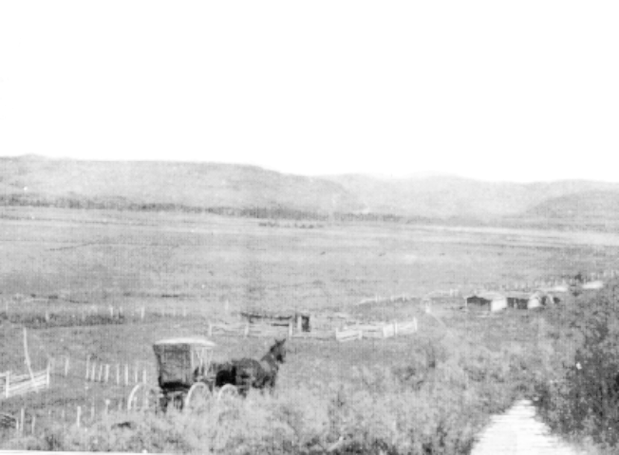
In 1879, Colorado established Water Commissioners to distribute water rights in priority based upon principle of
“First In Time... First In Right”

Slide 15
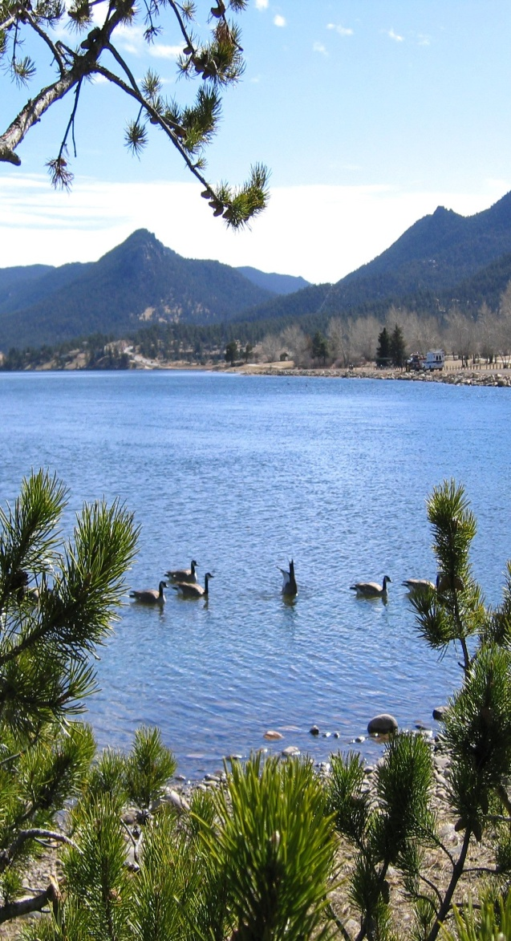
Colorado’s Water Administration System
The Prior Appropriation Doctrine means those that put the water to use first are entitled to get their water first during periods of water shortage.
In Colorado, the priority of a water right is determined by BOTH the date when the water was first put to a beneficial use and the date when the right was decreed by the Water Court.
This is opposed to the Riparian Doctrine that recognizes water rights as being attached to lands adjacent to the river or stream.

Slide 16
Colorado Average Precipitation
U.S. Department of Commerce
NOAA -National Climatic Data Center

Slide 17
Definition of Terms for a Call
Free River – the supply of water in the river exceeds the demand for water by all decreed water users
Call – the demand for water by a user with a decreed water right
Valid Call - recognized and administered by Division of Water Resources – the determination by the Water Commissioner of the most junior right that may divert when the supply of water in the river is less than the demand on the river by all decreed water users (also known as “The Call”)

Slide 18
Over-Appropriated South Platte
More water is usually claimed or desired by water users than is available.
Generally, experience a water shortage much of the year.
Almost always throughout the summer only water users who have water rights dating from the 1860’s to the 1890’s can divert in-priority.
Plans of augmentation allow replacement of out-of-priority diversions.

Slide 19
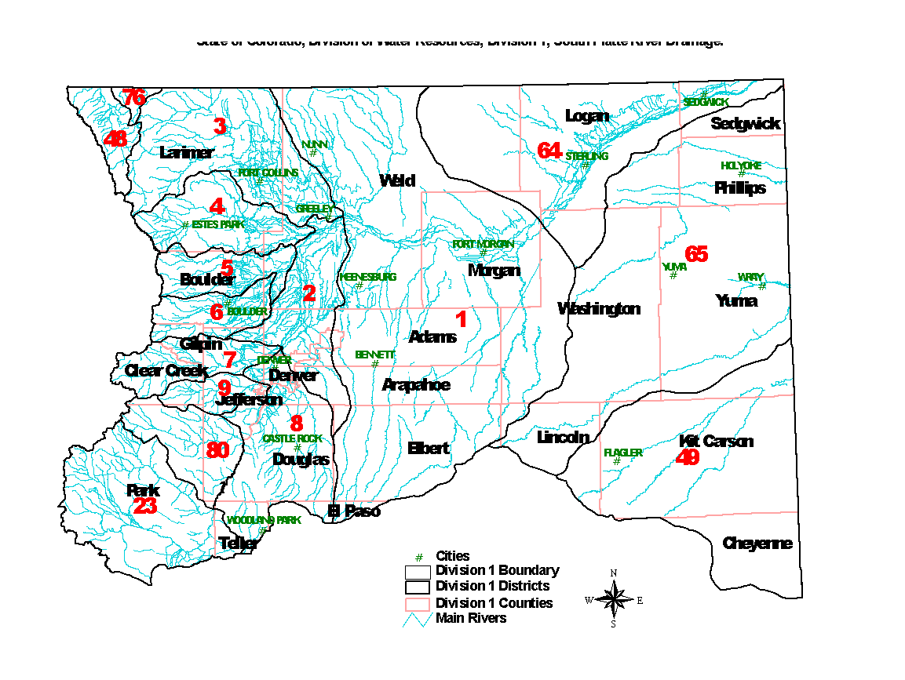
South Platte River Drainage Water Rights Development
Priority Dates
Of Controlling
Water Rights
A D
A C A
A B
A B C
A D
A
A
A
Early 1860’s
Late 1860’s
To Early 1870’s
Early 1880’s
Late 1880’s
To Mid-1890’s

Slide 20
Northern Front Range Recent Trends
Stream Restoration Projects
Initiated after 2013 floods, and ongoing
Administration of Plan for Augmentation to Augment Stream Flows & Reservoir Releases for Fish and Wildlife Mitigation on the Poudre River
Fracking Operations
Use of Technology for Near Real-Time Water Administration
Electronic data loggers and remote reporting

Slide 21
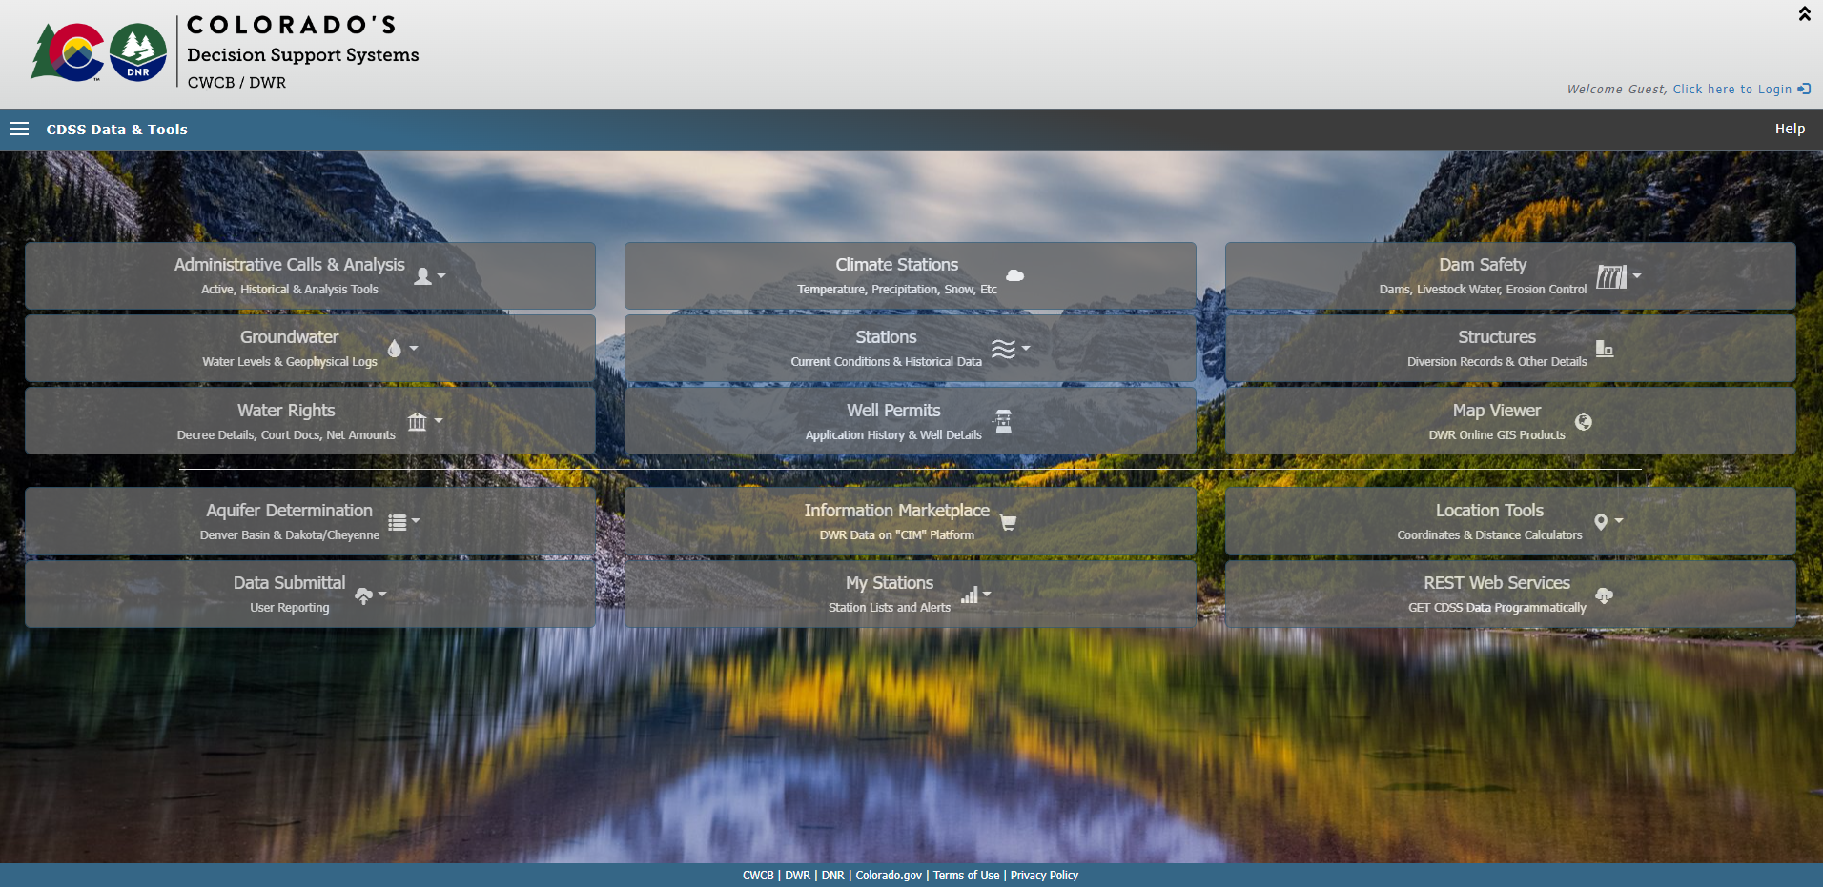
Colorado’s Decision Support Systems https://dwr.state.co.us/tools

Slide 22
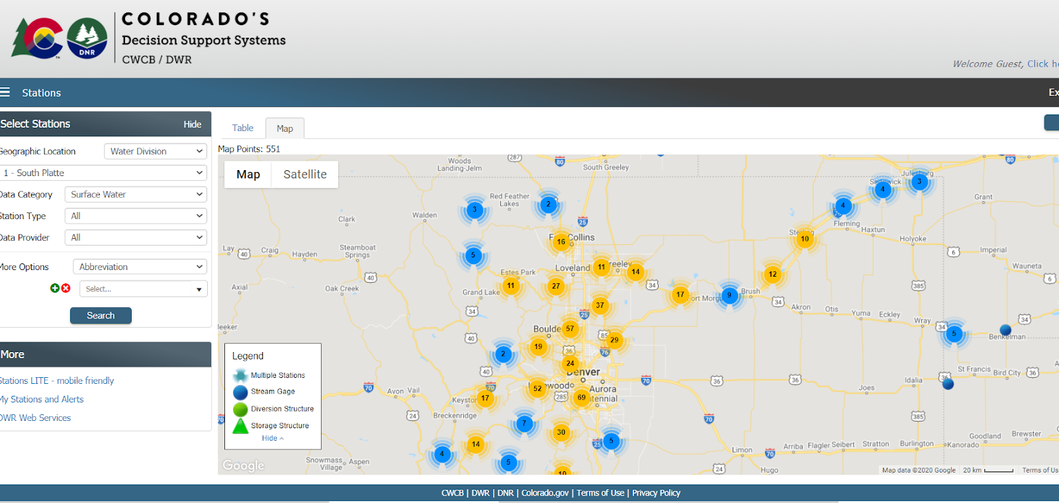
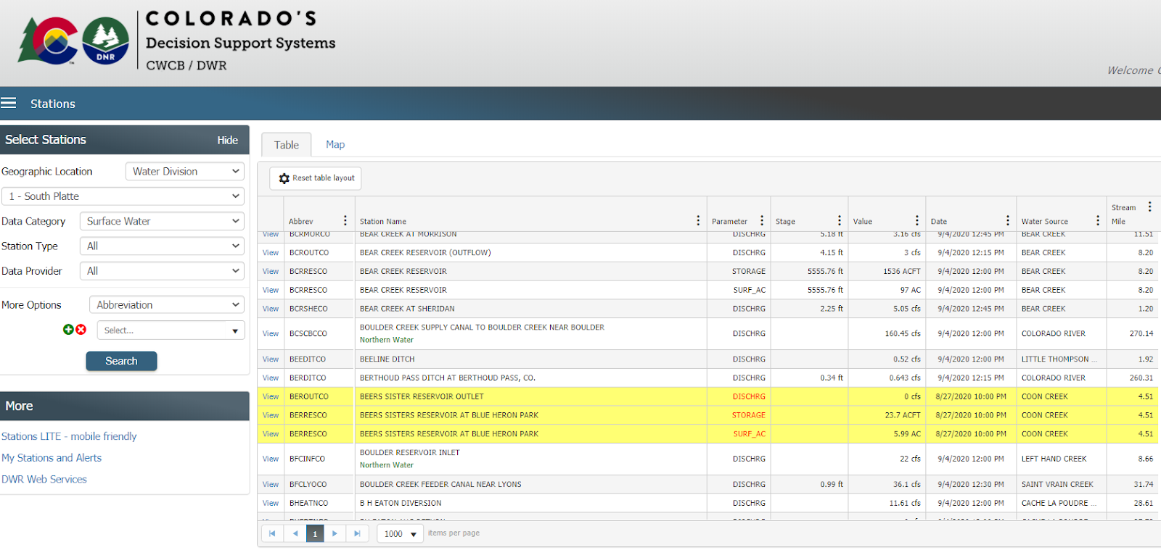
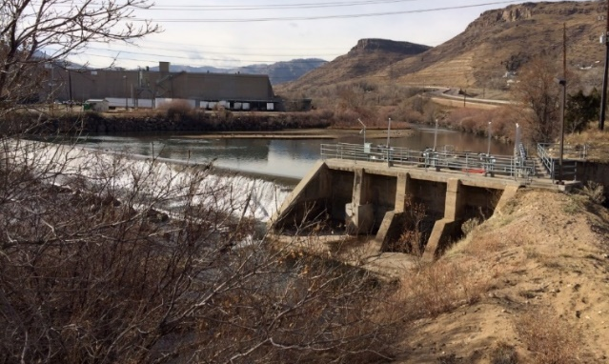
Telemetry Data – CDSS Stations https://dwr.state.co.us/surfacewater/
South Platte River Basin Division 1
Currently 643 Sites on website (Includes SPBRT Funding)
Cooperation with USGS, DWR, NCWCD, LSPWCD, CCWCD & Others
Notes:
Automation and telemetry of diversions, augmentation stations, return structures to allow administration near real-time throughout reaches.

Slide 23
Future Consideration
Development of water in the South Platte River basin will likely continue to include change of water rights applications.
2002 - 1,000 Augmentation Plans
2007 - 1,300
2019 - 1,900
The decrees for these change decrees include complex administrative provisions resulting from moving the supply of raw water to the intended place of use.
Increase of an average of 50 new plans per year out of nearly 300 new cases filed annually with the Water Court

Slide 24
Water Commissioner Responsibilities
Day to Day Administration
Setting the Valid Call Based on Supply and Demand
Assuring Diversions In Priority For Decreed Uses Without Waste
Delivery of Augmentation and Other Water After Assessing Transit Losses
Operating Exchanges
Assuring Diversions Are Measured
Assuring Augmentation and Return Flow Requirements Are Made
Assuring Compliance with Other Decree Conditions in Augmentation and Change Cases
Review of Accounting and Maintenance of Diversion Records

Slide 25
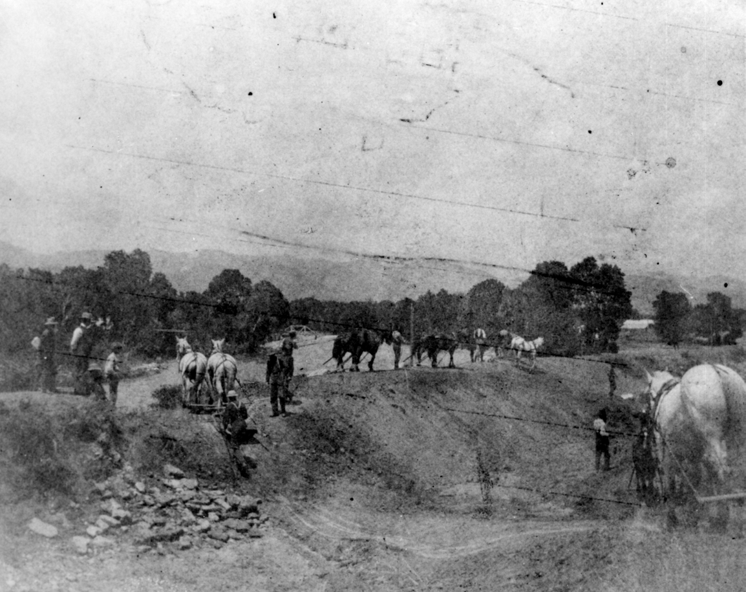
Poudre River – District 3
Irrigation Ditch Construction in Fort Collins – Late 19th Century

Slide 26
Where Does the Water in the Poudre River Come From?
Three main sources
Native River Water
C-BT System Water
Other Transbasin Supplies

Slide 27
Average Annual Poudre Basin Supplies
500,000
450,000
400,000
350,000
300,000
250,000
200,000
150,000
100,000
50,000
0
Other Transbasin Imports
C-BT & Windy Gap Imports
Amount (acre-feet)
Poudre River Flows

Slide 28
Native Poudre Water
Roughly 65% of the Poudre River’s water is native flows from snowmelt
Starts from Poudre Lake off Trail Ridge Road, RMNP
Flows vary from year to year
The annual volume is highly variable

Slide 29
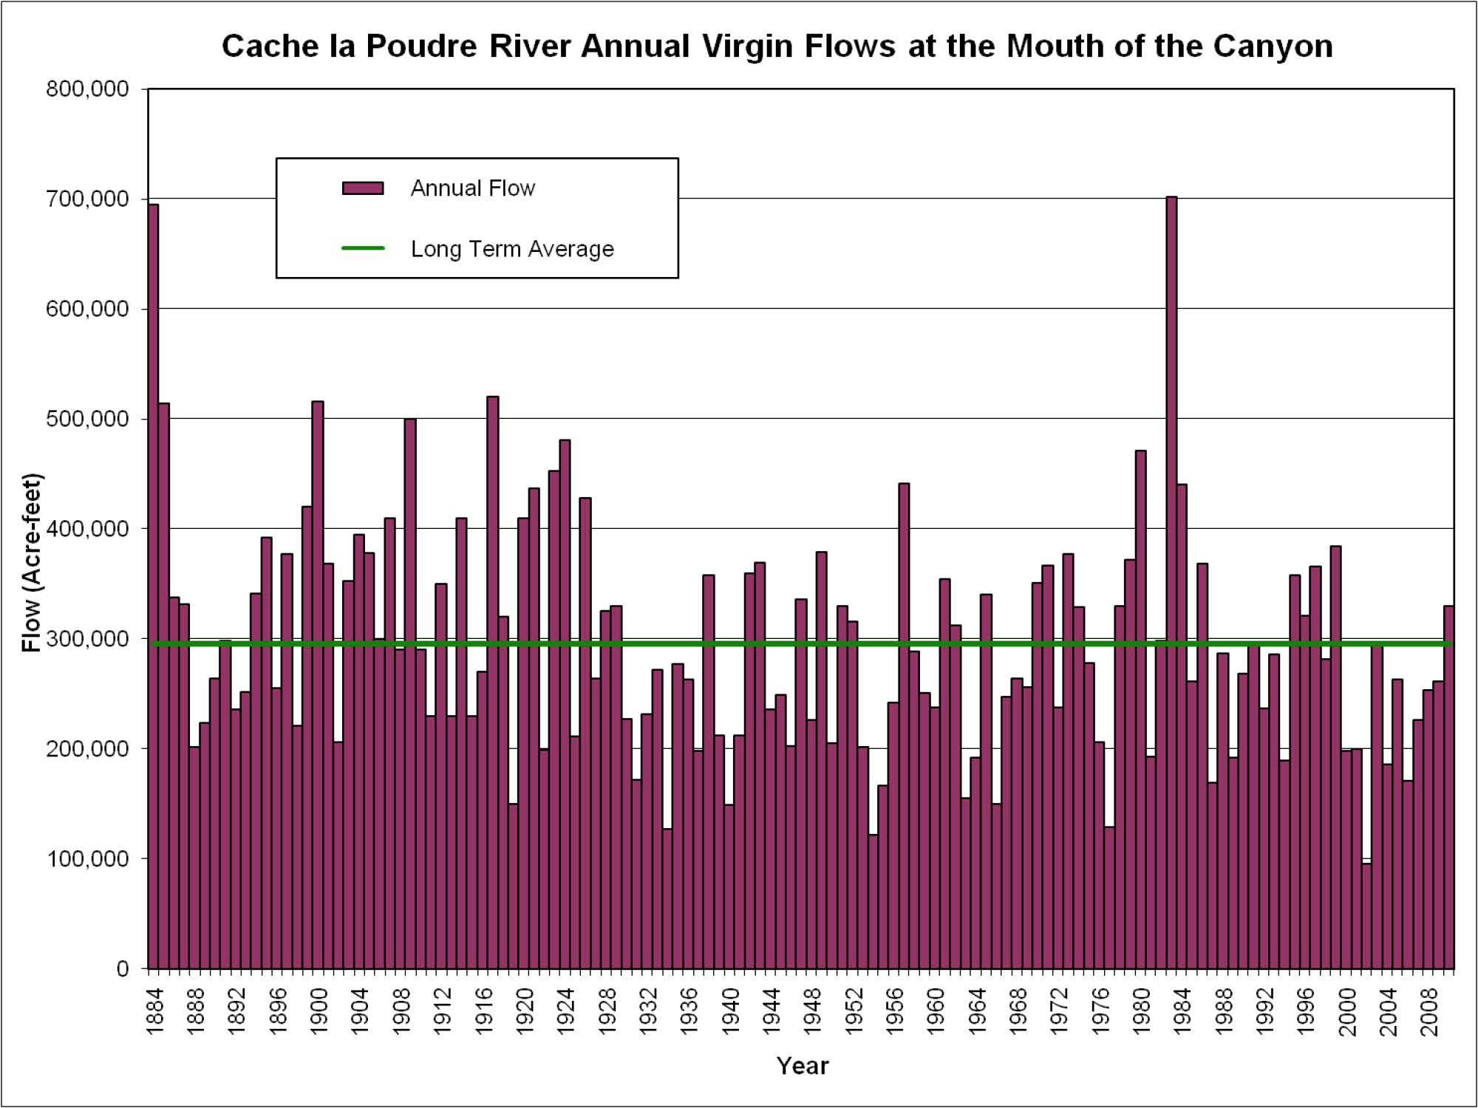

Slide 30
Native Poudre Water
Average daily flow varies depending on the time of year
Two-thirds of the annual volume comes in a two-month period
Winter flows are very low, accounting for only 1 or 2 percent of the annual flow each month

Slide 31
Average Poudre River Flows
1,800
1,600
1,400
2/3^{rds}
of runoff occurs in 2 months
1,200
months
1,000
800
600
400
200
0
Date
Source: Cache la Poudre River at the Mouth of the Canyon Gage (USGS 06752000)
Flow (cfs)
Jan
Feb
Mar
Apr
May
Jun
Jul
Aug
Sep
Oct
Nov
Dec

Slide 32
Cache la Poudre River Monthly Average Native Runoff at the Mouth of the Canyon (1950-2005)
120,000
39%
100,000
80,000
23%
60,000
Monthly Average Runoff (acre-feet)
14%
40,000
20,000
5%
5%
3%
3%
1%
1%
2%
2%
2%
0
JAN
FEB
MAR
APR
MAY
JUN
JUL
AUG
SEP
OCT
NOV
DEC
Month

Slide 33
Native Poudre Water
Lack of water in the late summer and winter months to meet demands
Extreme variability in the supply from year to year
Reservoirs were built to re-time the water so that it is available to meet irrigation and municipal demands

Slide 34
Poudre River Flows
4,000
3,500
Wet Year
(1980)
3,000
2,500
Flow (cfs)
2,000
Average Year (1993)
1,500
1,000
Dry Year (2002)
500
0
Jan
Feb
Mar
Apr
May
Jun
Jul
Aug
Sep
Oct
Nov
Dec
Month
Source: Cache la Poudre River at the Mouth of the Canyon Gage (USGS 06752000)

Slide 35
Colorado Big Thompson Project

Slide 36
Colorado Big Thompson Project CBT
Roughly 25% of the water in the Poudre is diverted from the Colorado River via the Colorado Big Thompson Project
Helps to fill in supply in years when annual supplies in native rivers are low
Helps to fill in supply during months when flows in native rivers are low (late-summer, and for municipalities, winter too)

Slide 37
Colorado Big Thompson Project CBT
Horsetooth Reservoir is part of the CBT Project, serving the Poudre
About 60% of the CBT project water is released into the Poudre via Horsetooth
Horsetooth releases made from April through October, mostly in late summer

Slide 38
Transbasin Diversions
Roughly 10% of the water in the Poudre is diverted from these other transbasin diversions, constructed in the late 1800 ‘s and early 1900’s

Slide 39
Other Transbasin Diversions
Grand River Ditch
Diverts water from the Colorado River Basin

Slide 40
Other Transbasin Diversions
Laramie-Poudre Tunnel
Diverts water from the Laramie River Basin

Slide 41
Other Transbasin Diversions
Other Transbasin Diversions
Michigan Ditch
Wilson Supply Ditch
Deadman Creek Ditch
Bob Creek Ditch
Cameron Ditch

Slide 42
Agricultural Uses
Four Large Irrigation Systems
North Poudre Irrigation Company
Water Supply and Storage Company
Larimer and Weld Irrigation Company
New Cache Irrigating Company (Greeley No 2)
Many Smaller Irrigation Companies

Slide 43
Irrigation Company Service Areas
Fort Collins
North Poudre Irrigation Company
Larimer-Weld Irrigation Company
Water Supply and Storage Company
New Cache la Poudre Irrigation Company
Greeley

Slide 44
2005 Poudre River Basin Irrigated Lands

Slide 45
Municipal and Industrial Users
City of Fort Collins
City of Greeley
Bellvue Water Treatment Plant
Tri-Districts (Soldier Canyon Filter Plant)
Fort Collins-Loveland Water District
East Larimer County Water District
North Weld County Water District

Slide 46
Municipalities and Water Districts

Slide 47
Recreational and Environmental Uses
CWCB In-Stream Flows
Recreational In-Channel Diversions (RICD)
City of Fort Collins has two RICDs
Two Recent Statutes
C.R.S. § 37-92-102(4.5) - Plan for Augmentation to Augment Stream Flows
C.R.S. § 37-92-102(8) – Reservoir Releases for Fish and Wildlife Mitigation

Slide 48
How are Rights Administered?
Direct Flow Water Rights
The water rights that were applied for first (1860s) get the senior priorities
The water rights in the Poudre are assigned numbers based on the application date
Number 1 is a senior right (6-1-1860)
Number 100 is a junior right (1881)

Slide 49
How are Rights Administered?
Water Storage Rights
Usually junior to the direct flow decrees on the Poudre
Typically, the storage season is Nov 1-Apr 15
Can also be diverted when the high flows occur
Water is measured at the reservoir using a staff gage

Slide 50
How are Rights Administered?
As the flow rate in the river increases, more water rights “come into priority” (can divert)
As the flow in the river decreases, the last right to divert is the first right to shut off
In some years junior water rights may not ever come into priority

Slide 51
Conclusions
The Poudre River gets its water from many sources
Poudre River flows vary considerably - annually, monthly, daily
Agricultural irrigation continues to use a large majority of the Poudre supplies
For many junior water right holders, the water is not available when the water is needed
Rules for diverting and using the water are prescribed by Colorado water law
The Poudre Water Commissioner is responsible to administer the “working river”

Slide 52
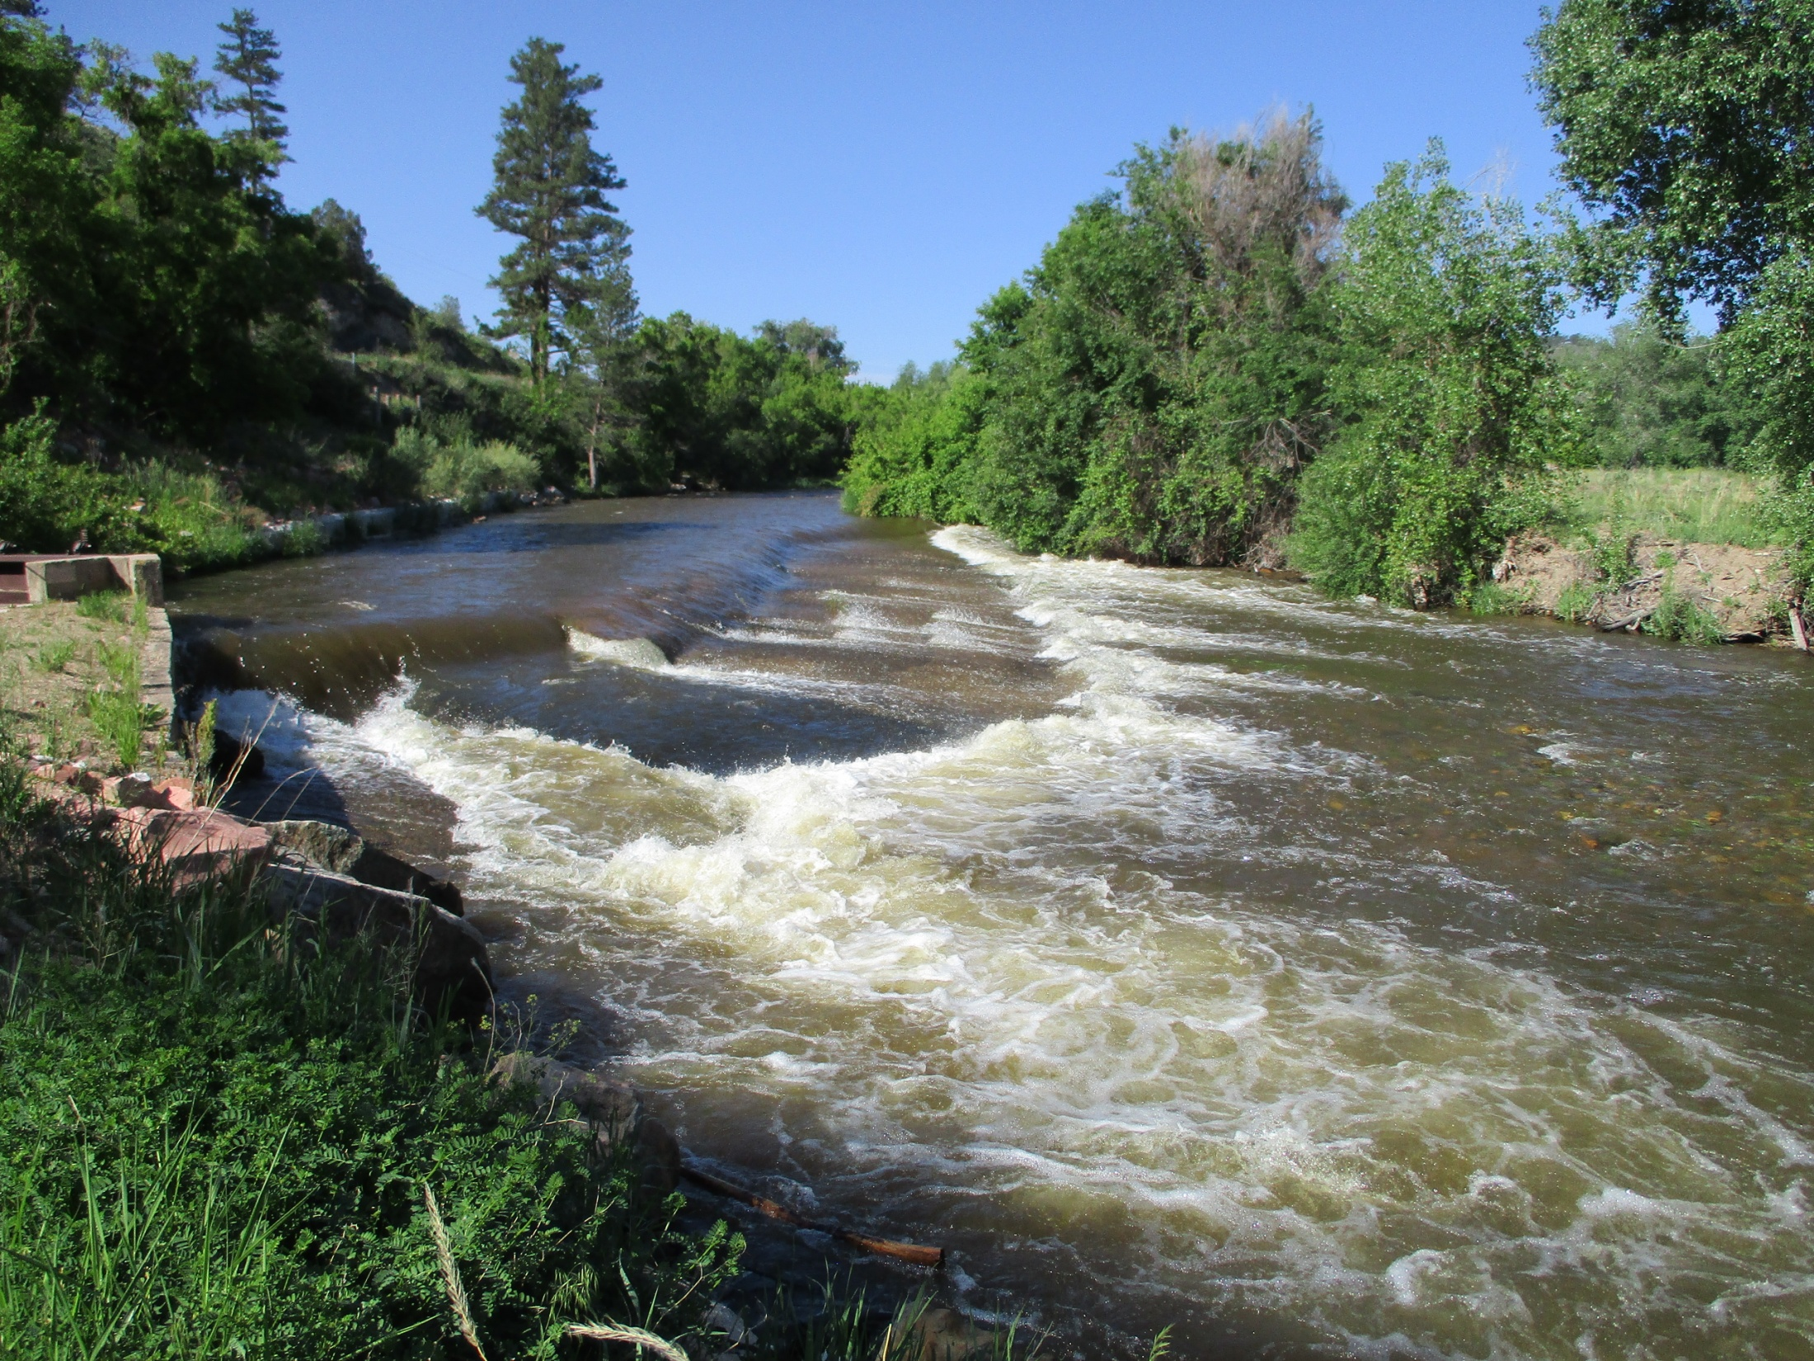
BIG THOMPSON WATERSHED
October 12, 2022
Jean Lever, District 4 WC

Slide 53
Water Sources for the Big Thompson River
Native Water
Direct Use
Storage
CBT / Windy Gap water
This is the only significant source of transbasin water for the Big Thompson Basin

Slide 54
Native Big T water
Approximately 75% of the Big T’s water is from snowmelt
Catchment Areas
RMNP (East side of Continental Divide) is the main catchment basin for the Big Thompson
The N Fork of the Big T and Buckhorn Creek contribute from the north side of the basin
Little Thompson catchment area is lower in elevation, south side of the basin
Seepage returns to the rivers downstream
Highly variable flows and volumes annually

Slide 55
Peak Flow at Big T Inlet to Lake Estes (DCFS)
Average Peak Flow Above Lake Estes: 907 cfs
2022 Peak: 1120 cfs at 12:45 on June 13
BTABESCO

Slide 56
2002 Dry Year: Peak May 31st at 401 cfs (369 + 32)
2019 Year: Peak July 1st at 1098 cfs (957+141)
Average Year: Peak June 17th at 742 cfs (610+ 132)
2022 Year: Peak June 13th at 1250 cfs (1120+130)

Slide 57
CBT / WINDY GAP SYSTEM
Only major transbasin diversion into the Big T is the Adams Tunnel from Grand Lake
Lake Estes: CBT and native water come together; it is not a storage container
USBR controls the movement of transbasin water from the West slope through to Horsetooth & Carter
NCWCD organizes and controls the release of CBT & Windy Gap to users

Slide 58
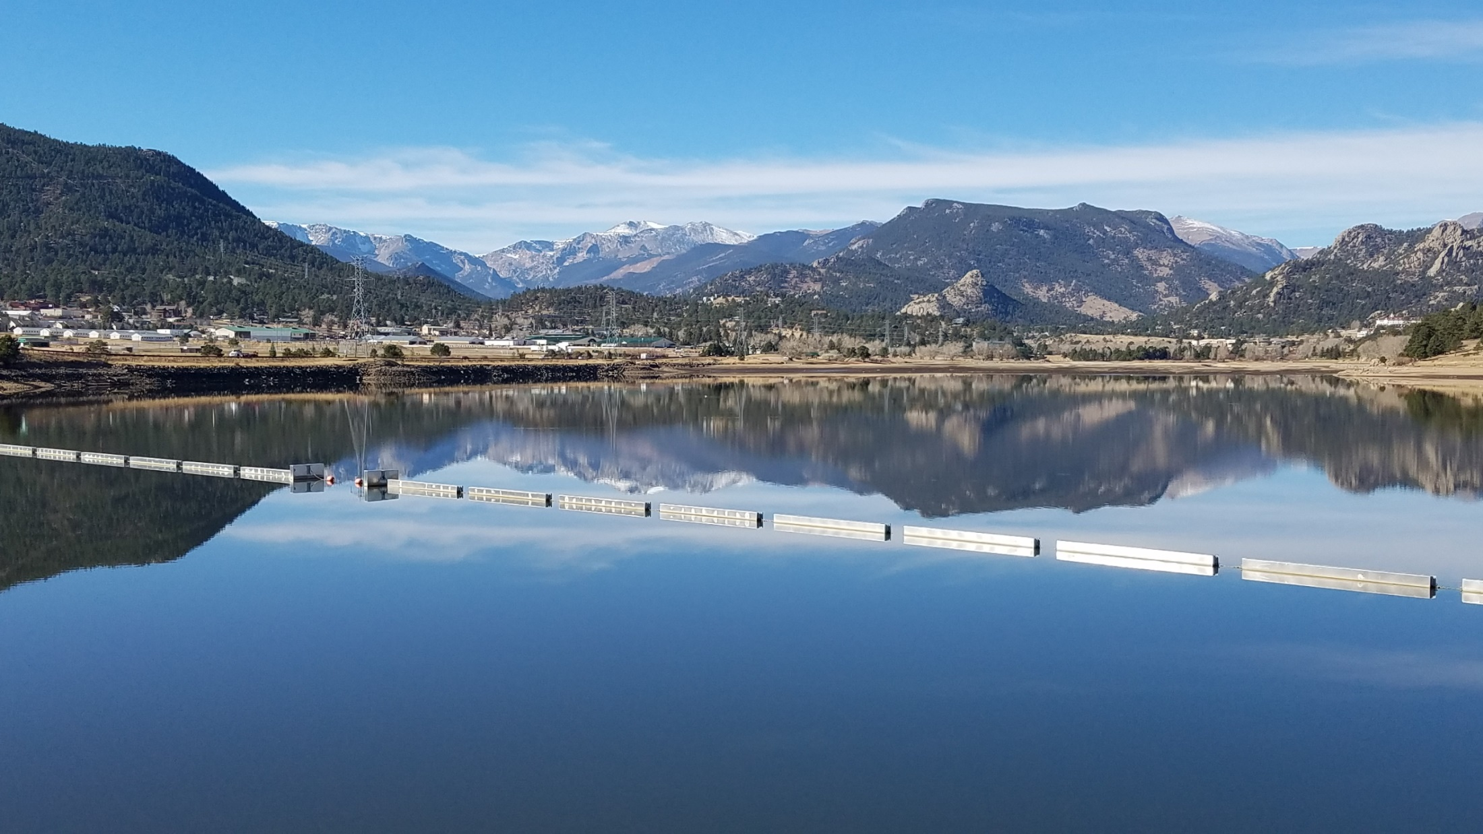
Lake Estes

Slide 59
Lake Estes
Lake Estes: CBT and native water come together
Big Thompson River enters from RMNP to the West + tributaries (Fish Creek)
CBT enters via the Powerplant
CBT is released to the Olympus Tunnel
Big Thompson water is released to the river and the Olympus Tunnel based on administrative and functional needs
Skim
City of Loveland, Berthoud
The main fill of Horsetooth and Carter: Dec-March and native water come together; it is not a

Slide 60
CBT Inflow
Volume of CBT: 215-250,000 AF/yr
Average Monthly volume: approx. 18,000 AF
Main filling period for Horsetooth and Carter is in winter: Dec – March
Reduced flows in May-June - more space in Lake Estes for the native flow of the river

Slide 61
Big T & Colorado water inflow to Lake Estes

Slide 62
Volume of CBT: Avg 215-250,000 AF/yr
Volume of Native Big T water entering Lake Estes: 105,000 AF/yr
Average Daily Volume in Lake Estes: 2350 AF
Average, the volume of water in Lake Estes is replaced every 2.5 days

Slide 63
Release of water from Lake Estes
Native flow enters in one 24 hour period and is released the next
No storage water right for Lake Estes = no storage of Big Thompson water in Lake Estes
CBT water may be held in the lake as determined by the USBR based on their operations and agreements
Typically: make one release change (gate change) at the Olympus Dam every day
Keeps a 24 hour steady flow in the Canyon, if possible
Try not to make too large changes down the Canyon interday, except during peak runoff season

Slide 64
CBT / WINDY GAP SYSTEM
Chimney Hollow Reservoir
Broke ground on construction in Aug 2021
Capacity: 90,000 AF
No Big Thompson storage right
Total CBT/Windy Gap storage = 370,000 AF

Slide 65
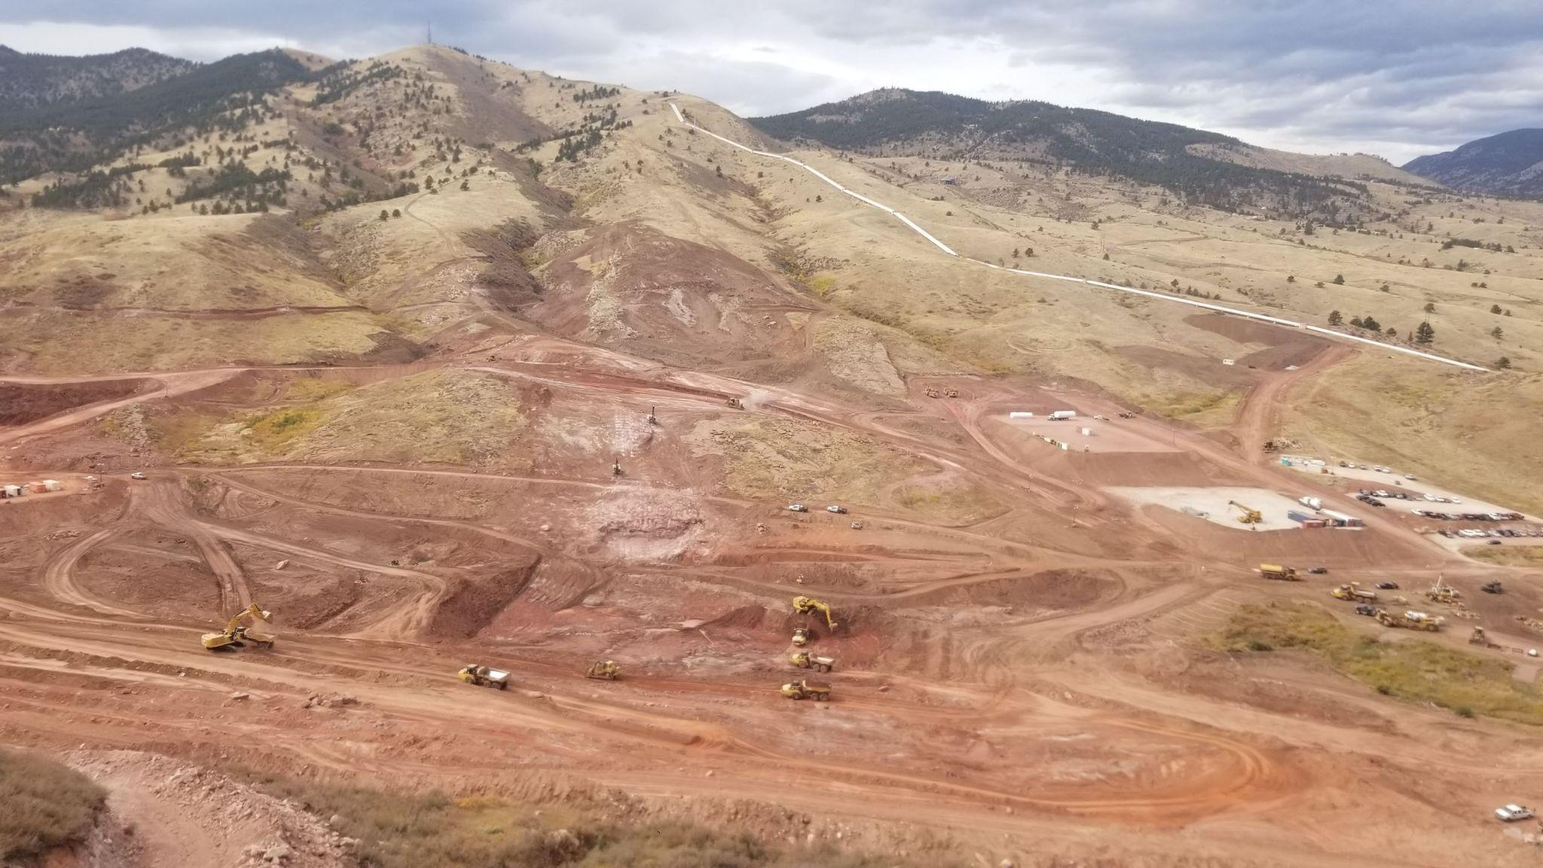
Chimney Hollow Reservoir
9 municipalities, 2 water districts, 1 power company
30,000 AF firm yield
Asphalt core dam
350’ tall dam wall
4 year construction
Day time recreational facilities

Slide 66
Major Ditches on the Big Thompson

Slide 67
Largest Diverters
GLIC system largest and most complex
spans from Lake Loveland to Greeley
Includes Boyd, Horseshoe, Lake Loveland (75,000 AF storage)
Water from this system owned & used by Loveland, Greeley, Evans, Windsor, as well as the ditch company
Home Supply
Spans from W side of Loveland to Johnstown and the Little Thompson
Includes Lonetree, Mariano, Lon Hagler
City of Loveland
Green Ridge Glade

Slide 68
Municipalities & Water Districts
Receive water from the Big Thompson
Loveland*
Greeley
Evans
Estes Park*
Berthoud*
Johnstown*
Milliken
Windsor
Little Thompson Water District – historically CBT only
Have applied for Thompson River water rights
*have own direct

Slide 69
Municipal Use of ‘Ditch’ Water
Municipal ownership of ditch water rights increasing
Change use of the shares to include municipal, storage, augmentation, recreation, etc.
Many & complex decrees
Need ‘plannable’ water supplies
predictable and consistent
ditch systems with reservoirs
senior water rights
A municipality may become the majority ditch share owner
Location of the diversion of the water changes
City requires water at its water treatment plants
Recreational & conservation use leaves water in the river or in reservoirs
Affects the operations of the ditch company
Affects administration of the river

Slide 70
In-stream Flow Requirements
Decreed in-stream flows
Only in the Canyon
Junior water rights
USBR Fish Flow Provisions
Same or greater than the decreed in-stream flows
No minimum stream flow requirements downstream of Dille Tunnel
WC does dry-up the river in Loveland

Slide 71
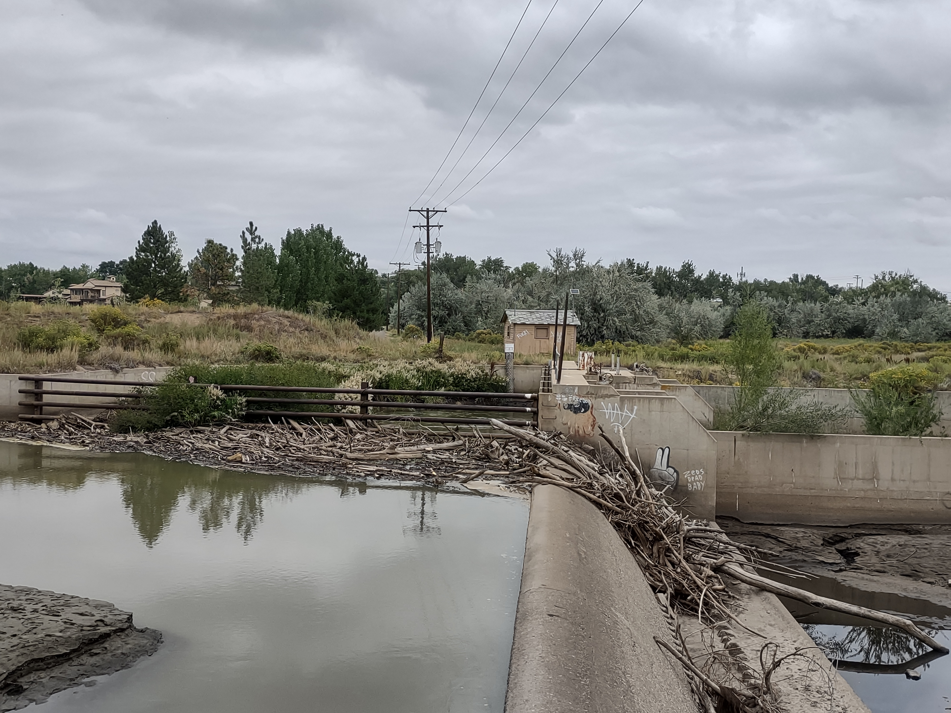
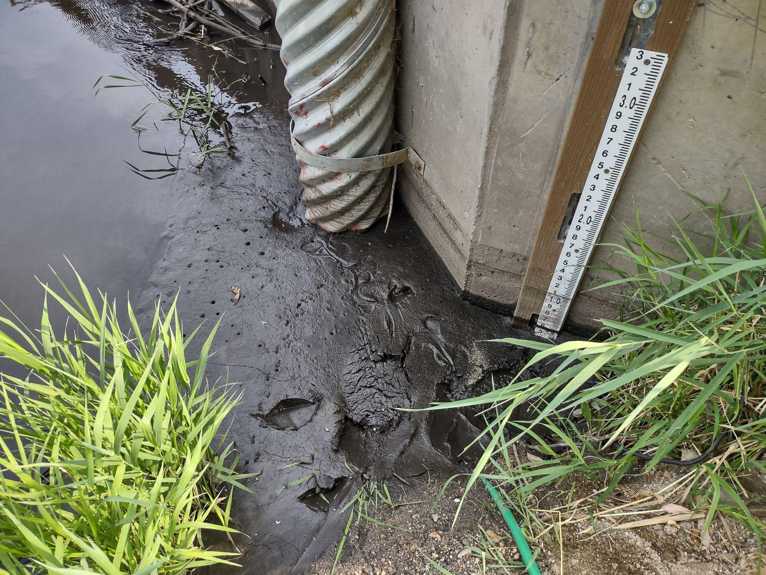

Slide 72
Big Thompson Watershed Coalition
Big T Reconstruction
Post 2013 Flood - mainly projects in the Canyon
Post 2020 Fire - mainly on the N Fork and Buckhorn
Big T Envisioning Project
Analysis of the river ‘health’ from Dam Store to I-25
Assessment by community of future vision for the Big T through Loveland
Colorado Water Plan
http://www.bigthompson.co

Slide 73
QUESTIONS

