Slide 1
Water-Economy Nexus
Water Literate Leaders | November 9, 2022
All Rights Reserved © WestWater Research

Slide 2
Water-Economy Nexus Water Market Drivers
Population Growth
Housing
All Rights Reserved © WestWater Research

Slide 3
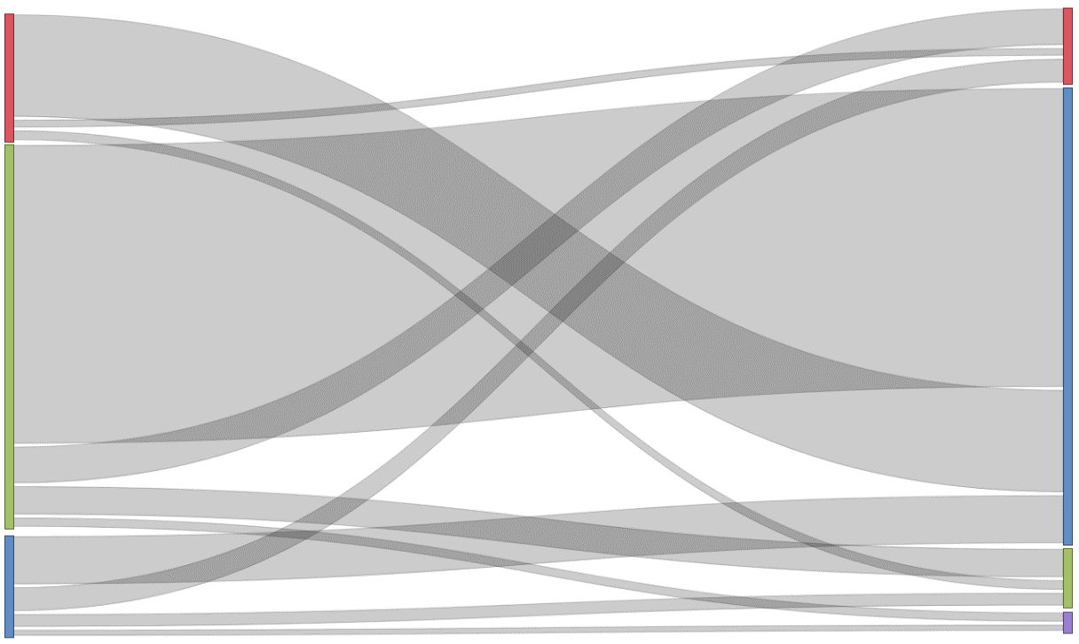
Water-Economy Nexus Market Participants
Industrial
10%
Industrial
20%
Agricultural to Municipal transactions are the dominant transfer type
Municipal
83%
Previous Water Use
New Water Use
Agricultural
67%
Municipal
13%
Agricultural, 6%
Environmental,1%
All Rights Reserved © WestWater Research

Slide 4
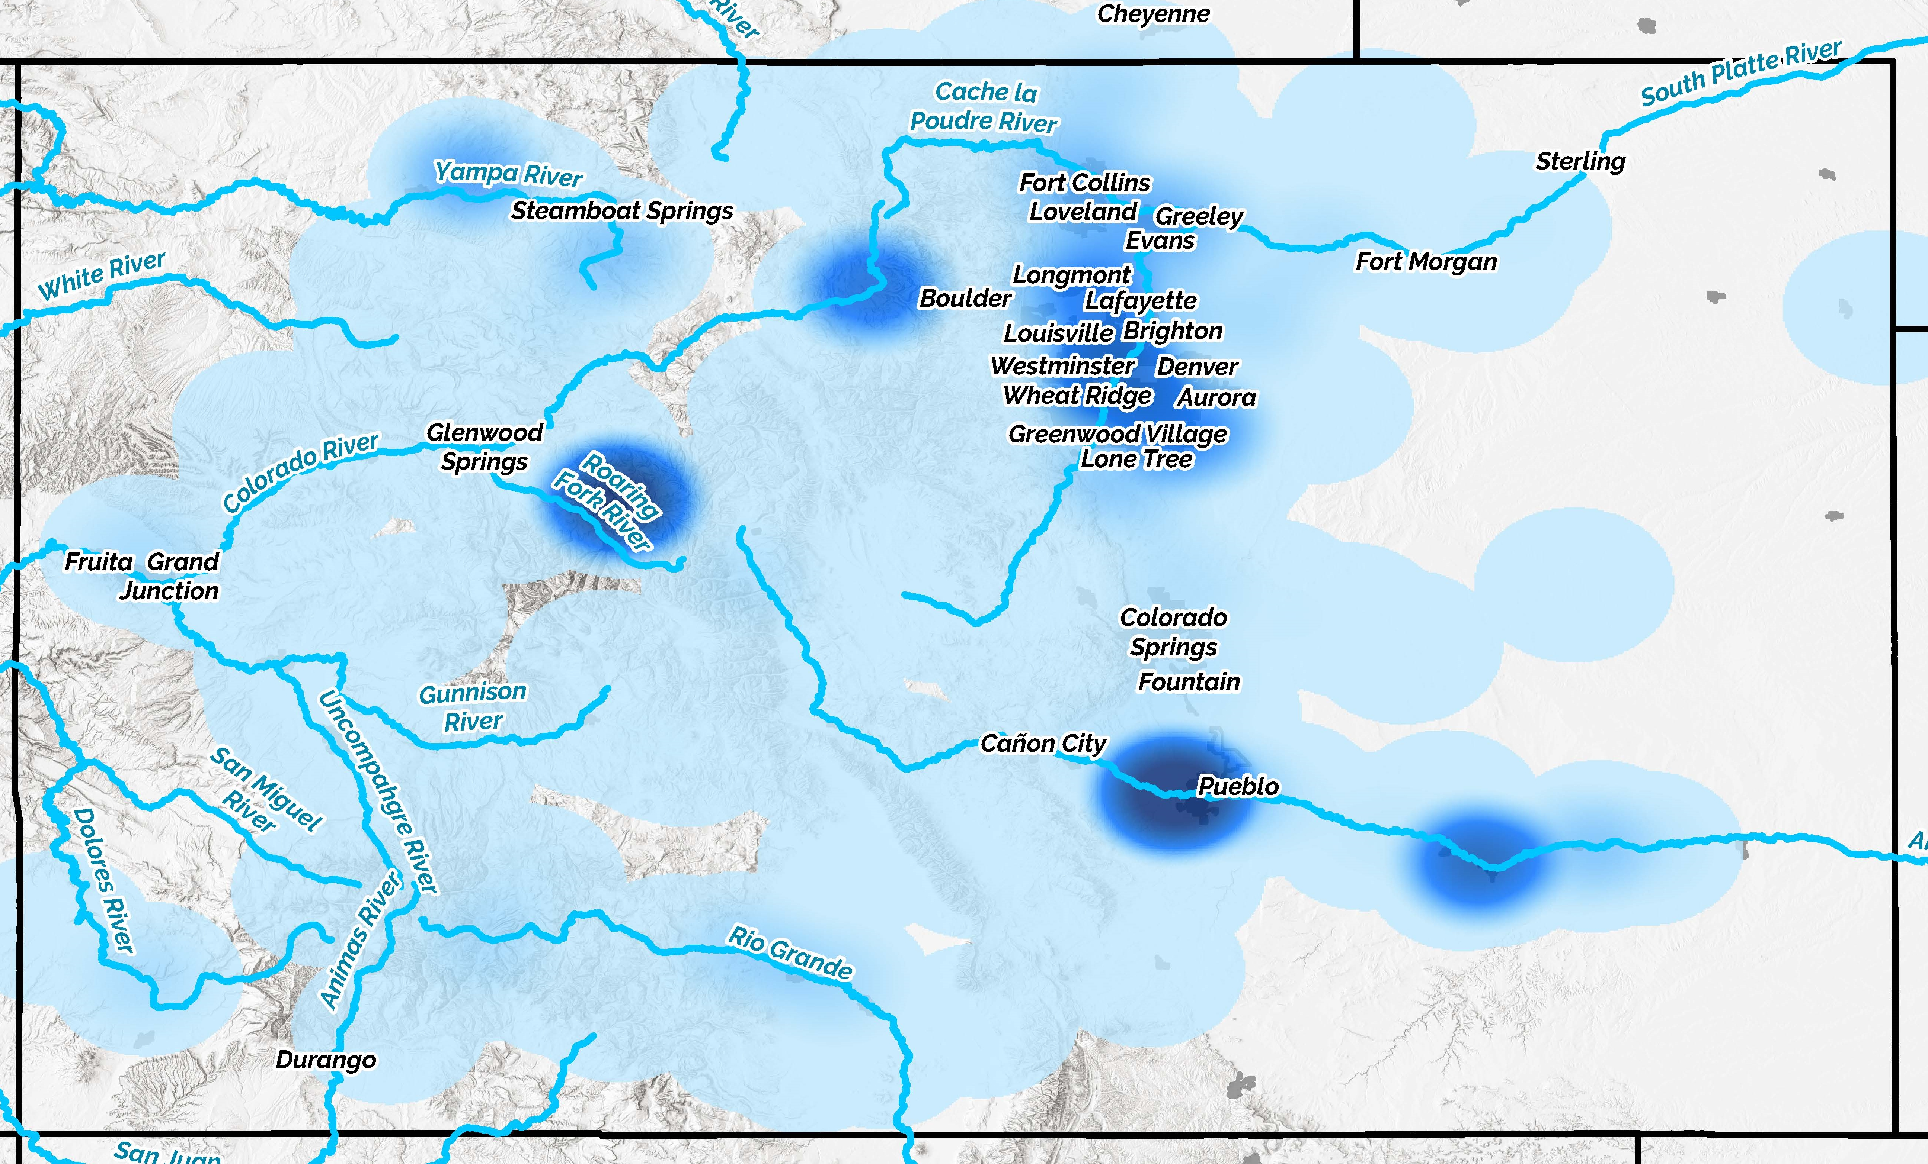
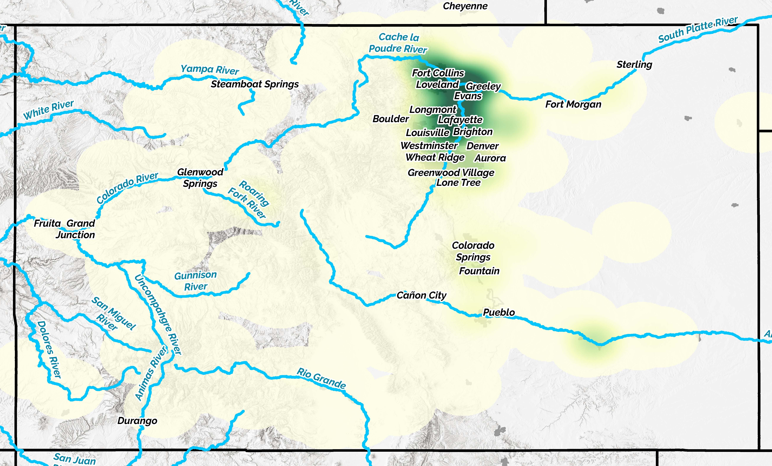
Water-Economy Nexus Market Location
Trading Volume
Trading Value
All Rights Reserved © WestWater Research

Slide 5
Water Rights to Build New Homes
Land purchased for development
LAND DEVELOPER
New homes need municipal water service
Most common approach is to tie into an existing municipal water provider
Growth pays its own way
Must dedicate water rights or an equivalent amount of cash (in lieu of water rights)
One time transaction between the developer and the water utility
Perpetual commitment for water service
WATER RIGHT OWNER
WATER UTILITY
All Rights Reserved © WestWater Research

Slide 6
How much does the water cost for new home?
It varies significantly: Approximate range of $20,000 to $80,000 per home
Water is can be 10% of the home price
(likely range of <5% to 20%)
Example:
CBT contract units have appreciated faster than home prices over the past decade, which has resulted in changing water market activity for new home construction
Land & Lots $100k
Permits / Fees $50k
Water $50k
House $200k
Overhead / Admin $50k
Profit $50k
TOTAL $500k
S&P/Case-Shiller CO-Denver Home Price Index, Index Jan 2000=100, Monthly, Seasonally Adjusted
Average CBT Contract Price Index, Jan 2002 = 100, Monthly
30-year mortgage at 6% interest on $50k water cost
$300 per month water cost (for the supply)
Compare to a $70 monthly water bill
All Rights Reserved © WestWater Research

Slide 7
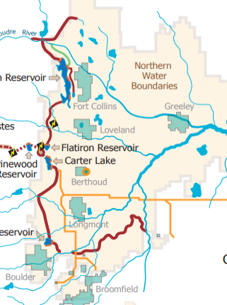
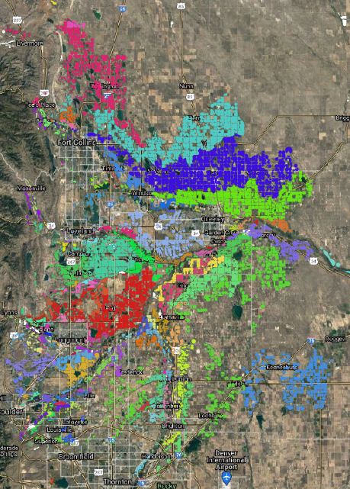
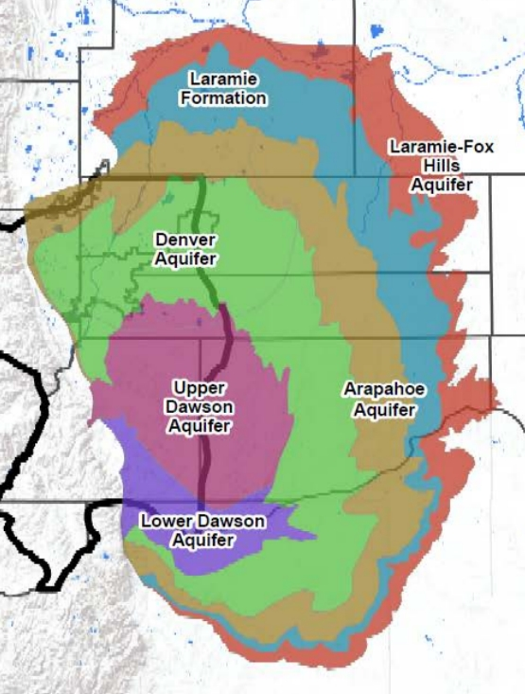
Typical Sources for Dedication
Transbasin Water
Ditch Company Shares
Groundwater
All Rights Reserved © WestWater Research

Slide 8
Water-Economy Nexus Pricing Trends
Large range in water prices on the Front Range
Influenced by location, availability, reliability, and transferability
All water is not equal in terms of usefulness to the municipal sector which influences market price
District 2
All Rights Reserved © WestWater Research

Slide 9
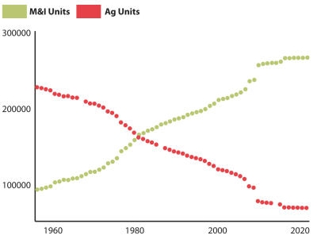
Water-Economy Nexus Pricing Factors
CBT has fueled NOCO growth
Majority (90%) of CBT units have already been transferred to municipal or are unlikely to ever be transferred
Reduced supply coupled with high demand
Individual Sellers
(10%)
Unlikely Sellers (22%)
Ditch Cos., Industry
Not Sellers (68%)
Munis, Districts
All Rights Reserved © WestWater Research

Slide 10
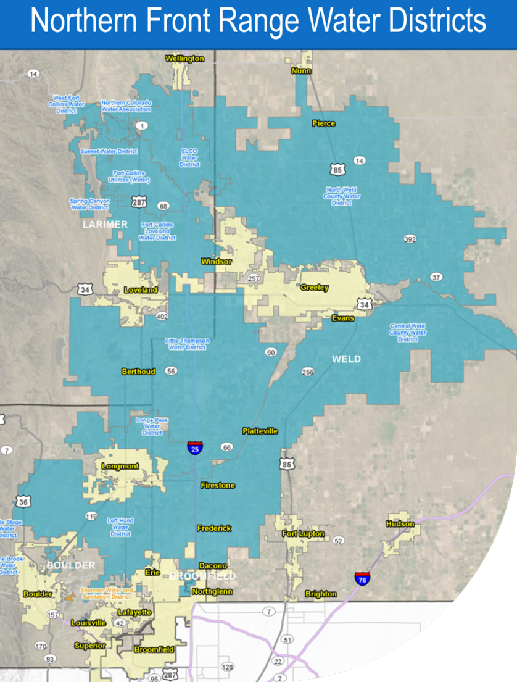
Colorado Water Market Pricing Trends
Colorado water utilities are decentralized – “Balkanization”
71 water providers on Front Range
Increases competition
Haves and Have-Nots
All Rights Reserved © WestWater Research

Slide 11
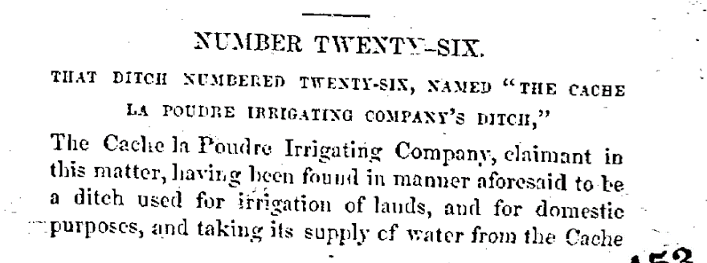
Water-Economy Nexus Pricing Factors
Large transfer costs for most water rights
Water Court fees regularly exceed $200,000 per case, and can exceed $2 million per case
Water Court can take years with uncertain outcome
1882 Adjudication
3 pages
2013 Change Case
286 pages
All Rights Reserved © WestWater Research

Slide 12
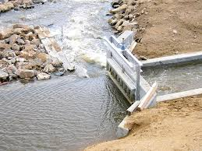
Water-Economy Nexus Impacts to Agriculture
Default for many municipal water providers is to buy or require dedication of agricultural water rights (e.g., shares in ditch companies)
“Buy and Dry”
Loss of farm economy disproportionately impacts rural communities
But significant source of wealth to individual farmers
Alternative transfer methods are possible, but have not gained traction – uncertainty, increased Water Court costs, lack of willing buyers/sellers, etc.
Water
Right
All Rights Reserved © WestWater Research

Slide 13
Water-Economy Nexus Summary
Population growth drives water prices
Short of new supplies or radical change in policy, water will continue to transfer from agriculture to municipal users
Water prices are likely to increase
Water prices have real economic impacts – home prices and rural economies
All Rights Reserved © WestWater Research

Slide 14
Thank You
Adam Jokerst
jokerst@waterexchange.com
All Rights Reserved © WestWater Research

