Slide 1
Finding Water for New Developments
Water Literate Leaders
November 9th, 2022

Slide 2
Topics Discussed today
Pricing Trends
AREAS that require water to be Brought
Process to find / acquire water
Competition
Changing Marketplace

Slide 3
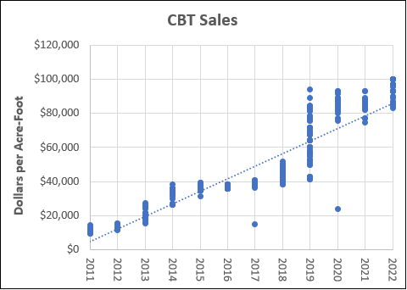
Historic CBT Pricing
Avg. $/Share = $62,000
Avg. Yield AF Pricing (.7AF) = $ 88,714
Firm Yield AF Pricing (.5AF) = $ 124,000
Average Price per Acre Foot
Source: WestWater Research, LLC, November 2022

Slide 4
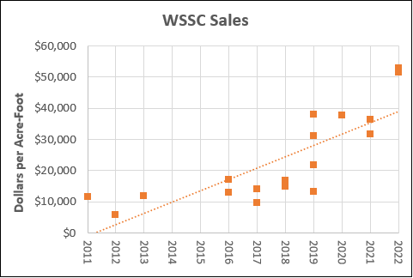
Historic Water supply and Storage Pricing
Avg. $/Share = $4,000,000
Avg. Yield AF Pricing (60 AF) = $66,666
Average Price per Acre Foot
Source: WestWater Research, LLC, November 2022

Slide 5
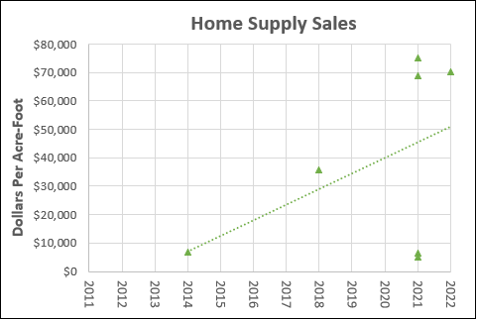
Historic Consolidated home Supply Pricing
Avg. $/Share = $613,000
Avg. Yield AF (Changed Share) Pricing (8 AF) = $76,625
Source: WestWater Research, LLC, November 2022

Slide 6
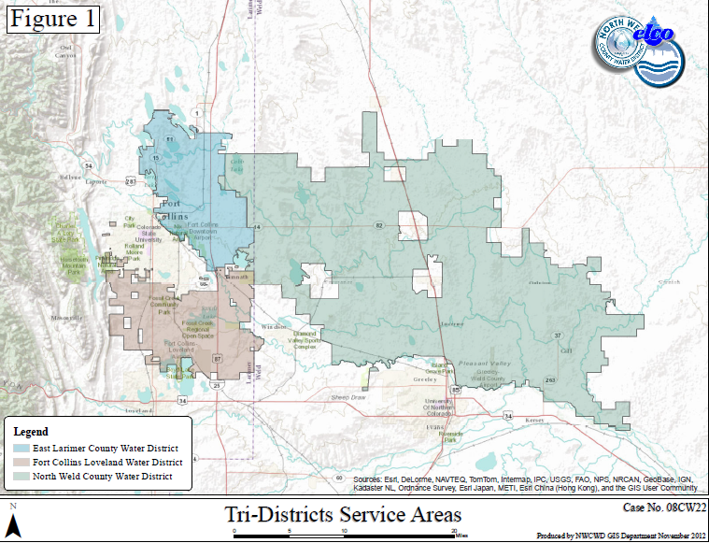
NOCO PROVIDERS requiring “Wet” water Dedication

Slide 7
PROCESS TO FIND AND AQUIRE WATER
Understand your Need
Indoor Use
Outdoor Use
Understand What Shares work within what systems
Different Water Providers accept different shares for dedication
This is a function of can they treat it or not
Familiarize yourself with the nuisances of the dedication policies of the provider you are dedicating too
What fees are associated with the dedication?
What is the timing of dedication?
Understand the Shares you are seeking to Buy
Not all shares are created equal
The same rights on different parts of the system will yield different results
What is the Historical Consumptive Use?
Is that changing over time?
Do I need to Dry-Up?
Enter the Market
Be prepared to buy quickly
Will not be able to wait for your project to get approved to buy
Be prepared to buy land
Be prepared for very short due diligence periods

Slide 8
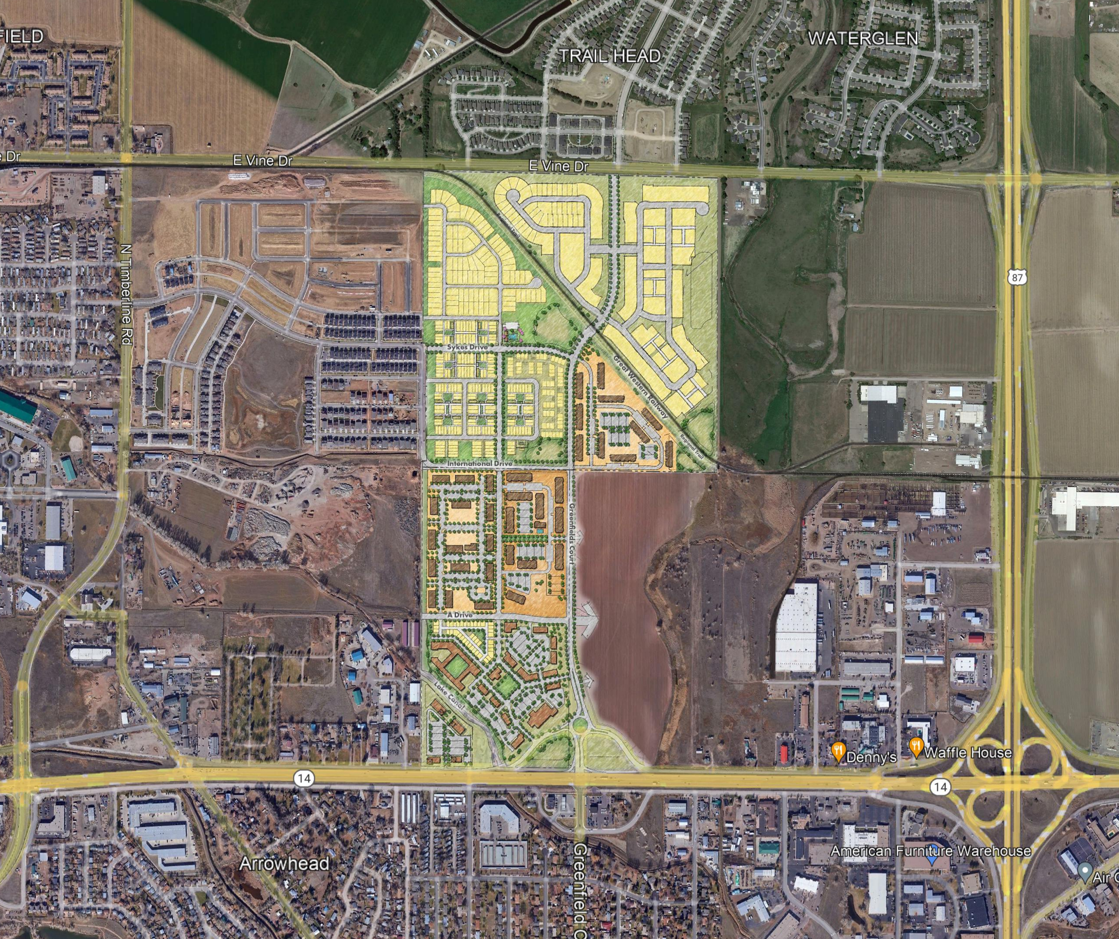
Example Cost “CBT” as a Function of Project
Bloom (NWC of Mulbery and I-25 - FC)
1,687 Total Units and 34 Acres of Commercial on 225 Acres
Apartments/ Traditional Single Family / Condos / Small Detached Single-Family Homes
Water Needs
1,687 Total Units at .315 AF/Unit = 532 AF Needed for Residential
34 Acres Commercial at 3AF/F = 102 AF Needed for Commercial
634 AF of Project Need
634 AF = 905 CBT Units (0.7 AF / Unit) at $62,500/Units
Acquisition Price of CBT = $56,562,500
$251,388 / Ac for Water vs. $50,000/Ac for Real Estate
Water is ~5X the price of the Real Estate!!!

Slide 9
Example Cost “AG Water” as a Function of Project
Bloom (NWC of Mulbery and I-25 - FC)
1,687 Total Units and 34 Acres of Commercial on 225 Acres
Apartments/ Traditional Single Family / Condos / Small Detached Single-Family Homes
Water Needs
634 AF of Project Need
634 AF = 11.74 WSSC Shares (54 AF / Share) at $4,000,000/Share
873 Acres Ag. Ground at $7,000/AC. = $6,112,561
Acquisition Price of WSSC / Farm = $53,072,561
$235,878 / Ac for Water vs. $50,000/Ac for Real Estate
Water is ~4.7X the price of the Real Estate!!!

Slide 10
So you have the money……NOT SO FAST Changed MUNICIPAL Shares are Running Out - CBT – 310,000 Units 70% of system already in M&I, 20% likely to remain in Ag - Water Supply and Storage – 600 Shares 400 Shares Owned By Thornton - NPIC – 10,000 Shares 65% in Municipal ownership – 2009, Windsor Potable water Master Plan With cbt pricing stabilizing, it has put pressure on traditional ag systems Competition is Stiff. WE have seen the Market change dramatically over the last Couple years. Builders are competing with Local Municipalities, south Weld County Builders and Municipalities, and Metro Area Municipalities for the same Poudre River Rights.

Slide 11
Out of Region Competition
Source: Arapahoe County Water and Wastewater Authority 2015 Municipal Water Efficiency Plan Update

Slide 12
“Look ahead and plan for others as others have planned for you” - Greeley tribune, 1941

Slide 13
Thank You!

