Slide 1
“If words were water the state would never run dry.”
Water Literate Leaders
Jim Yahn
November 9, 2022
“Success comes in cans;
failure comes in can’ts”
“No matter where we live, we cannot afford to let our farm and ranch land dry up.”
Notes:
Thank you for this opportunity to chat with you about water in Colorado. It’s an important time for this work on water that is so elemental to ag producers… including the more than 12,000 beef producers who call Colorado home.
I’m going to spend the first half of my time on Colorado’s Water Plan and the second half on our contingency planning efforts specific to the Colorado River. Both topics thought involve ag – we need to do a better job of creating options for ag producers and municipalities – alternatives to buy and dry are critical and you heard that from the Governor in his State of the State speech:
“If words were water the state would never run dry.”
“We must create alternative choices to buy-and-dry.”
“No matter where we live, we cannot afford to let our farm and ranch land dry up.”
[click] This is the first plan by Coloradans, for Colorado.

Slide 2
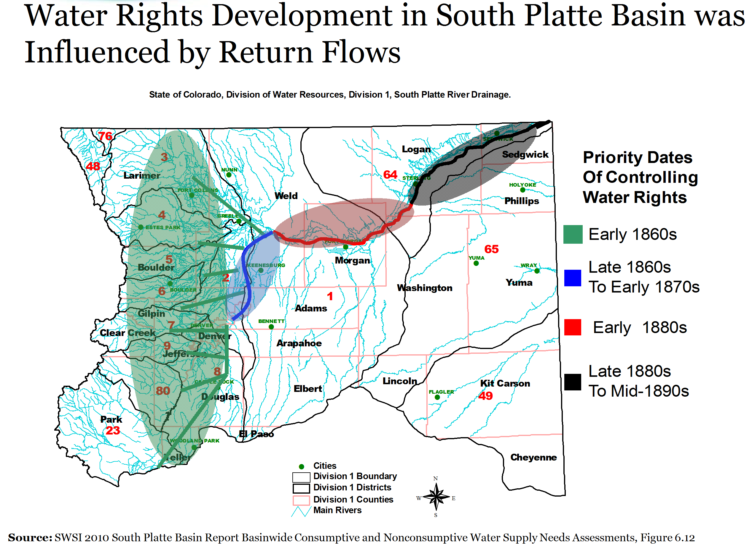

Slide 3
South Platte River Agricultural Development
Direct Ditch Systems
Reservoir Systems
Transbasin Diversion Projects
Well Development
Augmentation Plans

Slide 4
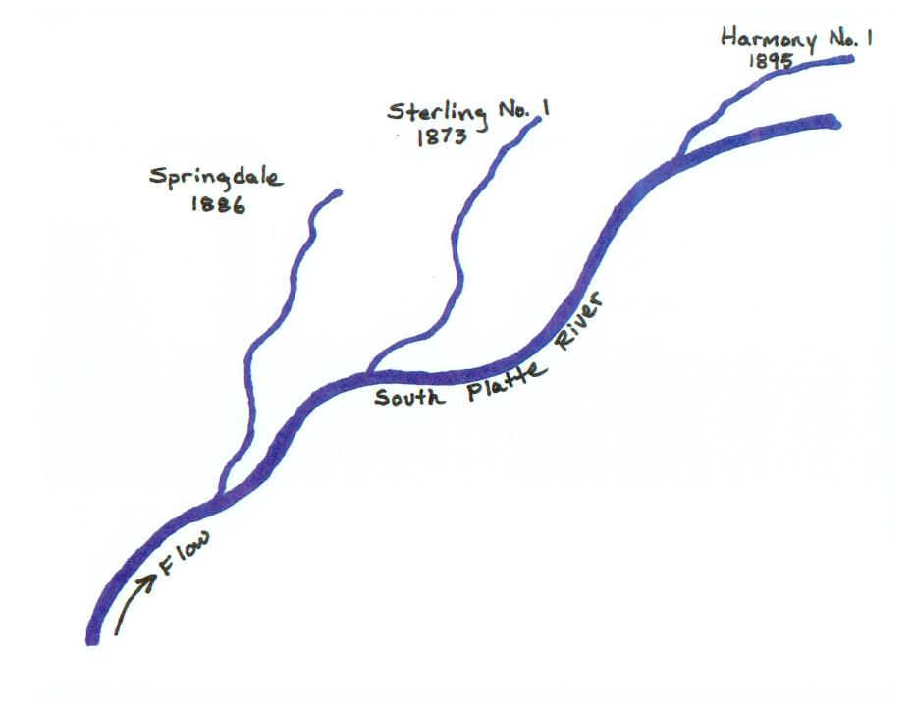
Ditch Development
and Administration

Slide 5
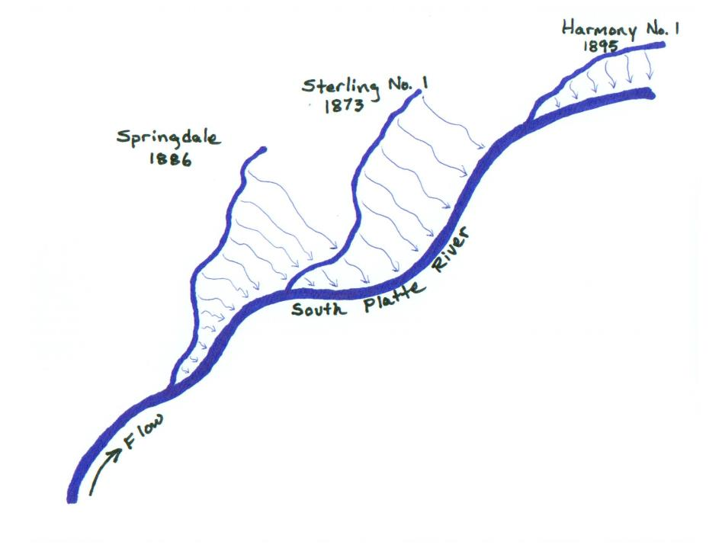
Historic Return Flows

Slide 6
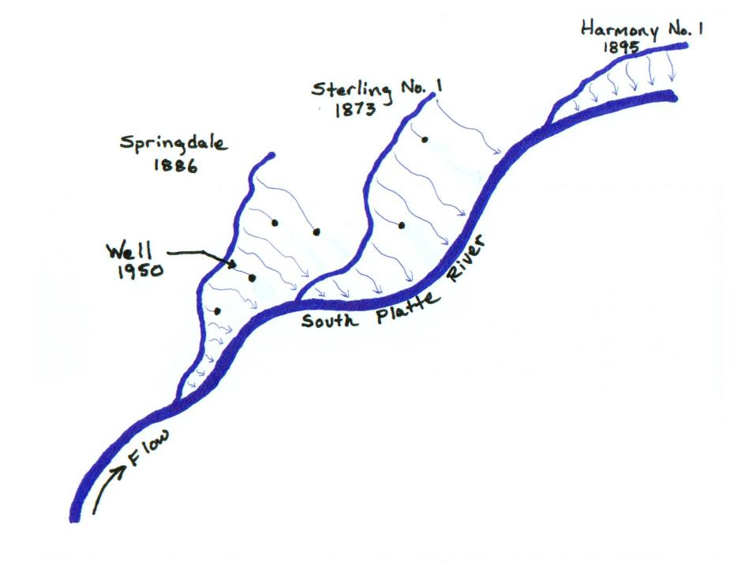
Intercepted Return Flows

Slide 7
Return Flows and Accretions
Ditch/Field Seepage
Return Flow
Stream
Alluvial Aquifer
Ditch, Reservoir and on-farm seepage fill up the aquifer which slowly makes its way back to river.
The volume released to the river is the “return flow ”.

Slide 8
Pumping and Depletions
Depletion
Stream
Well
Alluvial Aquifer
An alluvial well used, typically, for irrigation.
Pumping “depletes” or “intercepts return flows” which impacts river flow.

Slide 9
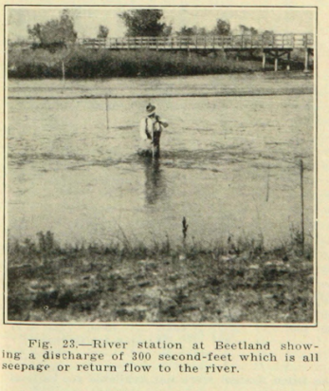
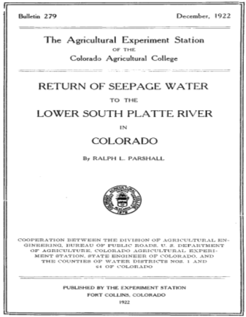
Ralph Parshall in 1922
Return of Seepage Water to the Lower South Platte River in Colorado
Ralph Parshall (Colorado Ag. College now Colorado State University) December, 1922.

Slide 10
Ralph Parshall in 1922
The Phenomenon of Return Waters
Return flows were increasing over time and continued to increase, mostly due to the general rise of the water-table over greater areas.
The water table has risen each year (since the early stages of irrigation development) as much as 100 feet in some areas.
Return flows varied from 2 to 8 ½ second-foot per mile and averaged 5 ¼ second-foot per mile.
The diversions from the river after the spring floods have subsided are practically all from seepage or return water, and only during summer floods or freshets is the river flow increased.

Slide 11
Nature of return flows in the South Platte
  “The flow was excessive in May and June and disappeared entirely during the summer. The river frequently became dry for months of each year to points as far west as the present city of Fort Morgan.” – Prior to surface irrigation.
  “The flow of return and seepage waters coming back to the river from irrigation of Colorado lands, has resulted in a constant supply at the interstate line.” – After surface irrigation development.
  “This flow is increasing and will soon be sufficient to care for the full demands of Nebraska as determined by the compact, while great quantities of water annually flow to waste across the interstate line, during the flood season and winter months…………………………….”
  “ The once “disappearing” flood stream has been converted into one of constant flow making possible the development in both states.”
Delph Carpenter, 1925 letter to CO Governor

Slide 12
The Water Problem
Ralph Parshall’s address to Ft. Collins Rotary Club
August 29th, 1956
Several issues impacting the dwindling river and hydrologic conditions.
Return flows have been investigated since the early 1880s and these past records strongly indicated a steady increase in the return flow to the river.
In 1956 it was found that seepage return was practically nil.
Partly due in the fact, that between Kersey and Julesburg, more than 4000 irrigation wells pumped to deliver enough water to fill Horsetooth Reservoir four times during the season of 1955 (584,000 ac-ft).
Appeared obvious that we cannot continue depleting the underground reservoir at that rate.

Slide 13
 | 1950 |  | 1955 |  | 1960 |  | 1965 |  | 1970 |  | 1975 |  | 1980 |  | 1985 |  | 1990 |  | 1995 |  | 2000 |  | 2005
South Platte Conjunctive Use Administration
1969 Water Rights Determination Act
Operation of Large Temporary Replacement Plans
Operation of New
Permanent Decreed Replacement Plans
1957 Colorado Ground Water Law
1953 Underground Water Act
1967 Senate Bill 407
1974
Amendments to 1969 Act
1965 Colorado Ground Water Management Act
Early Decrees for Augmentation and Recharge
1968 Supreme Court Fellhauer Case
Empire Lodge Case Ruling 2002
House Bill 02-1414 and Senate Bill 03-73

Slide 14
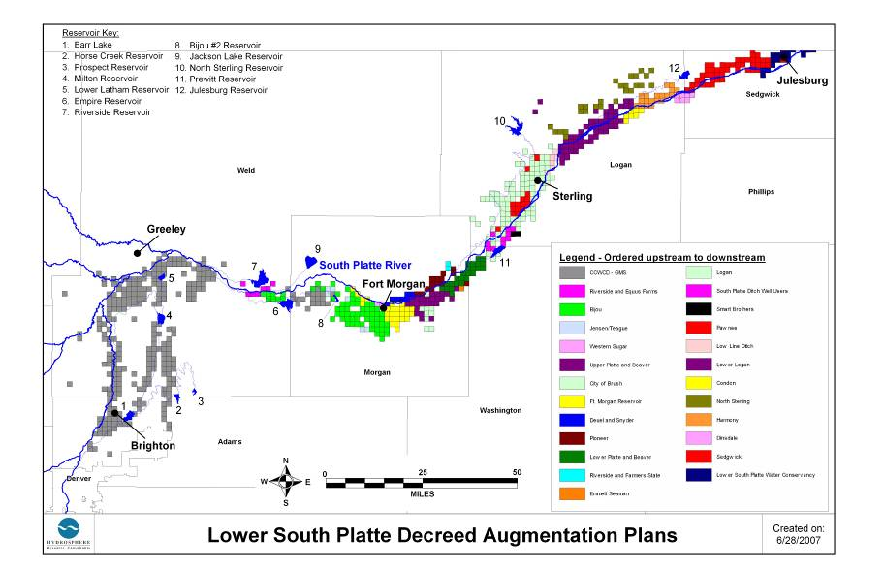
Augmentation Plan
Service Areas

Slide 15
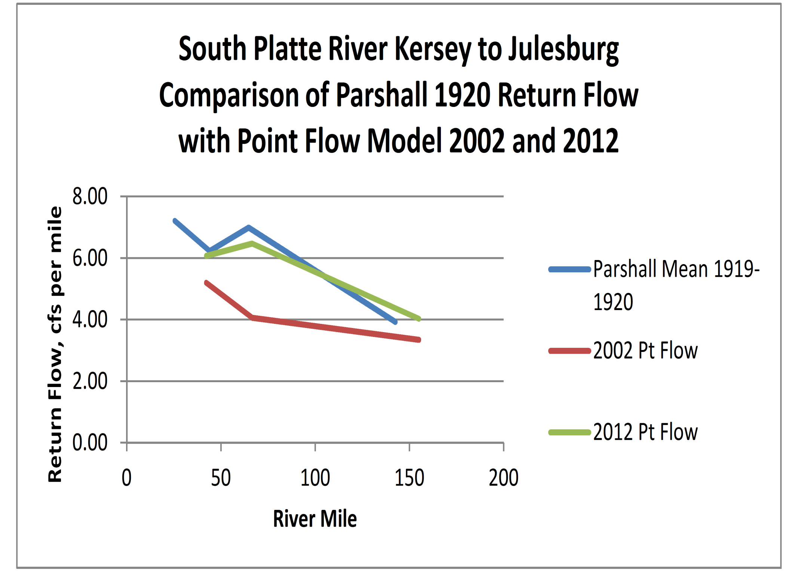

Slide 16
Average Supply
  1.4 million AF annual native flow for total basin
  400,000 AF generated from transbasin projects
  30,000 AF Non-tributary groundwater
Average Diversions
  500,000 AF tributary groundwater
  4 MAF total annual surface water diversions
Average Outflow
  300,000 AF to Nebraska
Notes:
Today the South Platte River Basin consists of a complex and diverse system of ditch and reservoir systems along with groundwater well pumping and augmentation efforts.
Top map - Each of the different color represents the service area of one particular ditch or reservoir system and the white (lighter) background colors represent lands irrigated in 2005.
Bottom Map – Decreed Augmentation Plans in the Lower South Platte as of June, 2007.

Slide 17
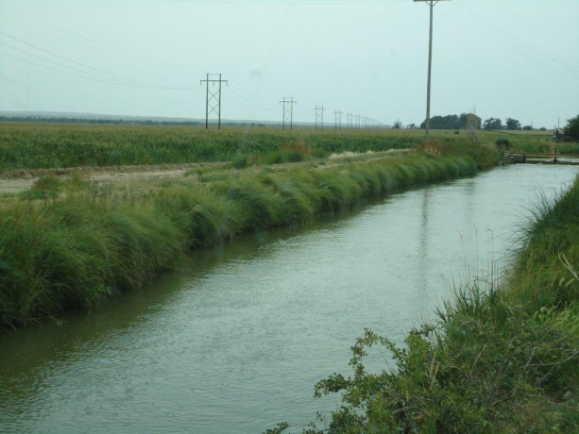
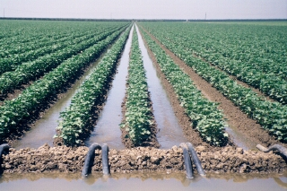
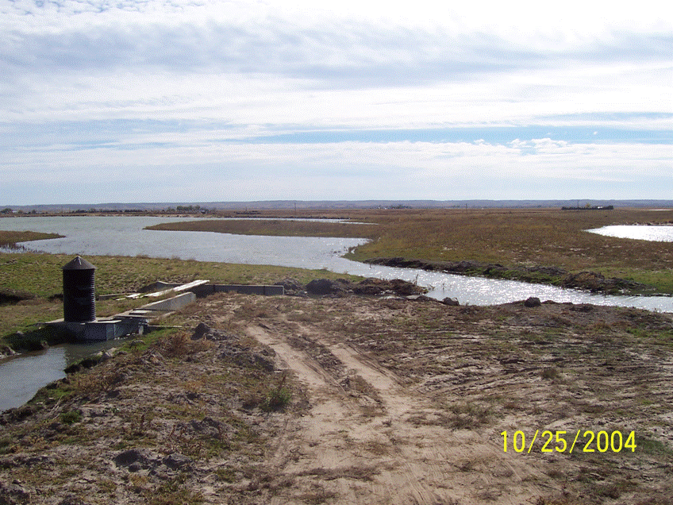
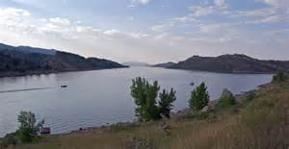
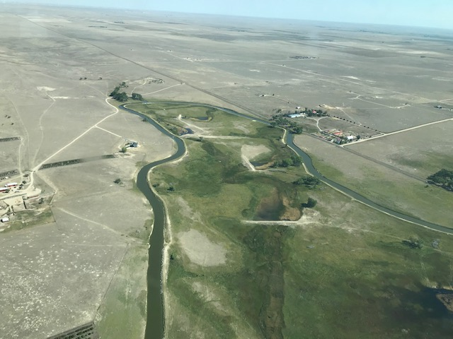
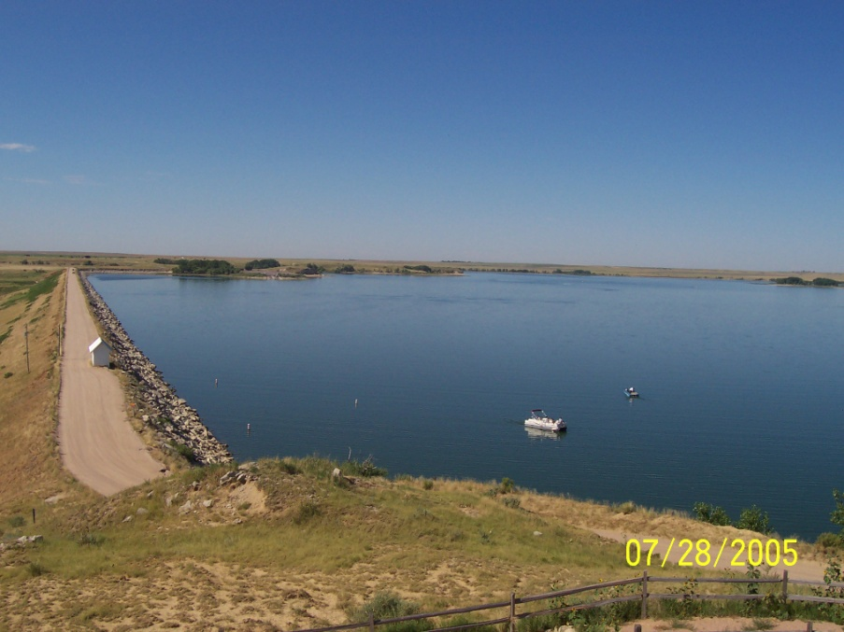
Benefits of Irrigated
Agriculture

Slide 18

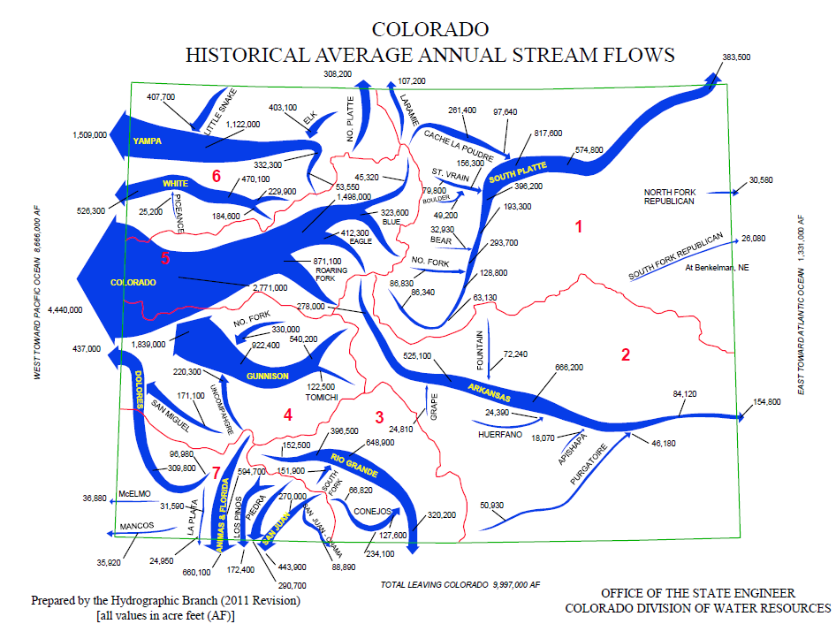
Notes:
You’re looking at a report from 1974 titled “the Colorado State Water Plan”. This was an appraisal-level review of water use in Colorado to determine the feasibility of building more federal projects. The Dept. of the Interior made these reports all over the West.
Nothing happened with this effort because it was conducted by the federal government for the purpose of utilizing federal dollars.
BUT, it did make the following interesting observation: “...in some cities along the South Platte River, especially near the Front Range, the municipal and industrial water supply is becoming critical and in the absence of other alternatives, agricultural water rights have been purchased. There is a danger there that the basic agricultural economy will be destroyed.”

Slide 19
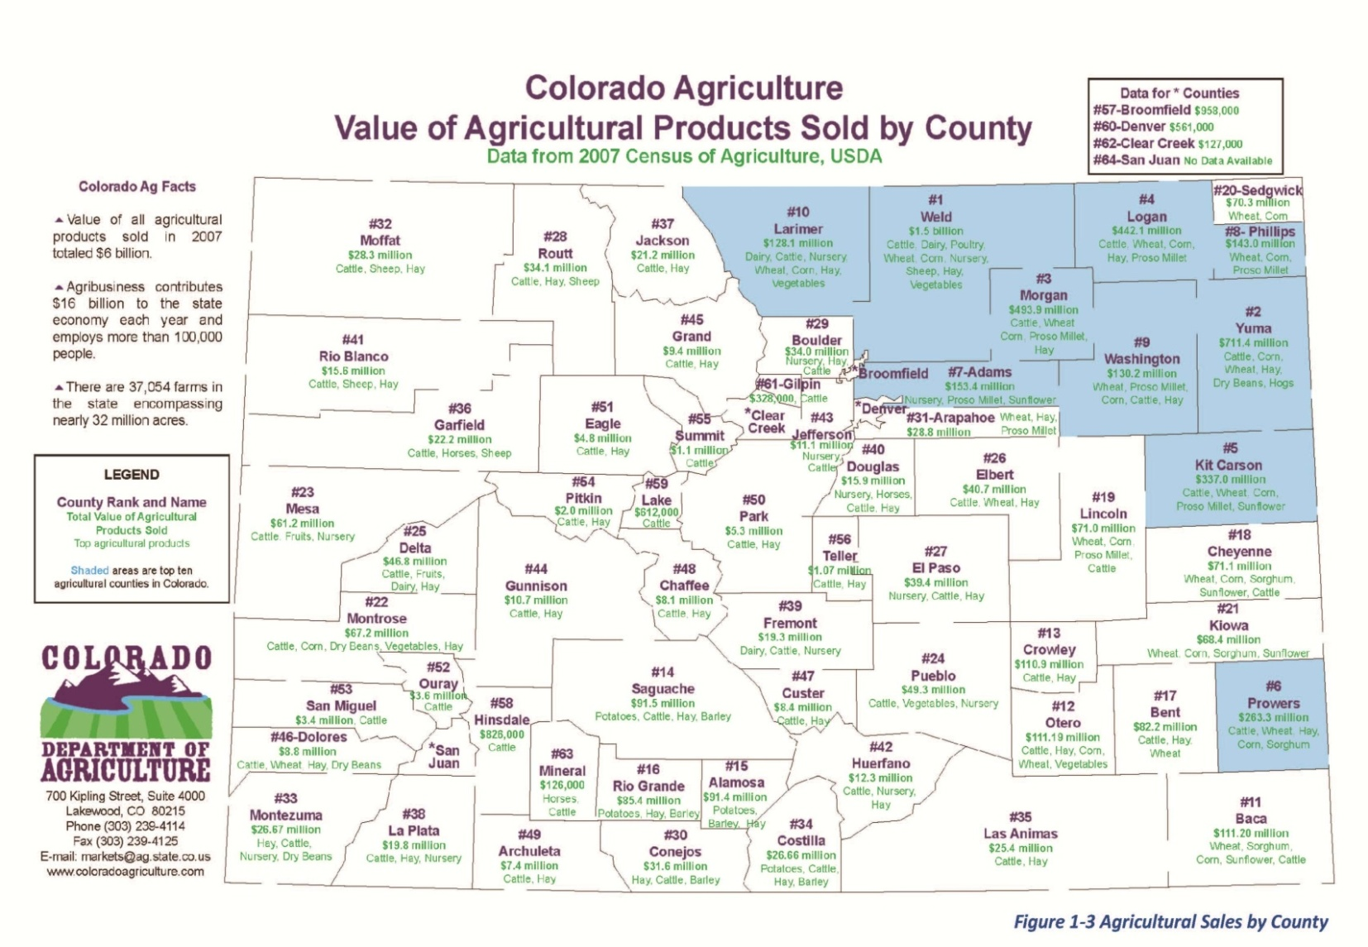
Irrigated Agriculture
South Platte Basin: Approx. 831,000 irrigated acres (SWSI 2010)
Republican Basin: Approx. 550,000 irrigated acres (SWSI 2010)
  40% of Colorado’s Irrigated land
South Platte 379,000 AF Avg. Annual Ag. Gap (SWSI 2010)
Republican 200,000 AF Avg. Annual Ag. Gap (SWSI 2010)

Slide 20
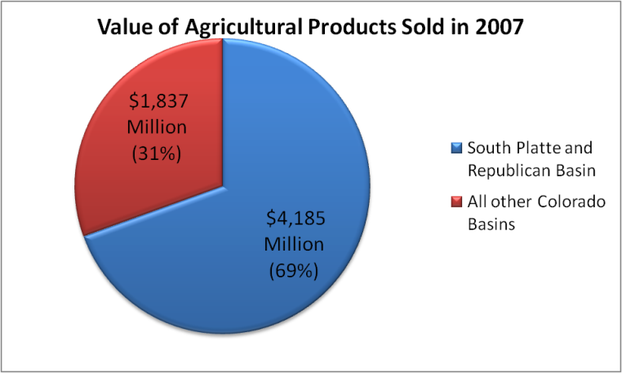
South Platte Basin Agricultural Production
Notes:
Todd

Slide 21
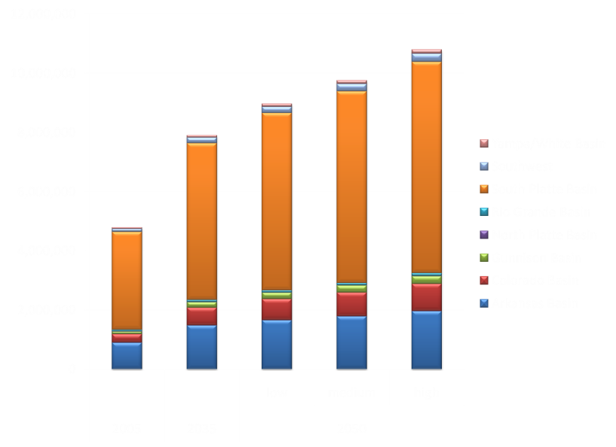
Population Projections

Slide 22
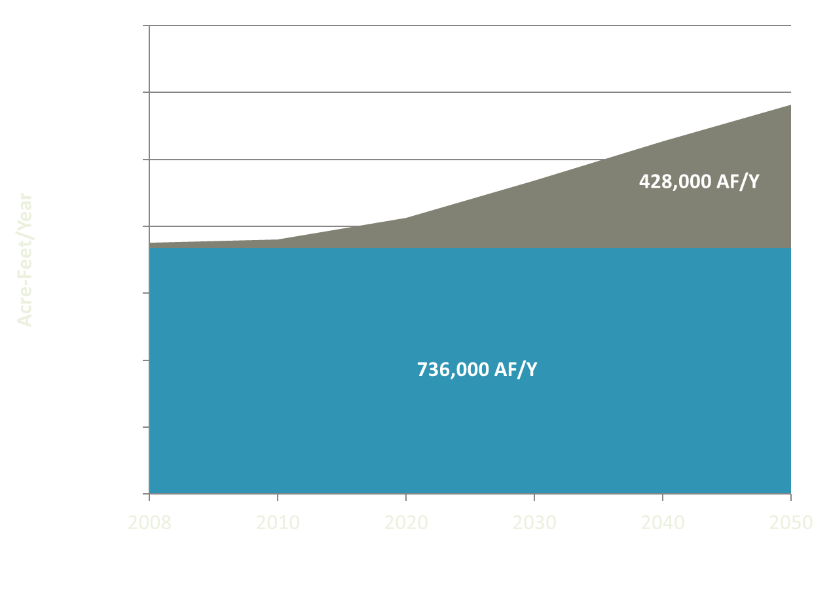
Municipal & Industrial (M&I) Water Supply Gap in the South Platte Basin
2050 Gap
Existing Supply
*Based on SWSI 2010 Medium Water Demands
Notes:
Our M&I gap at a medium growth rate with no other solutions = 428,000 acres.
This equates to 50% of the irrigated ag land in the basin being dried up.
Base M&I supply is critical and with increased conservation, reuse, and a changing hydrologic cycle we could see a decreased base supply, especially in dry years which in turn leads to a larger “gap.”

Slide 23
South Platte River Future Development
Agriculture - Maintain
Municipal and Industrial
  Conservation
  Reuse
  New Storage Projects on South Platte
  New Transbasin Diversion Projects
  Dry Up of Agriculture
  Agricultural Leases (Water Sharing Agreements)

Slide 24
South Platte Projects
Gross Reservoir Enlargement
Chatfield Reallocation
Windy Gap Firming – Chimney Hollow Reservoir
North Integrated Supply Project (NISP) – Glade and Galeton Reservoirs
Halligan Reservoir Enlargement
Greeley Terry Ranch Project
Platte Valley Water Partnership

Slide 25
Platte Valley Water Partnership
A Collaborative Renewable Water Supply Project for Municipal Water Suppliers While Also Increasing and Preserving Agricultural Uses Along the South Platte River
Lower south platte water conservancy district
&
Parker Water and sanitation district
Notes:
Thank you and Introductions (Rebecca)

Slide 26
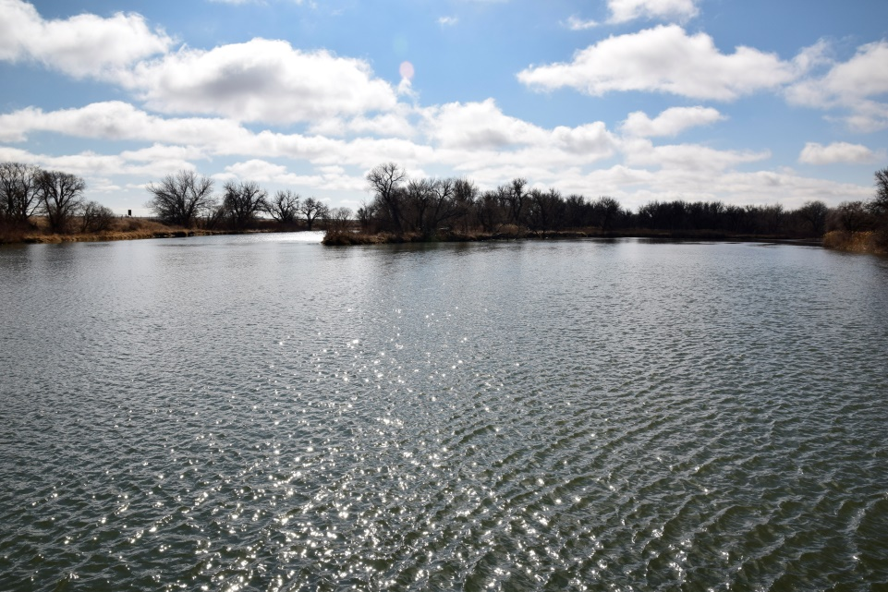


Project History:
The Journey to Our Partnership
Notes:
Rebecca

Slide 27
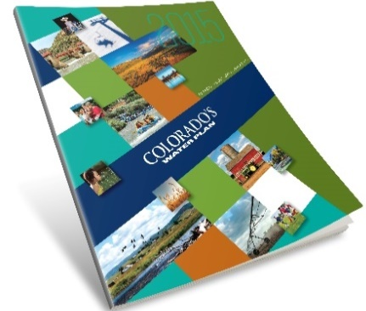
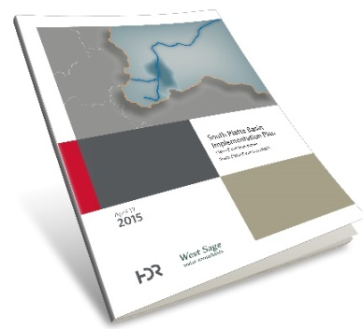
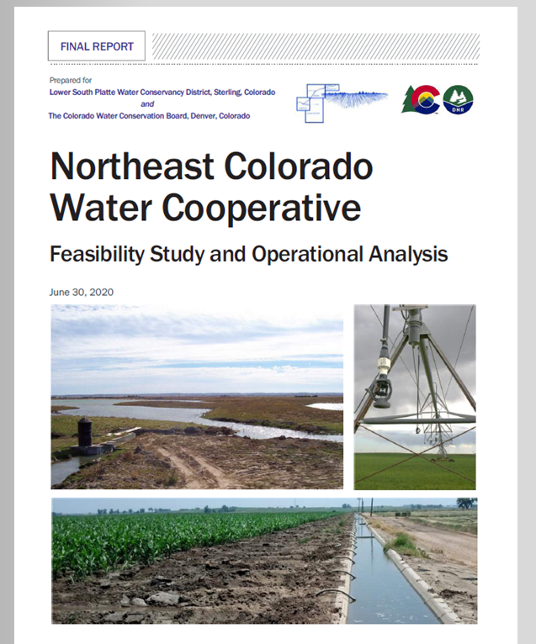

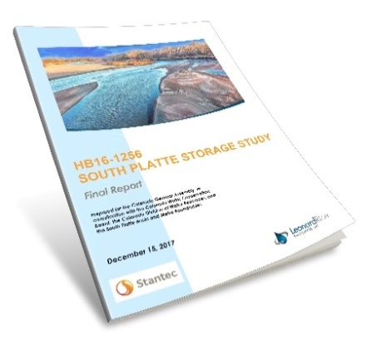
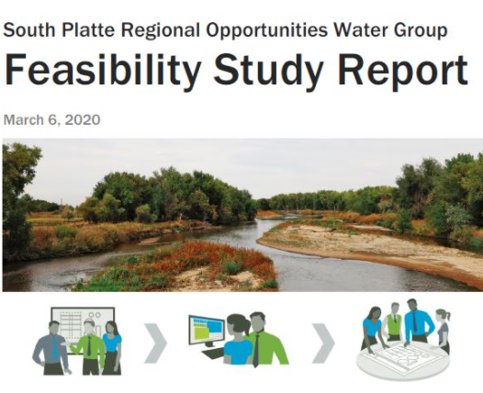
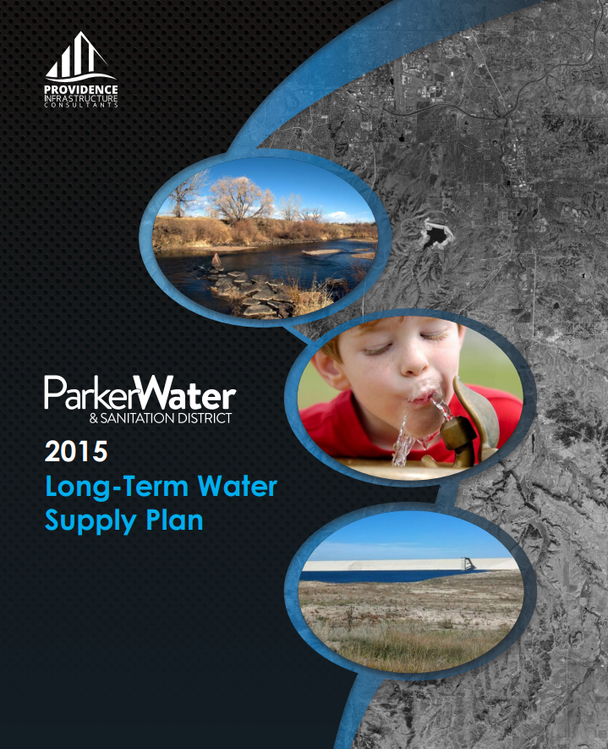
Realizing Ideas…
Colorado’s Water Plan
South Platte Basin Implementation Plan
Northeast Colorado
Water Cooperative
South Platte Storage Study
SPROWG Feasibility Study
Parker Water Long Term Water Supply Plan
Notes:
A perspective on the evolution of the project (Joe)

Slide 28
Follow the Plan…
Colorado Water Plan 2023 Draft:
- “Water supplies for Colorado’s urban growth should not come at the expense
of our rural communities through buy-and-dry methods.”
“Partnerships are needed to help prevent buy and dry of agricultural lands”
- “Storage projects are often out of reach financially for individual producers,
and developing partnerships for multi-purpose storage projects will be key”
“While the Denver Basin aquifer can be a viable water supply, it is challenged
by uncertainty in statutory allocation of water and declining water levels that
may limit its use to only drought resilience in some areas.”
Colorado’s Water Plan

Slide 29
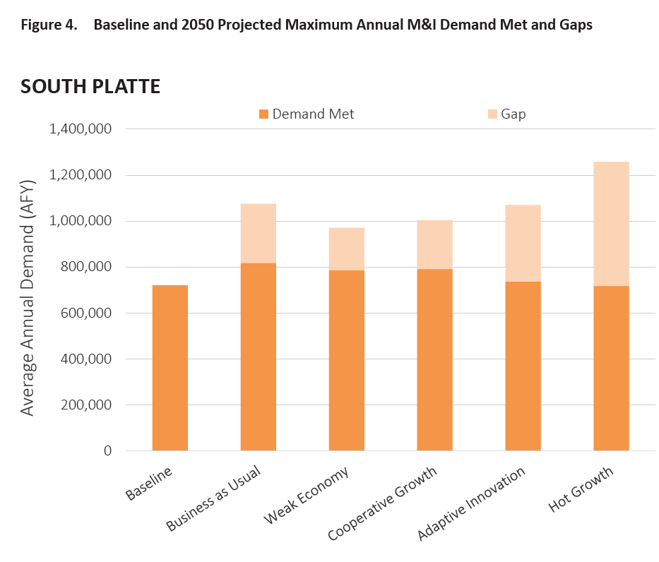
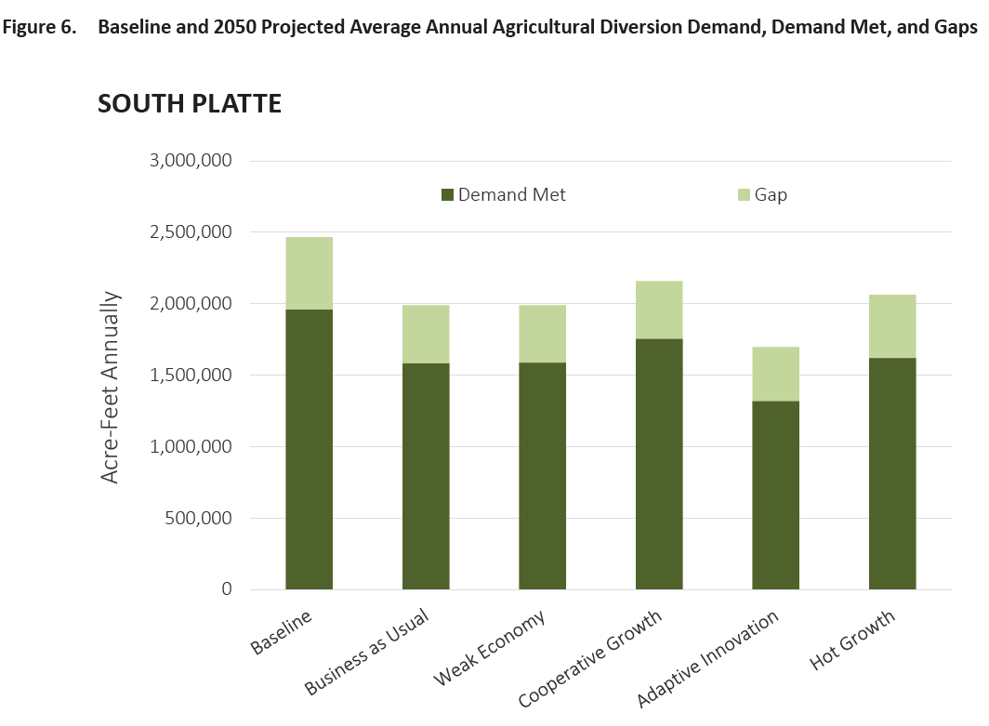
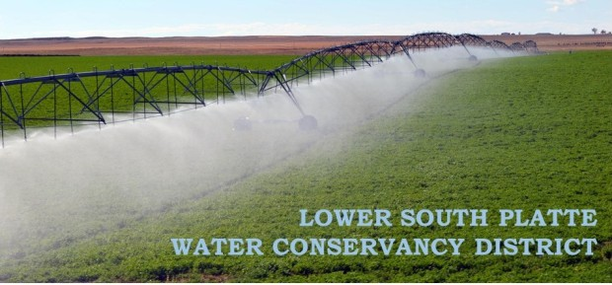

Why Do We Need This Project…
Municipal and Industrial Demands Continue to Increase
Significant Agricultural Shortages Exist Currently
Keeps South Platte Basin Water in the South Platte Basin
Does not Buy and Dry the Farms of Colorado’s Vital Agricultural Industry
2050 M&I Gap: ~250,000 ac-ft
2050 Ag Gap: ~400,000 ac-ft
Notes:
Joe

Slide 30
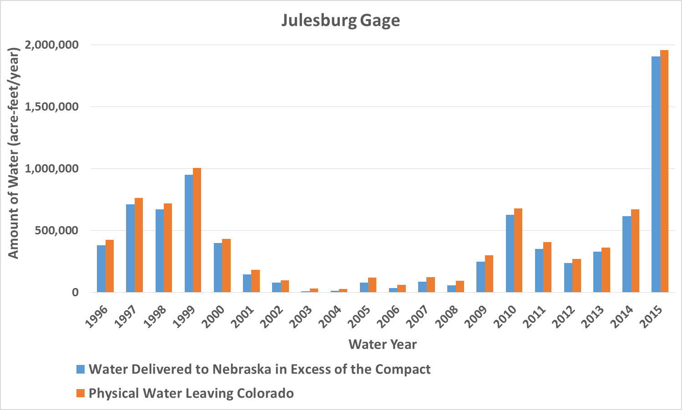
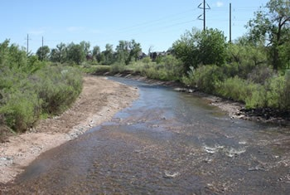
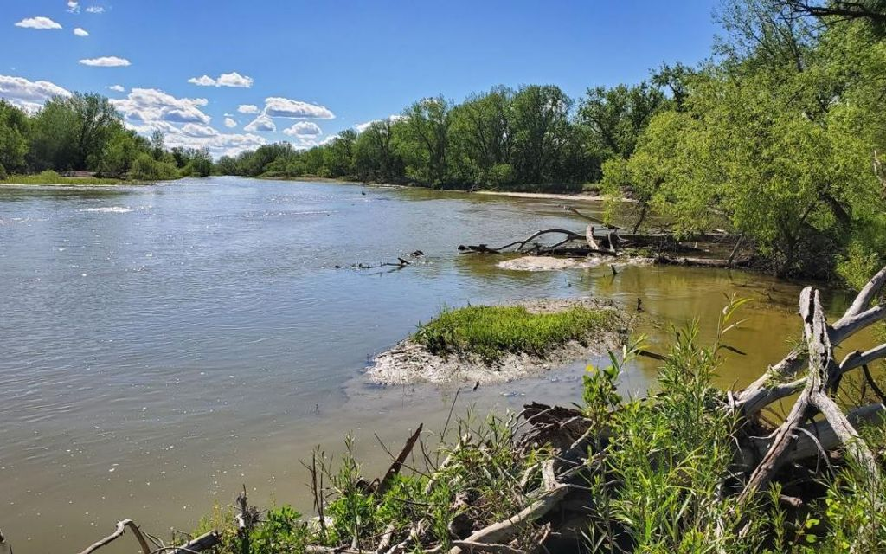
Why Do We Need This Project…
It uses Colorado Water in the South Platte Basin that would otherwise leave the State
Does Not Impact or Injure Existing Supplies
Is a Sustainable Project That Does Not Impact our Non-renewable Sources
Notes:
Joe

Slide 31
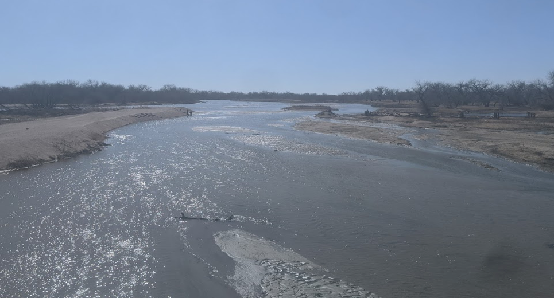
Project
Vision
Addresses PWSD Supply Gap
  75% Renewable by 2035
  Demand shortage in 2035-2040
Avoids “Buy and Dry”
  Optimizes available water
  Sets parameters for Municipal/ Agricultural partnership
  Establishes guidelines "types of water" in system
Provides Additional LSPWCD Water Supply
  Addresses local needs
  Develops critical habitat
Optimizes Existing Infrastructure
Benefitting both worlds
Notes:
Rebecca

Slide 32
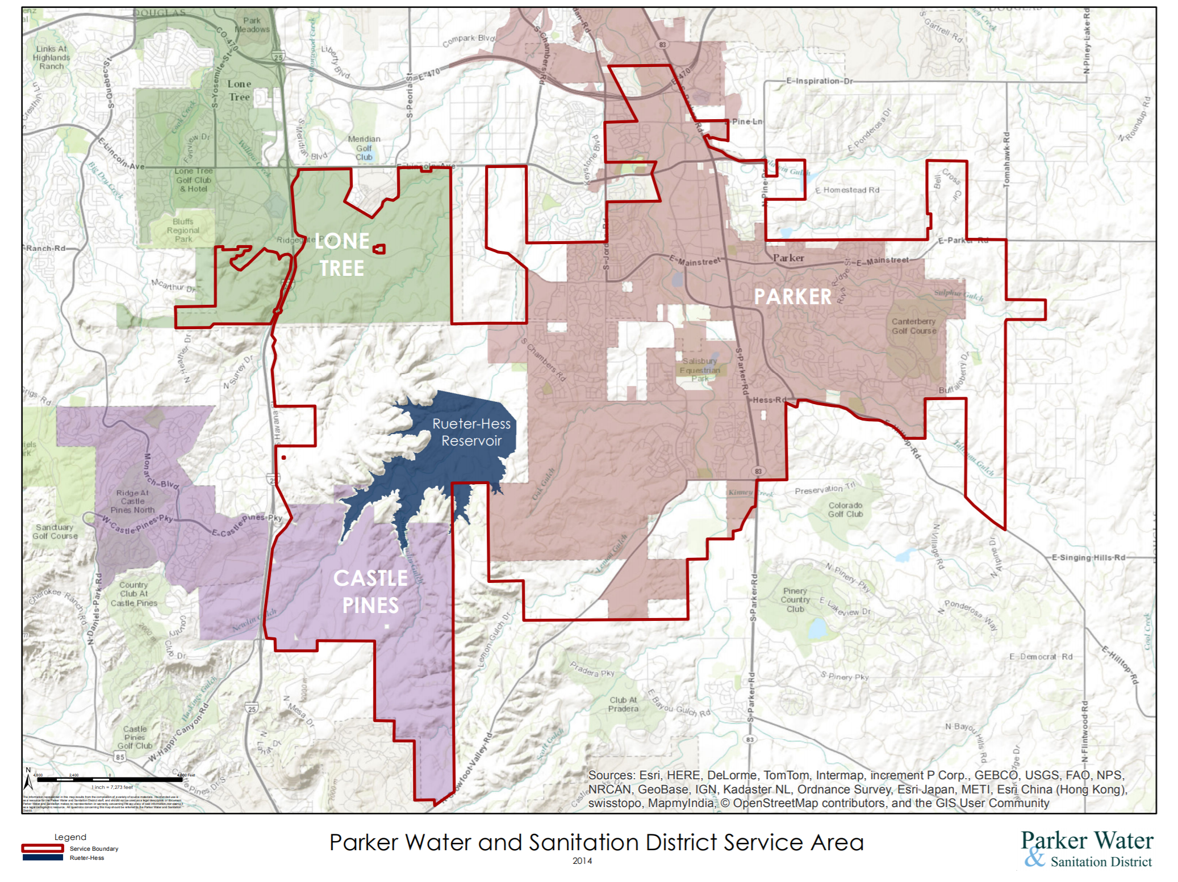
Current:
56,000+ Residents ​
44+ square miles​
​Build-out (2050):
New Developments to the South and West
117,000-120,000 Residents
Notes:
Rebecca

Slide 33
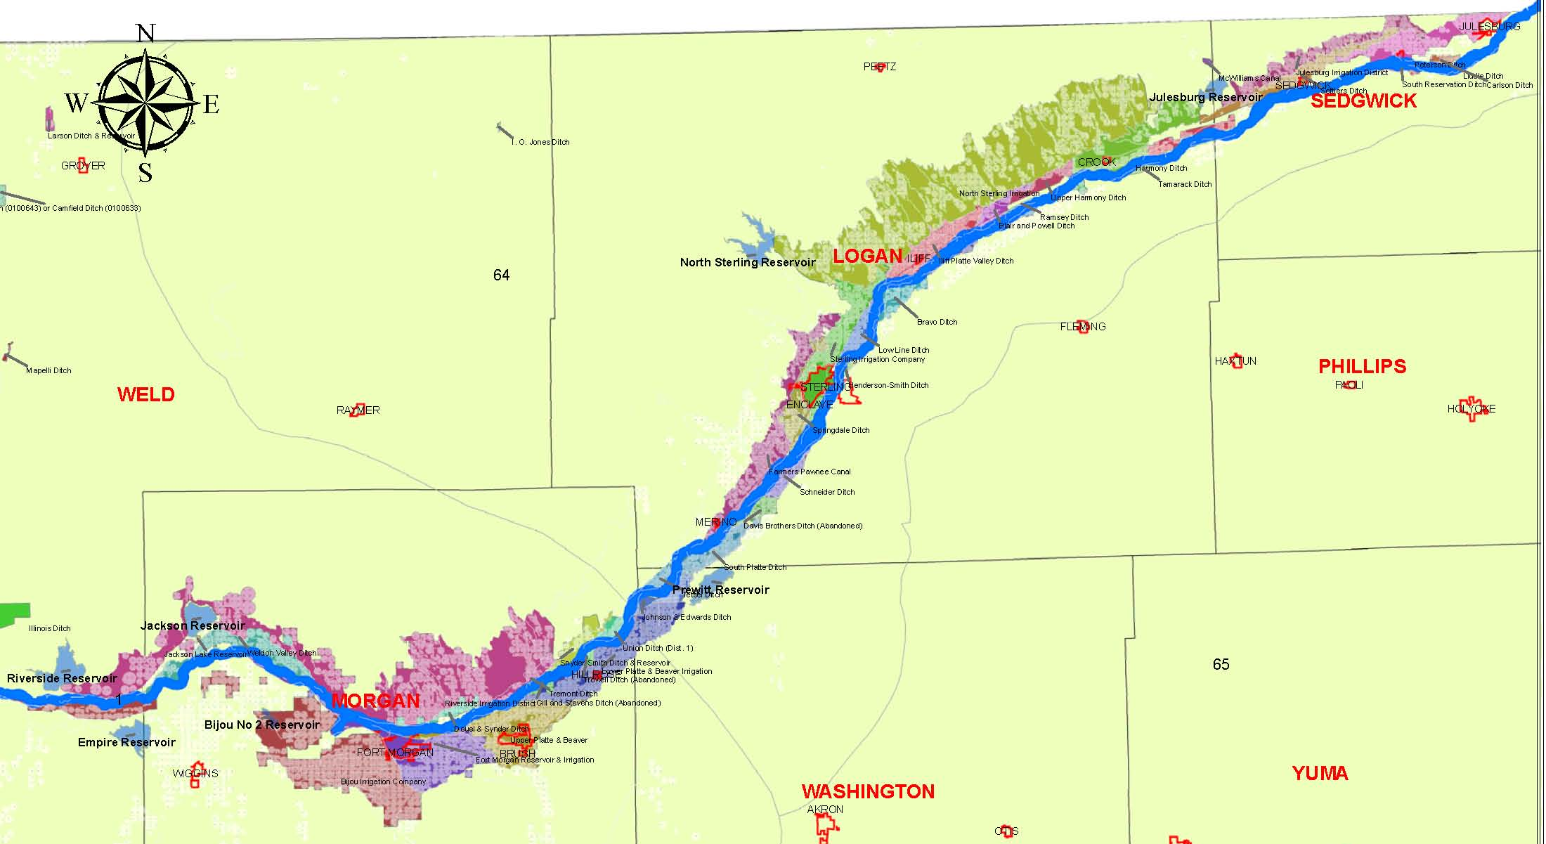
Lower South Platte River
Notes:
Joe

Slide 34
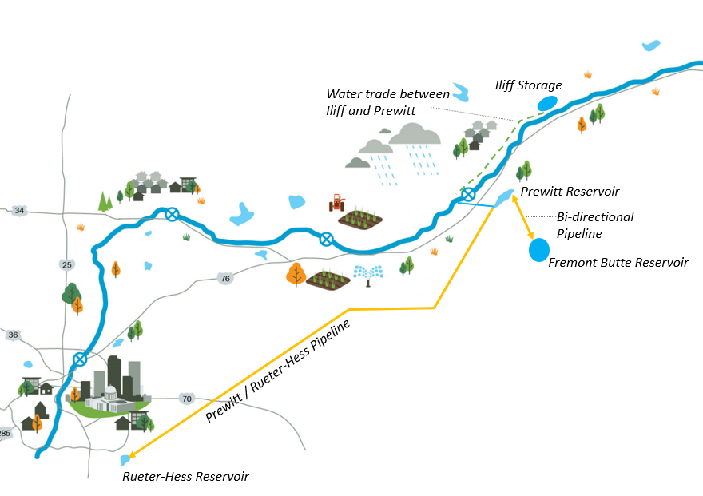



PROJECT OVERVIEW
    Iliff Reservoir –6,500 ac-ft
    Prewitt Reservoir – 6,500 ac-ft forebay utilizing existing infrastructure
    Trade between Iliff and Prewitt Reservoirs.
    ~125 Miles of Pipe
    Salinity Treatment Plant
    Rueter-Hess Reservoir
    Fremont Butte Reservoir – 72,000 ac-ft, up to 250 cfs pumped and piped from Prewitt Reservoir (Phase II).
LSPWCD Pipeline
Notes:
Joe (add LSPWCD delivery pipe)

Slide 35
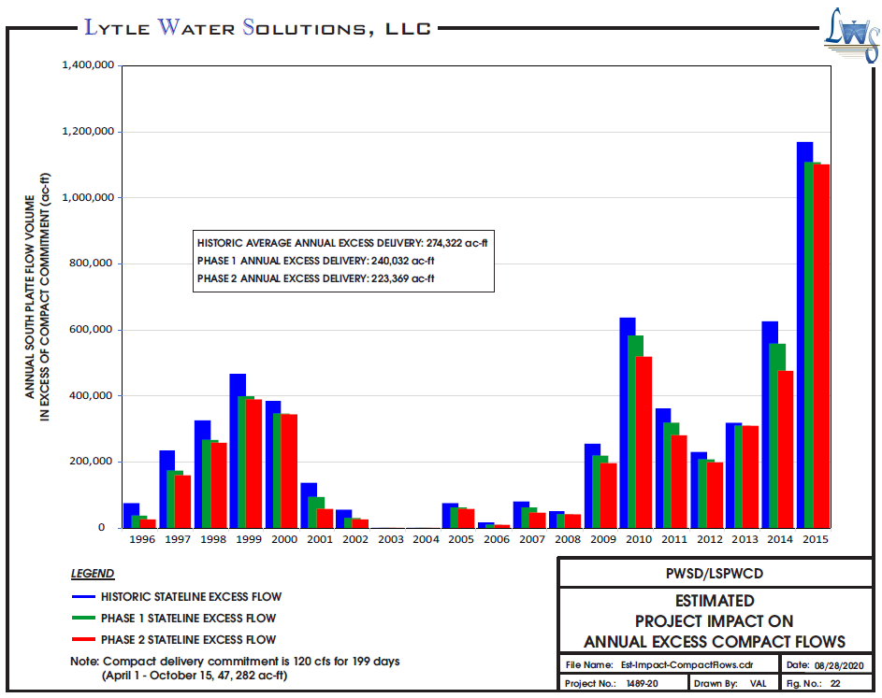
Key Benefits of the Project
Protects target flows for endangered species in Nebraska
Provides additional supplies for agricultural production in the Lower South Platte River Basin
No “buy and dry” of agricultural lands
Provides municipal water supplies for Front Range
Makes more efficient use of excess water available in the basin
Doesn’t impact Colorado’s obligations to Nebraska under South Platte River Compact
Notes:
Joe

Slide 36
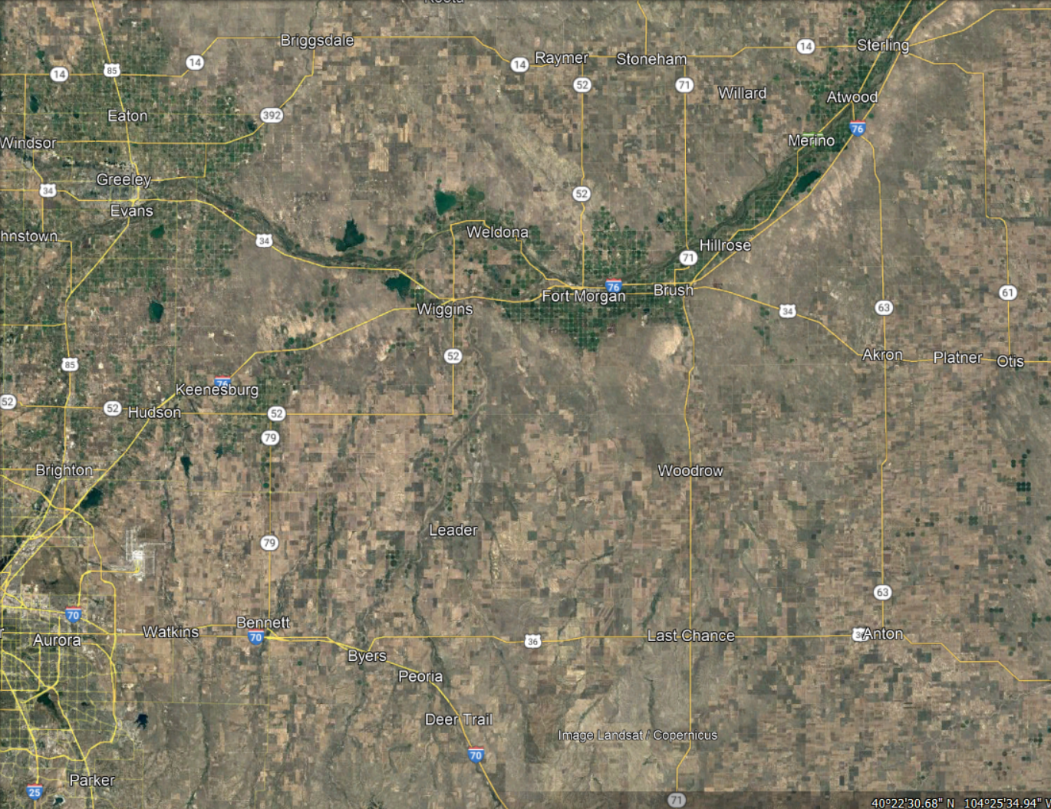

    Schedule
    January 2024
      Water Decreed
    Now – 2025
      Reservoir Land acquisition
      Developing Permitting Approach
      Partnerships
    2025 – 2030
      Conceptual Design
      Local & State Permitting
      Facility Siting & Land/Easement Acquisition
        Pipe Alignments
        RO Plant
        Pump Stations
    2030 – 2035
      Preliminary to Final Design
    2035 - 2040
      Construction
    2040
      Start Up
Iliff Reservoir
Prewitt Reservoir
Fremont Butte Reservoir
Stakeholder Engagement Throughout Process
Recreation
Environmental
Etc.
Rueter-Hess Reservoir
Notes:
Rebecca

Slide 37
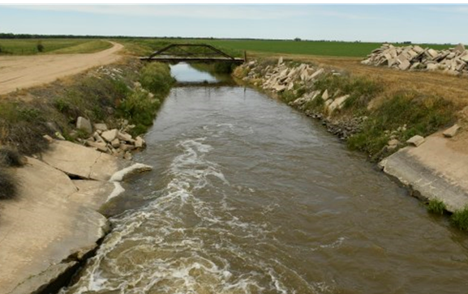
Next Steps:
  Current
    Water Rights Decree
    Parker WSD – LSPWCD agreement
    Prewitt Operating agreement
  Near Future
    Local and Regional Outreach
    Conveyance agreements
    Fremont Butte landowners
  Planned
    Permitting
    Advanced design, costs, financing, etc.
    Water delivery ~2040
Where do we go from here...
Notes:
Rebecca (may be inconsistencies in construction and delivery years (slides 7, 18, 19)

Slide 38
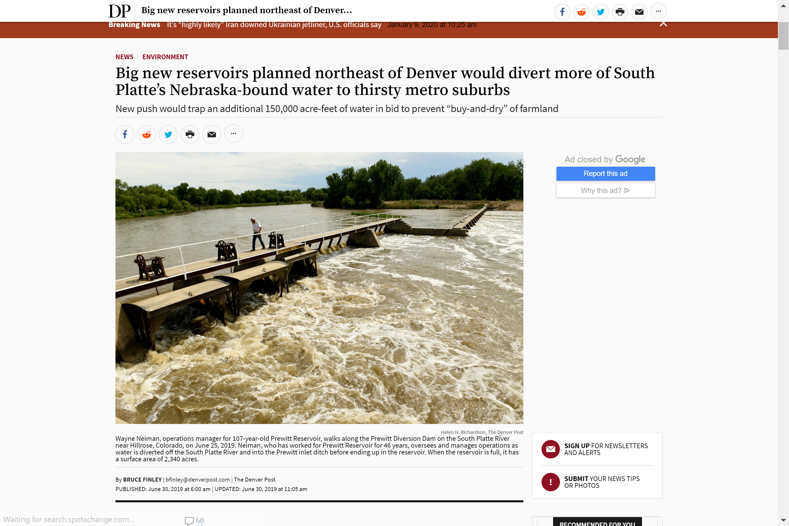
Questions?
Platte Valley Water Partnership
Pioneering a Collaborative and Sustainable Water Future

Slide 39


Nebraska

Slide 42
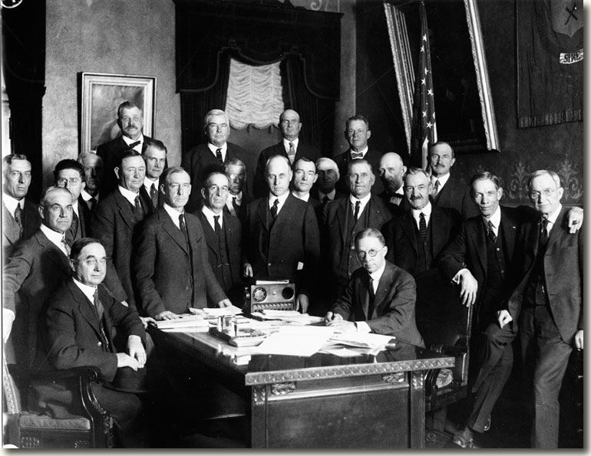
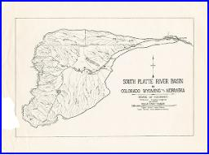
South Platte River Compact
Signed by CO and NE in 1923
Signed by CO Governor Clarence J. Morley in 1925

Slide 43
Nature of return flows in the South Platte
  “The flow was excessive in May and June and disappeared entirely during the summer. The river frequently became dry for months of each year to points as far west as the present city of Fort Morgan.” – Prior to surface irrigation.
  “The flow of return and seepage waters coming back to the river from irrigation of Colorado lands, has resulted in a constant supply at the interstate line.” – After surface irrigation development.
  “This flow is increasing and will soon be sufficient to care for the full demands of Nebraska as determined by the compact, while great quantities of water annually flow to waste across the interstate line, during the flood season and winter months…………………………….”
  “ The once “disappearing” flood stream has been converted into one of constant flow making possible the development in both states.”
Delph Carpenter, 1925 letter to CO Governor

Slide 44
South Platte River Compact
  Article IV – South Platte River Apportionment
    At all times between October 15th and April 1st, Colorado shall have the full and uninterrupted use and benefit of the waters of the river flowing within the boundaries of the state, except as otherwise provided by Article VI (Perkins Canal provisions).
    Between April 1st and October 15th, Colorado shall not permit diversions from the Lower Section of the river, to supply Colorado appropriations having adjudicated dates of priority subsequent to June 14th, 1897, to an extent that will diminish the flow of the river at the Interstate Station, on any day, below a mean flow of 120 cubic feet of water per second of time.
    Water deliveries are only for existing uses in Nebraska.
    Flow at Interstate Station for Nebraska to supply existing rights prior to new uses.
    72 hour rule.
    Reductions in diversions from the Lower Section shall not impair the rights of appropriators in Colorado to demand and receive equivalent amounts from other parts of the stream according to Colorado law.
    Colorado has full use of excess flows from April 1st to October 15th while Nebraska can use additional excesses from April 1st to October 15th under the provisions of Article VI (Perkins Canal).

Slide 45
South Platte River Compact
  Article VI – Perkins Canal
    Nebraska is permitted to construct Perkins County Canal (aka ‘South Divide’ Canal) in Colorado, commencing southwest of Ovid, CO and running easterly through Colorado for irrigation of lands in Nebraska.
    Rights for Nebraska to construct, maintain and operate canal in CO.
    Upper Section has full use water from Oct 15th to April 1st, Lower Section has full use of appropriated water perfected prior to December 17th, 1921 plus new future appropriations of 35,000 ac-ft. After such use by Colorado, Nebraska has right to divert up to 500 cfs of water in the Lower Section into the Perkins Canal from October 15th to April 1st
    No vested right for Nebraska in Perkins Canal from April 1st to October 15th, but ability to divert excesses if available.
    Shall not diminish superior claims in Nebraska.
    No transfer of Colorado appropriations to Perkins Canal.
    Rights by Nebraska and Colorado to regulate diversions for protection of rights in both states.

Slide 46
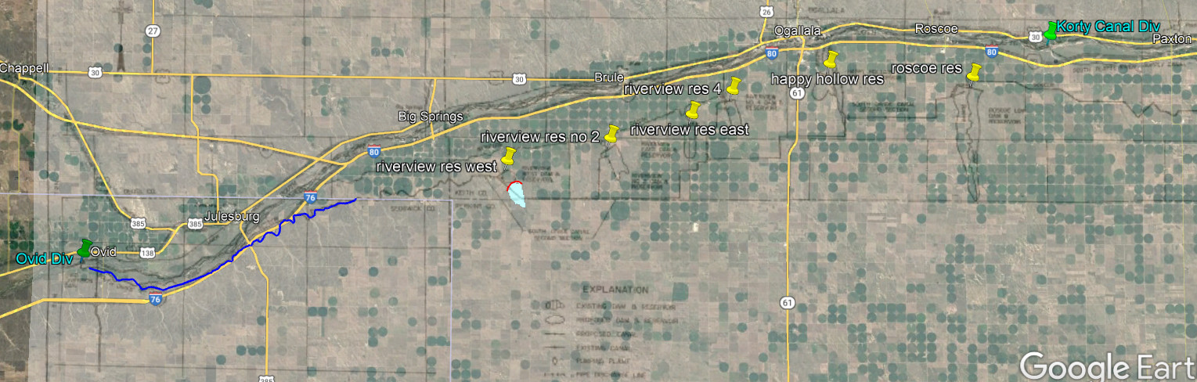
Nebraska – Perkins Canal Announcement:
$500 million request to construct Perkins Canal (aka South Divide Canal).
Used 1982 USBOR Study for preliminary estimate ($960 million if full build out).
Moving through Nebraska Legislature - $53.5 million for feasibility study, permitting, design, and potential land acquisition.

Slide 47
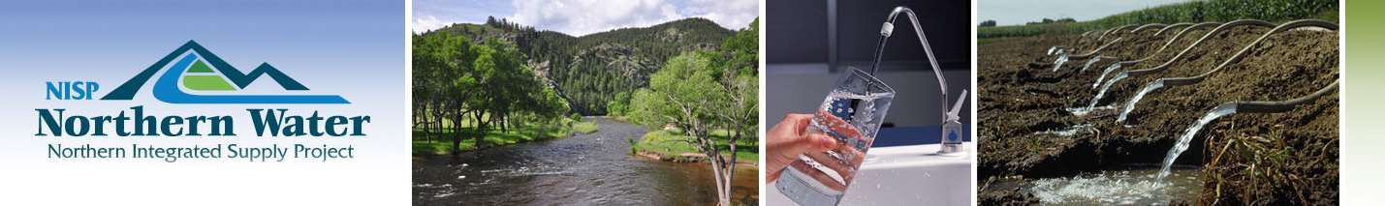
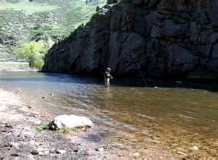
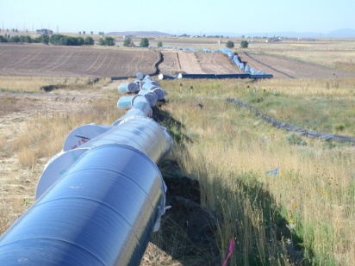
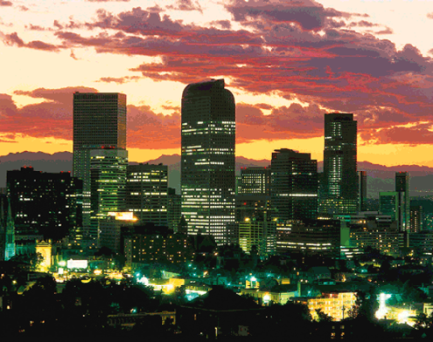
Questions?

