Slide 1
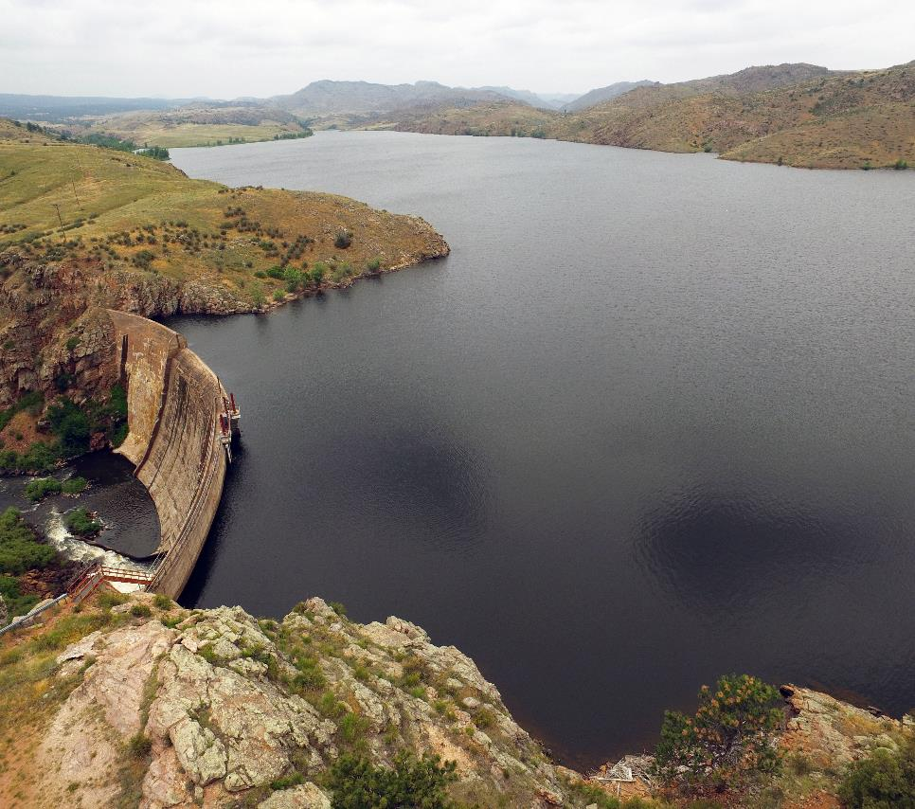
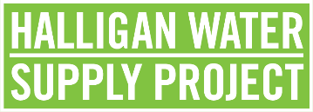
Halligan Water Supply Project Update
December 7, 2022
Jason Graham
Director of Water Utilities
Presented to:
Water Literate Leaders of Northern Colorado

Slide 2
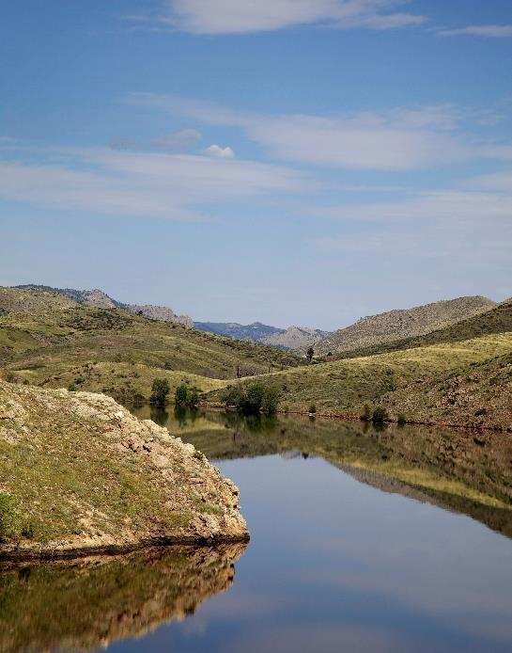
Purpose
Halligan Water Supply Project Update
Water Supply & Demand Background
Project Impacts and Benefits
Status of Permitting and Design

Slide 3
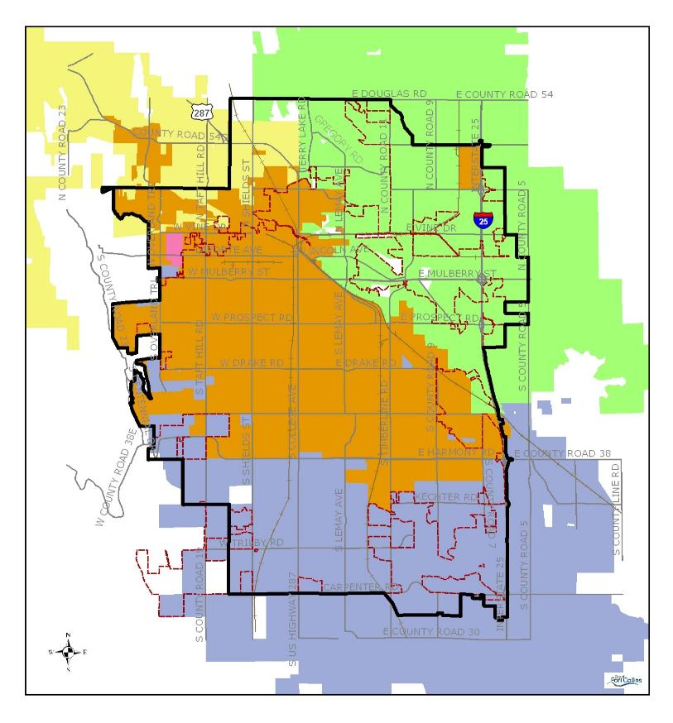
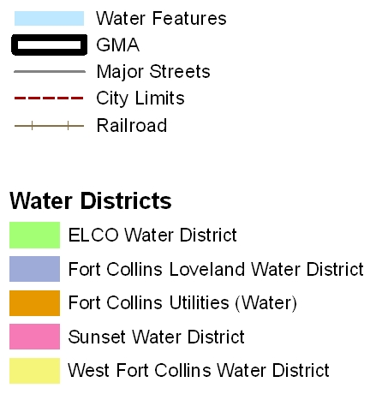

Fort Collins Water Districts
Halligan is for Utilities’ water service area
Legend
3
Notes:
This project is for Fort Collins utilities customers – area shown in orange.
This is a map of the Fort Collins area water provider boundaries. There are 3 main providers, with Utilities serving the central part of the City. The Halligan Project will be for use in the Utilities water service area (orange).

Slide 4
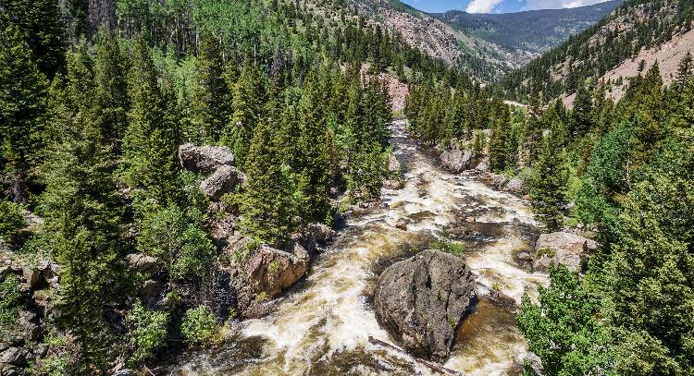
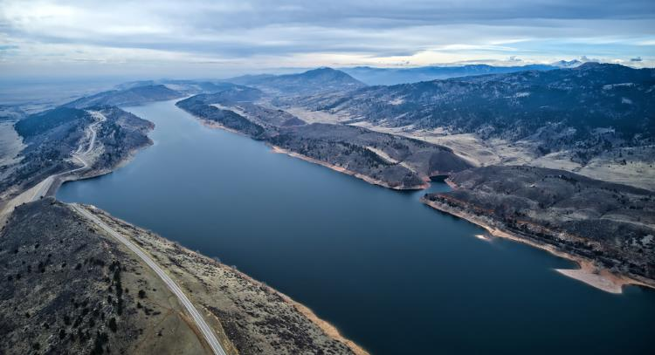
Utilities Water Supply Sources
Cache la Poudre River
Colorado-Big Thompson Project (CBT)
via Horsetooth Reservoir
~50/50 split between sources
Notes:
The Utilities current water sources are from a good portfolio of water rights in the Poudre River and ownership in units of the Colorado Big Thompson (or CBT) project, which we get delivery from Horsetooth Reservoir. On average we use about a 50/50 split between these two sources.

Slide 5



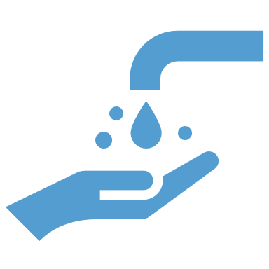
Water Supply & Demand Management Policy
Water Supply Planning Criteria
Drought Criterion
1-in-50-year drought
Storage Reserve Factor
20% of annual demands
Planning Demand Level
150 gallons per capita per day
Notes:
Key criteria of that Policy that drive need and size of Halligan are shown here; they include:
Having supplies that can meet demands through a 1-in-50 year drought;
Planning for a demand level that is slightly higher than our current demands to account for uncertainties in our future such as impacts of climate change, changing growth patterns and types, etc.
The storage reserve factor is essentially a bank account to deal with emergencies, like the recent fires and other vulnerabilities

Slide 6







Water Future Strategies
Sustainable and integrated approach
Avoid, minimize or offset impacts
Conservation
Portfolio of Resources
Infrastructure Security
Collaboration
Ongoing Data Evaluation
Innovation, Water Quality & Education
Plan for Emergencies
Notes:
We have a number of strategies for achieving our water future. We want to approach it with sustainability and integration in mind, as well as avoid, minimize and offset our impacts.
There are a number of things here – ones to highlight are:
Conservation – we have reduced our per capita use by around 30% over the last couple of decades; although a great stride, it still is not enough to avoid the need for Halligan
The Halligan Project fits into our portfolio of resources…City-owned water rights and CBT shares in Horsetooth
This portfolio is how we deal with droughts and other water supply shortages
As mentioned before, we have a good amount of water rights and benefit greatly from the CBT system
But where we lack is storage in our supply system, which the Halligan Project will provide

Slide 7







Portfolio of Resources
City-owned water rights and converted agricultural shares
CBT ownership
Storage (including 20% reserve)
Notes:
This portfolio is how we deal with droughts and other water supply shortages
As mentioned before, we have a good amount of water rights and benefit greatly from the CBT system
But where we lack is storage in our supply system, which the Halligan Project will provide

Slide 8
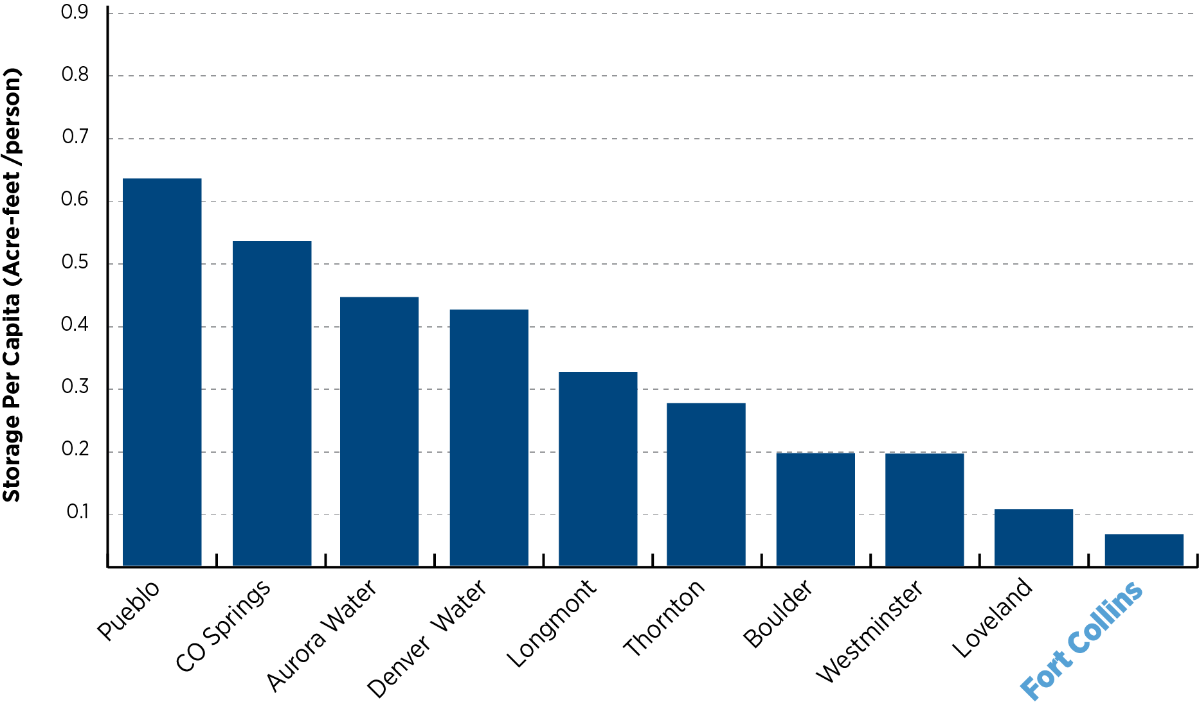
Storage Available to Provider
With Halligan
Notes:
This graph illustrates that lack of storage. This shows storage available to other Front Range water providers in a per capita format.
The bars represent the amount of storage capacity available to those providers divided by the number of people served.
As you can see, Fort Collins has the lowest amount of storage per capita
Acquiring Halligan would about double the amount for Fort Collins Utilities storage per capita

Slide 9
Future Water Demands
2065 ~178,000
people
2020 ~143,000 people
Projected Demand ~38,400 acre-feet
Annual Firm Yield ~31,000 acre-feet
Includes large contractual use increases (e.g., breweries, manufacturing)
Notes:
A key part of the need for the Halligan Project and a foundation in the permitting process is our future water demands.
The Corps’ review of our future needs are that we’re expecting about 35,000 additional people in our service area by 2065
Plus we have expected increases in the large contractual uses that we have
Currently our water supply system can meet a firm annual yield of about 31,000 AF and our future demands are about 38,400 AF
These are the values used in the permitting process, but recent information from our Planning Dpt indicate higher future populations in our service area (up to 195,000)

Slide 10
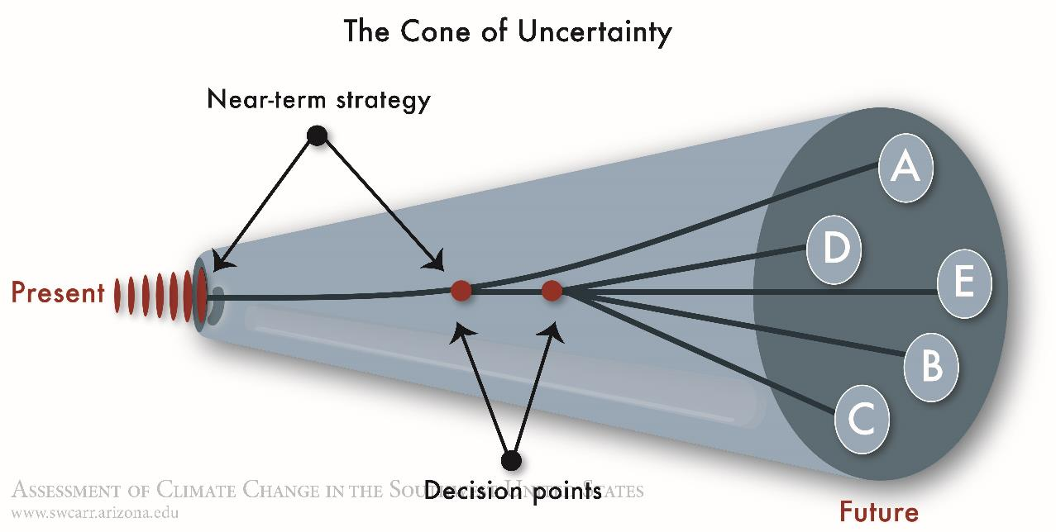
The Cone of Uncertainty
Near-Term Strategy
Decision Points
Image source: Denver Water
Notes:
This image by Denver Water tries to illustrate that our water future is not certain.
There are many things that can alter that future like impacts from a warmer climate, shifts in how our area grows,
or changes in how water is administered. We know that Halligan will help us address many of those uncertainties.

Slide 11
Future Water Demands
Future water demands
Drought security
  Climate change
Improved system reliability and flexibility
Storage reserve for emergency supply disruptions
ALTERNATE
Decision Points
Image source: Denver Water
Notes:
This image by Denver Water tries to illustrate that our water future is not certain.
There are many things that can alter that future like impacts from a warmer climate, shifts in how our area grows,
or changes in how water is administered. We know that Halligan will help us address many of those uncertainties.
One of the reasons I love working for Utilities is because we provide for people’s basic needs – electric, wastewater, stormwater, broadband, and (my area) clean, reliable drinking water.
To continue providing those essentials, the City must be constantly planning and looking ahead.
Our population continues to grow. Even with improving water conservation, which is very important in Fort Collins, we need to be able to meet growing water demand.
Meets 2065 demands
Federal permitting since 2006
A reminder of why we need Halligan - Halligan helps FCU meet demand of future utilities customers with added reliability to current customers.
Project is driven by the need for a reliable water supply. This project Increases overall resiliency of our water supply portfolio.
Reason we stay in this project after 14 years of permitting and over 2 decades of planning – remains the most cost-effective option to provide this reliable water supply.

Slide 12
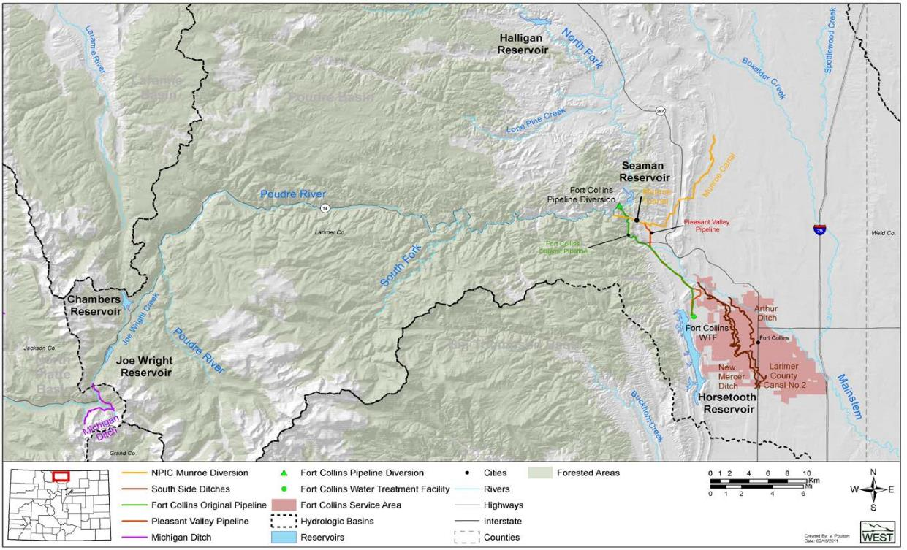
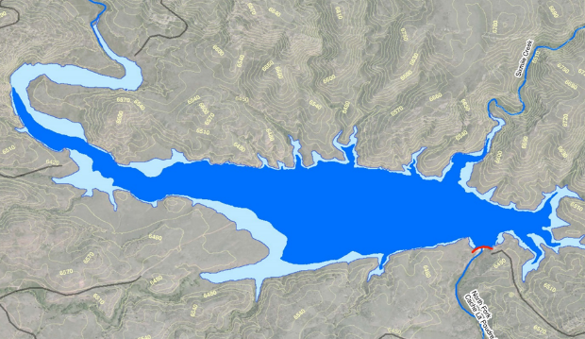
Halligan Reservoir Enlargement
Notes:
Eileen/Donnie notes:
Next portion of presentation will focus on a brief project overview, impacts and benefits of the project, permitting status and some elements of design.
This map shows the location of Halligan on the North Fork of the Poudre River and its relation to Fort Collins
Current and enlarged size of Halligan are shown, with dark blue being the current area and light blue being the additional area inundated
The enlargement would provide Utilities with about 8,200 AF of additional storage capacity

Slide 13
What differentiates Halligan?
Horsetooth Reservoir
~157,000 acre-feet
Proposed Halligan Reservoir
~14,500 acre-feet
Releases that improve flows
Releases during drought periods
Notes:
There are several water supply projects underway in Northern Colorado. What differentiates Halligan from others is:
1) it’s size – it’s relatively small – after enlargement it will be less than 1/10th the volume of Horsetooth.
2) It’s inherent benefits to the river downstream, which we’ll talk about later.
3) And the fact that our portion of Halligan will stay full majority of the time -- less impacts and less frequent diversions from the river.
3a) The graph on the right shows how the City’s storage in Halligan will fluctuation through time; there will be smaller changes in most years for the releases that improve flows and larger, but less frequent decreases in storage as water is released during drought periods.

Slide 14






Why Halligan?
Provides a safe, reliable water supply.
Replaces an aging dam.
Most cost-effective option to meet needs.
Uses existing reservoir instead of building a new one.
Year-round flows on the North Fork leading to fishery and habitat improvements.
Gravity-fed –no energy or greenhouse gas emissions.
Notes:
Project is driven by the need for a reliable water supply.
As part of our Safe Community Outcome Area-we aim to provide and maintain reliable utility services and infrastructure that directly preserve and improve public health and community safety
Halligan meets demand of future utilities customers while adding reliability to current customers.
It is also a an Environmentally Responsible Solution - year round base flows and no greenhouse gas emissions with no piping, pumping, or pretreatmen
Reason we stay in this project after 16 years of permitting - most cost-effective option to provide this reliable water supply.
----------------------------------------------------------------------
Without Halligan –future customers vulnerable to service interruptions
Opportunity to improve North Fork flow and habitat
Replaces aging dam, addresses eventual safety issues
Balances water supply needs and environmental impacts
For the change to the Safe Community Outcome Area as the key strategic objective: SAFE 5.5 Provide and maintain reliable utility services and infrastructure that directly preserve and improve public health and community safety. - A safe and adequate water supply is essential to community health and safety. A safe, high quality water supply supports community health through providing drinking water that meets all regulatory water quality requirements. An adequate water supply is needed to support fire protection services in the community.
Really talking up the advantages of a modern new dam makes sense here (you already nicely explain the critical need for more storage)

Slide 15
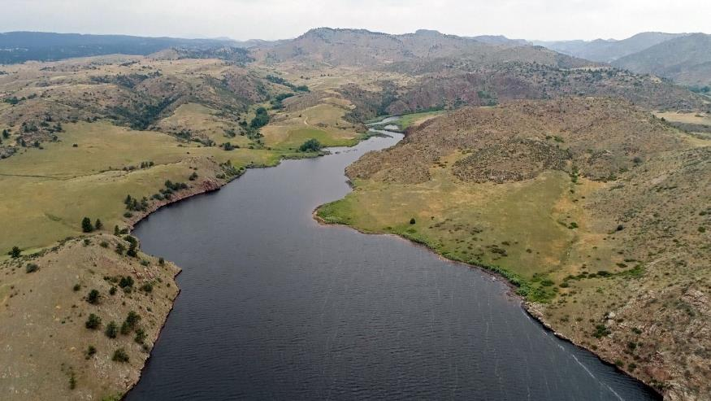
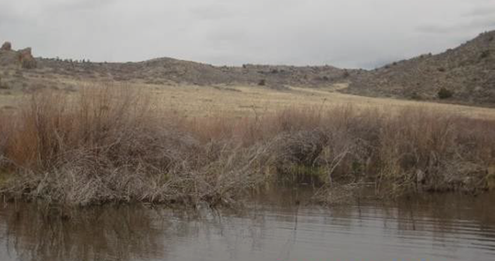
Impacts
Inundation of wetlands
Seasonal inundation of
¾-mile stream channel
Preble’s meadow jumping mouse habitat
Construction
Notes:
Every project of this scale has impacts. This slide lists a few related to inundation and construction.
But, the primary impact people likely wonder about is impact to the river:

Slide 16
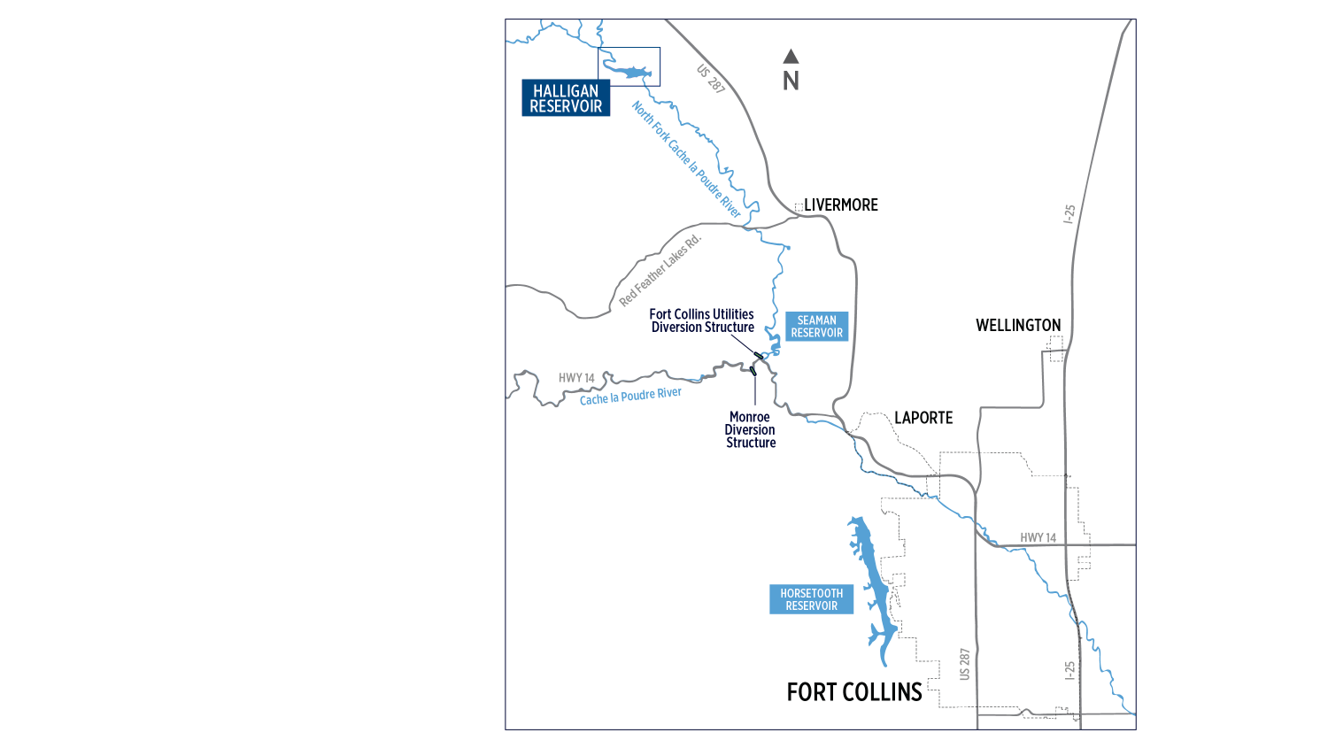
Flow Changes
Slight decrease in flows during spring runoff.
Most months, operations would increase flows.
Slight decrease in flows during spring runoff.
Notes:
This map shows the area from Halligan (in the NW corner) to Fort Collins.
Operation of an enlarged Halligan would result in a slight decrease in spring runoff flows on the North Fork and Poudre upstream of Laporte.
BUT an increase in flows most months of the year.
----------------------------------------------------------------------------------------------
If people, ask about actual numbers:
On average, on monthly basis, reduction of up to 10% on North Fork during spring runoff months May/June
On average, on monthly basis, reduction of less than 5% on Poudre River at Canyon mouth during spring runoff months.
On average, in 7 of 12 months flows would increase on the North Fork approximately 10% or greater.

Slide 17
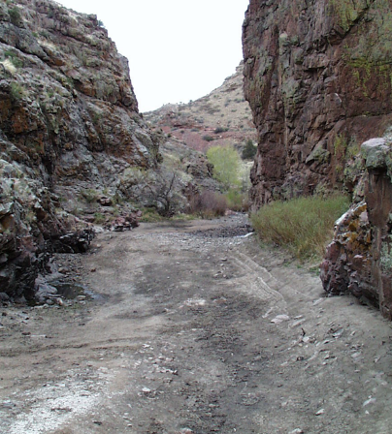
Benefits
Ensures year-round flows
on North Fork
Reconnects 22 miles of river
Enables fish passage
Improves water temperatures
Notes:
Project has many benefits, but the benefits to the river are what set this project apart:
Project would re-establish flows to a river that currently looks like this image in some locations in late summer, due to existing operations on the North Fork.
Re-establishing year-round flows provide river connectivity that’s missing today and is a fundamental need for a healthy ecosystem.

Slide 18
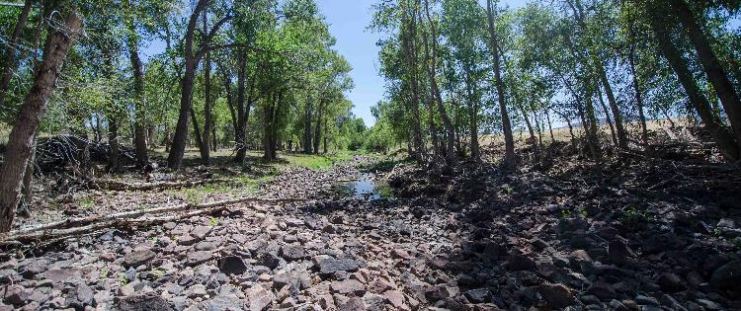
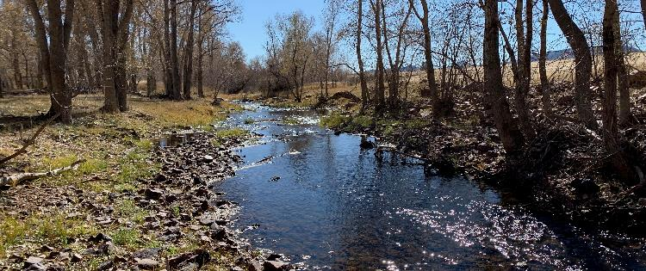
North Fork Habitat Improvement
Current periodic river conditions
Proposed river conditions
Mitigation Elements
Winter release plan
Summer low-flow plan
Ramping rate limitations
Peak flow bypass program
Temporary environmental pool
Protection of releases
Modify existing diversions
Reestablishment of wetlands and habitat
Mitigation of temporary construction impacts
Post-construction monitoring
Notes:
As an example, this slide lists mitigation elements that will benefit the North Fork system as a whole:
Establishing year-round minimum flows doesn’t only improve conditions of fishery, riparian veg, macroinverts, but benefits aquatic ecosystem as a whole.
Compare pictures – in same vicinity. What it looks like in typical summertime condition, versus proposed flows during summertime after enlargement.
As the list of mitigation elements show, the City has put a lot of energy into developing meaningful mitigation – which has been in consultation with the various permitting agencies

Slide 19
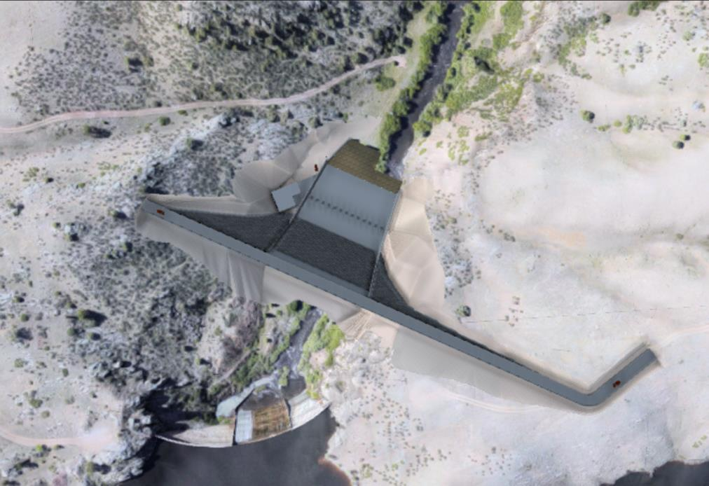
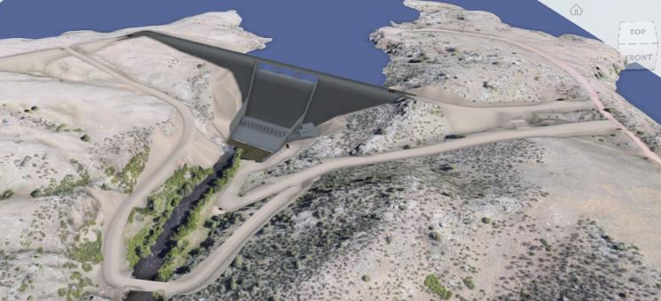
Design
Replacement dam approx. 200 ft downstream
Completed 30% design
Notes:
The design team has completed the 30% design and currently working on the 30% cost estimate that we will update Council in Q1 of 2023.
Our 3rd season of field investigation will occur this summer that will inform our 60% design planned for 2024.
Construction is expected in 2026-driver is the permitting process.
One item that came out of the alternatives evaluation for 30% was this concept of the adjacent alignment.
200’d/s of existing dam
Only a slight increase in wetland/habitat impacts
Similar cost as the raise on the existing alignment
significant reductions to project risk
and improved long-term functionality, operations, and maintenance
----------------------------------------------------------------------------
Design flexibility and implementation of modern design practices
Improved long-term functionality, operations, and maintenance
Reduction in construction risks
Reduction in operational impacts
during construction
-------------------------------------------------------------------------------------
Raise on existing dam-0.2 acres of wetland impacts
The environmental impacts to wetlands and habitat just downstream of the dam is about 0.5 acres. 0.3 acres more than Alt 1 which is minimal.
Risk
Raise on existing dam
$55.3M total
$14.7M probable
Adjacent Alignment
$40.7M Total ($14.6M or 26% reduction)
$9.1M probable ($5.6M or 38% reduction)

Slide 20
Path Forward
Scoping, Purpose & Need, Alternatives, Studies,
Develop and
Issue Draft EIS
Scoping, Purpose and Need, Alternatives, Studies
2006-2018
Nov. 2019
Construction
Public
Comment
Period
Prepare and
Publish
Final EIS
Record of
Decision
2019-2020
2022-2023
(estimated)
2025-2026
(estimated)
2025-2029
(estimated)
Other Permitting (e.g., 401 Cert., Fish & Wildlife
Mitigation Plan, County 1041, construction permits)
Preliminary and Final Design
Notes:
We’ve come a long way since starting the permitting process 16 years ago, and since the Corps released the draft EIS in 2019.
We’re currently focused on design, state permitting processes (401, FWMEP), and finalizing the EIS.
There are still quite a few steps before construction:
Permitting – key elements before the Corps’ ROD:
Schedule driver: Water quality modeling and State 401 certification process
Mitigation planning: FWMEP (CO Parks & Wildlife), wetlands (Corps), and Preble’s mouse (USFWS)
Larimer County 1041 permit after final EIS
- Landowner and ROW agreements” (or similar)

Slide 21



fcgov.com/halligan

