Slide 1
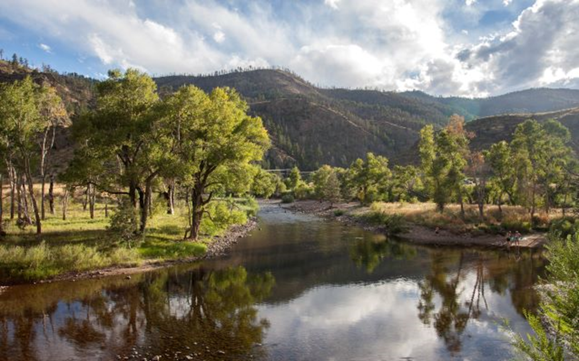
Water, Agriculture, and ATMs
Brett Bovee
WestWater Research, LLC
Fort Collins, CO
Colorado Water Literate Leaders
January 18, 2023
Photo: Poudre River, NPS

Slide 2
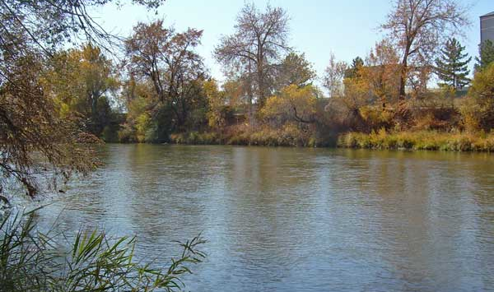
OUTLINE
Water & Agriculture
Seeking an Alternative (ATMs)
Trying to Define ATMs
ATM Examples in Colorado
Barriers to ATMs
Complementary Actions
Photo: South Platte River, USGS

Slide 3
Water & Agriculture in Colorado
Photo: South Platte River, USGS

Slide 4
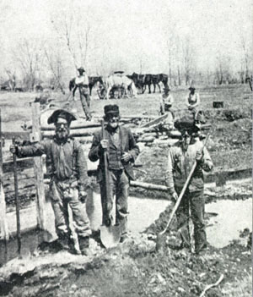
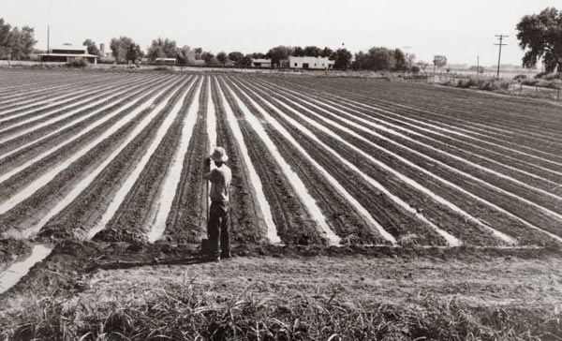
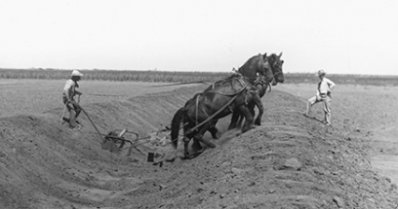
Irrigated Agriculture
History
Original economic engine
First water uses / water rights
Federal reclamation programs
WATER RIGHTS

Slide 5
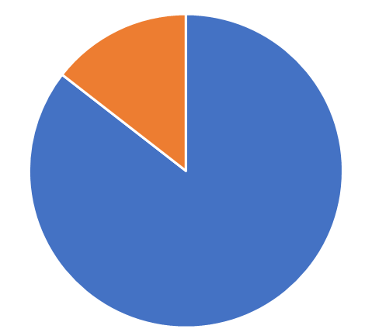
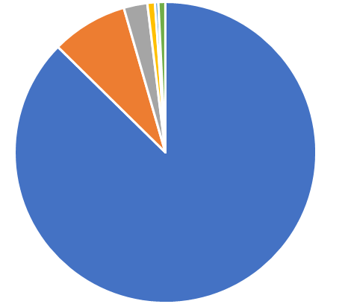
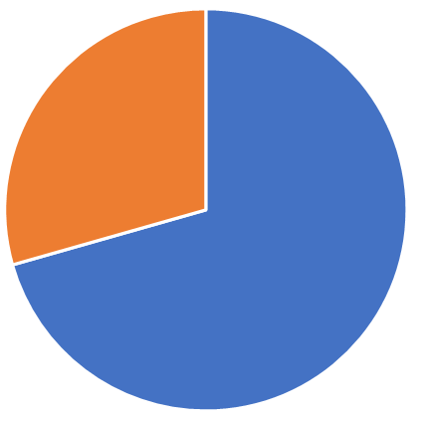
Irrigated Agriculture in Colorado
Water Use in Colorado (Diversion)
GW
15%
SW Irrig
85%
Public Supply
8%
Diversion
10.1Mafy
3.3 AF per acre
Irrigation
87%
Depleted
Consumed
30%
Diverted &
Returned
70%
Consumptive Use
3.0 Mafy
1.0 AF per acre
USGS Water Use Data 2015

Slide 6
Irrigated Lands in Northern Colorado
FoCo
Loveland
Greeley
Ft.
Morgan
Boulder
DIA
Why are irrigated lands located as shown?
Why are towns located along the Front Range?
CDWR Map Viewer
2015 Irrigated Lands in Division 1

Slide 7
Loss of Irrigated Lands
Data from USDA Census
For 12 Front Range Counties
1960
2017
1997-2017
-22% Overall Decline
in Acres over 20 years
Open Water Foundation
Irrigated Lands Visualization
District 1.2 Denver to Greeley

Slide 8
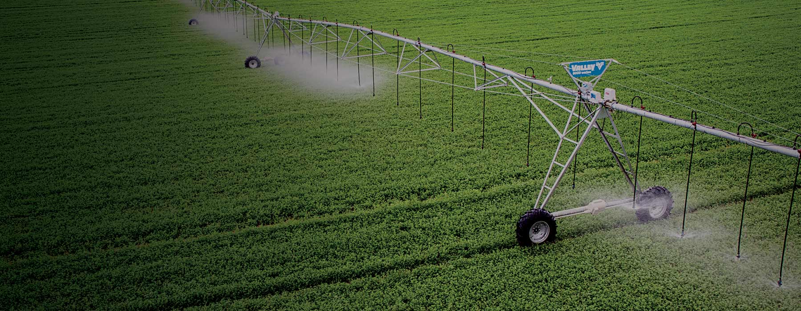
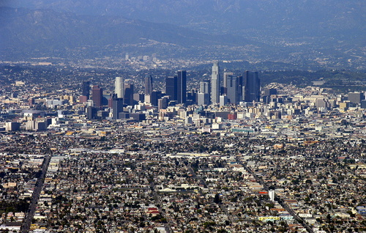
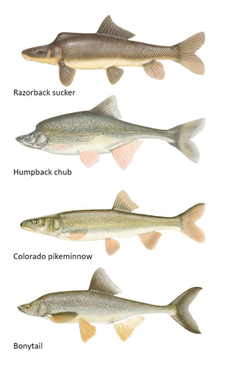
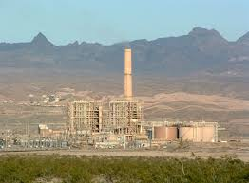
Changing Economy & Water Demands

Slide 9
Seeking an Alternative (ATMs)
Photo: South Platte River, USGS

Slide 10
History on ATMs
SWSI plans predicted 500k irrigated acres (~20% of total) could be lost statewide due to:
- Urbanization (100k acres, 20%)
- Municipal Transfers (200k acres, 40%)
Other Reasons (200k acres, 40%)
Augmentation Needs - CRP Enrollments
Compact Compliance - Groundwater Overdraft
Influence from:
Significant dry-up in Crowley County in Arkansas Basin
Example fallowing programs developed in Southern California
SB 07-22 (2007) authorized CWCB to develop a grant program to facilitate development and implementation of ATMs
CO Water Plan created an objective of 50,000 AF of ATMs by 2030

Slide 11
ATM Grant Program
$6,052,500 in Grants Awarded
(as of Nov. 2019)
CCGA
FlexMarket
Primarily Research
Primarily Pilots
CO
Water
Bank
Other
Projects
LAVWCD
NE CO
Water Co-op

Slide 12
Trying to Define ATMs
Photo: South Platte River, USGS

Slide 13
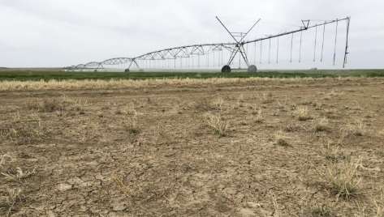
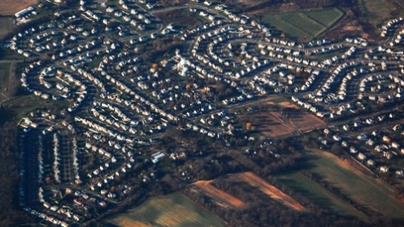
Water Trades ATMs = Water Trade / Sharing Agreements
Willing Seller
Willing Buyer
Large Payment
Freedom
Finality
Known Supply
Ownership
Finality
Status Quo
Permanent Sale
Farmers who do not want to continue farming
M&I water managers who demand permanency
Annual Payment
Keep Farming
Flexibility
Known Supply
Regional Benefits
Aesthetics / Ecology
ATM Concepts
ATM Agreement
Farmers who want to see the land irrigated
M&I water managers who can utilize variable supplies

Slide 14
Structure of ATMs
ATM =
Agricultural Water
Supply Method
+
Water Transfer
Method
Full-Season Fallow
Rotational Fallow
Split-Season Fallow
Regulated Deficit Irrigation
Crop Switching
Infrastructure
Water Bank
Buy & Supply
IWSA / Option Contract
Purchase / Lease
Lease to Fix

Slide 15
Purpose of ATMs
Should there be a strict definition of an ATM for state funding & tracking?
Do ATMs need to reduce permanent agricultural dry-up?

Slide 16
Example ATMs in Colorado
Photo: South Platte River, USGS

Slide 17
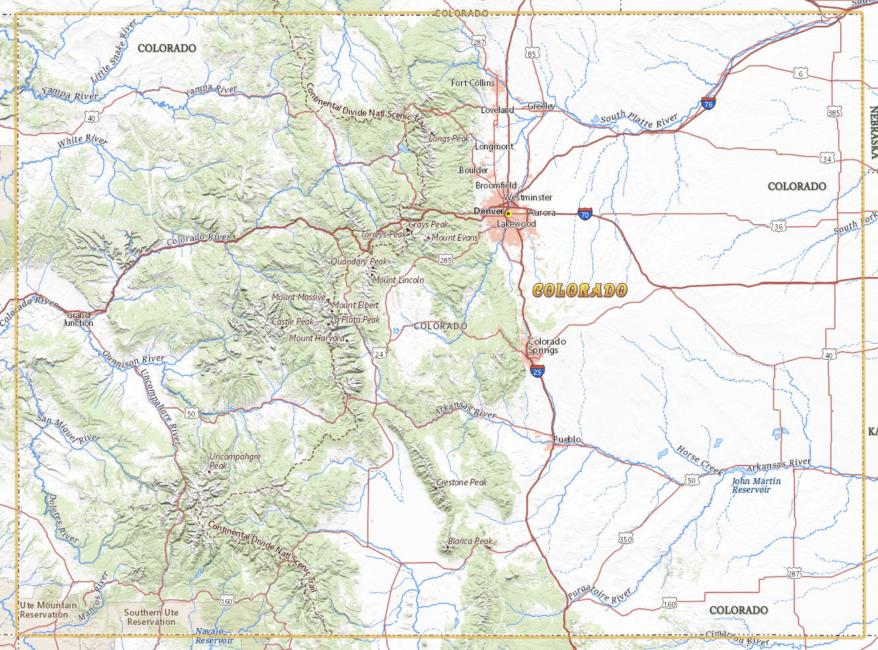
Broad Categories
Estimated to be about 10-15 example ATMs in Colorado
Municipal
Innovative transfers to provide a municipal supply
Avoid buy & dry
Compact Compliance
Fallow lands to increase flow into Lake Powell
Avoid curtailment of junior rights due to interstate obligations
Environmental
Fallow lands to improve streamflow in target reach
Typically short-term
Groundwater Sustainability
Reduce GW irrigation to boost aquifer levels & ensure interstate obligations
Fallowing, CRP, leasing, forbearance

Slide 18
ATM Examples in Colorado IWSA / Option Contract
Irrigation District operates 74,590 AF reservoir to supply 40,916 acres.
Xcel Energy wanted to set up an IWSA to provide 3,000 AF of winter-time augmentation water for its GW wells to supply the Pawnee power station
The need for water came out of revised GW administration along the South Platte River following the drought of 2002
District got initial 84% (of acres) approval to pursue an IWSA. Created Point of Rocks Water Company to act as the lessor and interested landowners subscribed their acres to the Company
Base Payment (every year): $50 per AF
Delivery Payment: $425 per AF
Payments escalate with CPI
25-Year Term of IWSA
Subscribed acres receive 0.14 AF (8.7%) less water in average year, and $41 per acre payment
Since 2005, Xcel has paid $1.6M to Company and District has not delivered any water.

Slide 19
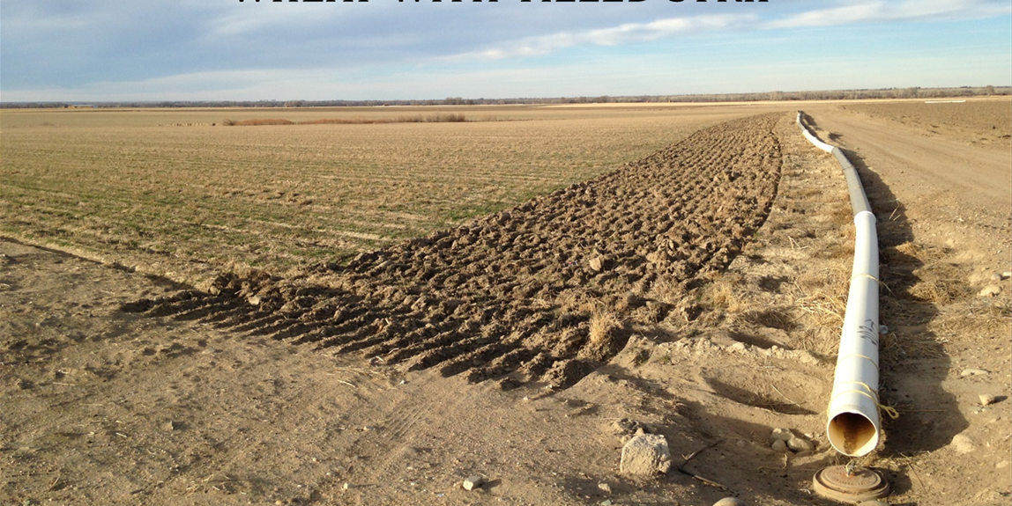
ATM Examples in Colorado Rotational Fallowing
Example: Catlin Canal Pilot Project
Originally ideas developed by the Lower Arkansas Valley Water Conservancy District in 2002 and Super Ditch Company in 2008
Legal battles over injury to other water rights prevented leases from occurring
State passed HB 13-1248 in 2013 to allow pilot lease-fallowing projects
Catlin Canal Pilot Project approved by State Engineer and started in 2015
Project consists of six farms totaling 911 acres, with goal of fallowing up to 30% of acreage each year
About 400 AF delivered to three municipal buyers in 2015 and 2016
Payment structure is $150 per acre fallowed and $500 per AF of delivered water supply on a take-or-pay basis
The Super Ditch and Catlin Canal projects have benefitted from about $2M of investment through District mill levies ($0.65M) and state grants ($1.35M)

Slide 20
ATM Examples in Colorado Irrigation Modifications
Example: Aurora High Line Lease
City of Aurora was in quick need of additional water supplies coming out of the severe 2002 drought
Phase 1
Short-term lease agreements with Highland Canal Co. to fallow farmland
The water supply yield for each fallowed acre was uncertain
Aurora entered into 124 individual lease contracts for 8,200 acres (37% of service area) for 2-year period
Aurora responsible for SWSP and water measurement
Total cost was about $750-$800 per AF of supply
Phase 2
Aurora acquired 2,810 acres of farmland with promise not to fallow all of it
About 880 acres remain in production
Aurora invested $1,400 per acre to install new GW wells and drip irrigation
Aurora receives 1.25 AF/acre for its use and provides 0.5 AF/acre for augmentation of well pumping
More recent example:
Colorado Springs Utilities water transaction involving LAWMA in the Lower Arkansas Basin

Slide 21
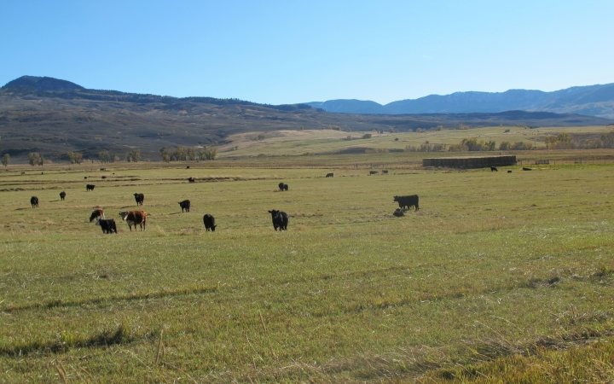
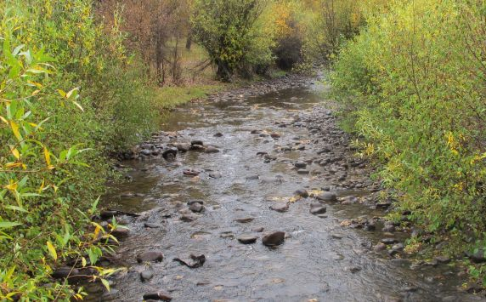
ATM Examples in Colorado Split Season Lease
In 2012, WRC purchased a 214 acre ranch with 1.5 shares (18.75%) of McKinley Ditch after a bank foreclosure.
In 2014, CWT purchased the water rights (5.8 cfs) for $500k and CWCB agreed to purchase a permanent “grant of flow restoration use” from CWT for $145k which will provide instream flows to the Little Cimarron River in the late summer when the river typically ran dry
CWCB purchase price was based on lost agricultural revenue for a late-season cutting of hay
Irrigation on ranch will continue as none, split-season, or full-season depending on hydro/climate conditions
Historical Farm
Headgate Delivery
Leased for instream flows
New Farm
Headgate Delivery

Slide 22
Barriers to Use of ATMs
Photo: South Platte River, USGS

Slide 23
1. Economic Barrier
ATM Study
Calculate long-term costs of water supply alternatives
Take Home Points:
Financial model was very sensitive to assumed inputs
Need to consider long-term costs when comparing purchased & leased water supplies
Over the long term, leasing water will likely be more expensive
There is also an economic barrier for farmers to maintain their water rights in agricultural use and take “buy & dry” off the table for the future.

Slide 24
2. Regulatory Barriers
Water transfers are not easy in Colorado. ATMs get the same level of scrutiny as permanent water transfers.
Example Catlin Canal rotational fallowing project used a new policy tool but it came with 50+ conditions
Minimum threshold cost to go through water court – whether you are taking 200 AF for use every year or 200 AF for use in only some years.
Municipal water providers need to show secure water supply. Are leased water supplies under an ATM considered secure?
Many ATMs try to use water in new & flexible ways, but tenants of Colorado water law must be met.
Shepherding water for CO River Basin demand management
Protecting water instream for environmental uses

Slide 25
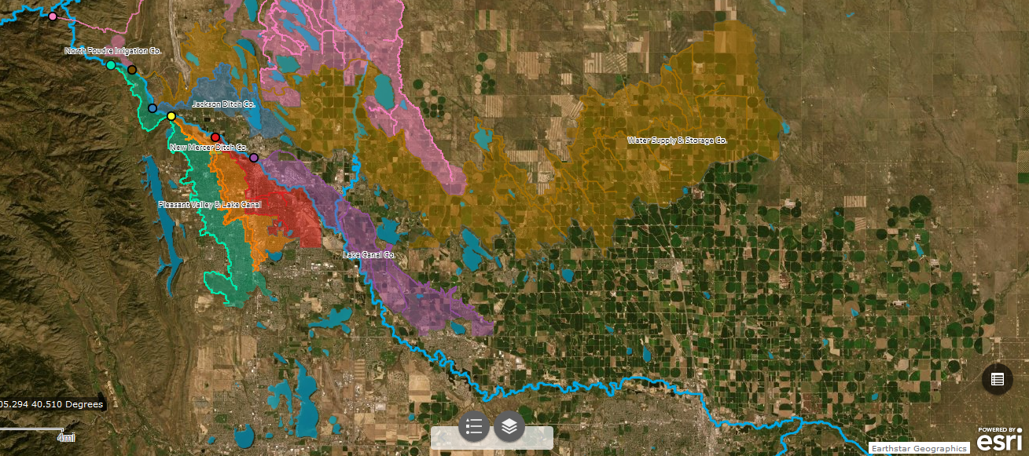
3. Infrastructure / Hydrologic Barriers
Poudre River Basin Example
Colors show service areas of ditches that are 60+% owned by municipal water providers
Water
treatment
plants
Most irrigated lands are located downstream & difficult to get water up to treatment plants
Same issues exists in most Front Range rivers: mainstem South Platte & Arkansas

Slide 26
4. Comfort Level
Municipal
Inherently low risk
Development pays its own way
Desire permanence
No upside – so why?
Agricultural
Inherently wary of municipal transfers
Disruptions to business partners
Multi-year effects of fallowing
Selling is often retirement plan
Industrial
Term-limited use
More risky & cost aware
Provides flexibility
Environmental
Limited funding – bang for buck
Desires more flexibility
Inherently creative & willing to test ideas
Often looking for temporary benefits

Slide 27
Complementary Actions
(to reduce buy & dry)
Photo: South Platte River, USGS

Slide 28
Conservation Easements
Boulder County
Example
Irrigated Lands
Longmont
City of
Boulder

Slide 29
Change Municipal Water Dedication Policies
Municipal water conservation has been successful
Dedication policies often require more water than will be used in typical year
Water right dedications must meet full demand of new development
Changing policy will likely add risk relative to status quo
1. Reduce water right volumes required by new development & require new developments to be low water use
Front Range
Water Use Rates
1985-2015
-38% Overall
2. Transition to Cash-in-Lieu policies so that existing supply can be used & innovative supplies can be developed
Data from USGS

Slide 30
Long-Term Lease Backs
Municipal → Agricultural
Most municipalities build portfolios to serve extreme droughts (1 in 50 years)
Most municipalities have leasing arrangements to keep water in agriculture before the water is transferred to municipal use
Most municipalities do not seek a “dual use” when water rights are changed to municipal use in water court → therefore restricted from lease-backs
Greater consideration of long-term leases for:
Flexible types of water supplies
Water court decrees allowing “dual use”
Average to wet water supply years
Results in extra costs & regulatory headache for municipality
Not desired by agricultural sector because it forces short-term planning

Slide 31
THANKS!
Brett Bovee | WestWater Research, LLC
205 S. Meldrum St., Fort Collins, CO 80521
bovee@waterexchange.com
Office: 970-672-1811 | Cell: 970-889-0469 ​
Water Resource Economics | Transaction Services | Water Valuation
Photo: South Platte River, USGS

