Slide 1
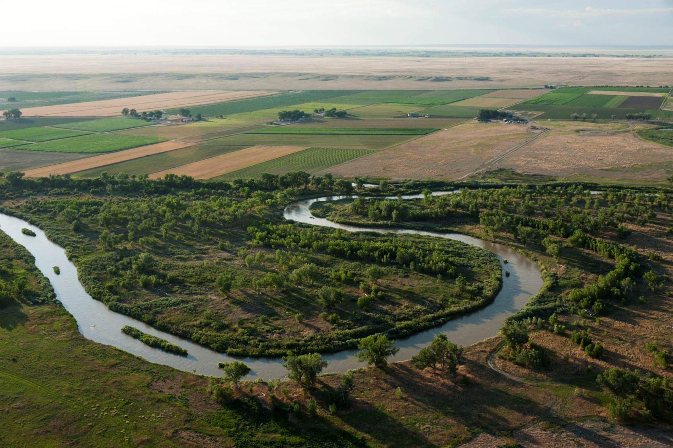

Water & Agriculture
Timothy K. Gates

Slide 2
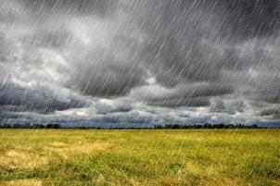
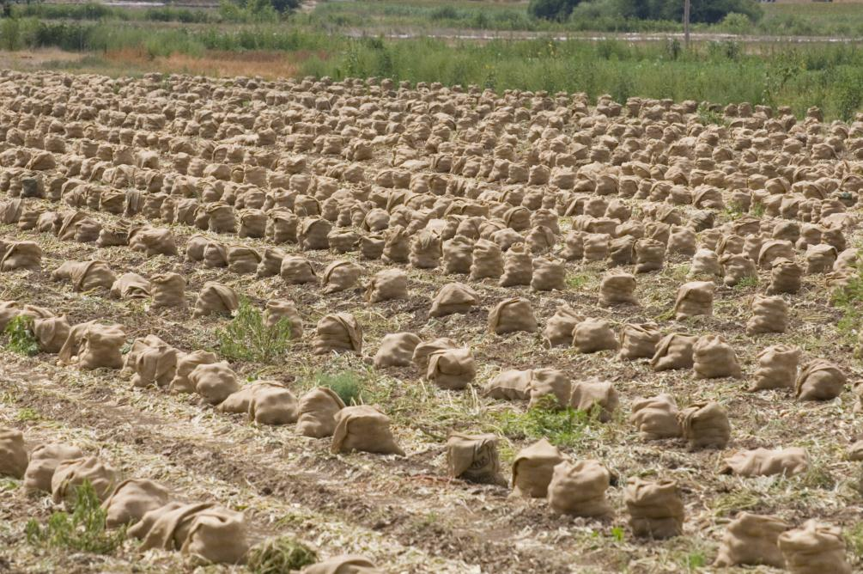
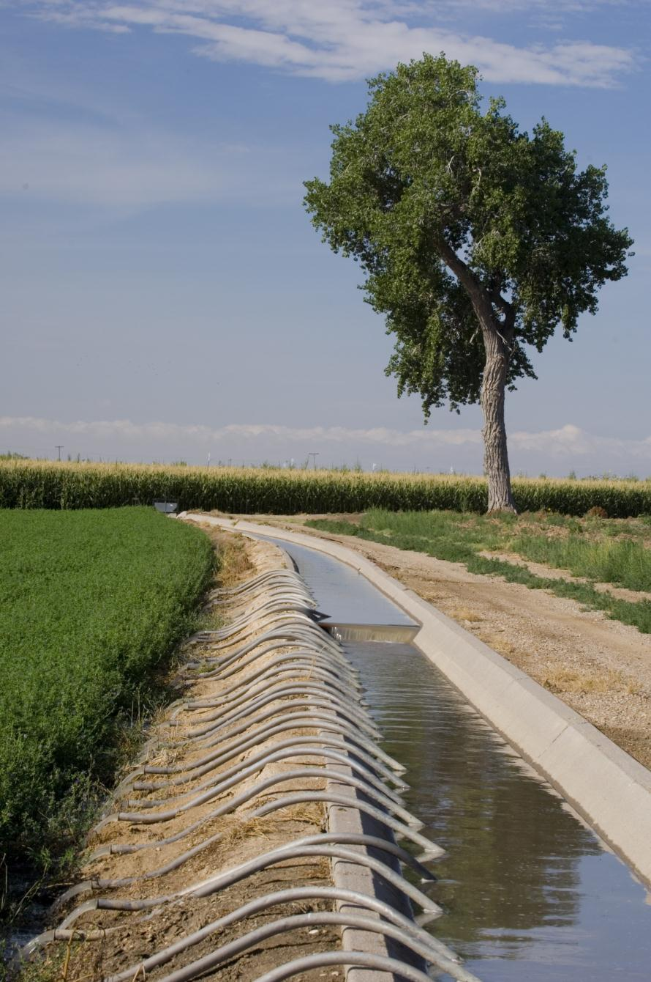
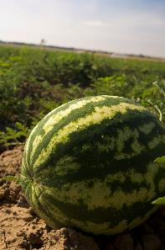
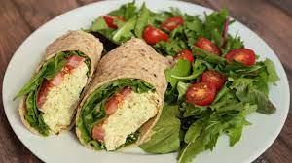
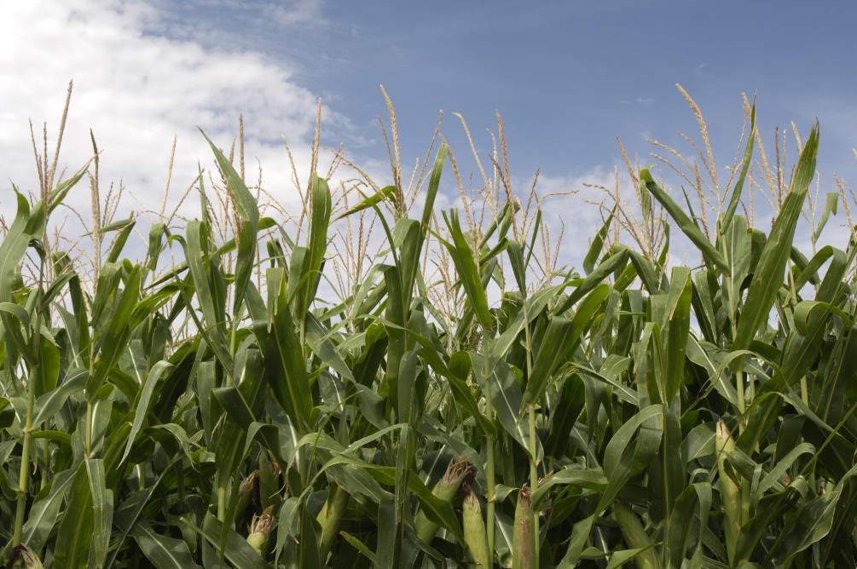
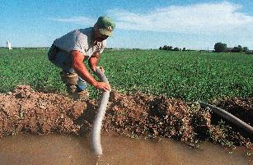
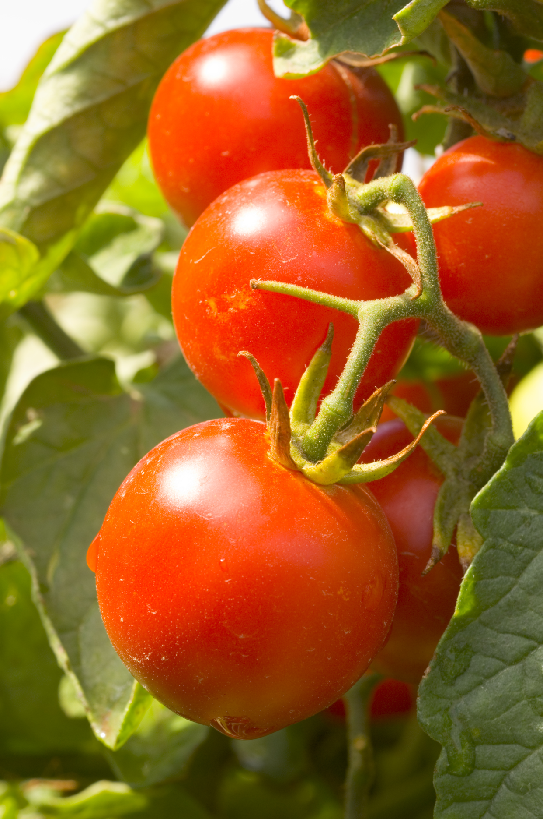
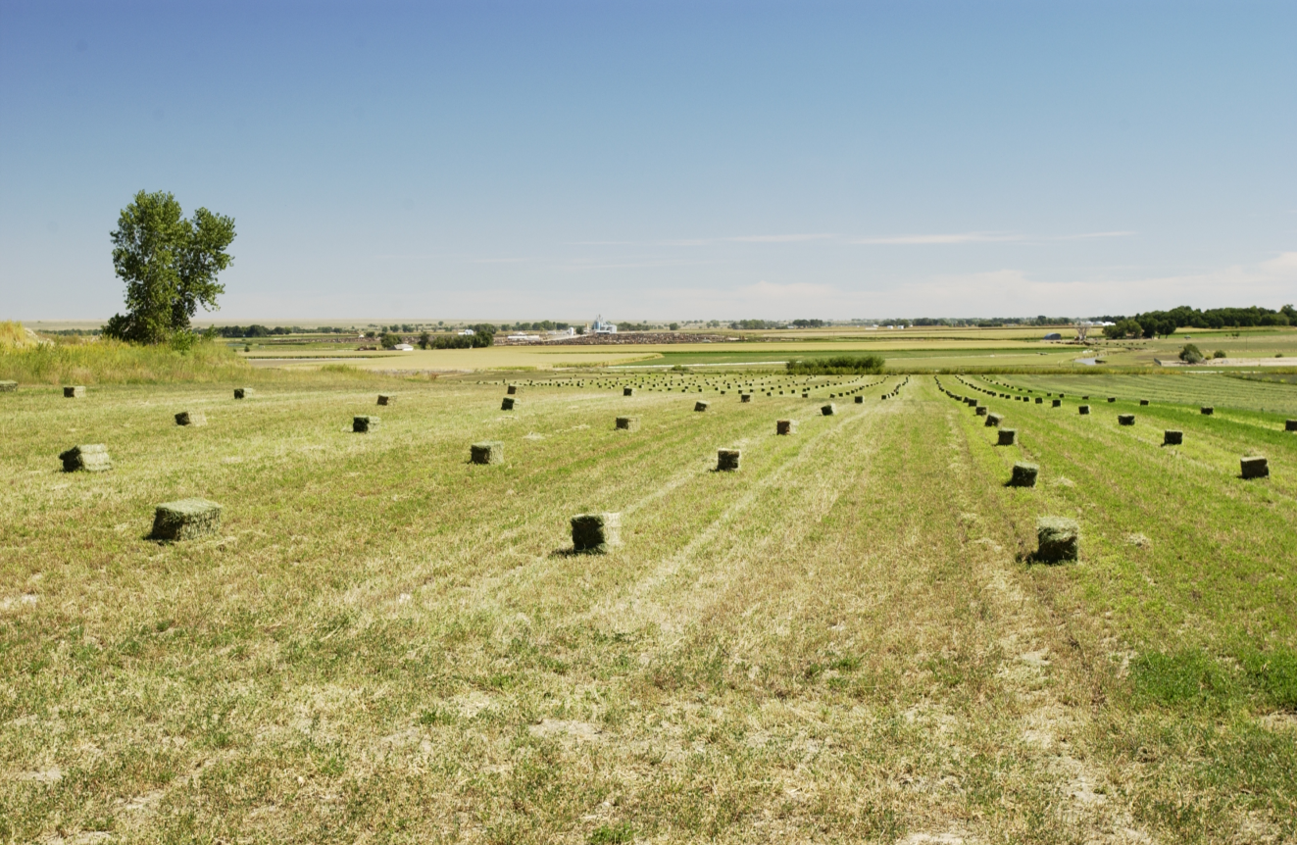
Notes:
Plate was meant to represent lunch we were scheduled to have today – a reminder that agriculture is an essential industry, and today we want to reflect on water as an essential resource for agriculture.

Slide 3
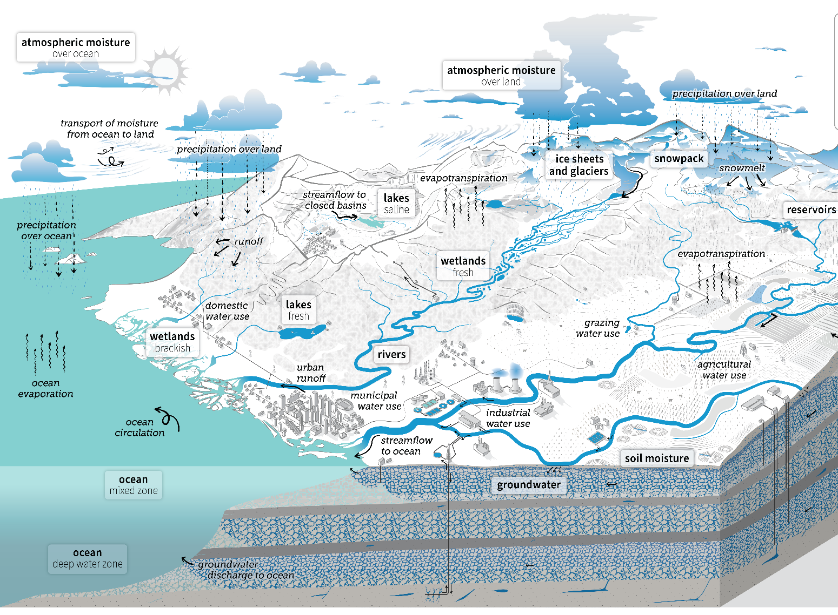
Source: USGS
Notes:
Water for agriculture can only be properly understood when seen in the context of the overall hydrological cycle and in relation to both natural water processes and human-engineered and managed processes.

Slide 4
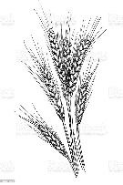
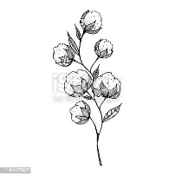
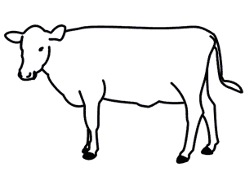
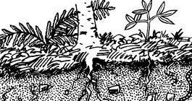
Beneficial Consumption
Precipitation
Agriculture
Objectives,
Technology,
Socioeconomic & Legal
Constraints
Non-Beneficial
Consumption
Withdrawal
Return
Stream & Aquifer
Systems
Notes:
Water is consumed in agriculture when it is incorporated into plant and animal tissues and as evapotranspiration (economically beneficial in crops and livestock, nonbeneficial in weeds and bare soil). Water that cannot be supplied by direct precipitation must be diverted from streams and aquifers (especially in arid and semi-arid regions). The portion not consumed returns back.

Slide 5
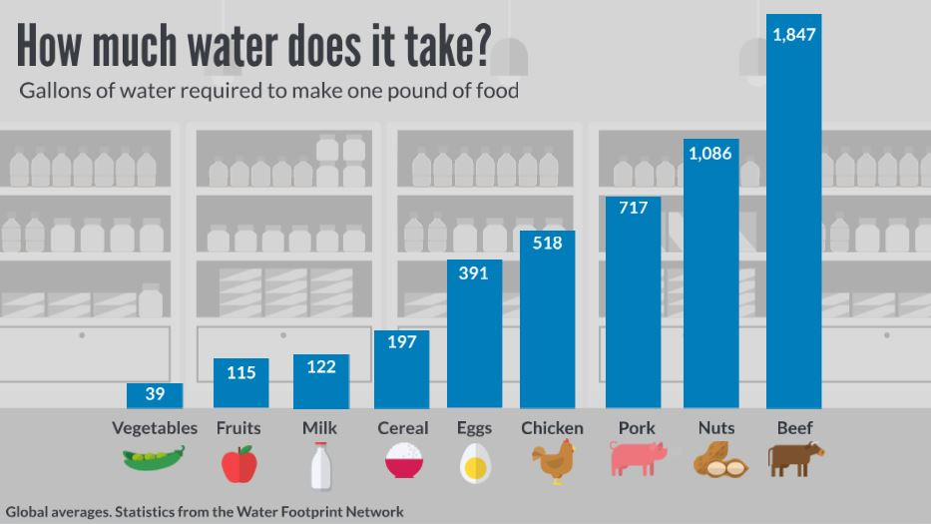

Slide 6
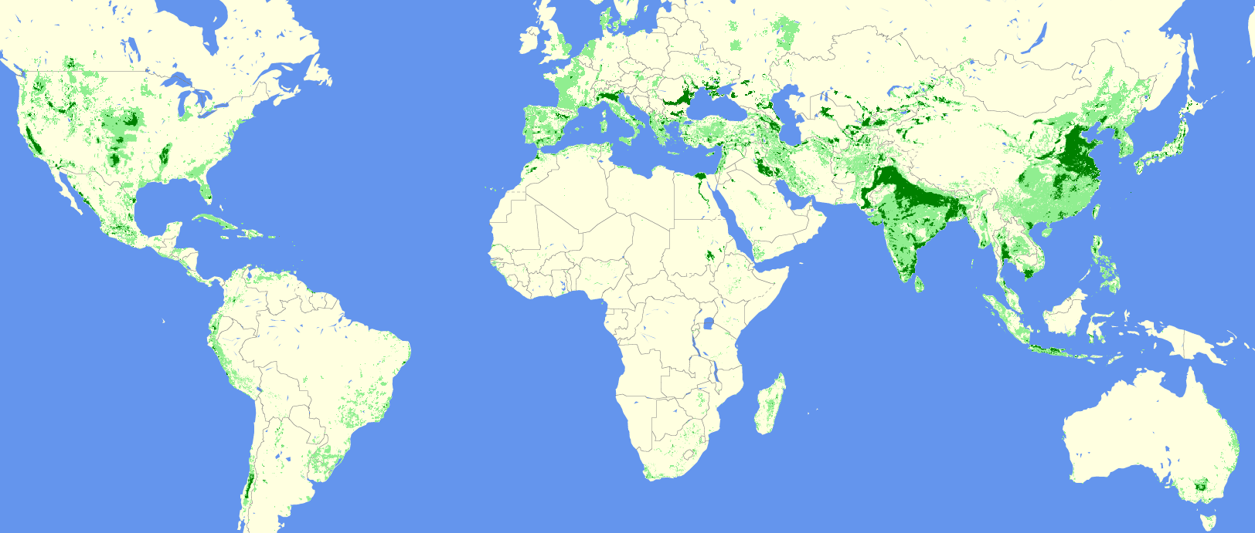
Global Irrigated Agriculture
630 M Acres
18% of Total Agricultural Land
35 to 40% of Total Crop Production
70% of Total Water Withdrawals
Source:
UC Berkley
Dept. Environ. Studies

Slide 7
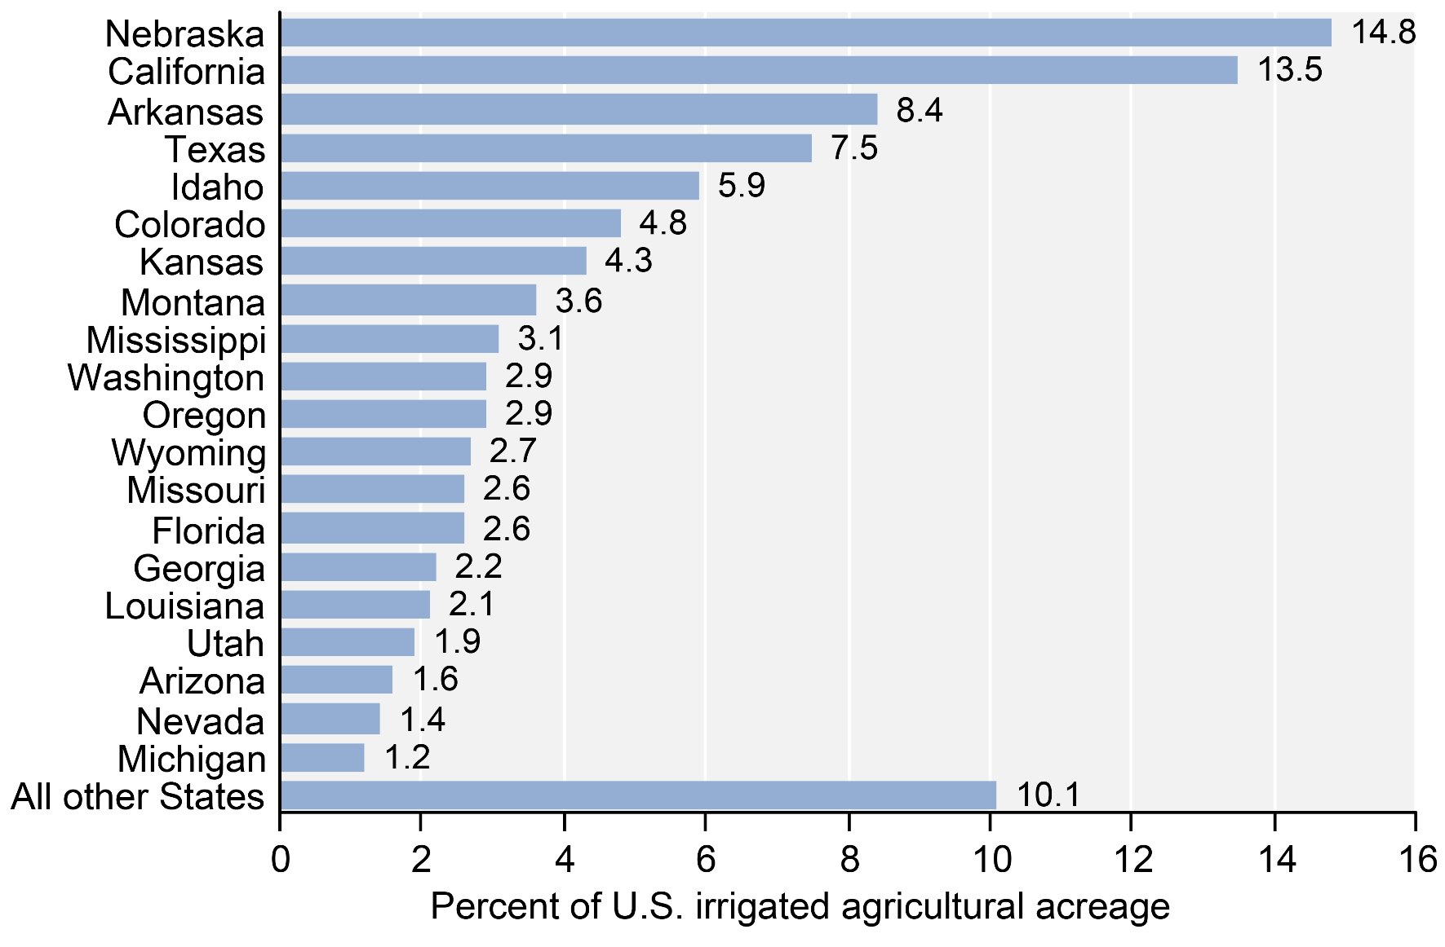
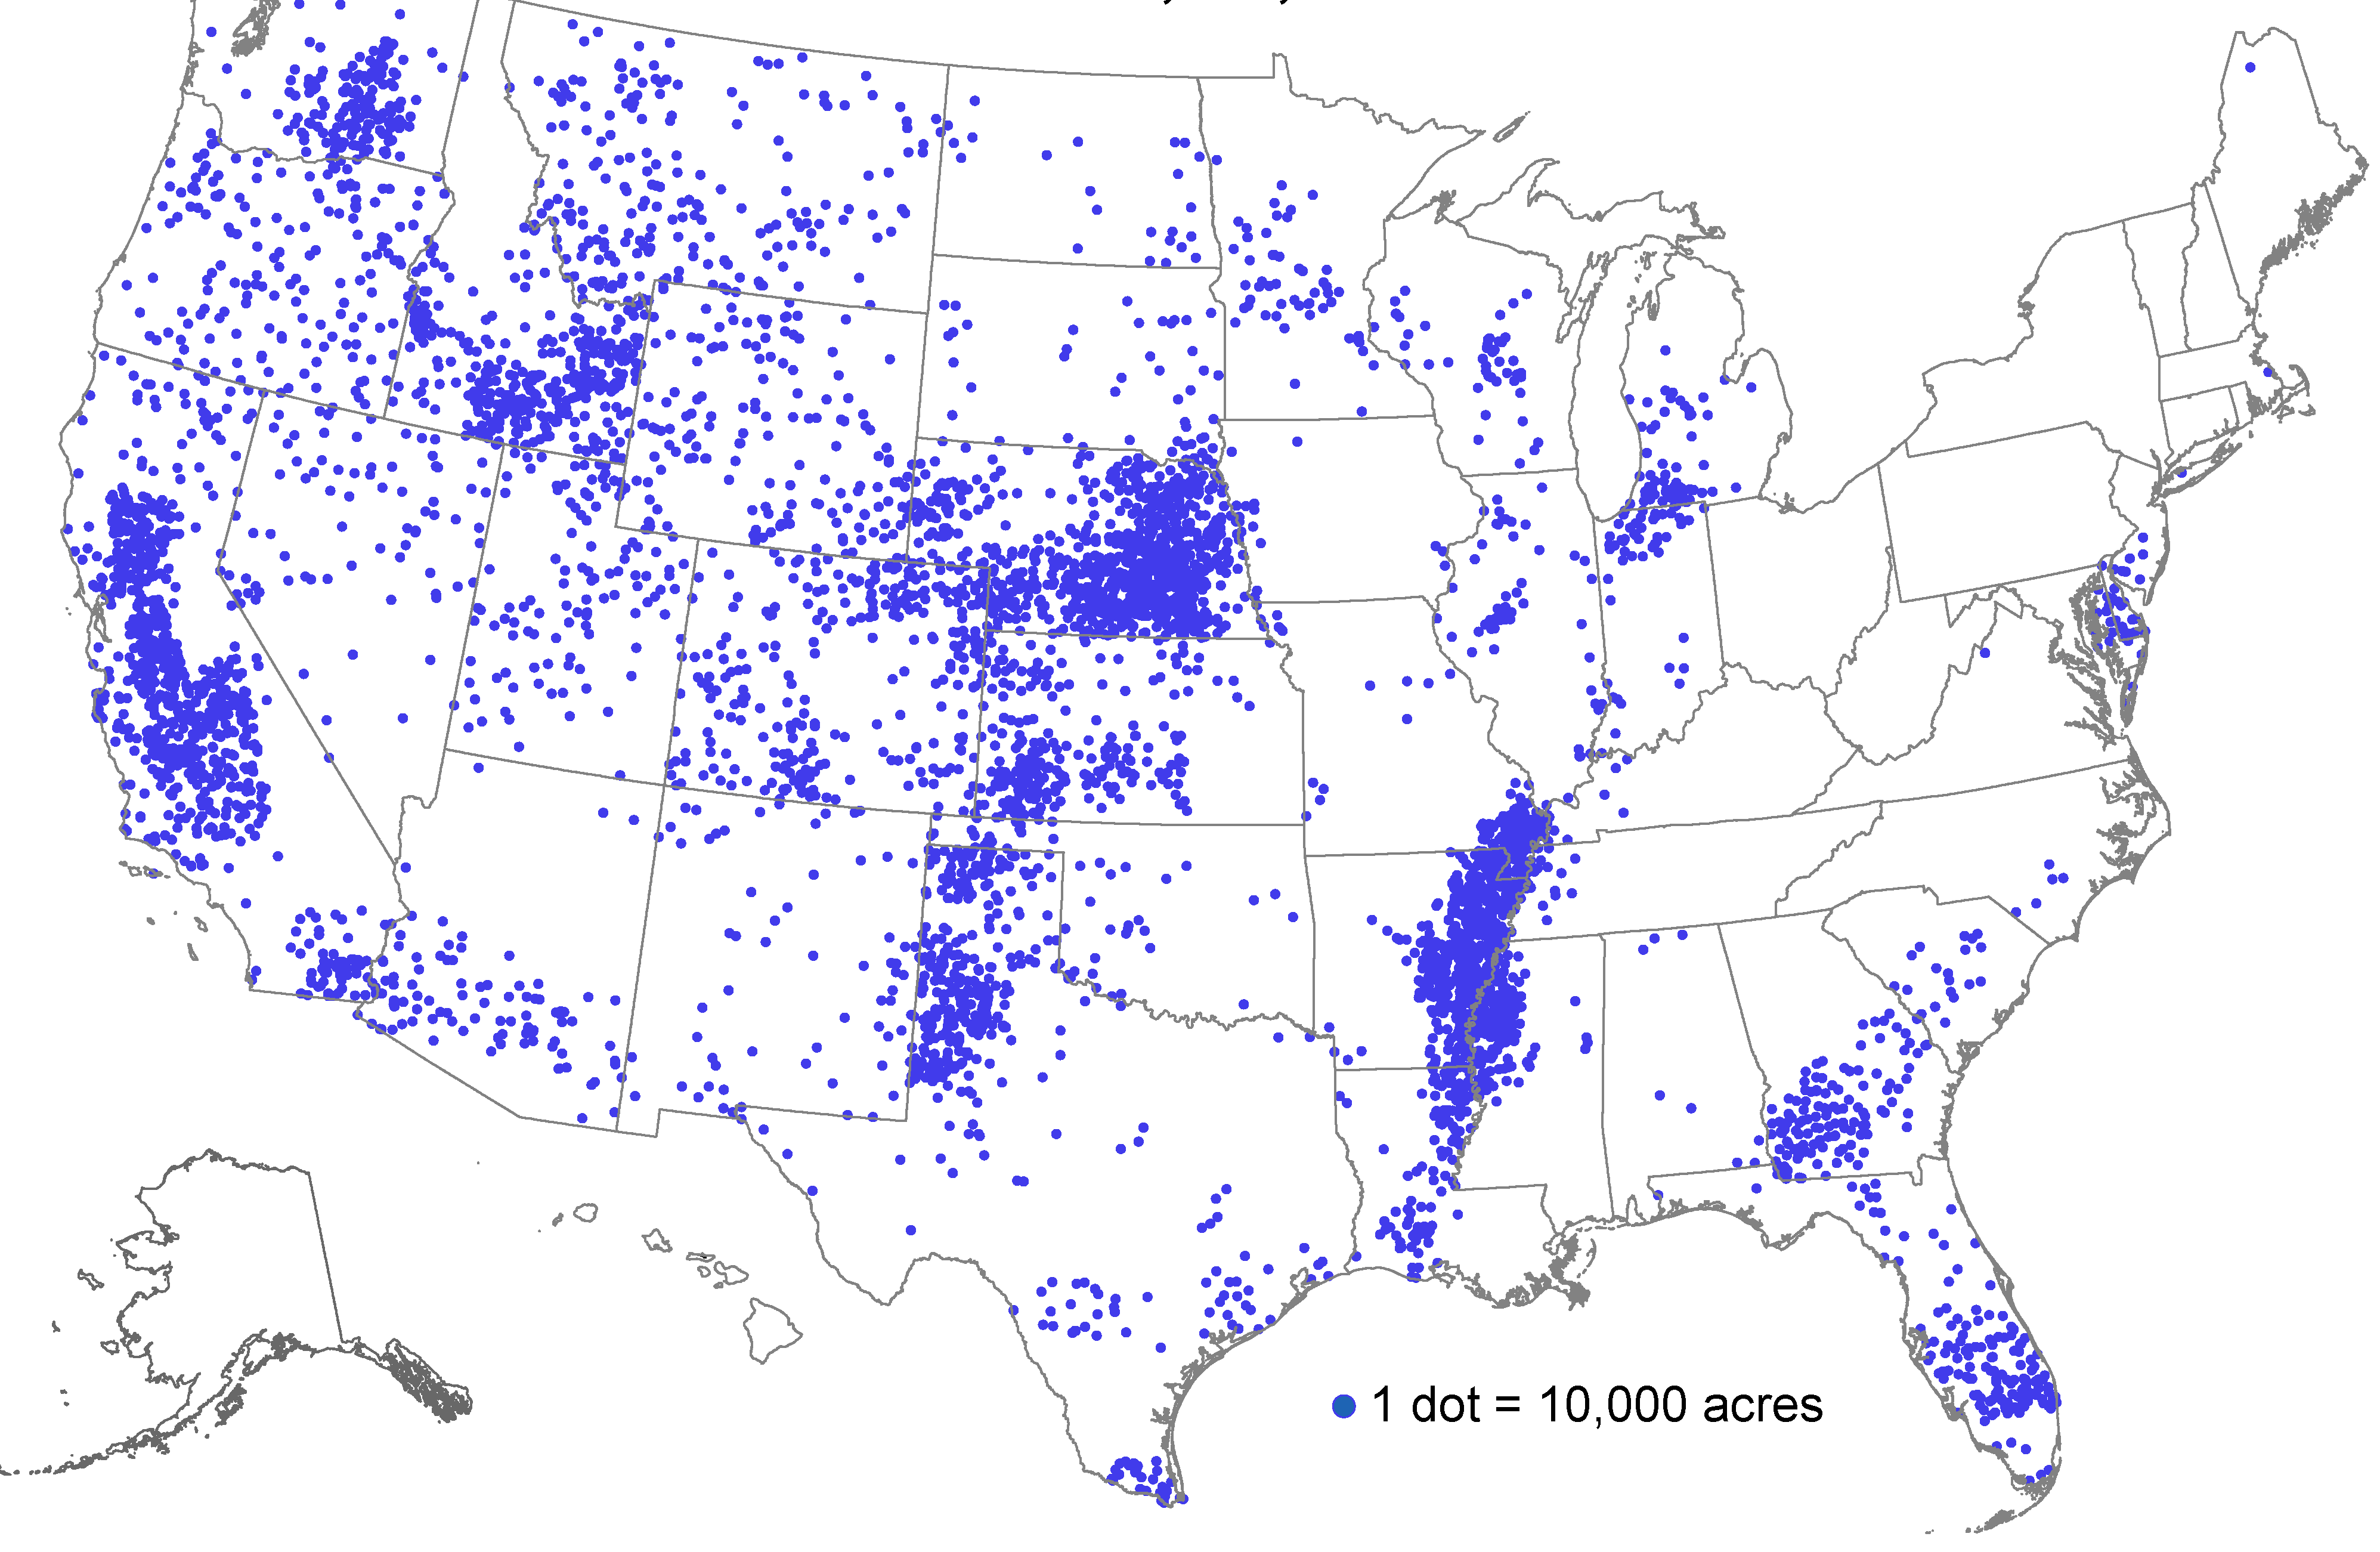
US Irrigated Agriculture
58 M Acres 2017

Slide 8
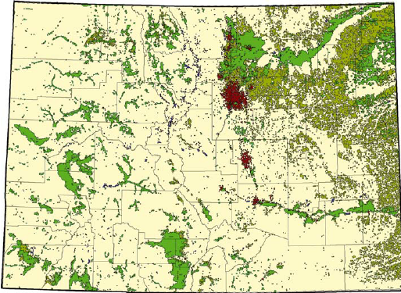
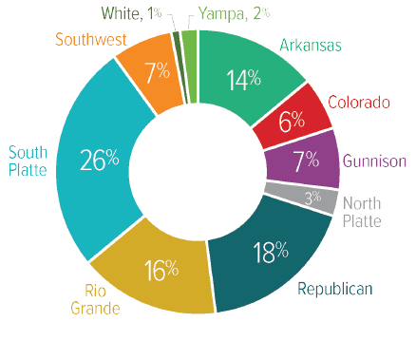
Colorado Irrigated Agriculture
3.3 M Acres
by Basin
Source:
Colorado Water Plan 2023

Slide 9
Colorado
Annual Water
91%
80% Streams
20% Groundwater
Source:
Colorado Water Plan 2023

Slide 10
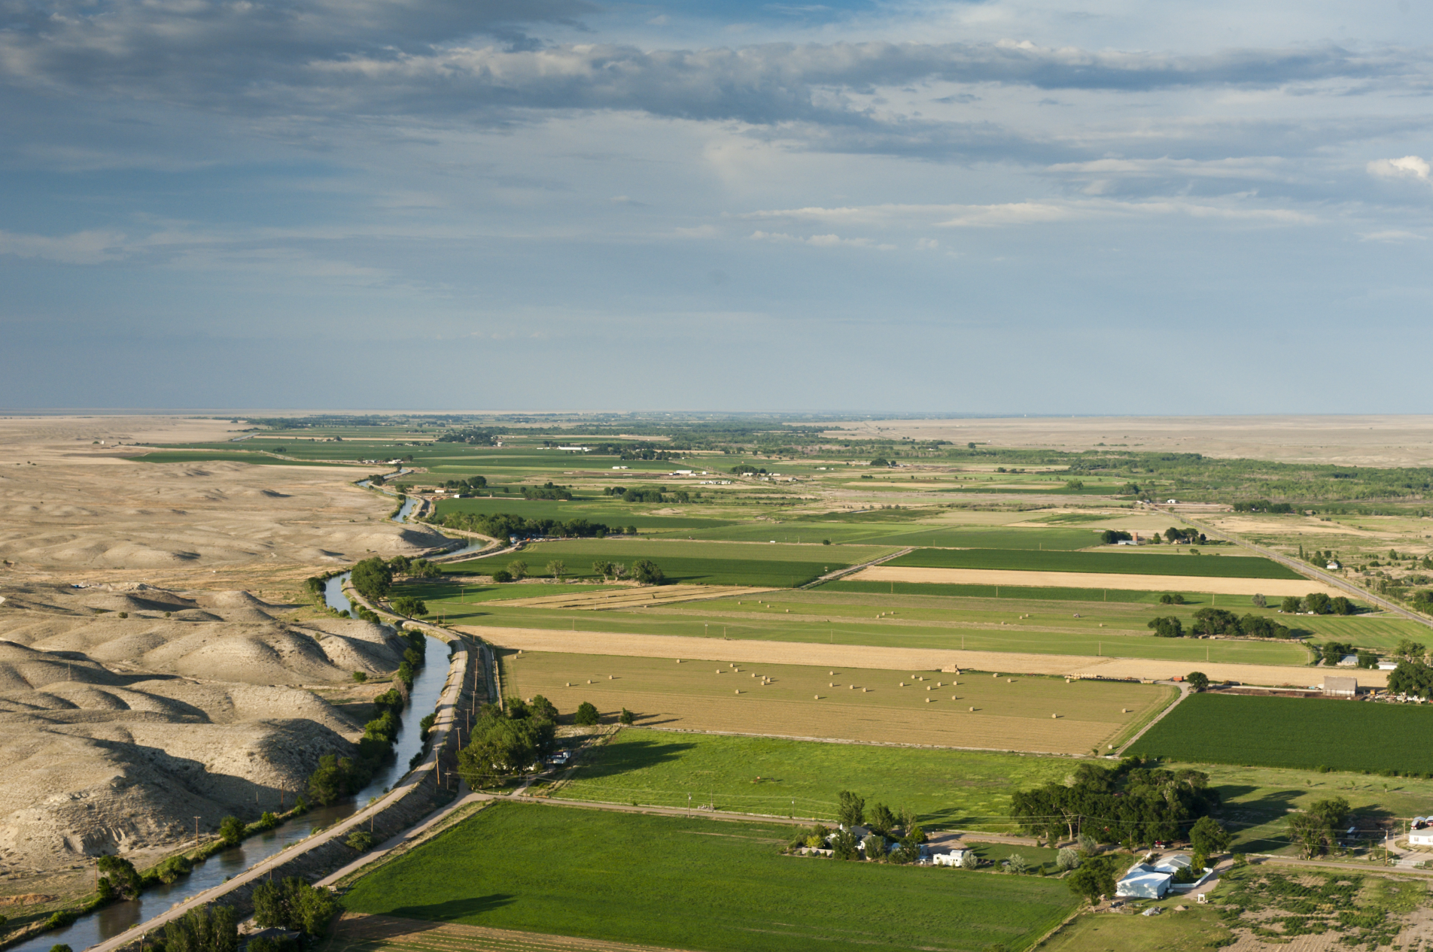

Notes:
Irrigation brings benefits of expanded and sustained crop productivity, expansive green vistas, enhanced rural economies and lifestyles.
Also, can markedly alter the landscape and the hydrologic environment – through withdrawals from streams and aquifers, and through irrigation return flow.

Slide 11
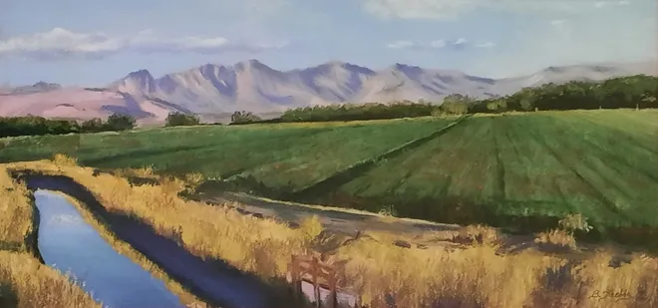
Painting: Betty Krebbs
Provide water to crops
with the right amount, quality, and timing
in a profitable way
that protects the environment.

Slide 12
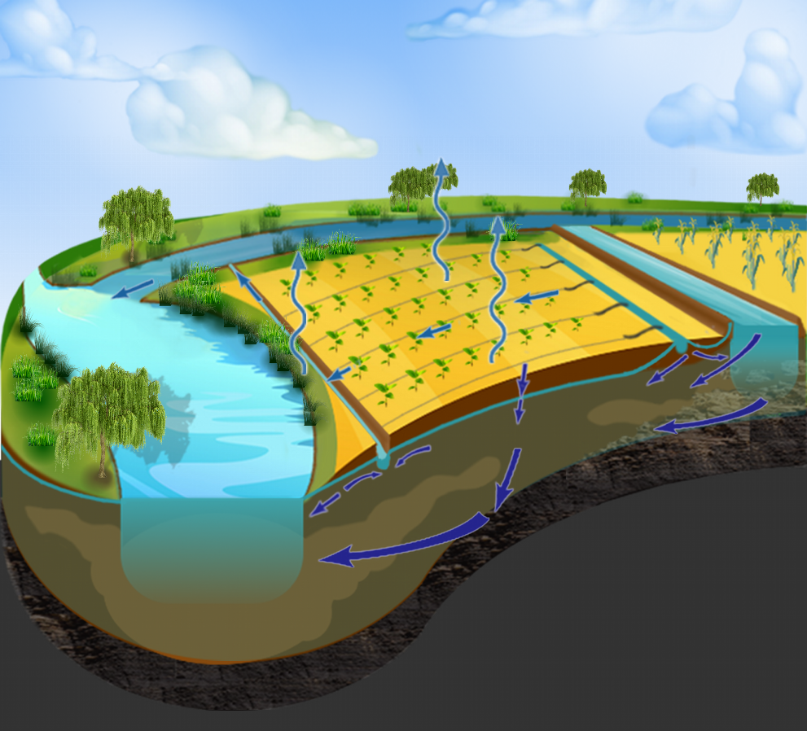
Where Does the Water Go?

Slide 13
Surface
Irrigation
Colorado
43%
Average of about 20 to 30% of water diverted from the streams into canals seeps into groundwater
Of the water applied to fields from canals, about 10 to 20% runs off the surface, 20 - 30% percolates below the root zone, and 50 - 70% is consumed by crops (evapotranspiration and tissues)
About 5 - 15% of the surface runoff, seepage, and deep percolation is consumed by weeds, phreatophytes, and evaporation
About 40 to 50% of water diverted from streams returns back, carrying solute mass loads

Slide 14
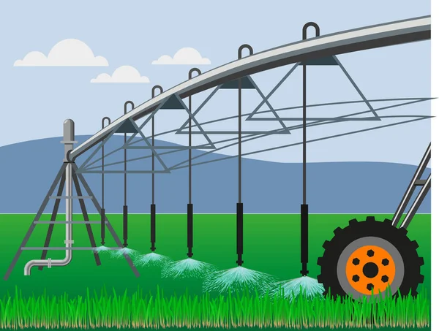
Sprinkler
Irrigation
Colorado
56%
Usually pumped directly from groundwater
Of the water applied to fields, very little runs off the surface, 15 - 20% percolates below the root zone, and 80 - 85% is consumed by crops
About 5 - 10% of the surface runoff and deep percolation is consumed by weeds, phreatophytes, and evaporation
About 15 to 20% of water pumped returns back, carrying solute mass loads

Slide 15
Water Quality Concerns
Total dissolved solids (salts)
Specific ions
Microbes
Total dissolved solids (salts)
Specific ions
Trace elements (Se, U, As)
Nutrients
Pesticides
Microbes
Notes:
A

Slide 16
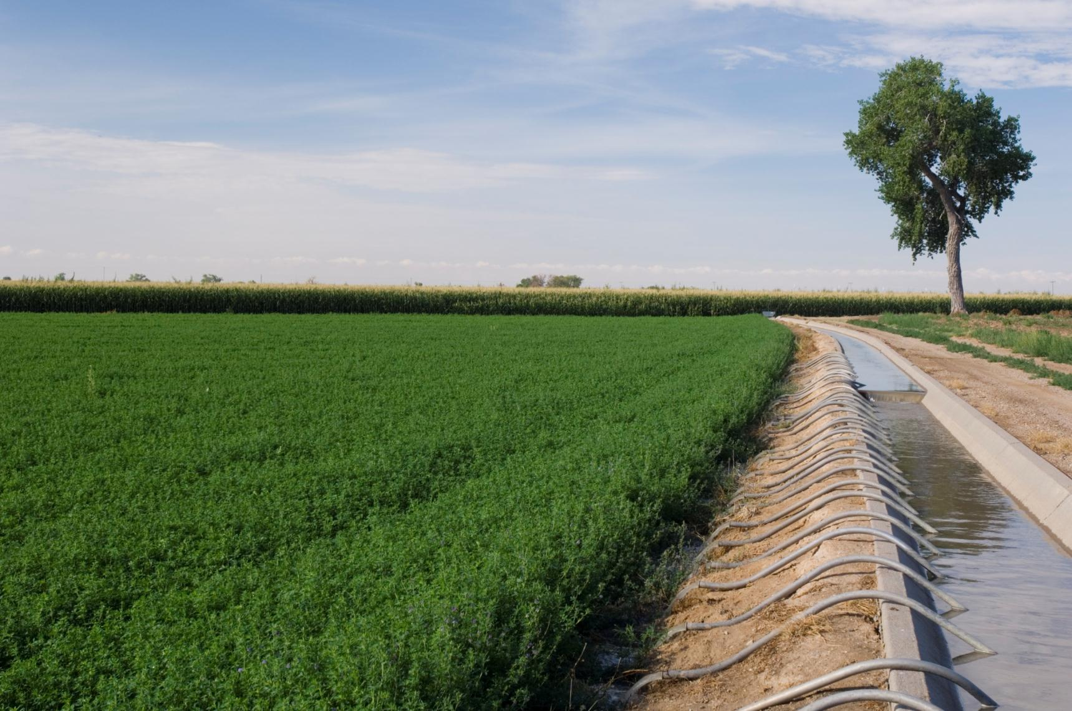
Major Issues for
Colorado Agricultural Water
Competing demands for water
Alternative transfer methods
Improved infrastructure and management
Nonbeneficial consumptive use
Salinity
Nonpoint source pollution
Return flows and water rights

Slide 17
2

Slide 18
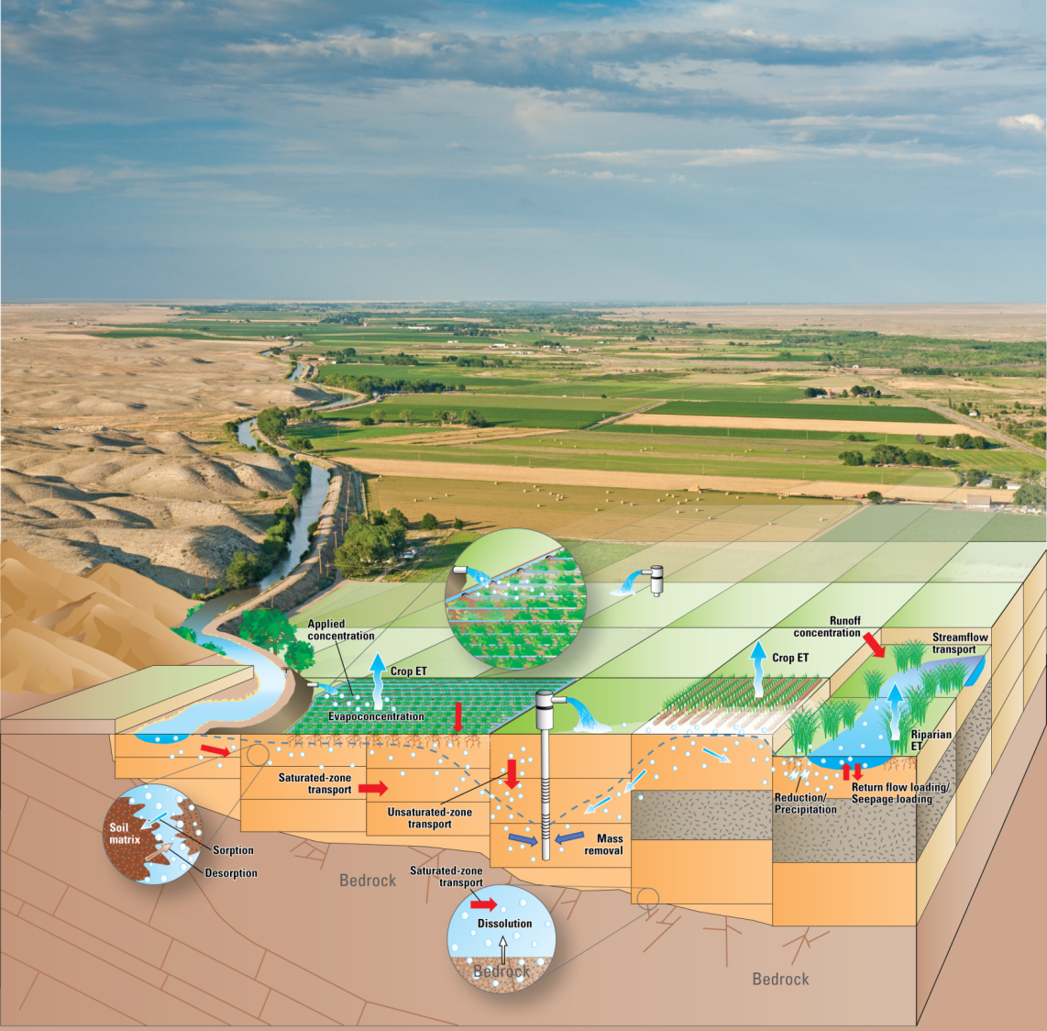
Irrigation
Return Flow and
Solute
Transport Processes in a
Stream-Aquifer System
Application and surface runoff
Seepage and deep percolation
Hydraulic gradients and advection
Diffusion and dispersion
Evaporative concentration
Oxidation-reduction (riparian & non-riparian)
Dissolution-precipitation
Sorption
Volatilization

Slide 19
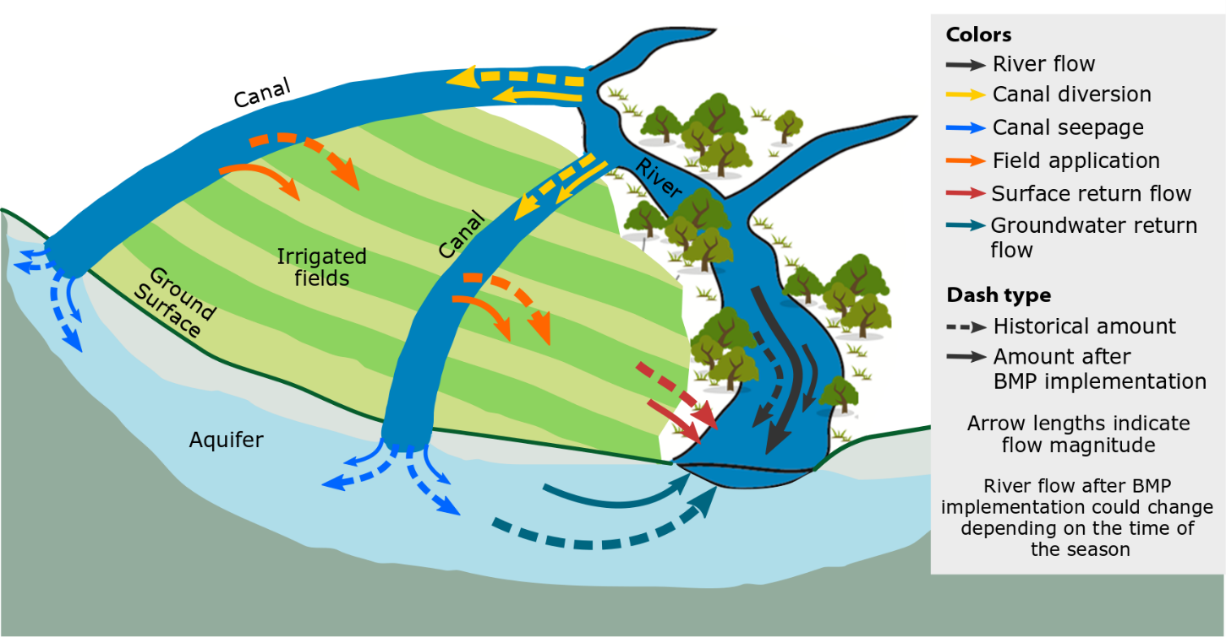
Side Effect of BMP Implementation: Altered Rates and Patterns of
Return Flows and River Flows

Slide 20
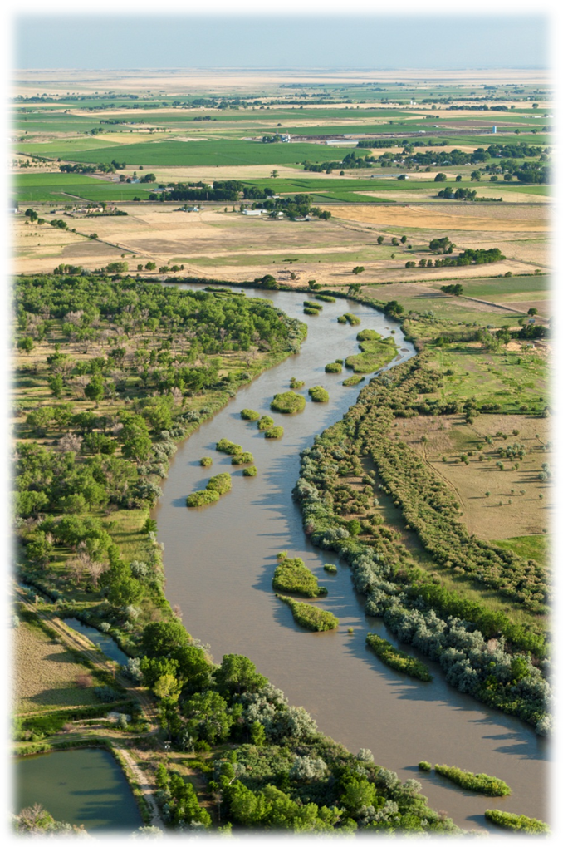

Questions &
Discussion

Slide 21
