Slide 1
City of Thornton’s Northern Properties Stewardship Plan
Emily Hunt, Deputy Infrastructure Director – City of Thornton
Water Literate Leaders
January 18, 2023

Slide 2
Thornton Northern Project
History
1956 - Thornton incorporated 1963 - Acquired Northwest Utilities Clear Creek and South Platte Well Field well supplies 1970s - 1980s - Thornton develops additional Clear Creek & South Platte Supplies 1982 - Thornton invests in the Two Forks Reservoir Project; 13,000 acre-feet of supply for Thornton

Slide 3
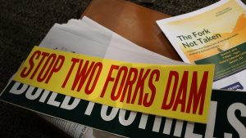
Thornton Northern Project
History
Mid1980s - Two Forks begins to falter Ongoing water quality challenges with South Platte supply 1985 - Thornton divests its interest in Two Forks & looks for alternative higher quality supply 1986-1987 - Water Supply and Storage Company System acquisition

Slide 4
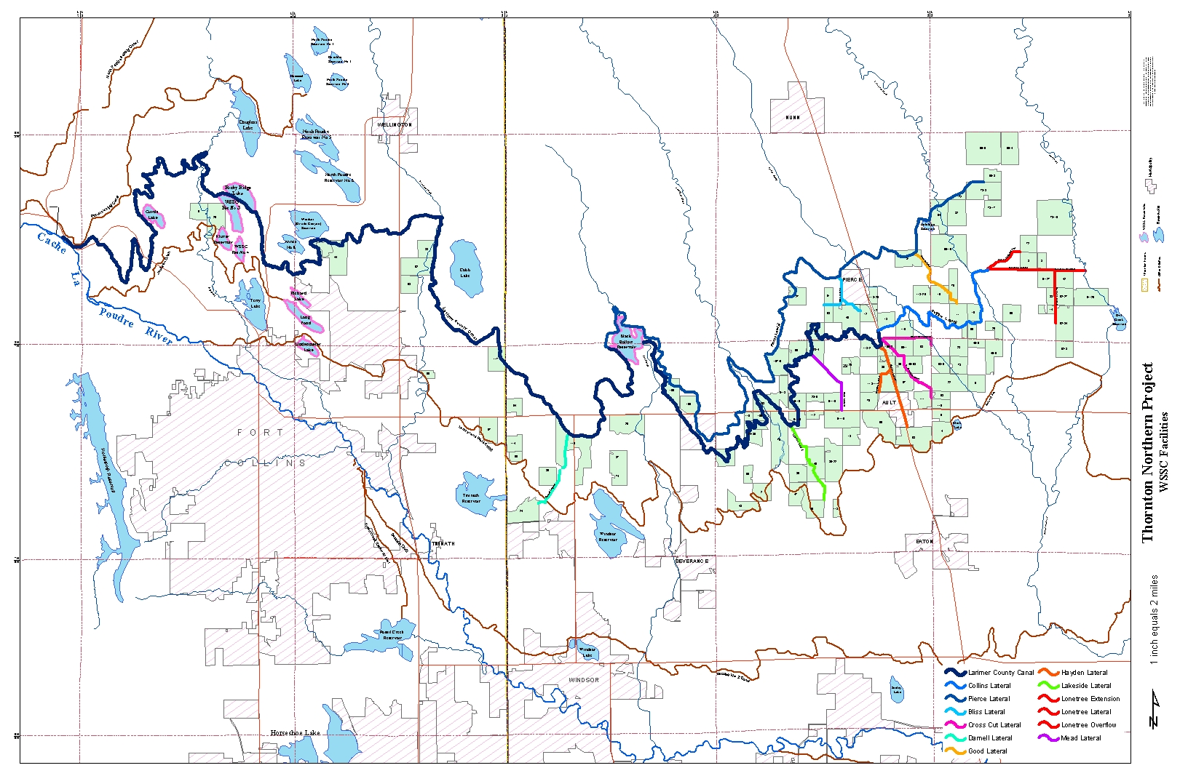
Thornton Northern Project

Slide 5
Thornton Northern Project
1985 to 1987
Acquisition
1986 to 1998
Water Court
Change WSSC shares from agricultural to municipal use
1985 to present
Property Stewardship
Continued irrigated agriculture
Acquired 110 farms, ~21,000 acres
284 shares of Water Supply and Storage Company (WSSC)
Farmhouses, wells, and other assets
Junior direct and exchange water rights
2014 to present
Thornton Water Project
74 mile pipeline and conveyance infrastructure
2018 to present
Northern Properties Stewardship Plan
Data-driven and community-informed property management and long-term land use planning
Phased water delivery beginning in 2027
Gradual conversion to self-sustaining and native grasses began in 2000s

Slide 6
Thornton Northern Project - Components
TNP
Water Court Decree
Thornton Water
Project
Regulatory – pipeline routing and construction
Northern Properties Stewardship Plan
Voluntary – community informed property management and divestiture
Legally binding – water rights injury, revegetation

Slide 7
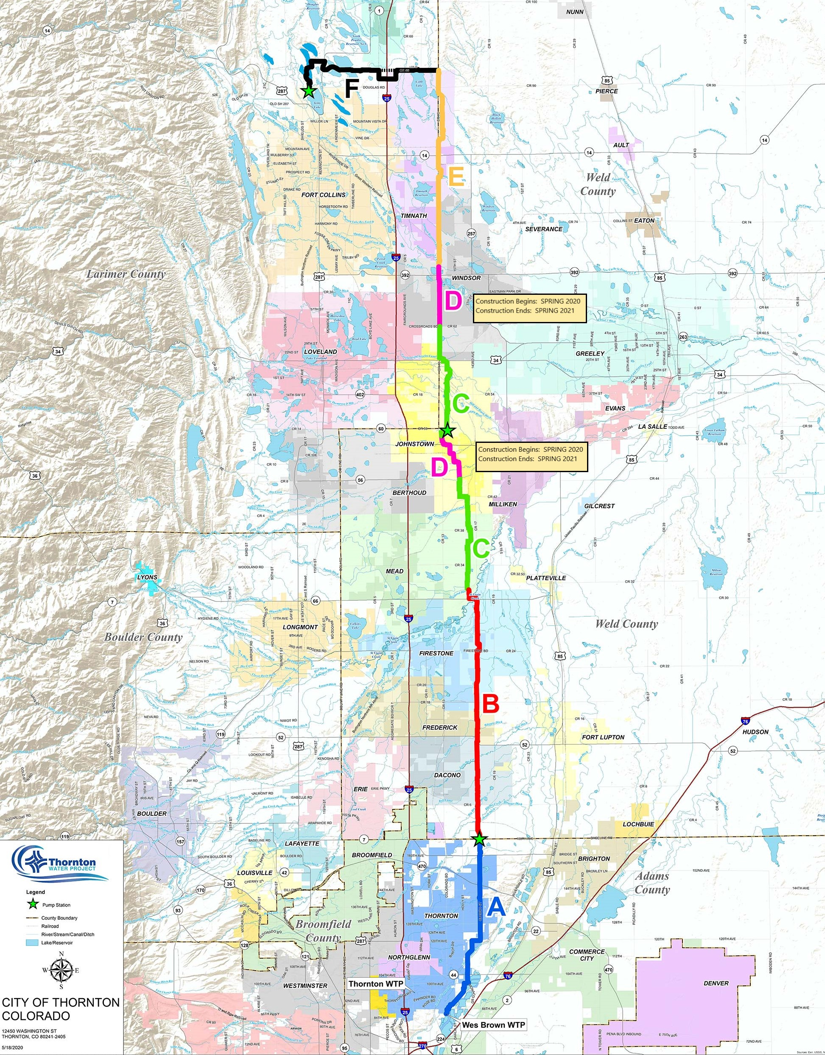
Thornton Water Project

Slide 8
Northern Properties Stewardship Plan
Objective:
The Northern Properties Stewardship Plan is a complementary process to Thornton’s agriculture-to-municipal water transfer. While Thornton’s water will be used in accordance with Thornton’s water rights decree, the Stewardship Plan is a vision for the management and future land use of Thornton’s 18,000 acres.

Slide 9
Northern Properties Stewardship Plan
Calls to Action
Maintain key components of the region’s agricultural heritage. Support transitioning agricultural economies. Promote economic diversification. Address a future with 1 million residents in 2040. Advance regional approaches to land and water planning and management.

Slide 10
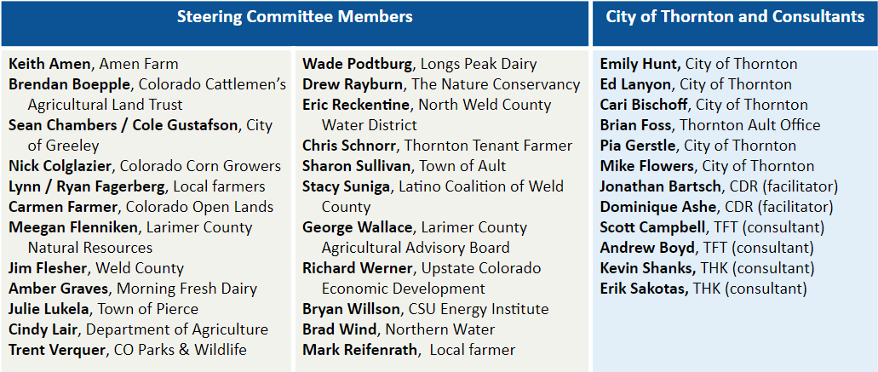
Northern Properties Stewardship Plan

Slide 11
Northern Properties Stewardship Plan
Work Plan

Slide 12
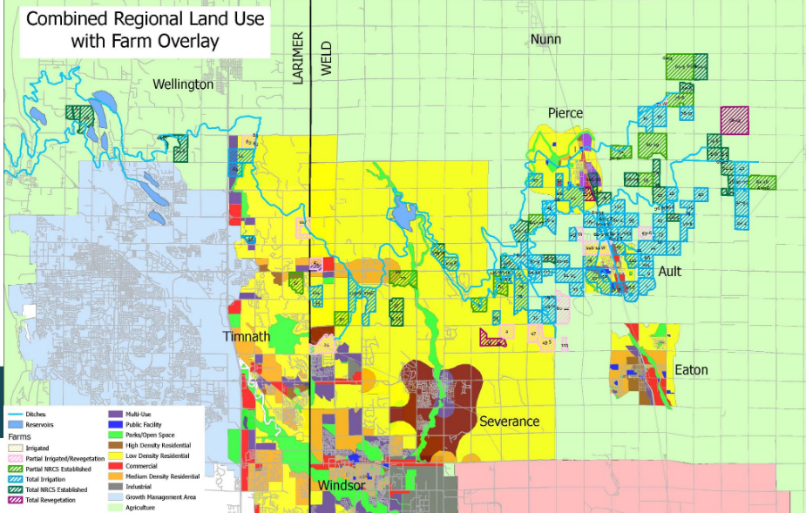

Slide 13
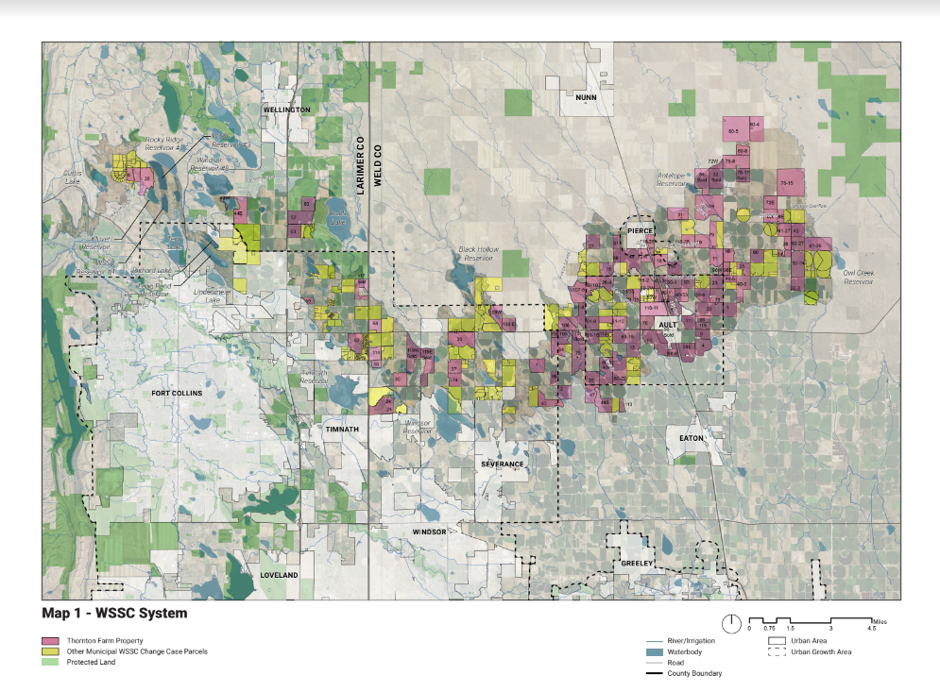
Municipal Acquisitions

Slide 14
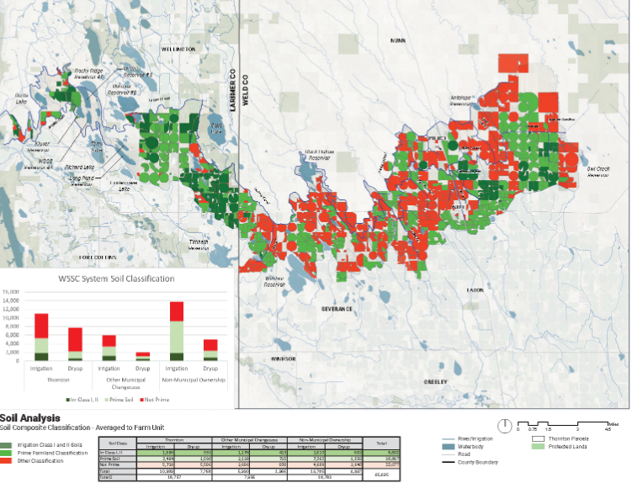
Prime Farmland

Slide 15
Northern Properties Stewardship Plan
Outcomes

Slide 16
Northern Properties Stewardship Plan
Funders
US Bureau of Reclamation WaterSMART Program
Colorado Water Conservation Board
City of Thornton
Colorado Water Plan Grant
Water Supply Reserve Fund Grants
Department of Local Affairs

Slide 17
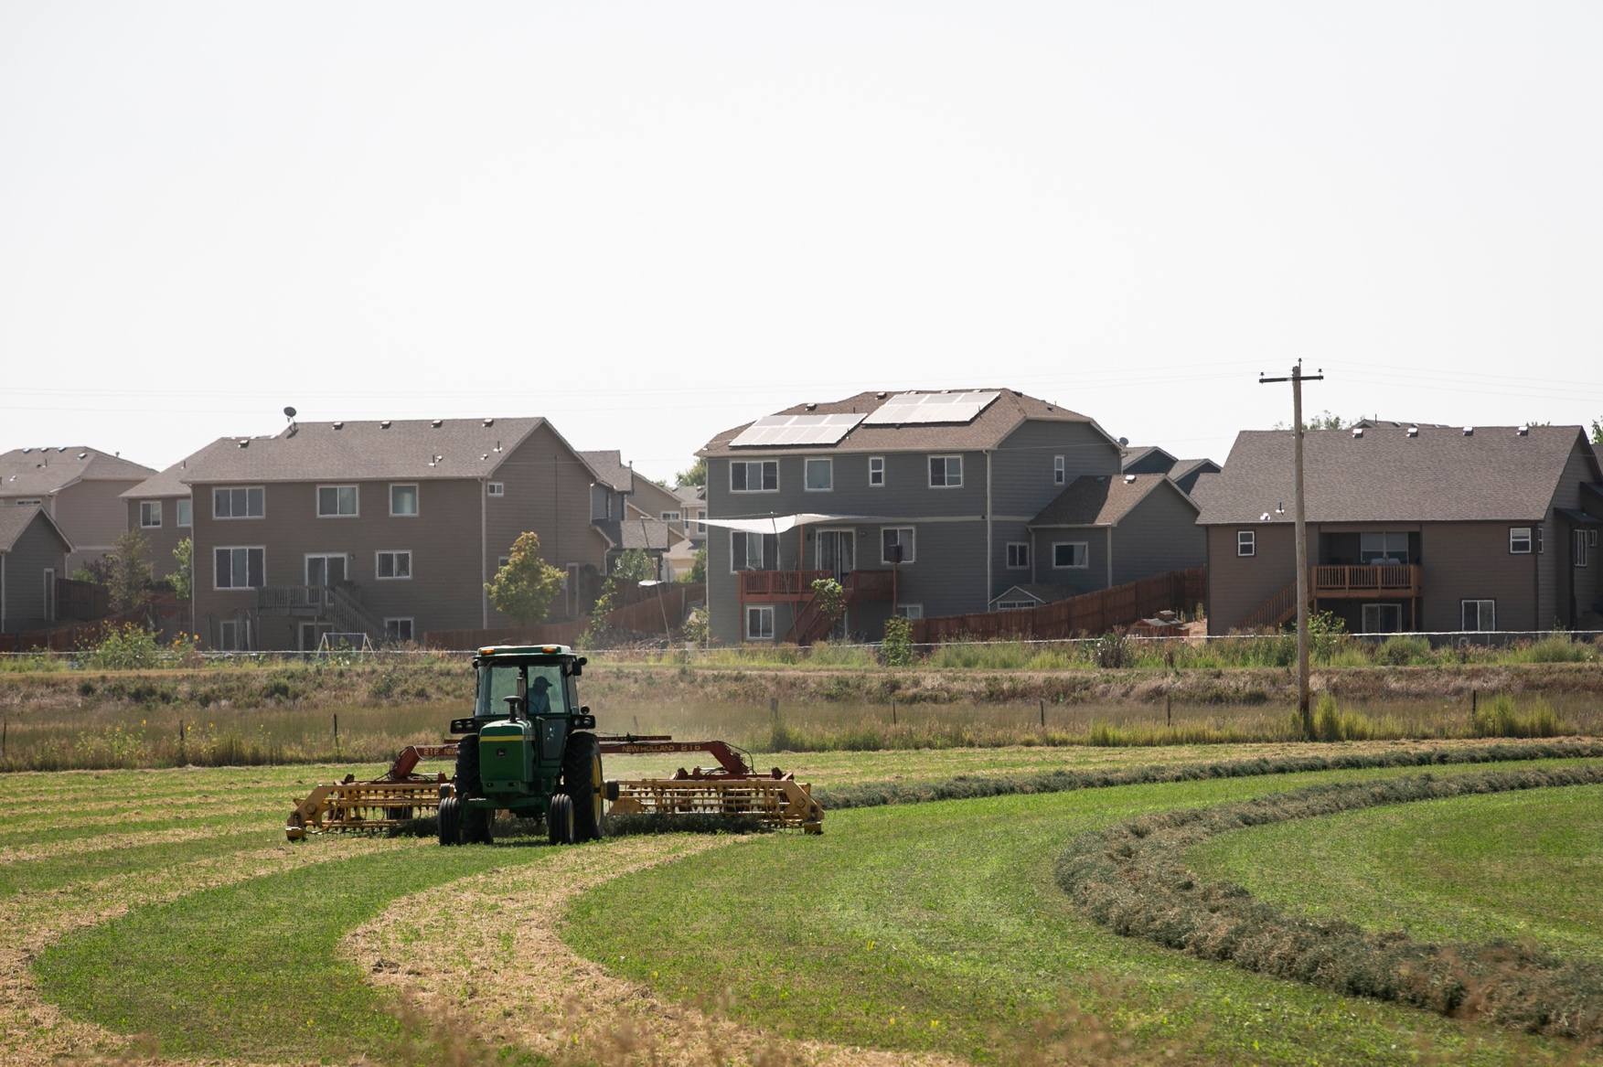
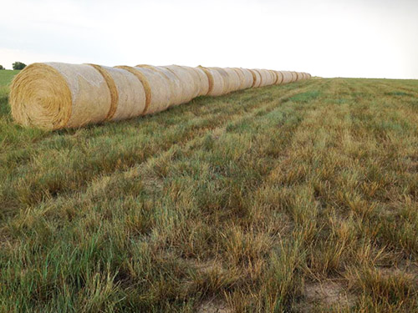
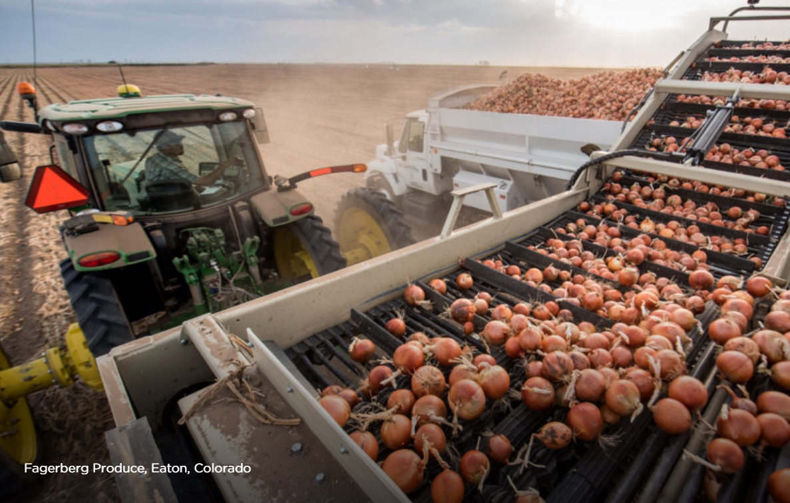
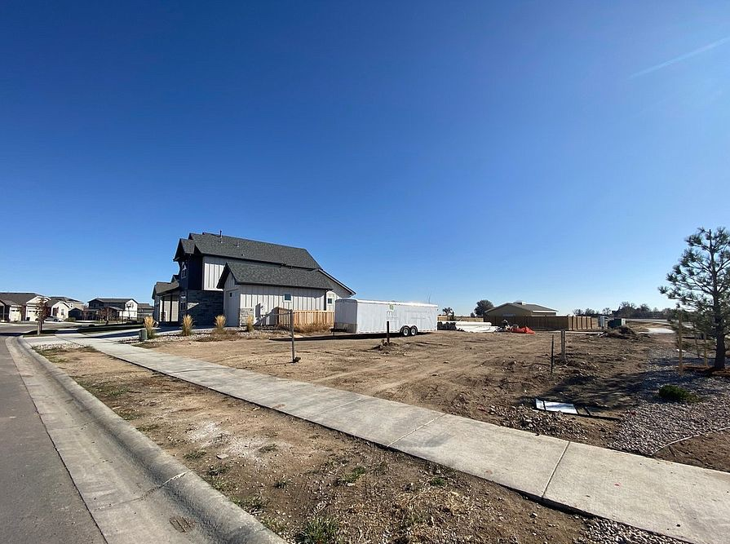
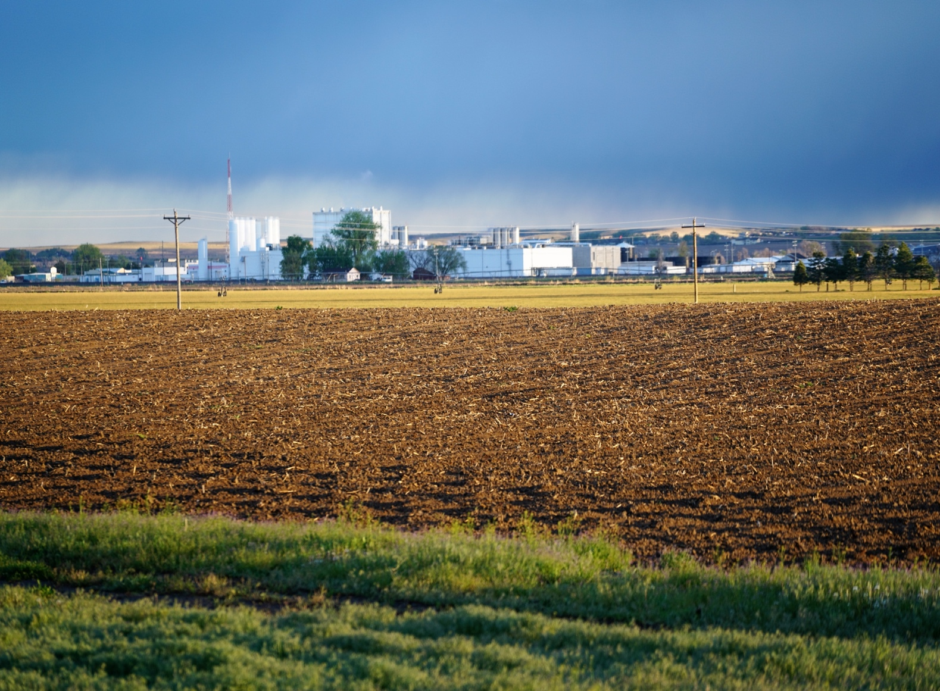
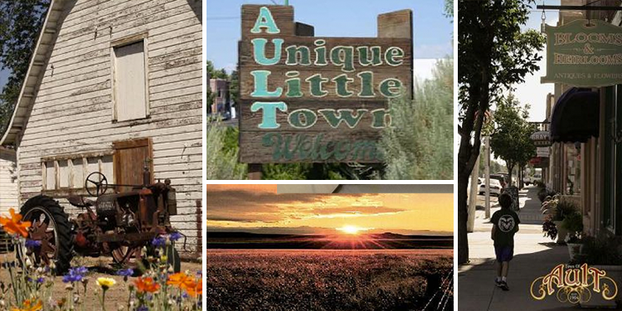
Questions?

