Slide 2
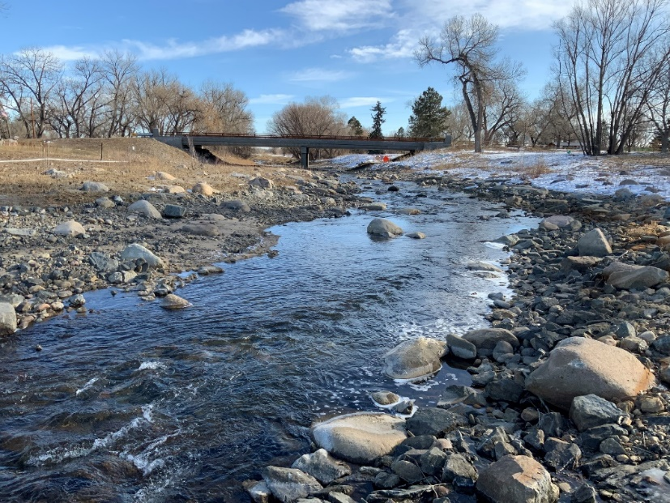
Water & The Environment A Starting Point
A healthy river system:
Resilient – takes care of itself
Supports life, health, & safety
Is diverse & natural
Beautiful & essential
A public amenity
Promotes economic vitality
Saves money

Slide 3
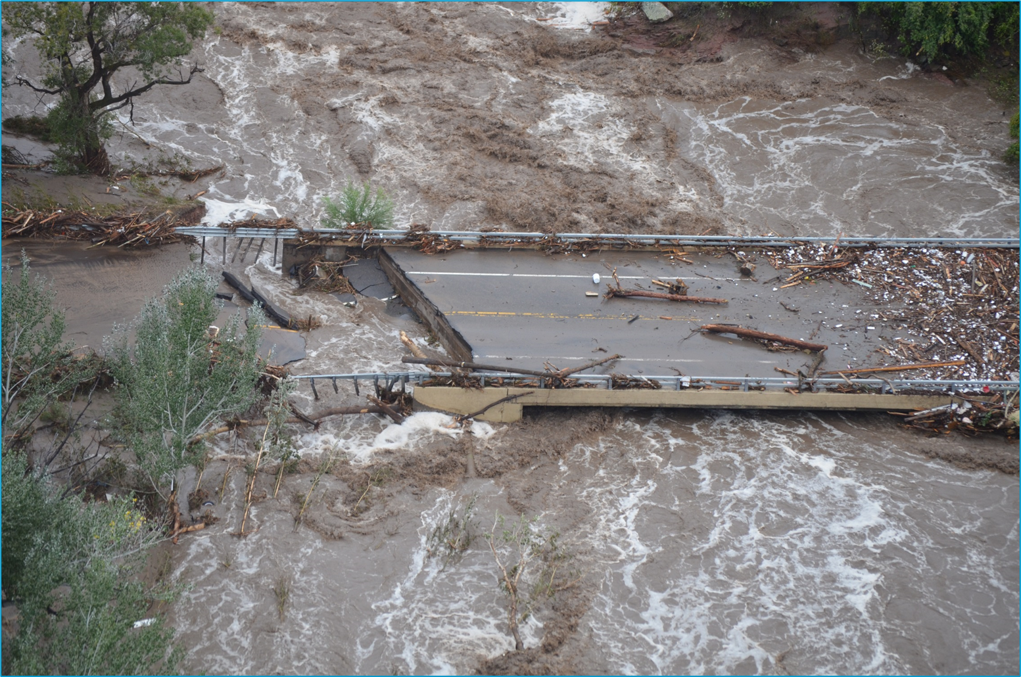
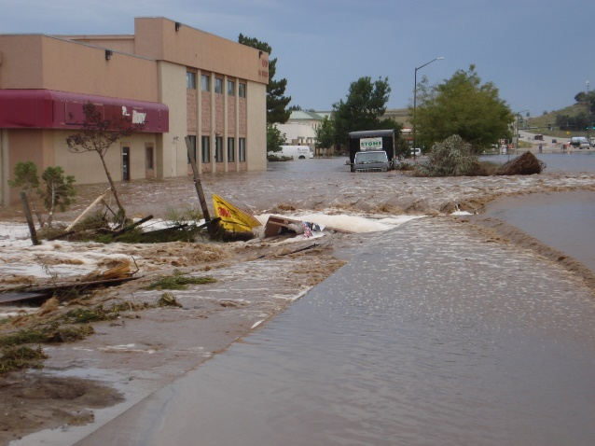
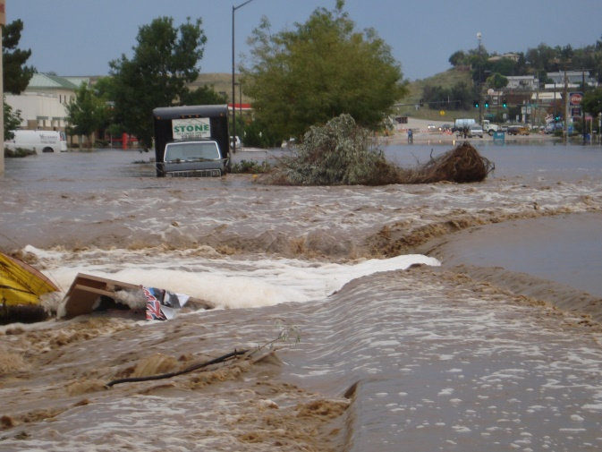
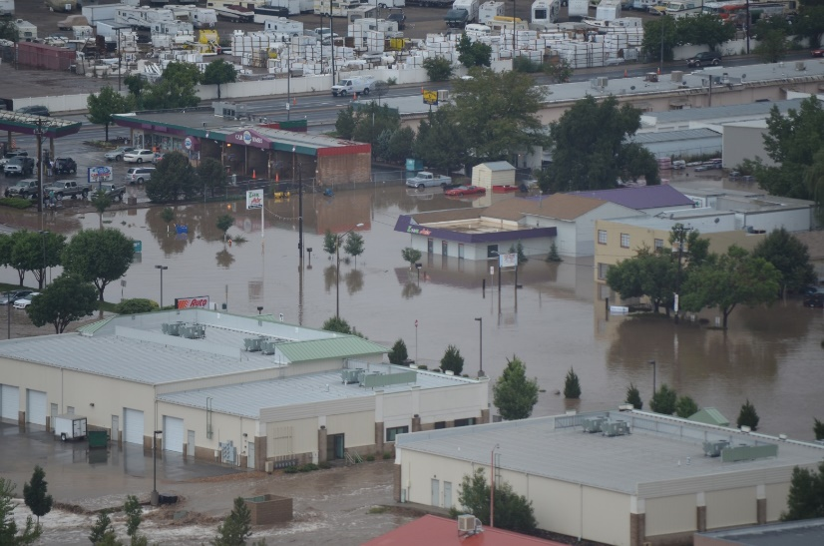
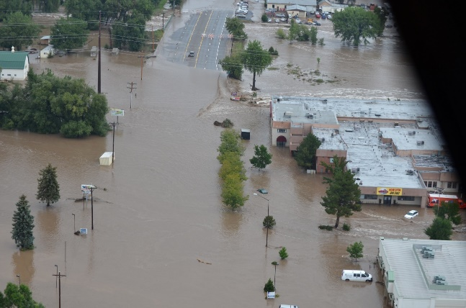
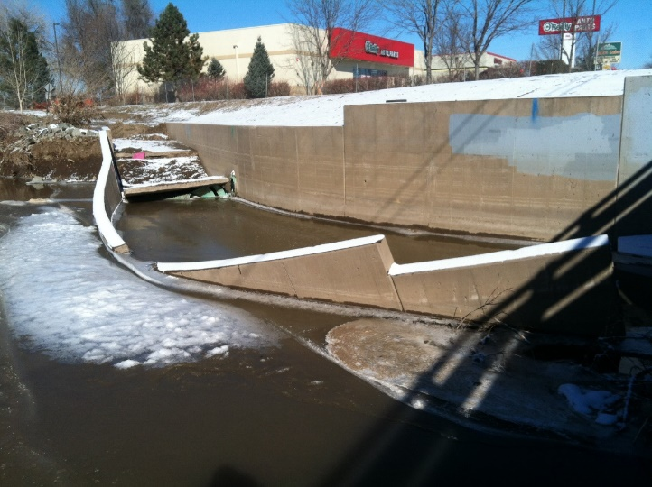
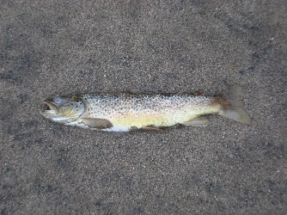
Are we resilient?

Slide 4
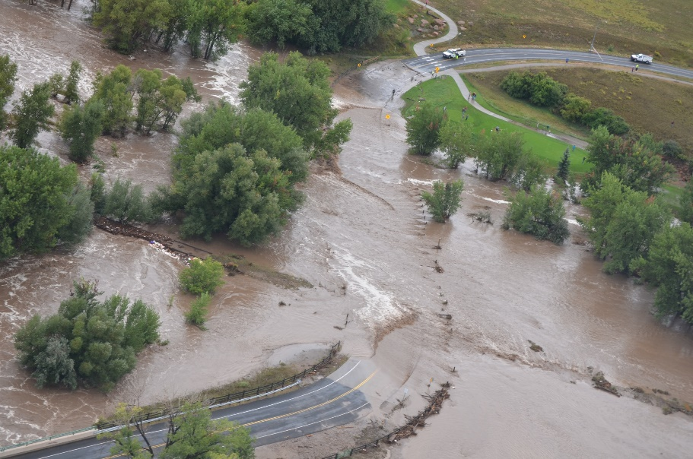
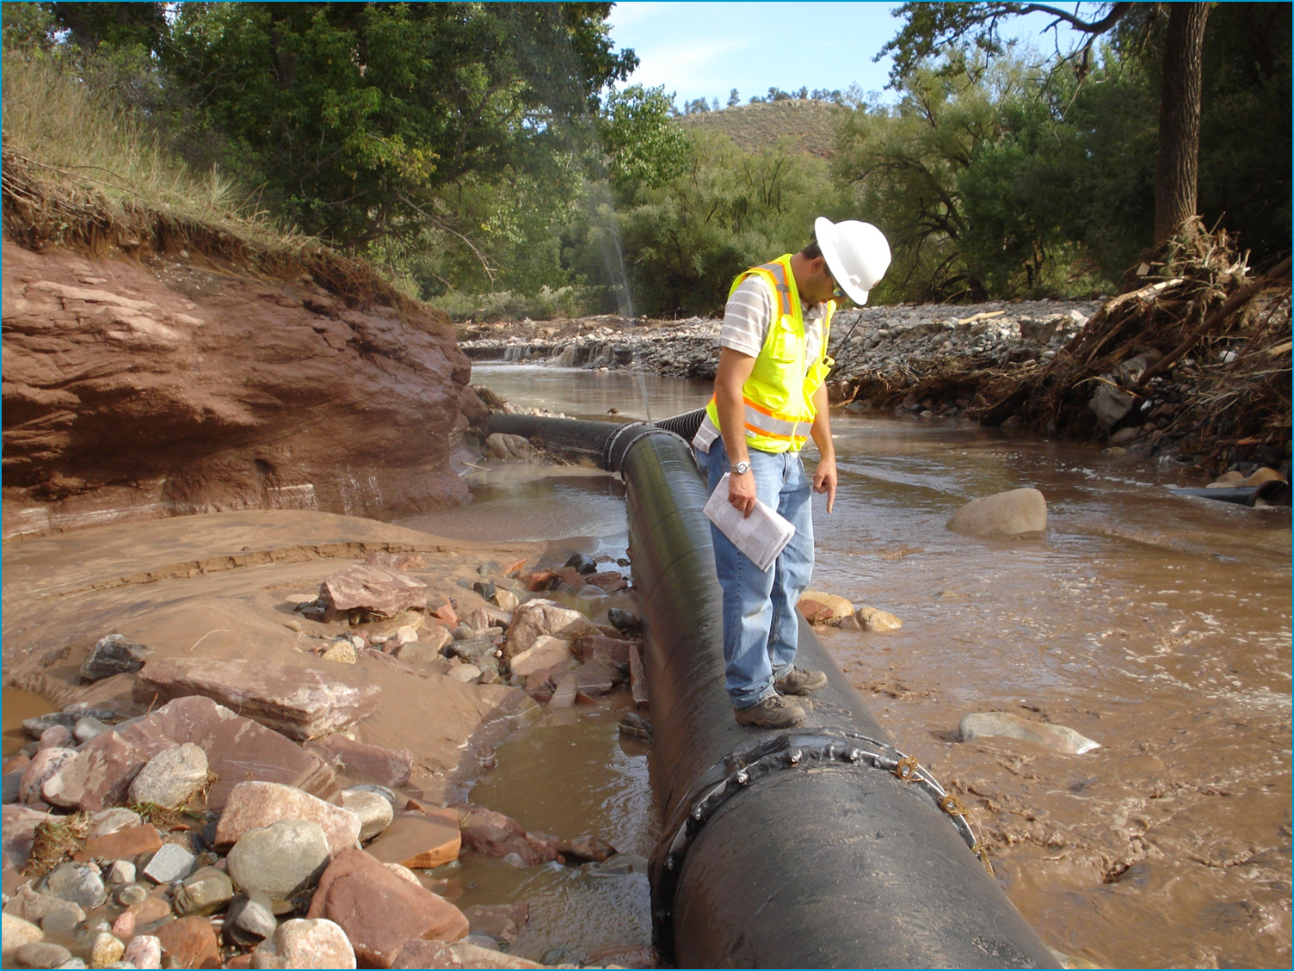
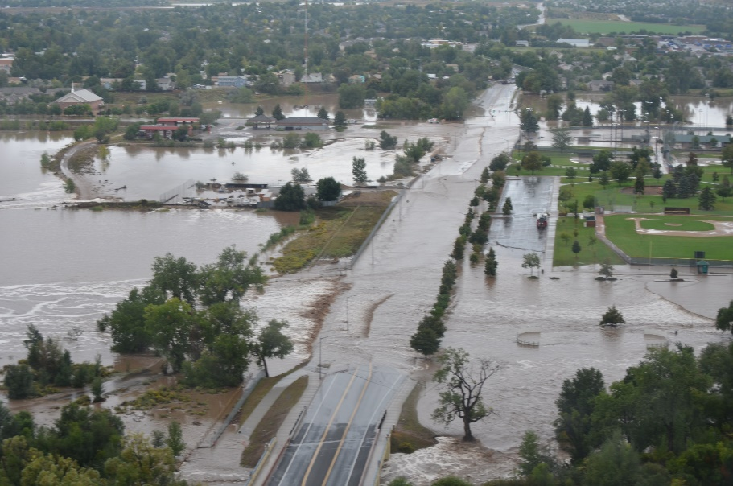
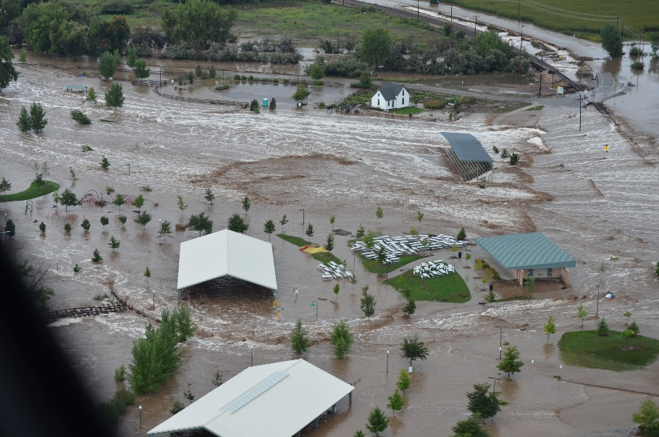
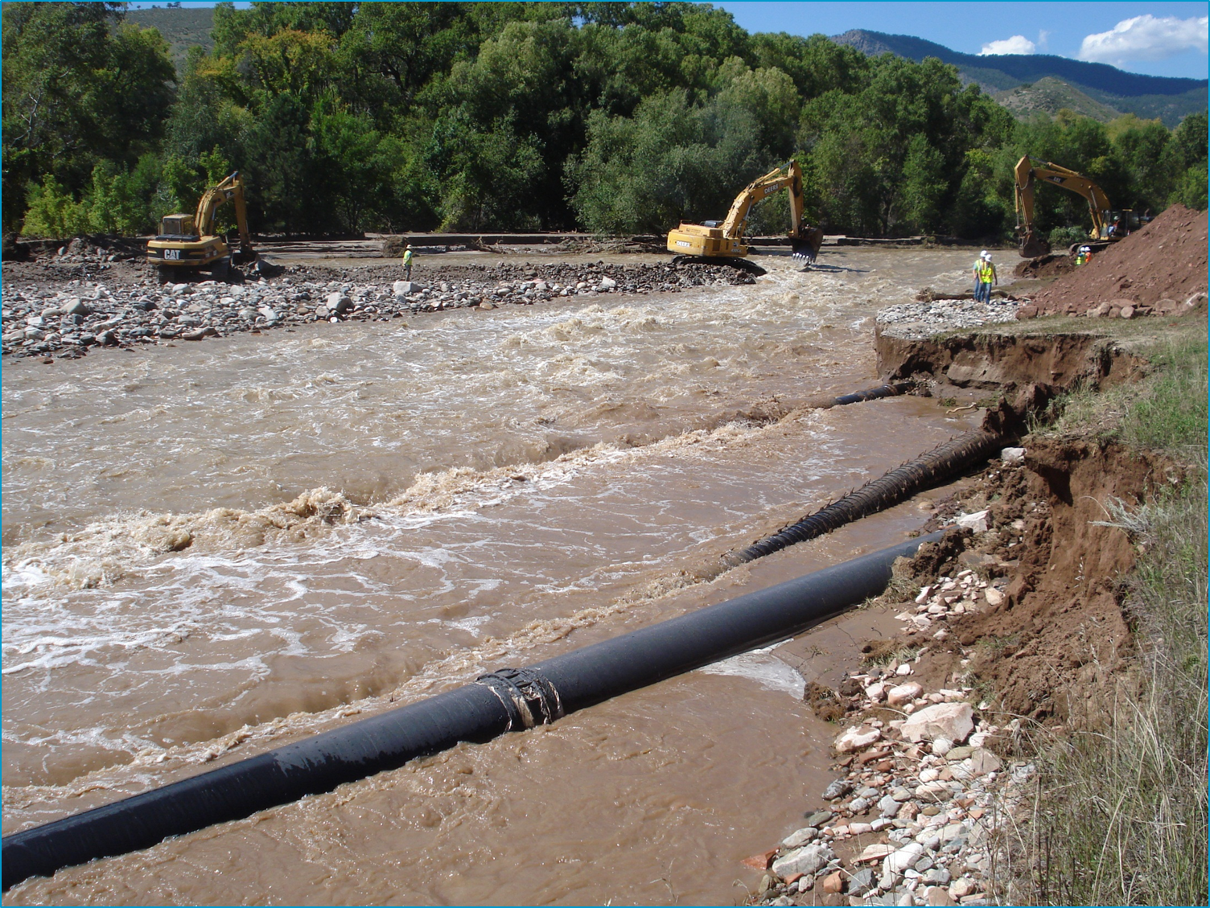
Why a Big Thompson River Master Plan?

Slide 5
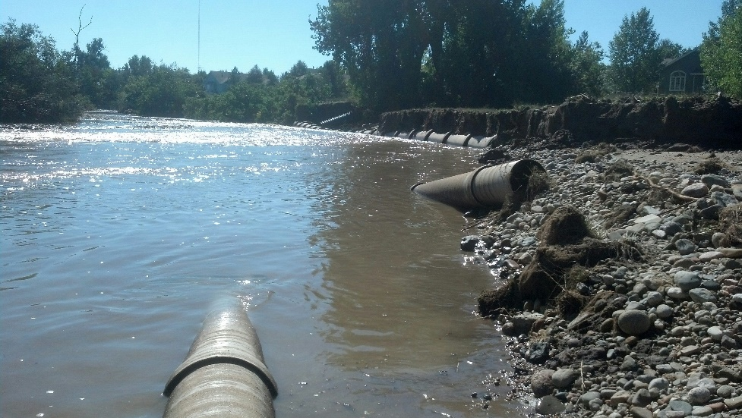
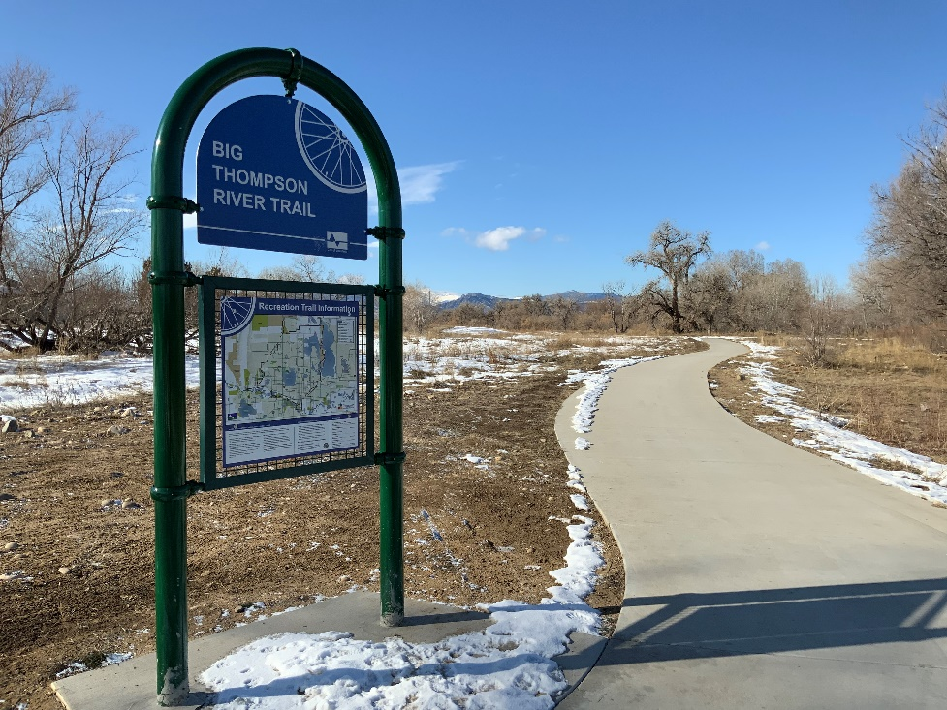
Master Plan’s Purpose:
Notes:
Capture a long term vision for the river corridor
Recommend projects that mitigate flood hazards, restore the river’s ecology, and meet multiple objectives
Improve resiliency of the corridor
Restore natural river and floodplain functions
Recommend how the City can better capitalize on its river – recreation, trails, wildlife viewing, tourism, redevelopment, etc.
Improve opportunities for public-nature interaction : get people out into nature
Recommend how to manage & maintain the river corridor

Slide 6
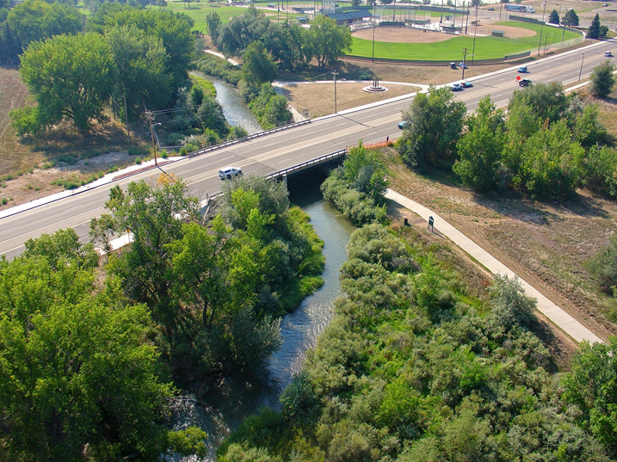
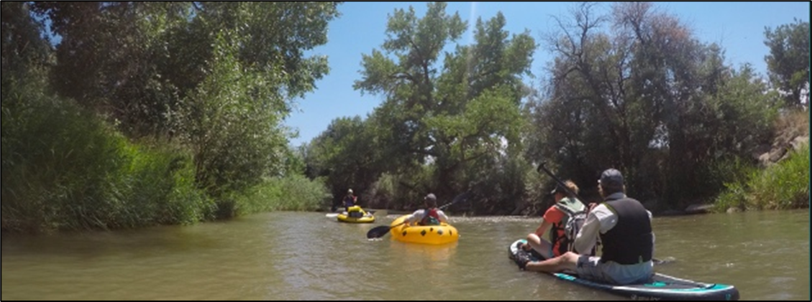
River Master Planning Approach: “Science Based, Community Driven”
Science + Engineering +
Planning + Outreach
=
VISION
Notes:
Reach “Fact Sheets”
Baseline resiliency score cards
Field investigations by experts
Gap analysis
Engineering & Planning:
H&H
Fish
Vegetation
Wildlife
Water quality
Irrigation diversions
Parks & recreation
Trails
Natural areas
Roads & bridges
Utilities
Buildings
Private property infrastructure

Slide 7
River Health Assessment
Average grade through central Loveland = D+
We have work to do!

Slide 9
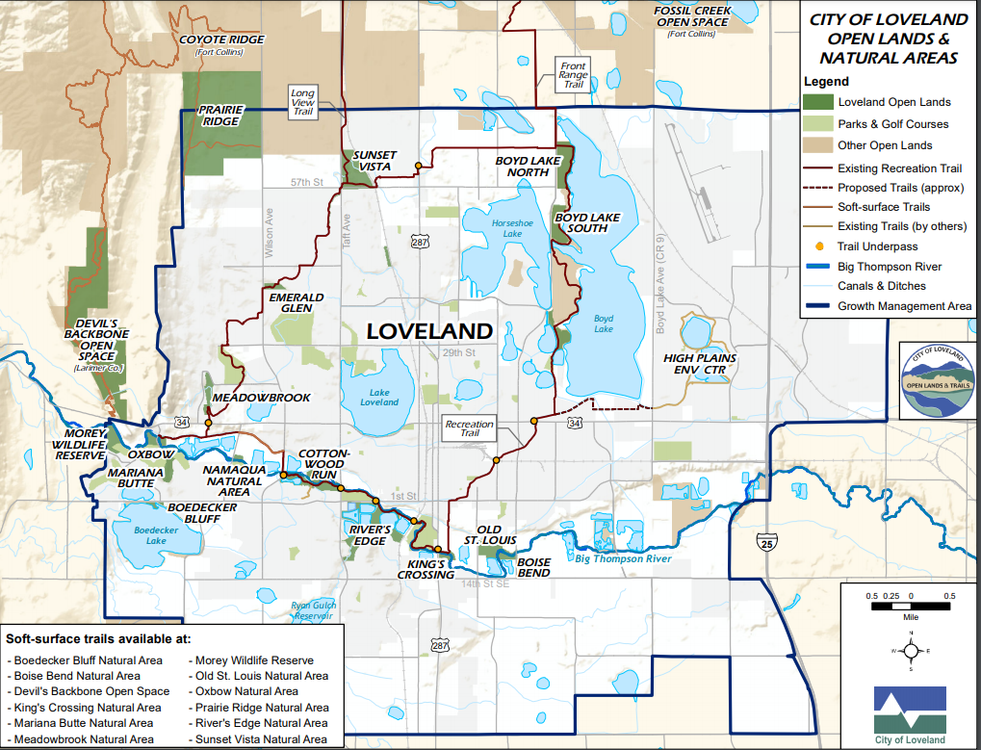
17 Open Lands, Natural Areas, & Parks

Slide 10
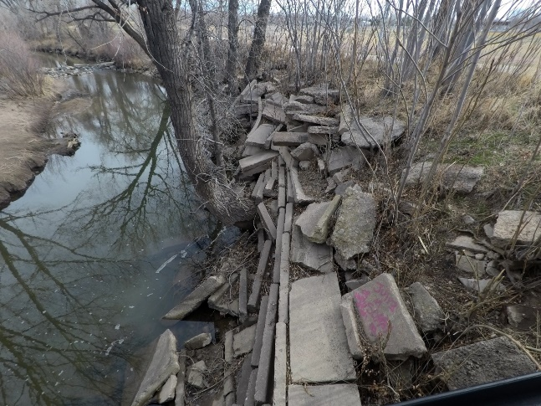
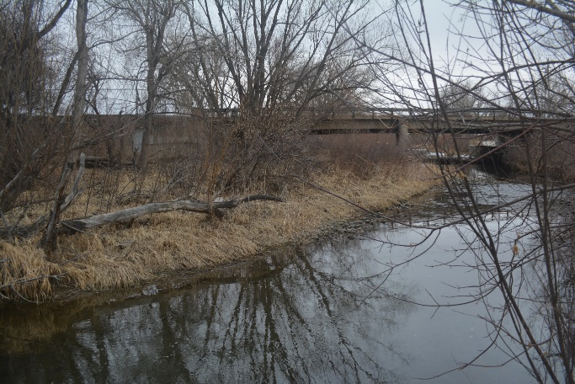
River Maintenance & Safety
Concrete Rubble & Debris Lined Banks
Bank Erosion & Downed Trees
Concrete Rubble & Debris Lined Banks
Trees Blocking Bridge Opening
Bridge Opening Plugged With Sediment & Trees

Slide 11
Hwy. 287 Flood Mitigation Project

Slide 12
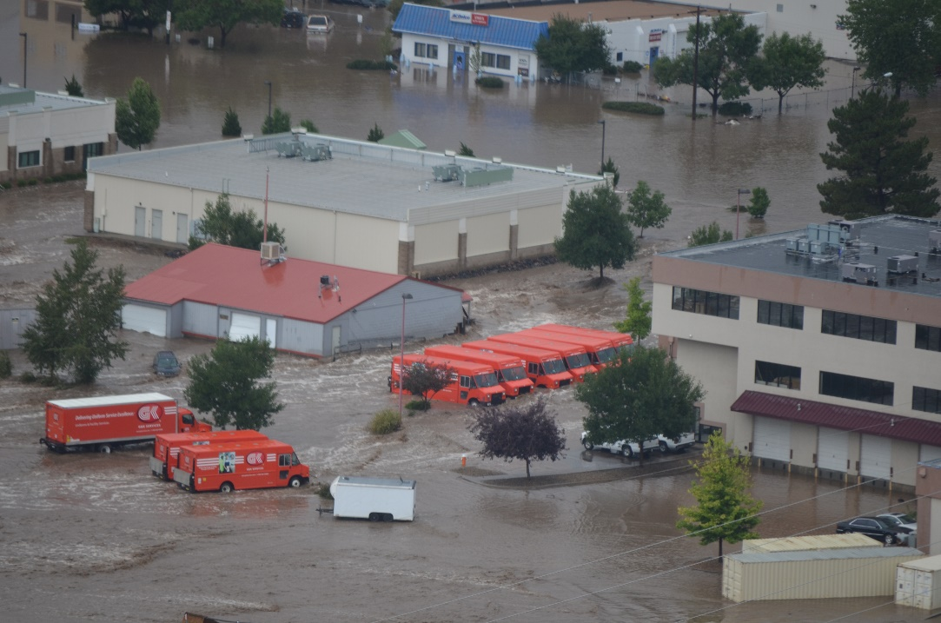
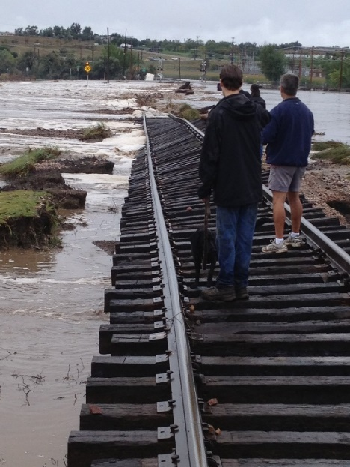
Businesses Flooded on S. Lincoln Avenue
Lincoln Avenue Bridge
Failed BNSF Railroad Embankment

Slide 13
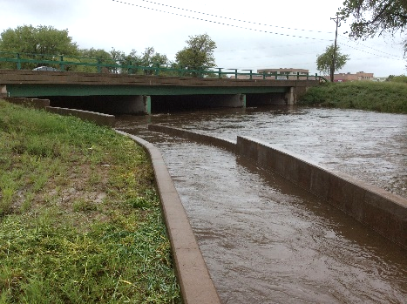
Hwy. 287 Flood Mitigation Project

Slide 14
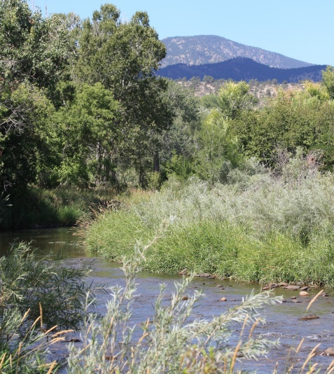
Nature Based Solutions
Incorporating cost effective nature-based solutions:
Restore channel-floodplain connectivity
Restore riparian vegetation
Instream channel variability
Sediment transport & erosion
Stormwater quality treatment
Wetlands
Linking habitats

Slide 15
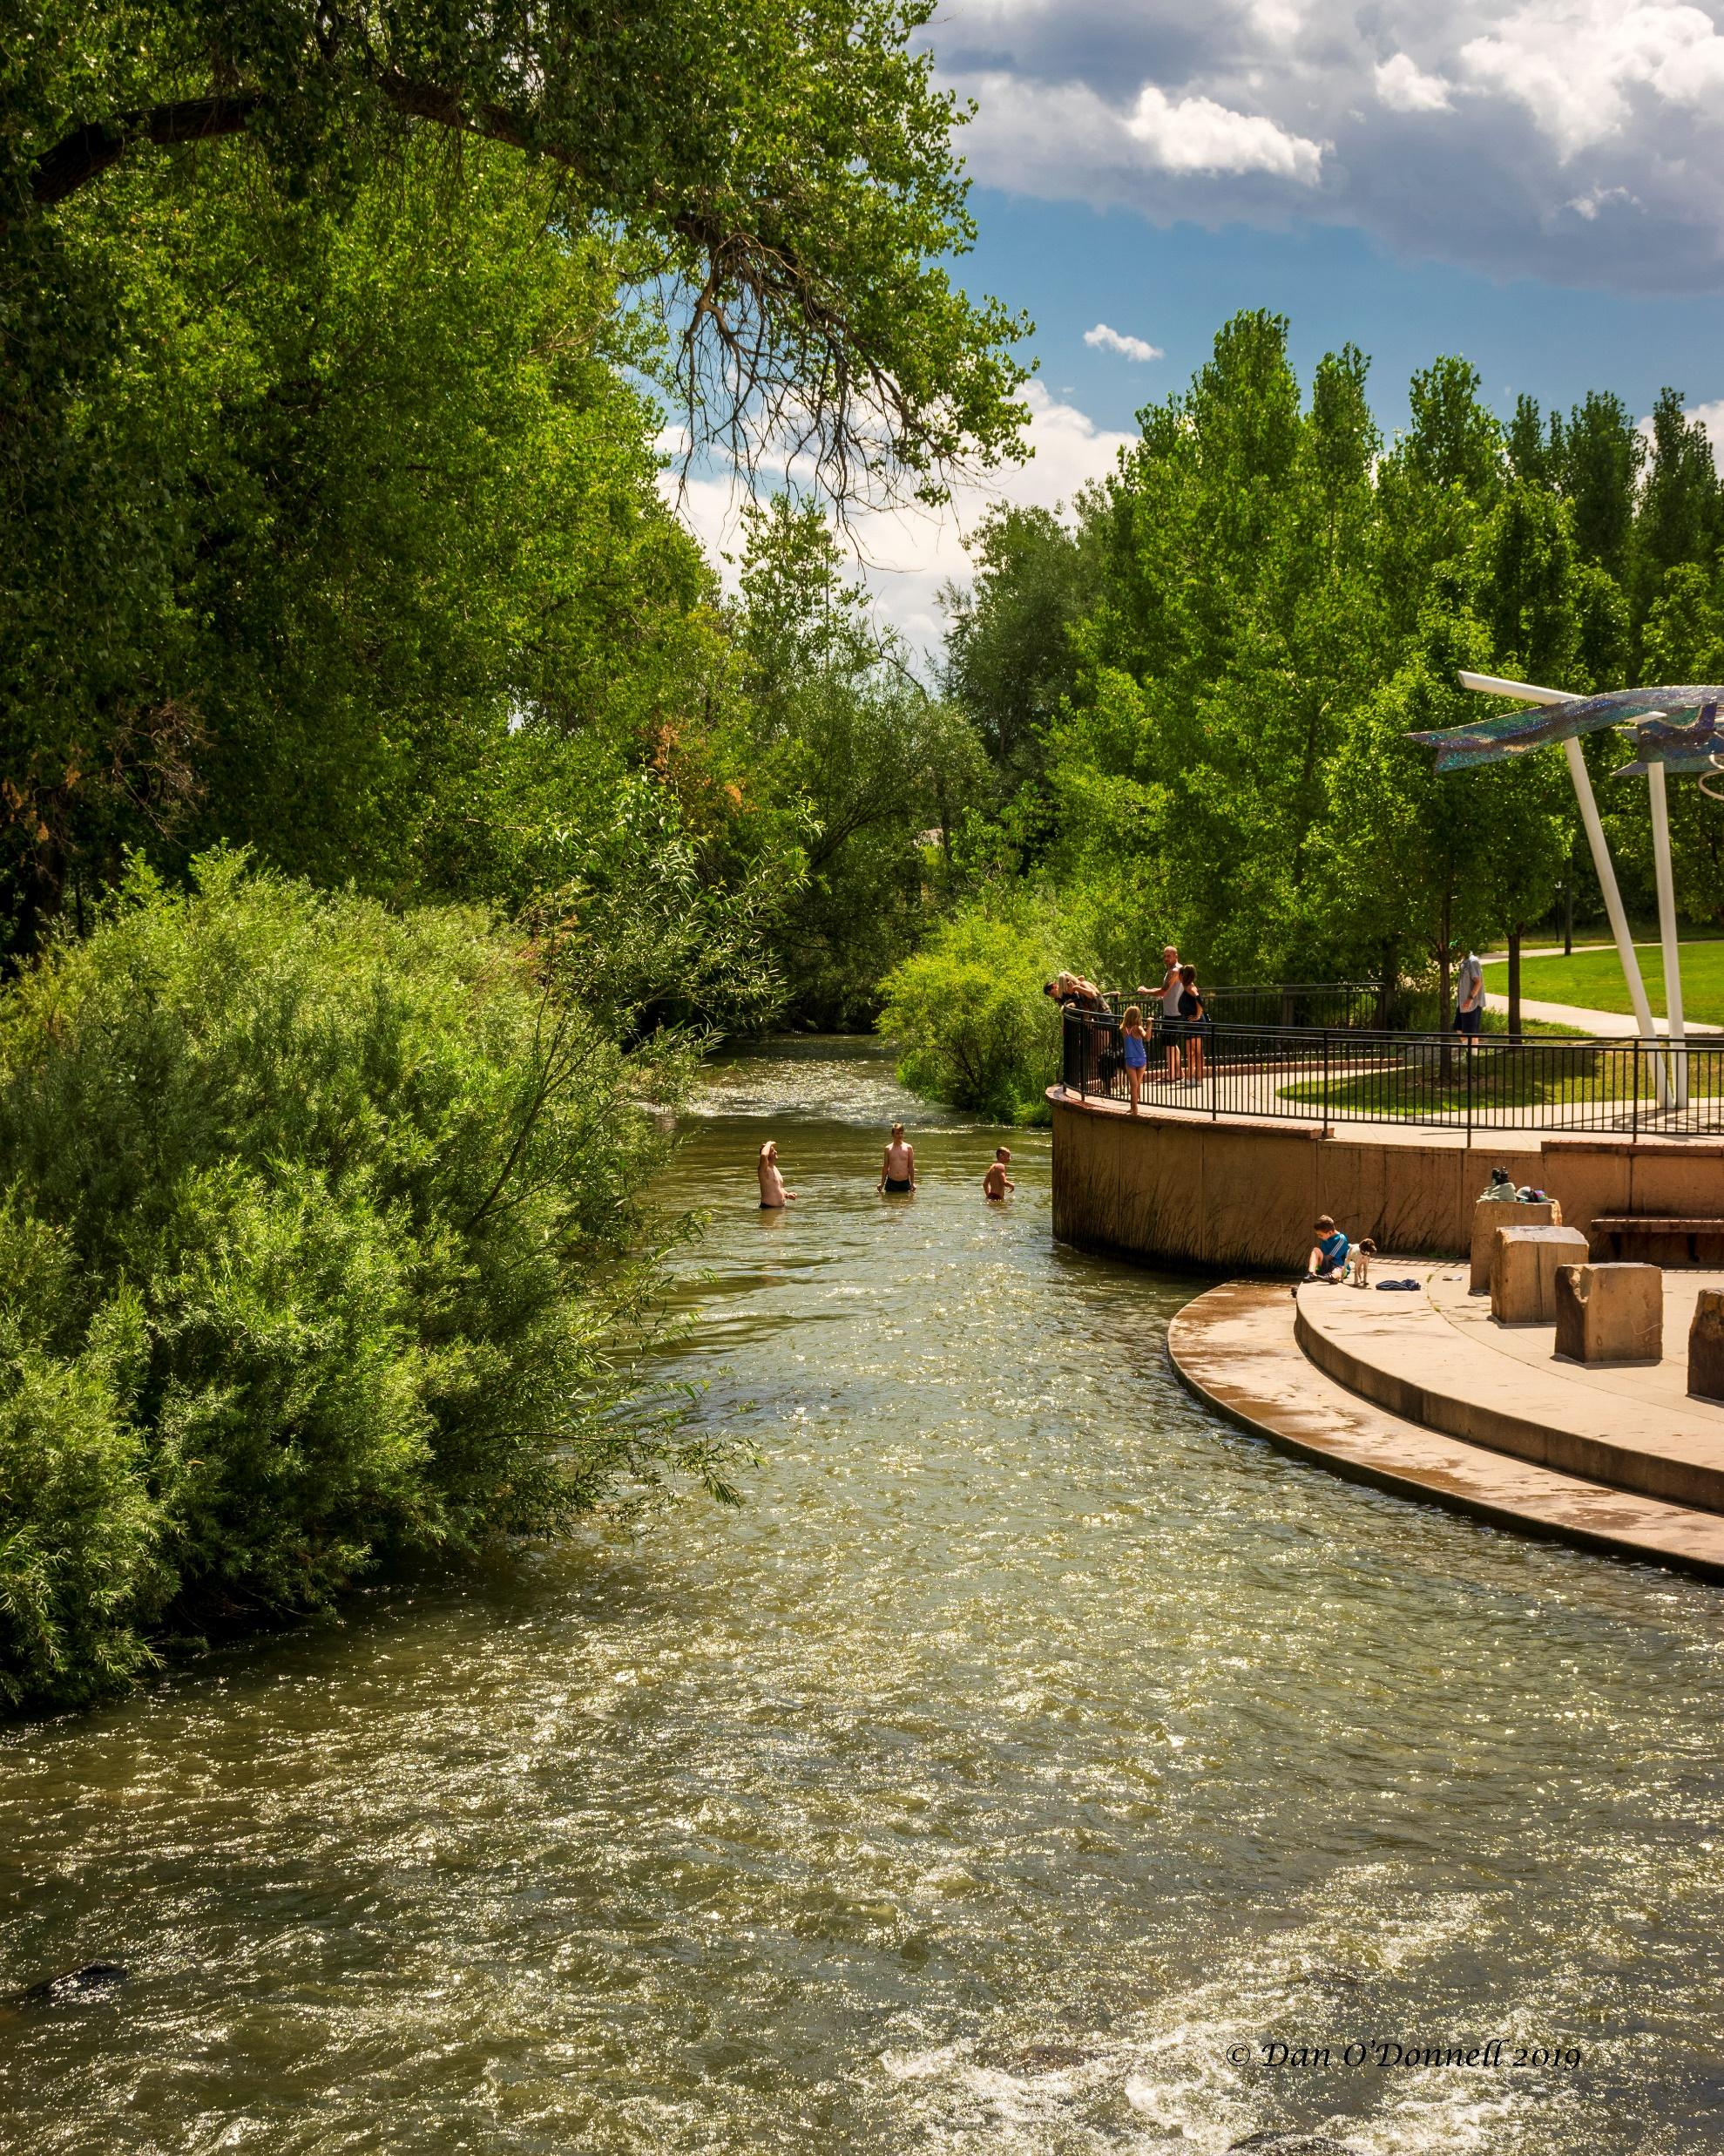
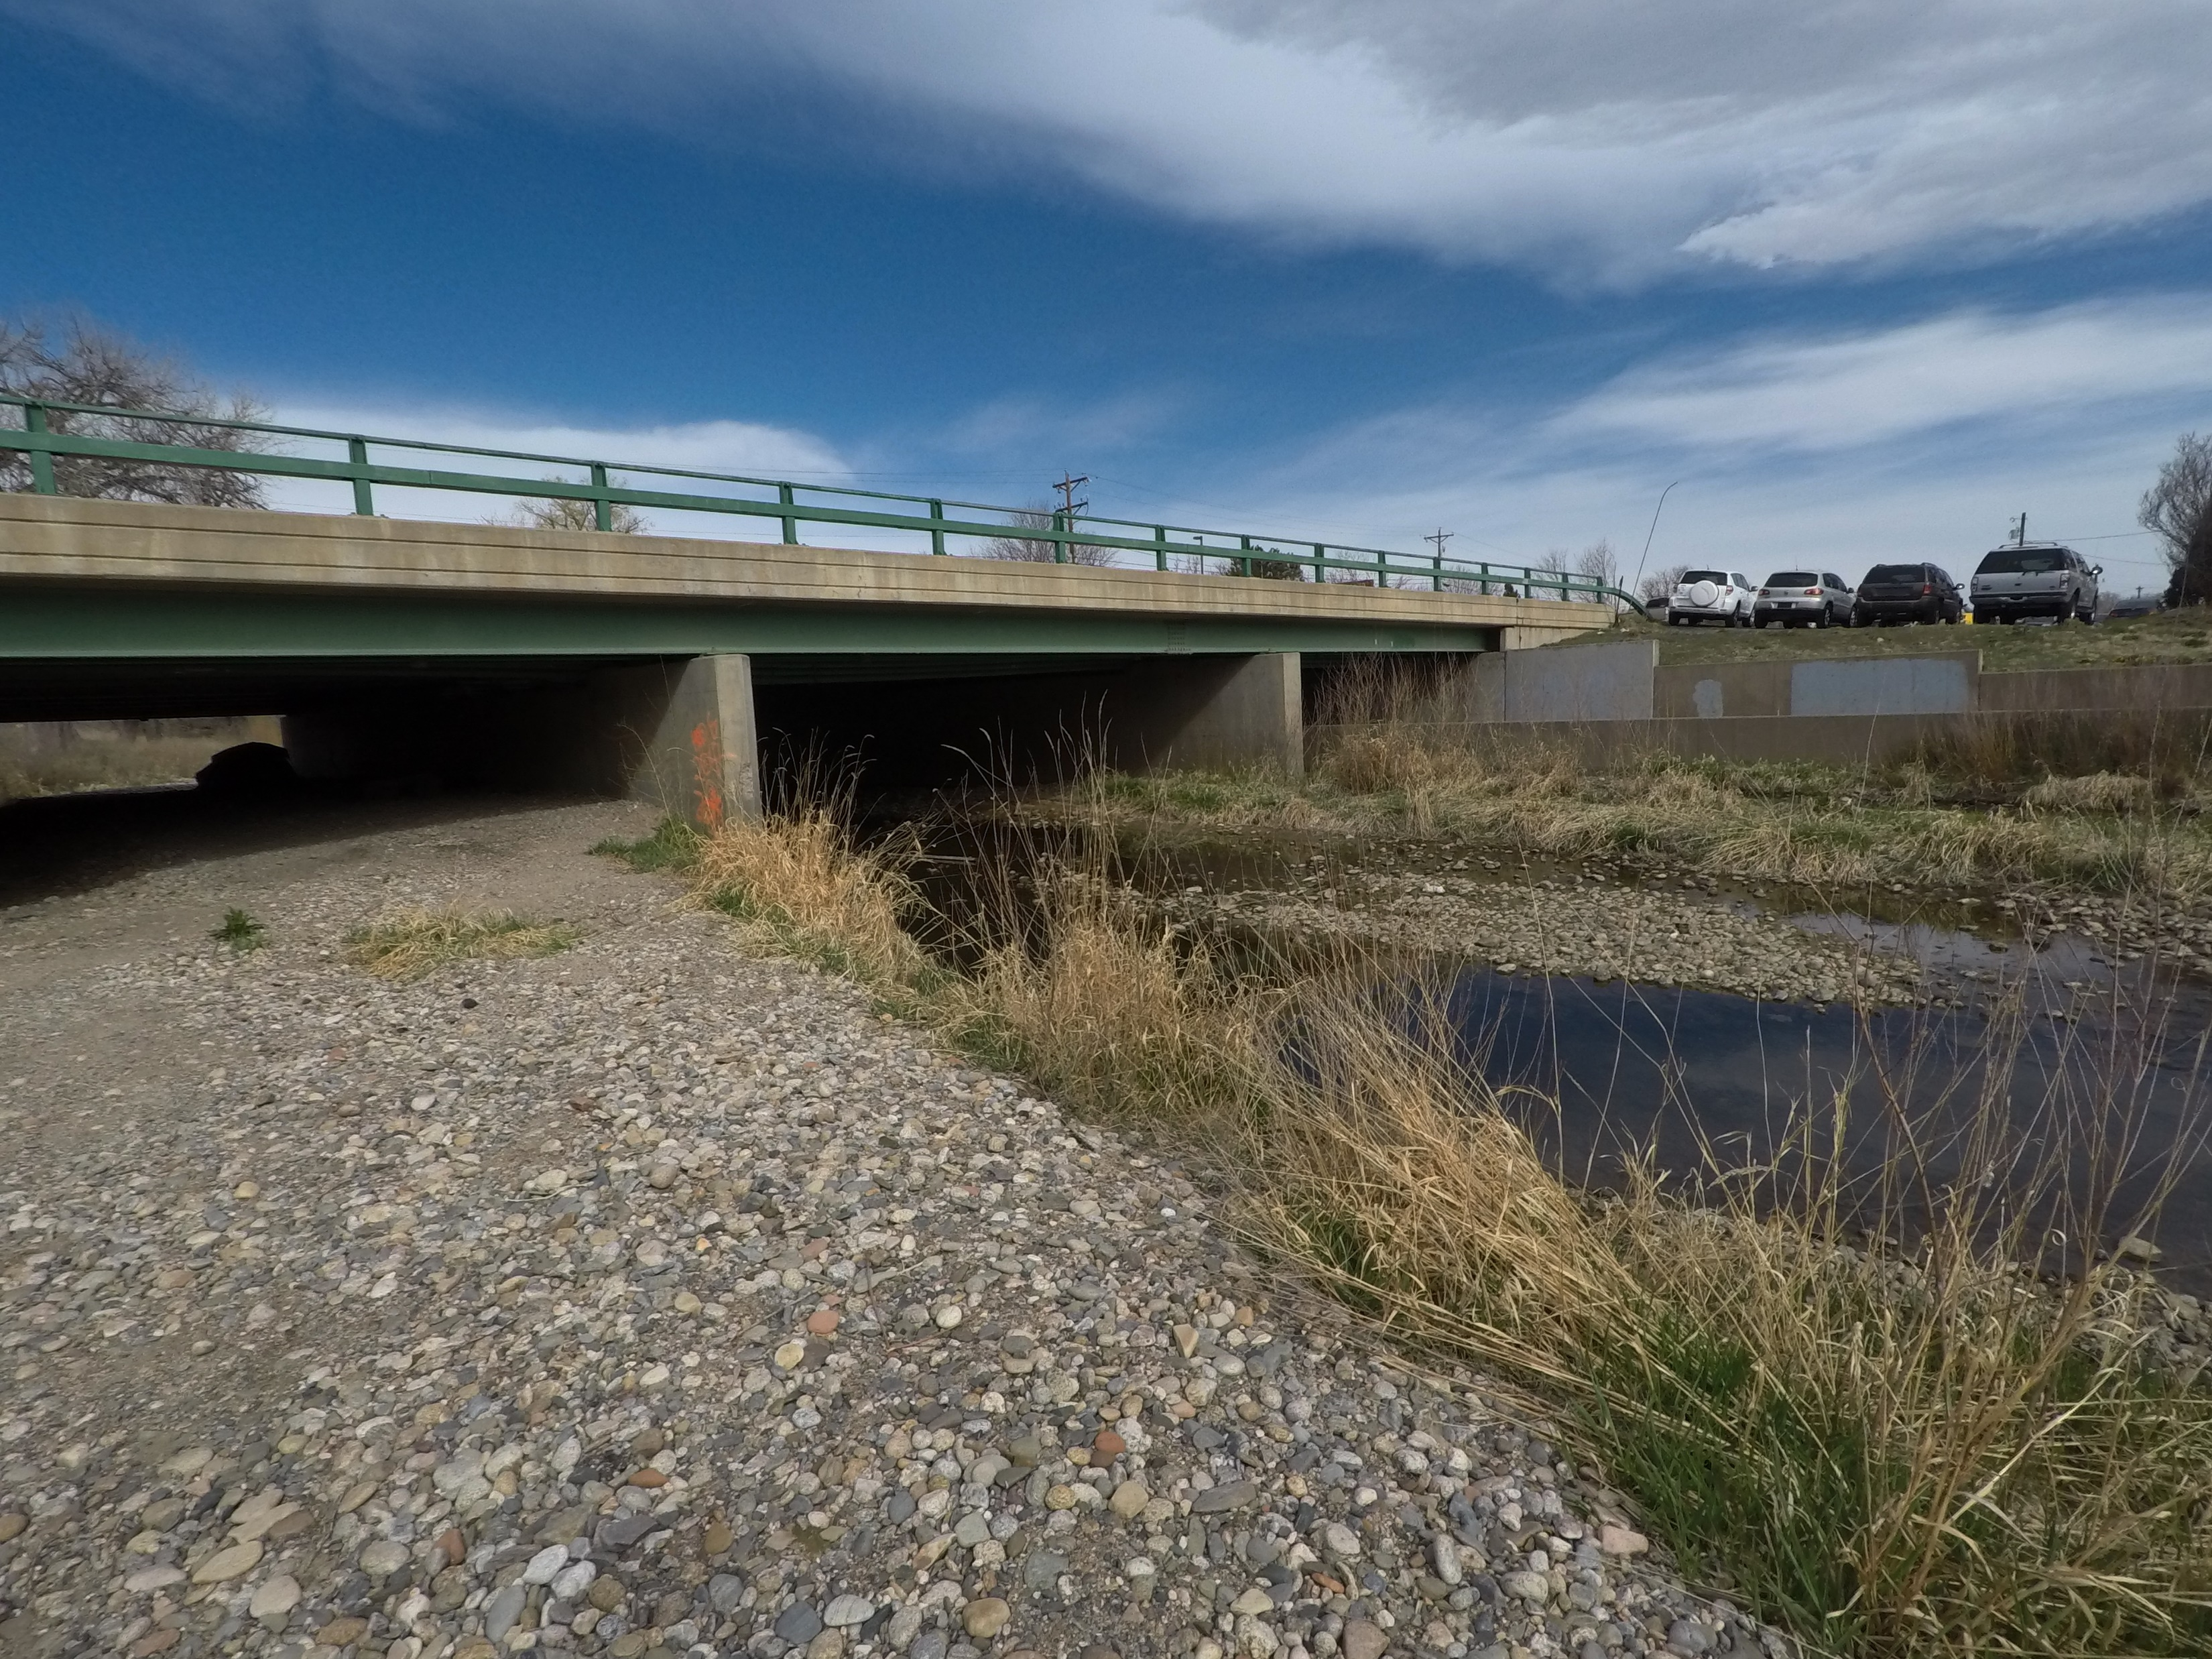
Hwy. 287 Project Benefits
1. Resilience
Flood hazard mitigation
Protect infrastructure & businesses
2. Economic
Reduce future flood impacts & recovery costs
Opportunities for new or redevelopment
Southern gateway into Loveland
3. Environmental
Natural floodplain functions
Water quality
River & riparian health
Fishery
Quality of life
4. Recreation
Trails, water recreation, public safety

Slide 16
Questions and Discussion

