Slide 1
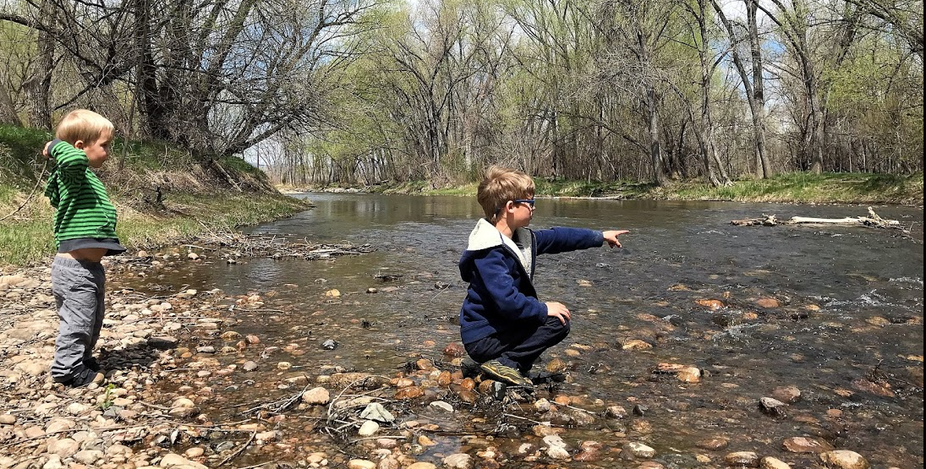
City of
Fort Collins: Selected
Environmental
Water Projects
Eric Potyondy, City Attorney’s Office, Water Attorney
March 15, 2023
Notes:
To switch the image, click on the background image and delete it, as well as the text box with directions. Insert or paste another picture (Please note: too low of resolution and it will not look very good, too much and the file size will get very large) and then send it to back so that it goes behind the header and footer.
To find imagery, visit the City’s Flickr Site or look through Shutterstock and submit a Photo Request to CPIO (CityNet) with the image number you’d like.

Slide 2
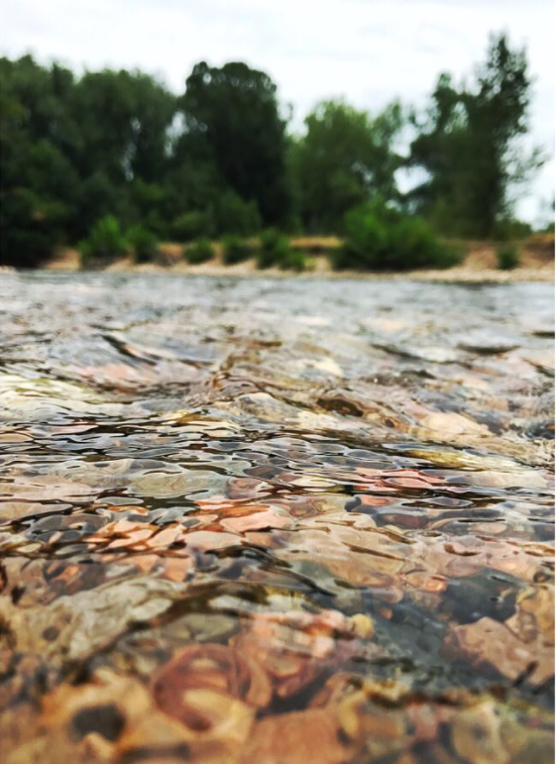
Overview of Presentation
The City of Fort Collins has numerous water-related projects related to environmental uses.
Projects by different departments:
Water Utility
Wastewater Utility
Stormwater Utility
Natural Areas Department
Presentation will briefly touch on several projects.

Slide 3
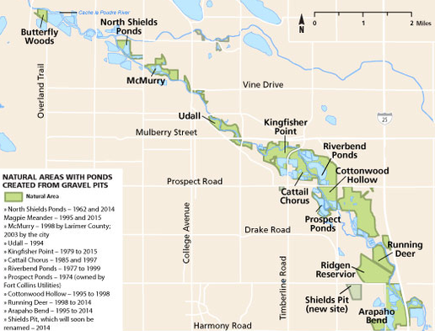
Gravel Pit Augmentation
Fort Collins has acquired numerous parcels along the Poudre River.
Many parcels were mined; and thus have ponds dug into the alluvium (water table).

Slide 4
Gravel Pit Augmentation
Alluvial ground water supports stream flows
Ponds dug into the alluvium consume water
Evaporation deprives senior water rights of water, so they need:
(1) Augmentation plan
(2) substitute water supply plan, or
(3) statutory exemption

Slide 5
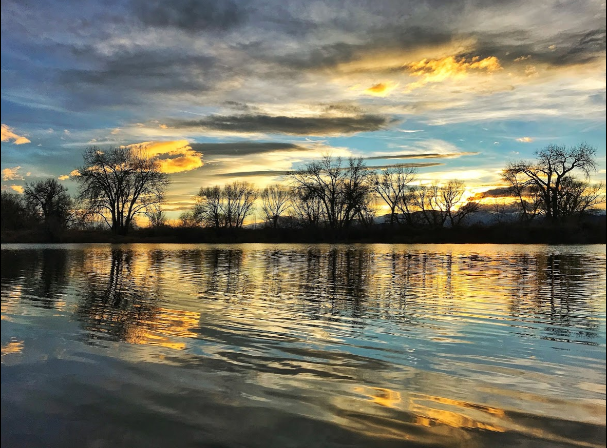
Gravel Pit Augmentation
Evaporation deprives senior water rights of water, so they need:
(1) Augmentation plan approved by Water Court
(2) substitute water supply plan approved by State Engineer,
(3) statutory exemption for pre-1981 ponds, or
(4) filled in.
Ponds provide habitat and recreational opportunities

Slide 6
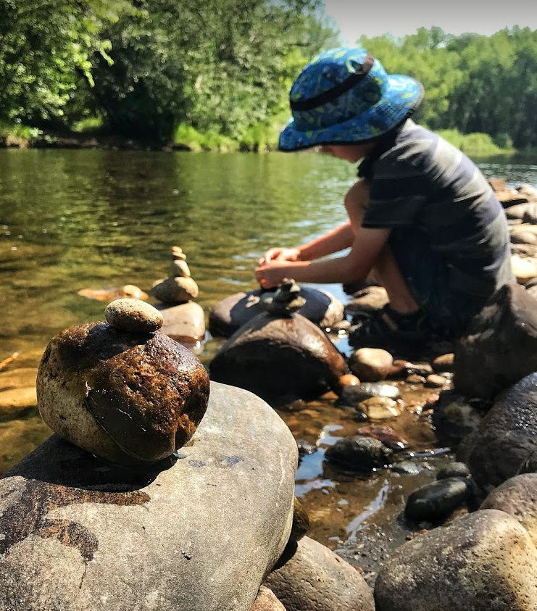
Poudre Flows Plan
Poudre Flows Plan began in 2013 in the “Poudre Runs Through It” working group.
Partners are:
Colorado Water Trust
City of Fort Collins
City of Greeley
City of Thornton
Northern Colorado Water Conservancy District
Cache la Poudre Water Users Association
Colorado Water Conservation Board (CWCB)
Colorado Parks and Wildlife

Slide 7
Poudre Flows Plan

Slide 8
Poudre Flows Plan
Targeted flows vary by reach
Depend on river conditions
Depend on fish species
Partners adding water to date:
Fort Collins
Greeley
Thornton

Slide 9
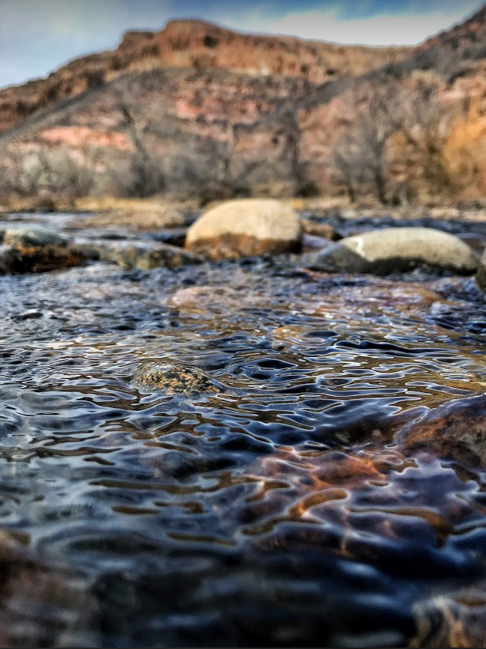
Poudre Flows Plan
Water Court Approval Process:
Application filed in 2021 (21CW3056)
Information circulated to opposing parties, with several rounds of comment and responses
Trial to be set soon (likely for 2025)

Slide 10
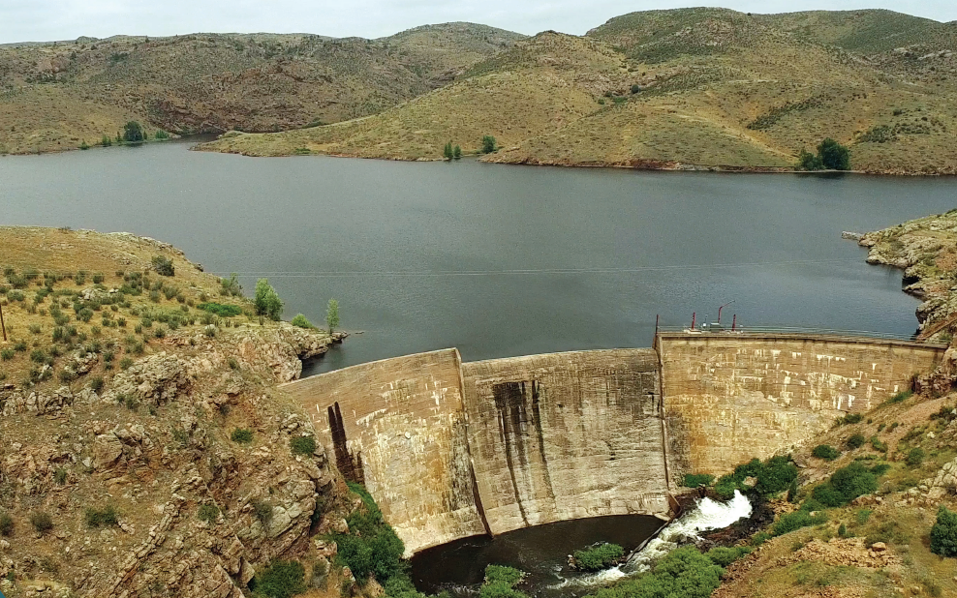
Halligan Water Supply Project
Fort Collins is seeking to enlarge Halligan Reservoir on the North Fork of the Poudre River to meet future demands and increase reliability.

Slide 11
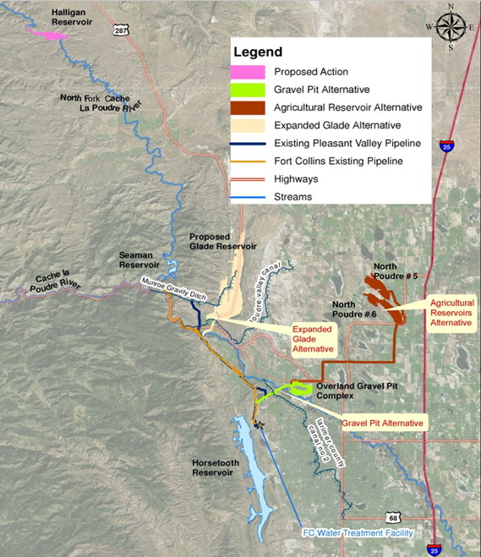
Halligan Water Supply Project
Selected key attributes:
Will be filled with water previously used to irrigate lands Fort Collins grew into
Will re-water dry stretches of the North Fork
Will increase fish habitat connectivity
Lots of other mitigation incorporated into the project

Slide 12
Halligan Water Supply Project

Slide 13
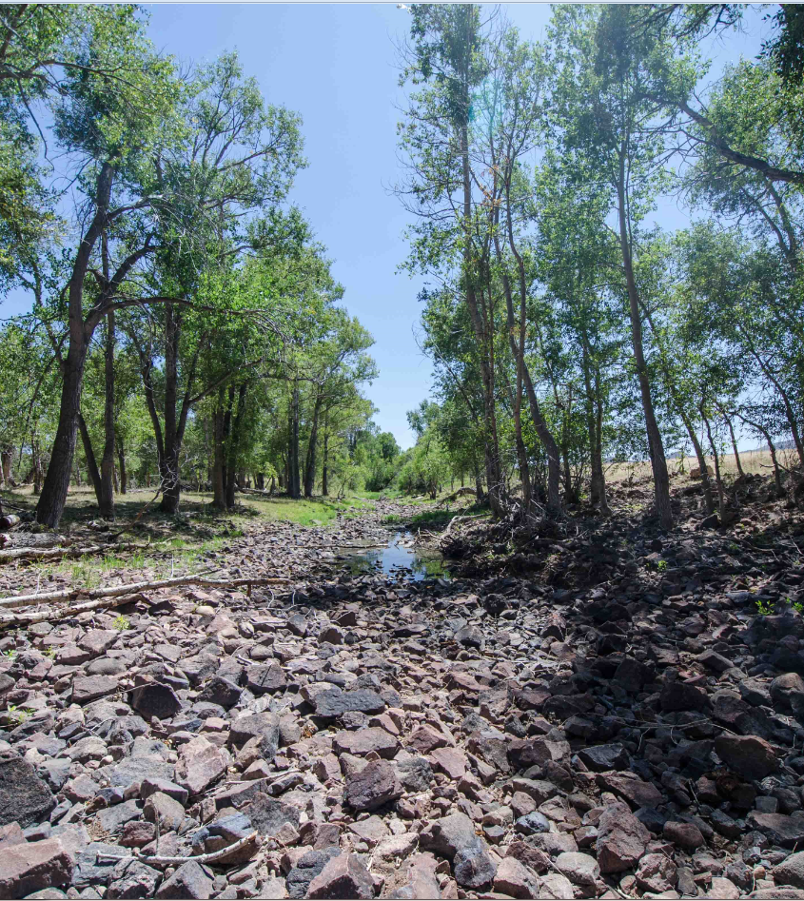
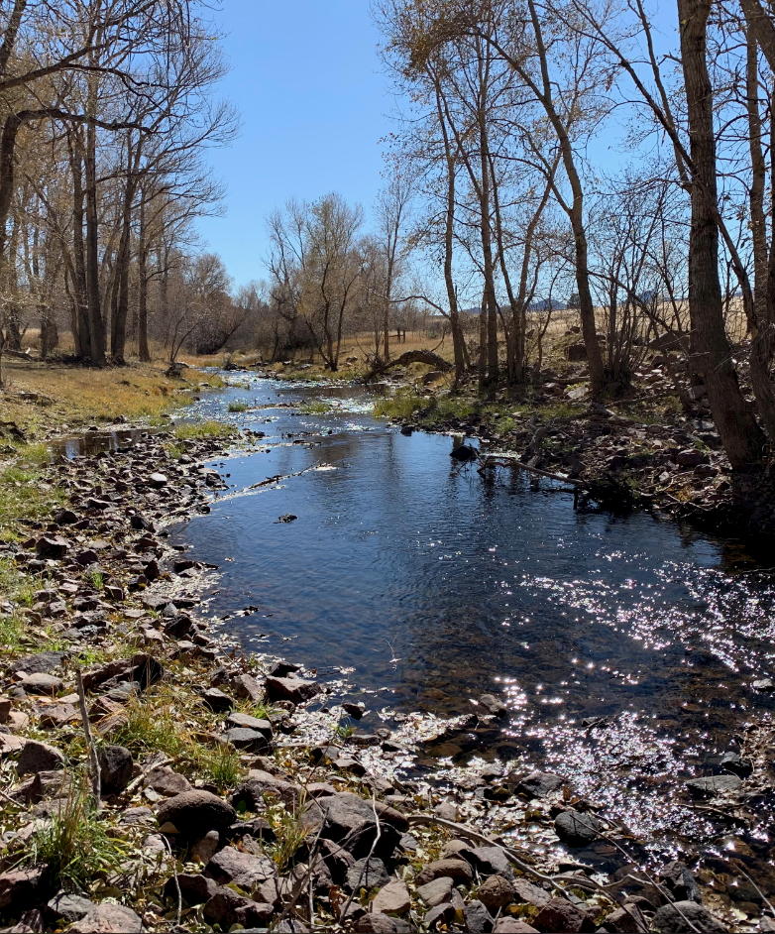
Halligan Water Supply Project

Slide 14
Questions?

