Slide 1
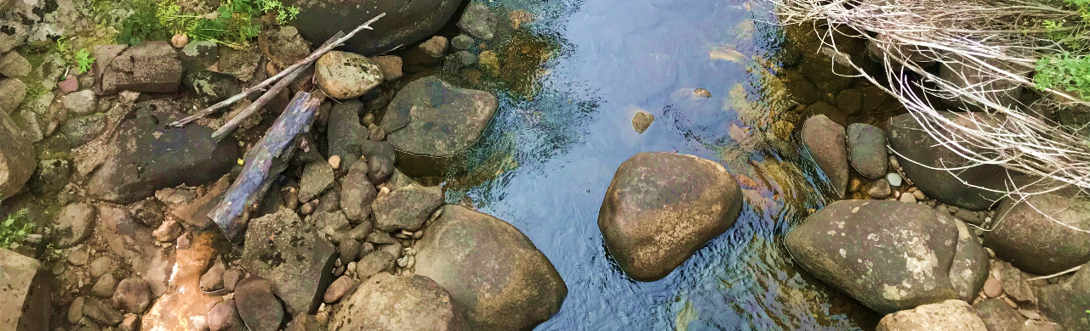

Environmental water in colorado
Instream flow rights and streamflow restoration tools
Colorado water Trust
Kate Ryan
Water literate leaders
March 2023

Slide 2

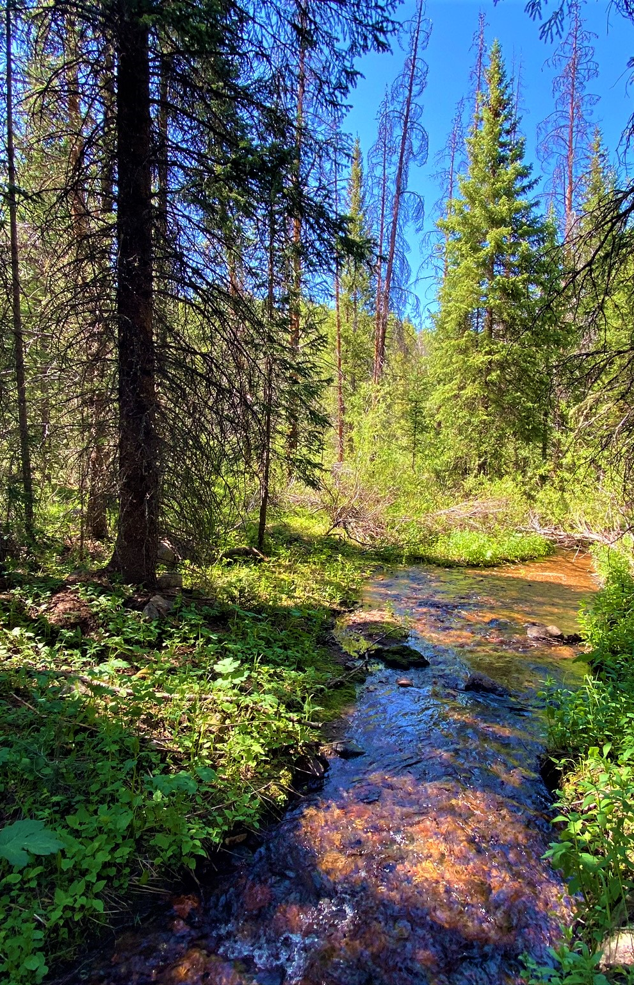
Colorado Water Trust
Denver-based non-profit working statewide to restore flows to Colorado’s rivers in need
Formed in 2001 to partner with Colorado’s Instream Flow Program and amplify its work
Work with water users to put together voluntary transactions to benefit the environment
Transactions are flexible - temporary or permanent, split-season, ATM
Work within the prior appropriation system and compensate water users at fair-market value

Slide 3
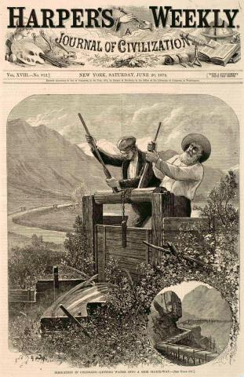
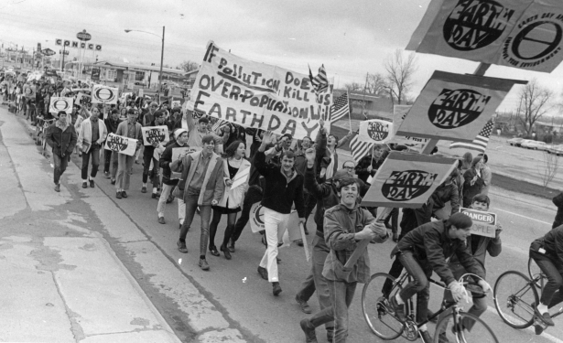
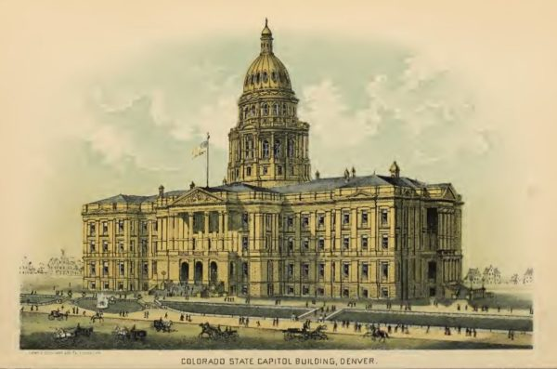
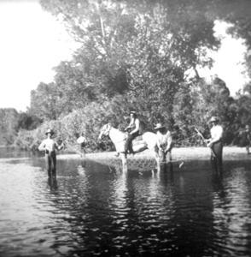
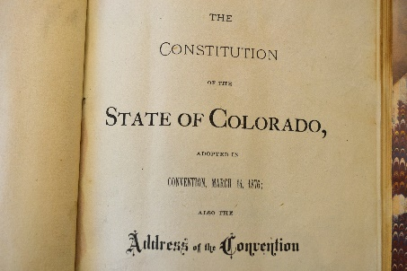
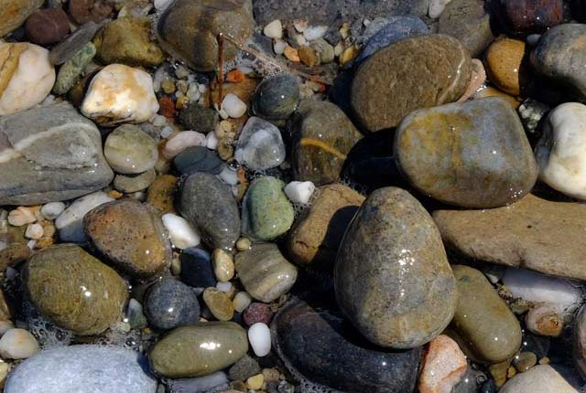
Colorado Water Rights History
Cache La Poudre Conflict
1876
1878
1903
…70 years….
1973
Photos: Denver Post, Colorado Encyclopedia, Fort Collins History Connection, Colorado Virtual Library, Denver Post (L>R).

Slide 4
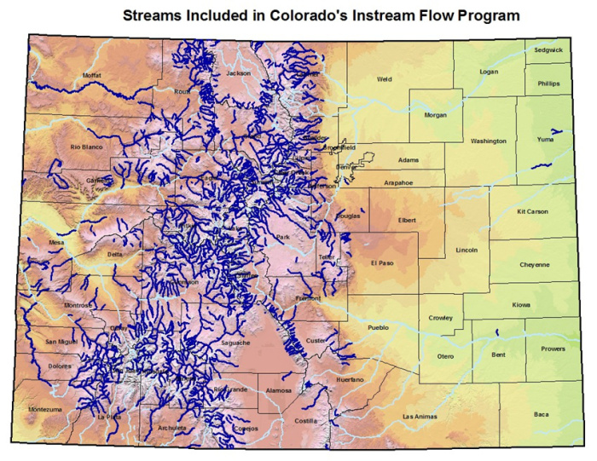
Colorado Water Conservation Board
CWCB is the state agency with exclusive authority to obtain instream flow water rights and minimum lake level rights.
There are administrative and judicial processes to go through to establish an ISF.
CWCB gains ISF water rights in 2 ways:
Appropriation: the traditional water court process – apply for a junior water right;
Acquisition: a variety of statutory and creative tools exist to provide opportunities for temporary and permanent transfers of senior water rights to ISF.

Slide 5
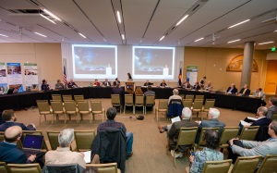
The CWCB: a Staff and Board
CWCB makes a quasi-legislative decision to appropriate or acquire;
  Guided by rules at 2 CCR 408-2
Colorado Parks and Wildlife models preserve and improve flow rates;
Water Trust, CWCB staff, and CPW staff collaborate on the project as a whole.
Administrative approval precedes water court, or further administrative approval for temporary changes to ISF.

Slide 6
The ISF Acquisition Toolkit
Permanent Acquisitions or Long-Term Loans, 37-92-102(3):
No conditional water rights
Preserve or improve
Water protected in priority for the length of ISF stream reach
Permanent change of water right approved in water court
5 in 10 Temporary Loans, 37-92-105(2)(b):
Used to preserve on an existing ISF reach for 5 years out of a 10 year period
ISF use cannot occur in more than 3 years consecutively
Preserve or improve, but only on reaches with an underlying ISF water right
Water protected in priority for the length of ISF stream reach
Administratively approved by State Engineer
Safeguards owner’s HCU allocation
Nonrenewable
Water Conservation Program, 37-92-305(3)(c):
Used with or without an ISF stream reach for 5 years out of a 10 year period
Water is not protected; available for diversion by any water user
Administratively approved by a water district or state agency
Safeguards owner’s HCU allocation
Nonrenewable
Not allowed in Water Division 7 (southwest Colorado)
ISF Plan for Augmentation, 37-992-102(4.5)
Plan to make water available for out-of-priority uses approved in water court
Preserve or improve
Permanent plan where additional augmentation water can be added post-decree
Getting Creative:
Alone or in combination with the tools above
Integrating storage and exchanges
Delivering water to downstream decreed uses
Sharing water for split season of deficit irrigation

Slide 7
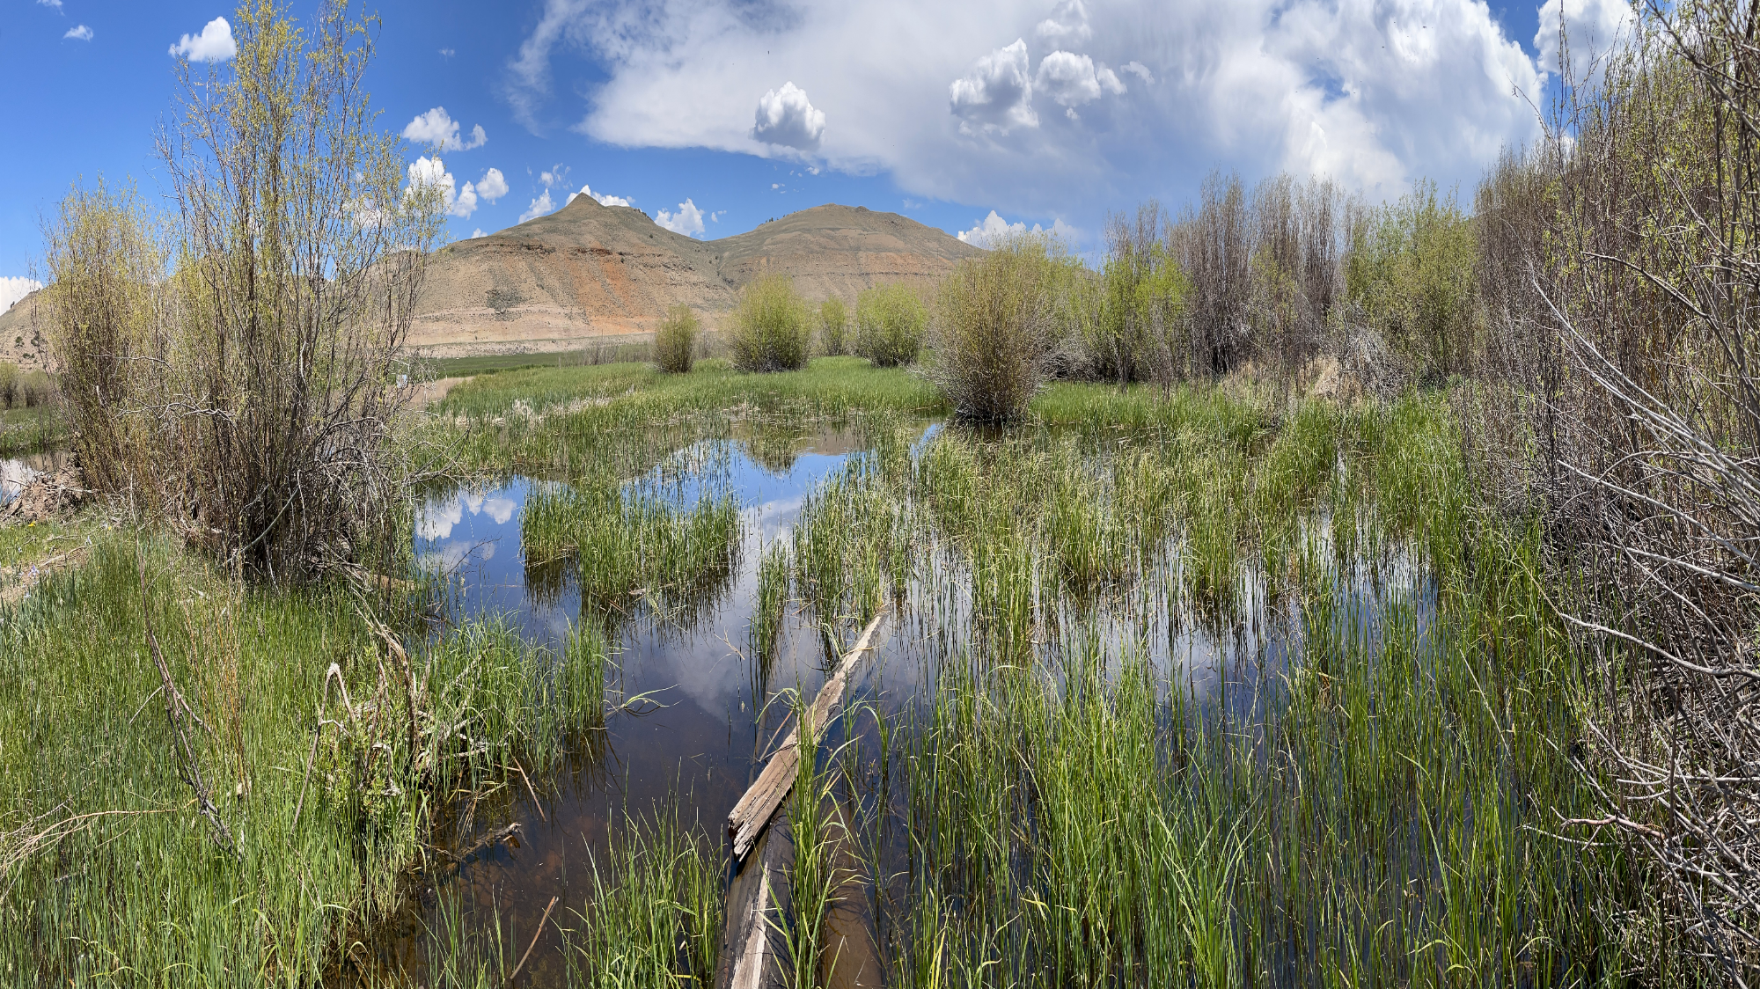
Evaluation Process
Figure out the best tool.
Temporary?
Permanent?
If the water right at issue can help the stream in time/place, figure out if there is a legal tool that will work.
Water conservation program?
Change of use to instream flow?
Interruptible water supply plan?
Flexible?
5/10 temporary loan to instream flow?
Change of use/ point of diversion/place of use?
Strategic reservoir releases?
Agricultural water protection water right?
Non-diversion agreement?
Substitute water supply plan?
Strategic abandonment?
Streamflow augmentation plan?
Downstream decreed beneficial use?

Slide 8
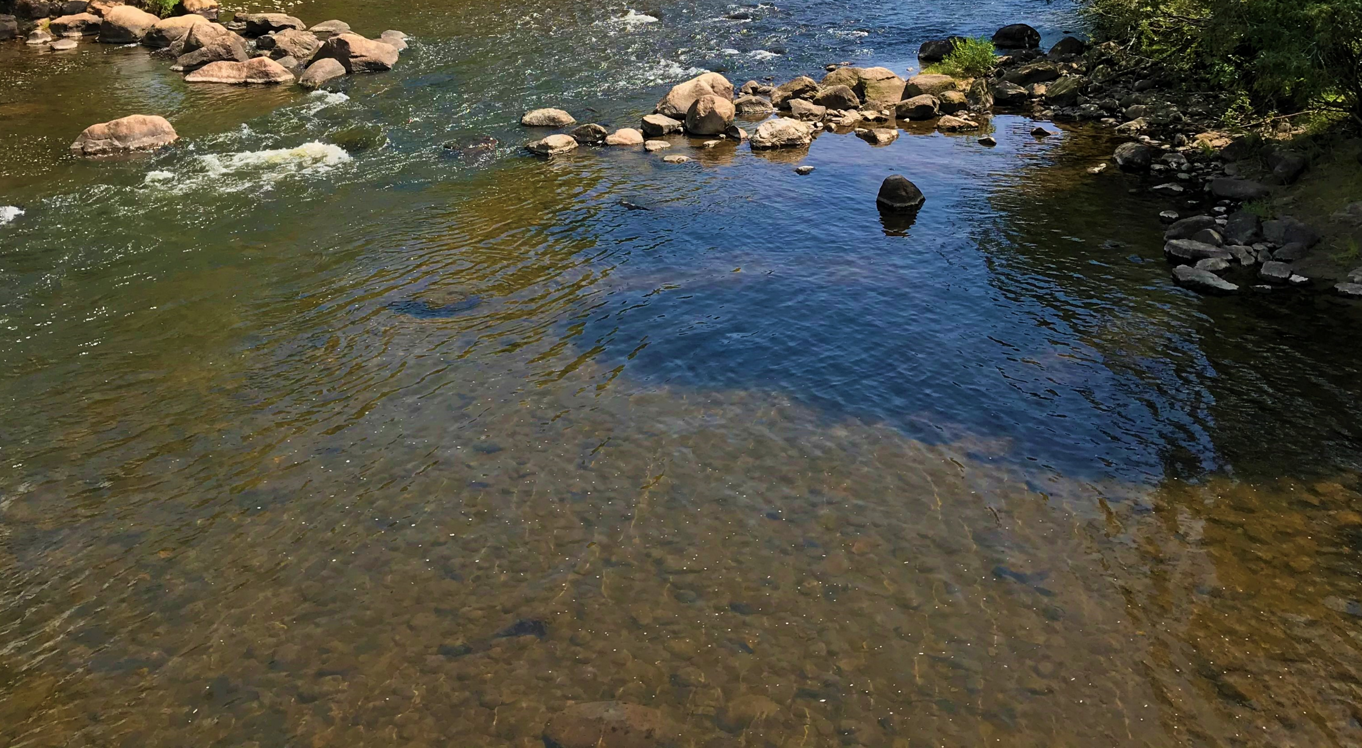
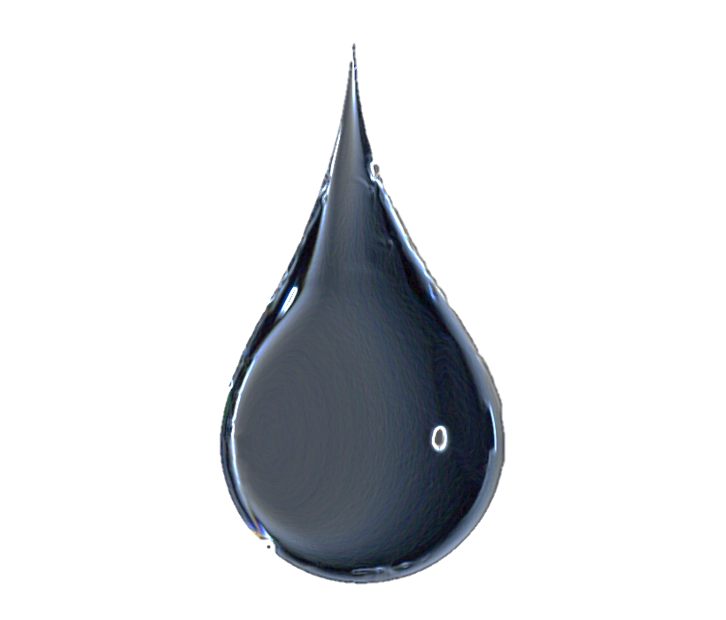
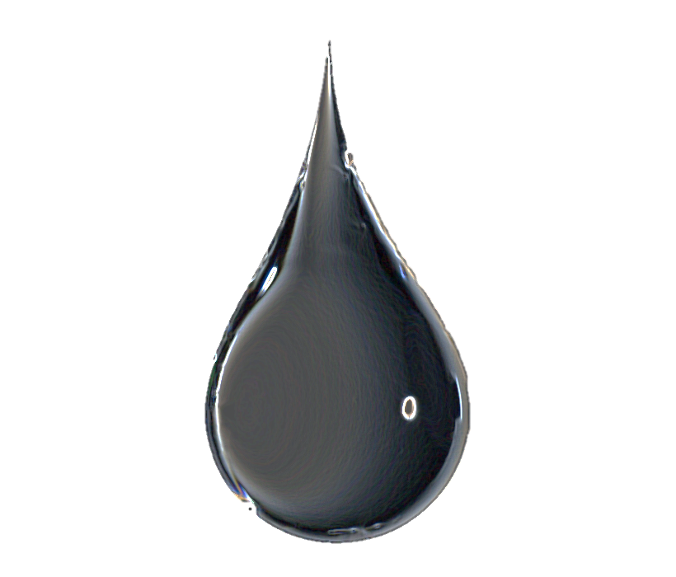

Compensation
The CWCB has statutory fund of $1 million per year for acquisitions and the Water Trust fundraises, from private donors.
If requested, market-based compensation is available for water that is successfully leased or conveyed to CWCB for ISF use.
Notes:
QUESTION: How far do you think $1 million per year goes? Any guesses on what implications for environmental water transactions might be? Talk about temporary vs permanent acquisitions

Slide 9
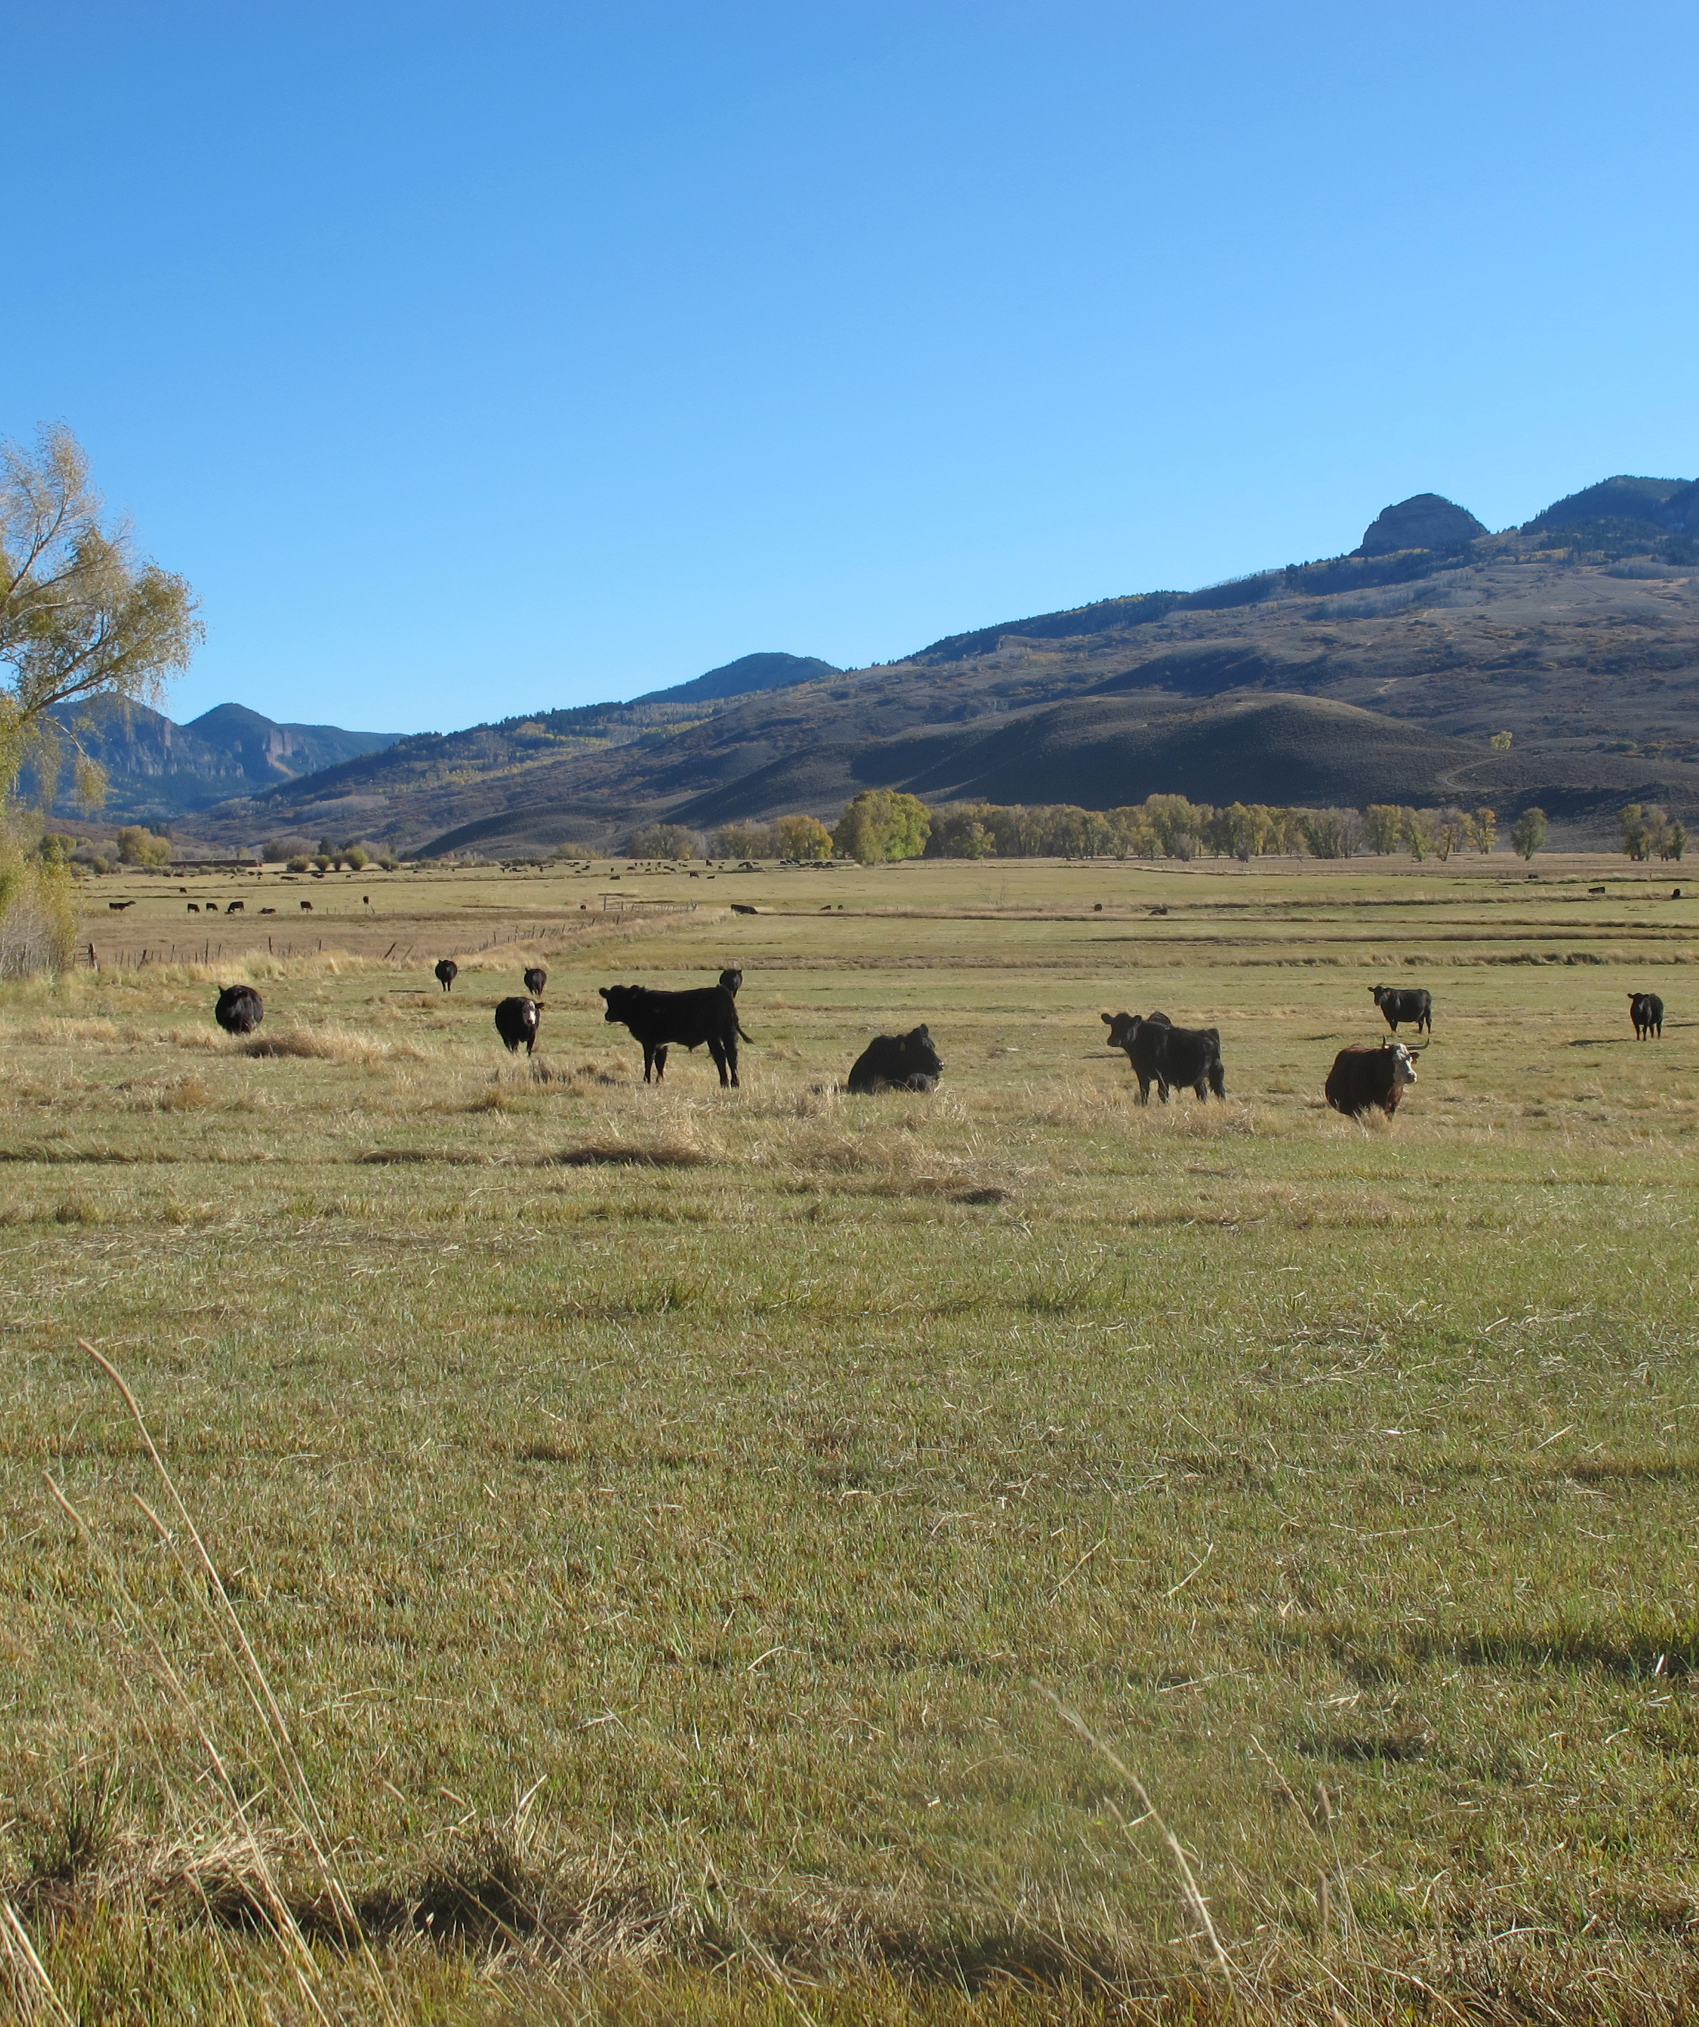
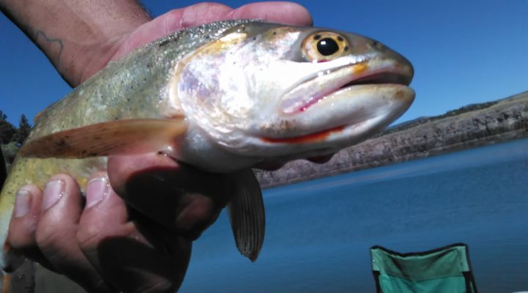
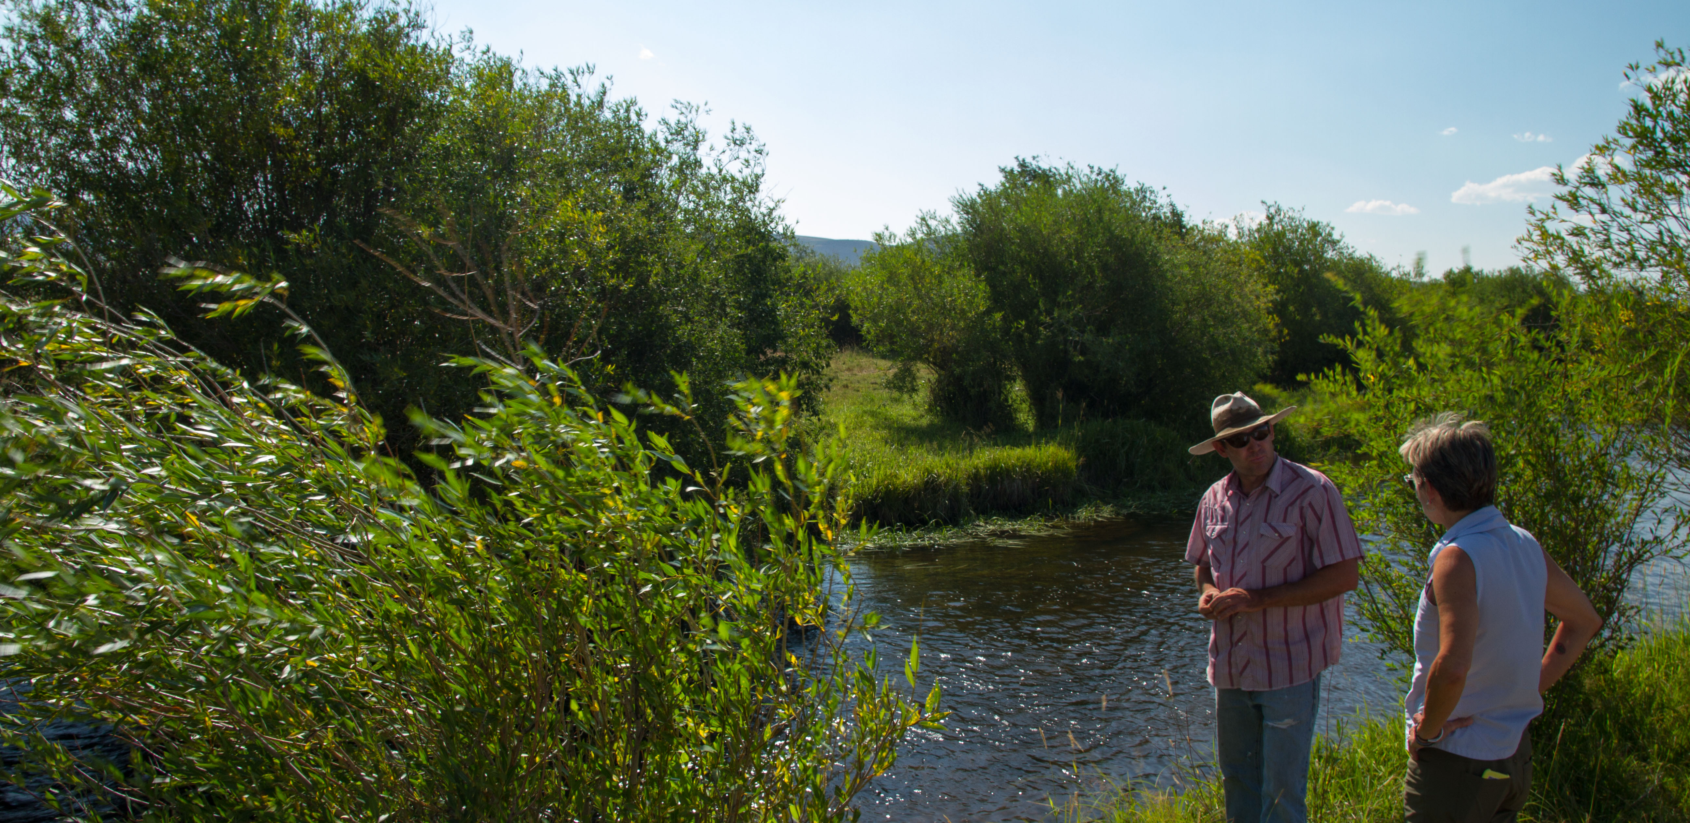
Acquisition and water right change PROJECT examples
Little Cimarron: Permanent acquisition; split-season irrigation; CWT owns water right subject to grants of irrigation and environmental flow uses; soil health & productivity study
Coats Bros Ditch: 3-in-10 Instream flow lease; split-season irrigation; WCP operations
Alamosa River: permanent changes of senior rights that are stored and released to extend season of flow
Notes:
Bait & tackle shop in Capulin

Slide 10
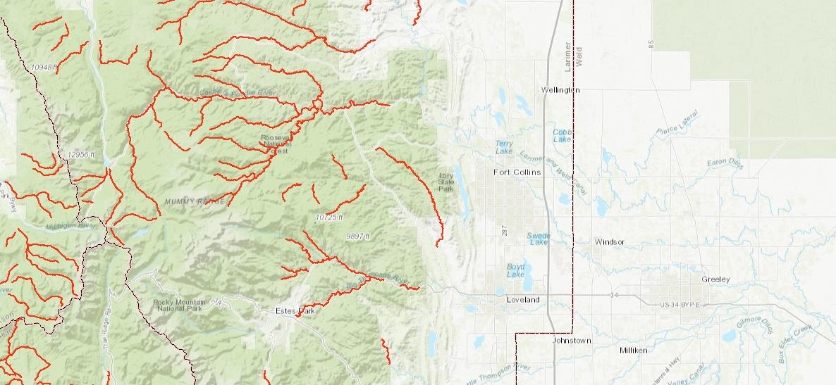
CWCB’s Decreed Instream Flow Water Rights (source: DWR MapViewer)
Cache la Poudre
Big Thompson

Slide 11
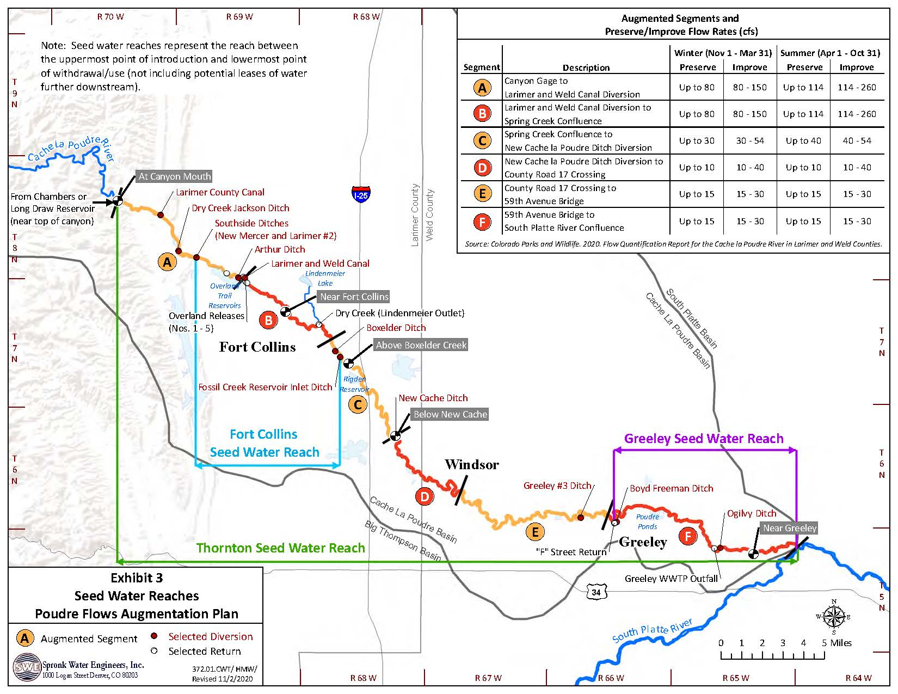
The Poudre Flows Instream Flow Augmentation Plan:
Dry-up points;
57 Miles of River;
Partnering with ag and municipal;
Post-decree supplies
Notes:
Back to ISF; note that this is a tool that municipal, gw and other consumptive uses have been relying on heavily since 80s

Slide 12
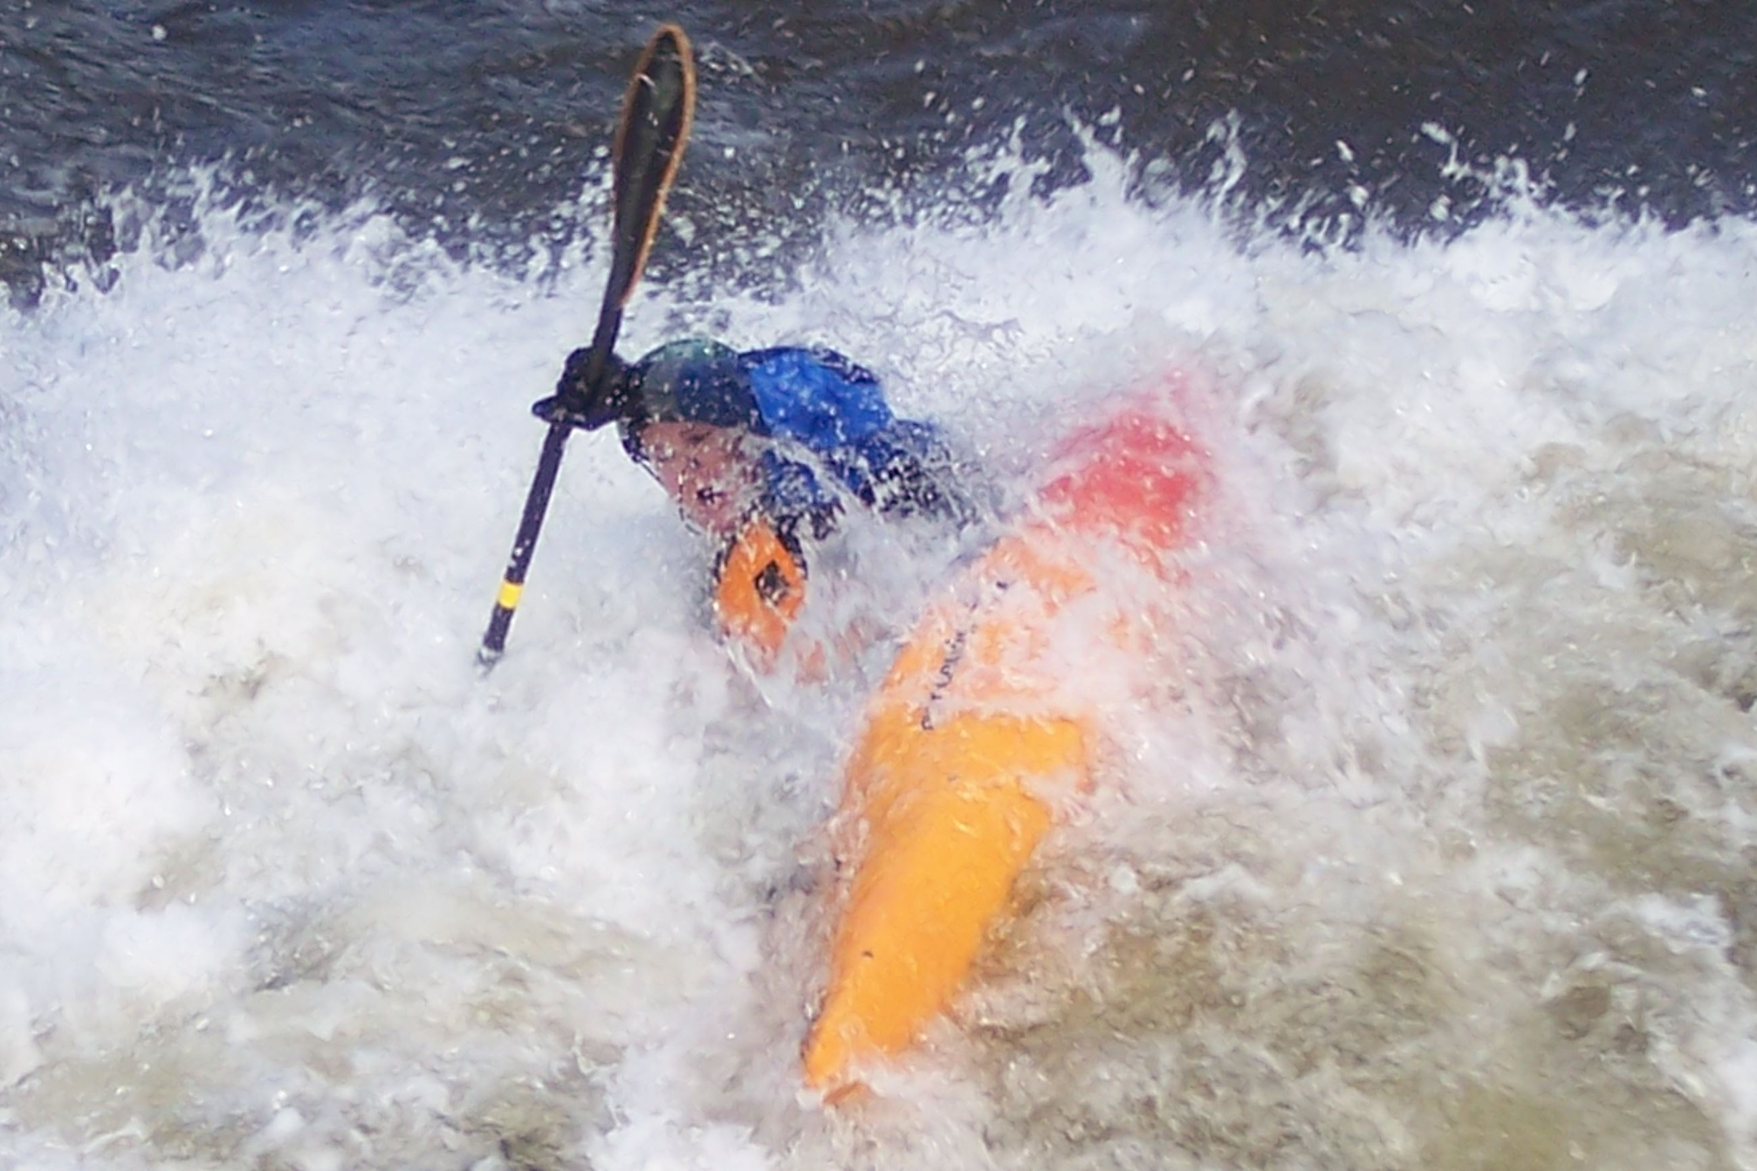
Recreational In-Channel Diversions
Approved by CWCB
Decreed in Water Court
Junior Priority – legislated in 2001
Use by local government only
Control structure required
Amount is the minimum required for reasonable recreation experience
Legislative efforts to expand led by American Whitewater

Slide 13
kryan@coloradowatertrust.org

