Slide 1
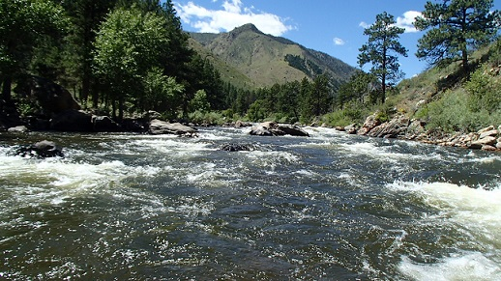
Cache La Poudre and Environmental Impacts
Presentation by Sally Boccella
Photo: USFS

Slide 2
Cache La Poudre The Natural History of a Rocky Mountain River
Book by Howard Ensign Evans and Mary Alice Evans
The narrative focuses on Howard and Mary Alice’s experiences wandering the banks of the river while they narrate the rich history and life from bacteria to humans that depend on it.
This book is organized into ten chapters to paint a picture of the Cache La Poudre’s natural history from the 1800’s- the 1990’s.
With its comprehensive data and anecdotal stories it was a charming read that could double as a handbook to the beauty of the Cache la Poudre.

Slide 3
What’s in a Name ?
The name of the river (French for 'Hide the Powder') is a mistranslation of the original Cache à la Poudre, or "cache of powder.”
Origins of the Cache La Poudre River name stem from an incident in 1825 when William Ashley’s expedition were forced to bury part of their gunpowder along the banks of the river.
The name is credited to Albert Gallatine Boone, (Daniel’s grandson)
Howard Evans said, “Cache La Poudre was exotic and suited the river well, but ‘The Poudre’ was how it became known in our frenetic and unromantic time.”

Slide 4
Setting
John C. Fremont described it beautifully in 1842:
“It was a mountain valley of the narrowest kind- almost a chasm and the scenery was very wild and beautiful…”
The 120-mile Cache la Poudre River originates in the Rocky Mountains and flows across the plains to merge with the South Platte River.
Three headed stream with two major forks joining the main stem
left side North Fork Cache la Poudre River where Watson Lake Fish Hatchery near Bellvue
right side South Fork Cache la Poudre River begins in RMNP

Slide 5
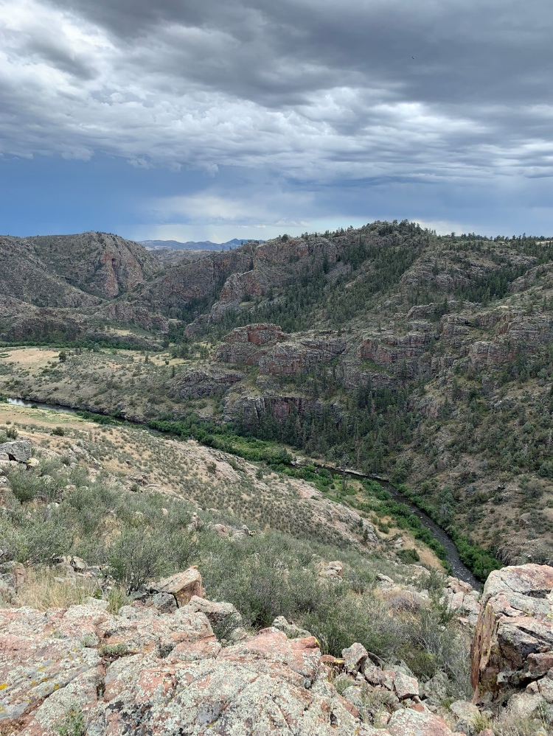
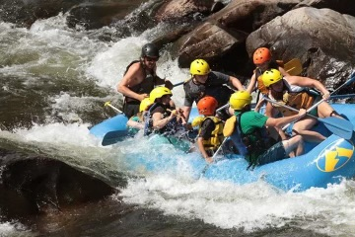
Wild and Scenic River
On October 30, 1986 Congress designation
76 miles (122 km) of the Cache la Poudre River is designated as a Wild and Scenic River under the National Wild and Scenic Rivers System.
This designation spans from the headwaters of the river at Cache la Poudre Lake in Rocky Mountain National Park, downstream along the south fork of the river.
30 miles are classified as wild, and 46 miles are classified as recreational.
Managing agencies: U.S. Forest Service, Arapaho and Roosevelt National Forests, National Park Service, Rocky Mountain National Park
Photos: SB

Slide 6
‘The Cache’ NHA
The Cache la Poudre River National Heritage Area in northern Colorado was established by an act of the U.S. Congress in October 1996.
It was the first National Heritage area designated west of the Mississippi River.
The Poudre Heritage Area follows the Poudre River downstream from the Roosevelt National Forest boundary to the river’s confluence with the South Platte River east of Greeley.
The 45 mile long corridor encompasses the 100-year flood plain. This stretch of the Poudre River is also called the “lower” or “working Poudre.
Credit: PHA

Slide 7
The National Heritage Areas Act 2022
S. 1942, the National Heritage Area Act passed with bipartisan support on December 22, 2022.
This bill reauthorizes 45 of the 55 National Heritage Areas for the next 15 years.
Colorado’s 3 NHA are included
Cache La Poudre River
South Park
Sangre De Cristo
This is an improvement over the standard 2-year renewals many sites must apply to Congress.
The long-term reauthorization allows for better planning efforts and investment by the heritage areas.
NHAs receive annual funding from NPS that is usually between $150,000 and $750,000.

Slide 8
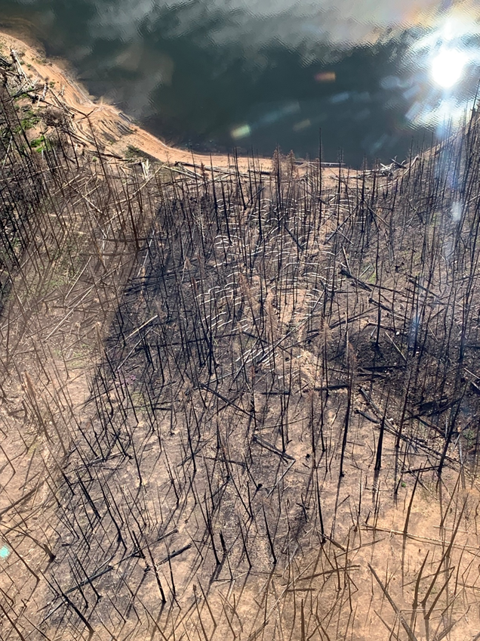
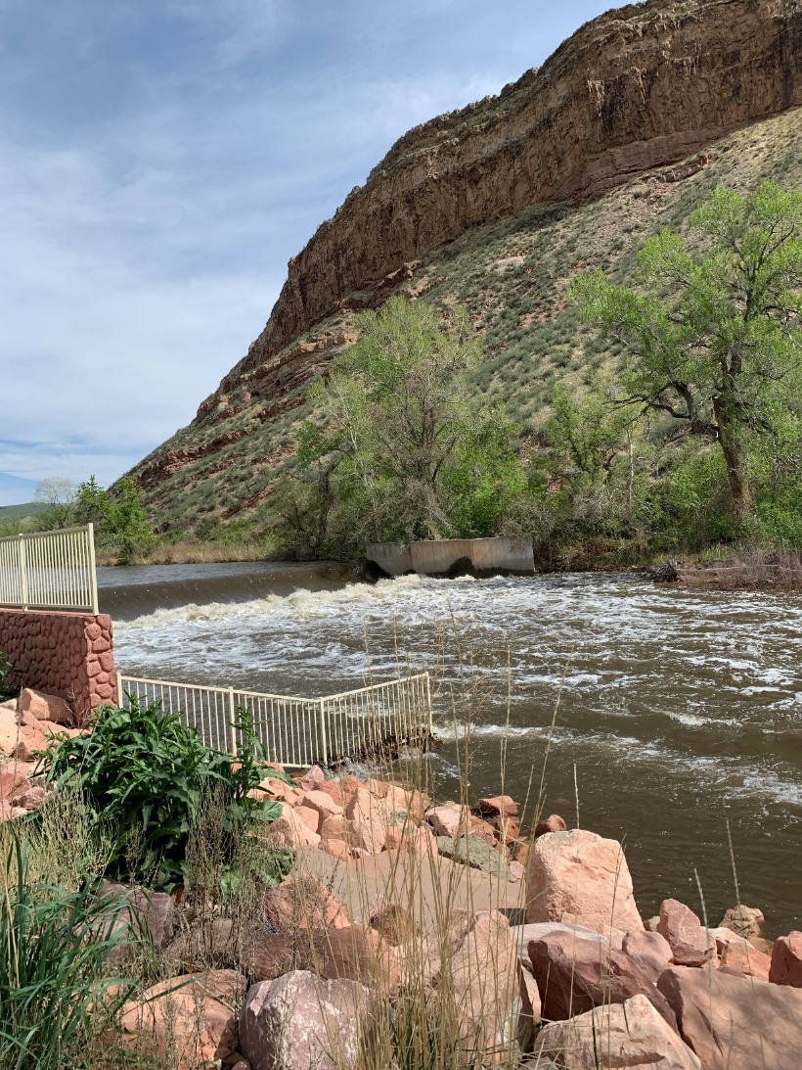
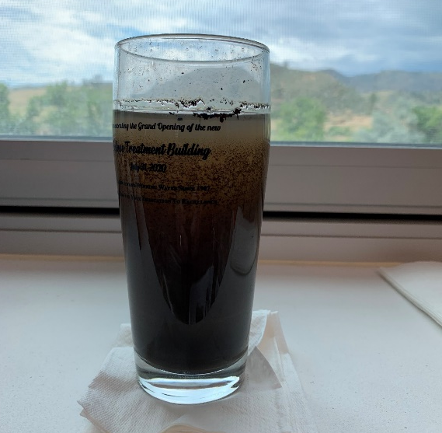
Cameron Peak Fire Environmental Impacts

Slide 9
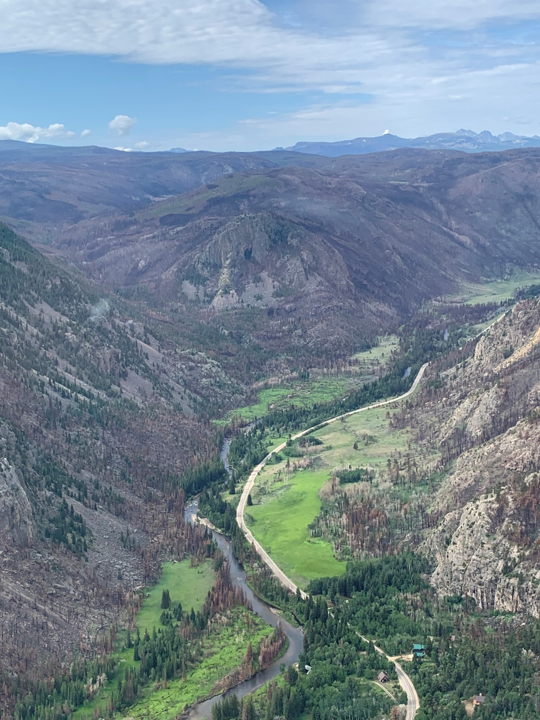
Projects in Cache La Poudre
Cameron Peak Fire
Recovery and resilience of Cache la Poudre River after wildfire fish kill (CSU)
Cameron Peak Post-Fire EWP Measures (Larimer County)
Landscape Scale Post-Fire Mitigation for the Cameron Peak
Fire to Protect Critical Watershed Values - Phase 4 (City of Greeley, Water & Sewer Department)
Credit: CWCB\
Photo: SB

Slide 10
Cameron Peak Fire Impacts
325 mile long fire perimeter
Over 1,050 stream miles (596 mi are in the Poudre watershed)
124 trail miles (95 mi in the Poudre watershed)
Over 41,700 acres of designated Wilderness Areas burned
32 miles of Wild and Scenic river corridor burned
Three watersheds affected - Poudre, Big Thompson & Laramie
At least five reservoirs that store and deliver water to the Front Range for agriculture and drinking water needs
At least 16 mountain communities and neighborhoods in the burn area or immediately adjacent to it have been affected
492 structures destroyed (residential and outbuildings)
Photo: SB
Credit: Poudre Watershed

Slide 11
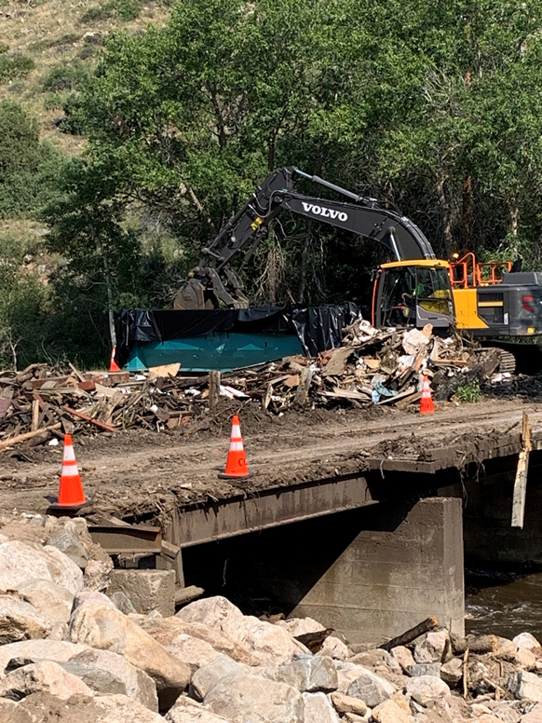
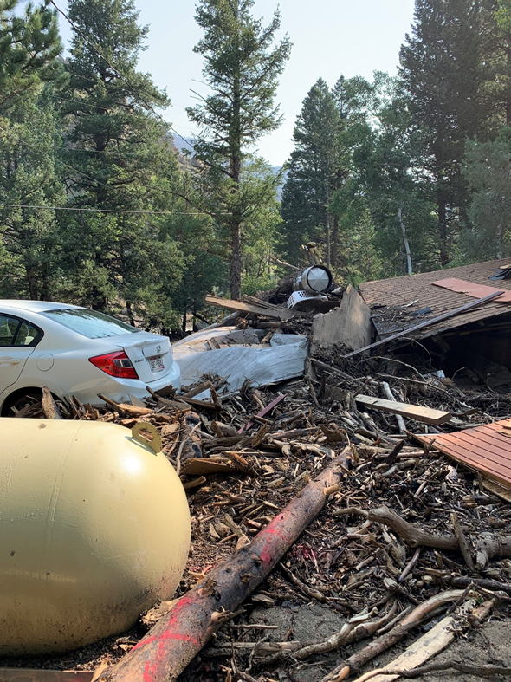
Black Hollow
July 2021 Flash flood and debris flow
River diverted
4 fatalities
Homes destroyed
Larimer County EMO hazardous debris removal
Credit: SB

Slide 12
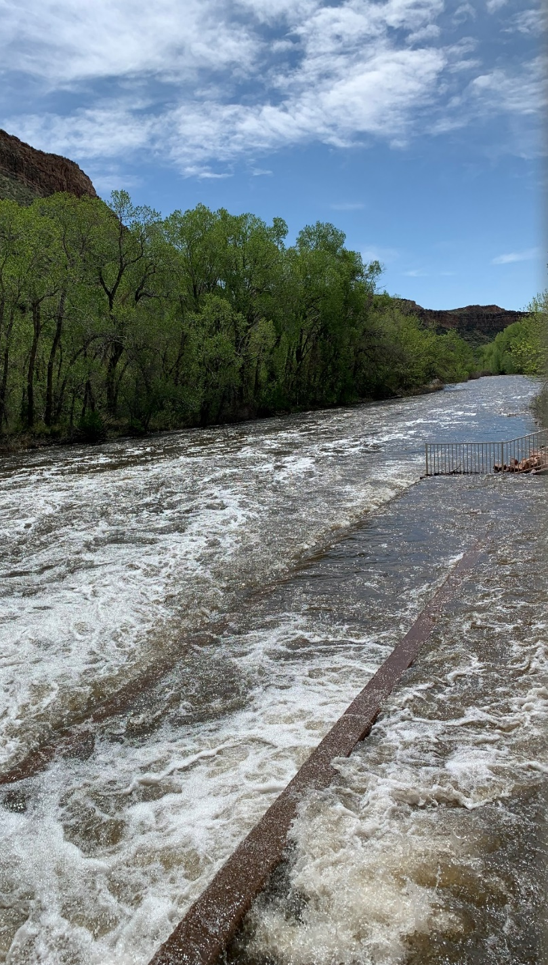
Projects in the Cache La Poudre
Watershed Health
Poudre Headwaters Restoration - Grand Ditch Barrier (Trout Unlimited)
Campbell Creek Restoration (Wildlands Restoration Volunteers)
Lower Cache la Poudre Priority Reach design Project and Fish Passage Design for Whitney and BH Eaton Reach,(Coalition for the Poudre River Watershed)
Hall-133 Riparian Restoration (Poudre Learning Center Foundation)
Credit: CWCB
Photo: SB, Watson Fish Hatchery

