Slide 2
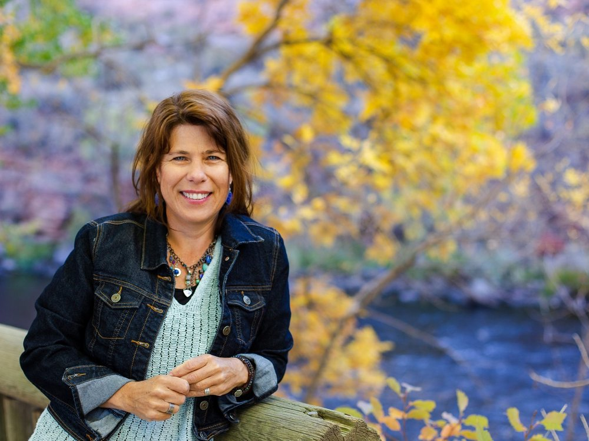
Edited by Gary Wockner & Laura Pritchett

Slide 3
Dedication:
To all those who have loved this river, those who do, and those who will
To the river itself, in the hopes it will always run well and wild
And to David Lauer, a true friend of the Poudre. He will be missed

Slide 4
Project conceived after announcement of
Glade Reservoir
Halligan Dam Expansion
Seaman Dam Expansion

Slide 5
Organized into four parts
Part 1: “Maybe I’m in Love”
Part 2: “A kind of Vertigo”
Part 3: “Spiral of Our Life”
Part 4: “Our bodies are Rivers”

