Slide 1
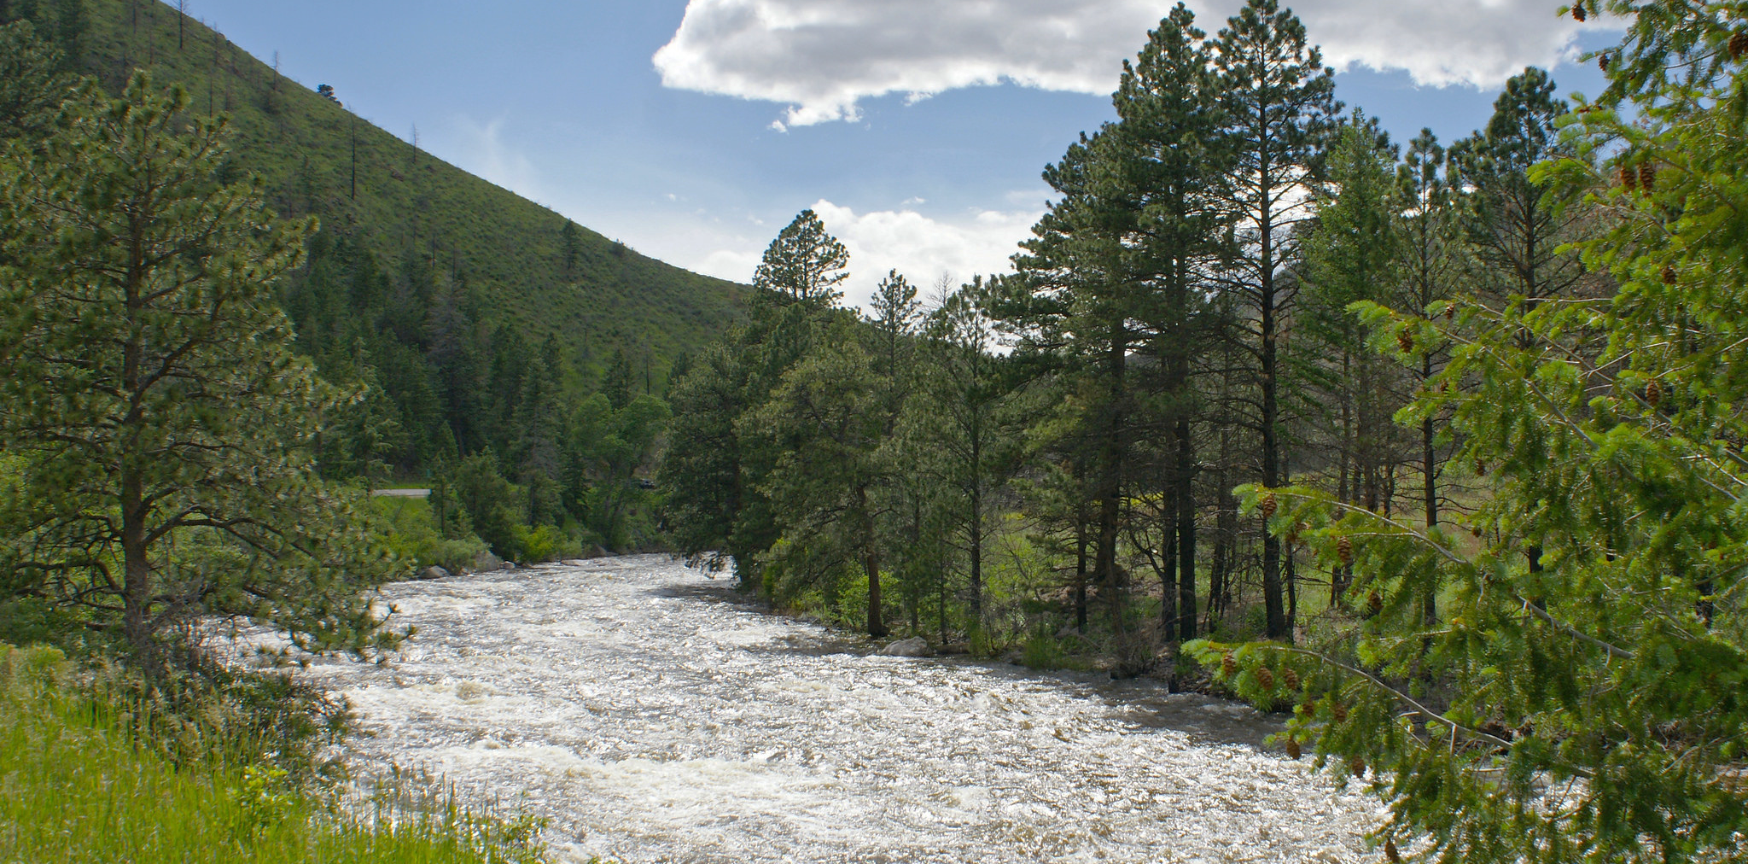
Water Literate Leaders Meeting: April 12, 2023
Fort Collins Utilities – Water Resources

Slide 2
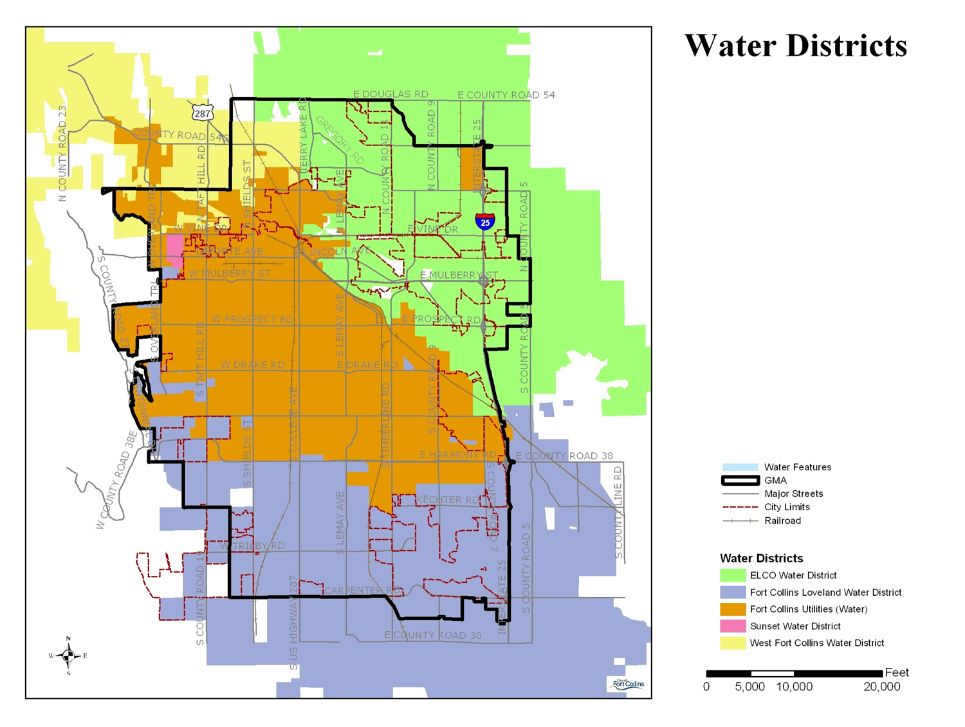
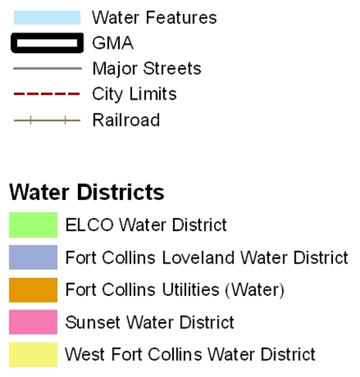
Service Area
Utilities Service Area
36,000 accounts​
145,000 people
24,000 AF​

Slide 3
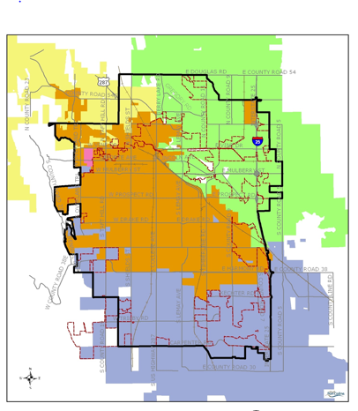
Challenges
Utilities service boundary, city boundary and GMA do not coincide
Significant differences exist:
Mission and vision
Policies
Organizational size
Water rights portfolio
Development patterns
Water Resources Matters Study
Notes:
Utilities the largest provider, with FCWLD and ELCO 2nd and 3rd. Districts purpose is to provide water. Very little planning and resources to do things like conservation, ect. Just speak to issues with different water rights, cost of water, development review and fees leads to difficult

Slide 4
Water Supplies

Slide 5
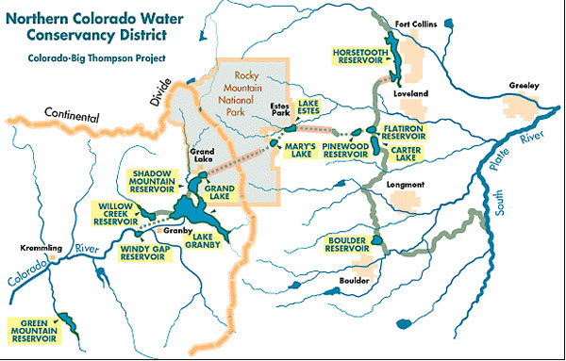
~50% C-BT Water Supplies
Horsetooth Reservoir
Utilities has access to 16,100 - 23,000 acre-feet of C-BT supplies each year

Slide 6
Water Supply Indicator: CBT Water Delivery Quota
CBT Quota
The amount of CBT water Northern makes available to allottees
100% quota = 1 acre-foot (AF) per CBT unit (last time was 2012)
Utilities has 18,855 units
November Initial Quota – 40%
Used for planning
Typically, 50%, lowest since 2003
Lower this year due to
Uncertainty regarding CO River Basin
Northern’s commitment to system resiliency
0.4 AF/share = 7,542 AF for Utilities
April 2023 Updated Quota – Typically 70%
Used for planning and (if needed) actions
Considers snowpack, CBT system storage, CO River Compact calls
0.7 AF/share = 13,198.5 AF
Notes:
Use for Water Senior Staff.
Use for CCSU.
A 100 percent quota makes 310,000 acre-feet of water available for delivery. In this scenario each C-BT allottee receives 1 acre-foot of water for each unit owned. Under a 70 percent quota each allottee receives 7/10 of an acre-foot per unit. And under a 50 percent quota declaration each allottee receives 5/10 of an acre-foot per unit.
https://www.northernwater.org/your-water/allottees/cbt-quota
Initial quota in Nov, typically 50%
Updated quota in April, typically adds another 20—30%
Can be additional supplemental quotas in summer, add another 10—20%
Last 100% quota year was 2012

Slide 7
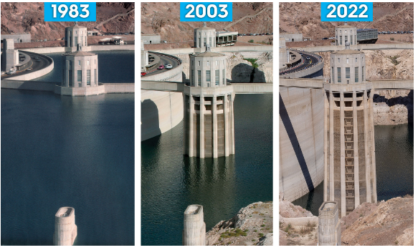
CO River Basin
CO River Basin in significant drought for over 20 years
CO River provides water to 40M people in seven states, two countries and 4,000,000 acres of farmland.
Lake Mead Water Levels
Source: Southern Nevada Water Authority
Notes:
Use for Water Senior Staff.
Use for CCSU.
Dept of Interior – Pursuing consensus among CO River Basin states, but also ready to take “prompt and decisive action necessary to protect the Colorado River System”.
Image: Lake Mead, showing power generation intake towers with dropping water elevation over time. Lake elevation has dropped about 170 ft since 2000. Impacts: In 2022, 1 water intake became inoperable due to low water levels. Added lower third intake in 2015 and low-lake pumping station in 2020 for $522 million. Power generation down 33% due to lower water pressure.
CNN —
The US Department of Interior announced Friday it is launching an “expedited” process to potentially change water-flow operations on the drought-stricken Colorado River, as Lake Mead and Lake Powell have fallen to alarming new lows.
In the possible actions it laid out, Interior said it will consider using its federal authority to restrict water releases through the Glen Canyon and Hoover Dams to help maintain water in Mead and Powell – the nation’s two largest reservoirs – and prevent the dams from losing the ability to generate hydroelectricity.
The seven Colorado River Basin states — Colorado, Wyoming, Utah, New Mexico, Arizona, Nevada and California — have been sparring over who receives the biggest reductions in allocations after Bureau of Reclamation Commissioner Camille Touton announced a 2019 deal with the states that hinged on them saving 2 million to 4 million acre-feet of water — as much as a third of the river’s flows — or the federal government would intervene.
https://rollcall.com/2022/11/03/tensions-rise-over-drought-stricken-colorado-river-water-use/

Slide 8
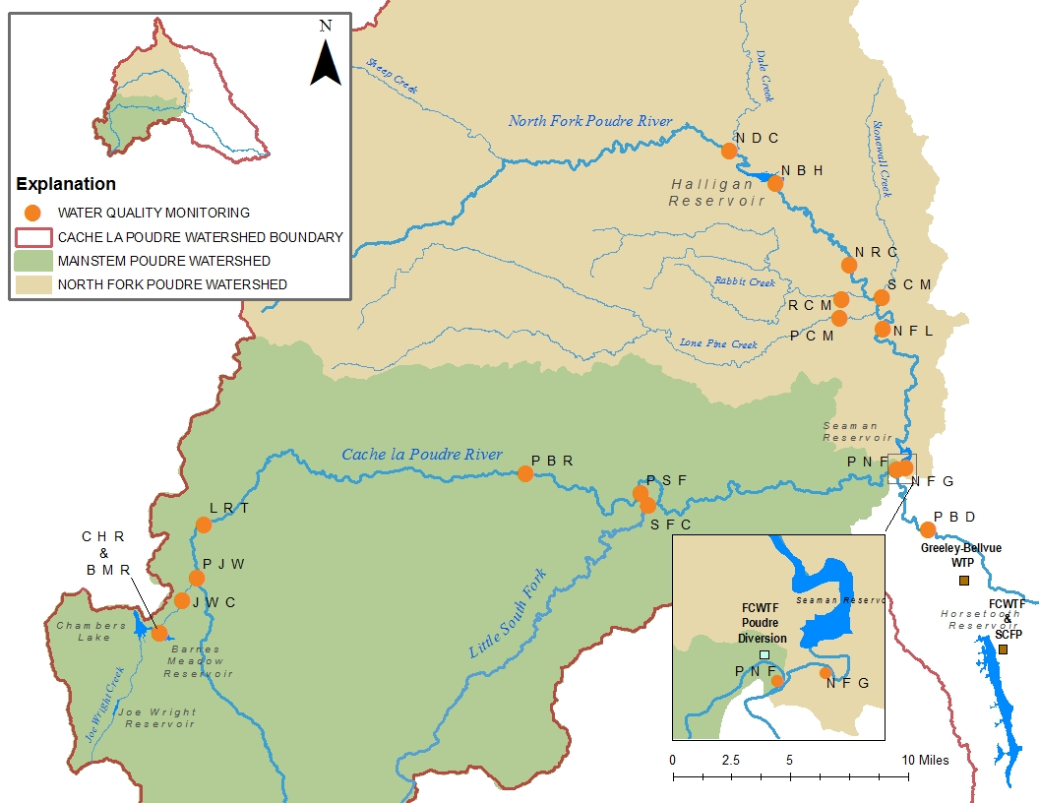
~50% Poudre Basin Water Supplies
Joe Wright Reservoir
Halligan Reservoir
Senior direct flow rights
Converted agricultural rights
Michigan Ditch/Joe Wright Reservoir system
Notes:
Create visual

Slide 9
Planning for the Future

Slide 10
Water: It’s Complicated
Increasing
Demand
Scarcity
Aging
Infrastructure
Increasing
Costs
Climate
Uncertainty

Slide 11
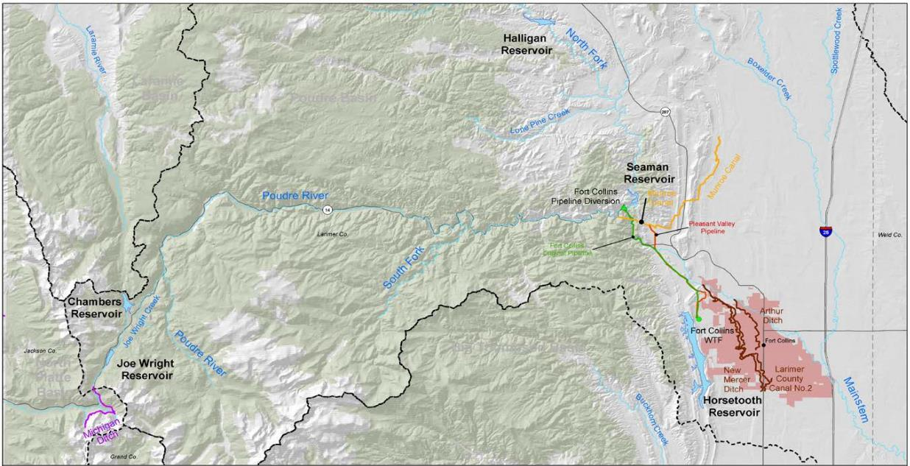
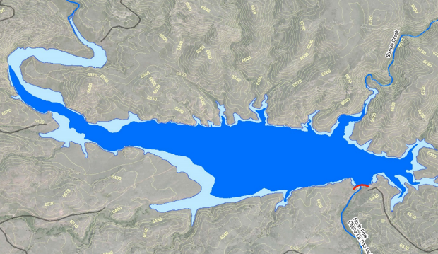
Poudre Basin Storage
Current Capacity: 6,400 AF
Proposed Capacity: 14,600 AF

Slide 12
Path Forward
Scoping, Purpose & Need, Alternatives, Studies,
Develop and
Issue Draft EIS
Scoping, Purpose and Need, Alternatives, Studies
2006-2018
2018-2019
Construction
Public
Comment
Period
Prepare and
Publish
Final EIS
Record of
Decision
2020
2020-2022
2023-2025
2026-2027
Other Permitting
Preliminary and Final Design
12
Notes:
As you know we’ve been working on this project for decades from feasibility into permitting and we’ve been in the permitting phase for over 13 years.
I’m thrilled to be able to tell you today that the DEIS is being released today.
We’re looking forward to public review and comment on this project.

