Slide 1
Best Practices for Implementing Water Conservation and Demand Management Through Land Use Planning Efforts
Lindsay Rogers,
Water Policy Analyst
April 12, 2023
Notes:
Introduce

Slide 2
Western Resource Advocates
MT
WY
Federal & Regional Collaboration
NV
UT
State Legislatures
CO
State Agencies & Commissions
AZ
NM
Local Governments
Electric Utilities
Diverse Coalitions & Communities
WRA works across seven states in the Interior West to protect our climate, land, air, and water.
Notes:
WRA is an environmental nonprofit and we work across seven states in the Interior West to protect our climate, land, air, and water.
And we do that by developing policy solutions and then working with decision-makers like state legislatures and commissions and local governments to help implement those solutions.
I’m based in Denver and my work on our Healthy Rivers Program team is really focused on advancing municipal water conservation and integrated water and land use planning programs and policies so that we can build more climate resilient communities while reducing the strain on our limited water resources.

Slide 3
AGENDA
Integrated Water & Land Use Planning
Introduction
Overview of strategies throughout the development process
Examples & case studies
Question
Notes:
Integration of Water & Land Use Planning
Introduce the topic, define some of the terms you’ll be hearing and some of the trends we’re seeing recently in the water & land use planning space
Quick overview of the various opportunities and tools we have throughout the planning and development process to consider water and demand management strategies
Then I’m going to spend most of my time walking through some examples from throughout the development process of some specific tools we can leverage that I think are particularly impactful when it comes to reducing our water demand
And then I’ll leave plenty of time for questions at the end

Slide 4
Why does municipal water use matter?
7% of total water use in Colorado
By 2050, 360,000 acre-feet/year projected M&I supply and demand gap
Population projected to be 7.5 million in 2050
Climate change & prolonged drought exacerbate supply challenges
~$93,000 - $98,000 per 1 AF of C-BT project water
More demand can lead to buy-and-dry and increased pressure on rivers
Notes:
Muni sector is small – it makes up about 7% of total water use in Colorado with the rest going to ag and industrial users - BUT we’re facing some pretty serious challenges in the municipal sector
By 2050, the CWP estimates that our Municipal and Industrial sector will face a 360,000 AF supply and demand gap. To put that in perspective in 1 AF/year is about enough water for 2 CO households, so that’s about the equivalent of what 720,000 CO households use in a year.
And this projected gap is largely because our population is growing so by 2050, Colorado is projected to grow by over 1.5M people AND because climate change and our prolonged drought conditions – or aridification in the region – are straining our limited water resources AND increased temperatures are leading to higher demands.
And that’s coupled with climate change and prolonged drought – or aridification in the region – straining our limited water resources
And this increased demand on limited supplies means the price of securing new supply is accelerating and only expected to go up, here in Northern CO we often look to the CO Big Thompson project managed by Northern Water to get a sense of water prices and – the current price to secure 1 AF of C-BT water is nearly $100,000
And this increased demand also means or municipal demands can impact other water users in the state like our farmers and ranchers through “buy and dry” water transactions and through increased pressure on our rivers and the wildlife that depend on them
And I’ll add that as we all know we have a really good water year a strong snowpack right now but unfortunately, it’s not going to be nearly enough to negate these long-term trends

Slide 5
Shift to Demand-side Water Management
Water Conservation = Encouraging water users to reduce their use
Water Efficiency = Requiring/encouraging the use of technology, building, or site design that uses less water
Water Reuse = Treating or converting gray and black water to replace/augment supplies
Notes:
So all of these challenges are why, more and more of our communities are shifting from a supply-side to a demand-side water management approach where they’re investing in demand reduction strategies instead of a more traditional focus on acquiring new supplies.
3 main types of demand-side water management strategies –
Water conservation: Encouraging water users to reduce how much water they use
Water Efficiency: is when we require or encourage the use of technology, building or site design that uses less water
And Water reuse is when we treat or convert gray and black water to replace or augment water supplies
When we talk about integrated water and land use planning, we’re really talking about how we can integrate water conservation, efficiency and reuse strategies into all stages of land use planning

Slide 6
Decoupling Growth from Demand
Fort Collins grew 6% from 2000 to 2015 and saw total water use reductions of 14%
Denver grew 17% from 2000 to 2015 but saw total water use reductions of 28%
Colorado Springs grew 92% since the mid-80s, but the City is using about the same amount of water today as it was 40 years ago
Notes:
When we shift to implementing these demand side solutions at-scale, we can actually start to decouple our population growth from our water demand meaning that even in the face of population growth and climate change, we can reduce our overall system demand and avoid or seriously downsize the need for new supplies

Slide 7
Reducing Outdoor Water Use
Nearly 50% of municipal water supplies in Colorado are used outdoors, mostly irrigating high water use turfgrass
Outdoor water use is consumptive
Replacing or limiting non-functional turfgrass is one our most impactful demand reduction opportunities
Notes:
And one of the main themes you’ll notice in our discussion is a real emphasis on outdoor water use in Colorado, so just a little context for why that’s the case
Almost 50% of our municipal water supplies in Colorado are used outdoors, and most of that water is going to high water use, cool season grasses like Kentucky Bluegrass – which has been a very, very common feature of our landscapes in Colorado for a long time
And the water that we apply outdoors is especially critical because it’s almost entirely consumptive, meaning the water we apply to our landscapes either evaporates or gets used by the plant and unlike indoor water use – it doesn’t get treated and reused somewhere down the line.
A term that’s being used more and more in the West is non-functional turfgrass – and to put that simply this is the type of turf where the only person walking on it, is the person mowing it. This could be tree lawns, median strips, sloped areas, parts of office parks, our front yards. And it differs from functional turf which serves an important recreational value or purpose so soccer fields, picnic areas, maybe backyards that our kids and dogs use.
And we know that limiting the amount of non-functional turfgrass and thus the amount of water we apply to our landscapes – while still protecting our street trees and all of the important benefits of our urban landscapes is a really impactful demand management opportunity

Slide 8
Why integrate water & land use planning?
Historically siloed, leading to inefficiencies
Significantly reduce the water demand of new and redevelopment
Empowers communities to improve water efficiency within their own context
Align water supply and demand to increase resilience to drought and climate change
2015 CWP Measurable Objective:
By 2025, 75% of Coloradoans live in communities that have incorporated water saving action into land use planning.
Notes:
Why integrate water and land use planning? Why is this important to reaching our demand management goals?
Historically the fields of water management and land use planning have been siloed, so the long-range planners and community development folks would determine how and where the community develops and then the water resource managers and public works directors (who may be in a separate dept or even a separate agency) would figure out how to supply safe and sufficient water for the growing community. But in recent years there’s been a growing recognition that that siloed approach often leads to inefficiencies and a lot missed opportunities to grow water smart throughout the development process.
When we integrate our water management into land use planning we can significantly reduce the water demand of our new development and our redevelopment, bolstering our water security
Empowers communities to improve water efficiency within their own context, so it recognizes that everyone community is different and it allows communities to include their own values and aesthetics and priorities in the process
And as we talked about, this helps us to increase our resiliency to ongoing and future droughts
Helps to align water supply and demands, even with population growth and declining supplies
And fortunately, just in the last 10 years or so there’s been more and more emphasis in CO around the value of this integrated approach and one of the original CWP measurable objectives developed in 2015 was that by 2025, 75% of Coloradoans would live in communities that have incorporated water saving actions into land use planning
- And I know a few organizations have tried to measure success on that objective and we’re currently somewhere in the ballpark of 60-80% of Coloradoans living in communities that have taken some action. Which is really encouraging and we’re going to talk about some examples of communities doing this.

Slide 9
Comprehensive Plans
Capital Improvement Plans
Water Efficiency Plans
Planning & Policy Making
Water adequacy requirements
Conservation-oriented tap fees
Pre-
Development
Zoning and subdivision regulations
Annexation policies
Planned development policies
Process incentives
Development Review
Building and plumbing codes
Landscape regulations
Water conservation rate structuring
Conservation incentives & education
Outdoor watering restrictions
Water budgets and auditing
Building & Construction
Post-
Occupancy
Notes:
So now I’ll walk through some of the specific tools available to us to integrate our water into land use planning, that happen at different intervention points throughout the development process. And this isn’t an exhaustive list but just some examples.
Planning & Policy Making Phase – This is when we’re setting the goals and vision for our community and they’ll influence our policy priorities for years to come.
This includes Comprehensive Plans which guides how communities will manage future land use and its implications for a lot of different community functions like transportation, parks and open space, housing affordability, economic development and, of course, water resources.
Capital Improvement Plans where we forecast and match our communities’ projected revenues to our capital project needs and will help ensure that our water infrastructure priorities are resilient to climate change and accounting for demand-side water management.
And then WEP – are a state requirement for water providers that sell 2,000 AF/yr of water in Colorado and our WEP outline our goals for water demand reduction, the strategies we’re going to implement to reach those goals and they present an opportunity to think through tools available throughout the land use planning process to reduce demand
2. Pre-Development Phase – which we use to link new development to water supply planning
- Water Adequacy requirements are a state requirement that requires local governments to determine that a proposed development will have an adequate and sustainable water supply for build out, and this will include demand projections for the new development and presents and opportunity to include pre-development requirements or incentives to reduce that projected water demand through conservation or efficiency practices.
Conservation-oriented tap fees: Water provider sets the fee schedule for how much a new development will need to pay for new water resources and infrastructure costs and this is another opportunity to incentivize more conservation activities.
3. Development Review Process – which can be used to determine what conservation and efficiency requirements or incentives are applied to new development.
Zoning and Subdivision regulations: which can encourage efficiency by allowing or encouraging certain forms of new development
PUDs and Annexation applications: When a community is reviewing annexation applications and Planned Unit Developments (PUDs) they can make approval conditional on meeting water conservation standards.
And they can also provide Process Incentives – so a faster review time or potentially leniency on certain measures to incentivize efficiency
4. Building and construction – This is where we can implement water efficiency tools and best practices into our building, plumbing and landscaping codes. So for example adopting the green plumbing code, adopting a graywater reuse ordinance, requiring submetering for MF-housing, and then we’ll talk about some of the specific strategies for reducing water demand in the landscape later on.
5. And finally, Post-Occupancy – these are the strategies that typically come to mind when we think about traditional water conservation programs.
Setting our water rates to encourage conservation by driving up the price of water when we hit certain tiers of usage or tying or water rates to a personalized household water budget where we’ll pay a premium for exceeding.
This is the conservation and education activities and programming our communities invest in so maybe they participate in “The Mayor’s Water Challenge” or they have a water wise demonstration garden or providing rebates or financial incentives for water conservation tools.
It could certainly be summer watering restrictions or water waste ordinance that limit the number of days and time of day you are able to apply water to your landscape
Assistance with conducting water audits on large properties to see how they could become more efficient.

Slide 10
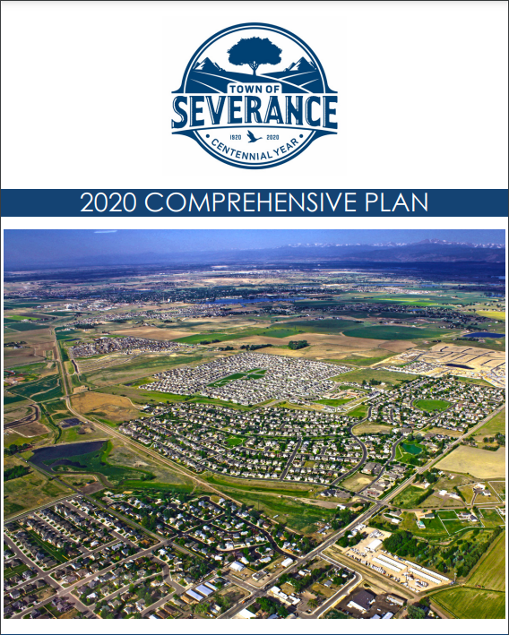
I. Planning & Policy Making: Comprehensive Plans
HB20-1095: Water in Master Plans
Discrete water system & utilities chapter
Identified specific policies & strategies for securing new supplies & demand reduction
“Any proposal for changing land uses in or around Severance will be evaluated based on… Water resource availability and commitment to water efficient development practices.”
Notes:
WRA worked with Severance on their Comp Plan update back in 2020 and at least at the time Severance was the fastest growing community by % in Colorado. And this was interesting timing – first because they were doing this at the start of COVID – and because the state had just passed HB20-1095, which was a piece of legislation that WRA supported, that said that IF a city or county was going to include water in their Comp Plan then they had consider water conservation elements and CO Water Plan objectives.
So we were tasked with helping Severance develop that water and water conservation element of their Plan and we worked with their land use Planners, their public works director and then their planning commission, city council and other interested community members
And we worked with them to develop stand-alone chapters to outline their water system and utilities and then to think through how to incorporate water throughout – in their future land use categories, their guiding principles and in their implementation sections
“Any proposal for changing land uses in or around Severance will be evaluated based on… Water resource availability and commitment to water efficient development practices.”
Recently checked in with them and they’re implementing policies identified in their plan so they update their MF standards to include water wise landscape provisions and density standards and they’re on schedule this year to update their commercial development code and their open space code both with emphasis on water conservation standards.

Slide 11
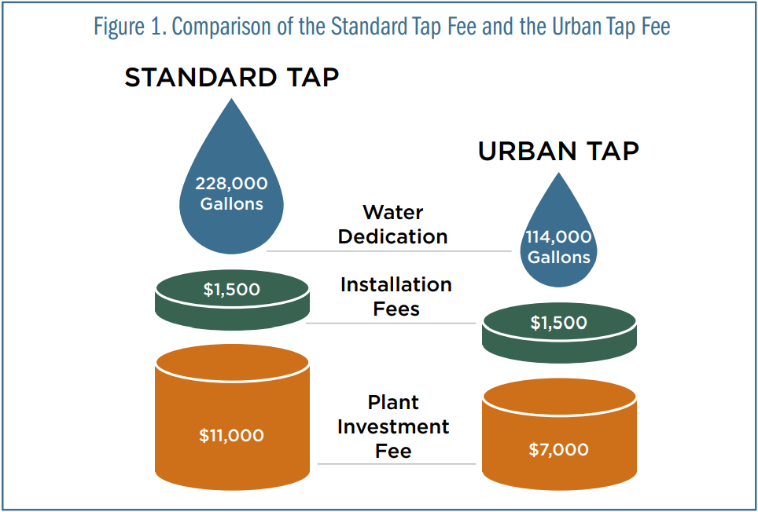
II. Pre-Development: Conservation-Oriented Tap Fees
Traditionally based on meter size
Conservation-oriented tap fees based on:
Lot size
Landscapable area
Number of bedrooms or bathrooms
Example: Little Thompson Water District
Notes:
Conservation-oriented tap fees are an opportunity in the predevelopment phase that incentivizes conservation by actually trying to more closely tie tap fee costs to actual water use. So traditionally, tap fees or system development charges, have been based on meter size. So for a single-family development that uses a 5/8 or ¾ inch meter you’ll pay the same water resources fee and a plant investment fee. But more and more, Colorado utilities are developing their tap fees based on factors like lot size and landscapable area and the number of bedrooms or bathrooms – so that a smaller home on a smaller lot with more water wise landscaping will pay a lot less for their tap fee than a mansion on 3-acre parcel.
As an example, WRA developed a guidebook on conservation-oriented tap fees in 2018 and we highlighted Little Thompson Water District, which services about 8,000 residential connections in Northern CO. And recently, they’ve noticed that new residential development was becoming a lot denser and more typical of urban areas so in 2016 they revised their tap fee structure to create an Urban tap option for smaller lots. So as you can see, for the urban tap the water rights dedication and the plant investment fee are both significantly lower than under the “standard” tap. BUT - Urban tap customers are on the hook to stay within their 114,000 gallon annual water budget and if they exceed that then they’ll pay a surcharge.
WRA is updating this guidebook this year and add new case studies this year.

Slide 12
III. Development Review: Zoning Codes
Compact, infill development reduces water demand and infrastructure costs
Compared to a single-family home:
ADUs = 22% less water
Small Multi-Family Unit = 63% less
Large Multi-Family = 86% less
(Keystone Policy Center, 2018, Colorado Water & Growth Dialogue Final Report)
Notes:
Compact infill development reduces water demand and infrastructure costs through shorter pipes that reduce losses, less 15 landscaped space per unit, and better use of existing infrastructure
Compared to a single-unit detached dwelling, accessory 17 dwelling units use twenty-two percent less water, small multifamily homes sixty-three percent less, and larger multifamily homes eighty-six percent less, based on data from Denver and Aurora water users analyzed 20 for the Colorado water and growth dialogue Final Report in 2018.
https://www.keystone.org/wp-content/uploads/2018/06/Colorado-Water-and-Growth-Dialogue-Final-Report_June-2018.pdf

Slide 13
IV. Building & Construction:
Landscape Regulations
Example: Town of Castle Rock
No lawns in front yards & limited to 500 sq ft in backyards
Soil amendment & mulch
Irrigation efficiency best practices
Requires landscape/irrigation professional certification
Notes:
Landscape regulations, and landscape regulations are an important opportunity to significantly limit the water demand of new landscaping. And limiting water demand in new development is going to be a lot more efficient and cost-effective than retrofitting existing properties which we’ll talk about next.
Water wise landscaping codes have been in the news a bit recently because both Aurora and Castle Rock recently passed some of the strongest landscape codes in CO that significantly limit the installation of new high-water use turfgrass. And other cities, like Greeley, have also passed some strong landscape codes recently.
Castle Rock’s code prohibits lawns in front yards and it limits lawns in backyards to 500 sq ft and then their code also includes a lot of other best practices for water wise landscaping including an approved plant list with native and drought- tolerant species, requirements around applying soil amendments like compost and mulch like gravel or wood chips which help retain water and reduce demand, their code includes standards around how to design, install and maintain an irrigation system to be as water wise as possible
And then CR’s codes also requires that people who are designing and installing landscaping and irrigation must be trained and certified in water wise best management practices a program called QWEL (the Qualified Water Efficient Landscaper program). And this is important because unlike other skilled trades like plumbers and electricians, the State of CO doesn’t have any kind of license or certification requirements for the landscaping industry currently and so it’s up to local jurisdictions to implement those requirements and to ensure that the professionals working on these projects are able to comply with the landscaping code and install a water wise landscape.

Slide 14
V. Post-Occupancy:
Turf Replacement
29 cities/water providers offer turf replacement incentives
Residential & Commercial
~$1-$2 per sq ft rebates
Programs save ~1-2 AF/acre/yr
Resource Central partnership
$2M appropriated through HB22-1151: Turf Replacement Program
“Introduce a program to reduce the quantity of non-functional turf grass by 30% through replacement with drought- and climate-resilient landscaping...”
- CO River Basin MOU, Aug 2022
Notes:
Finally, I’ll talk about the other side of the equation which is what cities and water providers can do to reduce landscape water demand in existing properties.
So turf replacement projects incentivize homeowners or business owners to replace their non-functional turfgrass with drought-tolerant, native plants and grasses that in addition to saving water, have many other benefits like creating pollinator habitat and reducing air pollution from lawn mowing and drought-proofing our landscape investments. And this is some detail on the current state of turf replacement programs in CO:
To our knowledge, there are currently 29 cities and water providers that will be offering turf replacement incentives this coming summer. Northern CO: Greeley, Fort Collins, Longmont, Northern Water, Berthoud, Evans, Frederick, Loveland Water & Power…
And some of these programs are geared towards residential customers whereas others are geared towards larger commercial or institutional customers, like Northern Waters programs
Most programs offer a rebate amount that’s in the ballpark of $1-2 per square foot
And based on data from those that are measuring their savings, they’re seeing savings of about 1-2 AF/acre/ yr so as you can imagine – at scale – these programs can result in significant savings
And then a number of providers on the Front Range partner with Resource Central, a Boulder-based non-profit to administer their landscape programs through their turf removal and Garden in a Box programs. Anyone ever used Resource Central?
This topic is really timely because last year the legislature passed HB22-1151 which created the first statewide turf replacement funding program with an initial allocation of $2M and they actually just closed the first round of applications for those funds on March 31st. So we don’t know how many communities applied yet but are anticipating a lot of interest in the funds, and even just given the media attention that the bill got last session many of our municipal partners reported that they saw unprecedented demand for their turf replacement program funds. This is actually a bill that WRA got to work on and help draft and we’ll also be working to secure additional funding for the program moving forward.
And then another thing that’s really helping to accelerate investment in turf replacement is last summer with the ongoing supply shortages on the CO River, a number of water providers came together and signed an MOU that committed them to a number of different water conservation actions and one of the most concrete actions was their commitment to introduce a program to reduce the quantity of NF-turf grass in their communities by 30%. So far there are 30 signatories including Aurora, Denver, Pueblo and Castle Rock. So that’s a huge and potentially very impactful commitment these communities have made and there’s still opportunities for other communities to sign on.

Slide 15
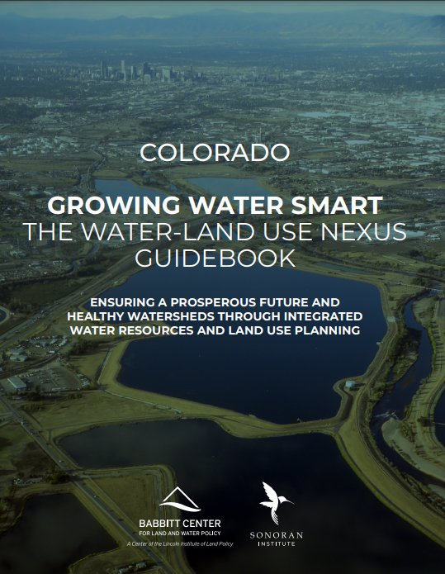
Want to learn more?
3-day workshop
Community teams of 5-7 planners, water managers & electeds
Develop 12-month action plan
Follow-up technical assistance
sonoraninstitute.org/growingwatersmart/
Notes:
That was a lot of information in a short amount of time and if this topic is of interest to you, I would strongly encourage you to check out the Growing Water Smart Program. And this is an image of the Guidebook that’s publicly available online and covers many of the topics we walked through today but many more examples and useful resources.
Anyone had a chance to participate in GWS?
So this is a program that was developed by the Babbitt Center and the Sonoran Institute and WRA has been involved with it in CO since 2017 and we actually launched Growing Water Smart in Utah just last year. It’s a 3-day highly interactive and intensive workshop that brings together community teams of 5-7 planners and water managers and local electeds and other community leaders to develop a 12-month action plan for how they want to start or further the integration of water and land use planning in their communities. And then, after the workshops, communities are eligible to take advantage of follow-up technical assistance to implement their Plan.
So this is a really incredible resource for communities that are starting to undertake integrated water and land use planning and actually, Sonoran estimates that 62% of Coloradoans live in communities that have participated in GWS.

Slide 16
LINDSAY.ROGERS@WESTERNRESOURCES.ORG

