Slide 1
Water Literate Leaders of Northern Colorado
Water Supply and Demand: Municipal Organizations
Mariel Miller, Fort Collins Utilities, Water Conservation Manager
April 12, 2023
Notes:
Good afternoon, Water Literate Leaders.
My name is Mariel Miller and I’m the Water Conservation Manager for Fort Collins Utilities.
It’s a pleasure to be here today and an honor to share more about Fort Collins Utilities supply and demand.
I’m going to focus mostly on demand management or what is also sometimes called water conservation and efficiency. You can think of it in terms of supply and demand, the act of managing demands so there is enough supply.

Slide 2
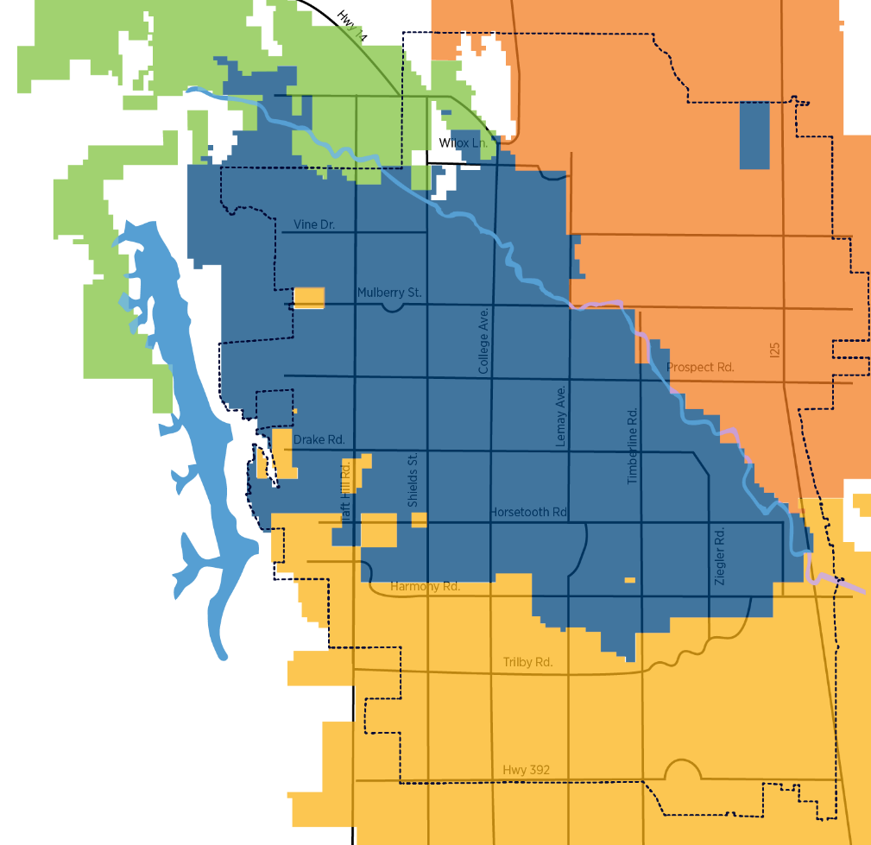
Fort Collins Utilities
West Fort Collins Water District
Water by the Numbers (2022)
ELCO Water District
Poudre River
137,000 people
(70% of population)
33,000 residential accounts
3,00 commercial accounts
Horsetooth Reservoir
Fort Collins Utilities
Average 22 million gallons per day (MGD)
~40 MGD peak
8 billion gallons a year
Award-winning taste!
Fort Collins Loveland Water District
Notes:
Fort Collins Utilities serves about 70% of the City’s population. We are boarded by a few other water districts, which can present challenges and also opportunities for regionalism when it comes to supply and demand efforts.
We treat about 8 billion gallons a year and about 22 MG a day
We have about 36,000 customer accounts

Slide 3
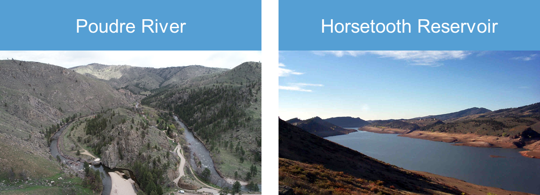
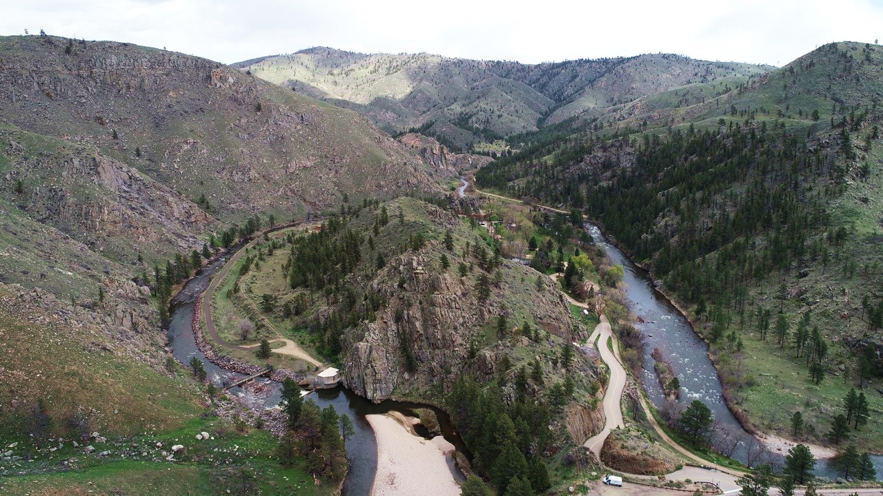
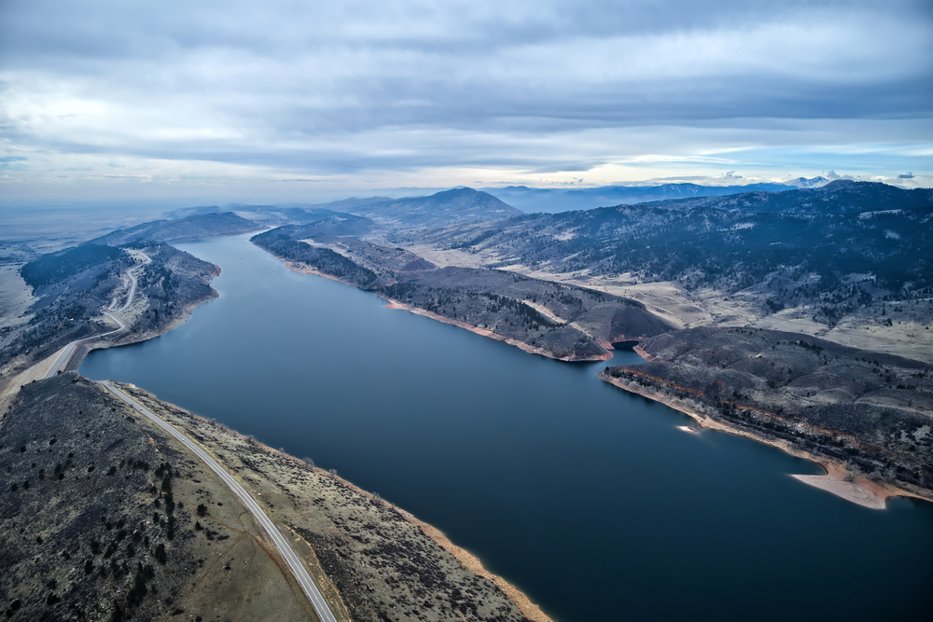
Fort Collins Utilities - Supply
Cache la Poudre River
2 Sources of Supply:
Each source provides about half of our annual water
Redundancy is good, but we also need both
Supply Challenges:
Climate impacts:
Less snowpack
Colorado River Basin
Earlier runoff
More frequent water restrictions
Stress to trees and other landscapes
We have good water rights, but lack storage capacity
Halligan Reservoir
Horsetooth Reservoir
Colorado-Big Thompson Water
Notes:
We are lucky to have two sources of supply, which allow us to switch from one to another to treat and deliver, depending on what we have for supply and water quality in either source
In a year, we will use about 50% of each source
We have good water rights, but we lack storage for those, especially true of the Poudre River system
This inability to store water during good water years is further impacted by hotter and drier climate
This leads to a number of challenges such as more frequent water shortages, less snow pack, which means less supply

Slide 4
WATER CONSERVATION DEPT. – Demand Management Efforts
WHAT WE DO:
Create, implement and evaluate water efficiency/conservation policies, plans, programs, and services to help customers and meet cross-departmental goals.
Demand management is utilizing water efficiency, conservation and using other alternative supplies like graywater to reduce water use
We started managing demands in 1977
Over 16 programs with measurable water savings
Additional education and customer support tools and services
We’re beginning to look at policies and code regulations more
Notes:
I manage a team of 7 with a diverse skillset to address all the water demand complexities that exist – horticulture, irrigation specialists, planners, project managers, data analysts.
We have been managing demands since 1977 and have built a robust set of services and programs to address indoor, outdoor, residential, commercial, industrial, MF water use.
We have primarily been focused on incentives and voluntary programs, but are beginning to look at more policy solutions that could take the form of requirements or codes.

Slide 5
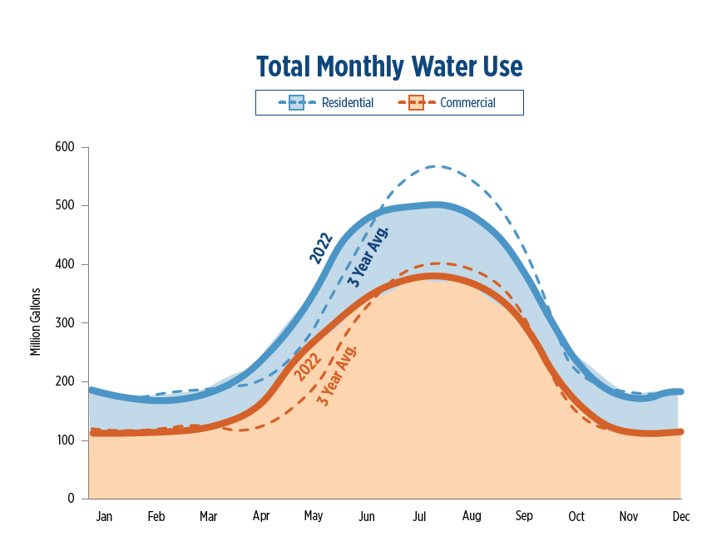
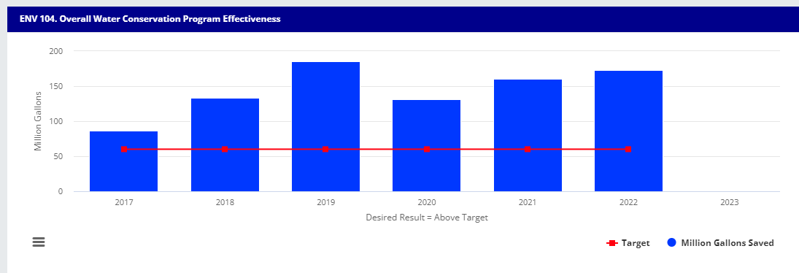
Fort Collins Utilities Demands in 2022
Colorado-Big Thompson Water
Notes:
The graph on the top left is water use in 2022 and the 3-year average. Commercial is orange and residential is blue
You see this bell curve shape that is notorious for western states. Does anyone know what this might signify?
We have a pie chart that shows what amounts are comm. vs. residential and a break out of residential
43% is outdoor use in 2022
Estimated water savings from measurable programs – this number is crawling back from the dip it took in 2020, when folks weren’t engaging or participating as much.
You can see it’s only about 2-3% of our total treated demands

Slide 6
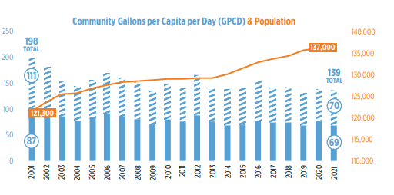
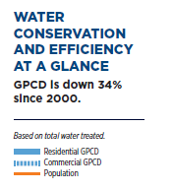
Fort Collins Utilities - Demands
Water Efficiency Goal: 130 GPCD by 2030
5-year average is 138 GPCD
2022 is also 139 GCPD and should have been 138 if on target
Need 6.5% reduction to reach goal
Colorado-Big Thompson Water

Slide 7
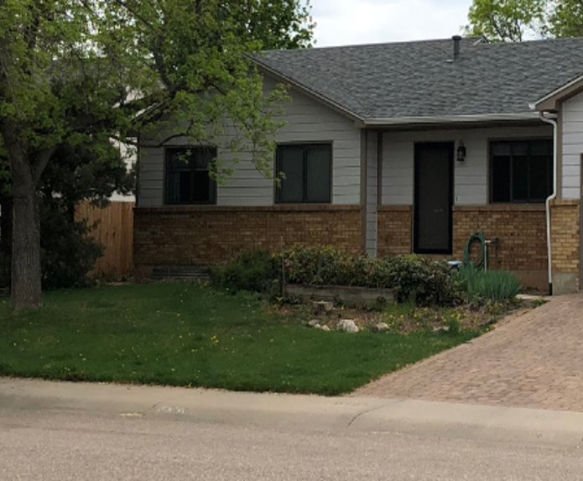
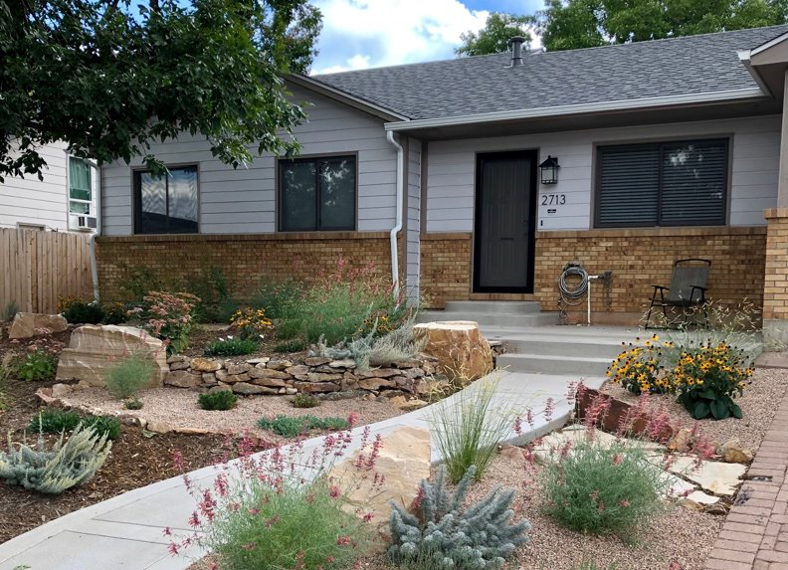
Fort Collins Utilities - Demands
Demand Challenges:
Growth
Water rights limiting reuse/graywater
Leaks in distribution system
Outdoor opportunities, but...
Knowledge
Aesthetics
Trees
Behavior
Low hanging fruit has been picked
Moving from voluntary to mandatory
Rental housing
Climate Impacts:
Hotter, drier means more water use (also less supply)
How do we match demand management to projected supply to ensure sustainable supply?

Slide 8
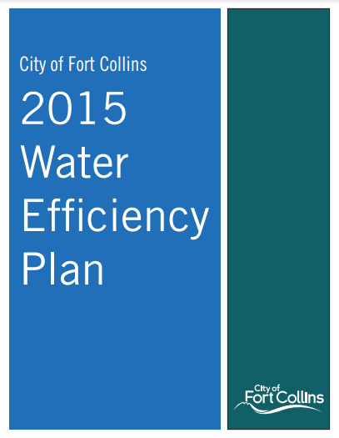
Water Efficiency Plan Update
Update timeline is 2023-2024
One Water – integrated planning
Equity analysis
Climate impact and water saving strategies modeling

Slide 9
Mariel Miller, Water Conservation Manager
MaMiller@fcgov.com

