Slide 1
Centennial
James A Michener
1974

Slide 2
Overall Review
Centennial = Greely
Inspired by true events
Sand Creek Massacre (History Colorado Center in Denver)
Levi Zendt = William Bent (trader and rancher)
Hans “Potato” Brumbaugh = Rufus “Potato” Clark (University of Denver)
You can watch the mini-series but Michener’s writing is supreme!

Slide 3
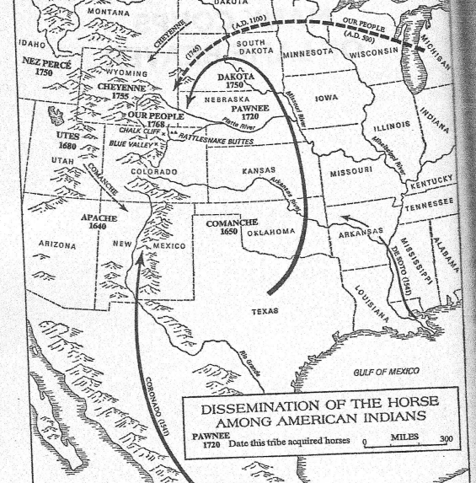
The Land, The Inhabitants, and the Many Coups of Lame Beaver (Geology, Dinosaurs, and Native People)

Slide 4
The Yellow Apron
Beaver trappers from Missouri River
Indian battles among each other
Rumors of gold in the streams of Rocky Mountains
Early attempts to rendezvous and negotiate about trade and land

Slide 5
The Wagon and the Elephant
PA butcher - migrants by horse and wagon
Flatboat boat to St Louis down the Ohio River
Fort John = Fort Laramie
Elephant makes you turn around

Slide 6
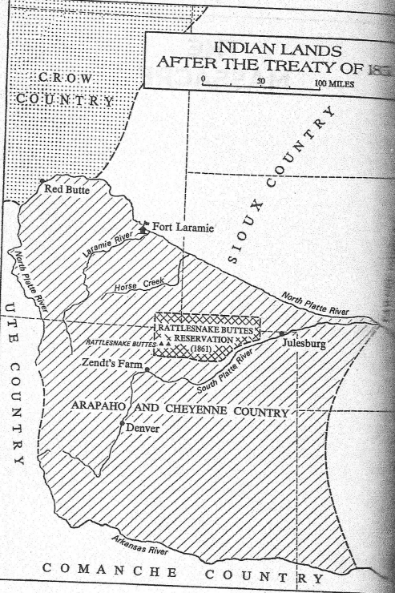
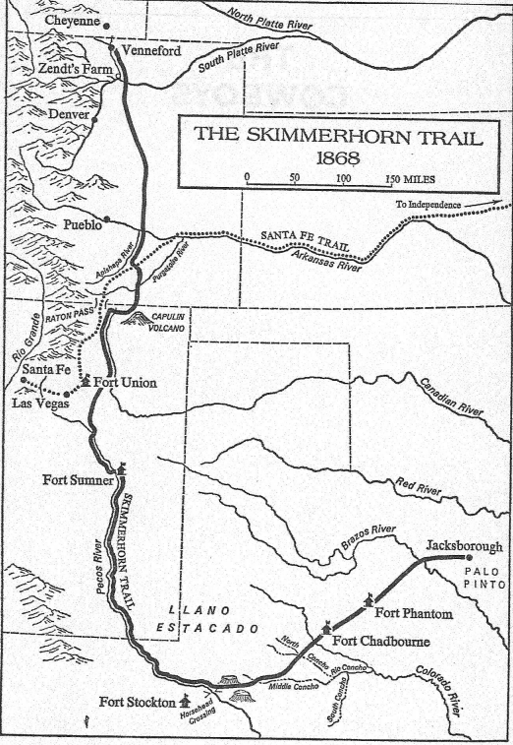
The Massacre and The Cowboys
The Great PowWow and it’s failure
Cattle runs from TX to WY – arid wasteland (marked by skulls)
Zendt Family once heros now traitors
No sharing of the river water with Indians = starvation

Slide 7
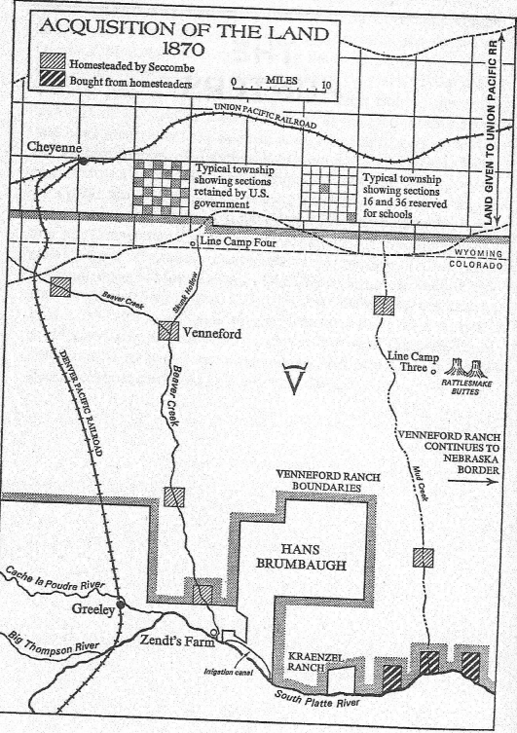
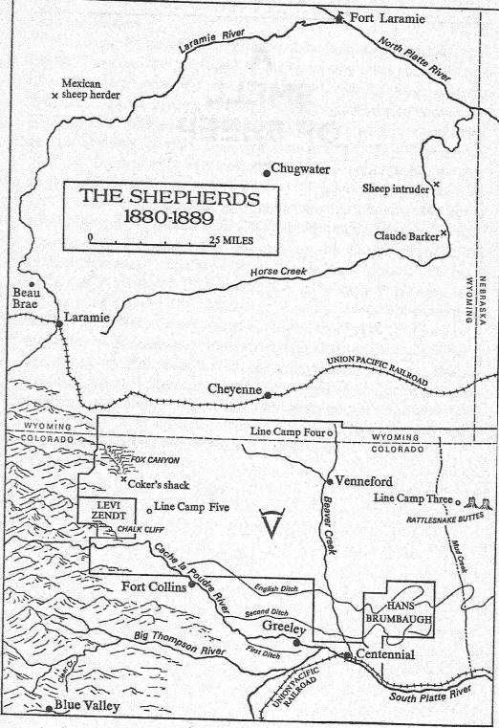
The Hunters and A Smell of Sheep
Gold to farms
Railroad
Sheep smell bad
First water right via ditch as no spare river land

Slide 8
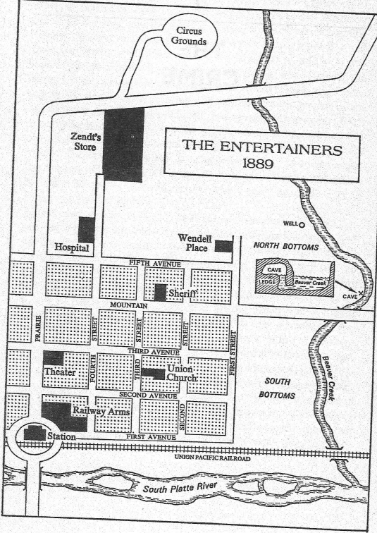
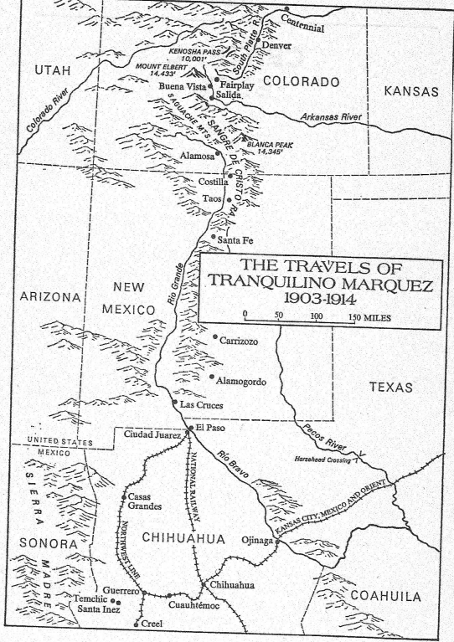
The Crime and Central Beet
Traveling entertainers and a murder
Beet farmers – Russians, Italians, Germans, Mexicans
Mexican revolution
Marketing to bring settlers with promise of irrigated land

Slide 9
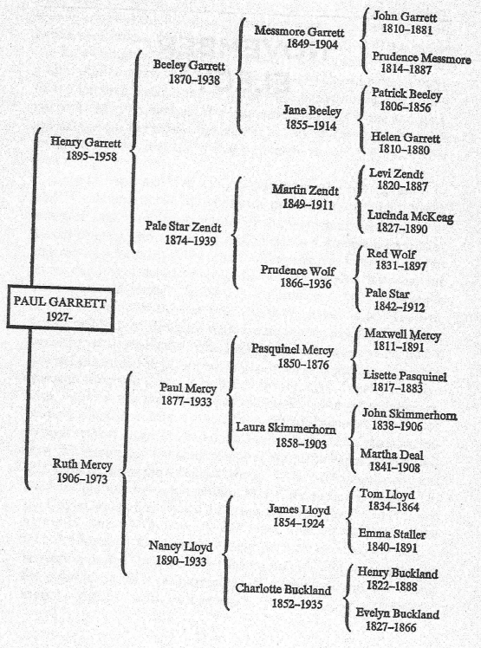
Drylands and November Elegy
Farmers vs ranchers
Drought and wind storms
Failure ghost towns and successes
Colorado = mother of rivers
Precarious balance

