Slide 1
NORTH WELD COUNTY WATER DISTRICT
2023

Slide 2
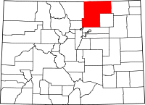
District Overview
Established in 1962.
Service area encompasses about 325 square miles of commercial, agricultural, and residential land within Larimer and Weld Counties, with the largest portion of the service area being within Weld County (roughly 95%).
Provides retail water services to individual customers within unincorporated Weld and Larimer Counties and the towns of Gill, Galeton, and Lucerne.
Provides wholesale water services to the towns of Ault, Eaton, Nunn, Pierce, Severance, and Windsor, and also to Northern Colorado Water Association, a non-profit serving retail customers in Wellington.
Serves approximately 6500 customers or 27,000 equivalent dwelling units, of which 89% are standard domestic taps, 60 large commercial agricultural customers and seven wholesale customers as of end FY 2020.
NWCWD location and general service area
Denver
North Weld County Water District, Colorado

Slide 3
Map of Service Area
North Weld County Water District, Colorado

Slide 4
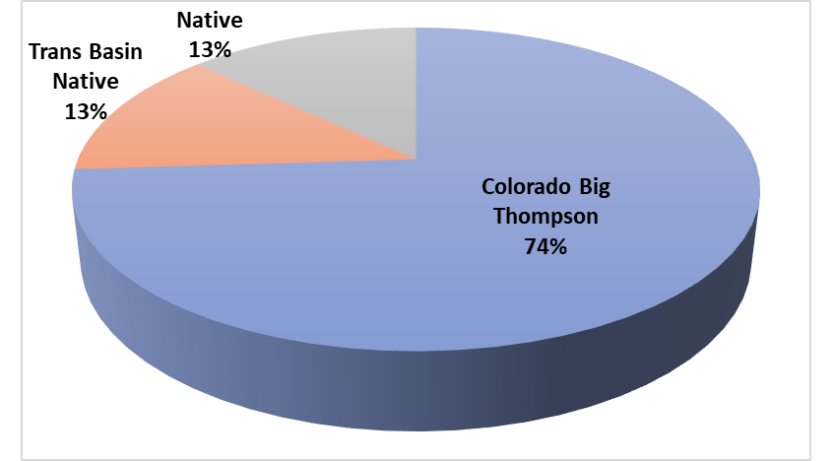
Water Supply and Distribution
Distribution Network of over 730 miles of pipeline and associated facilities
Infrastructure Replacement
And
New Capacity for Demand
Water System Design Capacity: 7 MGD Treatment Plant Expansion
Average Daily Demand: 9 MGD
Peak Demand: 18 MGD
Most of the District’s potable water is delivered through the Colorado-Big Thompson Project from the Colorado River.
The water supply comes through the CBT system into Horsetooth Reservoir and is delivered directly to the District’s water treatment plant, which is located just east of the reservoir at the Soldier Canyon Dam.
About 10% of the District’s potable water is delivered from the Poudre River through the Pleasant Valley Pipeline, an 8 mile raw water transmission line that also serves water treatment plants owned by the City of Fort Collins and the City of Greeley.
The District continues to expand within its service area, and between 2017 and 2020, the District added approximately 2,000 taps -10% increase annual Demand
North Weld County Water District, Colorado

Slide 5
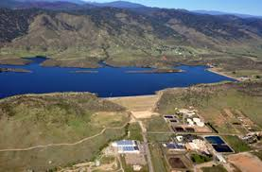
North Weld County Water District, Colorado
Soldier Canyon Dam

Slide 6
Challenges
Development
Pressure
Policy Changes
Demand Shifters
Drought and Colorado River Curtailment
Policy Changes
Demand Reduction and Shifters
Rising Capital Improvement Costs
Rates and Fees
Schedule

