Slide 1
Rural Northern Colorado Before 1962
Potable
Water wagons and water trucks delivered water to cisterns for indoor use by rural customers.
$0.25 for 500 gallons from the City of Fort Collins.
Faucet located by Trolley Barn on North Howes Street.
Non-potable
Wells for outdoor use and livestock.

Slide 2
Title 32 Special Districts
Single purpose – treat and deliver domestic water to the tap holders in the District.
Government agency – compliance with election and financial reporting laws.
ELCO – 1962
Fort Collins-Loveland Water District – 1961
North Weld – 1962
Wholesale Customers – treat and deliver water to other communities.

Slide 3
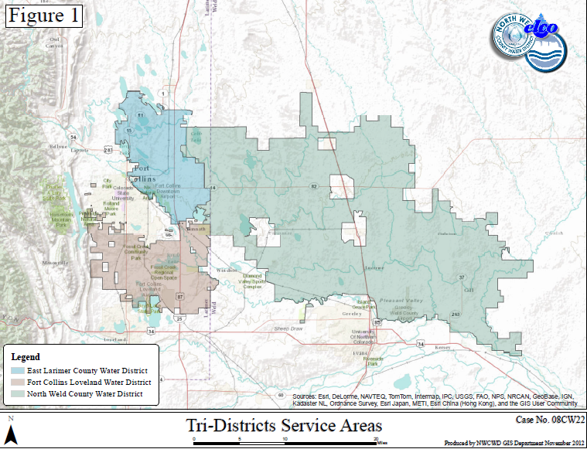
ELCO, Fort Collins-Loveland and North Weld
Also serving 8 wholesale accounts (Ault, Pierce, Nunn, Eaton, Severance, Windsor, Northern Colorado Water Association, Sunset Water District

Slide 4
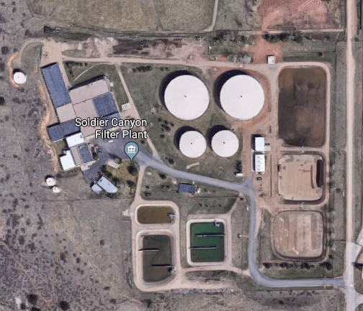
Soldier Canyon Filter Plant
Serves approximately 100,000 people and 50,000 dairy cattle.
Differing seasonal demands by District.

Slide 5
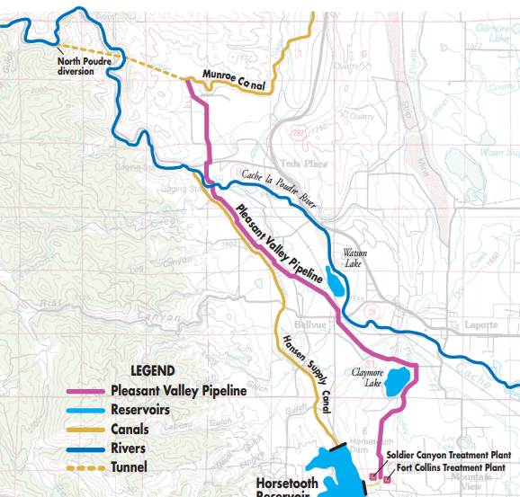
Pleasant Valley Pipeline
Coordination between:
ELCO
Fort Collins-Loveland
North Weld
City of Fort Collins
North Poudre Irrigation Company (supplier and carrier)
Northern Water (owner)
City of Greeley

