Slide 1
Notes:
Thank you, it is great to be part of this conference and discussing water smart policy with all of you today. As we start the discussion today, it is important to know where we started.

Slide 3
Notes:
Video URL: https://www.youtube.com/watch?v=oS65_Ei6SOw&t=1s

Slide 5
Notes:
Fee guaranteed for future building permits in the development, Immediate credit in water development fees, Tap fee reduction program, Priority inspections Incentivizing conservation through reduced tap fees or systems development charges (pg 30)

Slide 6
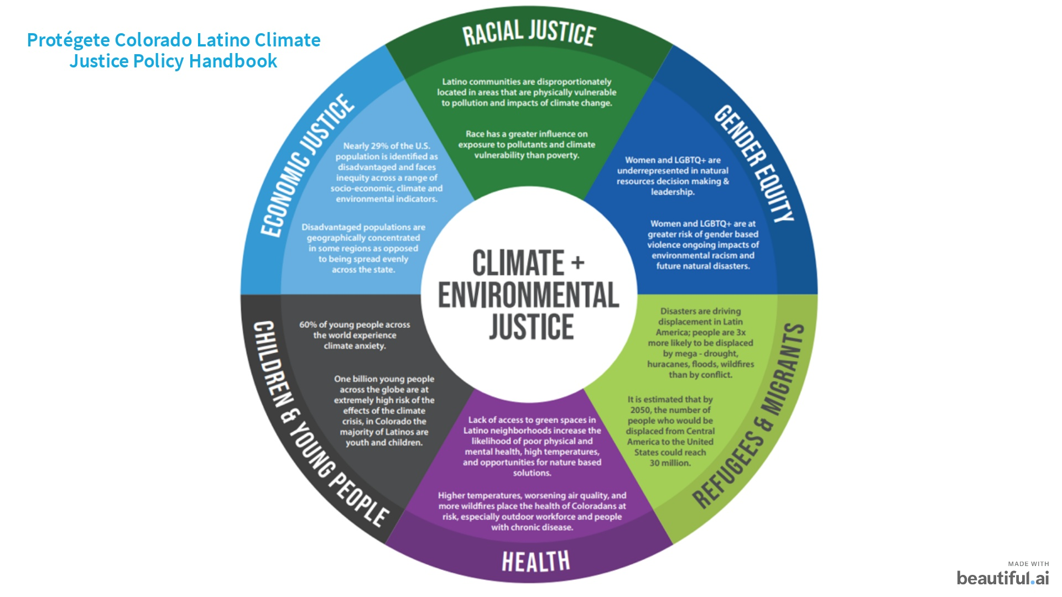

Slide 7
Notes:
Fee guaranteed for future building permits in the development, Immediate credit in water development fees, Tap fee reduction program, Priority inspections Incentivizing conservation through reduced tap fees or systems development charges (pg 30)

Slide 8
Notes:
Fee guaranteed for future building permits in the development, Immediate credit in water development fees, Tap fee reduction program, Priority inspections Incentivizing conservation through reduced tap fees or systems development charges (pg 30)

Slide 16
Notes:
Fee guaranteed for future building permits in the development, Immediate credit in water development fees, Tap fee reduction program, Priority inspections Incentivizing conservation through reduced tap fees or systems development charges (pg 30)

Slide 17
Notes:
Fee guaranteed for future building permits in the development, Immediate credit in water development fees, Tap fee reduction program, Priority inspections Incentivizing conservation through reduced tap fees or systems development charges (pg 30)

Slide 22
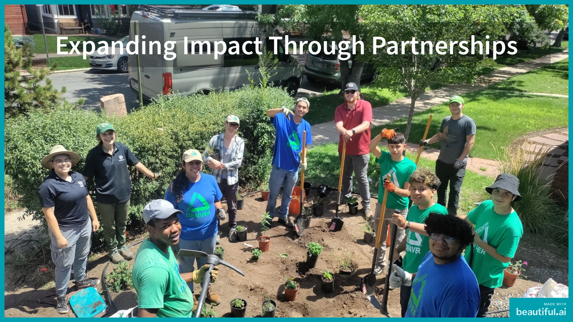

Slide 23
Notes:
Fee guaranteed for future building permits in the development, Immediate credit in water development fees, Tap fee reduction program, Priority inspections Incentivizing conservation through reduced tap fees or systems development charges (pg 30)

Slide 30
Notes:
Native plants - Adapted to our climate, drought tolerant, vegetation breaks up soil and increases infiltration Mulch - super absorbent sponge, prevents weeds, insulates the soil, reduces evaporation

Slide 31
Notes:
Add in two polls here!

Slide 32
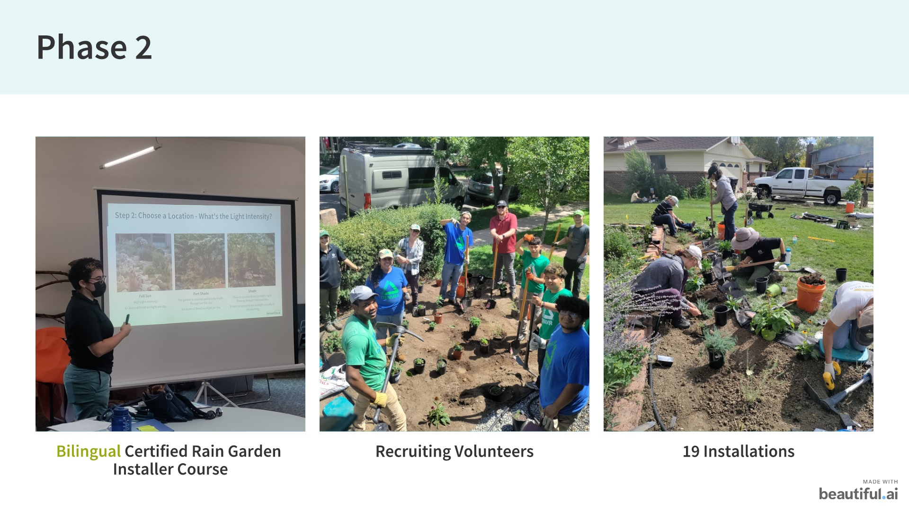
Notes:
Add in two polls here!

Slide 34
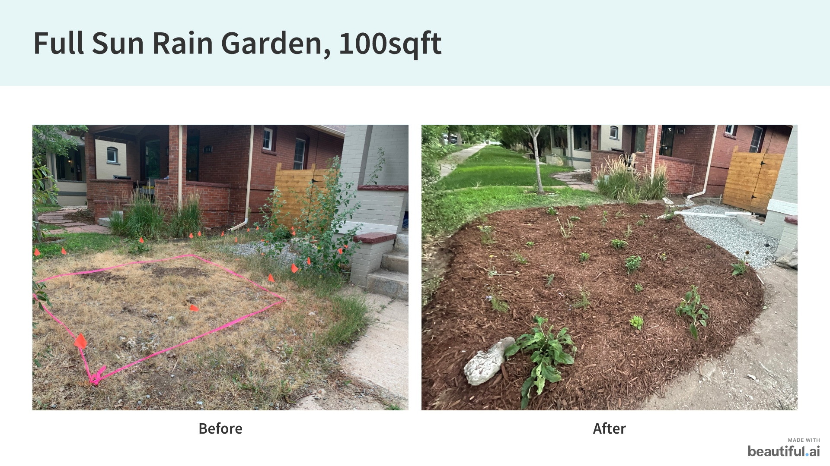

Slide 35
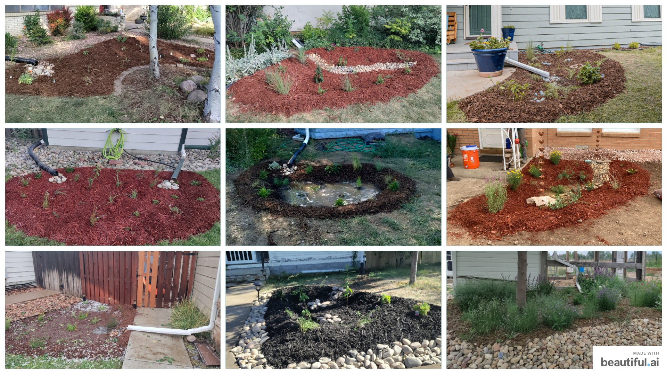

Slide 36
