Slide 1

An Introduction to Water Resources Management in Colorado and the West
John Tracy, Director of the Colorado Water Center
Presented at the Water Literate Leaders of Northern Colorado
September 13, 2023

Slide 2

Topics
How does water move through the environment?
How much water exists on earth, and how much do we use?
How does Colorado manage its water?
What are Colorado’s water management challenges?

Slide 3
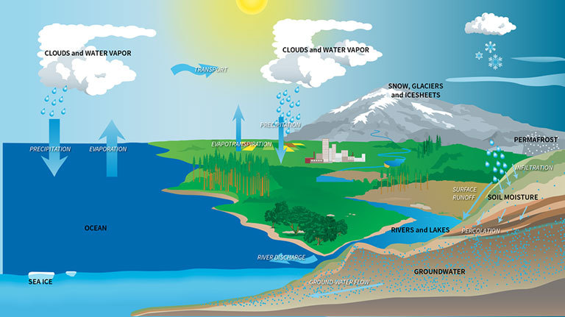
The Hydrologic Cycle
Water moves in a cycle.
When water is used, it is never created or destroyed
It simply changes its form or is transported to a new location
One groups water use turns into another groups water supply

Slide 4
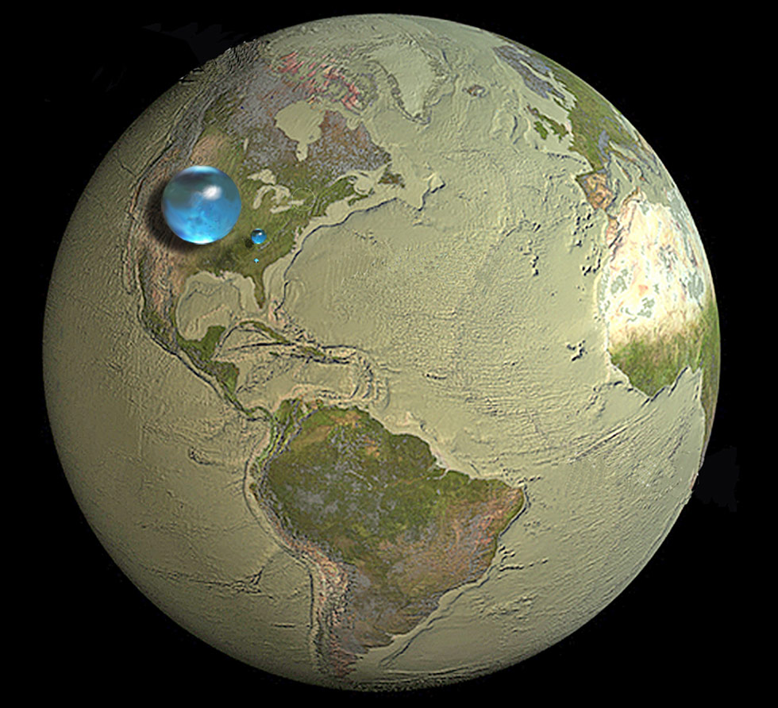
How much exists on earth?
Water is found in many forms:
Oceans = 3.53e+20 gallons of water: 96.6%
Lakes = 2.93e+16 gallons of water: 0.008%
Streams = 7.31e+14 gallons of water: 0.0002%
Ice Caps and Glaciers = 6.22e+18 gallons of water: 1.7%
Groundwater = 6.22e+18 gallons of water: 1.7%
Fresh = 2.93e+18 gallons of water: 0.8%
Saline = 3.29e+18 gallons of water: 0.9%
Atmosphere = 3.66e+15 gallons of water: 0.001%
From the USGS

Slide 5
How rapidly does water move between its forms?
Estimate of flux into and out of water’s forms:
Atmosphere ~ 9.52e+18 gallons per year (2 weeks residence time)
Streams ~ 1.27e+16 gallons per year (3 weeks residence time)
Lakes ~ 1.46e+16 gallons per year (2 years residence time)
Icecaps and Glaciers ~ 6.22e+17 gallons per year (1,000 years residence time)
Groundwater ~ 2.93e+16 gallons per year (100 years residence time)

Slide 6
How much water do humans use?
On an annual basis, our best current estimate on the amount of water that humans extract from the environment is:
Annual Global Water Use ~ 1.06e+15 gallons per year
Which is Approximately:
1.87% of the flux of all fresh water in lakes, streams, and groundwater;
or
0.011% of the amount of water that cycles through the atmosphere on an annual basis

Slide 7
What is the Water Situation in the West?
Managing water in Streams, Reservoirs, Canals, Ditches, and Groundwater
Groundwater
Snowpack in Headwaters
Canals allow water that is not needed to be returned to the river
Water Use
Reservoir
Natural Stream
Canal
Dam
Ditch
Flow increases as snow melts in early summer, then decreases later in summer
Reservoirs allow balancing flows out over the summer when water is needed
Ditches allow water to be moved from natural stream to where it is needed

Slide 8
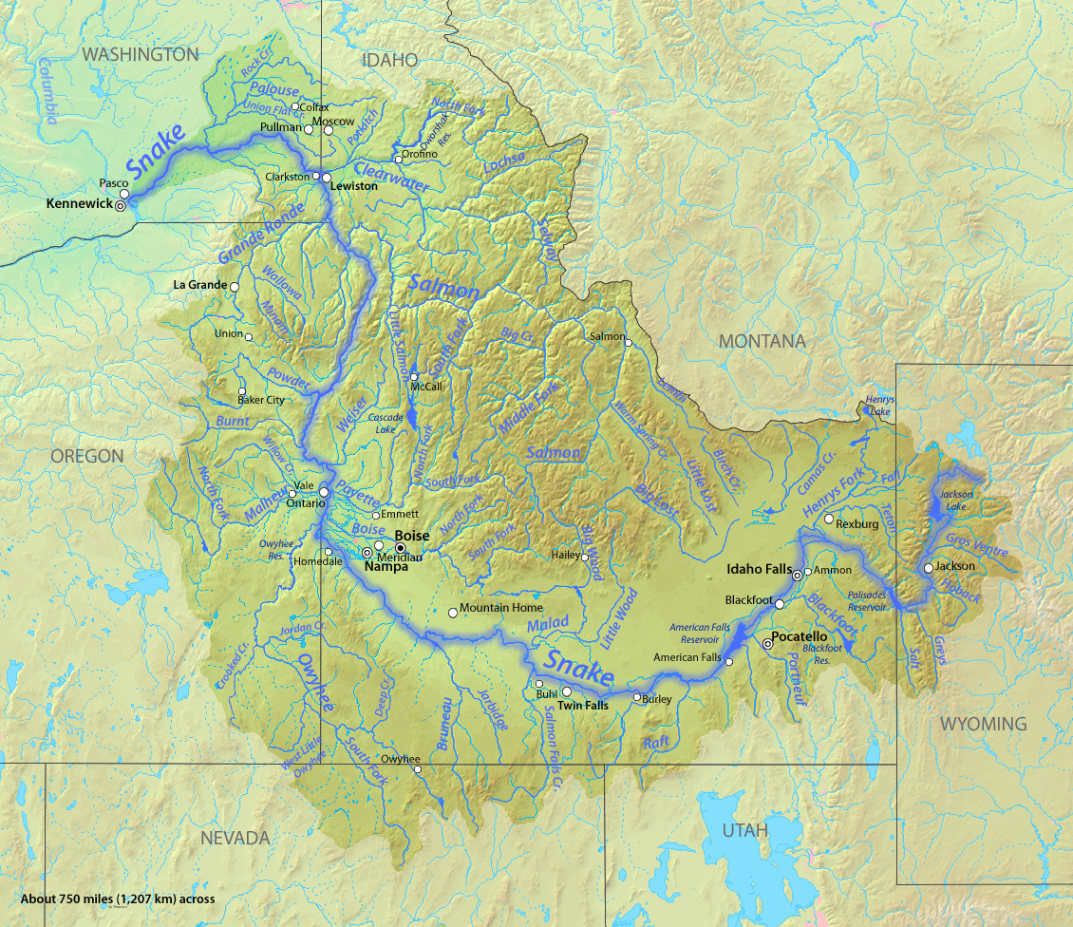
How does this management change flows?
The Snake and Salmon River Example
Clearwater River
above Lewiston
Over 9 Million Acre-ft of water storage was added to the Snake River above Joseph from the 1900s to the 1980s.
The majority of this storage was for water supply, with additional storage for hydropower generation.
None of this storage was designed to carry water over from year to year.
There are no water storage facilities in the Salmon River Drainage
Salmon River before the Snake River
Snake River above the Salmon River
Image From Wikipedia (http://en.wikipedia.org/wiki/Snake_River)

Slide 9
How does this management change flows?
The Snake and Salmon River Example
Ratio of monthly flow to average flow is:
Peak Snake River Flow: 1.35 to 1.00
Low Snake River Flow: 0.6 to 1.00
Peak Salmon River Flow: 3.50 to 1.00
Low Salmon River Flow: 0.45 to 1.00
Desired effect of river management is to “flatten” the flows to reduce flooding in the high runoff months, and increase water supply in the low runoff months

Slide 10
What is the Water Situation in Colorado?
North Platte River Watershed
Yampa-White River
South Platte River
Colorado River
Gunnison River
Arkansas River
Southwest Rivers
Rio Grande
From 2023 Colorado Water Plan

Slide 11
What is the Water Situation in Colorado?
Two Main Types of Groundwater Aquifers
Alluvial Aquifers –
Tend to be near the ground surface and act as extensions of nearby streams
Bedrock Aquifers –
Tend to be well below the ground surface, are not well connected to streams, and are often non-renewable
85% of Colorado’s groundwater is used for irrigated agriculture
18% of Colorado’s population relies on groundwater for their home water supplies
60% of groundwater use is from non-renewable sources

Slide 12
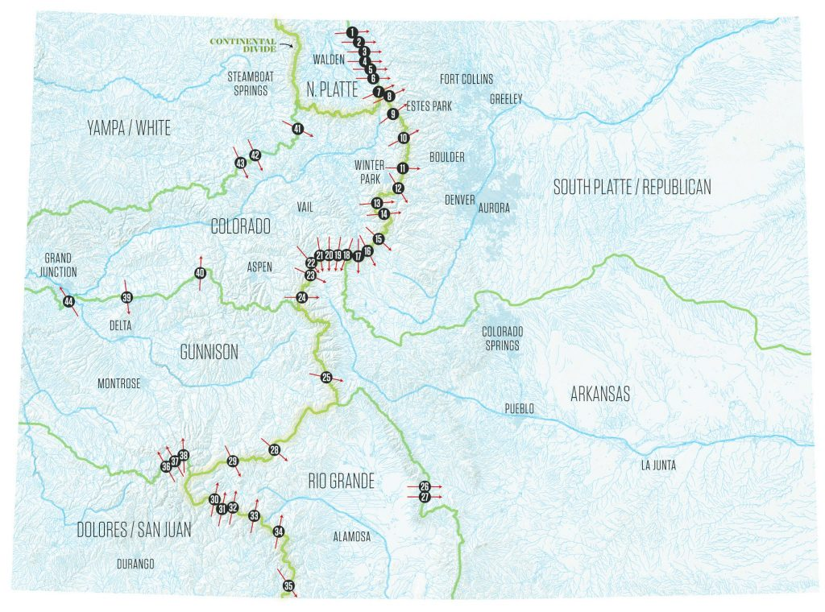
What is the Water Situation in Colorado?
Colorado has a total of 44 structures that divert water from one watershed to another
The majority of these diversions divert water from the western watersheds of the Continental Divide to the eastern watersheds
The largest diversion is the Redlands Power Canal, which diverts over 500,000 acre-ft per year from the Gunnison to the Colorado River
The largest diversion to the Eastern Watersheds is the Adams Tunnel, which diverts over 200,000 acre-ft per year from the Colorado to South Platte River Watershed

Slide 13
What is the Water Situation in Colorado?
Colorado’s largest uses are for Irrigated Agriculture and Municipal Purposes (2015 USGS)
Irrigated Agricultural Use:
  Extracted = 8,999.64 Mgal/day
  Consumed = 2,651.1 Mgal/day
  Irrigated area = 3,036,930 acres
Municipal Use:
  Extracted = 843.95 Mgal/day
  Consumed (billed) = 636.69 Mgal/day
  Population = 5,170,100 persons
  Per capita use = 163 gallons/person/day
Self-supplied Use:
  Extracted = 35.37 Mgal/day
  Consumed = 35.37 Mgal/day
  Population = 286,474 persons
  Per capita use = 123 gallons/person/day

Slide 14
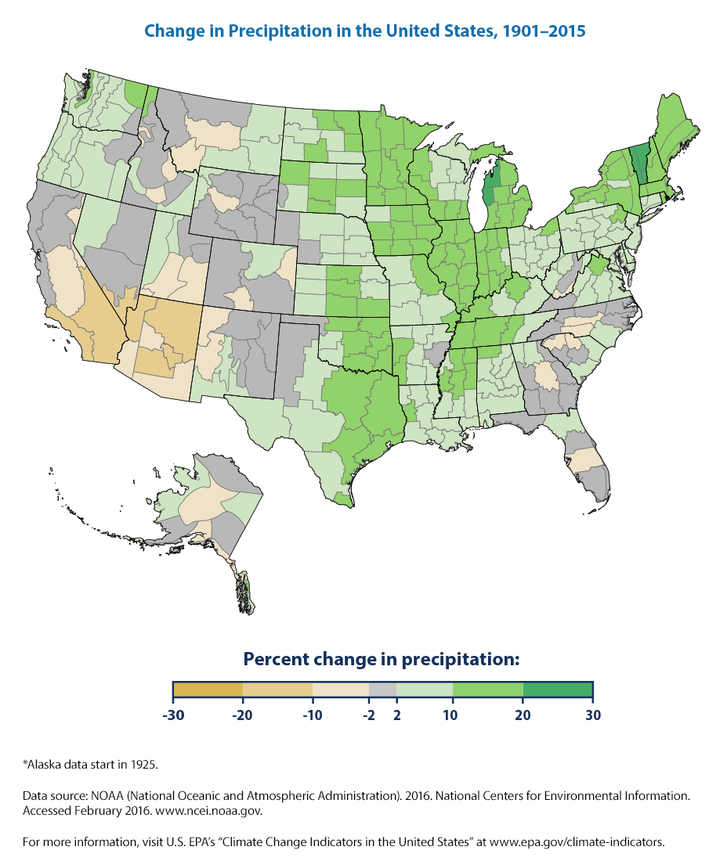
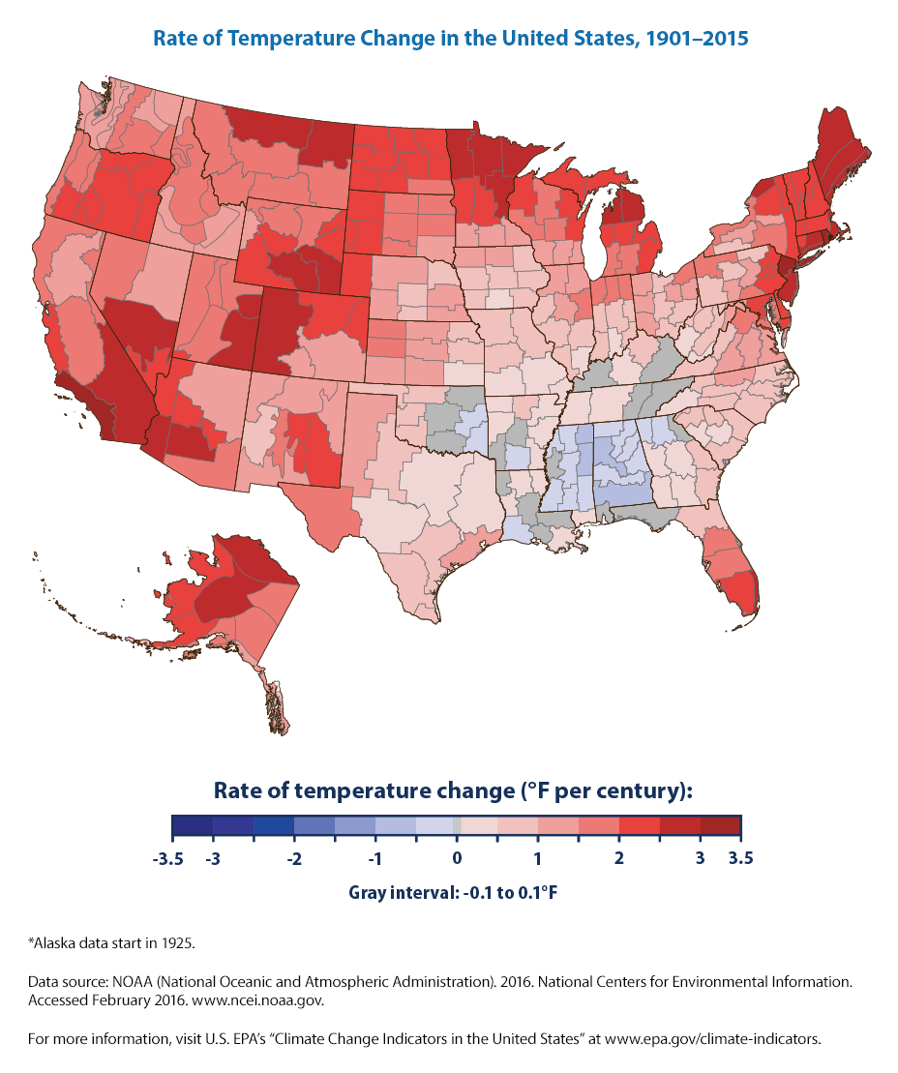
What are Colorado’s Water Management Challenges? – A Changing Climate
Changing climate leads to:
Increased wildland consumptive use of water;
Alteration of hydrologic patterns;
Less certainty in understanding drought and flood frequencies/magnitudes.

Slide 15
What are Colorado’s Water Management Challenges? – Demographic Change
Population Growth in the US, West, and Colorado
Population Growth leads to:
Increased competition for water resources;
Changes in our relationship with water and the natural environment;
Differing priorities for Hydro-Services.

Slide 16
Does Colorado Need More Water to Address these Challenges?
Passed Peak water use in 2005; Agriculture passed peak water use in 2000.

Slide 17
Does Colorado Need More Water to Address these Challenges?
Has Reduced Water Use Impacted our Economic Productivity?
Water Use Plateaued
From US Bureau of Economic Analysis (1960 to 2020)

Slide 18
Does Colorado Need More Water to Address these Challenges?
Has reduced water use affected our agricultural productivity?
Water Use Plateaued
From USDA Economic Research Service (1960 to 2020)

Slide 19
Does Colorado Need More Water to Address these Challenges?
The answer that the data is suggesting is that Colorado does not need more water to address its growing population, economy, and changing climate.
This data also suggests that Colorado needs to improve its focus on growing the social, ecological, and economic value we receive from effectively managing our water resources.
Increasing this value of water management will require embracing a holistic, as opposed to incremental, approach to water management.
It will also require creating more a more inclusive and equitable environment for engaging in discussions on the future management of water resources.

