Slide 1
Let There Be Water
By Seth M. Siegel
Notes:
Apologies for not being there in person, but am glad I get to share this book with you.

Slide 2
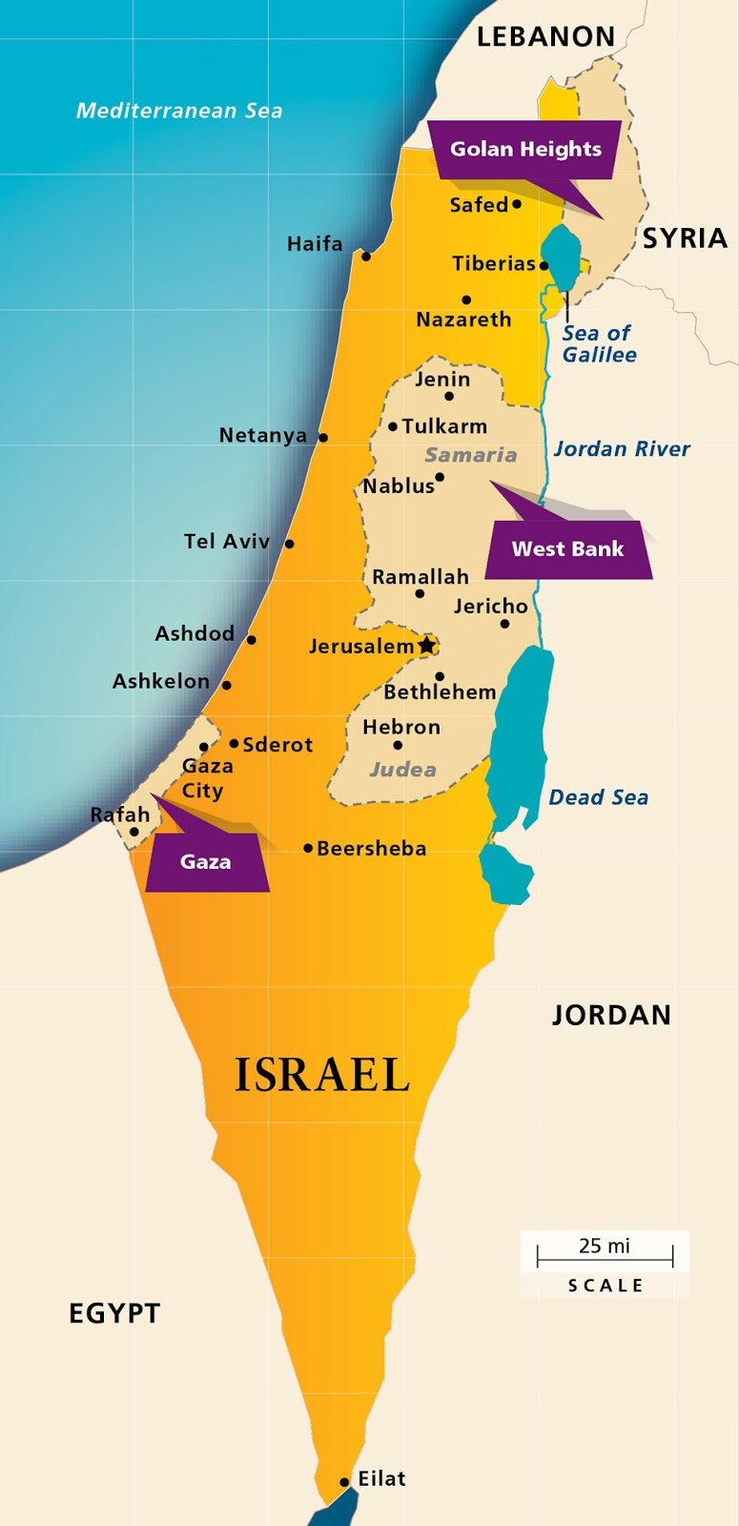
Model for World in Crisis
60% of Israel is desert.
Population has grown ten-fold
Annual rainfall has dropped 25%
Challenging climate/challenging landscape
Has a water surplus
This Photo by Unknown Author is licensed under CC BY
Notes:
A little background about Israel today.

Slide 3
Israel’s Solution for a Water Starved World
Message of the Book:
”In the middle of the desert and in the world’s driest region, Israel has managed and innovated its way to a water surplus. Not only has this assured the continued growth of Israel’s economy with few resource constraints, but Israel also has been able to help its neighbors by sharing some of that surplus.”
Notes:
This book shares how this surplus came about starting before Israel was even a country.

Slide 4
Overview of Book
4 Parts
Creation of a Water-Focused Nation
The Transformation
World Beyond Israel’s Borders
How Israel Did It

Slide 5
Israel’s Solution for a Water Starved World
Timeline
1920 – British Mandate of Palestine (Israel, West Bank, Gaza)
1937 – Mekorot (Israel’s national water utility) is founded
1938 – Piped water is brought to the Jezreel Valley.
May 1939 – British White Paper is issued.
July 1939 – National Water Plan issued in response to White Paper.
1947 – Drip drilling uncovers water in the Negev desert.
May 14, 1948 – British Mandate for Palestine ends. State of Israel declared.
July 1955 – Yarkon-Negev Pipeline opens bringing water to south desert farms.
Notes:
Next 3 slides are the timeline of Israel’s water program. I am only highlighting a few to help give you a high level overview for an appreciation of what they have done
British Mandate – Great Britain was called upon to facilitate the establishment of a Jewish national home in Palestine.
National water utility was founded in 1937 before Israel became a nation.
British White Paper was issued in effect to curb immigration to Israel for political reasons.
Jewish people responded with National Water Plan which basically brought water from the north to the south Negev Desert allowing more immigration and in 1948 Israel became a nation.

Slide 6
Let There Be Water Israel’s Solution for a Water Starved World
Aug 1959 – Comprehensive water law passed. Creation of Israel Water Commission
June 1-2 1964 – President LBJ and PM Levi Eshkol meet in first Israel state visit
June 10, 1964 – National Water Carrier opens creating national water system
1966 – Drip irrigation equipment offered for sale for first time
1969- The Shafdan wastewater treatment plant opens
1989 – Pipeline for treated water from Shafdan to Negev farms is opened
1995 – Palestinian Water Authority is created
2000 – Dual flush toilets made compulsory
2005 – 2016 – 5 Large seawater desalination plants built
2006 – Israel Water Authority Created
Notes:
Begin to refine their water structure so passed a comprehensive water law and created the Israel Water Commission.
Drip irrigation which would become a big part of their water structure made an appearance in 1966 for the first time.
2006 Israel Water Authority was created

Slide 7
Let There Be Water Israel’s Solution for a Water Starved World
2010 - Water pricing at real price begins and municipal water utilities are established.
Oct 2013 – Israeli government declares water independence from weather
Dec 2013 – Red Sea – Dead Sea agreement is announced by Israel, Jordan, Palestinian Authority
March 2014 – Israel - California water cooperation agreement announced
Notes:
Moving into more recent times, water pricing at real price begins and municipal water utilities are established and as you can see Israel began to export its expertise and its water to other countries.

Slide 8
Part 1: Creation of a Water Focused Nation Ch. 1-3
Rain, rain go away,
Come again some other day!
-American Nursery Rhyme
Rain, rain from the skies
All day long, drops of water
Drip drop, drip drop
Clap your hands!
-Israeli Nursery Rhyme
Notes:
Part 1 of the book focuses on relating how Israel became such a water focused nation. Basically because they had to and you can see in these children’s rhymes the difference in value they place on their water.

Slide 9
Part 1: Creation of a Water Focused Nation Ch. 1-3
How did Israel become a water focused nation?
- White Paper of 1939
Created a water respecting culture
Taught in schools
Permeates cultural scene – songs, plays, writings, currency, stamps, etc.
National heroes were water engineers.
Part of their religion
Old Testament provides guidance on how to think about water and is a moisture infused document.
Dew mentioned 35 times
Flood appears 61 times
Cloud shows up 130 times
Water is found 600 times
Rain mentioned nearly 100 times with special names for first/last rainfalls of the season
Notes:
White Paper of 1939 essentially forced the Jewish people to create a water respecting culture.

Slide 10
Part 1: Creation of a Water Focused Nation Ch. 1-3
Israel’s respect for water codified into law in the new nation.
Decision to make water common property of all
Series of 3 laws
1955 – prohibited drilling anywhere (private/public) w/o license
1955 – prohibited distribution of water unless through a meter
1957 – surface water including rivers, streams, rainwater, sewage could not be diverted w/o permit.
Water Law of 1959
All water resources became public property subject to control of the state.
“Israel today has a dynamic, capitalist economy, but with a state controlled, centrally planned approach to water. “
Notes:
As a result

Slide 11
Part 1: Creation of a Water Focused Nation Ch. 1-3
Managing a National Water System
Water Law of 1959 appointed powerful water commissioner and Water Council which was placed under Minister of Agriculture.
Renamed Water Commission and moved to Minister of Infrastructure.
2006 Water Commission renamed Israel Water Authority and power was transferred to a technocratic level instead of a political one.
2008 customers began paying the real price for water (transporting) w/ water fees paying exclusively for the nation’s water needs.
Same time the Water Authority took away all management of water and sewer from municipalities and formed apolitical system of municipal utilities.
Notes:
Even though the water plan was created before the creation of the country this plan continued to be refined through a series of moves by the government.
Even with these moves, the government realized that water management needed to be as apolitical as possible so in 2006
Continuing to make water management apolitical, they

Slide 12
Part 1: Creation of a Water Focused Nation Ch. 1-3
Israel’s plan to manage water and distribute evenly to the country.
Plan to construct a national water infrastructure began with the issuance of the White Paper, continued through the war and into the postwar period led by Simcha Bass.
This plan served to unify the nation while transforming the country.
3 phase approach
Deep drilling in the Negev
Pumping water out of the Yarkon River to the Negev.
Water be brought from north to south via underground infrastructure – National Water Carrier.
Notes:
Going a little bit deeper into the management plan
This infrastructure plan not only provided water for the nation, but served as a great unifier of the newly formed country.

Slide 13
Part 1: Creation of a Water Focused Nation Ch. 1-3
National Water Carrier
-Continued to be refined over the years by Blass.
-Even used the diversion of the Colorado River as a model.
-Plan for the National Water Carrier used to combat White Paper restrictions as well as persuade the UN with regards to the boundaries of the new nation.
-Phase 2 & 3 of the plan was paid for by reparations from German government.
Notes:
Some interesting things about the National Water Carrier infrastructure

Slide 14
Part II: The Transformation Ch. 4-7
Ways Israel refined water management
Made a move away from flood irrigation to drip
Developed through partnership w/3 kibbutz communities (Netafim)
Created a booming industry around drip irrigation processes/equipment
Saved 40-70% of water wasted through flood irrigation (80% of world’s irrigated fields use flood irrigation)
Reduced ag runoff making rivers, streams and lakes healthier
Developed fertigation and nutrigation processes
Created an irrigation on demand system
Began developing own seeds acclimated to water stressed environments.
-Led to idea of developing seeds that thrive on brackish water.
-Began using water found in fossil aquifers underneath the Arava desert after a process of dilution and desalination.
Notes:
Israel planned for water, created a water respecting culture and then began to refine their water management. The technical aspects of their water management is relayed by the author in an extremely engaging way as he also relates the stories of how the process and inventions came about and gives a personal account of the people involved.

Slide 15
Part II: The Transformation Ch. 4-7
Began using wastewater for agriculture
-Shafdan aquifer and SAT (Sand Aquifer Treatment)
-Dedicated a pipeline from Shafdan to Negev
-Used for everything but drinking
-Wastewater infrastructure built with help from JNF
-Created a consistent, reliable, predictable source of water
-Quality is high and farmers are beginning to pay market price
- Beginning to use it to restore instream flows in rivers and fight wildfires
-Very efficient system
- Wastewater facilities operate at high rates of energy efficiency
- Natural gas by-products captured to help run operations.
- Aqwise invented better ways to house bacteria/reduce sludge and aerating sewage.
- Resource recovery (ex. Cooking grease, toilet paper)
- Concerns (salt and pharmaceuticals)
Notes:
Another way they refined their water plan was to begin to use wastewater for ag. This began with the use of Sand Aquifer Treatment at the Shafdan aquifer which allowed tertiary treatment of wastewater which was used for everything but drinking and provided a predictable source of water and allowed a departure from the practice of dumping in the sea. The ability to treat wastewater and reuse it opened up a whole new field of innovation and technology.
Cooking grease is skimmed off the sewage and reused for industrial applications.
Microscopic bits of toilet paper, lint, fruits/vegetables not removed by bacteria are used to create cellulosic material used in the pulp and paper industry.

Slide 16
Part II: The Transformation Ch. 4-7
Desalination – Chasing the dream
“Desalination has the feel of science, engineering and alchemy combined.”
- Johnson, Eshkol and Gurion
- Alexander Zarchin
-MVC and MED
-IDE Office privatized Built plants in Canary Islands, Carlsbad California, China, India
-Creation of Israel Desalination Society in 1995
-Reverse Osmosis created by Sydney Loeb
-Ashkelon plant opened in 2005 water (5 plants in all as of 2013)
50% cheaper
cleaner, lower in salinity/higher in clarity
-Benefits include environmental, economical, infrastructure, public health, politically
Notes:
After innovating the use of wastewater, they turned to chasing desalination. Wish I had time to tell all the stories involved in their chase for desalination as the process included people like President Johnson, David Ben Gurion. The book also relates the different iterations of Reverse Osmosis and how Israel has exported not only the technology and manufactured parts to other countries, but they have also marketed their expertise as well.

Slide 17
Part II: The Transformation Ch 4-7
Diversification of water sources led to other things such as
river restoration
parks building
creation of lakes
Notes:
Israel’s diversification includes reuse of wastewater, use of brackish water, and desalination. This has led to

Slide 18
Part III: The World Beyond Israel’s Borders Ch 8-11
Capitalizing on Israel’s water success
Mekoret (Israel’s National Water Utility)
Offered inventors/entrepreneurs seed money to work on problems plaguing production.
Keep intellectual property rights/form own companies
Baruch “Booky” Oren/Oded Distel Convinced government to create agency to support exporting Israel’s water expertise and technology to the world Office of Chief Scientist Kibbutz businesses Atlantium – UV lights to treat wastewater TakADu – data to spot anomalies to find leaks/predict trends Hydrospin – generator to monitor water at the source
Israel’s water-related exports is a $2.2 billion industry.
Notes:
Israel has expanded their water knowledge beyond their borders because they created an incubator state for the latest in water management and technology.
Office of Chief Scientist which partners with incubator companies to bring forth ideas for new technology and companies.

Slide 19
Part III: The World Beyond Israel’s Borders Ch 8-11
Regionalism
Israel works with region to solve water issues not only for their country but for surrounding areas as well.
Jordan Shares 14 billion gallons water/year Stores water in Sea of Galilee Palestinians (West Bank/Gaza) Need cooperation to ensure no sewage contamination Israel has provided most Palestinians in WB with clean water Before 2008 the PA cooperated w/ Israel Red Sea – Dead Sea Conveyance Project

Slide 20
Part III: The World Beyond Israel’s Borders Ch 8-11
Globally
Helped transform Israel’s relationship w/world and establish diplomatic relationships
150 countries have welcomed an Israeli role
China, India, South Africa, California

Slide 21
Part IV: How Israel Did It Ch. 12
Summary of Book
Water belongs to the nation
Use water to unify the country
Create a water-respecting culture
Regulators not politicians
Pay full price for water
Use water fees for water
Encourage innovation and technology
Measure and monitor
Plan today for long into the future

Slide 22
Part IV: How Israel Did It Ch. 12
Pursuit of water
Pumps and purifies natural water from aquifers, wells, rivers and Sea of Galilee
Desalinates seawater
Drills deep for brackish water
Develops seeds that thrive on salty water
Treats nearly all of its sewage to a high level of purity and reuses
Captures and reuses rainwater
Discourages water heavy landscaping in parks/homes

Slide 23
Part IV: How Israel Did It Ch. 12
Seeds rain clouds to enhance rainfall
Hyper water efficient appliances
Emphasis on maintenance
Educates schoolchildren
Prices water to encourage efficiency
Financial incentives for technologies that save water
Experiments with ideas to reduce evaporation
Water efficient crops
Drip irrigation

Slide 24
Personally
“The fields that used to lie empty and desolate in plain view
of everyone will again be farmed. And when I bring you back,
people will say, ‘This former wasteland is now like the Garden
of Eden!’…’’ Ezekiel 36:34-35 NLT

Slide 25
Conclusion
“Rising demand and limited quantities don’t have to restrict economic growth or lead to political instability. The lack of natural supply of water, or declining rainfall, need not determine a country’s destiny. If handled wisely, these limits can propel a country and create new opportunities.”

