Slide 1
The Man who thought he owned water
Water literate leaders book report
Carrie Rossman
May 2023

Slide 2
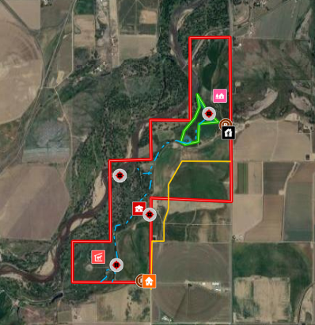

Slide 3
characters
“What’s the more beneficial use: food or golf course and exotic landscape?”
Ben Eaton
Bill (Pop) & Gogo Phelps
Tershia d’Eglin
Other family members, farm caretakers, neighboring farmers, environmentalists, attorneys, municipalities, lawmakers, chemical companies, Northern Leopard Frogs, oil and gas producers, big ag, etc.
“In a Front Range without water would wet tears have value?”

Slide 4
Story of…
Humans/Family
Hydrology
Environment
Interplay between municipal water and farm water
Government
Agriculture

Slide 5
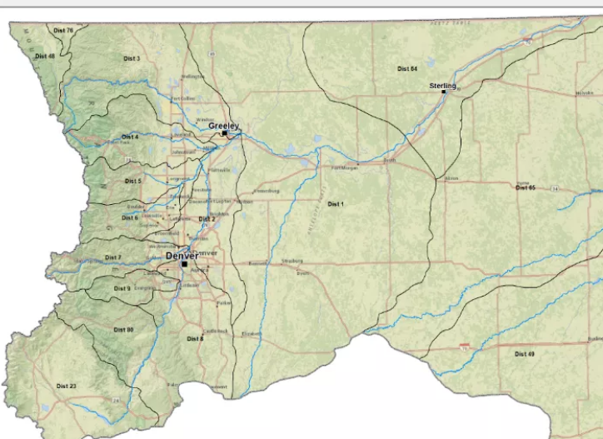
Water timeline
April, 30 2003
SB 03-073
Signed by Gov. Owens
(complimentary HB 02-1414)
1969 Colorado Water Right Determination and Administration Act
Dec. 17, 2001
Empire Lodge case decision
Justice Hobbs
2013 floods
SWSP: Substitute Water Supply Plans
Out of priority diversion & augmentation
2002 catastrophically dry
2004-2009
52 CO farmers commit suicide

Slide 6
The Man who thought he owned water
Resources: To be inserted
May 2023

