Slide 1
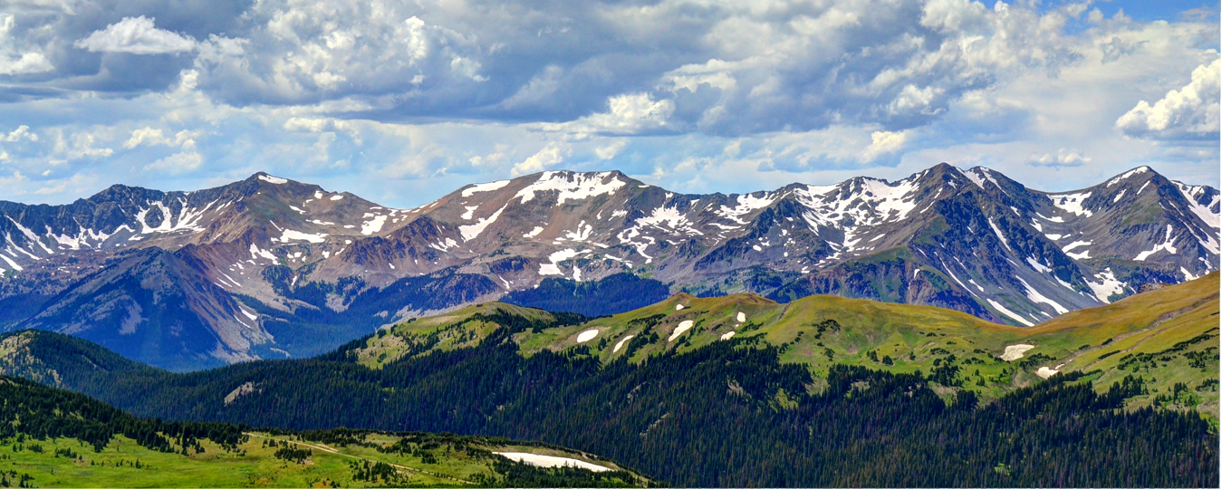
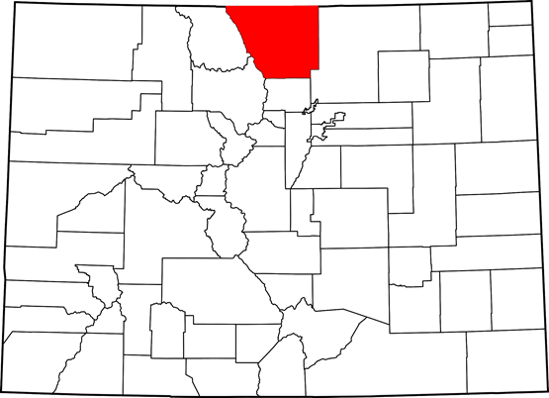
Larimer County Colorado
Notes:
No discussion on this slide. It will be displayed at start, and as soon as Mark is ready, we go to next slide.

Slide 2
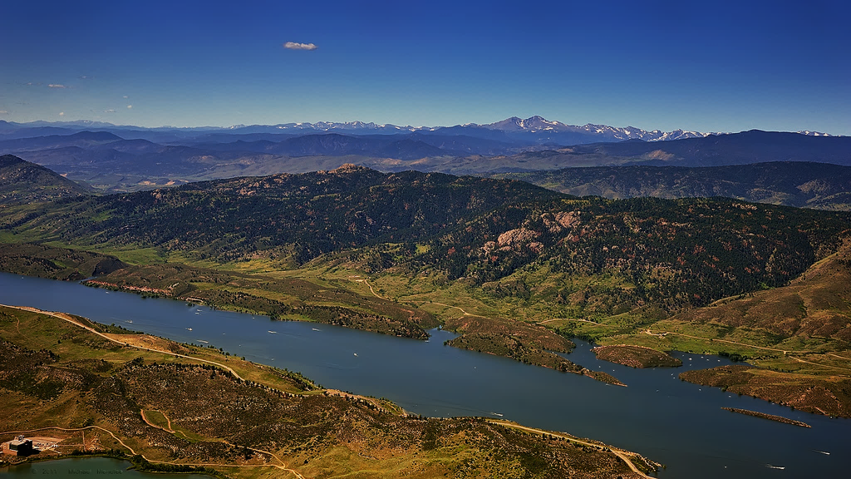
Introduction: Larimer County
6th Largest County in Colorado 2,640 sq. miles, Over 50% Public Lands
~370,000 Residents, ~2,000 FTE’s
Fort Collins, Loveland, Estes Park
Rocky Mountain National Park (4.6M annual visitors)
3 Commissioners; 7 elected offices; 30+ depts
Colorado Conundrum (TABOR)
Notes:
Mark: idea here is to give folks a general idea of scope and talk about how we needed to move from an informal organization to a scaled up enterprise organization in order to meet the growing demands of a large county.

Slide 3
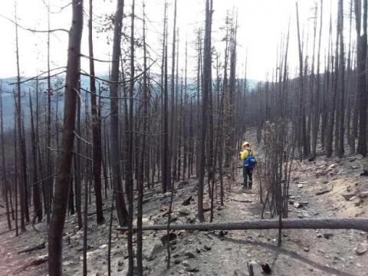
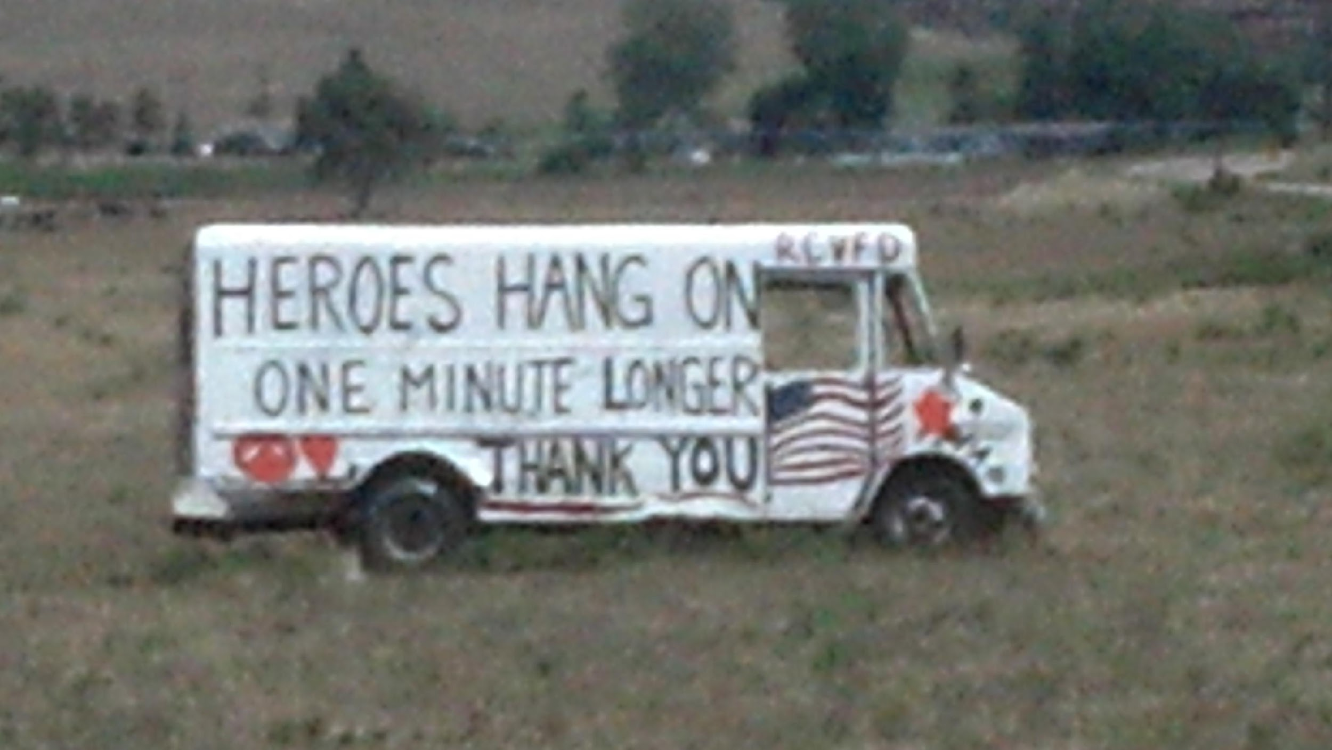
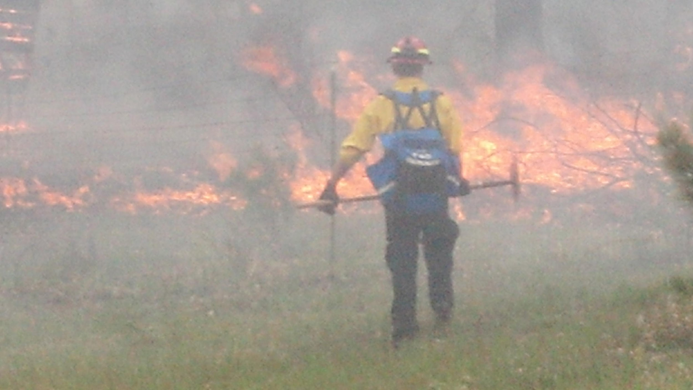
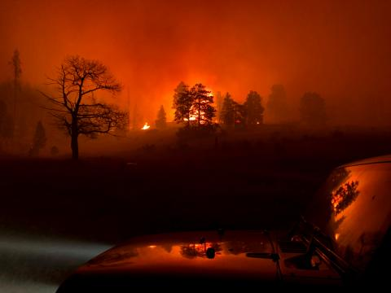
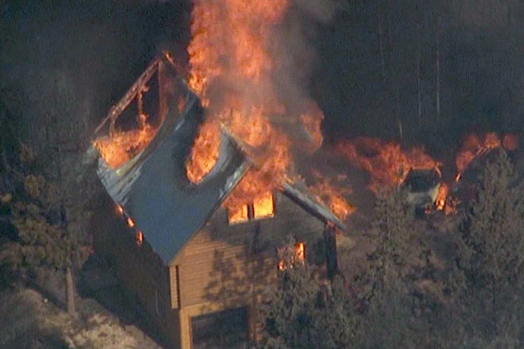
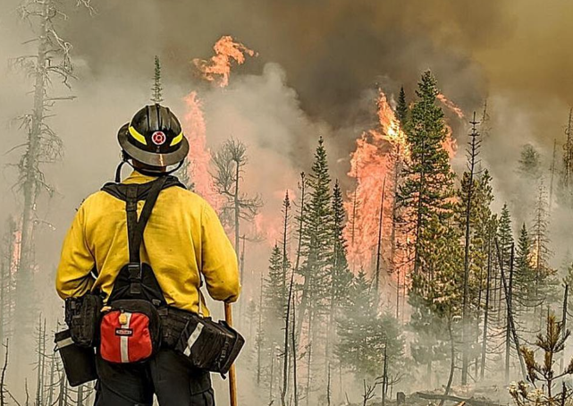
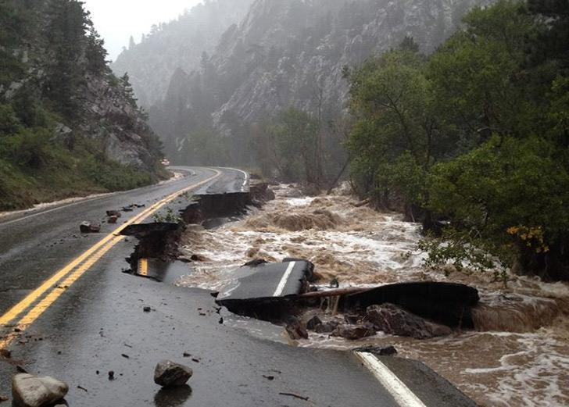
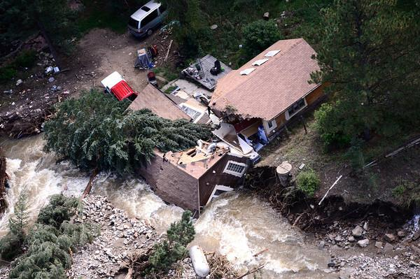
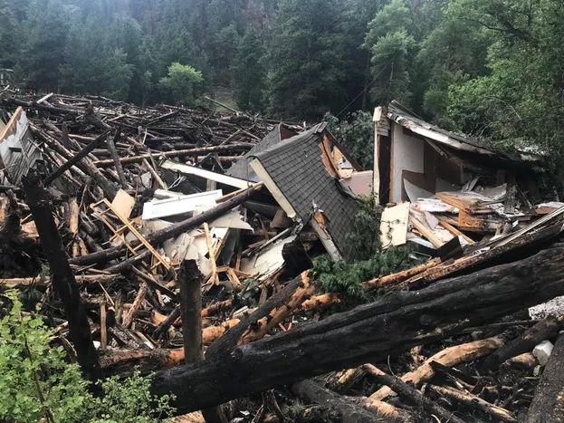
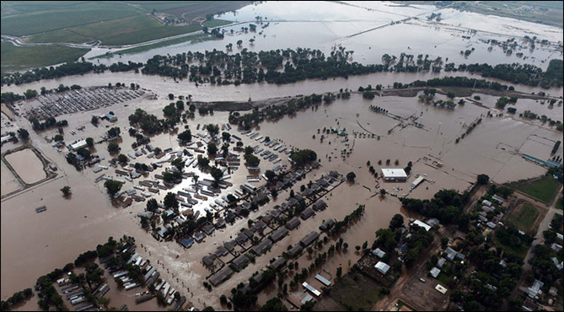
High Park Fire 2012
fast moving & destructive
Cameron Peak Fire 2020
Largest fire in CO History
Northern Colorado 2013 Flood
Poudre River Flash Flood 2021

Slide 4
EXISTING CONDITIONS REPORT
June 2022
Posted on larimer.org/planning/water
Notes:
Approached the existing conditions report
Scope limited to water supplies and ag land – many other water topics not addresses
Budget dictated that we rely on existing data sources vs new data collection
Main sources included County comp plan, State of Colorado water databases, and publicly available plans from providers
The regional existing conditions report focused on water supplies and agricultural land. Most review comments were addressed through report revisions. Additional comments on the report include:
It is important to see the entire region summarized in one place. More detail would be good too.
It is important to note that water use in Larimer County includes the 4+ million annual visitors to Rocky Mountain National Park.
Stakeholder input on future regional existing conditions work led by Larimer County included the following suggestions:
A thorough assessment of water service providers for water waste ordinances, water shortage action plans, and past water use restrictions.
A thorough assessment of system development and billing charges, as well as comparison of fees and charges across providers for example development types.
Discuss local permitting requirements (e.g., for Larimer County, Fort Collins) and how those affect and potentially encumber regional water projects.
Expand scope to include environmental and recreational flows, wastewater, water quality, drought, wildfire, reduced water rentals to the agricultural sector, stormwater, and cross-media connections (e.g., air, soils).
Further analyze the risks and effects if the Colorado-Big Thompson system were to fail or be curtailed.
Conduct a more extensive analysis of raw water providers (i.e., reservoir, irrigation, and ditch companies) and water associations. For example, the Water Association of the Rockies appears to be missing from the report.

Slide 5
IN JUNE 2022 - COMPLETED FOUNDATIONAL WORK
Existing Conditions Assessment
Initial Vision and Goal Setting
Assessed existing conditions related to water supplies and agricultural land and identified risks and vulnerabilities
Deliverable: Regional Existing Conditions Report
Held work sessions and invited stakeholder input
Deliverables: Updated Regional Existing Conditions Report and memo that documents outcomes, key findings, action items and recommendations for developing the water element
A combination of county and grants funded this work – Department of Local Affairs, Sonoran Institute, Community Development and Natural Resources Depts. ($45K)

Slide 6
WATER MASTER PLAN CRS §30-28-106 WATER ELEMENTS IN MASTER PLANS
Water elements are not required. If a community includes a water element, the community must:
Consult with the public water systems that supply water to ensure coordination on water supply and facility planning.
Identify water supplies and facilities sufficient to meet the needs of the public and private infrastructure reasonably anticipated or identified in the planning process.
Include water conservation policies, ideally tied to the Colorado Water Plan.
This law allows policies to be implemented that require water conservation to be a condition of development approvals, including subdivisions, planned unit developments, special use permits, and zoning changes.
Notes:
Talking points
One way the County can formally achieve the strategic plan goals is through the development and adoption of a water element…

Slide 7
GROWTH IN LARIMER COUNTY
Population Growth | 56% 343,853 535,756 12% 66,639 74,554 96% | Projected growth in total population from 2017 to 2040 Total population in 2017 Projected total population in 2040 Projected growth in unincorporated areas from 2017 to 2040 Unincorporated population in 2017 Projected unincorporated population in 2040 Growth that will be absorbed by municipalities through 2040
Development Units | 39,384 acres 23,245 acres | Land designated as urban expansion areas ^{[1]} Land designated as urban/rural interface areas ^{[2]}
^{[1]} Per the Larimer County Comprehensive Plan, Urban Expansion Areas are areas located within Growth Management Areas where municipal development and services are anticipated (Logan Simpson et. al., 2019).
^{[2]} Urban/Rural Interface areas are areas adjacent to municipal planning boundaries that could be incorporated into Growth Management Areas or developed in unincorporated Larimer County (Logan Simpson et. al., 2019).
Notes:
One outcome we wanted to highlight is metrics around land use and water in the County
You have the full report in email, the executive summary as handout for reference
County’s role in unincorporated areas clearer – land use authority etc.
Does County also have role as regional convener on water topics?
What we got from the comp plan – how much growth is expected and where

Slide 8
COUNTY-WIDE RISKS AND VULNERABILITIES
Reduced water availability and poor water quality from natural hazards
Reduced water availability from climate change
Curtailment of Colorado River water
Relatively low water reuse potential
Information gaps (e.g., non-tributary groundwater wells are generally not monitored and reported)
Diminishing agricultural lands
Development of additional water rights and diversions
Water delivery limitations by some providers
Notes:
Amy
Talking points:
Second outcome = key risks and vulnerabilities that arise from the data we analyzed
Doesn’t capture all risks and vulnerabilities
Reduced water availability from droughts, fires, climate change
97% of Colorado river water could be curtailed under a compact call
Relatively low reuse potential without graywater programs
Already seeing service delivery limitations happening and expect that to continue

Slide 9
WATER SYSTEM RISKS AND VULNERABILITIES
Heavy reliance on Colorado-Big Thompson water
Need for more raw water storage
Community water systems are more connected than may be apparent, creating both system resiliencies and cascading risks
Aging and insufficient infrastructure
Information and planning gaps
Notes:
Amy
Talking points
Almost all planned projects in LC are around improved raw water storage
Muni providers have senior, diversified portfolios; Districts tend to be working to diversify from C-BT to include local supplies
Complicated IGAs and contractual arrangements – good and bad
Need much more infrastructure investment
Need consistent, better, public info for all providers

Slide 10
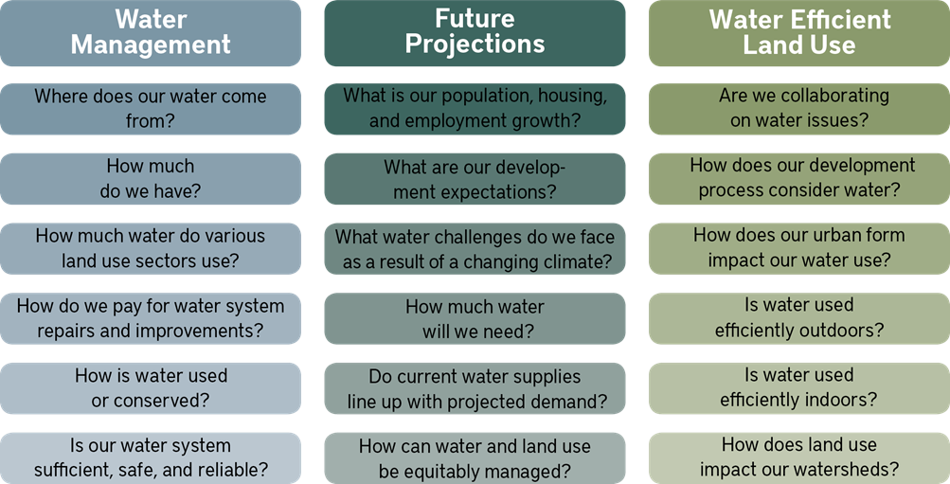
WATER AND COMP PLANNING
Water-Related Questions to Answer in a Comprehensive Planning Process
(source: Lincoln Institute, 2020)

Slide 11
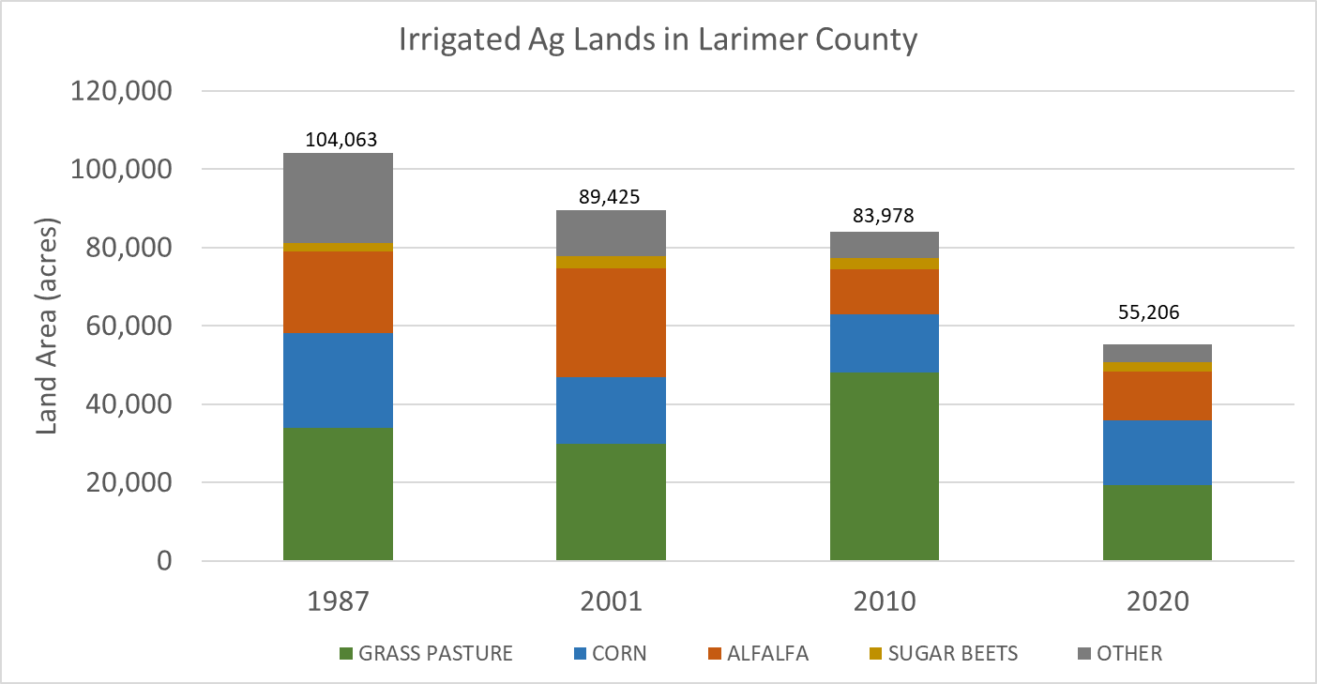
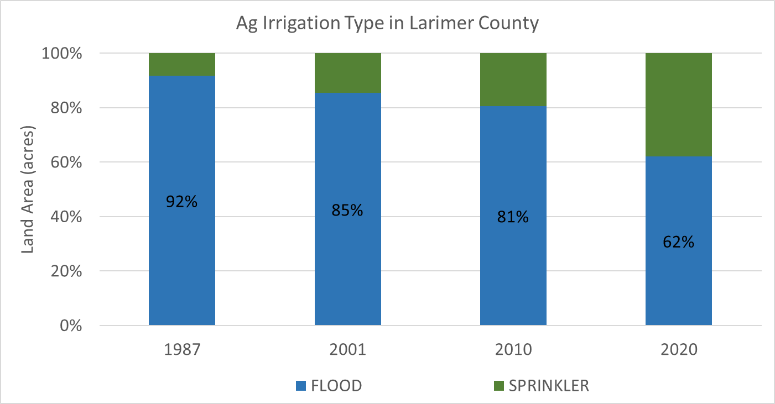
AG PRESERVATION AND IRRIGATION EFFICIENCY
Data sources: CWCB/DWR Irrigated Lands Analysis

Slide 12
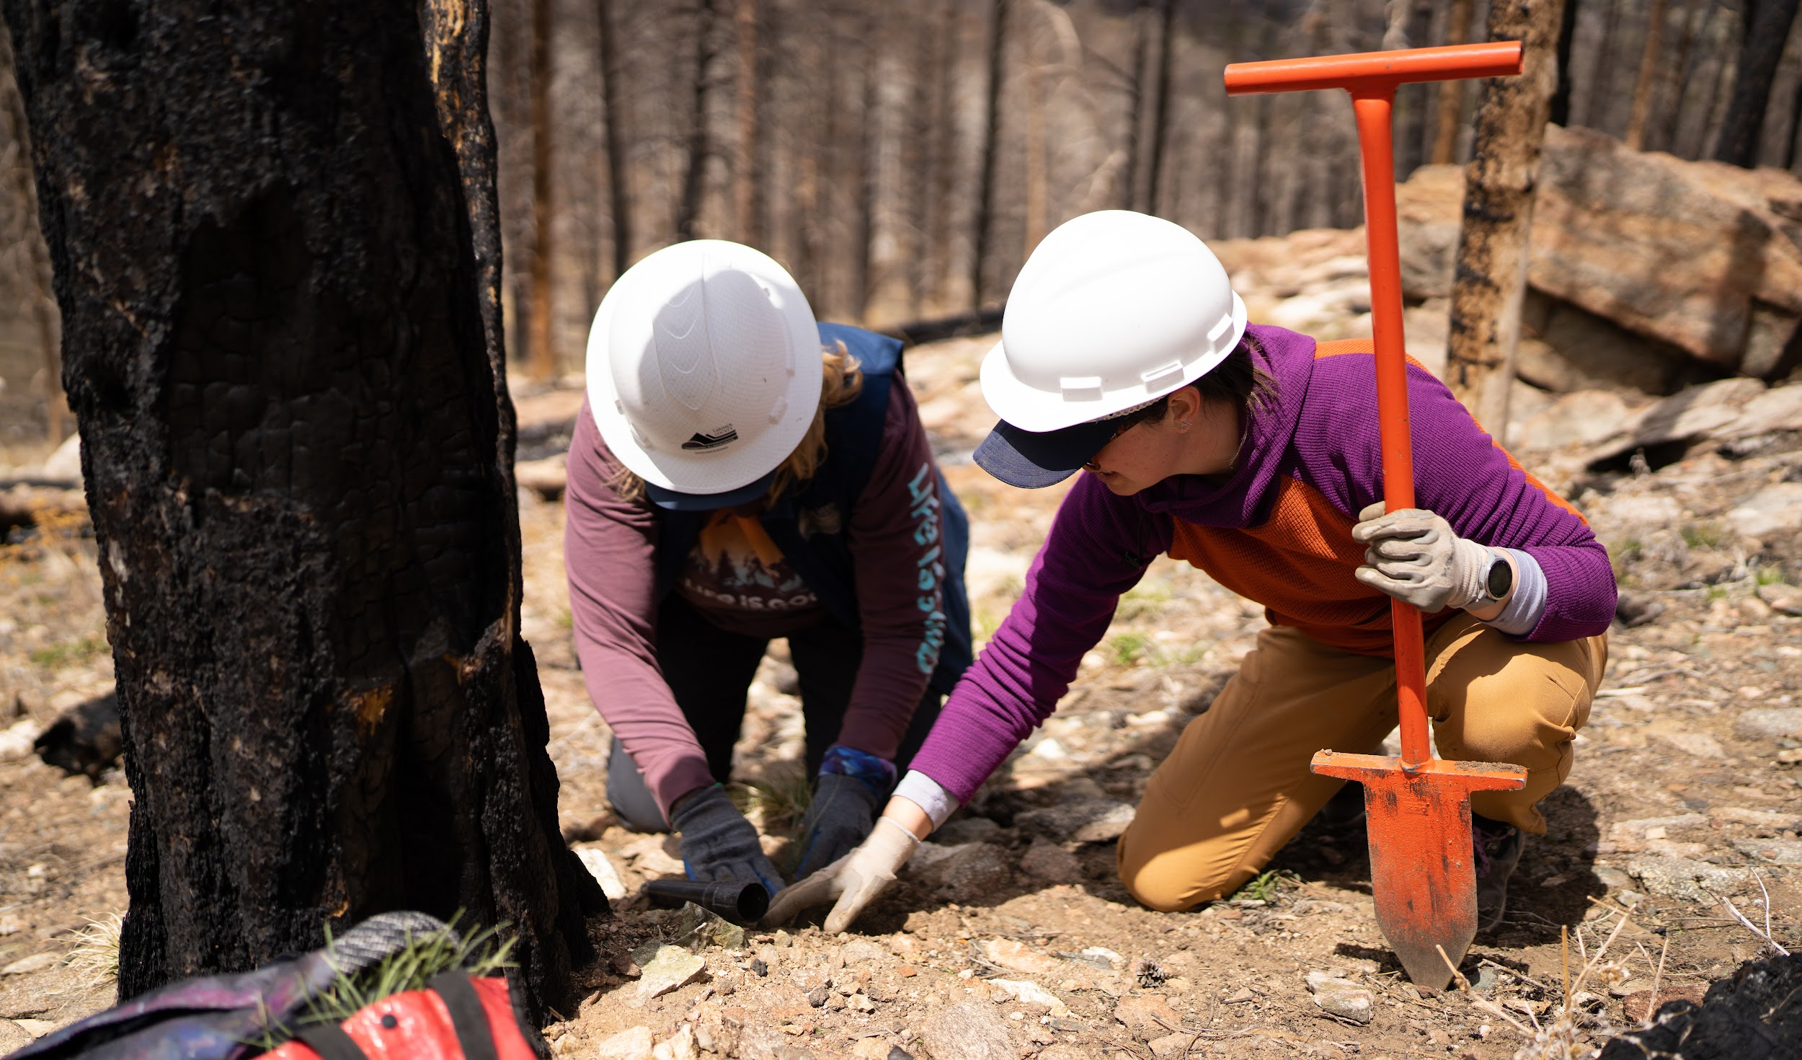
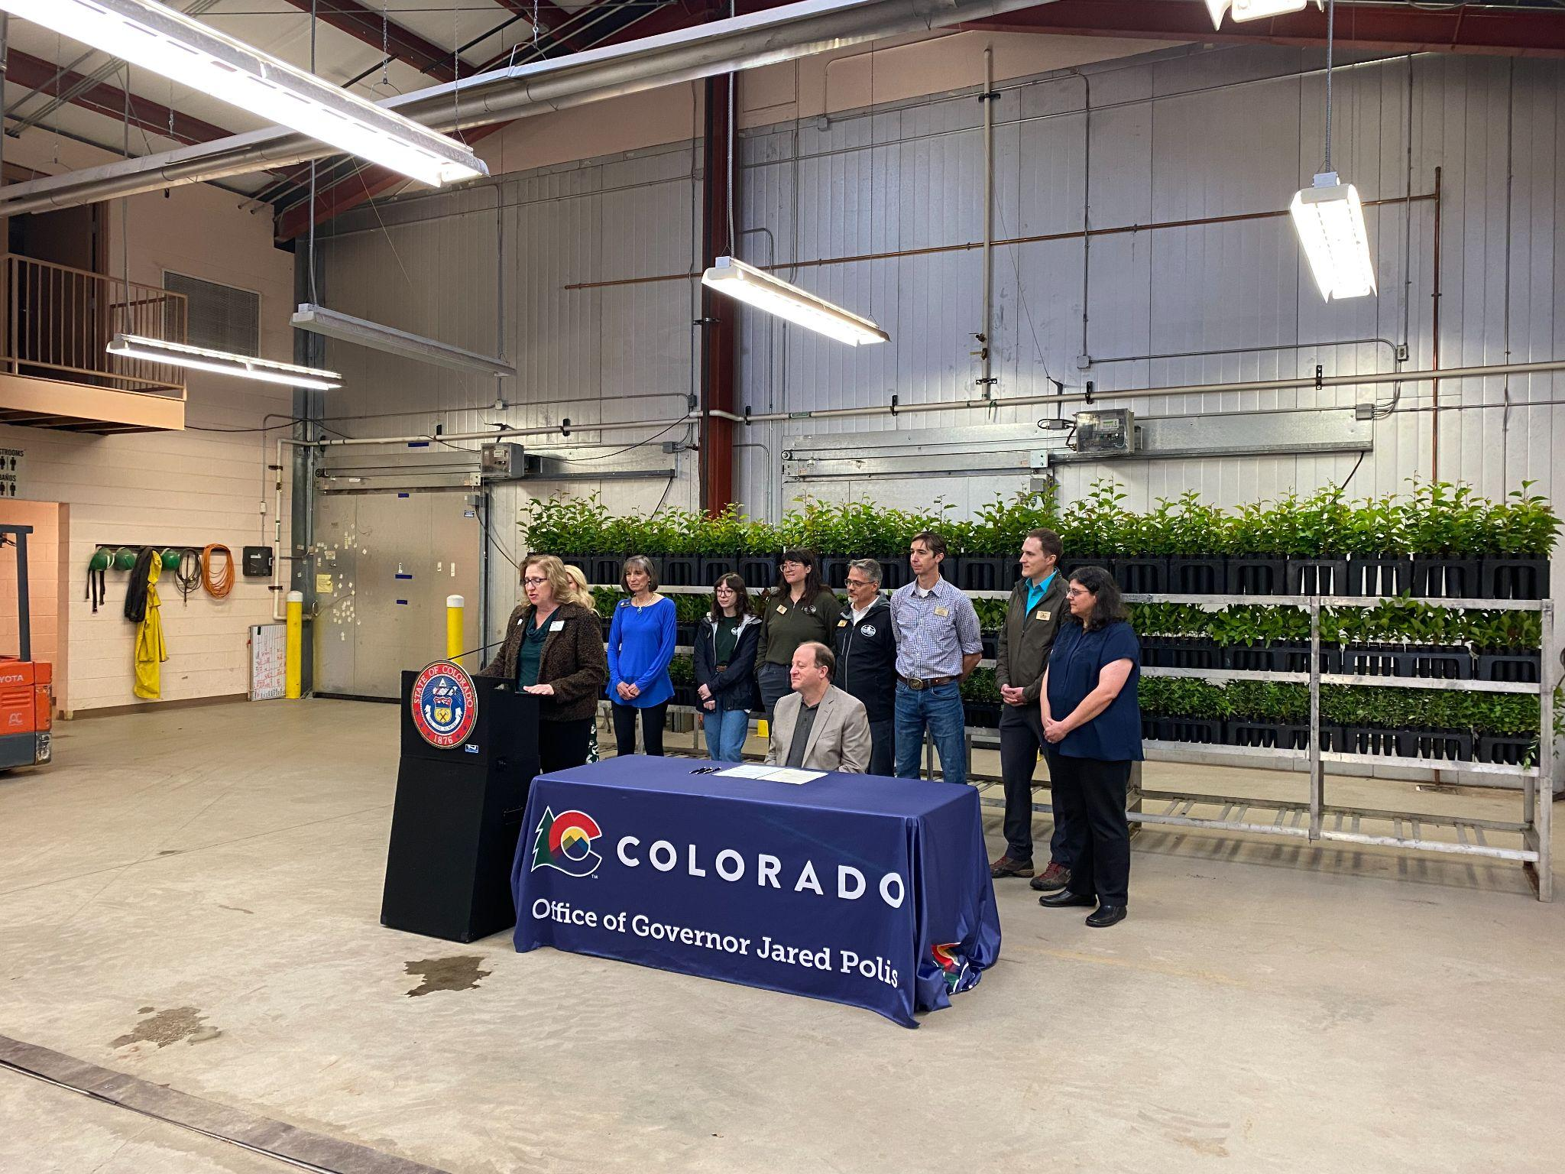
Larimer County Colorado
Forest Health is Watershed Health is the future of our County.
Larimer County Colorado
QUESTIONS ? Thank you

