Slide 1
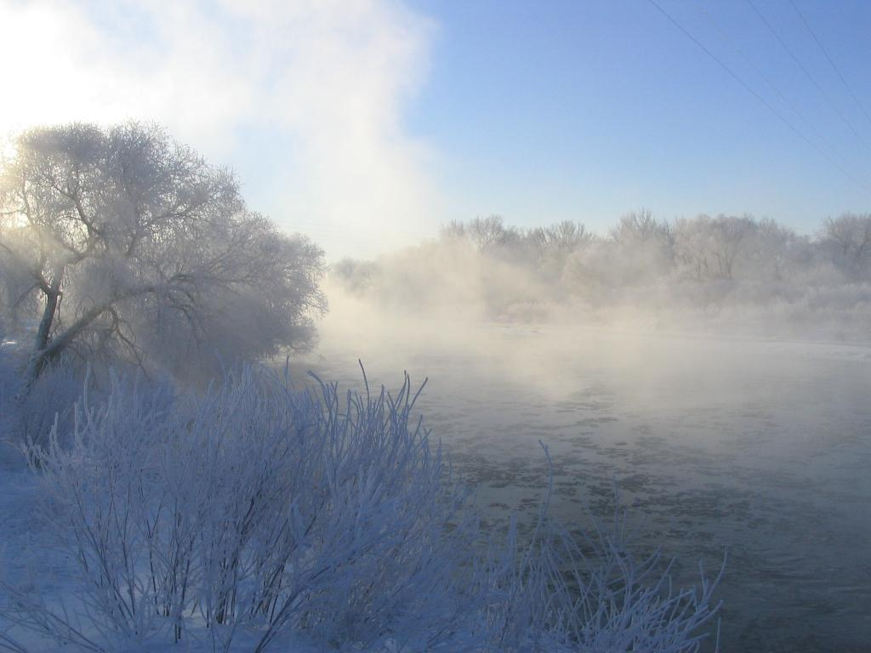
Colorado Division of Water Resources
Water Literate Leaders of Northern Colorado
October 11, 2023
Michael Hein, Assistant Division Engineer
Jean Lever, Thompson Water Commissioner
South Platte River at Kersey
(Photo by Jason Smith)

Slide 2
https://dnr.colorado.gov

Slide 3
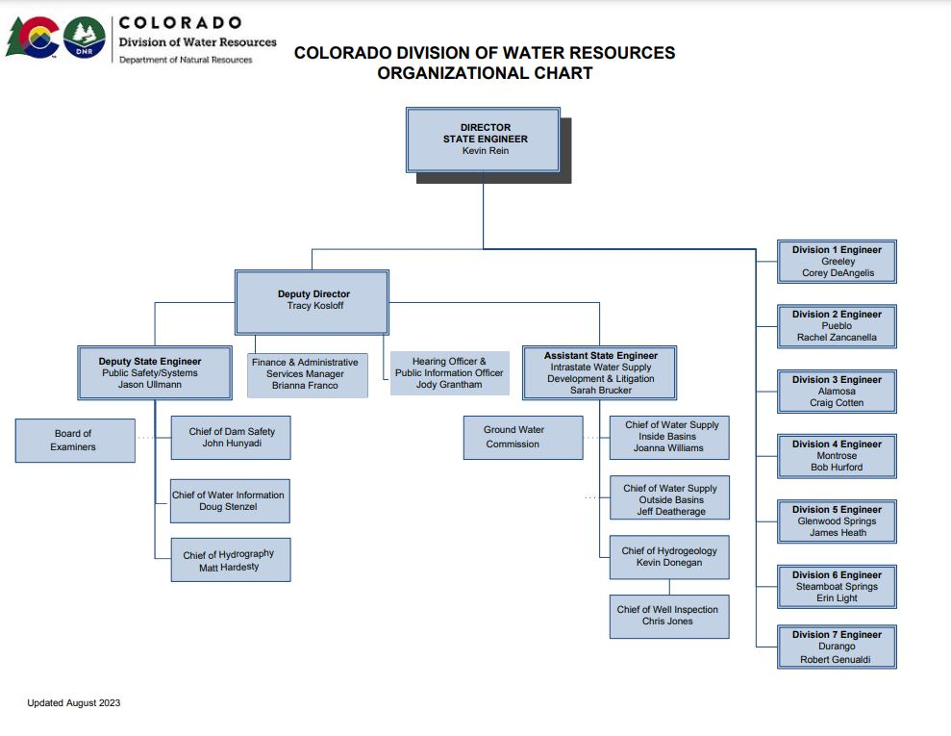

Slide 4
Division of Water Resources Mission
The Division of Water Resources will administer the waters of the State to maximize lawful beneficial use, ensure that dams and water wells are properly constructed and safe, and provide information about water resources to the public.

Slide 5
Division of Water Resources Roles and Responsibilities
Water Administration
Surface & Underground
Water Court Participation
Interstate Compacts and Decrees
Flow Measurement (Hydrographic Program)
Well Metering
Public Safety
Dam Safety
Well Construction & Inspection
Well Permitting
Public Data & Information

Slide 6
The office of State Hydraulic Engineer was created by the Legislature in 1881
State Engineer’s Office became part of the Department of Natural Resources in 1969
Water Right Determination and Administration Act of 1969 included, among other provisions, the creation of the Water Divisions and Division Engineer
State Engineer and Director of Division of Water Resources is Appointed by the Governor
State Engineer’s Office includes 260 employees
https://dwr.colorado.gov

Slide 7
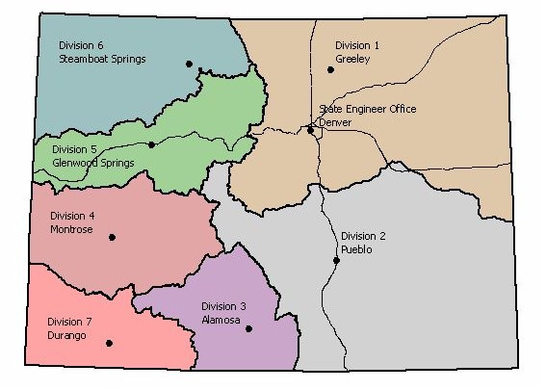
DWR Water Divisions & Offices

Slide 8
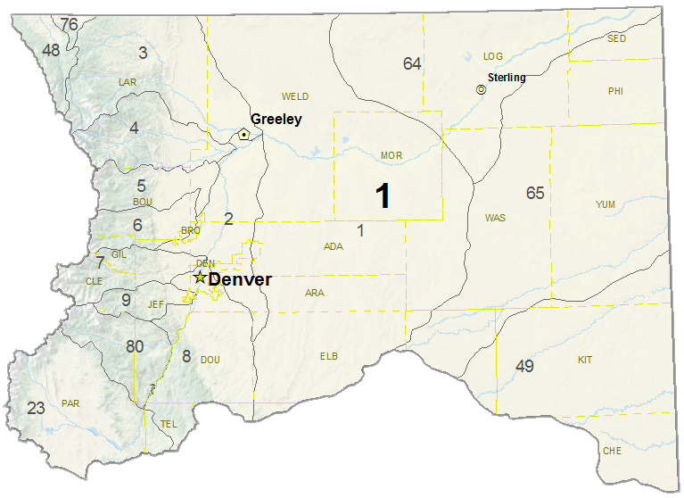
Division 1 Water Districts Map
Wyoming
Nebraska
Kansas

Slide 9
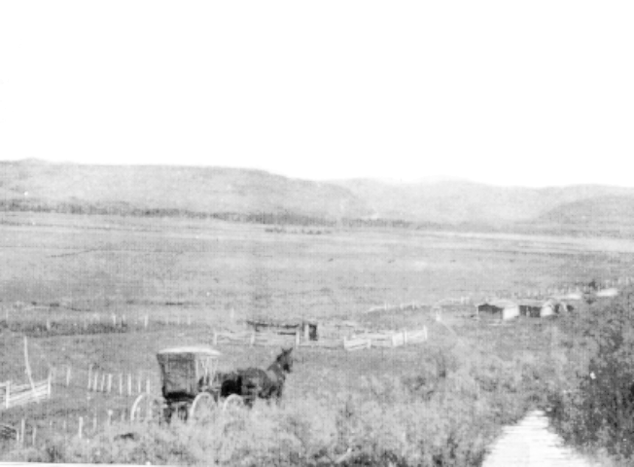
In 1879, Colorado established Water Commissioners to distribute water rights in priority based upon principle of
“First In Time... First In Right”

Slide 10
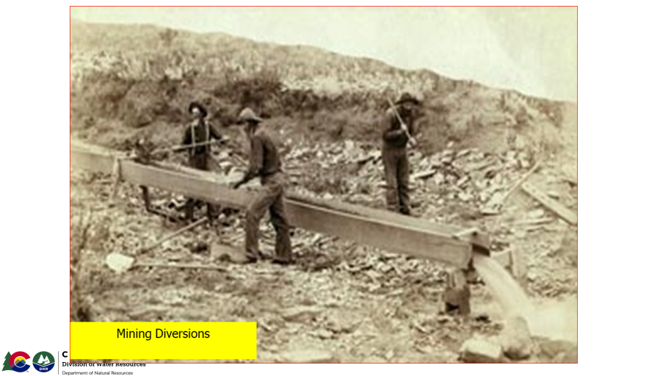
Colorado’s Water Administration System
The Prior Appropriation Doctrine means those that put the water to use first are entitled to get their water first during periods of water shortage.
In Colorado, the priority of a water right is determined by BOTH the date when the water was first put to a beneficial use and the date when the right was decreed
by the Water Court.

Slide 11
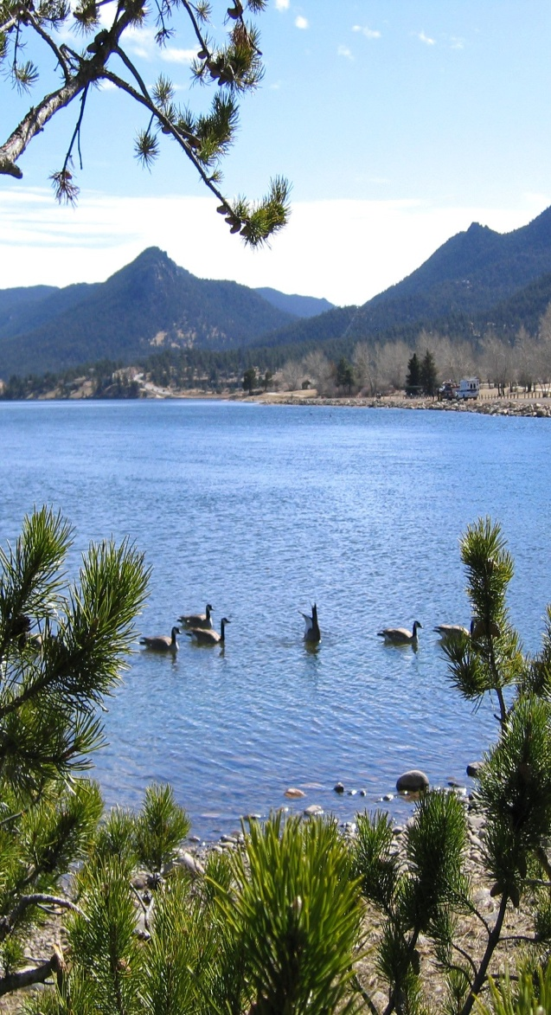
Colorado’s Water Administration System
Constitution, Article XVI, Section 5 & 6
“The water of every natural stream…is hereby declared to be the property of the public…subject to appropriation as hereinafter provided.”
“Priority of appropriation shall give the better right as between those using the water for the same purpose…”

Slide 12
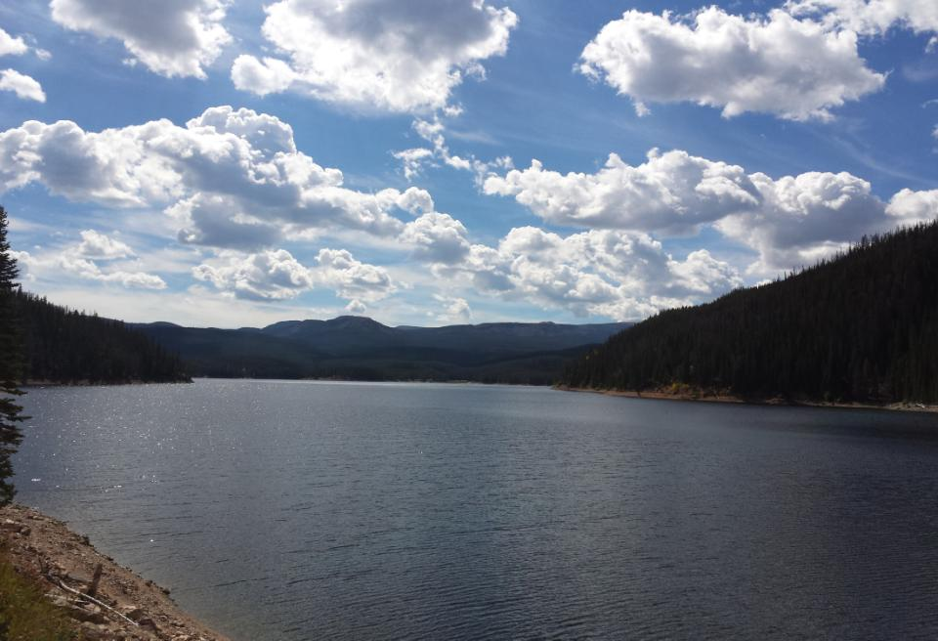
Water Division One
Interstate Administration
Compacts
South Platte River Compact
Republican River Compact
U.S. Supreme Court Decision
Wyoming v Colorado - Laramie River Administration
Interstate Agreement
Sand Creek Agreement with Wyoming

Slide 13
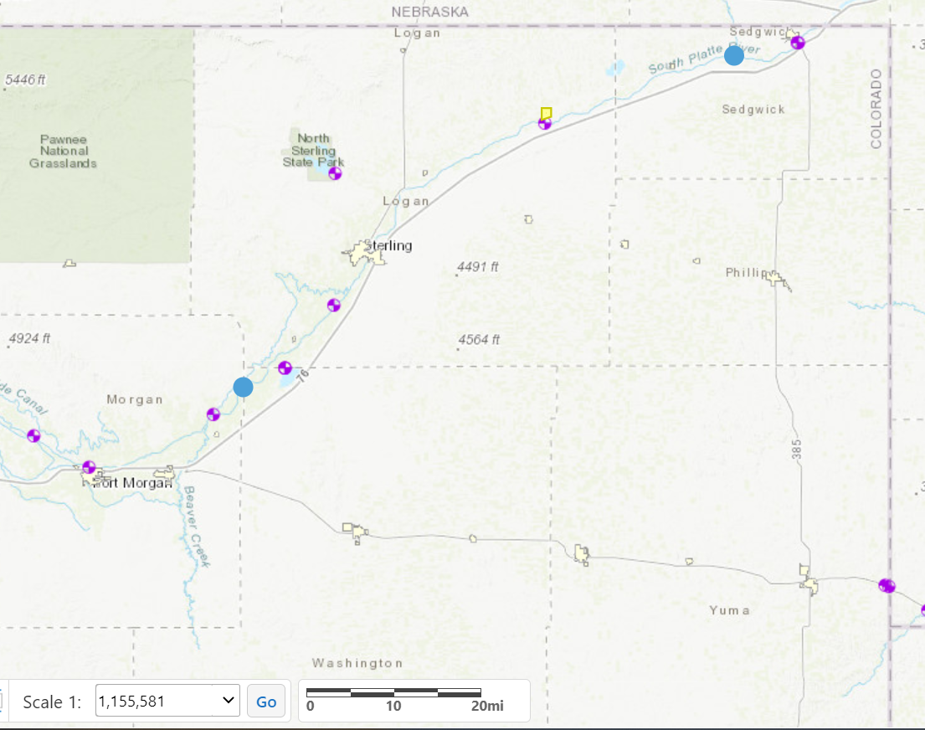
Ratified between Colorado and Nebraska 04/27/1923
Only impacts water district 64 (Hillrose, CO)
Does not extend above Westerly Boundary of Washington County to Stateline (Julesburg)
April 1 - October 15 must maintain daily flow of 120 cfs at the Stateline(Article IV)
Flow < 120 cfs, curtail water rights junior to 6/14/1897
Senior water rights may divert, even if flows below 120 cfs
October 16 - March 31 , no requirement for delivery except (Article VI)
Nebraska to construct Perkins County Canal (a/k/a “South Divide Canal”) near Ovid, CO
Priority - Junior to 12/17/1921, diversion rate of up to 500 cfs
Junior to 35,000 acre-feet of storage and use by Colorado
Julesburg Reservoir, Priority Date 2/4/1902, Storage of 28,178 Acre-Feet 3-States Agreement / Endangered Species
Colorado has complied & remains in compliance with the South Platte River Compact
Julesburg
Reservoir
Julesburg
Sterling
Compact
Extents
Perkins Canal
South Platte River Compact
Water District 64
Washington
County Line (west)
Fort Morgan

Slide 14
Laramie River Supreme Court Decree
On May 13, 1957 the US Supreme Court entered a revised decree (“Decree”) based on the April 28, 1957 Agreement between the owners of irrigated land adjacent to the Laramie River and its tributaries (“Meadowland Users”) and the Water Supply & Storage Company, The Tunnel Water Company, The Divide Canal and Reservoir Company, and the City of Greeley (“Transmountain Users”)
Apportionment of the water per the Supreme Court Decree:
Total Diversion by the State of Colorado shall not exceed 49,375 acre-feet in each calendar year
19,875 ac-ft for use outside the Laramie River Basin
29,500 ac-ft for use inside the Laramie River Basin
1,800 ac-ft shall be diverted after July 31
The State of Wyoming shall have the right to divert and use all water flowing and remaining in the Laramie River after such diversion and use by Colorado

Slide 15
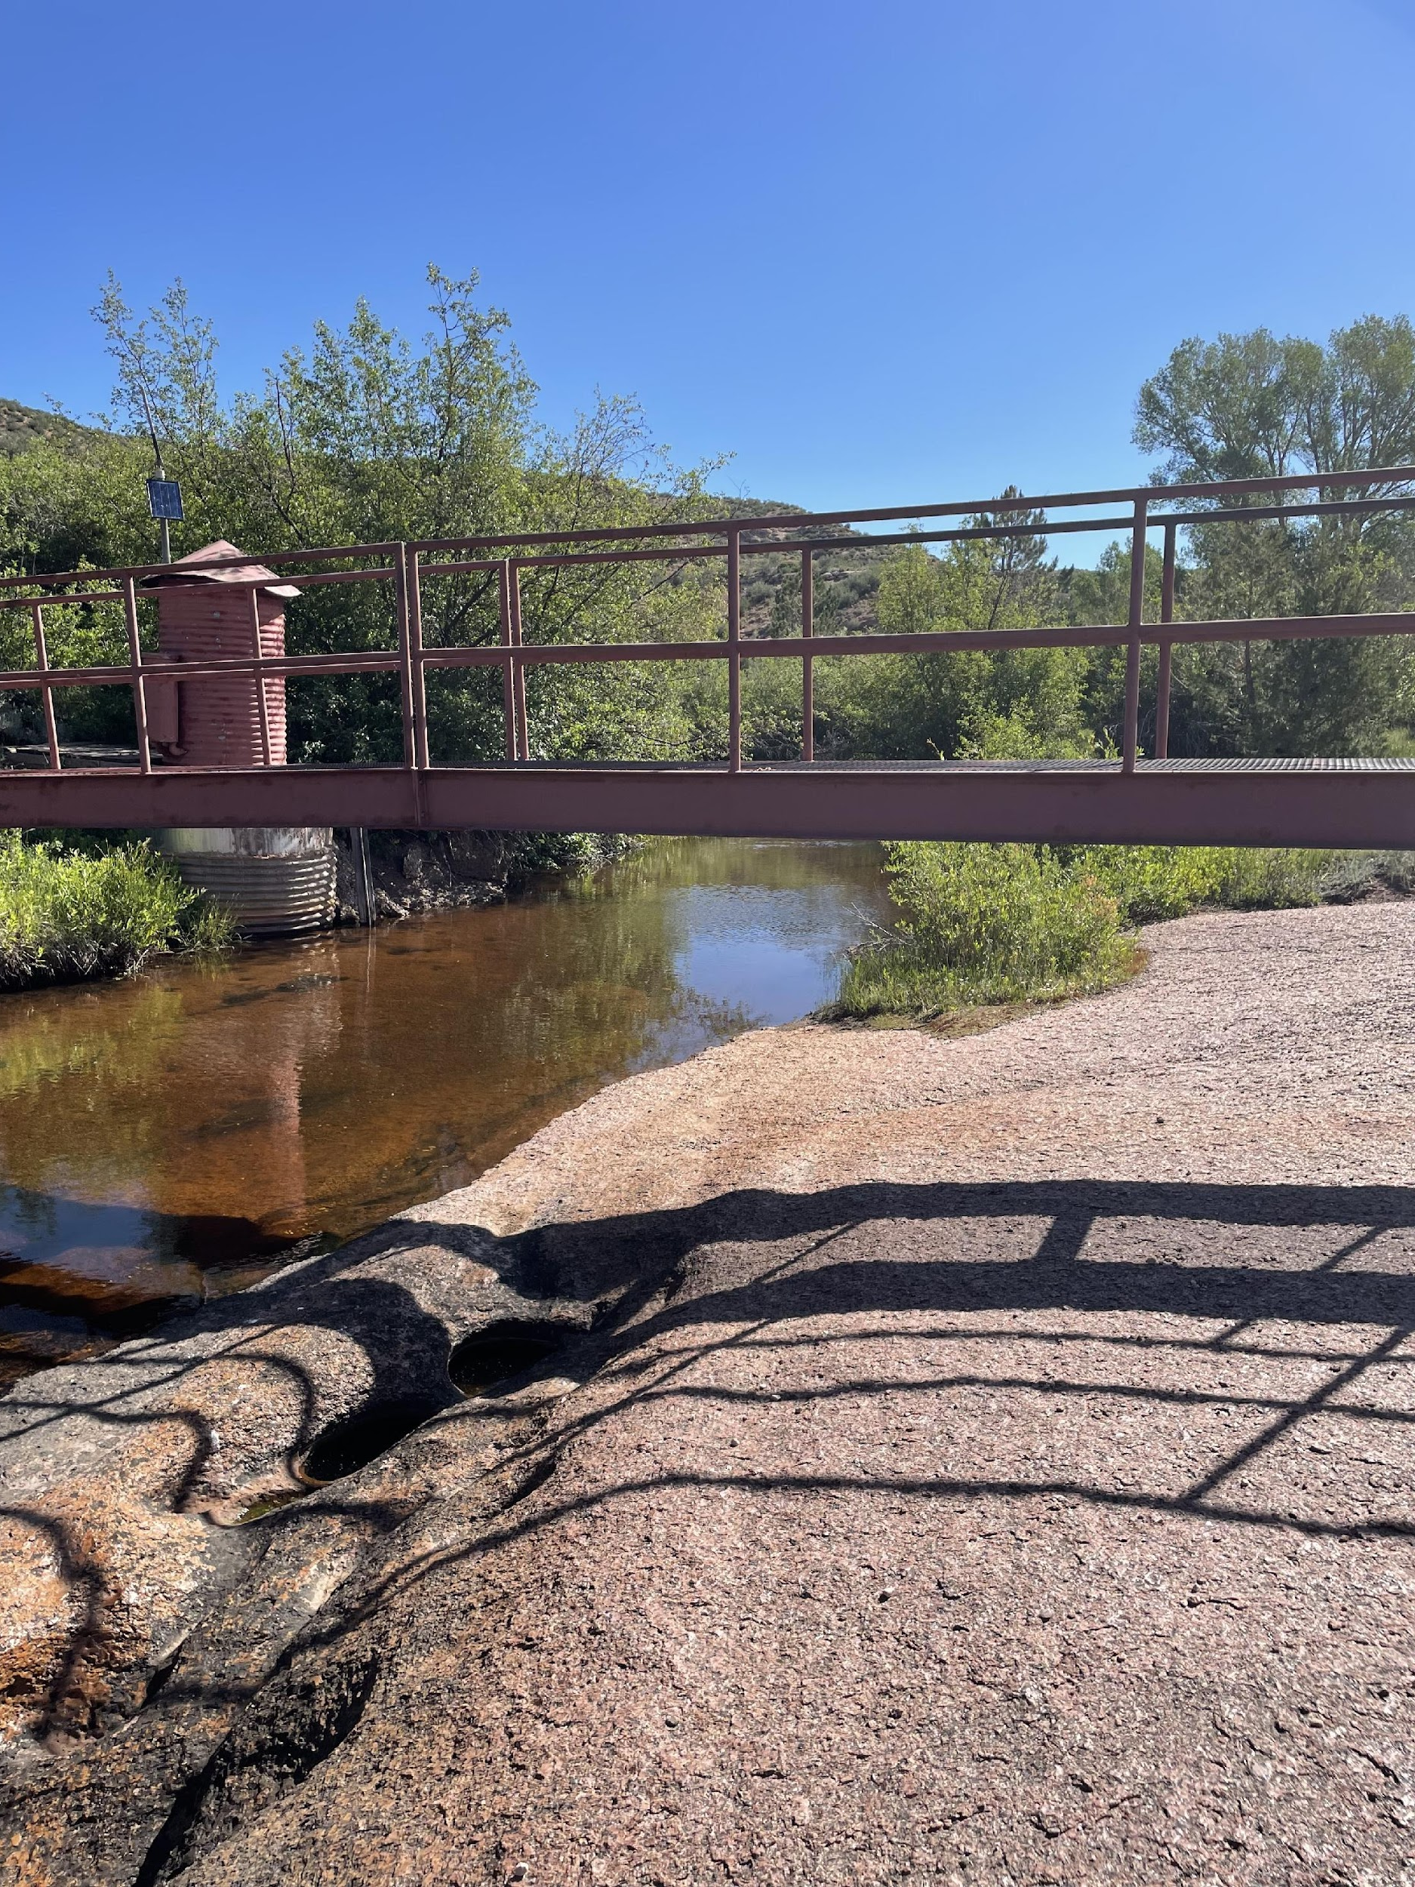
Sand Creek Agreement with Wyoming (Amended August 7, 1997)
Sand Creek
State Line Gage
At the start of each irrigation season, Wyoming gives notice to Colorado when irrigation demand reaches 40 cfs, and Colorado shall deliver that, or such lesser amount*, to the state line gage
Once Colorado delivers 40 cfs for 7 days, delivery is reduced to 35 cfs, or such lesser amount*, to the state line gage
* such lesser amount is described as an amount that can be made available by administering water rights in Colorado

Slide 16
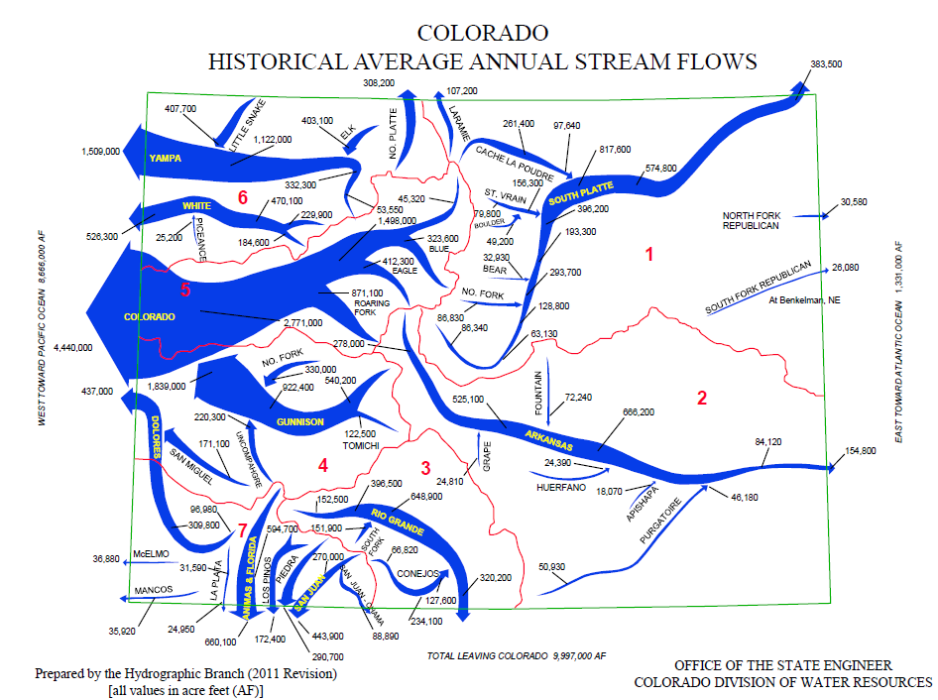

Slide 17
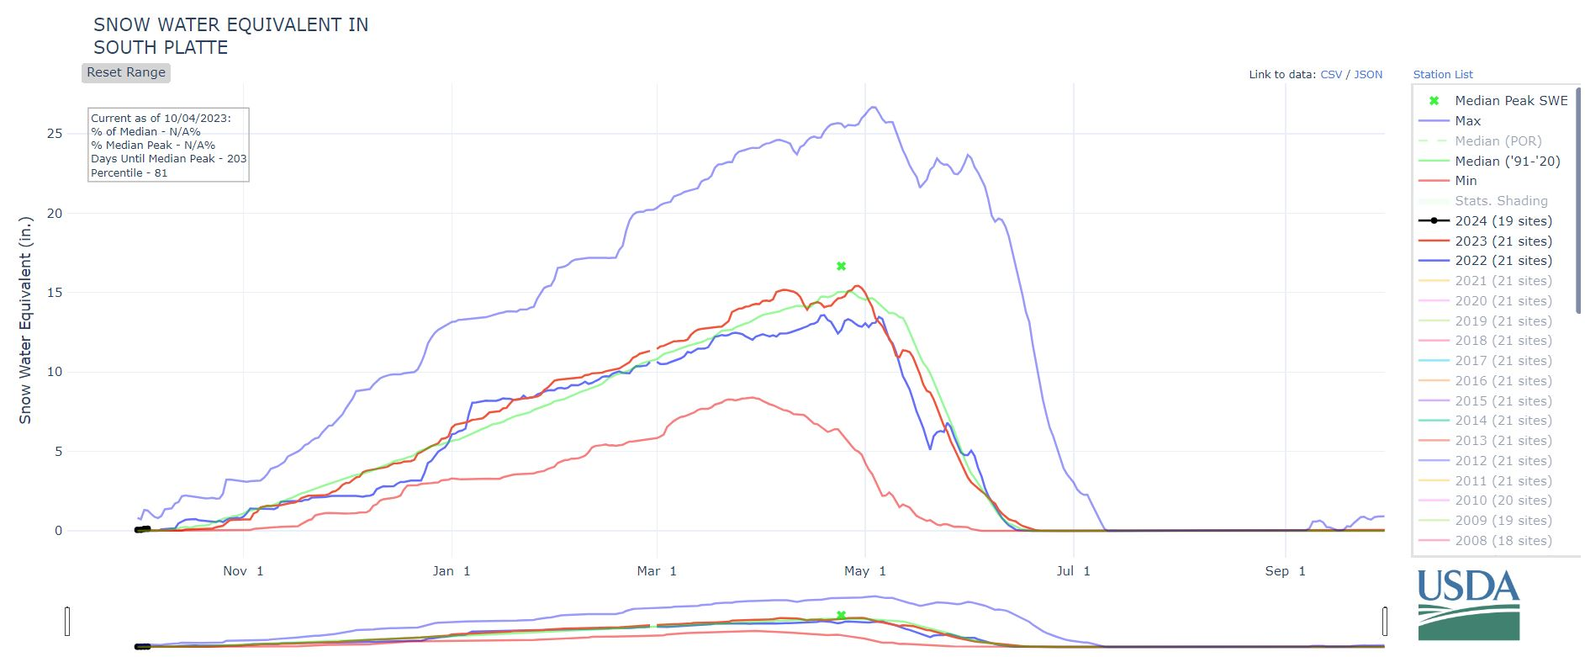
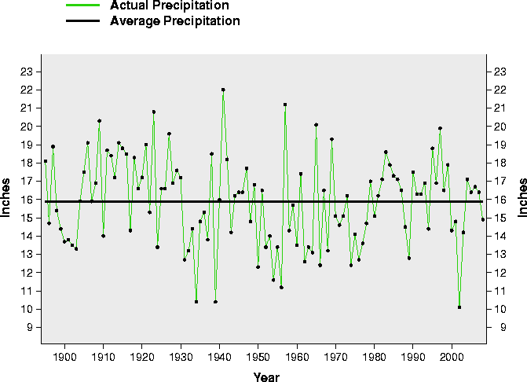
South Platte River Basin
2023
Max
Median
2022
Min
Total South Platte River basin drainage area is approx. 23,138 sq. miles
South Platte River is approx. 400 miles in length
Precipitation average - 10 to 17 inches per year
Elevation - 3,400 to 14,000+ Ft

Slide 18
TRANSMOUNTAIN DIVERSIONS
OFFICE OF THE STATE ENGINEER
1
6
2
RIVER
3
STEAMBOAT
SPRINGS
4
YAMPA
5
RIVER
6
PLATTE
7
TO COLORADO RIVER BASIN
30. SARVIS DITCH
31. STILLWATER DITCH
32. DOME DITCH
30
8
SOUTH
32
31
GREELEY
TO SOUTH PLATTE BASIN
1. WILSON SUPPLY DITCH
2. DEADMAN DITCH
3. LARAMIE POUDRE TUNNEL
4. SKYLINE DITCH
5. CAMERON PASS DITCH
6. MICHIGAN DITCH
7. GRAND RIVER DITCH
8. ALVA B. ADAMS TUNNEL
9. MOFFAT WATER TUNNEL
10. BERTHOUD PASS DITCH
11. VIDLER TUNNEL
12. HAROLD D. ROBERTS TUNNEL
13. BOREAS PASS DITCH
14. HOOSIER PASS TUNNEL
9
1
5
10
DENVER
16
11
19
17
15
COLORADO RIVER
GLENWOOD
SPRINGS
18
20
12
GRAND
JUNCTION
13
21
14
4
2
DELTA
RIVER
GUNNISON
22
TO ARKANSAS BASIN
15. COLUMBINE DITCH
16. EWING DITCH
17. WURTZ DITCH
18. HOMESTAKE TUNNEL
19. CHARLES H. BOUSTEAD TUNNEL
20. BUSK-IVANHOE TUNNEL
21. TWIN LAKES TUNNEL
22. LARKSPUR DITCH
PUEBLO
MONTROSE
ARKANSAS RIVER
24
23
DOLORES RIVER
3
25
RIO GRANDE RIVER
7
26
27
28
ALAMOSA
DURANGO
29
TO RIO GRANDE BASIN
23. TARBELL
24. WEMINUCHE PASS DITCH
25. PINE RIVER-WEMINUCHE PASS DITCH
26. WILLIAMS CREEK-SQUAW PASS DITCH
27. DON LA FONT DITCHES 1 & 2
28. TREASURE PASS DIVERSION DITCH
29. TABOR DITCH

Slide 19
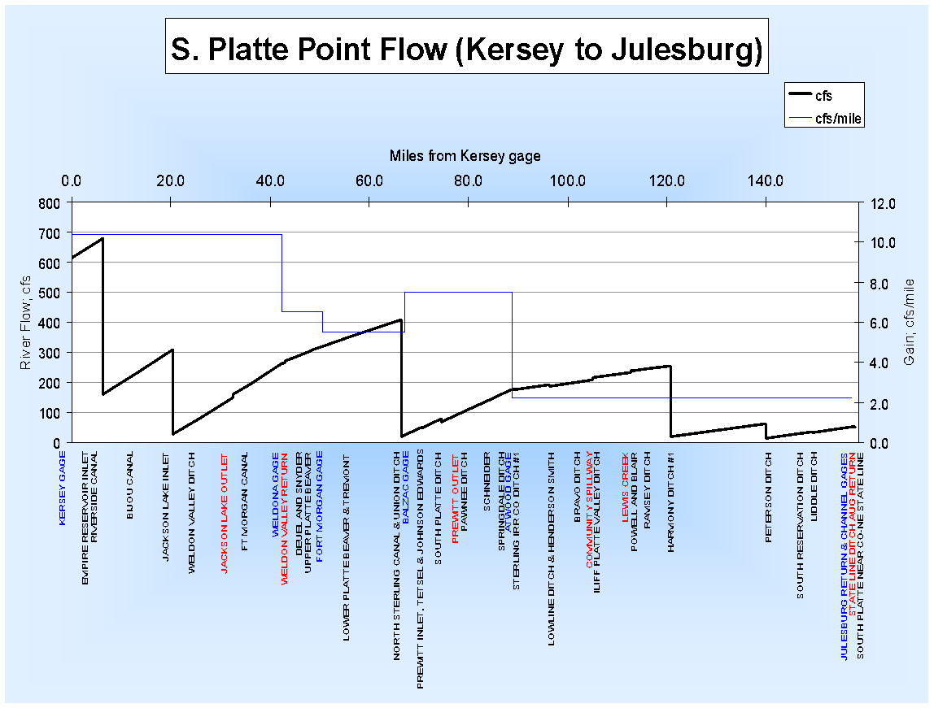
South Platte Basin Hydrology
USGS estimates total basin native flows to average about 1,400,000 acre-feet annually
Transmountain water imports average about 400,000 acre-feet annual
Total annual surface water diversions average about 4,000,000 acre-feet annually
Return flows “make” the River

Slide 20
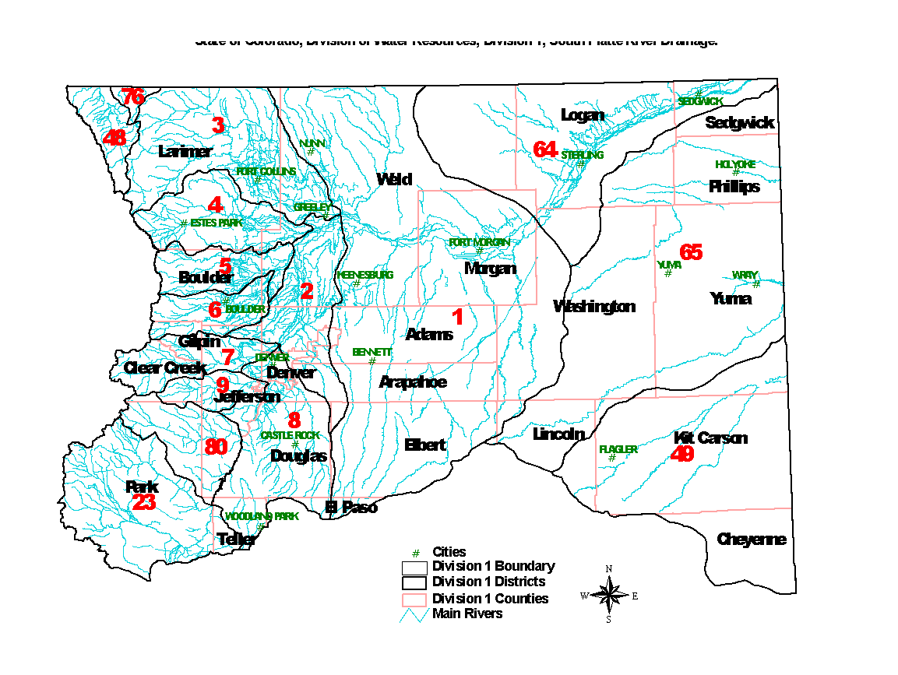
South Platte River Drainage Water Rights Development
Priority Dates
Of Controlling
Water Rights
A D
A C A
A B
A B C
A D
A
A
A
Early 1860’s
Late 1860’s
To Early 1870’s
Early 1880’s
Late 1880’s
To Mid-1890’s

Slide 21
Over-Appropriated South Platte
More water is usually claimed or desired by water users than is available.
Generally, experience a water shortage much of the year.
Almost always throughout the summer only water users who have water rights dating from the 1860’s to the 1890’s can divert in-priority.
Plans of augmentation allow replacement of out-of-priority diversions.

Slide 22
Definition of Terms for a Call
Call – The demand for water by a user with a decreed water right
Valid Call - Recognized and administered by Division of Water Resources – the determination by the Water Commissioner of the most junior right that may divert when the supply of water in the river is less than the demand on the river by all decreed water users (also known as “The Call”)
No Call – The supply of water in the river exceeds the demand for water by all decreed water users

Slide 23
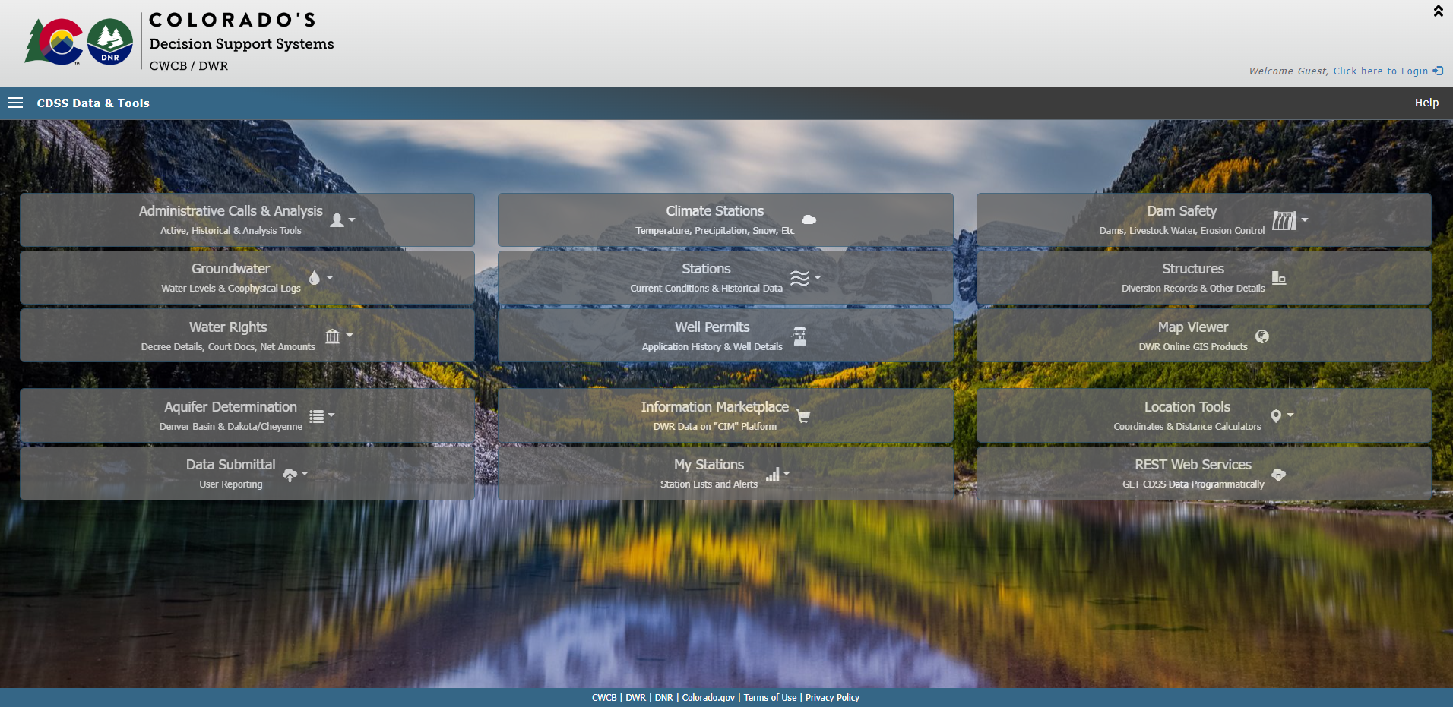
Colorado’s Decision Support Systems https://dwr.state.co.us/tools

Slide 24
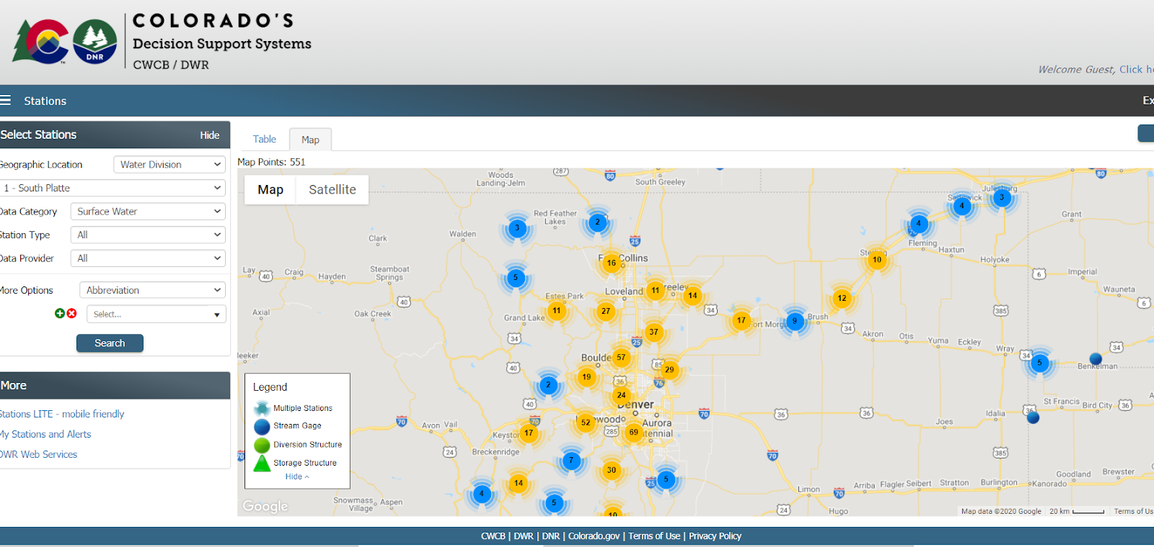
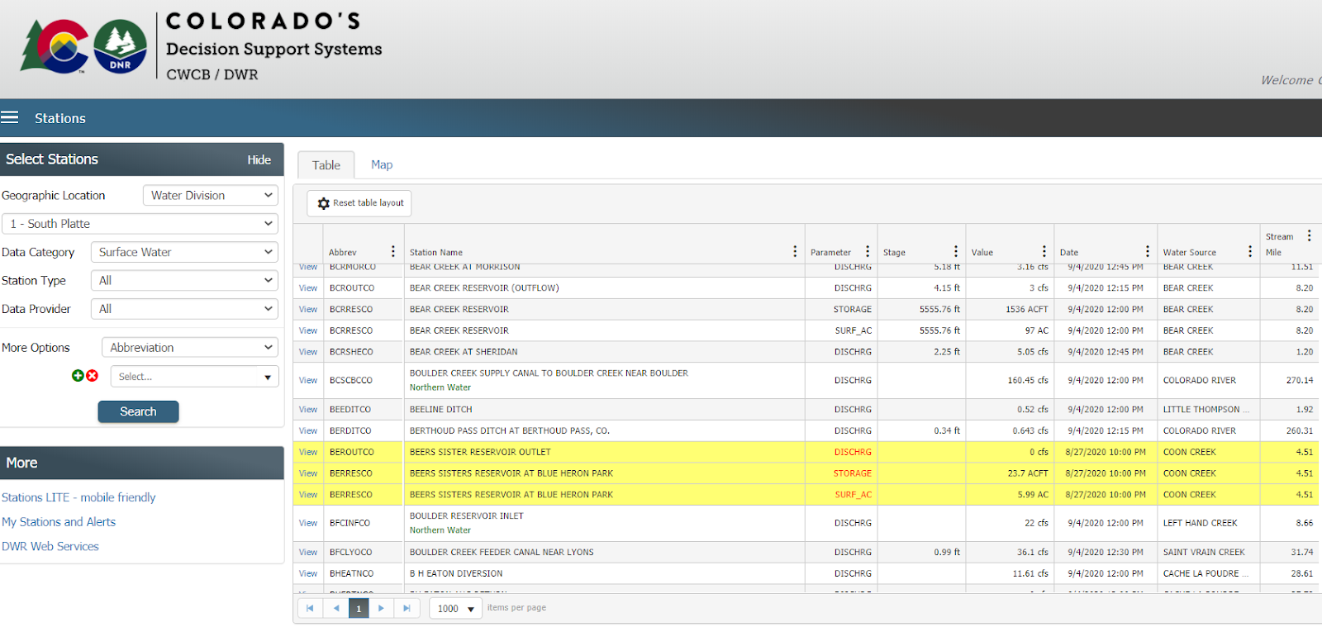
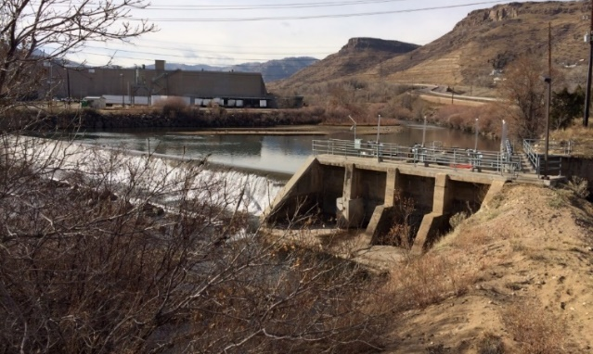
Telemetry Data – CDSS Stations https://dwr.state.co.us/surfacewater/
South Platte River Basin Division 1
Currently 864 Sites on website (Includes SPBRT Funding)
Cooperation with USGS, DWR, NCWCD, LSPWCD, CCWCD & Others
Notes:
Automation and telemetry of diversions, augmentation stations, return structures to allow administration near real-time throughout reaches.

Slide 25
Future Consideration
Development of water in the South Platte River basin will likely continue to include change of water rights applications.
2002 - 1,000 Augmentation Plans
2007 - 1,300
2019 - 1,900
The decrees for these change decrees include complex administrative provisions resulting from moving the supply of raw water to the intended place of use.
Increase of an average of 50 new plans per year out of nearly 300 new cases filed annually with the Water Court

Slide 26
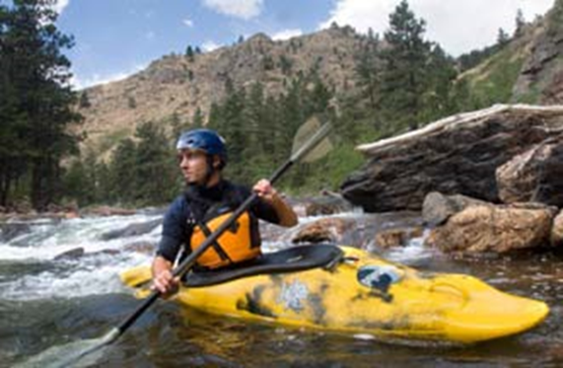
Future Consideration
Recreational and Environmental Uses
CWCB In-Stream Flows
Recreational In-Channel Diversions (RICD)
Colorado Revised Statutes
C.R.S. § 37-92-102(4.5) - Plan for Augmentation to Augment Stream Flows
C.R.S. § 37-92-102(8) – Reservoir Releases for Fish and Wildlife Mitigation

Slide 27
Water Commissioner Responsibilities
Day to Day Administration
Setting the Valid Call Based on Supply and Demand
Assuring Diversions In Priority For Decreed Uses Without Waste
Delivery of Augmentation and Other Water After Assessing Transit Losses
Operating Exchanges
Assuring Diversions Are Measured
Assuring Augmentation and Return Flow Requirements Are Made
Assuring Compliance with Other Decree Conditions in Augmentation and Change Cases
Review of Accounting and Maintenance of Diversion Records

Slide 28
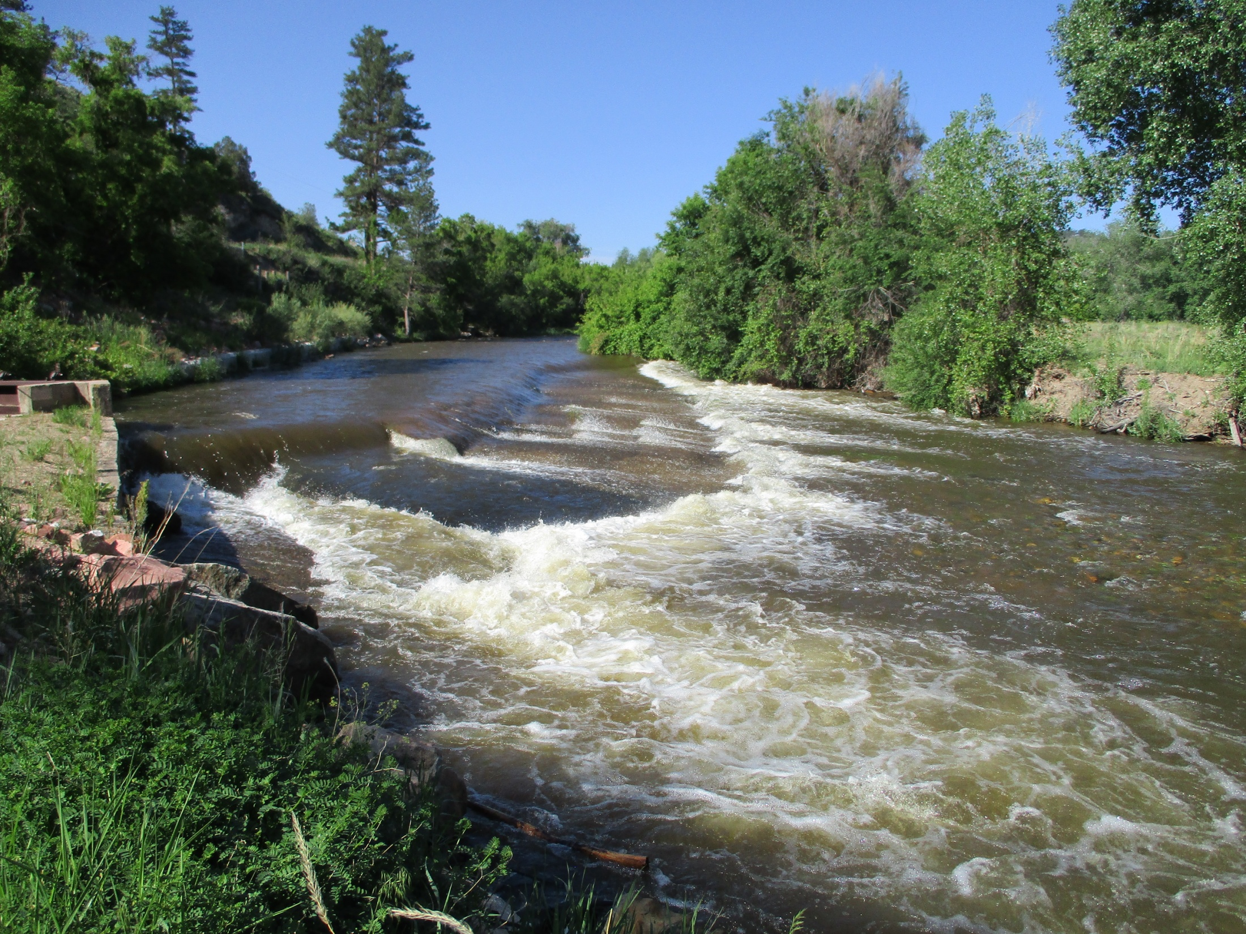
BIG THOMPSON WATERSHED
October 11, 2023
Jean Lever, District 4 WC

Slide 29
Water Sources for the Big Thompson River
Native Water
Direct Use
Storage
CBT / Windy Gap water
This is the only significant source of transbasin water for the Big Thompson Basin

Slide 30
Native Big T water
Approximately 75% of the Big T’s water is from snowmelt
Catchment Areas
RMNP (East side of Continental Divide) is the main catchment basin for the Big Thompson
The N Fork of the Big T and Buckhorn Creek contribute from the north side of the basin
Little Thompson catchment area is lower in elevation, south side of the basin
Seepage returns to the rivers downstream
Highly variable flows and volumes annually

Slide 31
Peak Flow at Big T Inlet to Lake Estes (DCFS)
Average Peak Flow Above Lake Estes: 907 cfs
2023 Peak: 895 cfs at 12:45 on June 9
BTABESCO

Slide 32
2002 Dry Year: Peak May 31st at 401 cfs (369 + 32)
2019 Year: Peak July 1st at 1098 cfs (957+141)
Average Year: Peak June 7th
2023 Year: Peak June 13th at 1370 cfs (895 + 475)

Slide 33
CBT / WINDY GAP SYSTEM
Only major transbasin diversion into the Big T is the Adams Tunnel from Grand Lake
Lake Estes: CBT and native water come together; it is not a storage container
USBR controls the movement of transbasin water from the West slope through to Horsetooth & Carter
NCWCD organizes and controls the release of CBT & Windy Gap to users

Slide 34
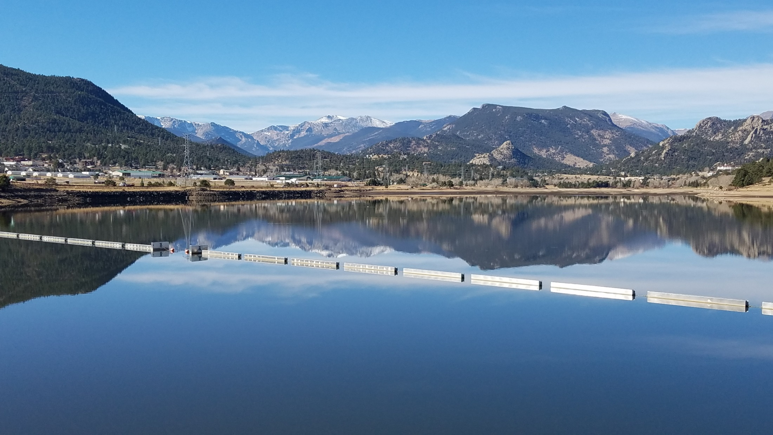
Lake Estes

Slide 35
Lake Estes
Lake Estes: CBT and native water come together
Big Thompson River enters from RMNP to the West + tributaries (Fish Creek)
CBT enters via the Powerplant
CBT is released to the Olympus Tunnel
Big Thompson water is released to the river and the Olympus Tunnel based on administrative and functional needs
Skim
City of Loveland, Berthoud
The main fill of Horsetooth and Carter: Dec-March and native water come together; it is not a

Slide 36
CBT Inflow
Volume of CBT: 215-250,000 AF/yr
Average Monthly volume: approx. 18,000 AF
Main filling period for Horsetooth and Carter is in winter: Dec – March
Reduced flows in May-June - more space in Lake Estes for the native flow of the river

Slide 37
Big T & Colorado water inflow to Lake Estes

Slide 38
Volume of CBT: Avg 215-250,000 AF/yr
Volume of Native Big T water entering Lake Estes: 105,000 AF/yr
Average Daily Volume in Lake Estes: 2350 AF
Average, the volume of water in Lake Estes is replaced every 2.5 days

Slide 39
Release of water from Lake Estes
Native flow enters in one 24-hour period and is released the next
No storage water right for Lake Estes = no storage of Big Thompson water in Lake Estes
CBT water may be held in the lake as determined by the USBR based on their operations and agreements
Typically: make one release change (gate change) at the Olympus Dam every day
Keeps a 24-hour steady flow in the Canyon, if possible
Try not to make too large changes down the Canyon intraday, except during peak runoff season

Slide 40
CBT / WINDY GAP SYSTEM
Chimney Hollow Reservoir
Broke ground on construction in Aug 2021
Capacity: 90,000 AF
No Big Thompson storage right
Total CBT/Windy Gap storage = 370,000 AF

Slide 41
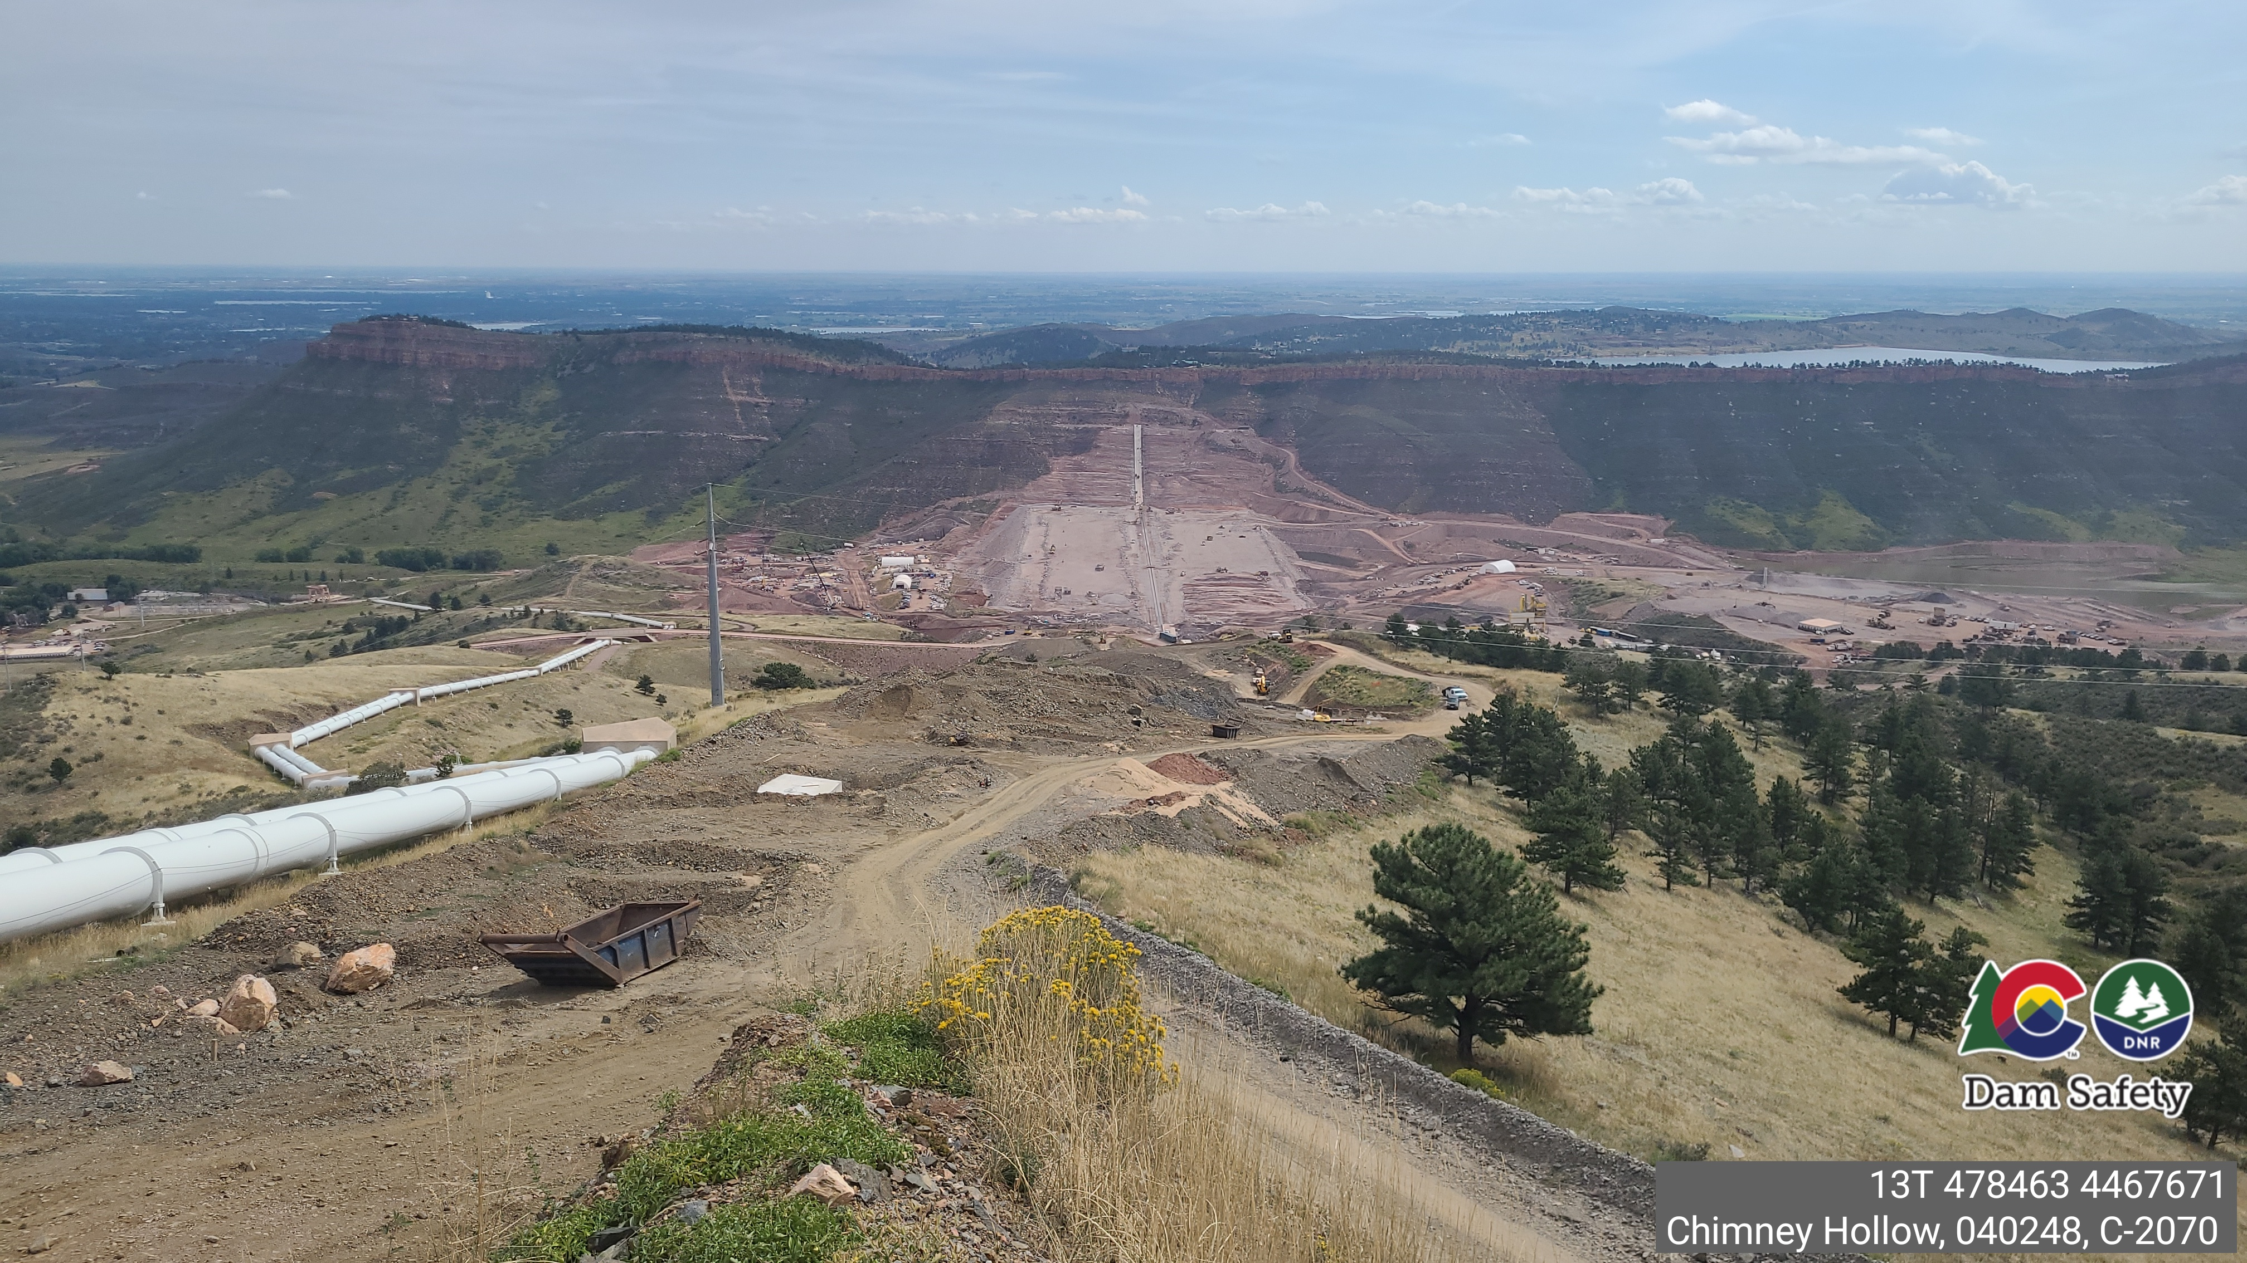
Chimney Hollow Reservoir
9 municipalities, 2 water districts, 1 power company
30,000 AF firm yield, Asphalt core dam
350’ tall dam wall, Completion: 2024-2025
Day time recreational facilities

Slide 42
Major Ditches on the Big Thompson

Slide 43
Largest Diverters
GLIC system largest and most complex
spans from Lake Loveland to Greeley
Includes Boyd, Horseshoe, Lake Loveland (75,000 AF storage)
Water from this system owned & used by Loveland, Greeley, Evans, Windsor, as well as the ditch company
Home Supply
Spans from W side of Loveland to Johnstown and the Little Thompson
Includes Lonetree, Mariano, Lon Hagler
City of Loveland
Green Ridge Glade

Slide 44
Municipalities & Water Districts
Receive water from the Big Thompson
Loveland*
Greeley
Evans
Estes Park*
Berthoud*
Johnstown*
Milliken
Windsor
Little Thompson Water District – historically CBT only
Have applied for Thompson River water rights
*have own direct

Slide 45
Municipal Use of ‘Ditch’ Water
Municipal ownership of ditch water rights increasing
Change use of the shares to include municipal, storage, augmentation, recreation, etc.
Many & complex decrees
Need ‘plannable’ water supplies
predictable and consistent
ditch systems with reservoirs
senior water rights
A municipality may become the majority ditch share owner
Location of the diversion of the water changes
City requires water at its water treatment plants
Recreational & conservation use leaves water in the river or in reservoirs
Affects the operations of the ditch company
Affects administration of the river

Slide 46
In-stream Flow Requirements
Decreed in-stream flows
Only in the Canyon
Junior water rights
USBR Fish Flow Provisions
Same or greater than the decreed in-stream flows
No minimum stream flow requirements downstream of Dille Tunnel
WC does dry-up the river in Loveland

Slide 47
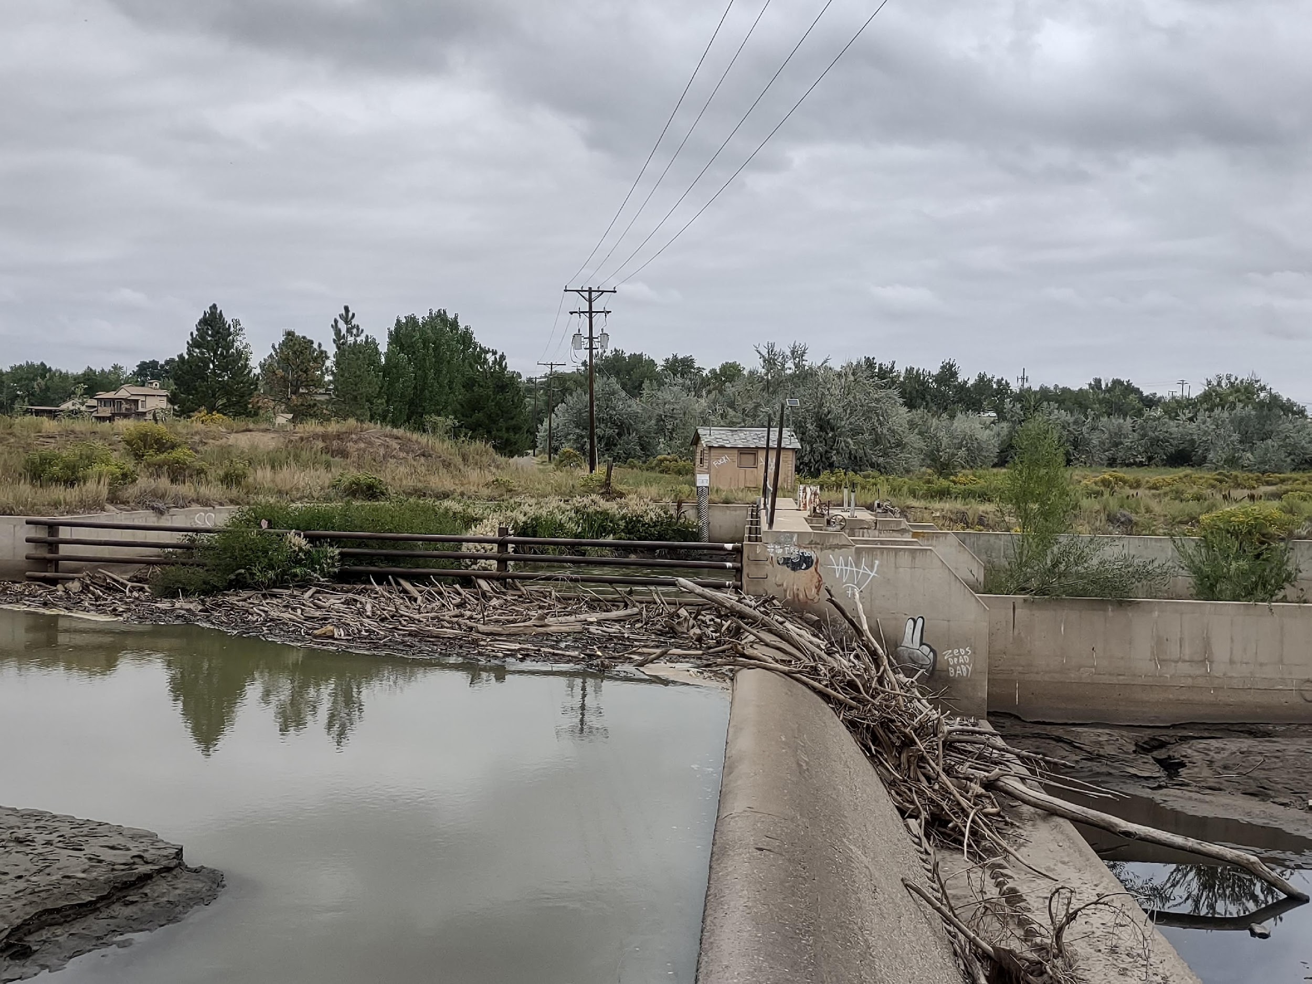
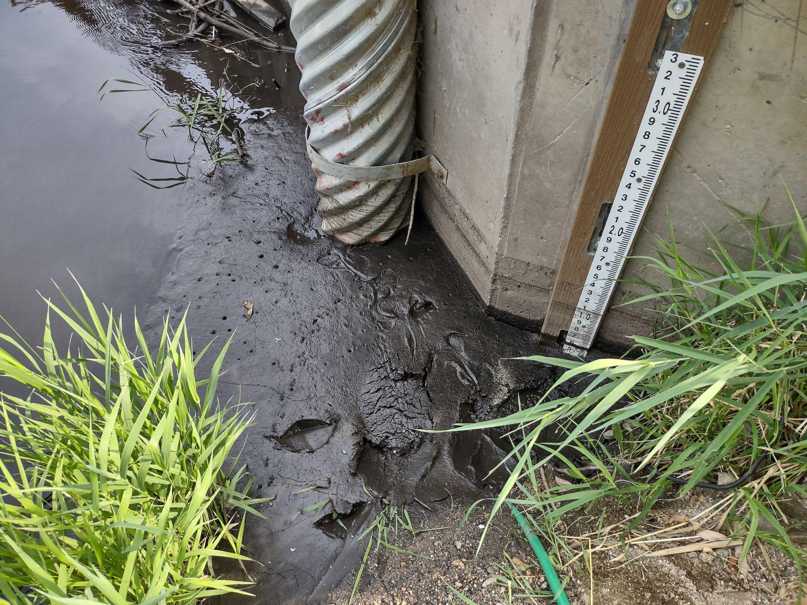

Slide 48
Big Thompson Watershed Coalition
Big T Reconstruction
Post 2013 Flood - mainly projects in the Canyon
Post 2020 Fire - mainly on the N Fork and Buckhorn
Big T Envisioning Project
Analysis of the river ‘health’ from Dam Store to I-25
Assessment by community of future vision for the Big T through Loveland
Colorado Water Plan
http://www.bigthompson.co

Slide 49
QUESTIONS

