Slide 1
Confluence: The Story of Greeley Water
Water Literate Leaders Class
December 14, 2022
Presented by Cheri Witt-Brown

Slide 2
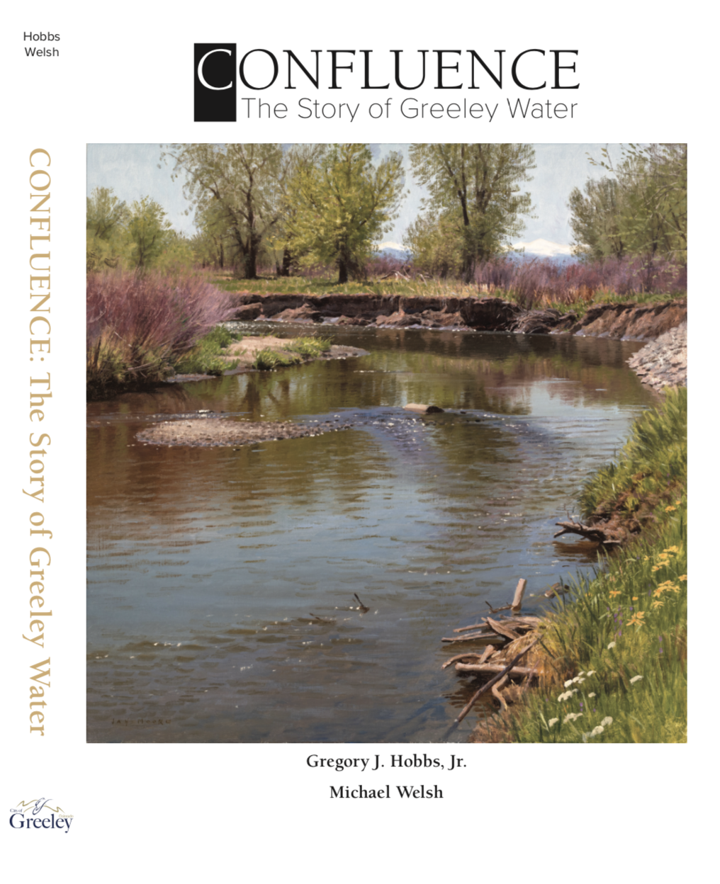
Notes:
Cover is an original oil painting or the river off of the Poudre Trail near Kodak. Spring 2019 by Jay Moore
Written by Colorado Supreme Court Justice, Gregory J Hobbs, Jr. and UNC Professor Michael Welsh, Publisher Greeley Water & Sewer Board Chair, Harold Evans

Slide 3
THE STORY
This book on the history of Greeley Water presents an unique history spanning 150 years. Greeley Water has evolved from a vast sea of buffalo grass and cactus in, 1870, into a modern award-winning water system that serves 140,000 customers today. The story starts in the spring of 1870 with the establishment of the Union Colony and the settlement of the City of Greeley. The first order of business was the construction of the Union Colony Ditch Number 3. Water was turned into the ditch 150 years ago on June 10th of 1870.
The story is comprised of the system’s infrastructure, irrigated agriculture, engineering, water law and administration, acquisition of water right, construction of water treatment plants, pipelines, and reservoirs, utility organization and governance, and the contributions of Greeley water leaders and professionals.

Slide 4
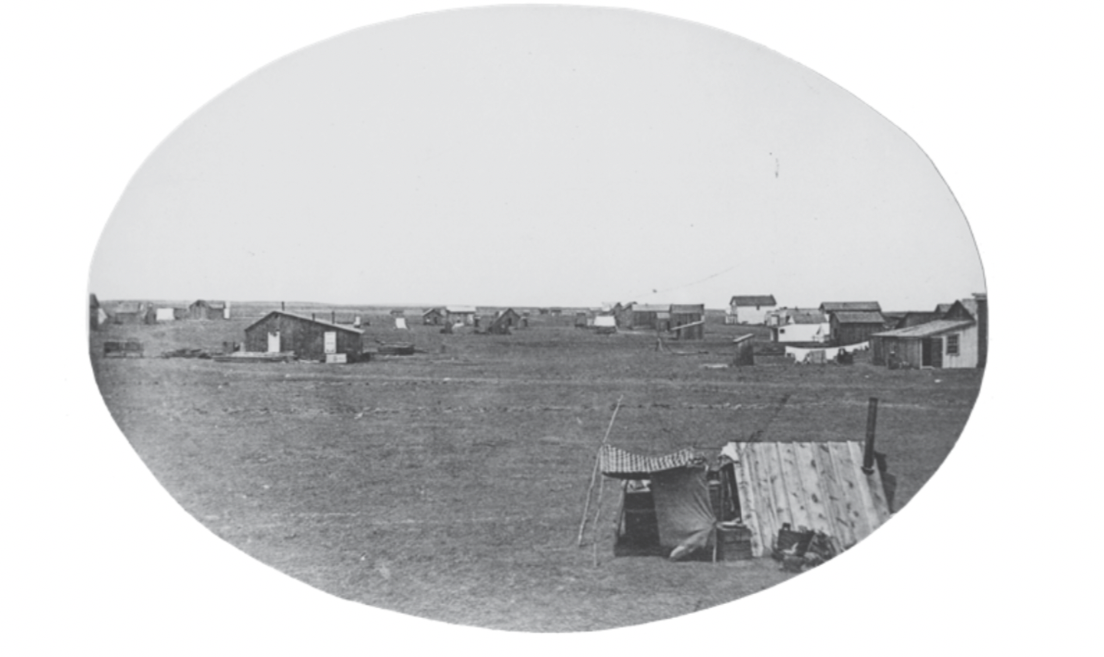
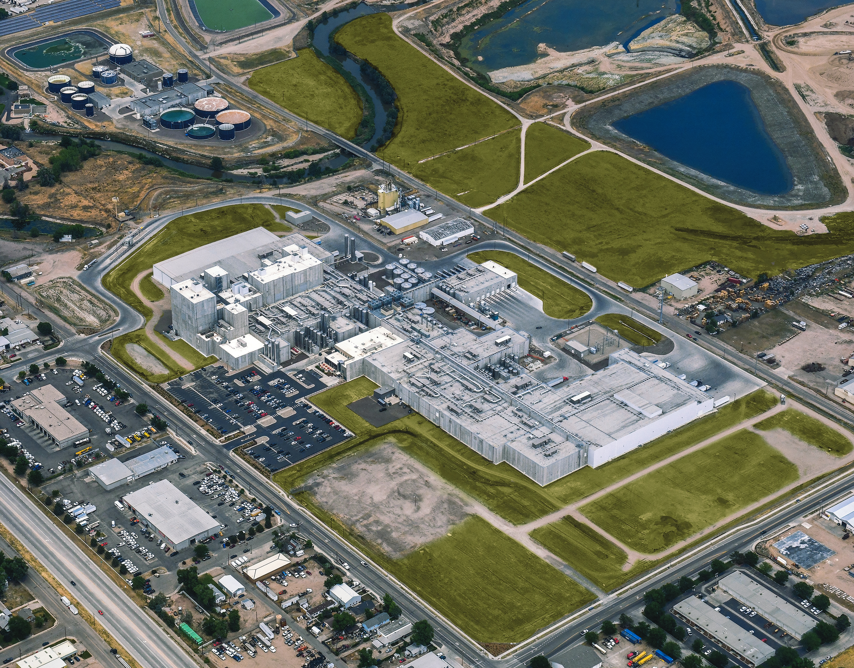
Figure 2.1 - 8th Street Looking East 1870
Leprino 2020
Notes:
Change and progress over 150 years.

Slide 5
CONTENTS
Forward by Regan Waskom
Preface by Roy Otto
Introduction, At the Confluence
Chapter 1. Desert or Garden: The Land and People Before 1870
Chapter 2. The Promise: The Union Colony and its Quest for Water, 1870-1880
Chapter 3. City of Water: Greeley and the Progressive Era, 1880-1900
Chapter 4. The Sugar Factory and Bellvue Treatment Plant, 1900-1910
Chapter 5. The Greeley Water System Matures, 1910-1930
Chapter 6. Dark Clouds: Greeley Water in the 1930’s
Chapter 7. Greeley Transformed: Water for War and Peace, 1940-1950
Chapter 8. A Small Town No More: Postwar Growth and Greeley Water, 1950-1970
Chapter 9. Keeping Meeker’s Promise: Cleanliness, Abundance, and Affordability, 1970-1980
Chapter 10. Currents of Controversy: Along the Cache la Poudre River,1980-2000
Chapter 11. Greeley Water at 150: Challenges Met, Lessons Learned, 2000-2020
Chapter 12, 150 Years Later: The Magic Touch of Water, by Harold Evans
Notes:
Chapter 1 pages 13-14 CA Gold Rush & and the formation of prior appropriations water use doctrine, CA Supreme Court ruled “the first in time, first in right”

Slide 6
KEY EVENTS PT. 1
Prior to 1870:
Early explorers and Military Expeditions
Migration west
California Gold Rush and the Colorado Gold Rush
1870-1880:
Founding of the Union Colony
Union Colony Ditch #3 and Ditch #2
1874 Dispute Over Water with Fort Collins
1876 Colorado Constitution
1879 Adjudication and Administration Act
1880-1900:
Drilling of the Artesian Well
First Water Treatment Plant
Water Adjudication and Administration
Potato Farming
1900-1910:
Sugar Beet Plant
Bellvue Water Treatment Plant and Pipeline
1910-1930:
Additional Water Purchases
Laramie Poudre Project
Delph Carpenter and Interstate Compacts
Colorado River Compact
Notes:
Major Stephen Long in 1820 and the early fur trappers, Col. Henry Dodge in 1835, Captain John Fremont three surveys from 1842 to 1845. California Gold Rush in 1849 and Colorado in 1859. The First Artesian Well was drilled in August of 1883, a total of 8 were drilled, with the first one being in Lincoln Park. Sugar Beet Plant was constructed in 1902. Bellvue Water Plant 1907, 38 miles of 20-inch wood stave pipeline. Colorado River Compact 1922.

Slide 7
KEY EVENTS PT. 2
1930-1940:
Depression and Drought
Colorado Big Thompson Project
Conservancy District Act
First Sewer Plant in 1936
1940-1950:
Construction of Seaman Dam and Reservoir
World War II and the Greeley Prisoner of War Camp
Purchase of the High Mountain Reservoirs
1950-1970:
Colorado Big Thompson Project Operational
Formation of the Greeley Water Board in 1958
Drought of the 1950’s
Monfort Packing Plant Opens
Agreement with the Greeley Loveland Irrigation Company
Boyd Lake Treatment Plant and Pipeline
Kodak of Colorado
Wastewater Treatment Plant Expansion
Notes:
CBT came out of meeting at the Greeley Post Office on August 14, 1933, Charles Hanson became the leader of the effort. Conservancy District Act author by two Greeley attorneys. First Bureau of Rec project in the country to include municipal uses. Seaman Dam constructed 1940 to 1945. High Mountain Reservoirs purchased in 1947. Charter passed June 24, 1958, Greeley Loveland Agreement in 1961, Waste Water Plant Expansion 1964, Kodak in 1968

Slide 8
KEY EVENTS PT. 3
1970-1980:
Windy Gap Project
Become the Greeley Water and Sewer Board
1980-2000:
The Environmental Era Begins
Wild and Scenic Designation for the Poudre River
Federal Reserved Water Rights Claims
By Pass Flow Claim by the U.S. Government
Thornton Water Purchase
Sale of the High Mountain Reservoir Controversy
Water Purchase of the 1990’s
Expansion of the Wastewater Treatment Plant
2000-2020:
Drought of 2002
Water Conservation
Water Master Plan of 2003
Seaman Reservoir Expansion Permitting
Windy Gap Firming Project
New 60 inch Treated Water Pipeline from Bellvue
Water for Economic Development: ConAgra and Leprino
Best Tasting Water in America Award
Greeley Water at 150:
Concluding Summary Chapter of the Past 150 years
Challenge of the Future
Notes:
Windy Gap Project 1967 to 1985, added sewer to the Water Board in 1973 to become the Water and Sewer Board, Poudre Wild and Scenic Act in 1986 through the efforts of Rep. Hank Brown, 1986 the Thornton Water Purchase of farms and water rights. City Council turns down the sale of the High Mountain Reservoirs, 1994 expansion of the Sewer Plant. ConAgra Headquarters in 2000 and Leprino in 2007 bought the Great Western Sugar Beet site. 2017 Best Tasting Water

Slide 9
“Go West Young Man” Horace Greeley 1865
Notes:
Horace Greeley’s phrase came to symbolize the idea that agriculture could solve many of the nation's problems of poverty and unemployment characteristic of the big cities of the East. It is one of the most commonly quoted sayings from the nineteenth century and may have had some influence on the course of American history.

Slide 10
California Gold Rush First in Time, First in Right Prior Appropriation Water Use Doctrine
Notes:
Profound effect on future Colorado water law development and, in particular on the soon to be established Union Colony.

Slide 11
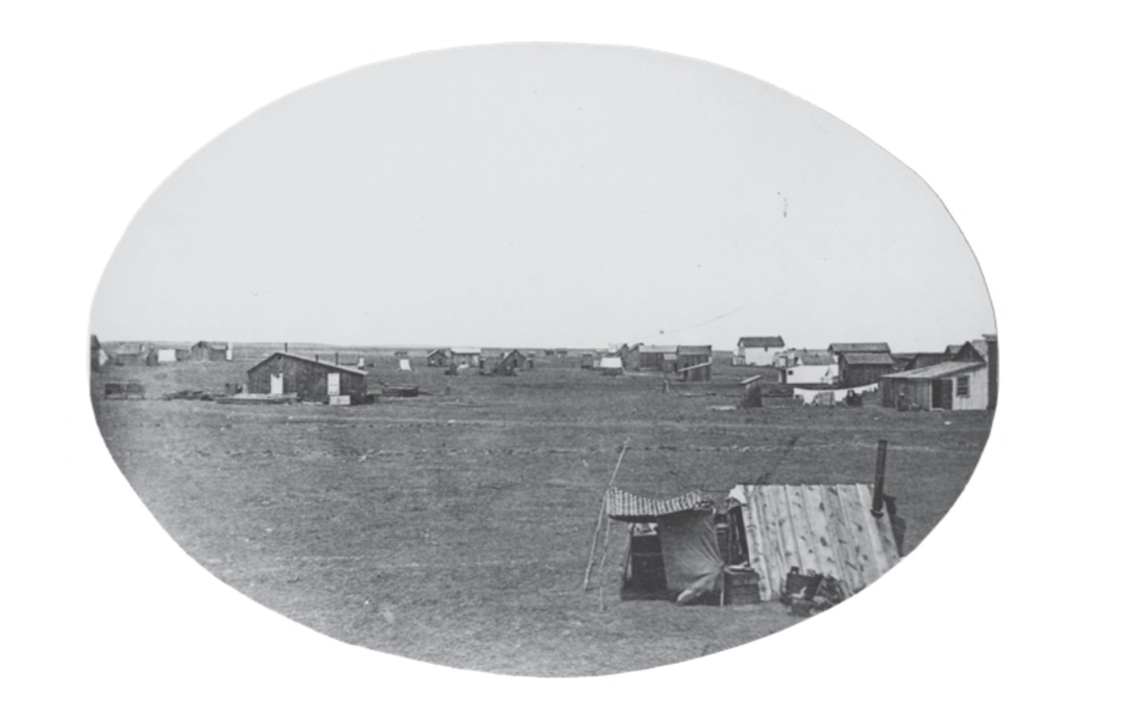
Figure 2.1 - 8th Street Looking East 1870
Notes:
Pg 21- Arrival of the Union Colonists Chapter 2 1870-1880 “The Promise” The Union Colony and its Quest for Water – Pages 23

Slide 12
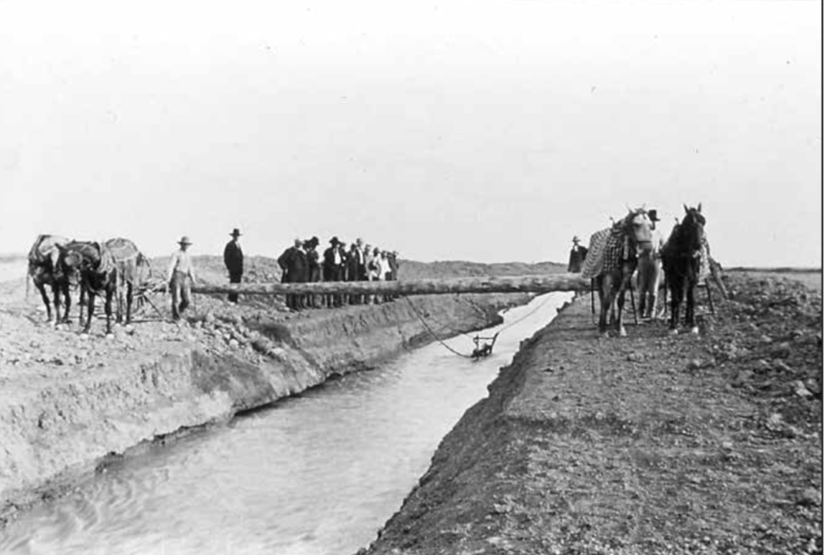
Figure 2.2 Irrigation Ditch Excavation
Notes:
Bringing water to the plains - Greeley number 3 irrigation ditch excavation pg 27-28

Slide 13
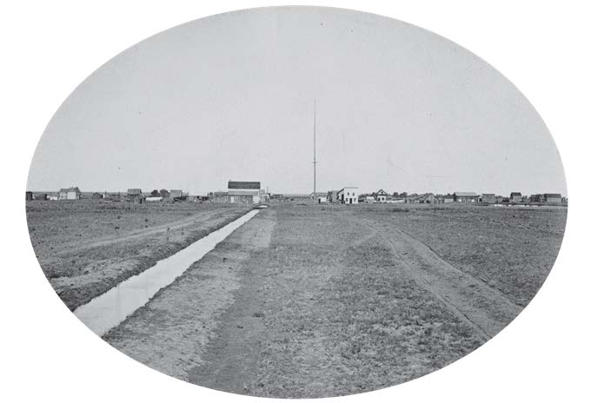
Figure 2.3 - Number 3 Ditch Lateral on July 4th 1870
The “magic touch of water”
Notes:
Page 27-28 The magic touch of water, pg 33, Greeley’s namesake Horace Greeley’s one and only visit to Greeley to the mouth of the # 3 ditch-pgs 33-34
Grave threat presented itself in 1874. Benjamin Eaton and other developers had constructed two new irrigation systems upstream of the Union Colony’s diversions.
The future of Colorado Water Law was birthed out of a heated conflict with Fort Collins in 1874 at the Eaton/Whitney Schoolhouse. pgs 37-39, 40
“John Wesley Powel created Greeley for pioneering the Colorado Doctrine of Prior Appropriation”

Slide 14
Colorado Doctrine of Prior Appropriation Five Guiding Principles

Slide 15
1st Principle: The public owns all of the water of the natural streams within the State of Colorado. 2nd Principle: The water is dedicated to the use of the people through appropriation of unappropriated waters. 3rd Principle: Actual beneficial use of the public’s water resource is required for the establishment of water rights-(Beneficial use is a necessary derivative of appropriation as opposed to hoarding for later resale) 4th Principle: When there is not sufficient water to satisfy all use rights, the earlier established right prevails. 5th Principle: All persons and corporations, upon payment of just compensation, are entitled to a right of way across private lands of another for the construction and operation of water works for use rights.
Notes:
Pages 42-44 The drafting of the Water Committee’s Colorado Constitution’s water provisions – Priority of appropriation is the means for determining who has the better right. This is now known around the world as the Colorado Doctrine of Prior Appropriation. (pg 42) Pg 46-why Greeley was a the center of water management & water law creation.

Slide 16
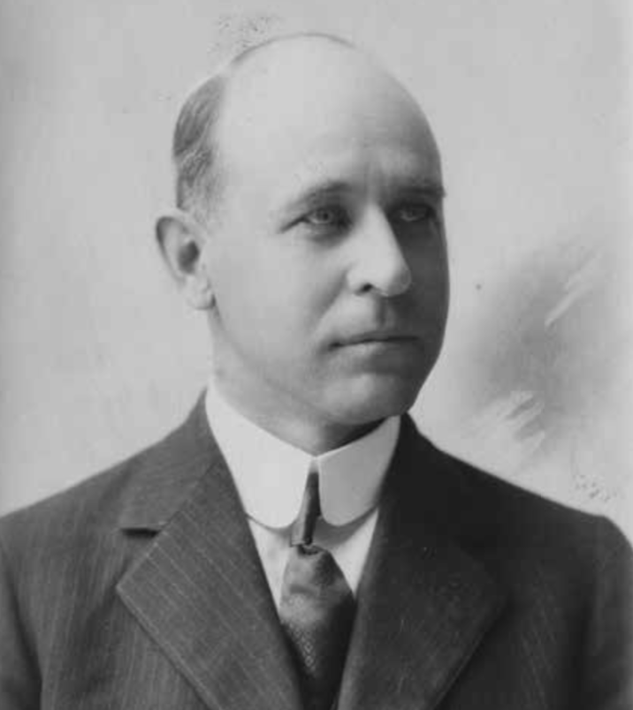
Figure 5.2 - Photograph of Delph Carpenter
Notes:
Born at Union Colony, early in the book it was noted as a youth Delph guarded against water theft as a ditch rider. Graduated from Greeley High, DU Law School and the father of the Colorado River Compact of 1922 – more to come about Delph Carpenter later in the book.

Slide 17
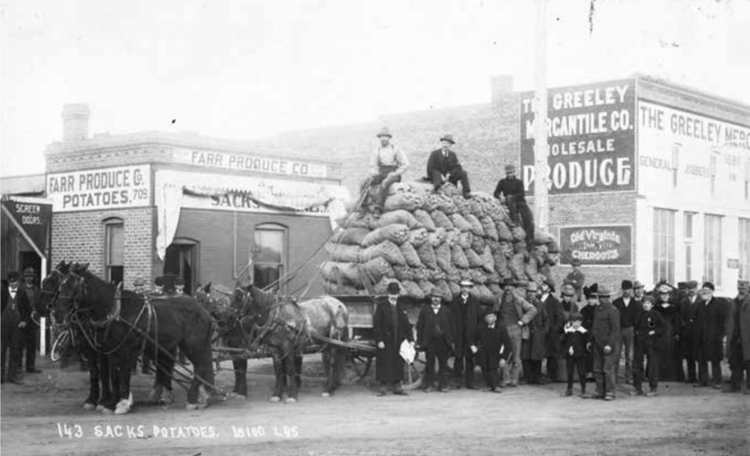
Figure 3.4 - Wagon Load of Potatoes 1891
Notes:
Improved irrigation expansion in northern CO pg. 62 resulted in increased agricultural production pg 65 143 sacks of potatoes that weight 18,100 pounds pg 66 end of the 19th century

Slide 18
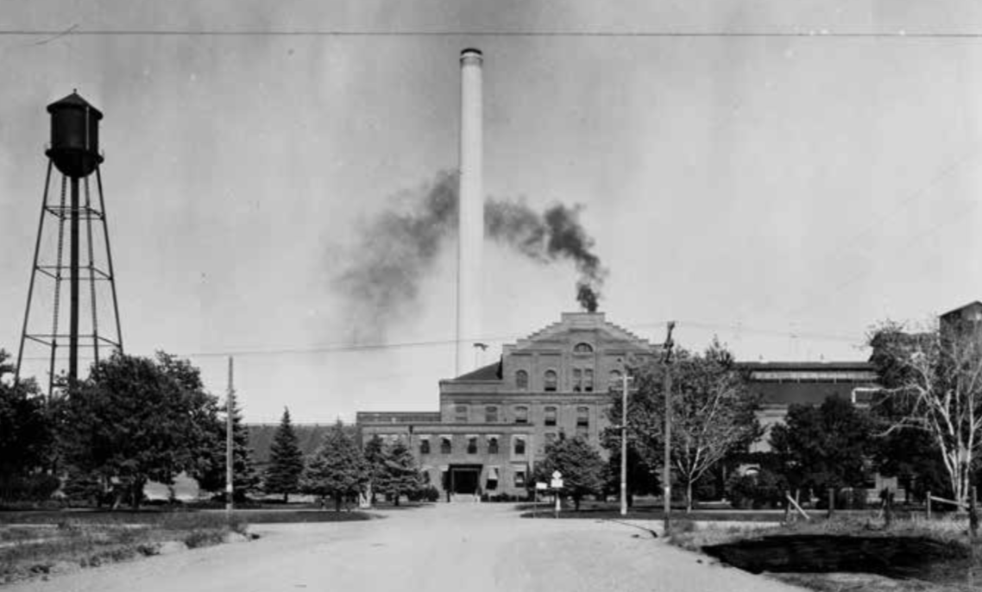
Figure 4.1 - Greeley Sugar Beet Factory 1902
Notes:
Pg 67-68 Progressivism Greeley would use the region’s natural resources – in particular, water to expand commerce and grow the population of Greeley. Pg 68 The increased need for water led to Greeley’s interest in securing high mountain water. City officials looked to the nearby Rocky Mountains for their future water supply. It would be a view that would dominate the outlook of Greeley water managers for the next 100 years.

Slide 19
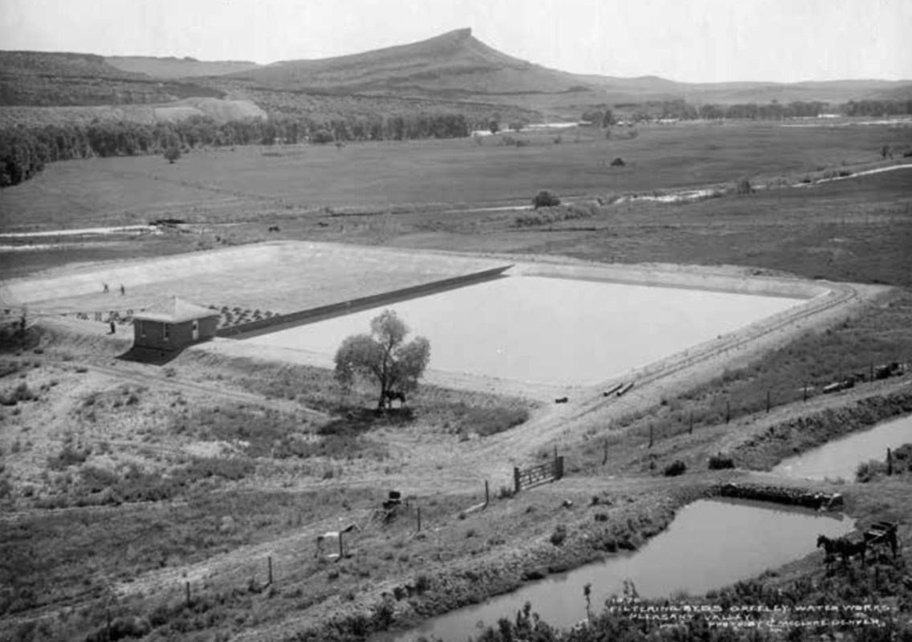
Figure 4.4 - Bellvue Water Treatment Plant 1907
Notes:
Chapter 4, A vote to the citizens of Greeley in 1905 passed and plans for the Bellvue Water Treatment plan was cleared to move forward. At that time, the pipeline which began at the Bellvue plant located near the mouth of the Poudre Canyon could carry up to five million gallons of filtered water per day. The city now had a secure water right and an excellent irrigated farm site for its new water treatment plant. The 1905 bond election was a defining moment in the history of Greeley Water, setting the stage for future development into the next century and beyond.

Slide 20
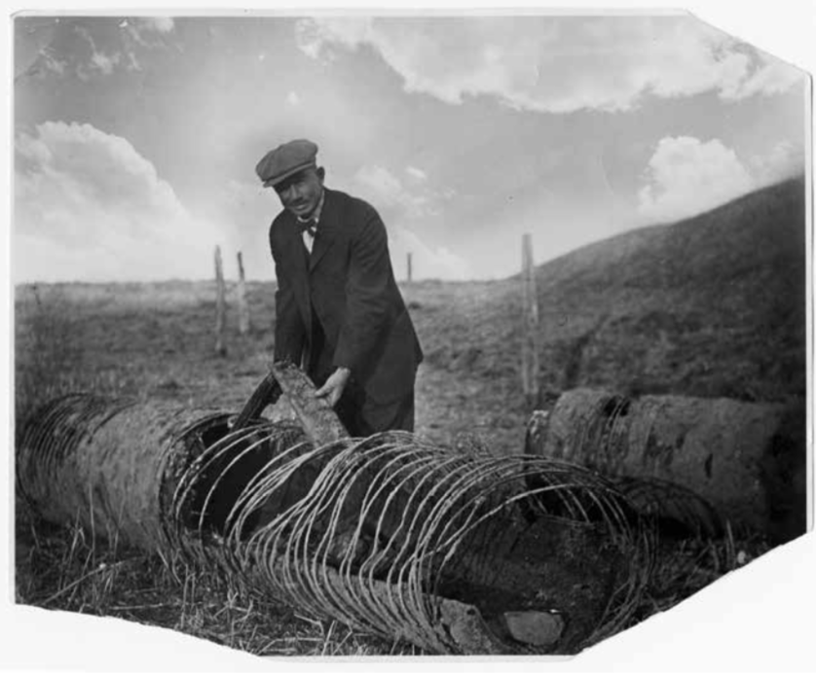
Figure 5.3 - Repair of the Bellvue Water Pipeline 1918
Notes:
Considered at its inception the state of the art pipline in 1907 and ran 38 miles from the Bellvue plant to Greeley didn’t “hold water” pun intended as long as anticipated as you can see by this photo of the pipeline in 1918. The pipeline was built out of wooden staves (narrow planks) shipped from the West Coast claimed it would last a generation, and at much cheaper cost. Milton Seaman was superintendent of the Greeley Water Department until his death. Pg. 98-100

Slide 21
Figure 5.2 - Photograph of Delph Carpenter
Notes:
Heralded as the “father of the Colorado River Compact” and the “Water Oracle of Greeley” his forte was the development of interstate compacts to provide equitable distribution of water from river basins through the American West. Carpenter served in the state senate and was the first native born senator. Pg 95-96 Carpenter’s legacy would rest in the annals of US legal history. Carpenter in 1913 was doing double duty defending the interests of the state of Colorado. He contended “All waters within Co “are owned by it,” are subject to the right of appropriations thereof under her laws” Pg 104-105,106

Slide 22
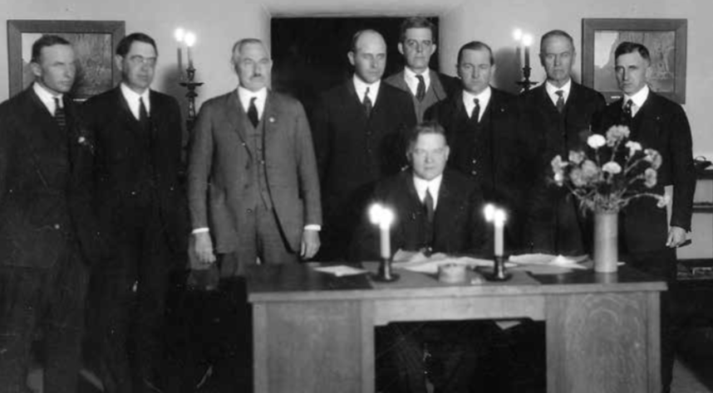
Figure 5.5 - Signing of the Colorado River Compact
Notes:
Read Pg 102 Quote Gov. Ralph Carr –Read pg. 107 the formation of the Colorado River Compact. Which took a total of 28 meetings to forge the 1922 Colorado River Compact. In 1922, Carpenter received a blow and a win. Pg109-110 November 24, 1922 in Santa Fe, NM Quote 112 “A better way”

Slide 23
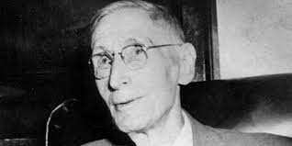
Depression, Drought, CBT & Voluntary Collectivism Greeley Water in the 1930’s
Charles Hansen C-BT Advocate
Notes:
Pg 139 – Hansen’s influence on the CB-T Project Creation of Northern Colorado Water Conservancy District would be the first collaboration of its kind between legal irrigators, cities and the federal government. Pg 143 Where we set for today’s meeting.

Slide 24
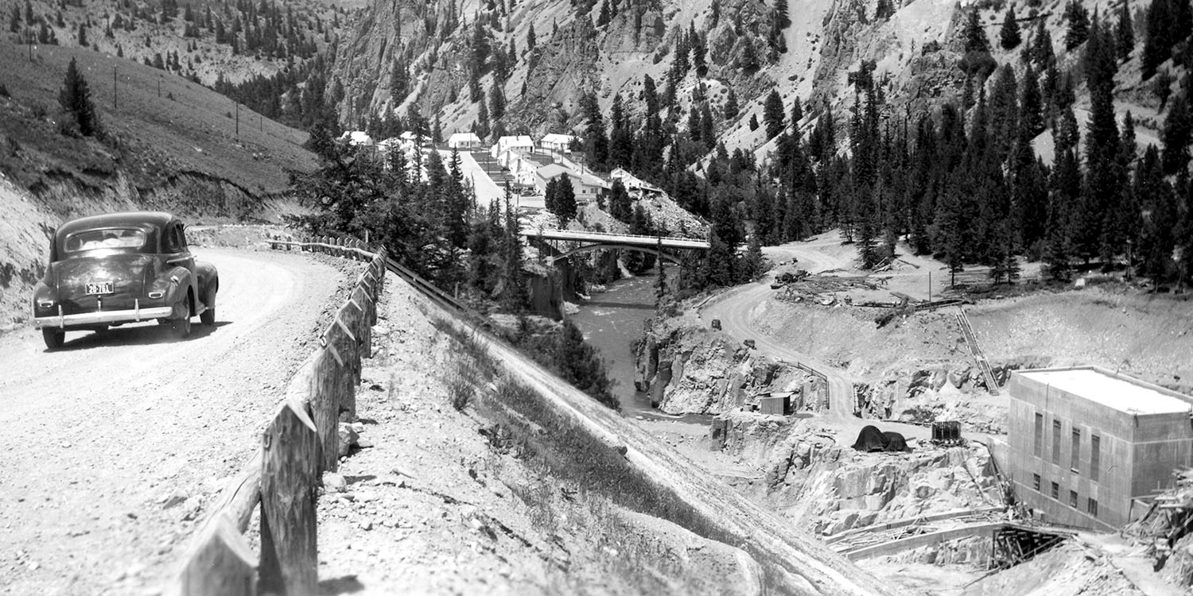
Northern Water CB-T Contract of 1938
Notes:
Pg 148 Northern Water signs a contract with the United States to repay a portion of C-BT Project construction costs. Warner Construction Company begins excavating the foundation for Green Mountain Reservoir dam, the first major C-BT Project feature constructed.

Slide 25
GREELEY WATER 1940-1950 Greeley Transformed
Notes:
With “Work Projects Administration (WPA) & Civilian Conservation Corps (CCC) Milton Seaman Dam & Reservoir on the North Fork of the Cache la Poudre, improvements to the Bellvue pipeline, acquisitions of high mountain reservoirs enhance the city’s water portfolio. Pg 153-154 Keep Politics out of Water

Slide 26
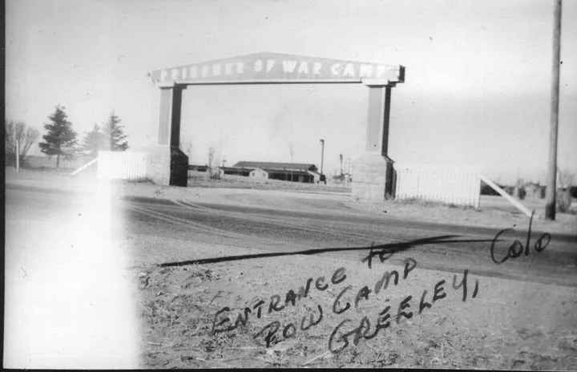
Greeley Tribune – Entrance to German Row Camp Greeley
Notes:
US Government takes an interest in Greeley’s water for a new military hospital – decides against that but brought the city another plan. Water continues to shape Northern CO in unexpected ways: Pg 162

Slide 27
Greeley Epiphany The idea of securing treated water from two separate river basins-the Cache la Poudre and the Big Thompson Rivers
Notes:
The beginnings of the Boyd Lake Treatment Plant Greeley owns ample water but lacks conduits to deliver it to Greeley in quantities sufficient to permit unlimited use. Pg 170-171

Slide 28
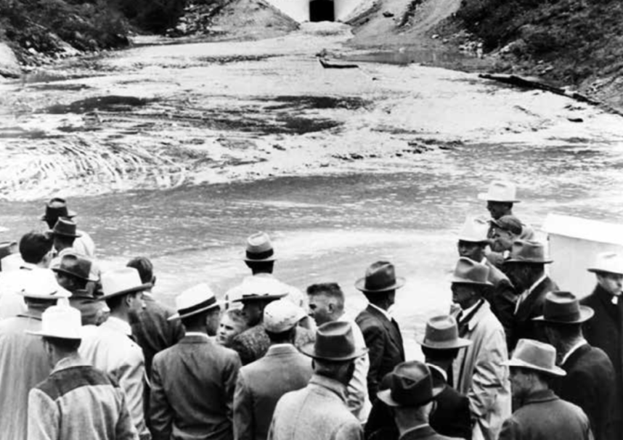
CB-T
Arrives
From the
Western Slope
June 23, 1947
Figure 8.2 - First Water out of the Adams Tunnel
Notes:
June 23, 1947 pg 176 On June 23,1947, an enthusiastic gathered at the east portal of the 13.1 mile long Alva B. Adams tunnel, part of the Colorado-Big Thompson project, and witnessed the arrival of West Slope water. The tunnel is 9’” in diameter and cost 12.8 million ($189 million in 2020 dollars). At the time, it was the longest tunnel in the US that delivered irrigation water.

Slide 29
1950-1970 A Small Town No More
1950-1970:
Colorado Big Thompson Project Operational
Formation of the Greeley Water Board in 1958
Drought of the 1950’s
Monfort Packing Plant Opens
Agreement with the Greeley Loveland Irrigation Company
Boyd Lake Treatment Plant and Pipeline
Kodak of Colorado
Wastewater Treatment Plant Expansion
Notes:
In 1958, the hallmark achievement of the decade would be voter approval of a city charter, with a provision to create the Greeley Water Board. This new administrative process would be instrumental in planning and analyzing water supply opportunities as well as handling aging infrastructure and water quality issues. This was urgently promoted by W.D. Farr., Greeley’s current Water Godfather.

Slide 30
Keep Politics Out of Water
Notes:
W.D. Farr said, “We thought that the only way we could solve the Greeley problems was to get it (the water board) out of city politics. Pg 174 Creation of the Water Board –a hallmark achievement

Slide 31
MAINTAINING & EXPANSION “WINDY GAP PROJECT”
Notes:
Pg 192 Windy Gap Project proposed in 1969 by Greeley, Loveland, Fort Collins, Longmont, Estes Park and Boulder would make up for an annual average of 49,000acre-feet of water that would have been provided by unbuilt features of the original C-BT project. Pg 195

Slide 32
1970-1980 Keeping Meeker’s Promise Cleanliness, Abundance, & Affordability

Slide 33
1980-2000
1980-2000:
The Environmental Era Begins
Wild and Scenic Designation for the Poudre River
Federal Reserved Water Rights Claims
By Pass Flow Claim by the U.S. Government
Thornton Water Purchase
Sale of the High Mountain Reservoir Controversy
Water Purchase of the 1990’s
Expansion of the Wastewater Treatment Plant
Notes:
1980’s CO Congressman Hank Brown was instrumental in leading a collaborative effort to create the Cache la Poudre Wild and Scenic River designation, protecting state water rights and federal interests. The next decade saw Brown create the Cache la Poudre River National Heritage Area through an Act of Congress, securing the river’s political and historic national prominence. Pg 227 Hobbs & pg 228 WD Farr’s impact
City of Thorton Water Grab – Thorton officials were able to cloak a major municipal decision in absolute secrecy for about 10 months. He also learned that there were few, if any, Weld County people who knew who was purchasing the farms or why. Pg 234

Slide 34
Notes:
Windy Gap Project proposed in 1969 by Greeley, Loveland, Fort Collins, Longmont, Estes Park and Boulder would make up for an annual average of 49,000acre-feet of water that would have been provided by unbuilt features of the original C-BT project. Pg 192 In 1985, the project came online and its major features are seen on this map. – Of course we all know the results of this effort brought us the Chimney Hollow Reservoir we were privileged to see in Dec. 2022.

Slide 35
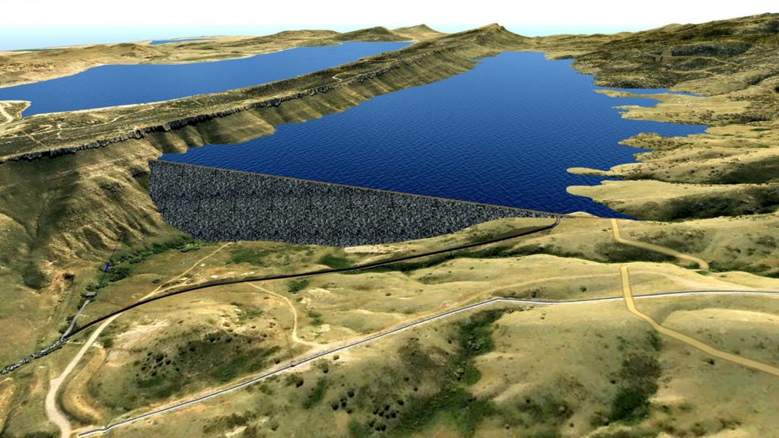
Notes:
A U.S. judge ruled in favor of Northern Water’s Windy Gap Firming Project this week, paving the way for the construction of a new reservoir located west of Carter Lake in southwest Larimer County. Colorado Newsline, Dec. 11, 2020. Chimney Hollow would firm up the Windy Gap water rights that Greeley had acquired three decades earlier, through the Six Cities plan (now called the Windy Gap Project). The new reservoir would be located in a valley west of Loveland and Carter Lake. Greeley would own 10 percent of the 90,000 acre-feet of storage in the new reservoir.

Slide 36
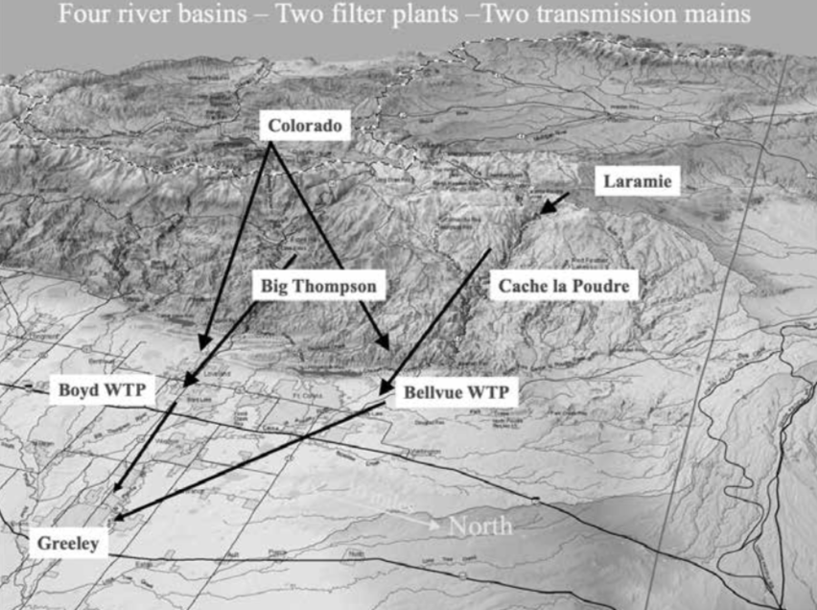
Figure 11.2 - Water Supply from Four River Basins
Notes:
Pg 255 This map illustrates Greeley’s “long reach” for water, from four river basins, the Laramie, Cache la Purdre, Colorado and Big Thompson. Water is treated at the Bellvue and Boyd Lake plants, with transmission lines from each facility delivering potable water to Greeley.

Slide 37
2000-2020
2000-2020:
Drought of 2002
Water Conservation
Water Master Plan of 2003
Seaman Reservoir Expansion Permitting
Windy Gap Firming Project
New 60 inch Treated Water Pipeline from Bellvue
Water for Economic Development: ConAgra and Leprino
Best Tasting Water in America Award
Notes:
The drought of 2002 led during these extraordinary times, to Greeley embarking upon its 2003 Water & Sewer Master plan and implemented four strategic initiatives critical to the city’s future:
Continued water acquisition
Construction of additional reservoir storage
Investments in capital improvement projects; and
Water Conservation
Seaman Reservoir projected plagued with permitting challenges; one being the protected status of the “Preble’s Meadow Jumping Mouse”

Slide 38
Greeley wins “Best of the Best” drinking water taste test June 14, 2017 The City of Greeley, Colo., has won the thirteenth annual “Best of the Best” Tap Water Taste Test at this year's ACE...

Slide 39
GREELEY WATER at 150
“Look ahead and plan for others as others have planned for you.”

Slide 40
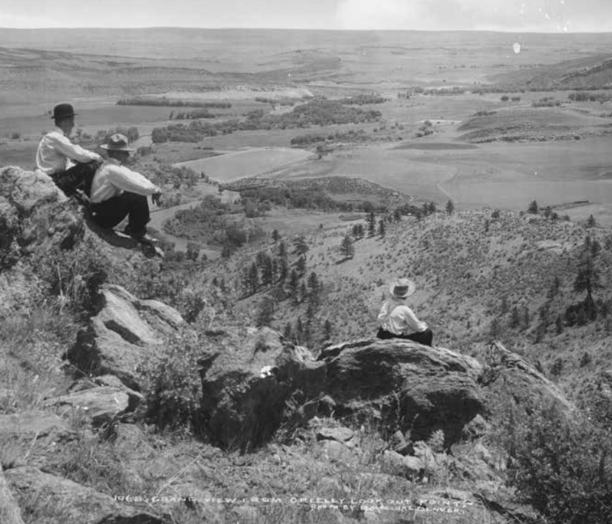
Figure 12.1 - Looking to the Future

Slide 41
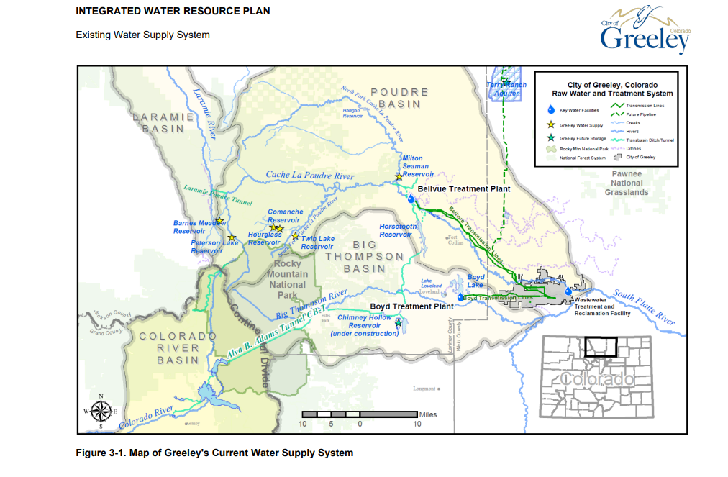
Existing Water Supply System
Greeley’s existing water supply system, shown in Figure 3-1, is geographically diverse, obtaining water from four river basins (North Platte, Poudre, the Colorado, and Big Thompson). The system is also flexible and efficient, with multiple locations to store water, utilize existing canals, ditches, and pipelines to deliver water to two treatment plants. Greeley is also in stages of developing infrastructure to utilize the Terry Ranch Project.

Slide 42
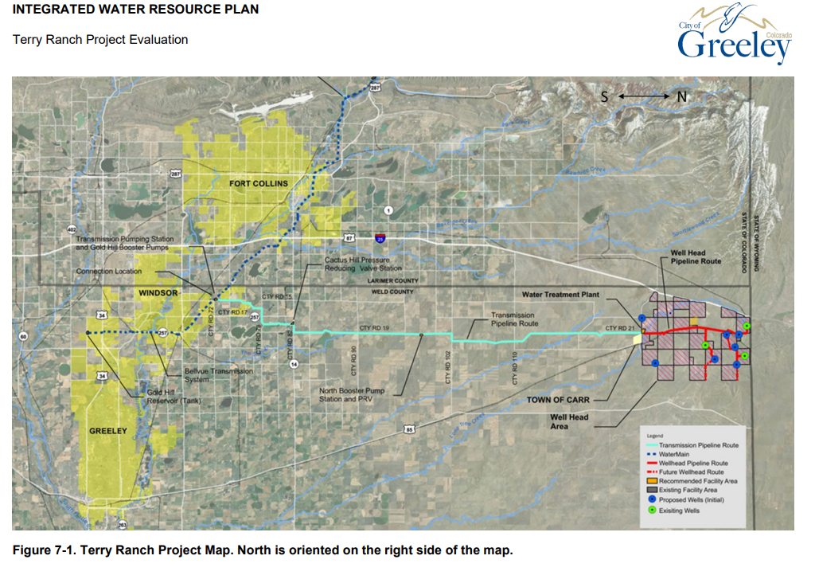
Notes:
The Terry Ranch Project will develop approximately 1.2 million acre-feet of non-tributary (i.e., does not flow from or to a surface water supply source) groundwater in northwest Weld County. The Terry Ranch Project is an aquifer storage and recovery project. In this type of project, treated surface water can be injected into the aquifer and stored and then recovered at a future time to be treated and delivered as water supply. Once brought online, Terry Ranch Project water will be used as a supply source during droughts when surface water supplies are stressed. Greeley plans to operate Terry Ranch ‘sustainably’ such that the aquifer supplies will be available to Greeley in perpetuity and would not be depleted.
A unique aspect of the Terry Ranch Project in the context of the IWRP is its native volume of approximately 1.2 million acre-feet, significantly higher than Greeley’s current demands. This native volume could be further increased with injection of surface water supplies into Terry Ranch up to 1.5 million acre-feet total. As opposed to surface water supplies that can vary significantly from year to year and are vulnerable to climate change impacts, water from Terry Ranch can be extracted as needed even during the most severe droughts. Greeley plans to operate Terry Ranch ‘sustainably’ such that the aquifer supplies will be available to Greeley in perpetuity and would not be depleted.

Slide 43
"Coloradans" — Gregory Hobbs (as recited on CPR’s Colorado Matters)
Coloradans
To each of us
The land, the air, the water,
Mountain, canyon, mesa, plain,
Lightning bolts, clear days with no rain,
At the source of all thirst,
At the source of all thirst-quenching hope,
At the root and core of time and no-time,
The Great Divide Community
Stands astride the backbone of the continent,
Gathering, draining, reflecting, sending forth
A flow so powerful it seeps rhythmically
From within,
Alive to each of us,
To drink, to swim, to grow corn ears
To listen to our children, float the streams
Of their own magnificence,
Out of their seeping dreams,
Out of their useful silliness,
Out of their source mouths,
High and pure,
The Great Divide
You and I, all that lives
And floats and flies and passes through
All we know of why.

