Slide 1
Northern Integrated Supply Project (NISP) Water Literate Leaders– November 2023
Carl Brouwer
NISP Program Manager

Slide 2
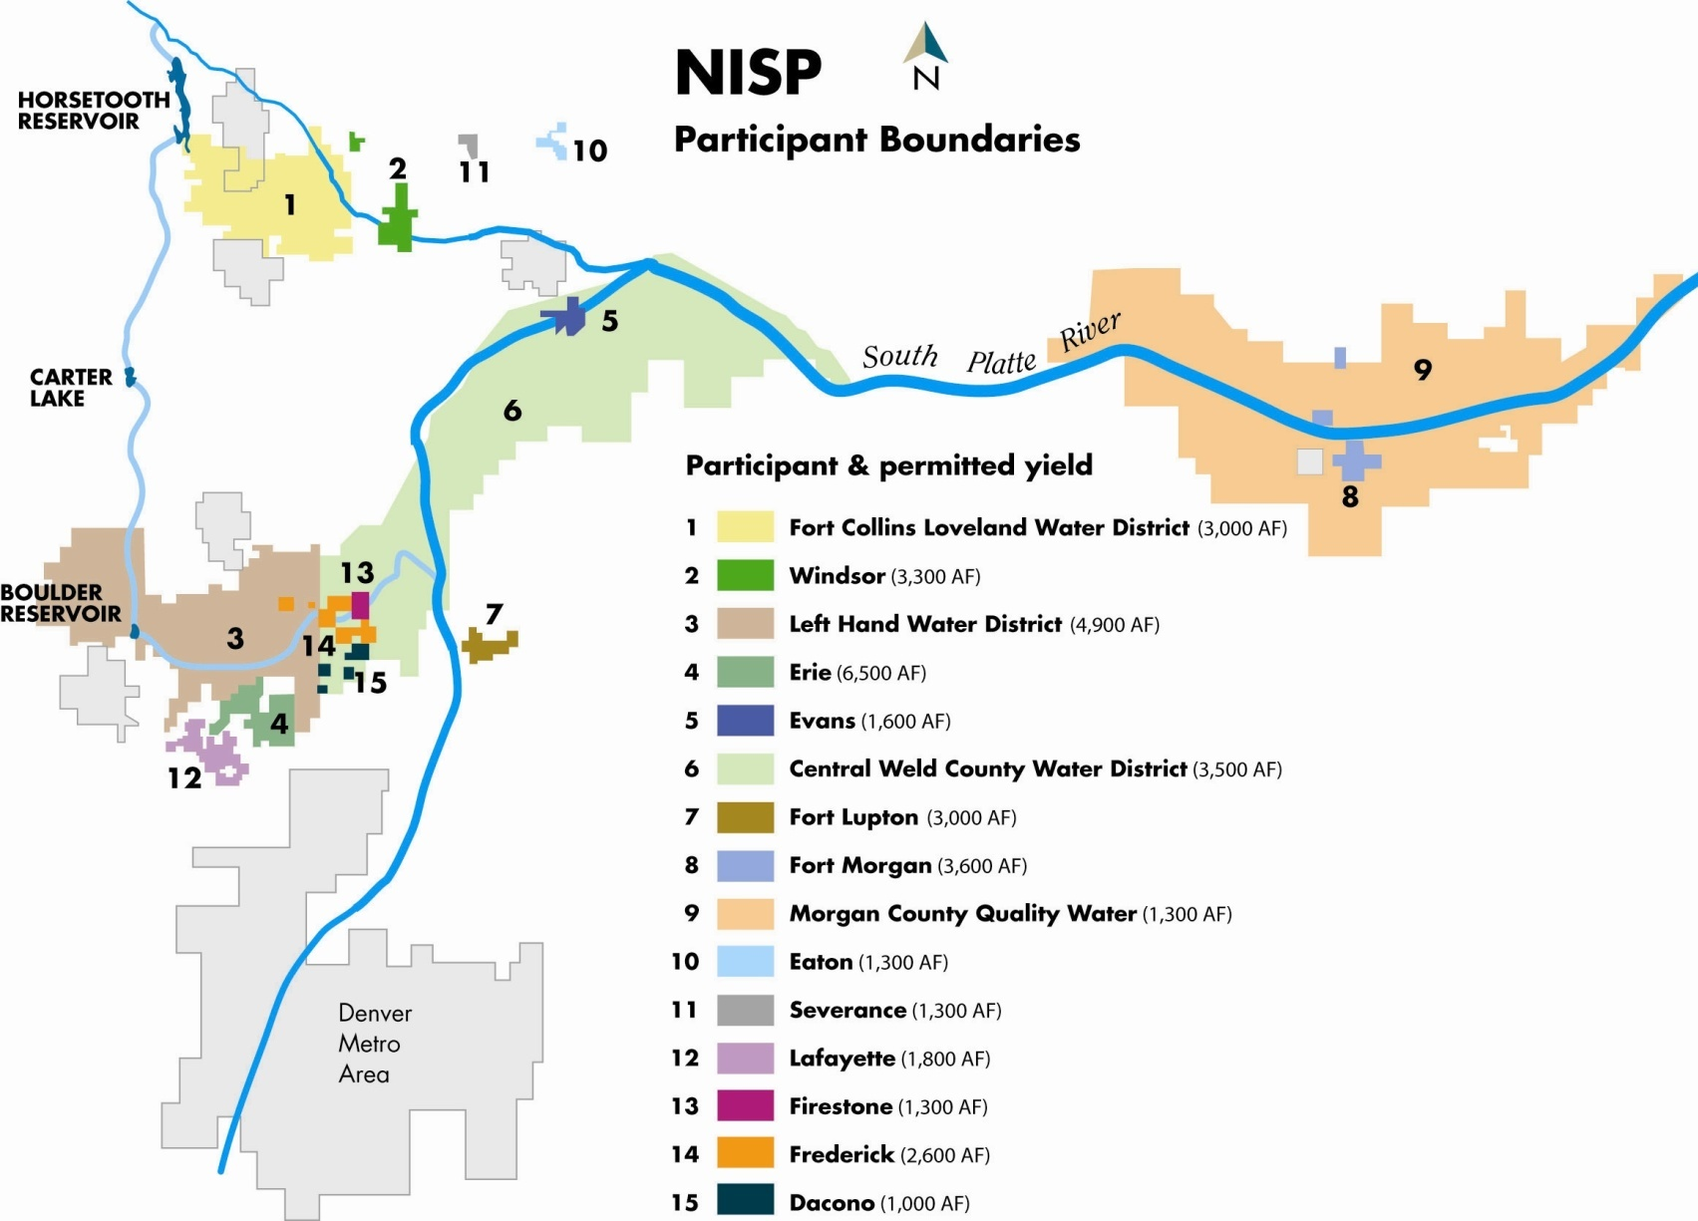
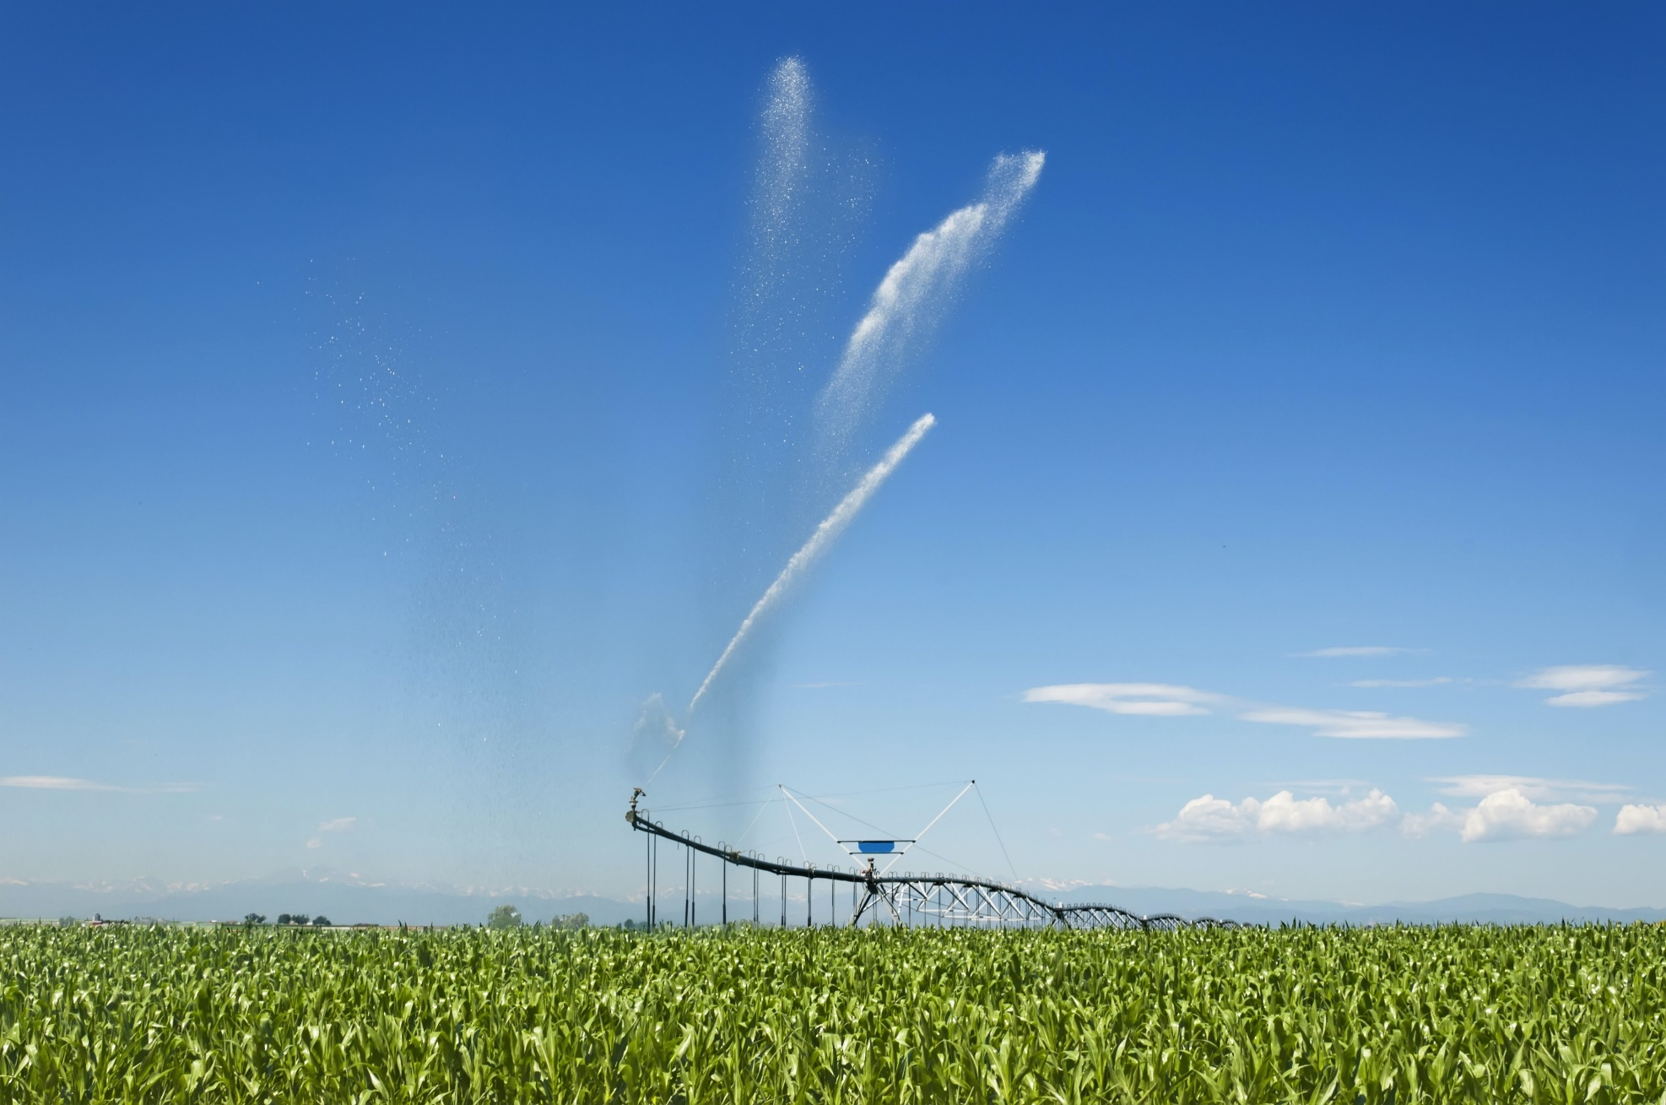
Why NISP?
Final Environmental Impact Statement Purpose & Need
To provide the Project Participants with approximately 40,000 acre-feet of new reliable municipal water supply annually through a regional project coordinated by the District, which will meet a portion of the Participants’ current and reasonably projected future additional water supply needs.
Notes:
Carl

Slide 3
NISP at a Glance
40,000 AF per Year
2 New Reservoirs
80 Miles of Pipelines
7 Miles of Highway 287 Relocation
Paid for by 15 Participants
Approx. $2B Total
$110M Cost to Date

Slide 4
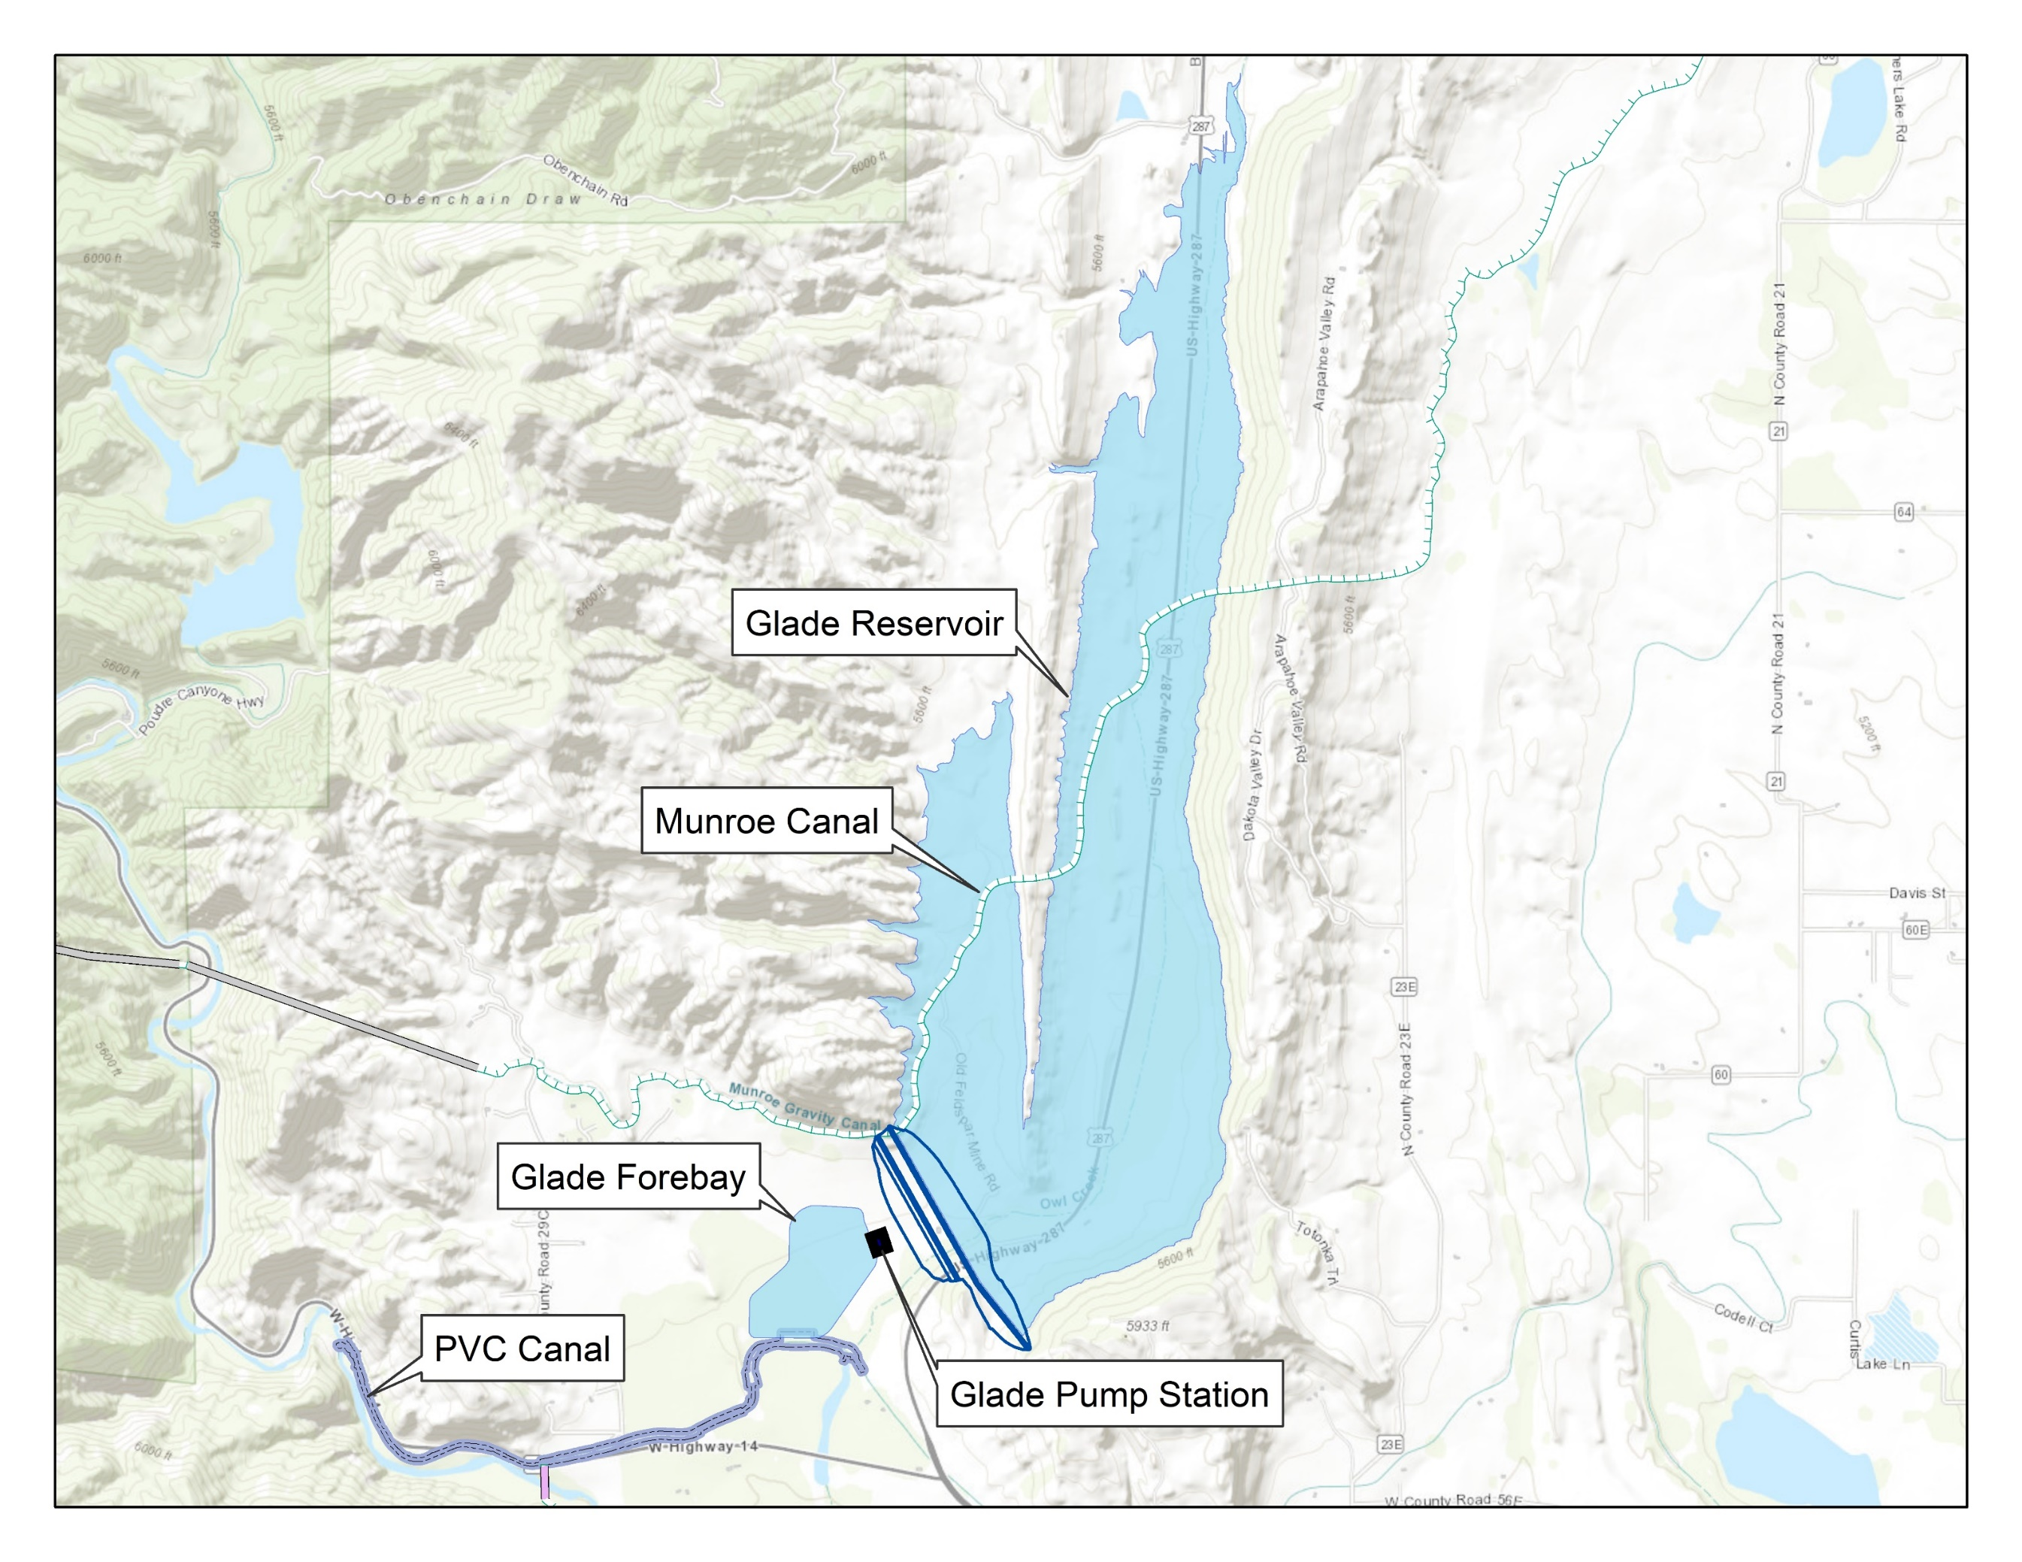
Glade Reservoir - Details
Dam
170,000 AF of storage
280-foot-tall Earth/Rock fill
Material all on-site
Approximately 18M cy of fill
40,000 Hp Pump Station
Munroe Canal Relocation
1,500 AF Forebay
Poudre Valley Canal Enlargement

Slide 5
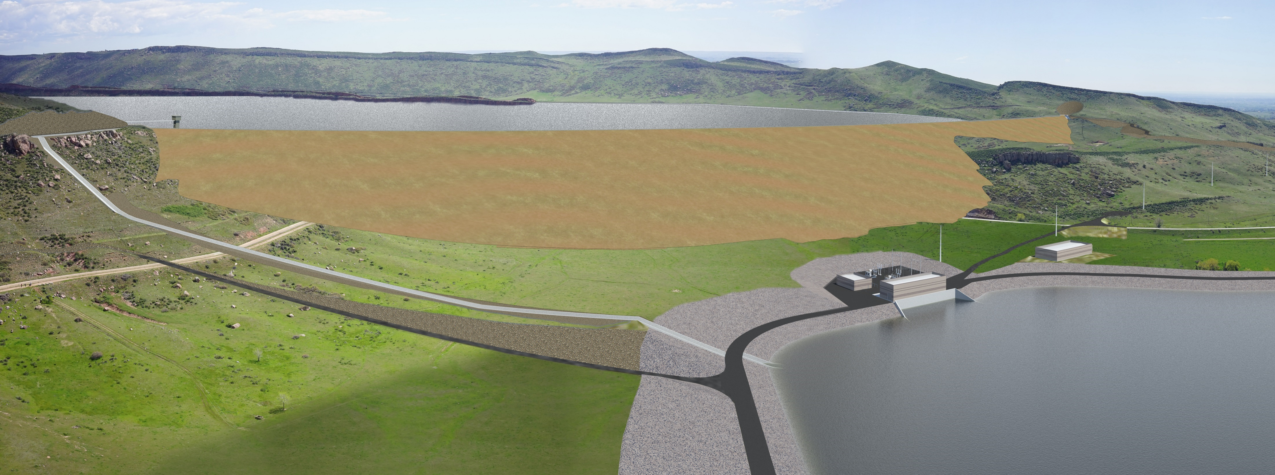
Glade Reservoir Advancement
Advancing towards 90% Design
Coordination with State & Technical Advisory Panel
www.NISPwater.org
Notes:
Steph

Slide 6
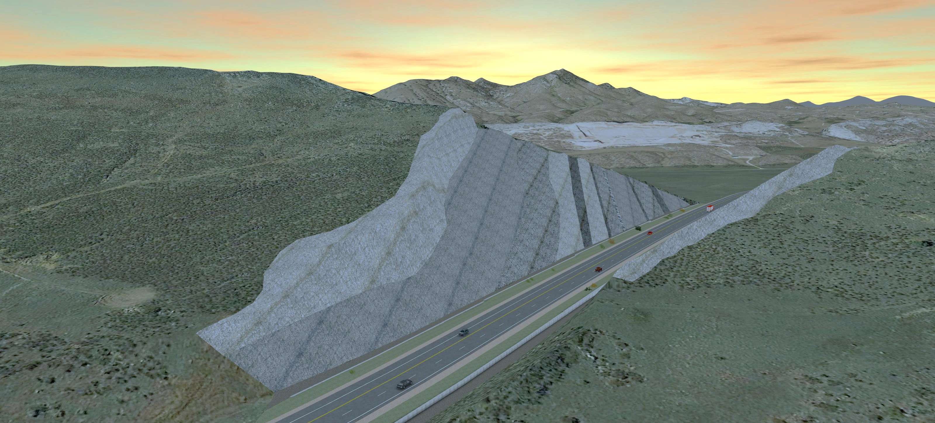
Highway 287 Relocation
Critical Path for Glade Reservoir
Advancing Towards 90% Design
Hired SEMA as CM/GC
Complete Land Purchases

Slide 7
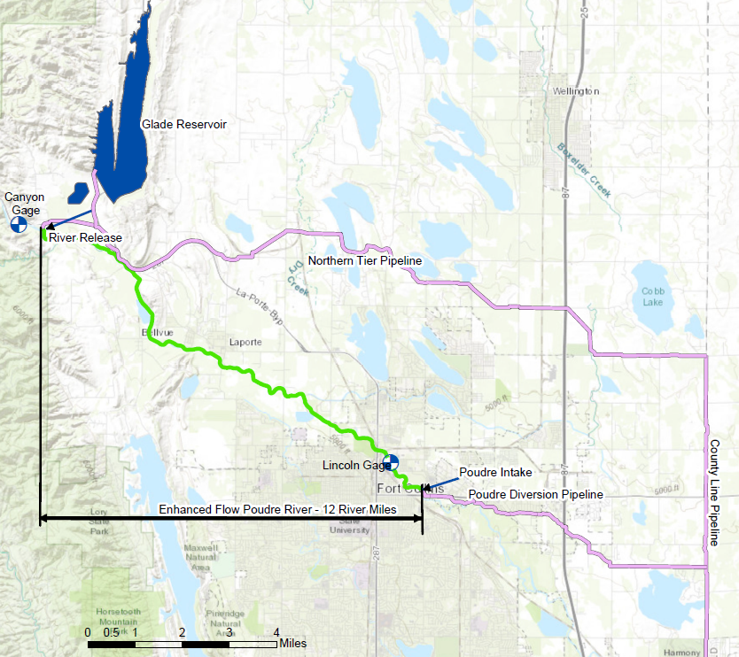
Delivery Conveyance Refinement
12 Miles of Poudre River
Year-Round Deliveries
Approximately 1/3 NISP Yield
Eliminates Dry-up Points
Required New Colorado Law
Improves Environment

Slide 8
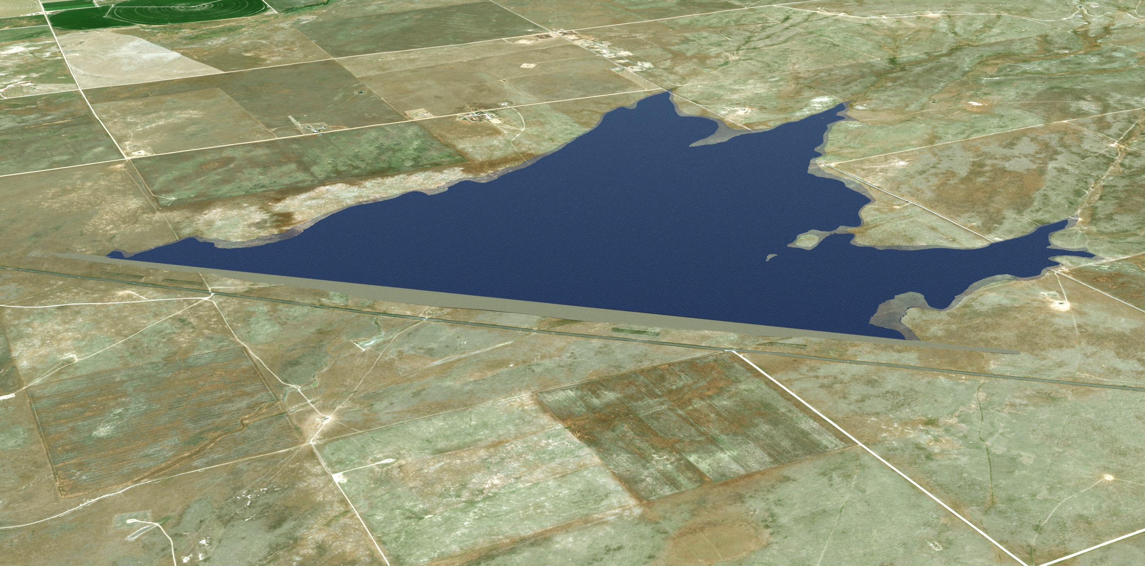
Galeton Reservoir
45,600 Acre-ft
75 Feet Tall Dam
1,700 Acres
All Land Purchased
Expandable to 81,000 Acre-ft

Slide 9
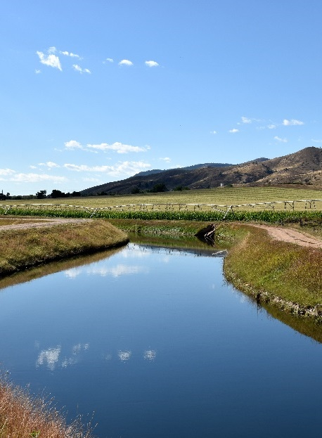
Ditch Substitution & Exchange
New Cache and Larimer & Weld to Poudre Valley Canal
Fraction of their total diversions
Compensate ag companies for benefit of shareholders

Slide 10
Permitting
404 Permit
State Reservoir Release Bill
State FWMEP Approved
Supplemental Draft EIS Released
State 401 Water Quality Certification
Federal NEPA Process Begins
Conveyance Refinement Added
Final EIS Released
2022
Participant Group Formed
Draft EIS Released
2018
2017
2015
2020
2004
2018
2016
2008
2003

Slide 11
Permitting Status
State Fish and Wildlife Mitigation and Enhancement Plan
State 401 Certification
Larimer County 1041
Federal 404 Permit

Slide 12
Clean Water Act Section 404 Permit
Culmination of 19 years of Environmental Process Led by US Army Corps of Engineers
Cooperating Agencies – EPA, BLM, USFWS, Colorado DNR, CDPHE, CDOT, Larimer County
No-Action – 60,000 acres of Agricultural Dry-up
Numerous Alternatives Analyzed Considering Environmental Criteria
Biological Opinion from US Fish and Wildlife Complete
Fish and Wildlife Coordination Act with USFWS Complete
Programmatic Agreement for Cultural Resources with State Historic Preservation Office Complete

Slide 13
Next Steps

Slide 14
Allotment Contract and Finance Plan
Allotment Contract for Units of NISP and Space in Glade
Funding Needed
2022 Dollars - $1,900 Million
Glade, HW 287, Delivery Pipelines - $1,400 Million
Galeton side - $500 Million
Spread over 5+ Years
Critical Path for Glade Reservoir
At 60% Design
Hiring a CM/GC
Land Purchases
Coordination
Potential Sources
EPA WIFIA - Approved to Apply for 49% of Project Except HW 287
CWCB
Municipal Bonds
CWRPDA, Other, Grants?

Slide 15
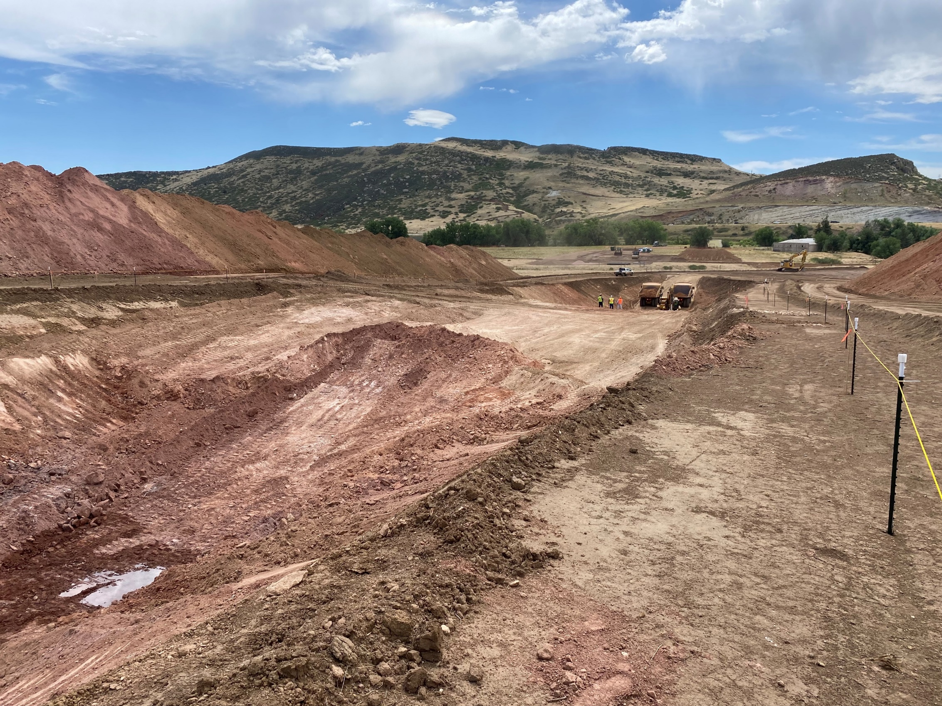
Finalize Glade/HW 287 Design
Complete Design by mid 2024
Select Contractor
Finalize Remaining Land Purchase

Slide 16
Galeton – Water Secure
Obtain Substitution Agreements with Irrigation Companies
Complete Design
Continue Water-Secure Program Development
Construct
www.NISPwater.org

Slide 17
Project Schedule
DESCRIPTION | 2023 |  |  |  | 2024 |  |  |  | 2025 |  |  |  | 2026 |  |  |  | 2027 |  |  |  | 2028 |  |  |  | 2029 |  |  |  | 2030
 | Q1 | Q2 | Q3 | Q4 | Q1 | Q2 | Q3 | Q4 | Q1 | Q2 | Q3 | Q4 | Q1 | Q2 | Q3 | Q4 | Q1 | Q2 | Q3 | Q4 | Q1 | Q2 | Q3 | Q4 | Q1 | Q2 | Q3 | Q4 | Q1 | Q2 | Q3 | Q4
RECORD OF DECISION
HIGHWAY 287 RELOCATION
GLADE RESERVOIR
GLADE PUMP STATION
NISP CONVEYANCE PIPELINES
GALETON PIPELINES
GALETON RESERVOIR
SCHEDULE KEY:
PRELIMINARY DESIGN
FINAL DESIGN & PROCUREMENT
CONSTRUCTION
Notes:
Storing water in Glade by 2029

