Slide 1
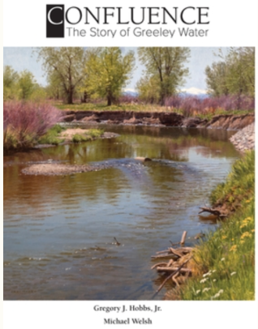
Mark Driscoll
Denis Symes
Staycie Coons

Slide 2
The book starts in 1870 surrounding the implementation of a single irrigation ditch. It then follows for over a hundred years of water system development in Northern Colorado.
The story follows some the most influential and groundbreaking people who developed and impacted water law, engineering and agriculture including Delph Carpenter, Milton Seaman and W.D. Farr.
Today, the water system supports more than 140,000 people and utilizes water from four different water basins in the state.

Slide 3
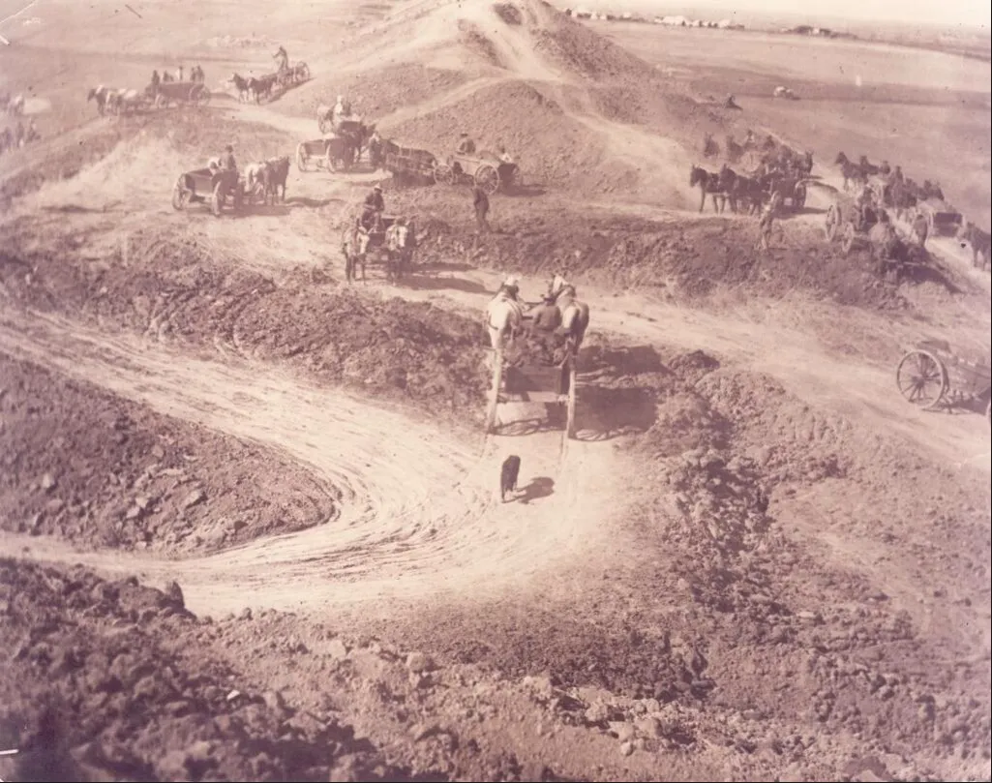
Greeley
Irrigation
Ditch
No. 3
(during construction)

Slide 4
Strengths
The book allows a broad audience to understand water, not written only for those in the water profession to comprehend:
This allows the average person to grasp the vastness and seriousness of water in Northern Colorado.
Yet still offers an incredible amount of new information to water professionals and historians.
The amount of historical photos & maps aids readers in visualizing the immense amount of work and space these projects necessitated.
The vast amount of research.

Slide 5
READ THE BOOK
We recommend that our classmates take the time to read Confluence.
Although some of the details become tedious throughout different parts of the book, the in-depth history of Northern Colorado water is unmatched.
As whole, Confluence stayed interesting and well-written throughout. We found it to be an easy read, and a highly researched book.

Slide 6
“in the West, when you touch water, you touch everything.”

