Slide 1
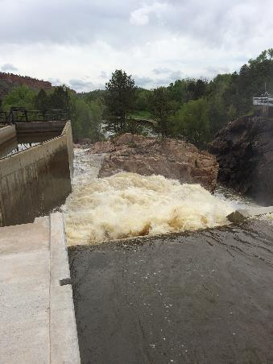
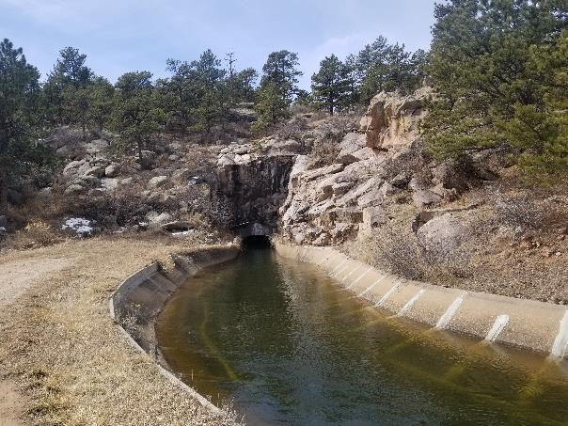
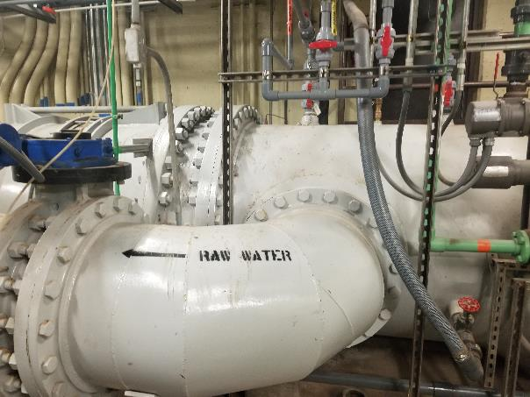
City of Loveland
Watery Supply System

Slide 2
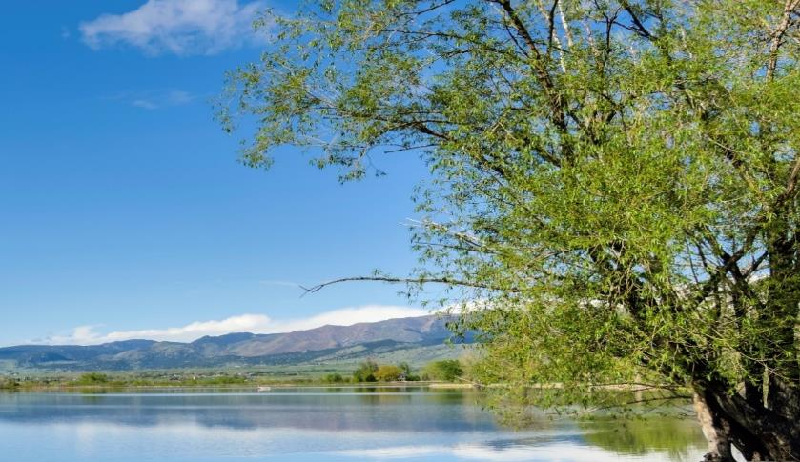
Loveland Water Supply

Slide 3
Loveland Water Facilities

Slide 5
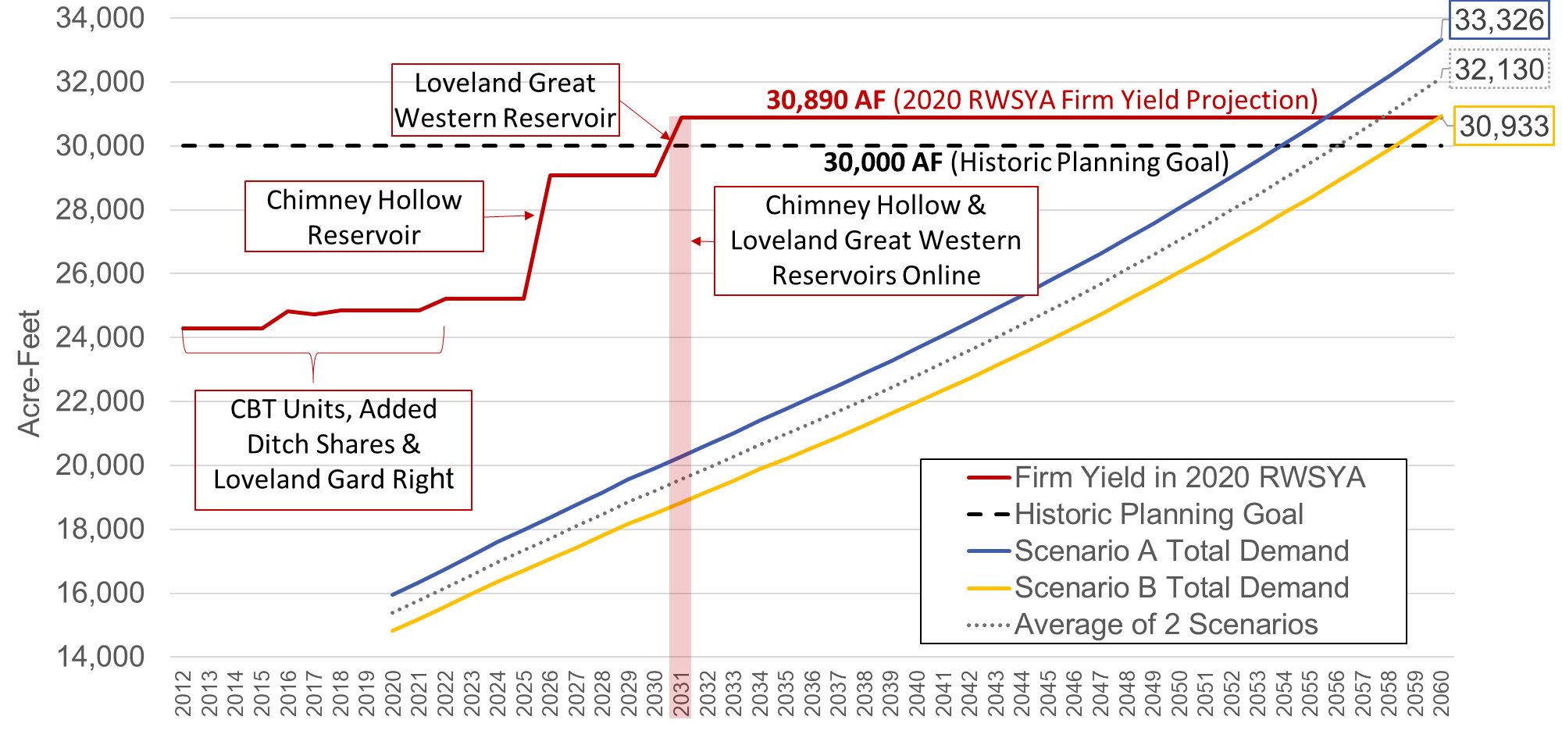
Total Water Demand Projections vs. Firm Yield Projections

Slide 7
Overview of Loveland Water Supply

Slide 8

Future Water Supply Projects
Chimney Hollow
Water Bank (Change Case)
Great Western Reservoir
GRGR Expansion
Water Conservation
Regional Cooperation
All options evaluated by
need, cost, and reasonableness.

Slide 9
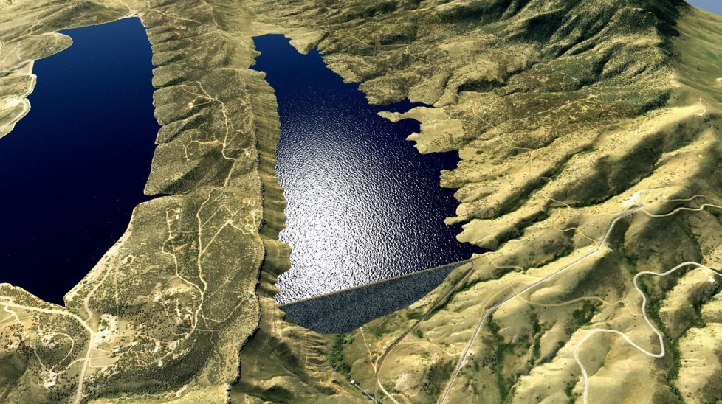

Top Issues
Supply Reliability/Vulnerability
  Fire
  Drought/Climate Change
  CO Basin Issues
Supply Development
  Chimney Hollow
  Loveland Great Western Reservoir
  Water Conservation
Growth
  Outpacing Water Supply Development
  Long Timelines for Supply Development

Slide 10
QUESTIONS?

