Slide 1
Windsor’s Water Resources
Challenges and Opportunities

Slide 2
Potable Water System Overview

Slide 3
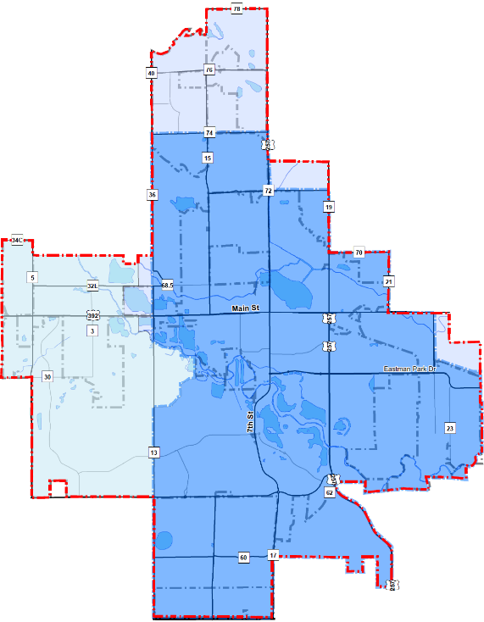

Water Service Area
North Weld
Harmony Rd
Fort Collins - Loveland
Average Daily Winter Demand ~ 1.8 mgd
Peak Day Summer Demand ~ 4 mgd
Town of Windsor
Main St
Windsor’s Total Population Estimate: 43,800
257
Colo. Blvd
Windsor’s Water Service Area Population Estimate: 25,000 - 26,000
Crossroads Blvd
Notes:
On a typical winter day Windsor provides about 1.8 million gallons of water to its customers. On a hot summer day that amount jumps to as much as 4.0 million gallons.
On average, a household in Windsor uses 0.25 ac-ft (81,500 gallons) per year inside the home. Irrigation adds another 0.25 ac-ft to the annual water usage. Windsor’s projected potable water demand at build-out of its Growth Management Area is 12,500 ac-ft. With typical water losses at the treatment plant and transmission lines, the total raw water requirement will be 15,800 ac-ft. Water rights currently owned by the town yield 4,000 ac-ft in a normal year.
Much of the land in Windsor’s Growth Management Area is or was used for irrigated agriculture and as it urbanizes the historical agriculture water rights can continue to be used to irrigate lawns, trees and shrubs. The town has an ordinance that requires a secondary non-potable water system within those new developments. For approximately the past 20 years most new residential developments in Windsor have included a non-potable water system. This has made significant difference in potable water demand. The non-potable system is typically owned and operated by either a Metropolitan District or Homeowners Association.

Slide 4
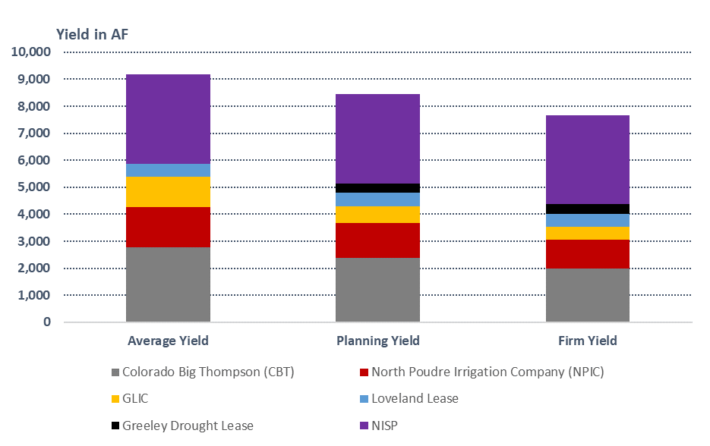
Pop ~ 60,000
Current Demand
– Pop 26,000*
* - Population refers to Windsor’s Water Service Area only

Slide 5
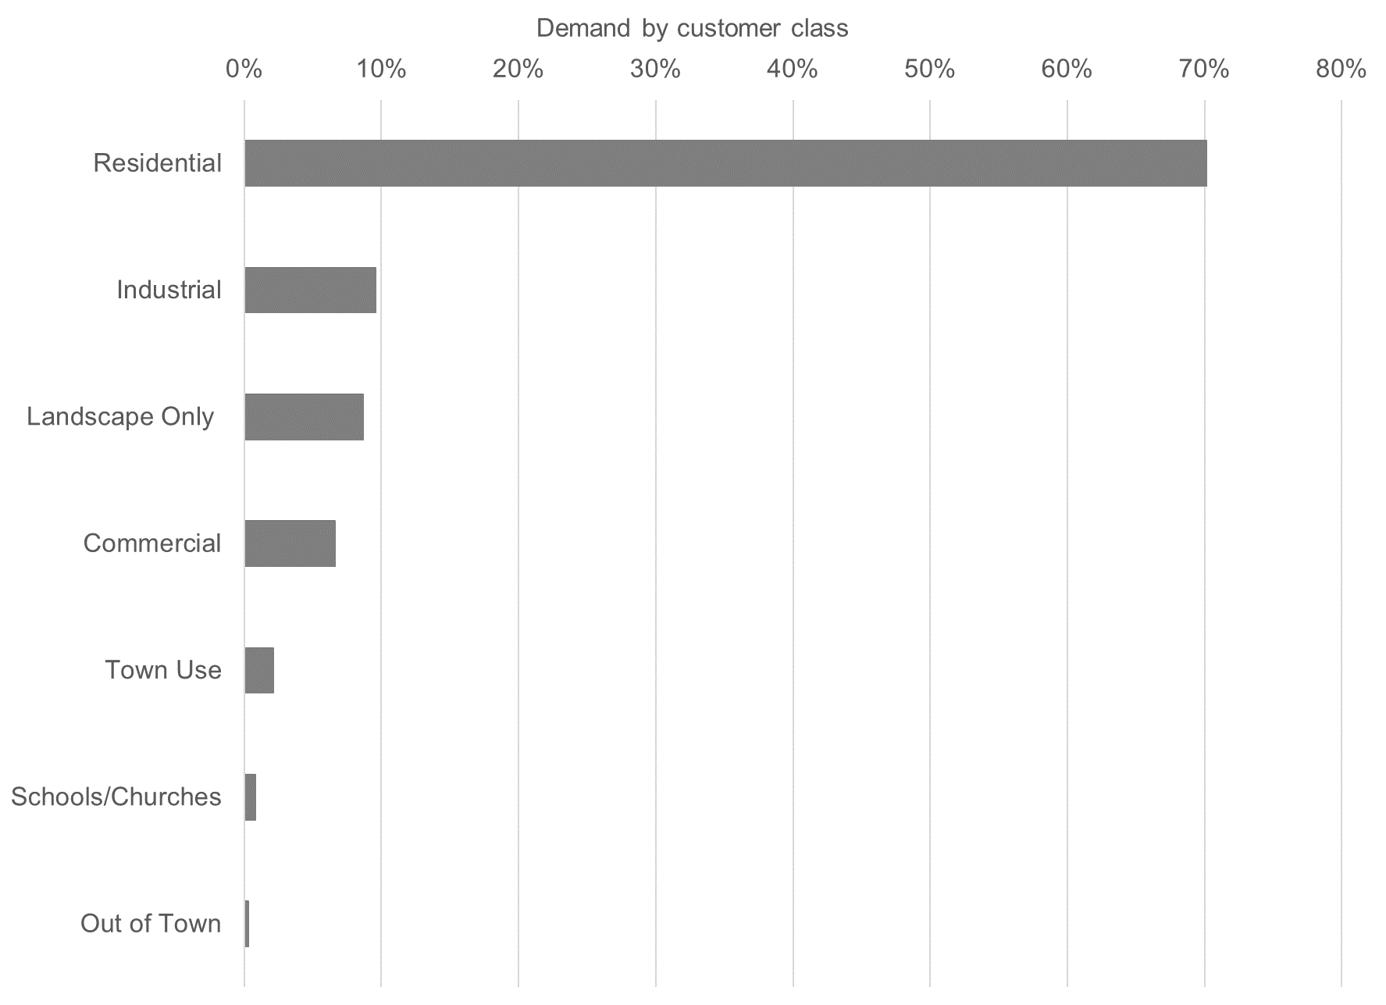
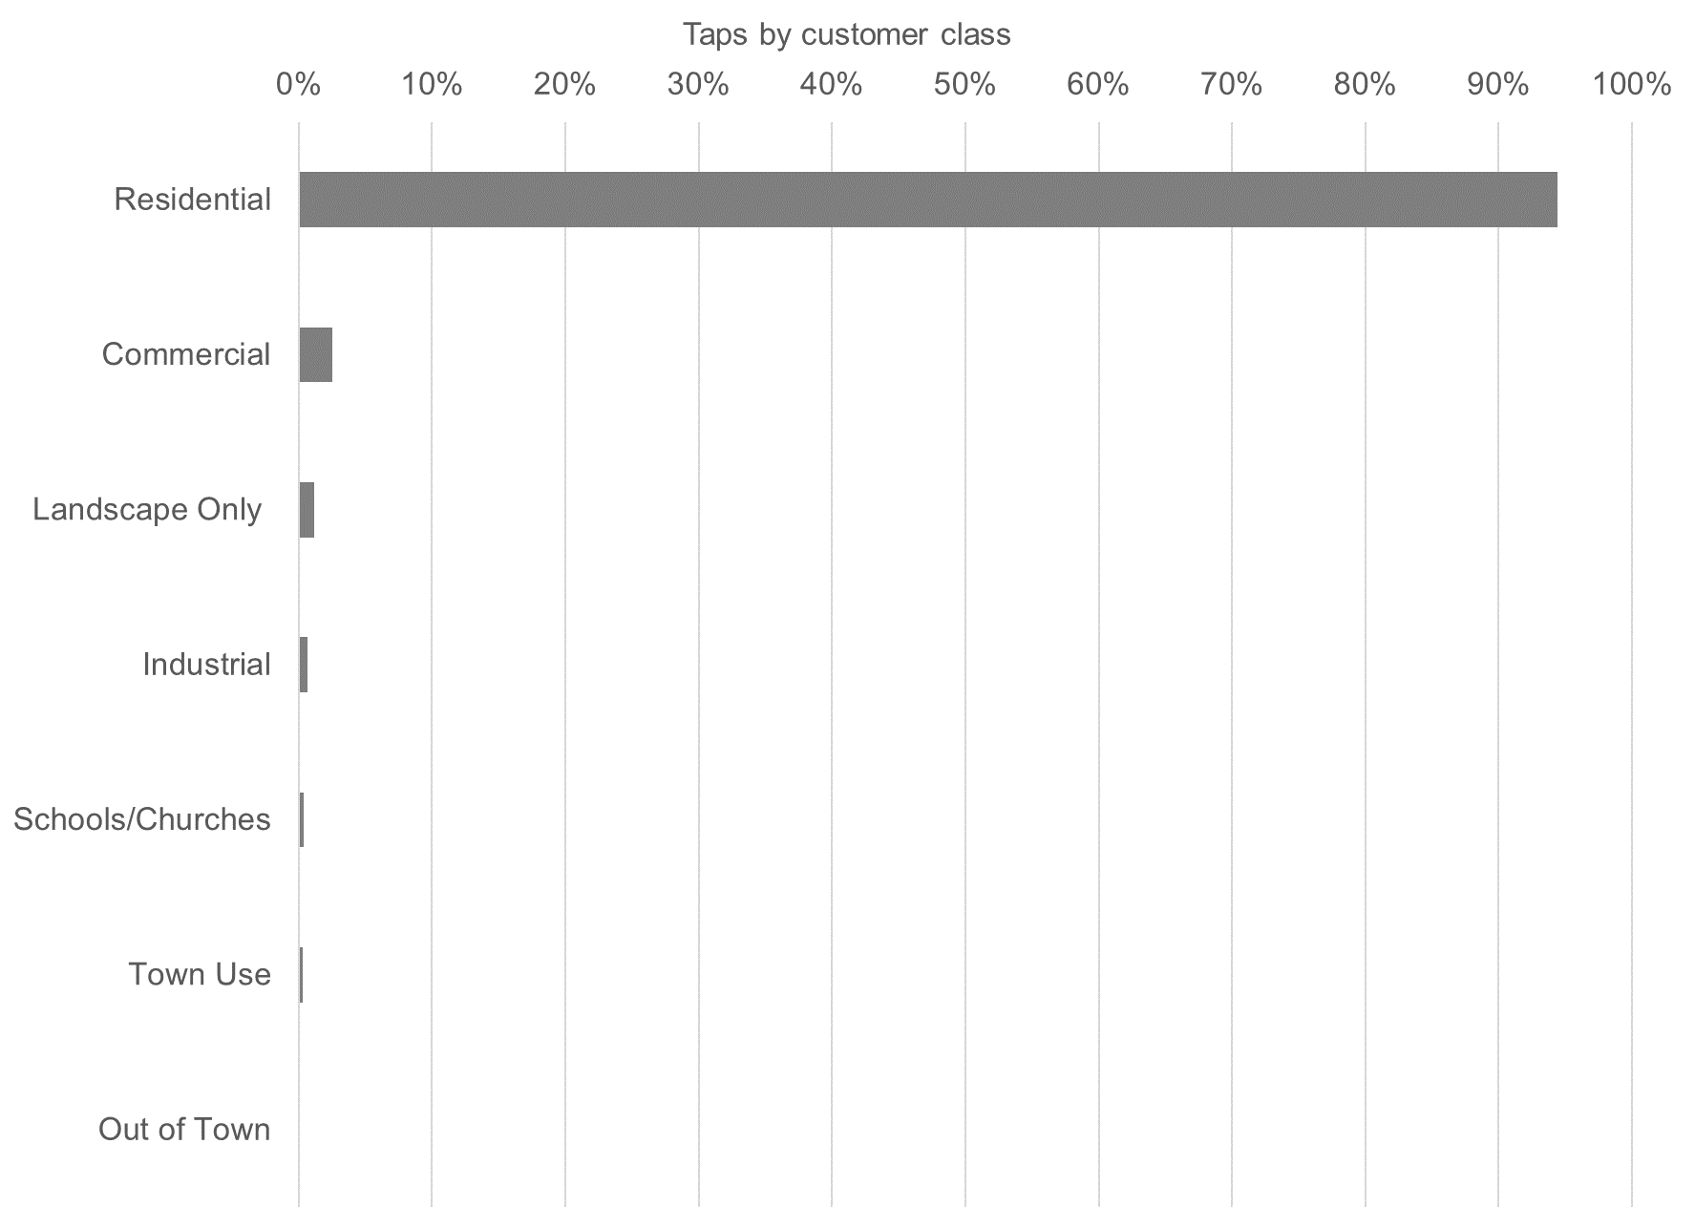
Water Use by Customer Class

Slide 6
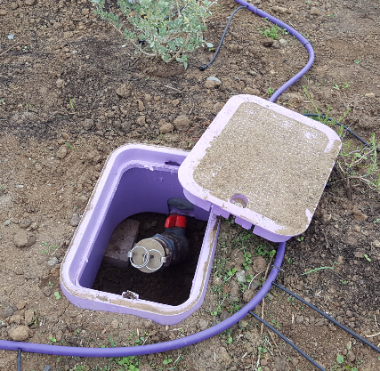
Private Non-Potable
Dual – Use Systems

Slide 7
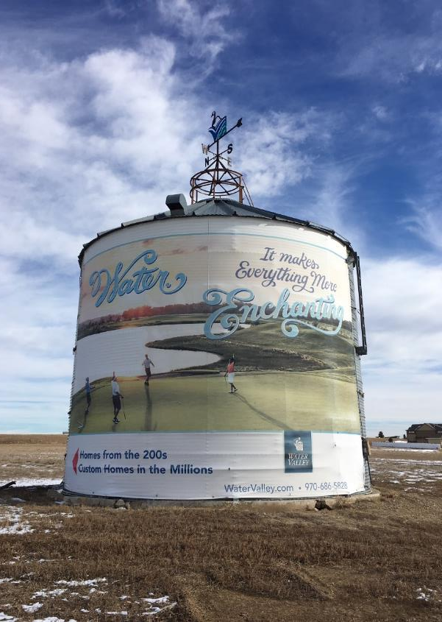

History
1994: Water Valley becomes Windsor’s first development to propose building a dual water distribution system.
1995: Data for existing homes showed that approximately 50% of total water use was for indoor use.
2003: Passed ordinance requiring secondary water systems for irrigation of new residential development within the Town of Windsor urban growth boundary.
Notes:
In 1994, Water Valley became the first development to propose building a dual water distribution system – one for potable and one for non-potable. Water Valley proposed to dedicate 1/3 of the normal raw water dedication and water Plant Investment Fee (PIF) for those served by the dual water system.
March 1995 – Windsor staff began analyzing actual water usage data for existing homes in Windsor and found that approximately 50% of the total water use was for inside domestic usage purposes. Calculating the reduction for the Water PIF turned out to be more complicated. A house served by a dual use water system essentially has the same impact on water distribution lines and storage tanks as a house without a dual system because both houses have the same fire protection demand.
However, the house on a dual system does have less impact on the water treatment and transmission part of the system and so discounting the PIF for those items seem to be justified. Windsor decided to charge 61.5% of the standard water PIF for potable water taps if a non-potable system is also available and that it provides 100% of the irrigation requirement of the development.
An ordinance was passed (2003-1142) in 2003 that required non-potable secondary water systems for the purposes of irrigation for new residential development within the Town of Windsor urban growth boundary.
Mandatory construction of non-potable secondary water systems for irrigation
Systems will be privately managed by metropolitan districts, HOAs, or other public or private entity subject to approval by the Town of Windsor
Established geographical areas where non-potable systems shall be required
Construction of non-potable secondary water systems shall be a condition of annexation
Windsor decided to charge 61.5% of the standard water PIF for potable water taps if a non-potable system is available and provides 100% of the development’s irrigation requirement.

Slide 8
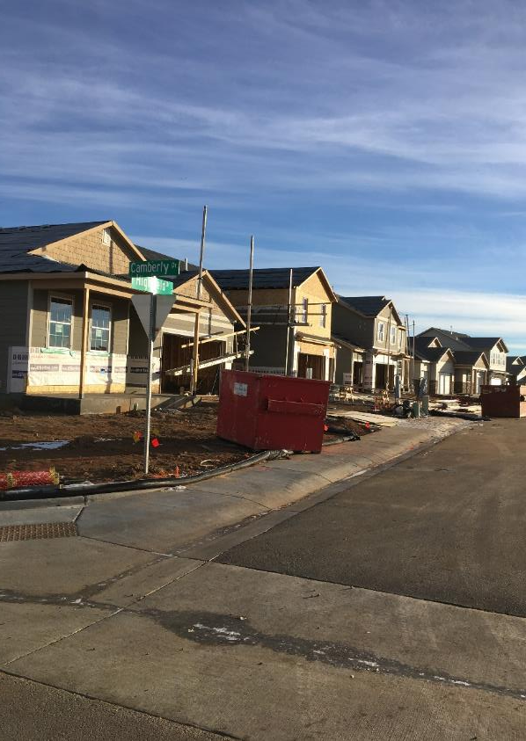
Ordinance
Mandatory construction of non-potable secondary water systems for irrigation
Systems privately managed by metropolitan districts, HOAs, or other public or private entity subject to approval by the Town of Windsor
Established geographical areas where
non-potable systems shall be required
Construction of non-potable secondary water systems shall be a condition of annexation

Slide 9
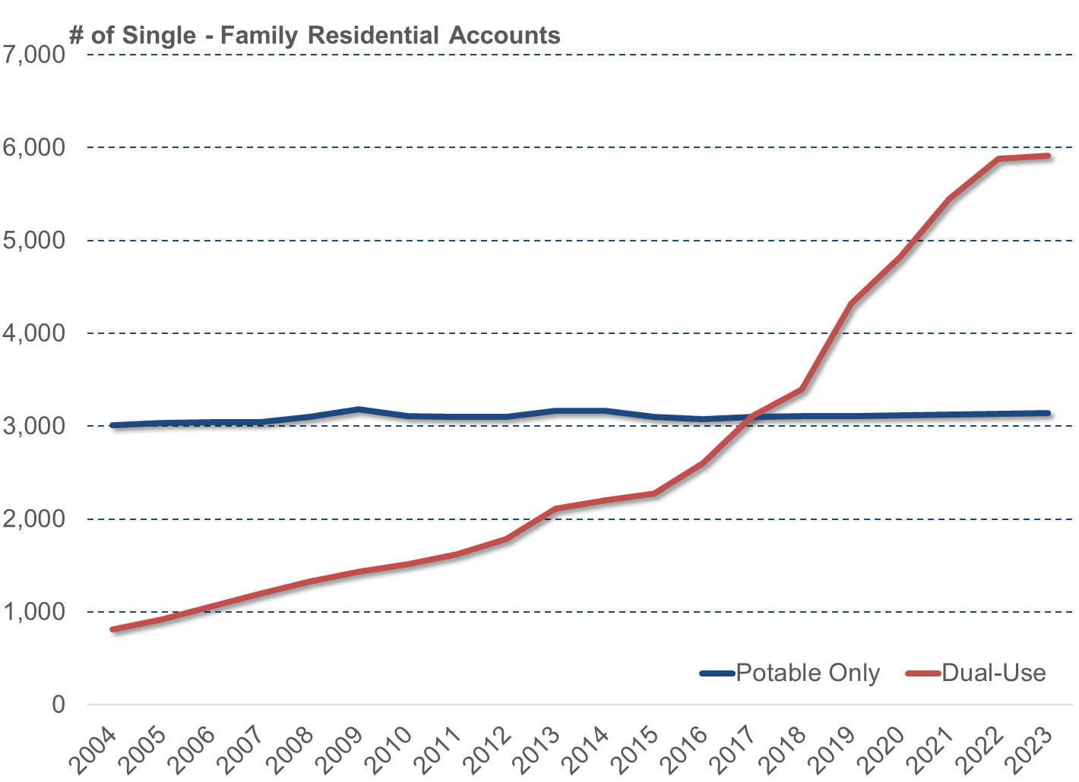

Slide 10
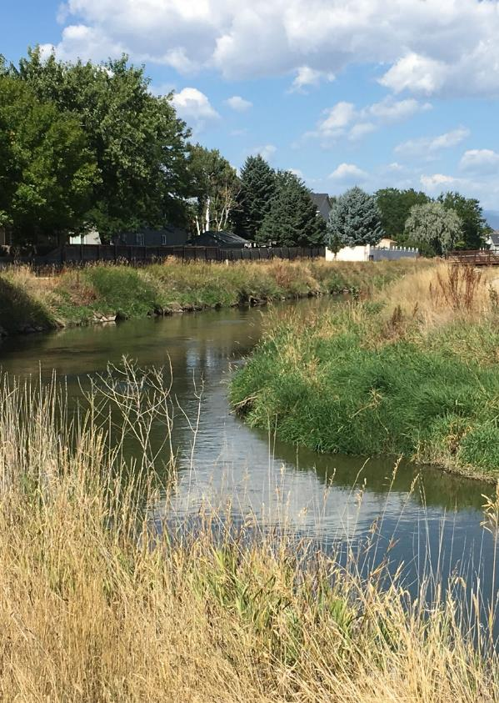
Benefits
Benefits the ditch company and ag users – keeps water in the ditch
Stretches the capacity of existing water treatment plants and delays the need to upgrade facilities or build new ones.

Slide 11
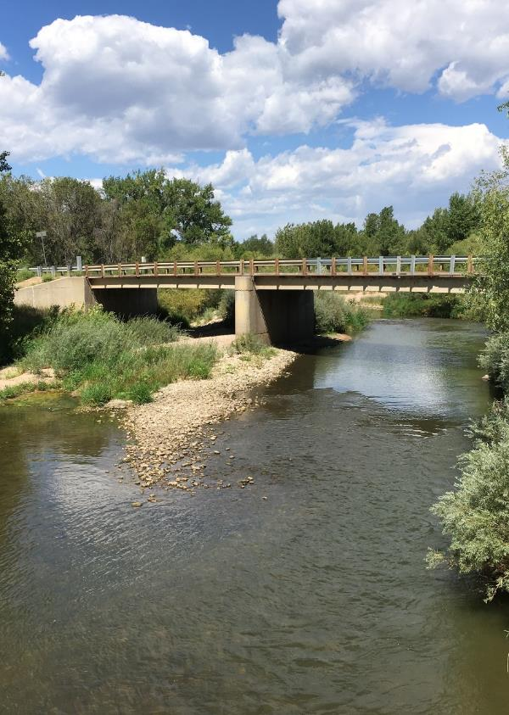
Benefits cont..
Reduction in peak summer demands keeps costs of potable treatment lower.
Keeps water in the river – supplies are not exchanged or diverted elsewhere for treatment.
Environmental benefits – reduced chemical use, reduced transportation of supplies, reduction in harmful residuals processing
Notes:
Only negative: hardens our demand.

Slide 12
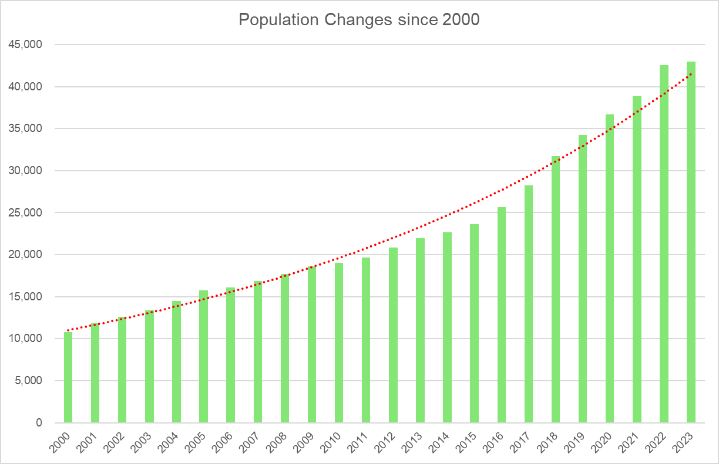
Working in Windsor
400% growth since 2000
C-BT no longer a real option

Slide 13
Hard time to grow
City of Greeley
City of Ft. Collins
1904 purchased farm for Bellvue treatment plant
1905 Boyd lake
1940-1945 Seaman Reservoir
1970 Population 38,902
1905 Joe Wright Reservoir constructed
1970 Population 43,387
1980 Expanded Joe Wright from 800-7200 acre feet
Notes:
Neighboring cities grew much earlier/prior to a lot of regulation. Any large project now requires regional cooperation.

Slide 14
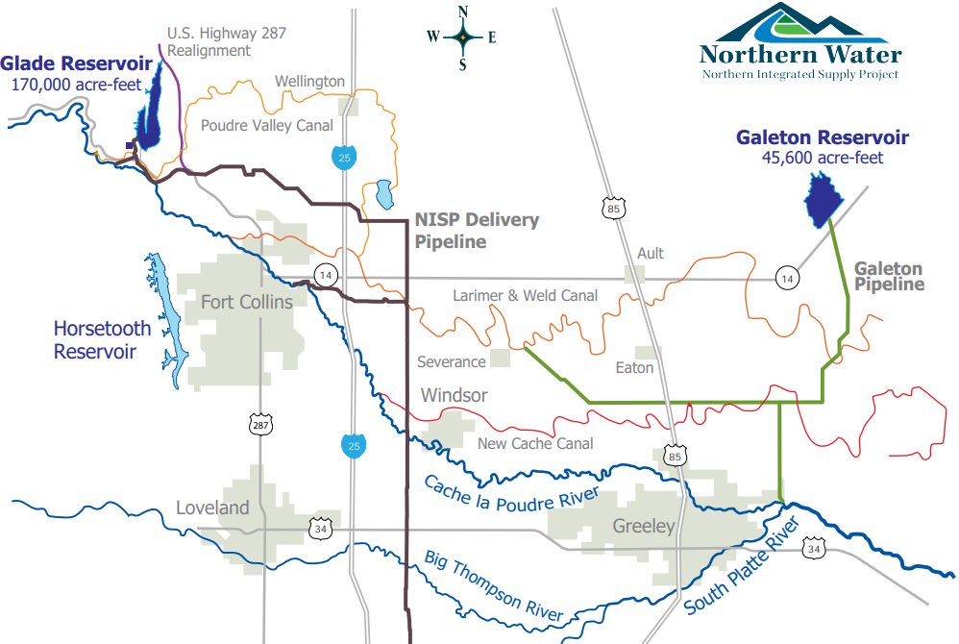
Northern Integrated Supply Project
  3,300 acre-feet yield
  $150+ million cost
  Record of Decision (ROD) 2022
  2018 EIS proved NISP was most sustainable/environmentally friendly way for NOCO water needs
  FOCO added 1041 regulations
  NOCO’s population will double by 2050
Notes:
. Started project 18 years ago. ROD was expected when I started in 2018—timing has been very difficult. Changed policy: accepting 100 cash in lieu.

Slide 15
Pop ~ 60,000
Current Demand
– Pop 26,000*
* - Population refers to Windsor’s Water Service Area only

Slide 16
  Regional collaboration
IGA with Greeley--Windsor will receive a reliable interim drought supply for 10-years (350 a.f.)as NISP is constructed
IGA with Loveland—Windsor lease of (500 a.f.) for 10-years as NISP is constructed
Planning treatment plant with Ft. Collins/ Loveland Water, Severance and Eaton

Slide 17
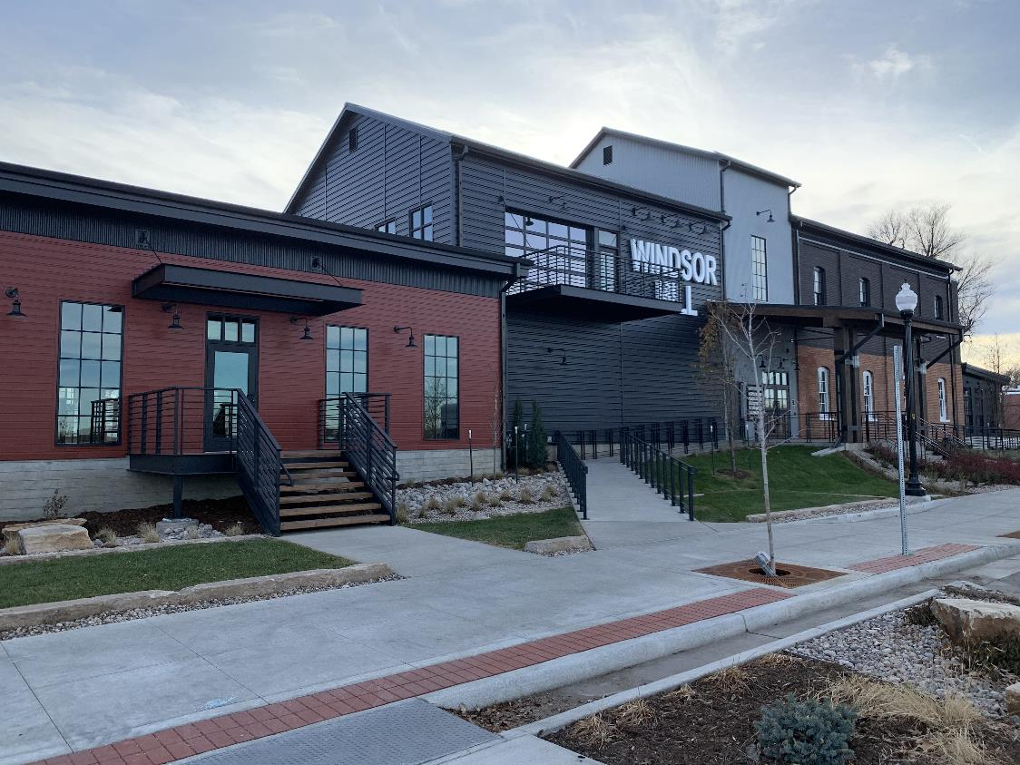
Thank you!

