Slide 1
City of Greeley: Water for Municipalities
2023/2024 Water Literate Leaders
December 13, 2023

Slide 2
Agenda
Introduction
History of Greeley
Greeley W&S Today
Challenges
Planning Ahead
Q&A

Slide 3
Introduction
Deputy Director of Water Resources at the City of Greeley
Lead Conservation, High Mountain Reservoir Operations, Non-potable Operations, Water Resource Operations, and Water Resource Planning teams
25+ staff, $10M+ operating budget, $90M+ 10-year CIP budget
Former Lead/Senior Planner at Denver Water
Englewood, Colorado Water & Sewer Board Member
Education
Adjunct Faculty Member @ University of Denver
PhD, Civil Engineering, University of British Columbia
MBA, University of Illinois
MS, Environmental Engineering Sciences, Colorado School of Mines
BS, Environmental Sciences, University of Vermont

Slide 4
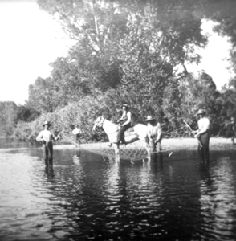
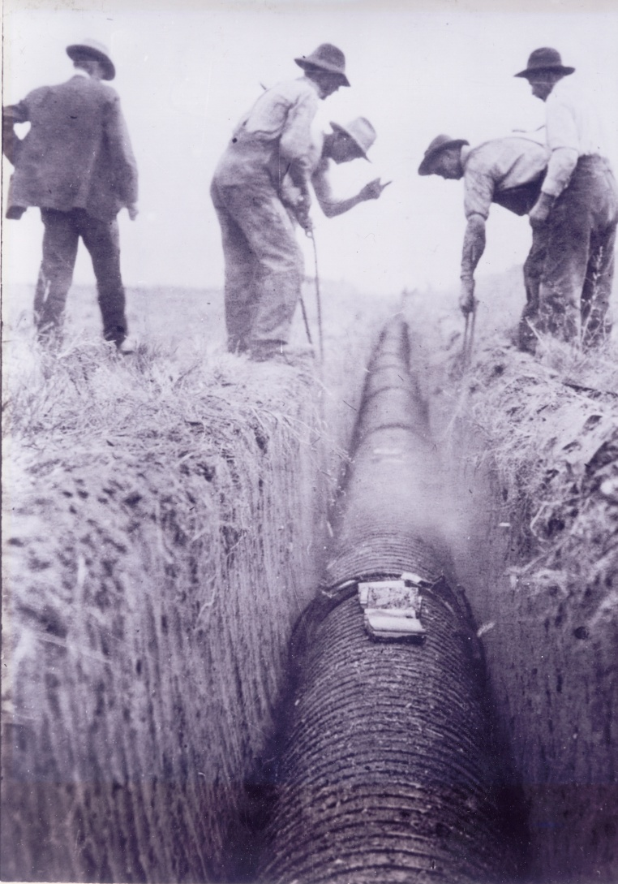
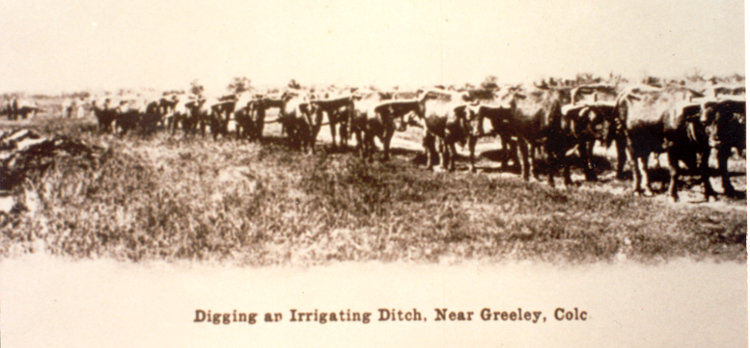
History
Union Colony founded in 1870, location chosen between Cache la Poudre & South Platte Rivers
Early agriculture revolved around wheat and other dry land crops with German-Russians later introducing potatoes and sugar beets, requiring more water
Farmers started digging ditches to get the water to their fields citizens were using water from infiltration wells along the river
Residents quickly realized that the water in the Poudre was limited to the wet season and not very good quality by the time it reached the confluence
Greeley went above Fort Collins at the mouth of Poudre canyon and built a slow sand filter plant (Bellvue)

Slide 5
Greeley Today

Slide 6
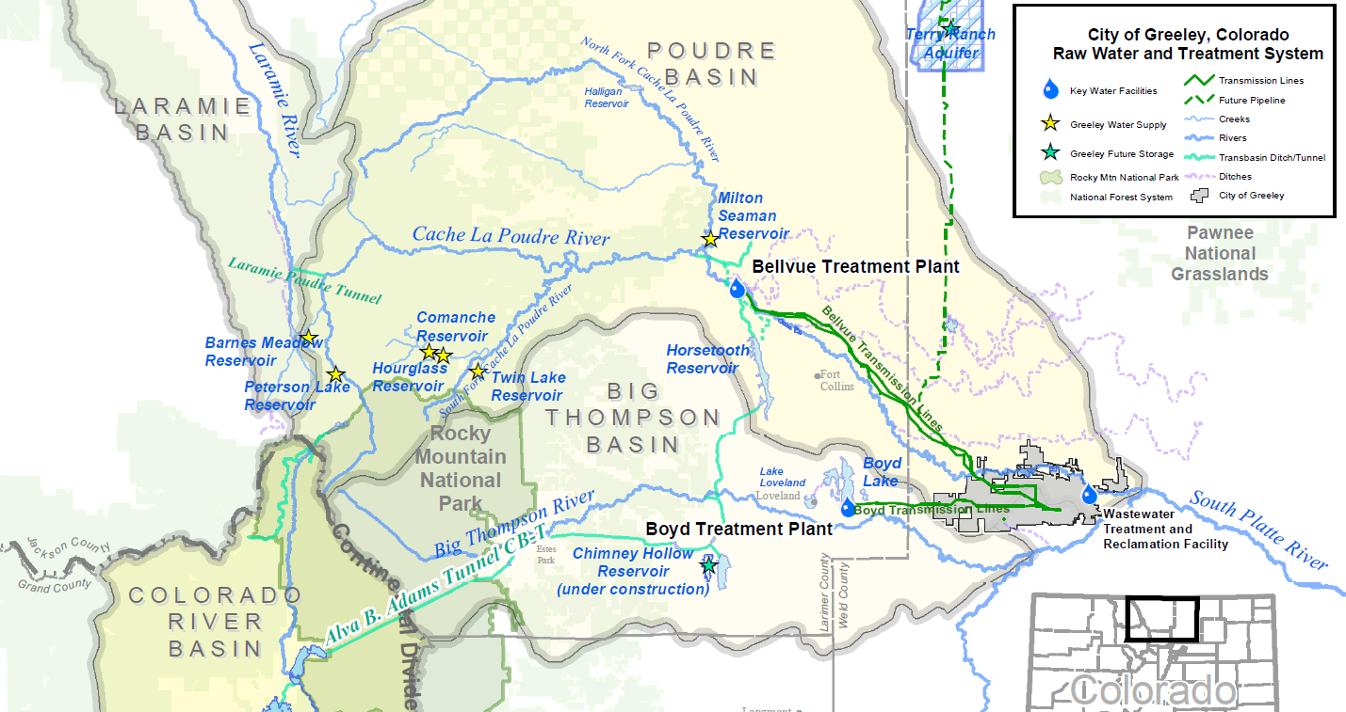
Source of Supply

Slide 7
Greeley’s Water & Sewer System
Potable Water Infrastructure
Bellvue WTP (35 MGD): Started operating in 1907, year-round (baseline) water plant
Boyd Lake WTP (38 MGD): Started operating in 1964, seasonal (peaking) water plant
~500 miles of pipeline, ~29,000 meters, ~3,700 fire hydrants, ~70 million gallons of storage
Non-potable Water Infrastructure
~25 miles of piped infrastructure, 40 pump stations, rely on regional ditch infrastructure
Currently use ~2,000 AF/year, anticipated to be ~7,100 AF/year at buildout
Wastewater Infrastructure
1 water treatment and reclamation facility (WTRF), treats 7.5 MGD
360+ miles of collection pipes, 10 lift stations

Slide 8
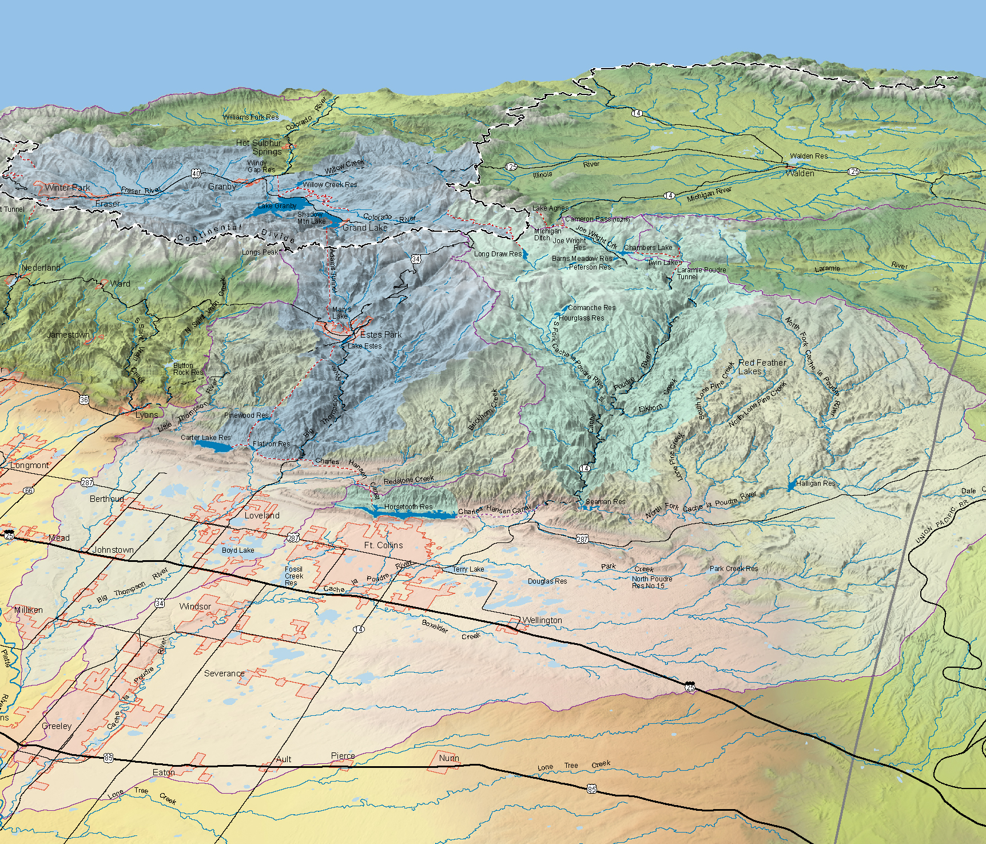
Treated Water
Colorado
Laramie
Big Thompson
Cache la Poudre
Boyd WTP
Bellvue WTP
North
Greeley
WTRF
Terry Ranch

Slide 9
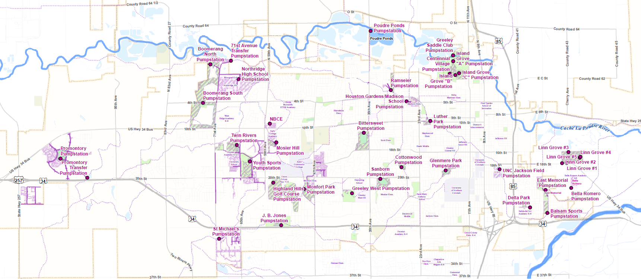
Non-potable System

Slide 10
Greeley-specific Challenges
Beyond aging infrastructure, regional workforce competition, changing regulatory environment, etc.…

Slide 11
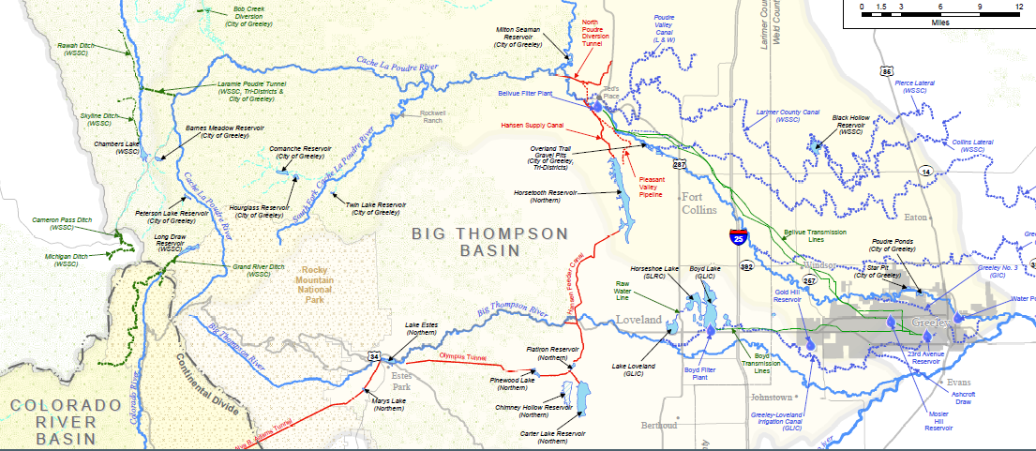
Infrastructure Footprint

Slide 12
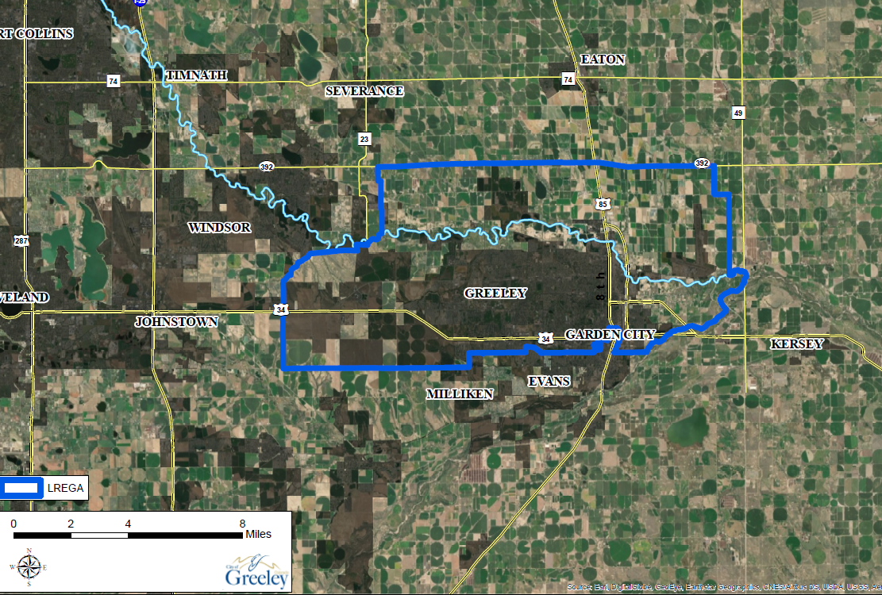
Long Range Expected Growth Area

Slide 13
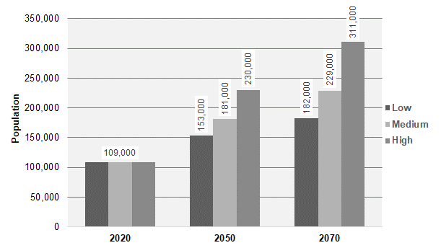
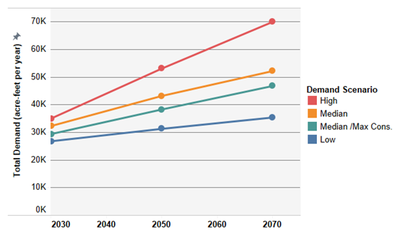
Planning for Uncertainty & Growth
Population Projections
Water Demand Projections

Slide 14
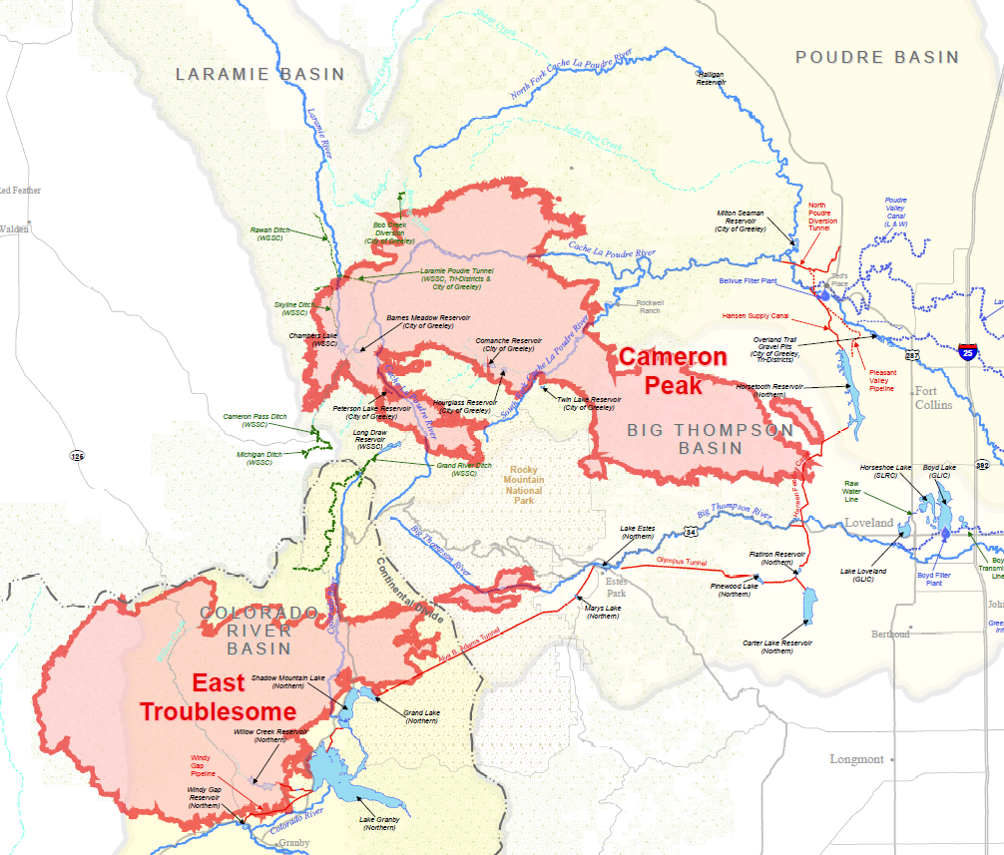
Impact of Wildfires

Slide 15
Planning for an uncertain future

Slide 16
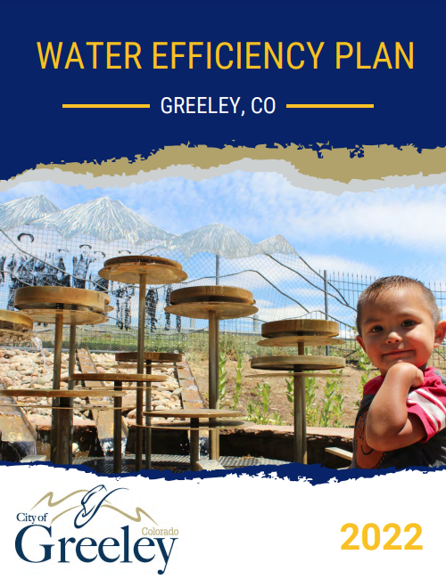
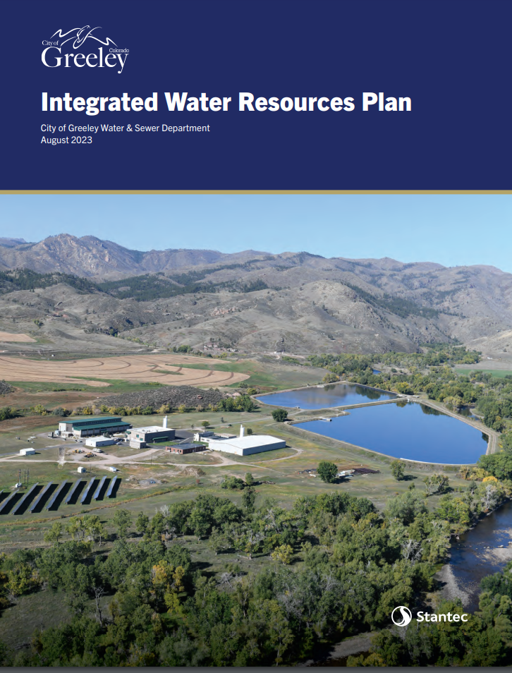
Formal Master Planning
Foundation of collaborative, data-driven planning efforts
Integrated Water Resources Plan (IWRP)
Long-range water supply strategy
Water Efficiency Plan
Conservation program blueprint
Technical Master Plans (e.g. Non-potable, Transmission and Distribution)

Slide 17
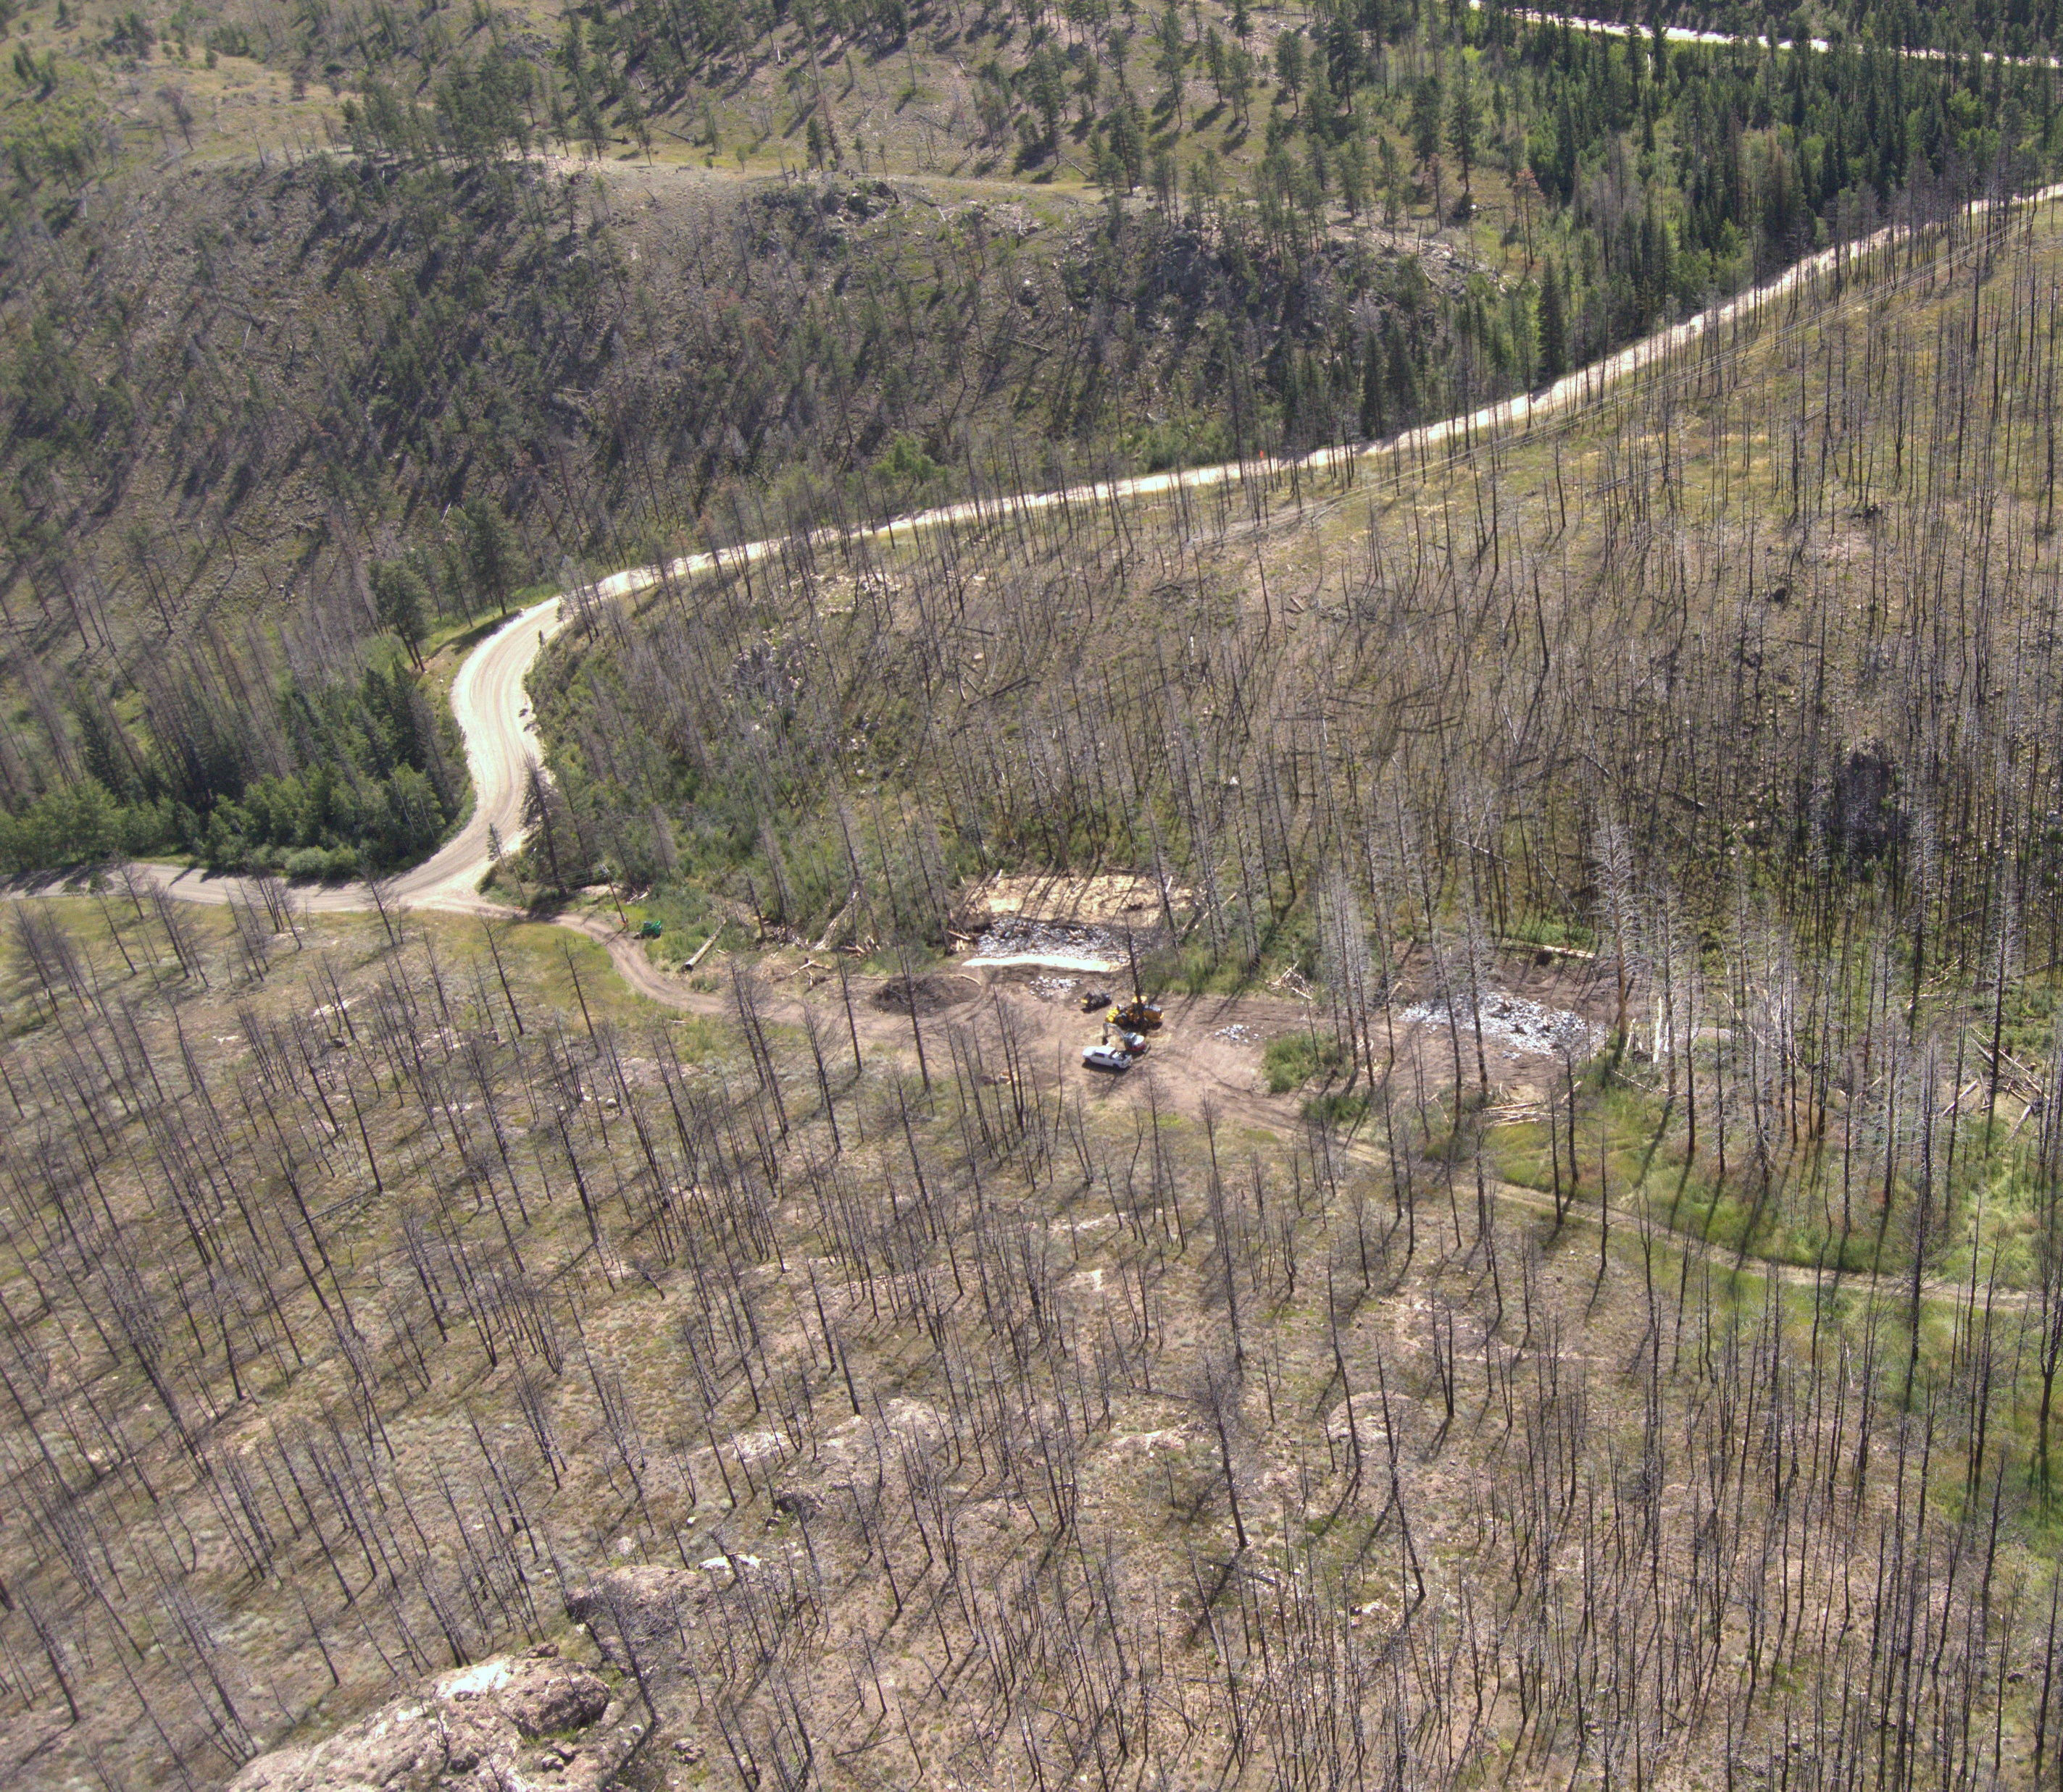
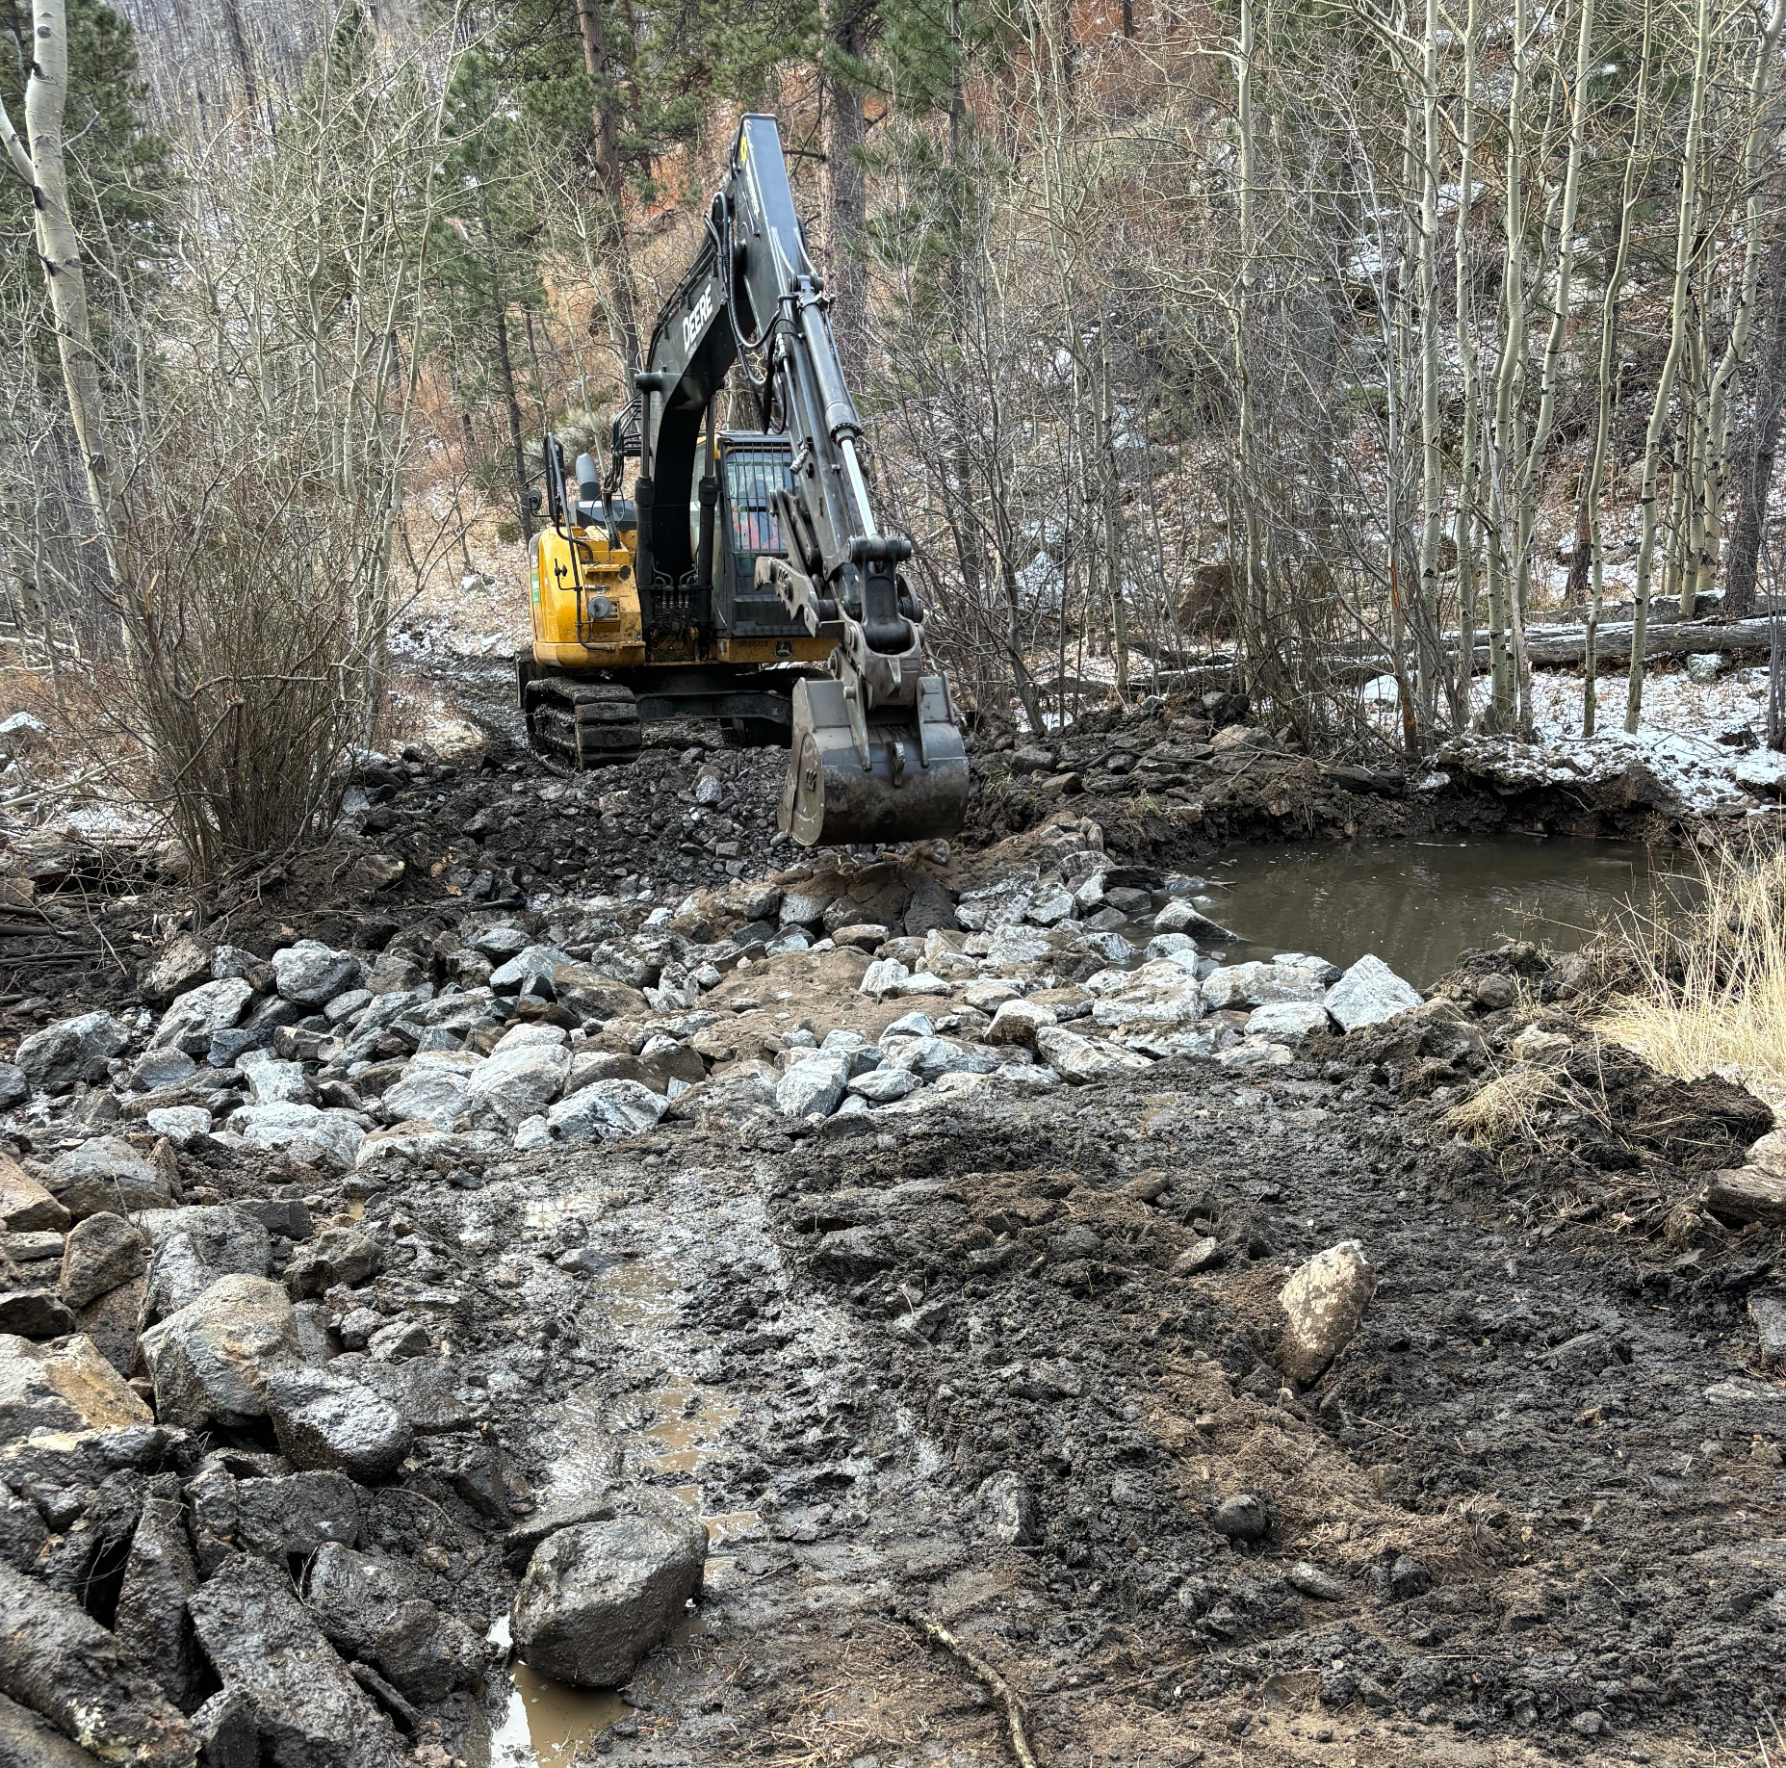
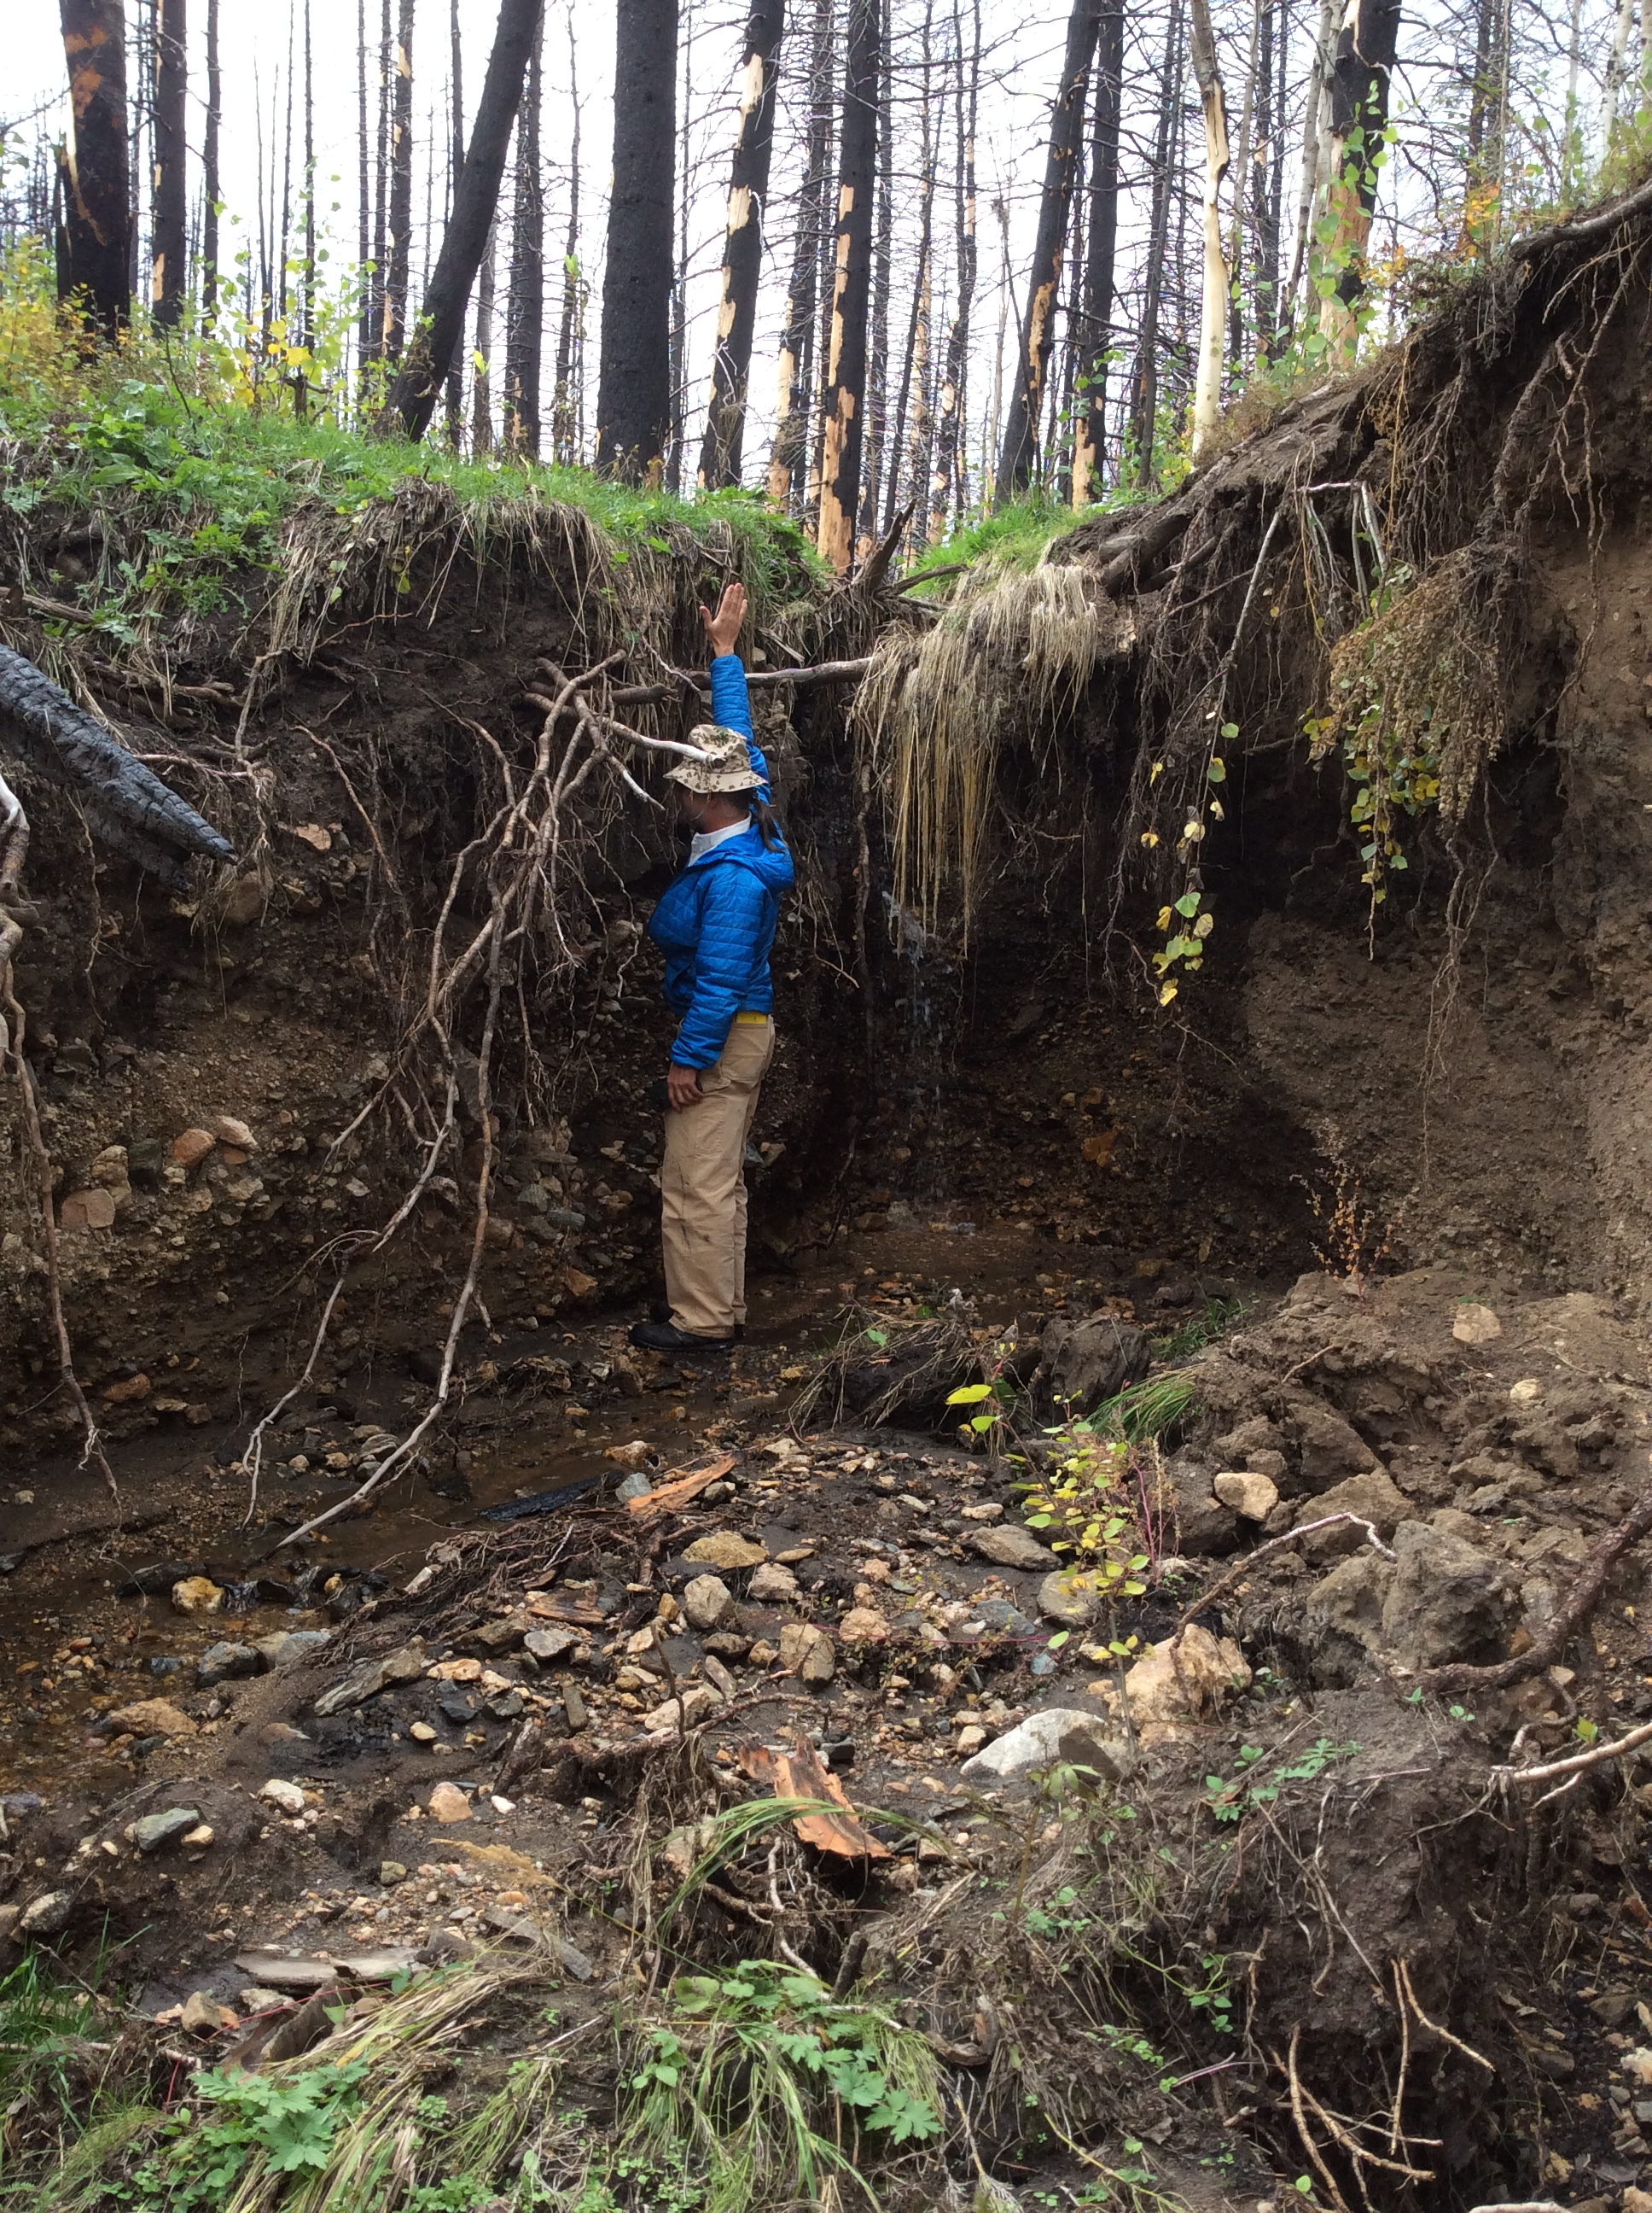
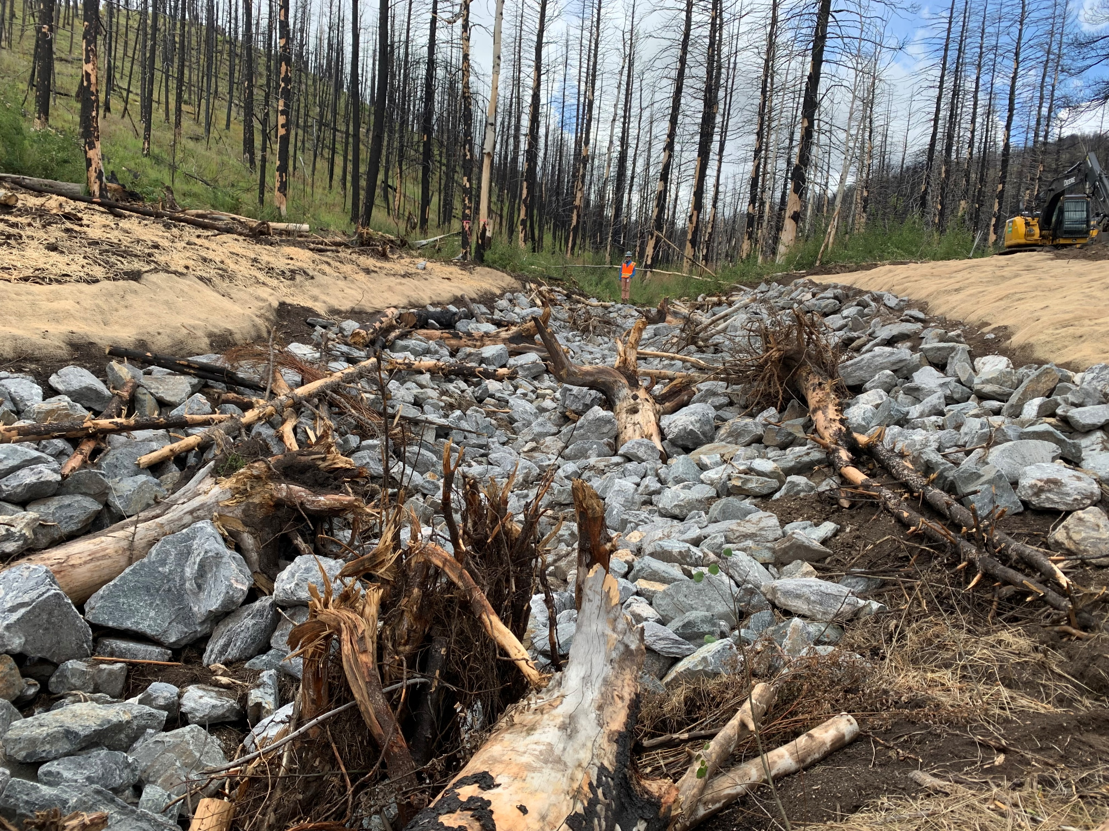
Investing in Watershed Health
Regional collaboration and proactive forest health initiatives
Board member representative for both Coalition for the Poudre River Watershed (CPRW) and Big Thompson Watershed Coalition
Stakeholder for Coalition for the Poudre River Watershed Upper Poudre Resiliency Plan and municipal stakeholder in American Forests/USFS reforestation strategy for Arapahoe Roosevelt National Forest
Partnering on Wildfire Ready Action Plan (WRAP) with Ft. Collins for Upper Poudre watershed and Big Thompson Watershed Health Partnership for Big Thompson watershed
Participant in Watershed Wildfire Protection Group, Watershed Health Investment Partners, and Cameron Peak Fire Restoration collaborative groups
Post-fire mitigation
Stabilize sites, minimize erosion & sedimentation, mitigate water quality impacts
$31M+ spent from Greeley/State/Federal funds, estimating $5M+ from USFS for 2024-2025 USFS-funded projects

Slide 18
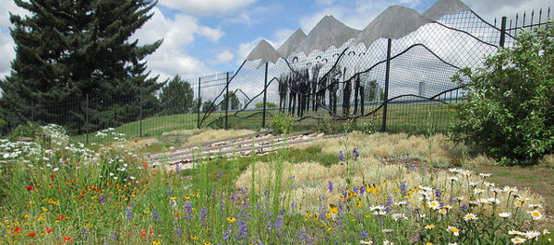
Conservation at the Forefront
Indoor and outdoor water efficiency assessments
Rebate and incentive programs
Professional landscape certifications
Life After Lawn, turf replacement program
Garden in a Box program
Online Water Efficiency Tools
Water Budget Portal
WaterSmart Portal
Online Plant Database
Youth, Adult and Teacher Educational Programs
Future income qualified programs

Slide 19
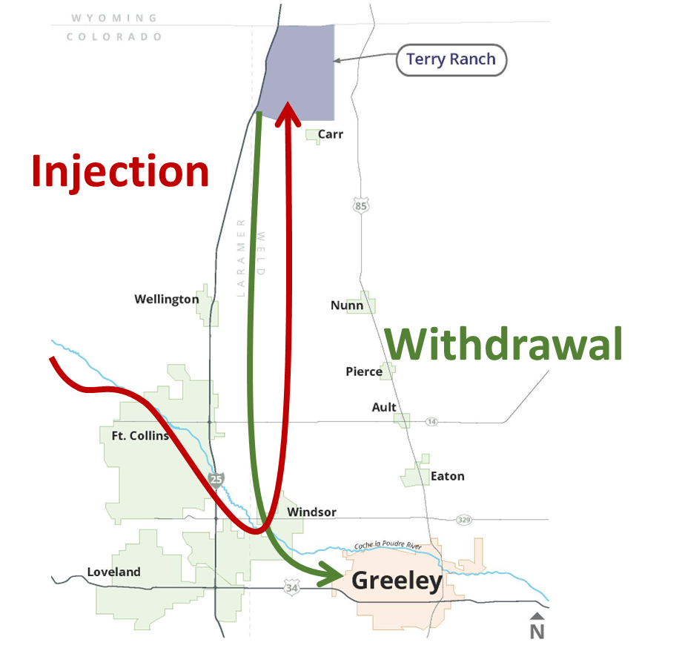
Terry Ranch (aquifer storage and recovery)
Non-tributary aquifer decreed with 1,200,000 acre-feet of native water
When available, treated surface water is injected into the aquifer
During droughts, water is extracted from the aquifer, treated again, and delivered to Greeley
Compliments acquisition strategy

Slide 20
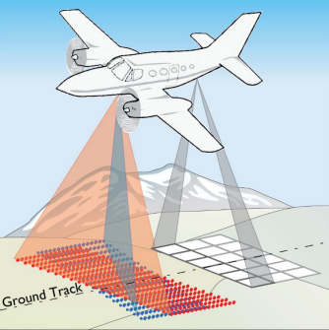
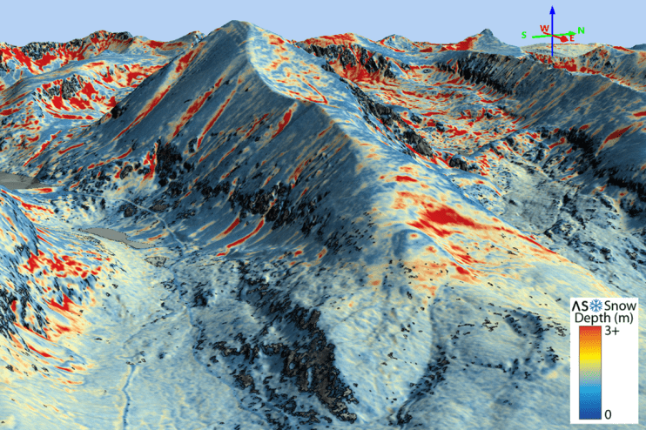
Innovating and Adapting
Formalize data empowerment and tech enablement
Support emerging technologies
Advanced Metering Infrastructure (AMI) full implementation by 2025
Geospatial AI for system assessment
Acoustic leak detection
Snowpack and canopy health LIDAR

Slide 21
Questions?

