Slide 1
Wellington Water Supply & Demand
Meagan Smith - Deputy Director of Public Works
December 13, 2023

Slide 2
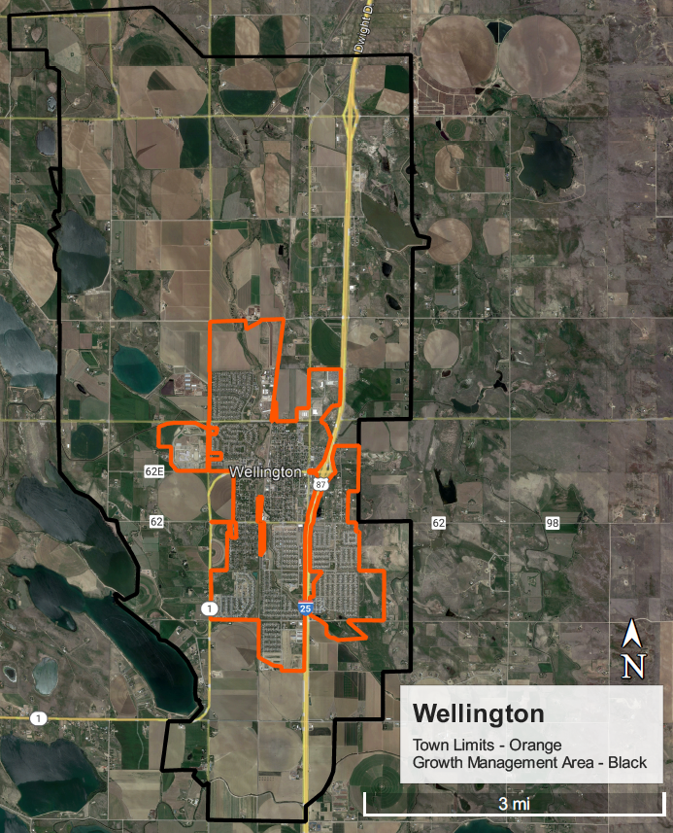
Wellington Today
~12 miles NE of Fort Collins
Population ~12,000-13,000
Two water sources
Groundwater – original Town water source (up to 370 AF; cheap)
Surface water – lease agreement with NPIC (up to 2,000 AF; very, very expensive)
Average annual water production ~1,200 AF
Notes:
1980 population – 1,215
1990 population – 1,340
2000 population – 2,672
>300% pop increase from 2000 to 2020
Current town limits – 2,500 ac
GMA – 14,500 acres

Slide 3
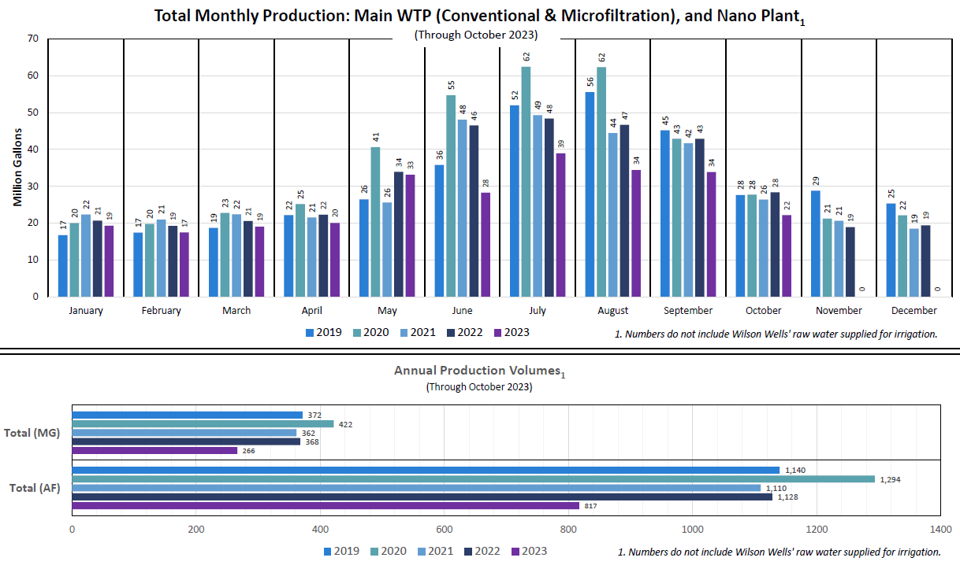

Slide 4
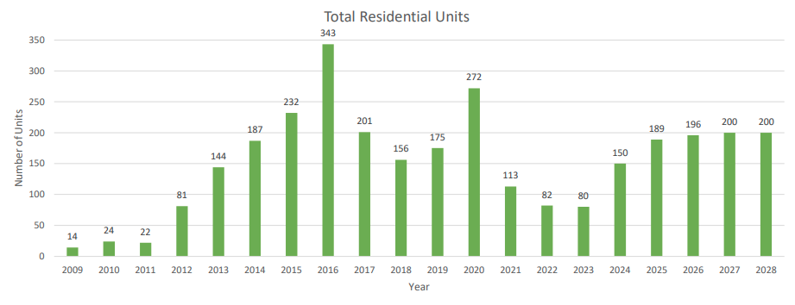
Residential Dwelling Units – Historic and Projected
57
50
108

Slide 5
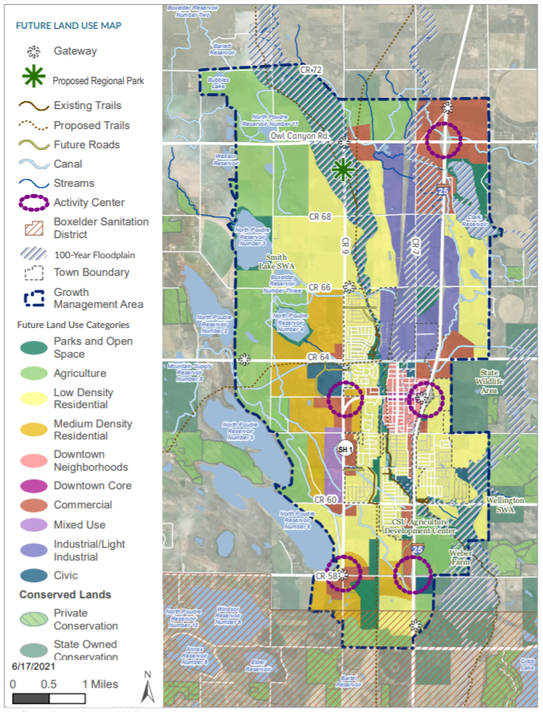
Wellington Tomorrow
Controlled and thoughtful growth
3% - 4% average annual near-term growth
2040 population ~24,000
Long-term growth estimates HIGHLY uncertain
Commercial growth less predictable
Near-term water resources needs
Negotiations with NPIC
Long-term water resources planning
Uncertainty is our motto
Notes:
2010-2019 growth rate 6.85%
2% growth beyond 2040, hit 45K pop near 2070
Near-term water resources needs
Negotiations with NPIC
Long-term water resources planning
Uncertainty is our motto
070

Slide 6
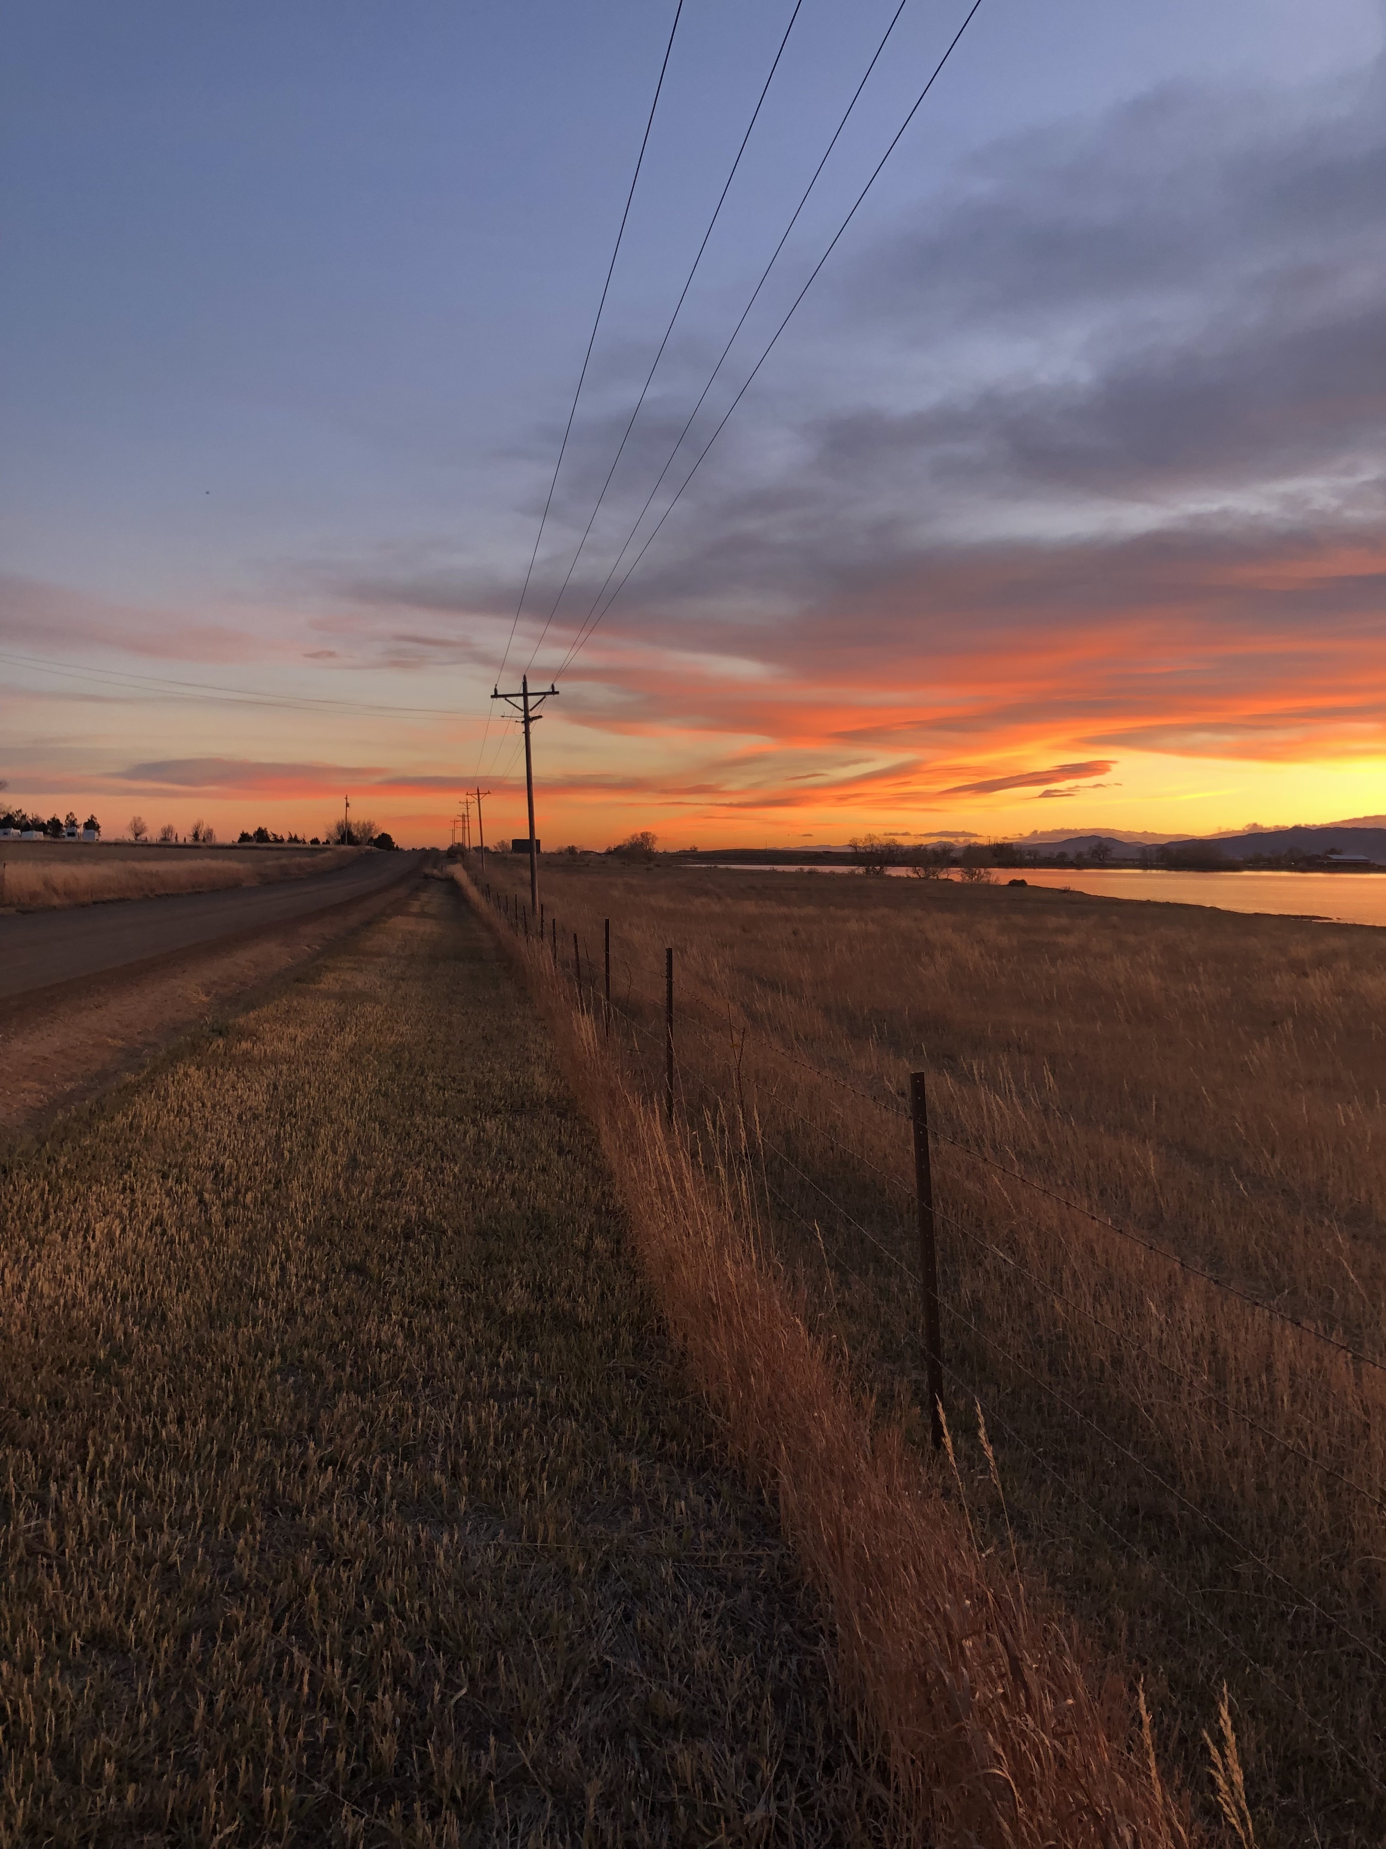
How do we get there?
No silver bullet
Negotiations with NPIC
Developers meet Raw Water Requirement
Water Resources Development Planning
NISP?
Groundwater?
Regional partners?
Conservation

Slide 7
Thank you
Meagan Smith – Deputy Director of Public Works
smithme@wellingtoncolorado.gov
970.217.5749

