Slide 1
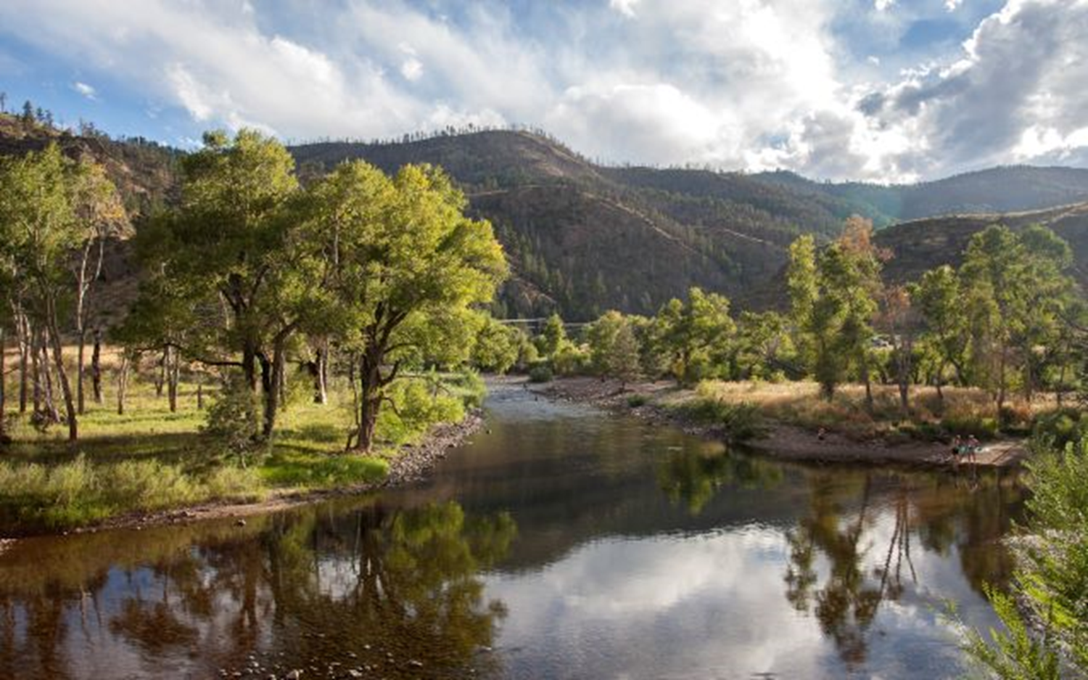
Water Sharing
Between Agriculture & Municipalities
Brett Bovee
WestWater Research, LLC
Fort Collins, CO
Colorado Water Literate Leaders
January 10, 2024
Photo: Poudre River, NPS

Slide 2
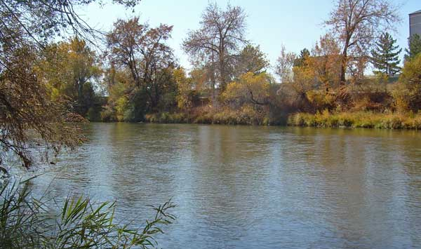
OUTLINE
Water & Agriculture
Alternative Transfer Methods
Example in Colorado
Barriers to Water Sharing
Complementary Actions
Current Status
Photo: South Platte River, USGS

Slide 3
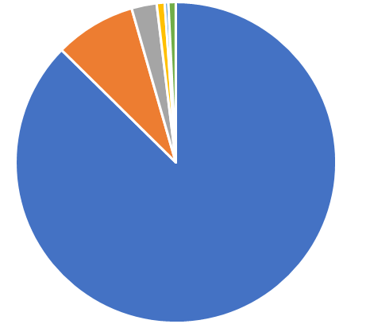
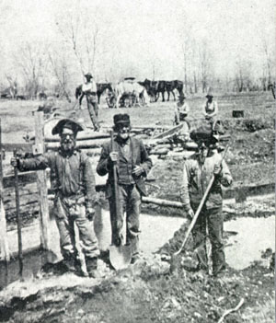
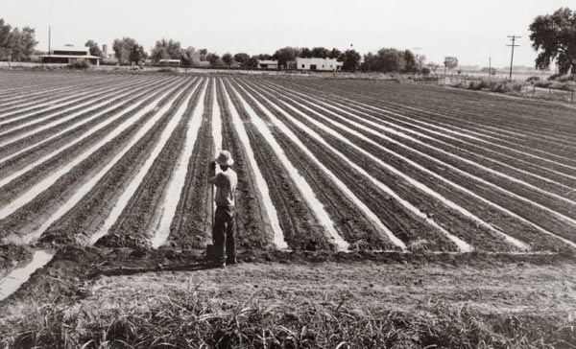
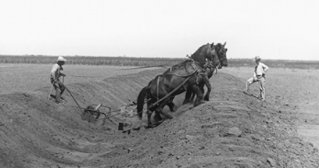
Irrigated Agriculture
USGS Water Use Data 2015
Statewide
History
Original economic engine
First water uses / water rights
Federal reclamation programs
Water Use in Colorado (Diversion)
Public Supply
8%
Irrigation
87%
WATER RIGHTS
Diversion
10.1Mafy
3.3 AF per acre
Consumptive Use
3.0 Mafy
1.0 AF per acre

Slide 4
Irrigated Lands in Northern Colorado
FoCo
Loveland
Greeley
Ft.
Morgan
Boulder
DIA
Why are irrigated lands located as shown?
Why are towns located along the Front Range?
CDWR Map Viewer
2015 Irrigated Lands in Division 1

Slide 5
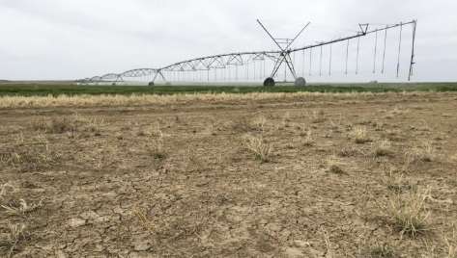
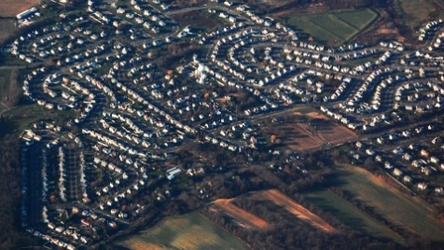
Water Sharing Agreements
Willing Seller
Willing Buyer
Large Payment
Freedom
Finality
Known Supply
Ownership
Finality
Status Quo
Permanent Sale
Farmers who do not want to continue farming
M&I water users who need a reliable base water supply
Annual Payment
Keep Farming
Flexibility
Known Supply
Regional Benefits
Aesthetics / Ecology
ATM Concepts
Water Sharing
Agreement
Farmers who have a long-term interest in the land
M&I water users who can bring in more flexible water supplies to their portfolio

Slide 6
History on Alternative Transfer Methods
2005 SWSI plans predicted 500k irrigated acres (~20% of total) could be lost statewide due to:
- Urbanization (100k acres, 20%)
- Municipal Transfers (200k acres, 40%)
Other Reasons (200k acres, 40%)
Augmentation Needs - CRP Enrollments
Compact Compliance - Groundwater Overdraft
Influence from:
Significant dry-up in Crowley County in Arkansas Basin
Example fallowing programs developed in Southern California
SB 07-22 (2007) authorized CWCB to develop a grant program to facilitate development and implementation of Alternative Transfer Methods (ATMs)
2015 CO Water Plan created an objective of 50,000 AF of ATMs by 2030

Slide 7
ATM Grant Program
$7,956,300 in Grants Awarded
(as of January 2023)
Primarily Research
Primarily Pilots
Research
Municipal
Pilots
Other
Projects

Slide 8
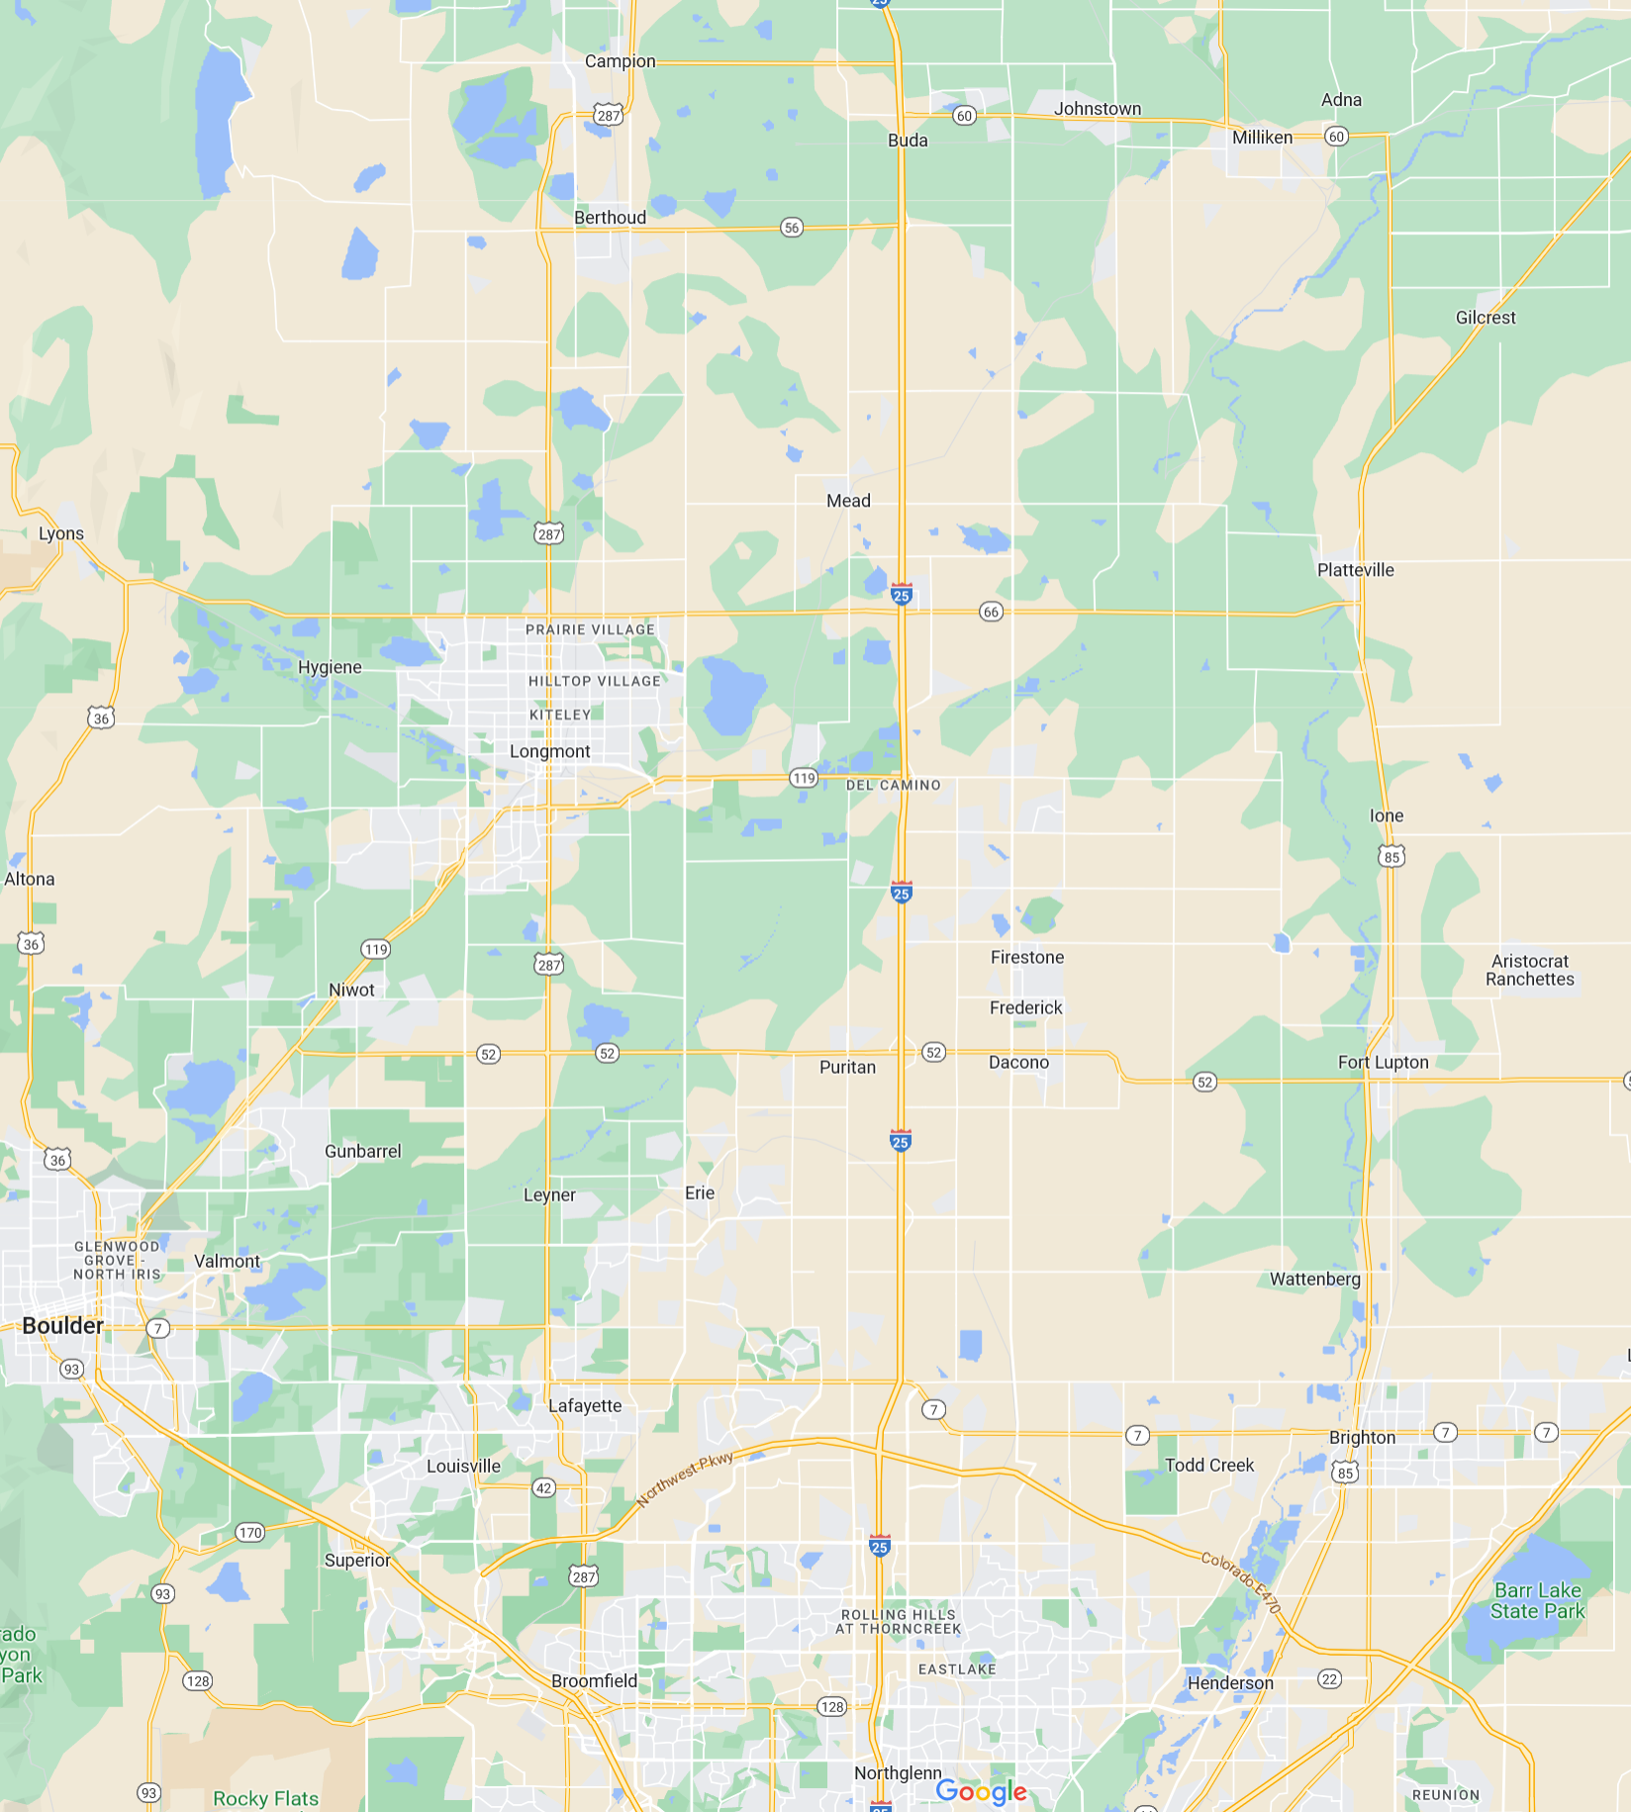
Example in Larimer County
Carter Lake
Little Thompson Farm
2017 water sharing agreement between Larimer County and City of Broomfield. A primary objective of this agreement was proof of concept.
Larimer County Open Space purchased 211 acre farm near Berthoud for $8.2M. Farm came with CBT units and ditch co. shares as water supply.
Broomfield paid $2.9M to buy some of the CBT units and paid $0.8M (upfront) for a 3-in-10 year call option for additional CBT units. Lease rate of $225/unit if lease is exercised.
Agreement is perpetual.
Involved a high valued and highly transferrable type of water supply
County has decisions around long-term management of the farm property
“Larimer County Little Thompson Farm”
City of Broomfield

Slide 9
Example in Eastern Colorado
Irrigation District operates 74,590 AF reservoir to supply 40,916 acres.
Xcel Energy wanted to set up an IWSA to provide 3,000 AF of winter-time augmentation water for its GW wells to supply the Pawnee power station
The need for water came out of revised GW administration along the South Platte River following the drought of 2002
District got initial 84% (of acres) approval to pursue an IWSA. Created Point of Rocks Water Company to act as the lessor and interested landowners subscribed their acres to the Company
Base Payment (every year): $50 per AF
Delivery Payment: $425 per AF
Payments escalate with CPI
25-Year Term of IWSA
Subscribed acres receive 0.14 AF (8.7%) less water in average year, and $41 per acre payment
Since 2005, Xcel has paid $1.6M to Company and District has not delivered any water.

Slide 10
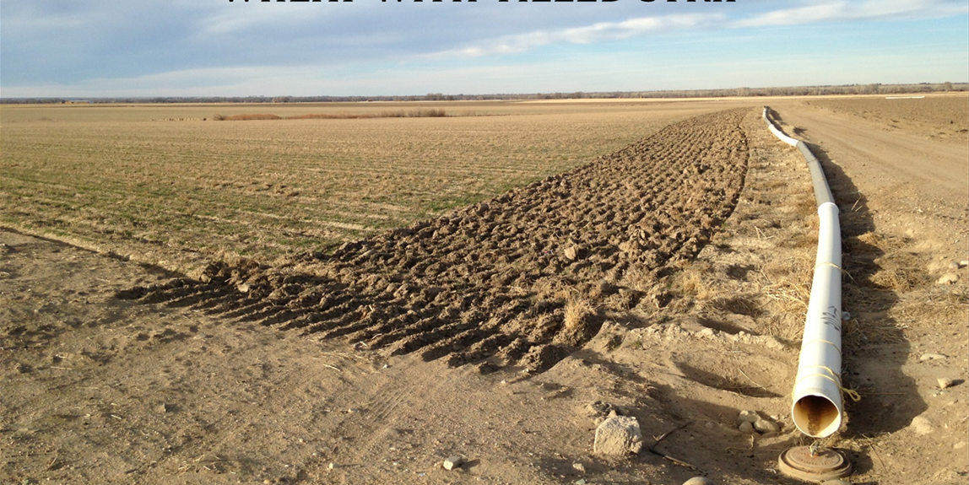
Example in Southern CO
Rotational Fallowing
Catlin Canal Pilot Project
Originally ideas developed by the Lower Arkansas Valley Water Conservancy District in 2002 and Super Ditch Company in 2008
Legal battles over injury to other water rights prevented leases from occurring
State passed HB 13-1248 in 2013 to allow pilot lease-fallowing projects
Catlin Canal Pilot Project approved by State Engineer and started in 2015
Project consists of six farms totaling 911 acres, with goal of fallowing up to 30% of acreage each year
About 400 AF delivered to three municipal buyers in 2015 and 2016
Payment structure is $150 per acre fallowed and $500 per AF of delivered water supply on a take-or-pay basis
The Super Ditch and Catlin Canal projects have benefitted from about $2M of investment through District mill levies ($0.65M) and state grants ($1.35M)

Slide 11
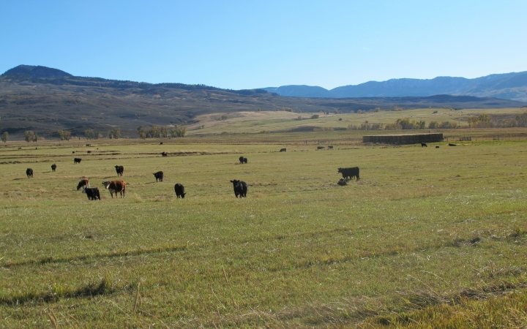
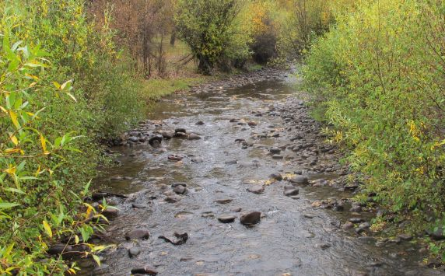
Example in Western Colorado
In 2012, WRC purchased a 214 acre ranch with 1.5 shares (18.75%) of McKinley Ditch after a bank foreclosure.
In 2014, CWT purchased the water rights (5.8 cfs) for $500k and CWCB agreed to purchase a permanent “grant of flow restoration use” from CWT for $145k which will provide instream flows to the Little Cimarron River in the late summer when the river typically ran dry
CWCB purchase price was based on lost agricultural revenue for a late-season cutting of hay
Irrigation on ranch will continue as none, split-season, or full-season depending on hydro/climate conditions
Historical Farm
Headgate Delivery
Leased for instream flows
New Farm
Headgate Delivery

Slide 12
Barriers to Water Sharing Agreements
Economic
Municipal: Often better to buy a long-term asset than rent it
Agricultural: Tying up high value water rights in an agreement takes flexibility and value off the table
Regulatory
Water transfers receive high level of scrutiny for regulatory approvals
Hydrologic
In Larimer County, most of the agricultural land is down-river from the municipal water treatment plants. Moving water uphill is difficult.
Comfort
Municipal: If permanent water acquisition options are available, it is difficult to see the upside of doing a water sharing agreement.
Agricultural: Dry up operations in transfer years are difficult to manage and a permanent sale may be the retirement plan.

Slide 13
Complementary Actions to Preserve Agricultural Lands
Agricultural Conservation Easements
Target the land aspect and not the water aspect. Water is complicated.
Focus on lands that have a particular value in agriculture
Municipal Water Dedication Policies for New Development
Provide developers the option for less water cost for less water demand
Encourages denser development and less outdoor water use
Municipal Water Leasebacks to Agriculture
Already taking place at a scale much larger than water sharing agreements
Long-term water leases are the most useful for agriculture

Slide 14
Current Status
Click Below for Report
CWCB Status Report (2020)
Inventory of ATMs – 10 to 15 active examples across CO
Recommendations for advancing water sharing agreements
Continued Activity in the Lower Arkansas River Basin
Municipal interest in water leasing
Spatial separation between agricultural lands and municipal growth
Continued Interest in Water Sharing for Environmental and Regulatory Purposes
System conservation programs in the Colorado River Basin
Environmental NGO project development

Slide 15
THANKS!
Brett Bovee | WestWater Research, LLC
205 S. Meldrum St., Fort Collins, CO 80521
bovee@waterexchange.com
Office: 970-672-1811 | Cell: 970-889-0469 ​
Water Resource Economics | Transaction Services | Water Valuation
Photo: South Platte River, USGS

