Slide 1
Thornton Northern Properties Stewardship Plan Presentation to Water Literate Leaders January 10, 2024 Emily Hunt, Deputy Utilities Director – City of Thornton

Slide 2
Agenda
Municipal water supply planning
Thornton’s water supply development
Historical context
Thornton Northern Project
Thornton Northern Properties Stewardship Plan
Update on the Thornton Water Project

Slide 3
Municipal Water Supply in Colorado … The Basics
Safe water is available for critical uses, even in a drought
Diverse water rights portfolio – geographic
Diverse water rights portfolio - senior and junior rights
Storage to carry water from wet periods to dry periods – seasonally and annually
Firm Yield – amount that can be reliably counted on in a multi-year drought; combination of water rights and storage
Water efficiency & demand management

Slide 4
Municipal Water Supply in Colorado … The Basics
Source of Supply
Water rights
Wells
Contracts
Raw Water Infrastructure
Storage
Pipelines
Pump stations
Tunnels
Treatment & Distribution Infrastructure
Water treatment plant
Tanks
Pipelines
Pump stations
Demand Management
Metering
Customer water efficiency

Slide 5
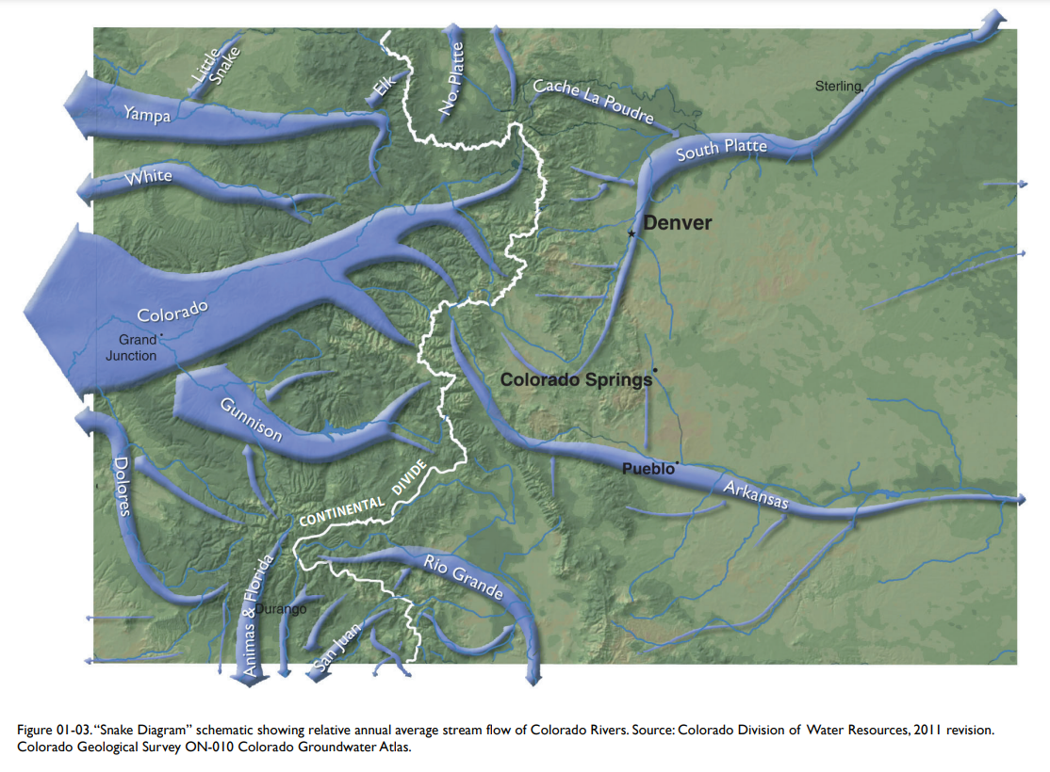
Municipal Water Supply in Colorado … The Challenges
Location

Slide 6
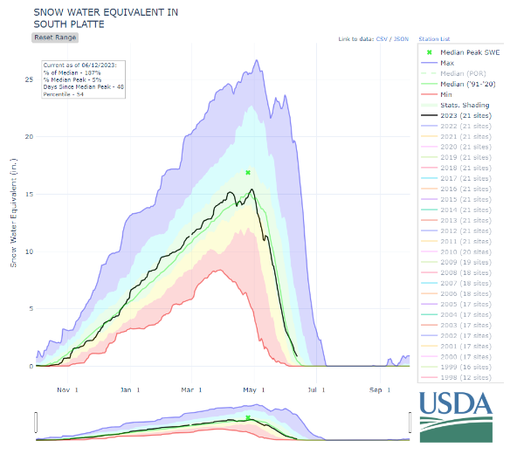
Municipal Water Supply in Colorado … The Challenges
Variability

Slide 7
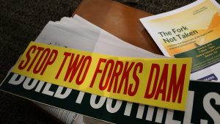
Thornton Water Supply Development
1956
Thornton incorporated
1963
Acquired Northwest Utilities
Clear Creek & South Platte supplies
1970s
Develop additional Clear Creek & South Platte supplies
1982
Two Forks Reservoir Project
Mid 1980s
Two Forks begins to falter
South Platte water quality challenges
1985 Thornton divests from Two Fork
Looks for higher quality supply
1986-1987
Water Supply & Storage Company acquisition

Slide 8
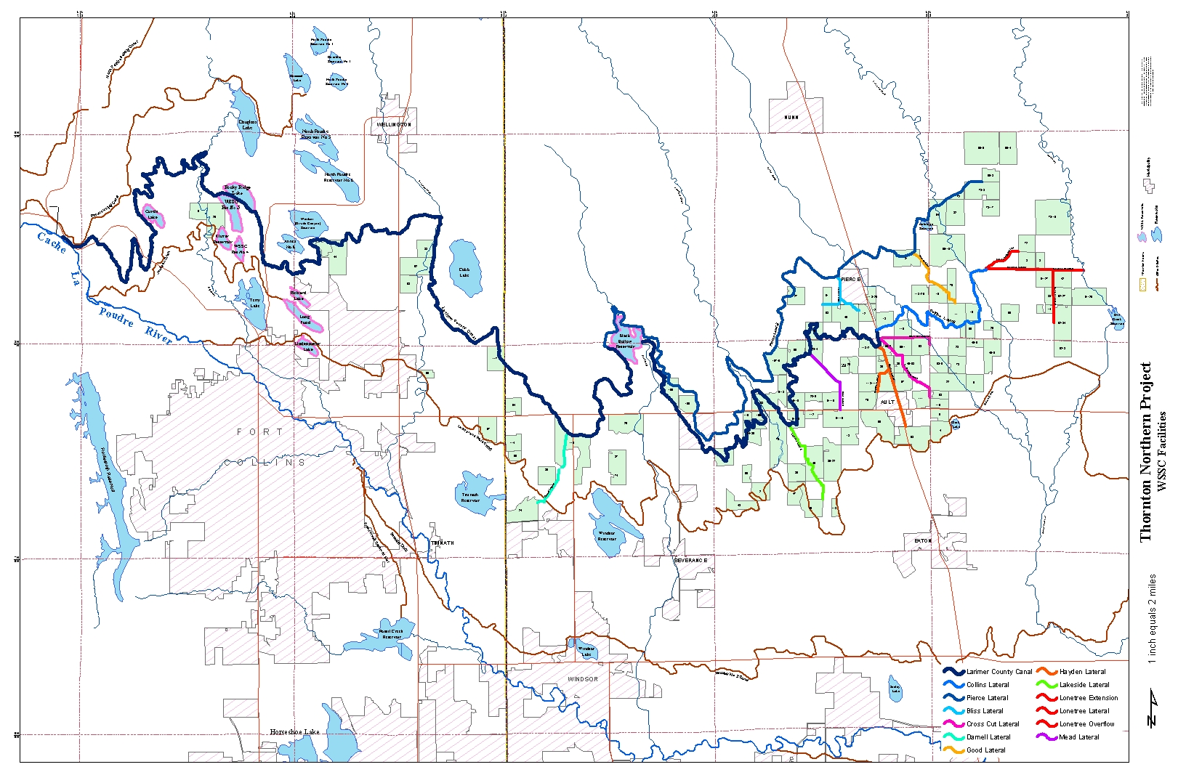
Thornton Northern Project

Slide 9
Thornton Northern Project
1985 to 1987
Acquisition
1986 to 1998
Water Court
Change of WSSC shares from agricultural to municipal use in Thornton
1985 to present
Property Stewardship
Continued irrigated agriculture
Acquired 110 farms, ~21,000 acres
284 shares of Water Supply and Storage Company (WSSC)
Farmhouses, wells, and other assets
Junior direct and exchange water rights
2014 to present
Thornton Water Project
Conveyance infrastructure
2018 to present
Northern Properties Stewardship Plan
Data-driven and community-informed property management and long-term land use planning
Conversion to self-sustaining dry-land/native grasses pursuant to Water Court Decree began in 2000s
Thornton Agricultural Stewardship Office – Ault, CO

Slide 10
Northern Properties Stewardship Plan - Objective
The Northern Properties Stewardship Plan is a complementary process to Thornton’s agriculture-to-municipal water transfer. While Thornton’s water will be used in accordance with Thornton’s water rights decree, the Stewardship Plan is a vision for the management and future land use of Thornton’s 18,000 acres.
https://www.thorntonco.gov/government/infrastructure/water/NPSP/Pages/northern-properties-stewardship-plan.aspx

Slide 11
Thornton Northern Project

Slide 12
Funding
Bureau of Reclamation
WaterSmart: Water Marketing Strategy Grant
City of Thornton
Colorado Water Conservation Board
Colorado Water Plan Grant
South Platte Basin Roundtable Water Supply Reserve Fund
Metro Basin Roundtable Water Supply Reserve Fund
Statewide Water Supply Reserve Fund
Department of Local Affairs (DOLA)
Energy Impact Administrative Grant

Slide 13
Community-driven process
Subject Matter Expert Interviews (February 2020)
Steering Committee Meetings (ongoing - eight meetings from November 2021 to present)
Water Optimization Study Group (October 2022 to present)
Weld County Commissioners Meeting (July 2021, March 2022, November 2022, March 2023)
Regional Working Group Meetings (Jan 2023)
Poudre Valley RE-9 Meeting (January 2023)
Towns of Eaton, Ault and Pierce Meeting (February 2023)
Town of Ault Meetings (recurring)
Farm Tenant Open House (March 2023)
Community Open House (March 2023)
Joint Regional Working Group Meeting (June 2023)
Community Open House (August 2023)
Thornton City Council (August 2023)

Slide 14
Steering Committee Members |  | City of Thornton and Consultants
Keith Amen, Amen Farm Brendan Boepple, Colorado Cattlemen’s Agricultural Land Trust Sean Chambers / Cole Gustafson, City of Greeley Nick Colglazier, Colorado Corn Growers Carmen Farmer, Colorado Open Lands Meegan Flenniken, Larimer County Natural Resources Jim Flesher, Weld County Amber Graves, Morning Fresh Dairy Julie Lukela, Town of Pierce Cindy Lair, Department of Agriculture Trent Verquer, CO Parks & Wildlife | Drew Rayburn, The Nature Conservancy Eric Reckentine, North Weld County Water District Chris Schnorr, Thornton Tenant Farmer Sharon Sullivan, Town of Ault Stacy Suniga, Latino Coalition of Weld County George Wallace, Larimer County Agricultural Advisory Board Richard Werner, Upstate Colorado Economic Development Bryan Willson, CSU Energy Institute Brad Wind, Northern Water Mark Reifenrath, Local farmer | Emily Hunt, City of Thornton Ed Lanyon, City of Thornton Brian Foss, Thornton Ault Office Pia Gerstle, City of Thornton Mike Flowers, City of Thornton Jonathan Bartsch, CDR (facilitator) Scott Campbell, ICS/TFT (consultant) Andrew Boyd, TFT (consultant) Kevin Shanks, THK (consultant) Erik Sakotas, THK (consultant)

Slide 15
Calls to action
Maintain key components of the region’s agricultural heritage.
Support transitioning agricultural economies.
Promote economic diversification.
Address a future with 1 million residents in 2040.
Advance regional approaches to land and water planning and management.

Slide 16
Northern Properties Stewardship Plan

Slide 17
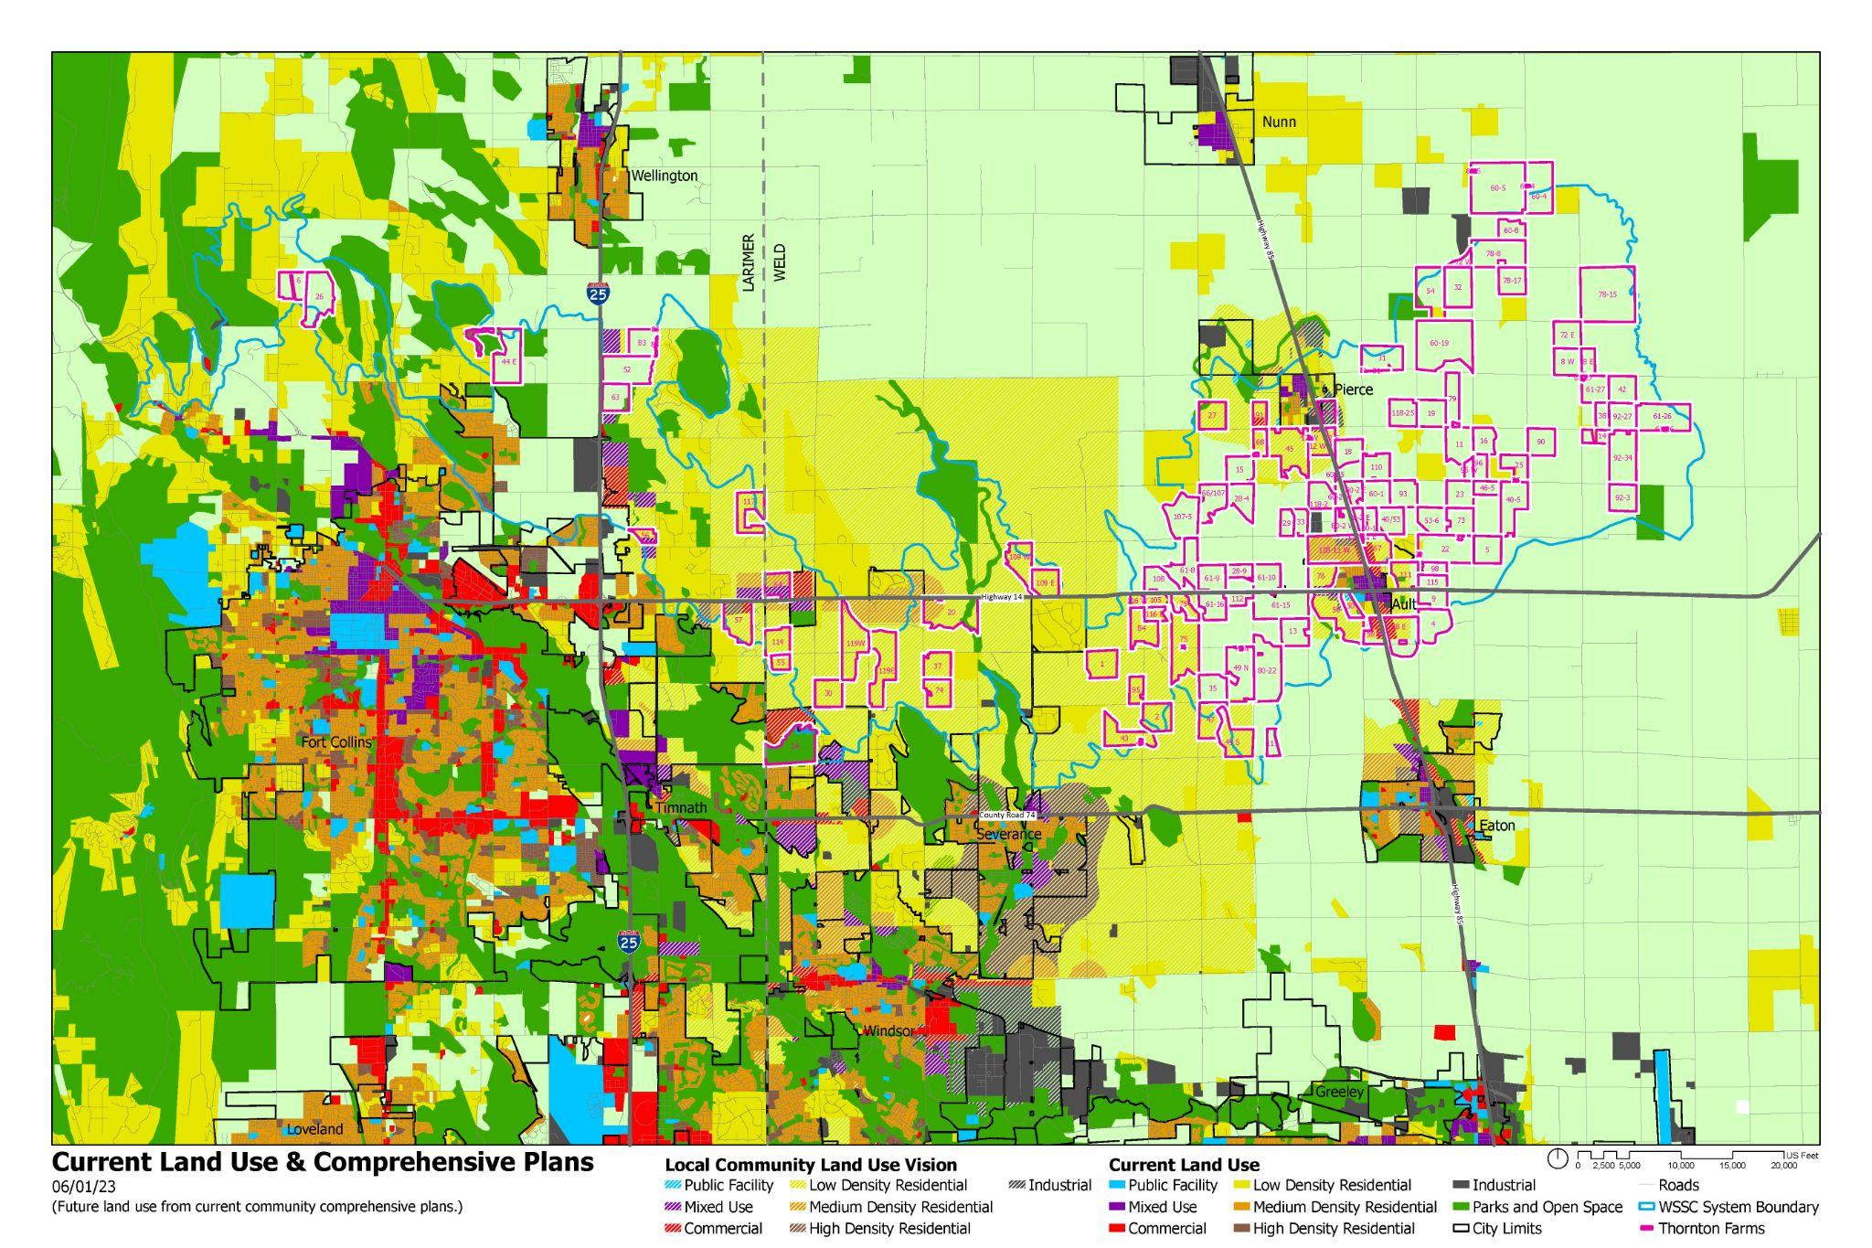
Land Use Analysis
Combination of Existing Land Uses and Combined Comprehensive Plans.
With input from Regional Working Group planning professionals regarding current development activities.

Slide 18
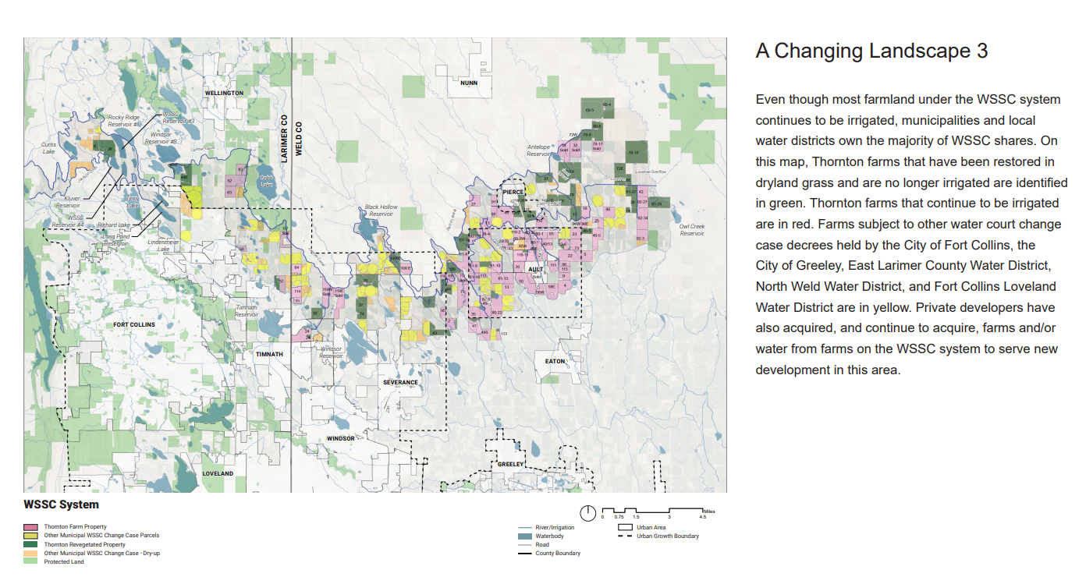
Water Optimization Study

Slide 19
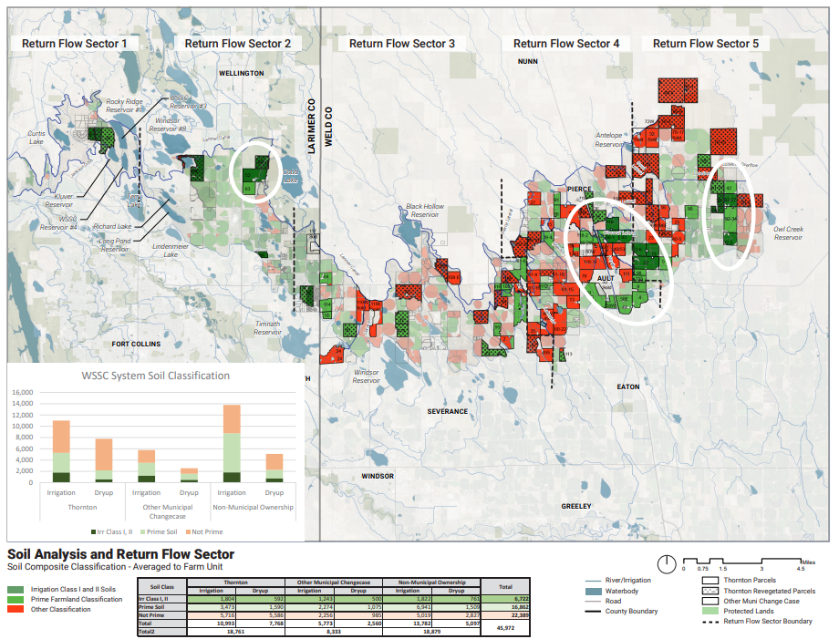
Water Optimization Study
Water Optimization Study Group
Keith Amen, Amen Farms , WSSC President
Brendan Boepple, Colorado Cattlemen’s Agricultural Land Trust
Nick Colglazier, Colorado Corn Administrative Committee
Carmen Farmer, Colorado Open Lands
Meegan Flenniken, Larimer County Natural Resources
Amber Graves, Morning Fresh Dairy
Cindy Lair, Department of Agriculture
Eric Reckentine, North Weld County Water District
George Wallace, Larimer County Agricultural Advisory Board
Richard Werner, Upstate Colorado Economic Development
Brad Wind, Northern Water
Susan Perez, City of Thornton
Matt Stockton, City of Thornton

Slide 20
Next Steps

Slide 21
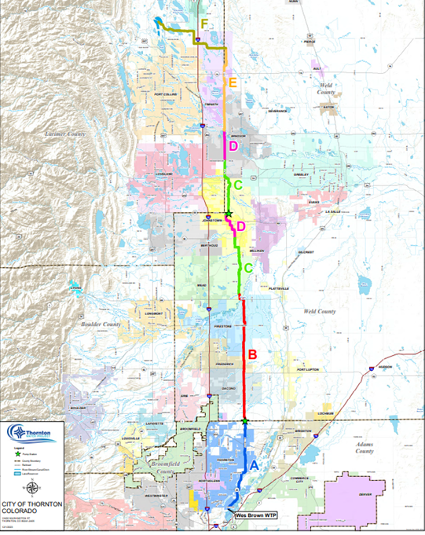
Thornton Water Project Update
F –1041 Permit Submitted November 2023
E – Design 95% complete- on hold pending Larimer County 1041
D – Complete
C – Start Construction mid-2024
B – Started Construction end of 2023
A – Start Construction early 2024
21

Slide 22
Larimer County 1041 Application
A different approach than 2018
Engagement with the Larimer Community first. Community feedback guided the design, location, and mitigation measures for the project.
one-on-one meetings and calls with local landowners and community stakeholders
two public informational open houses
additional input through community survey
22

Slide 23
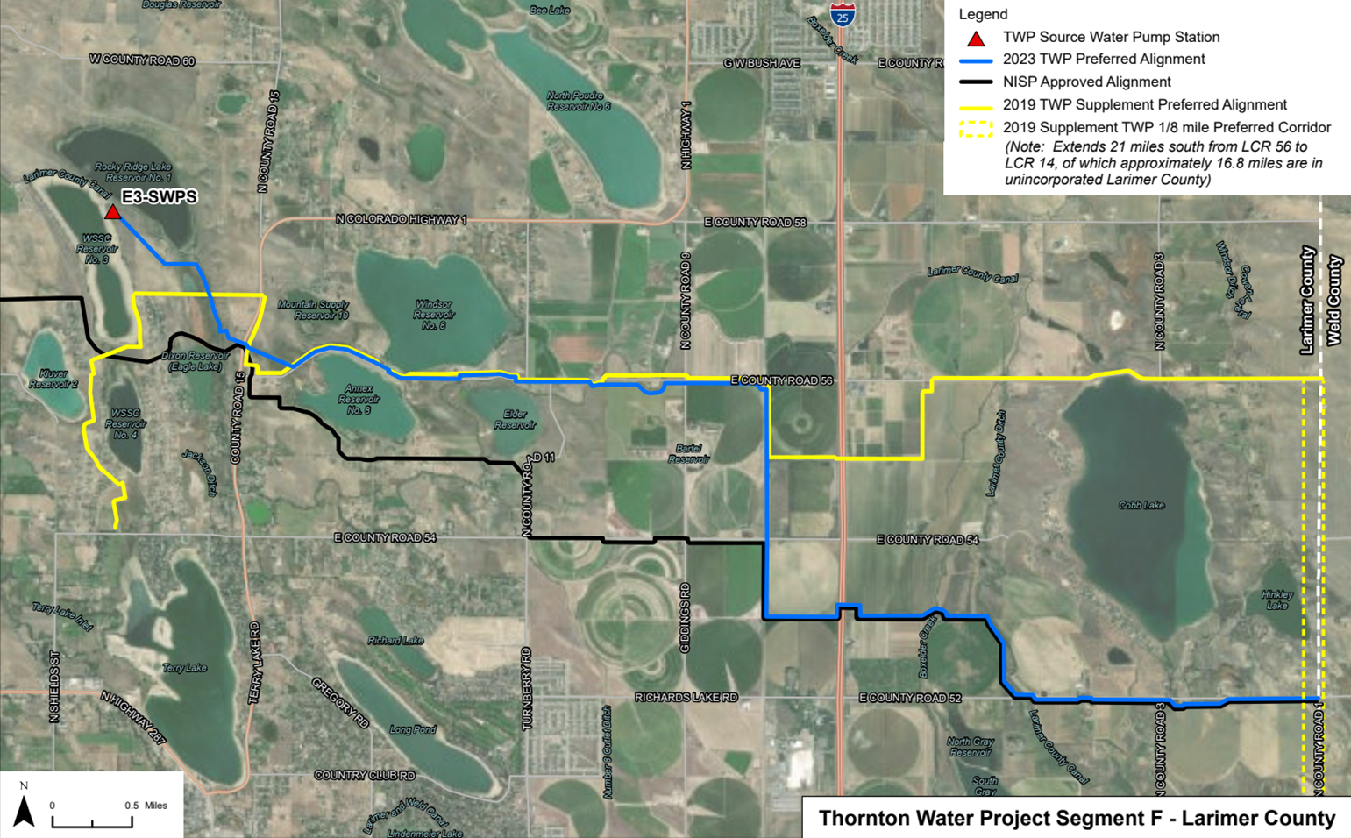
Larimer County 1041 Application
23

Slide 24
Larimer County 1041 Application Highlights
Source water pump station at WSSC Reservoir #3
42” buried raw water pipeline
10.4 miles in Larimer County
Pipeline will impact 22 properties
*1 owned by WSSC *1 owned by State Land Board
*2 owned by Thornton *1 owned by an HOA
*1 owned by Windsor Canal & Reservoir Company
*16 properties owned by 14 individuals
4.5 miles co-located with the Northern Integrated Supply Project
www.ThorntonWaterProject.com
24

Slide 25
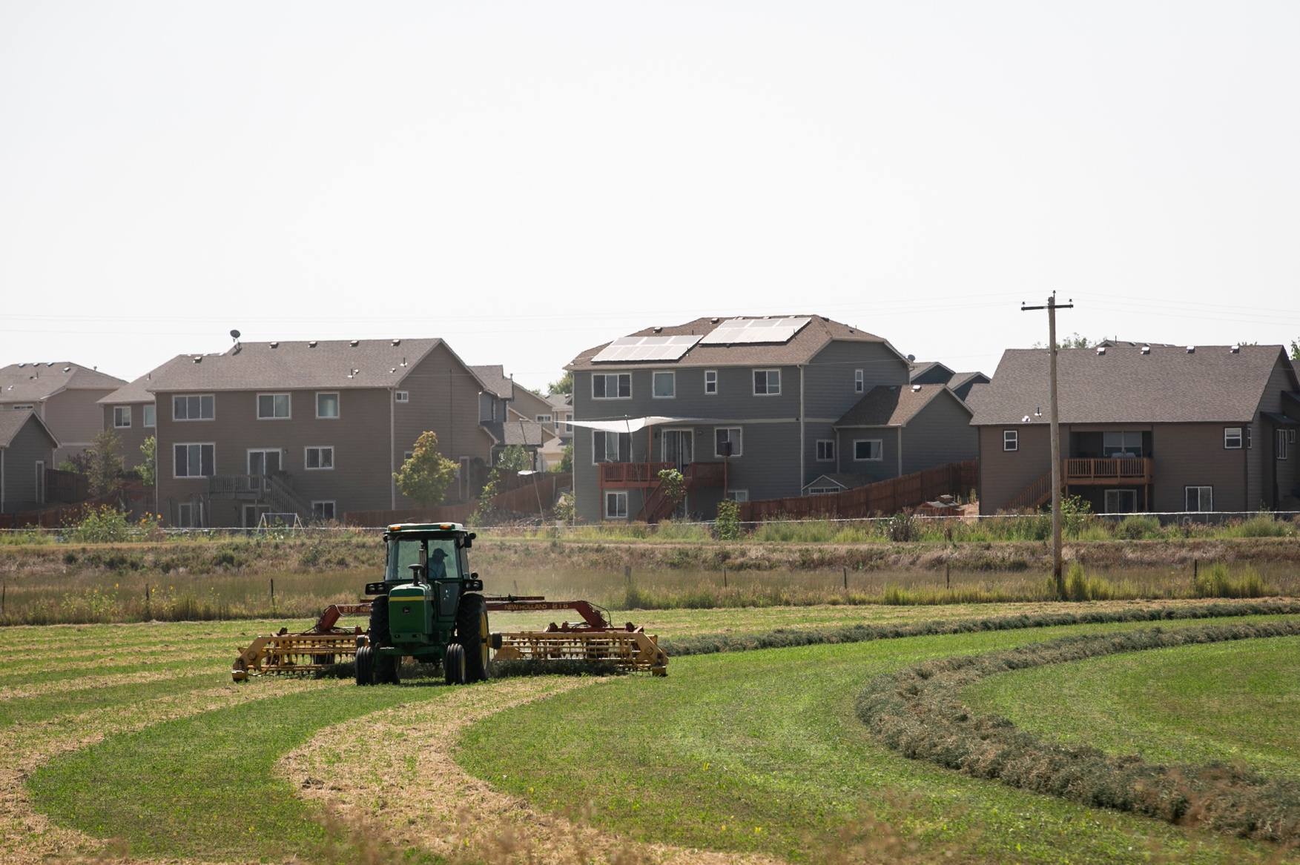
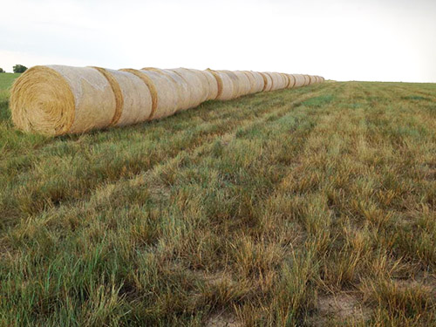
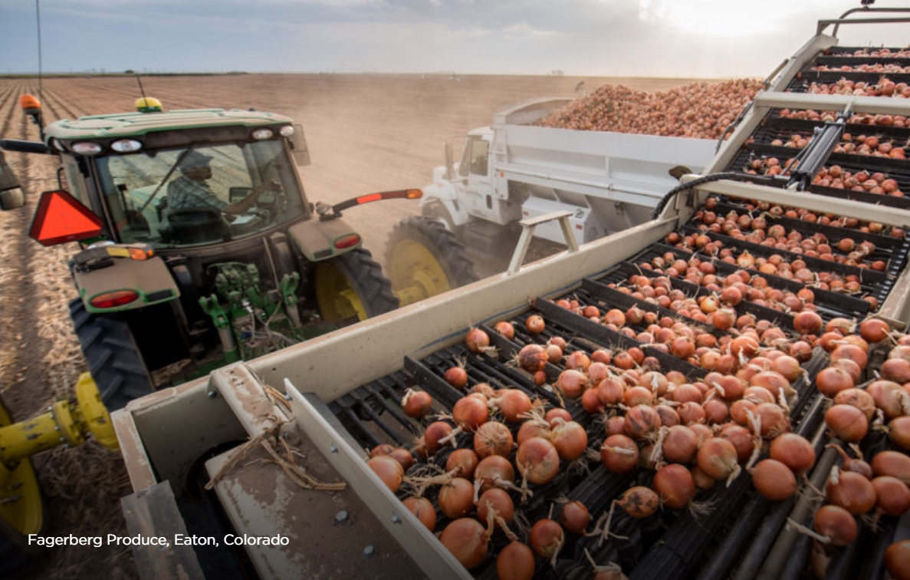
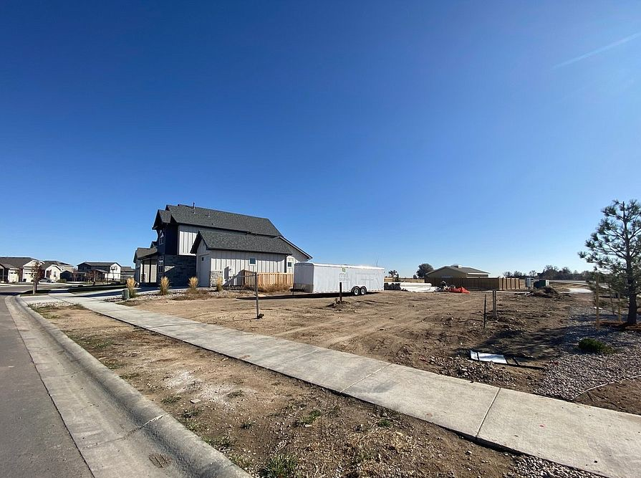
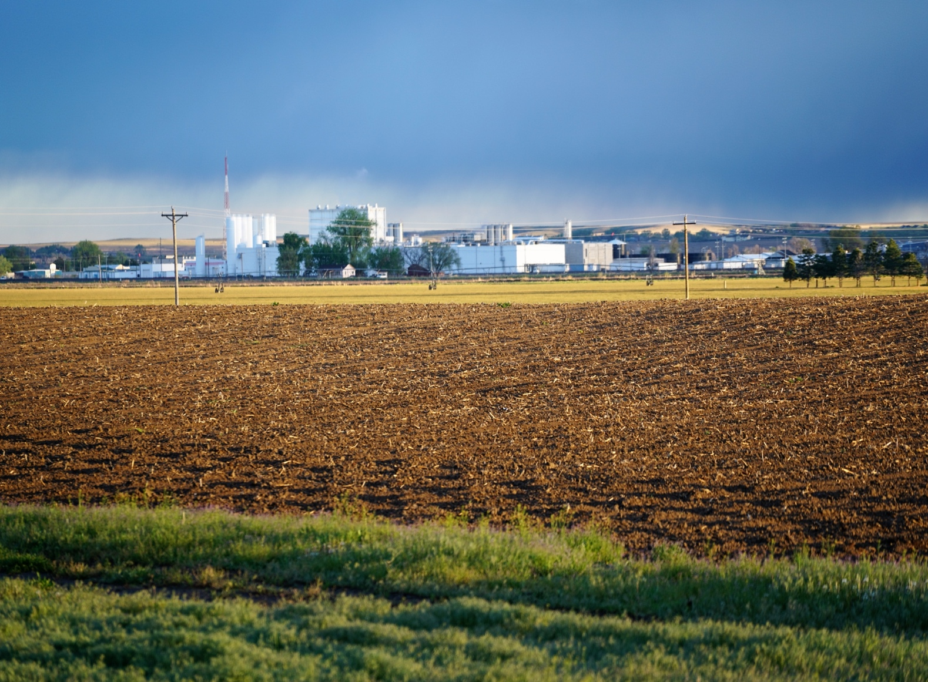
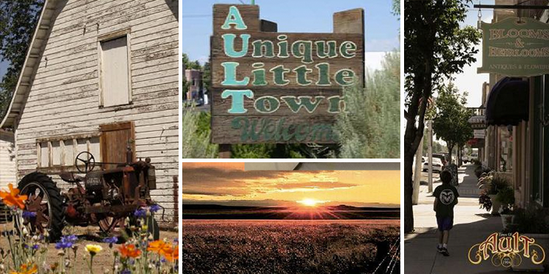
Wrap up

