Slide 1

South Platte Salinity Stakeholder Group
Water Literate Leaders
January 10, 2024
Karen Schlatter, Associate Director
Colorado Water Center
Notes:
Introduce self

Slide 2
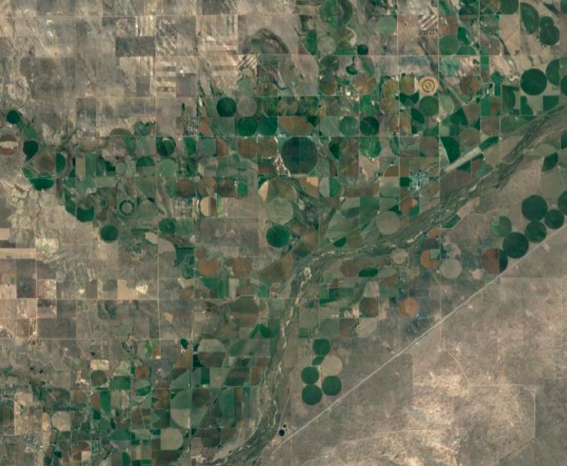
~700,000 acres of irrigated land
Ag lands account for
85% of water diversions
in the basin
Source: South Platte Basin Implementation Plan, Colorado Water Conservation Board
Notes:
South Platte tributaries and mainstem run through some of the most densely populated areas in Colorado, as well as largest concentration of irrigated agriculture with ~700K acres.
Irrigated agriculture accounts of 85% of water diversions in the basin – highest producing basin in CO in terms of value of products sold. Primarily corn, hay, wheat, some vegetable crops.
South Platte River basin also includes 70% of CO’s population – includes wastewater and stormwater discharge into the river.

Slide 3
Groundwater
Salinity
Average Total Dissolved Solids (TDS): ~1600-2000 mg/L
(USGS, Northern Water)
USGS (1987)
Northern Water (2006)
Slide credit: Dr. Timothy Gates, Oct 24, 2023

Slide 4
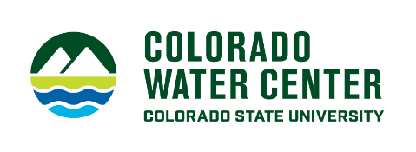
River Salinity
Average TDS
600 mg/L upstream of Denver
1300 mg/L near the CO-NE state line
(Neirbo 2020)

Slide 5
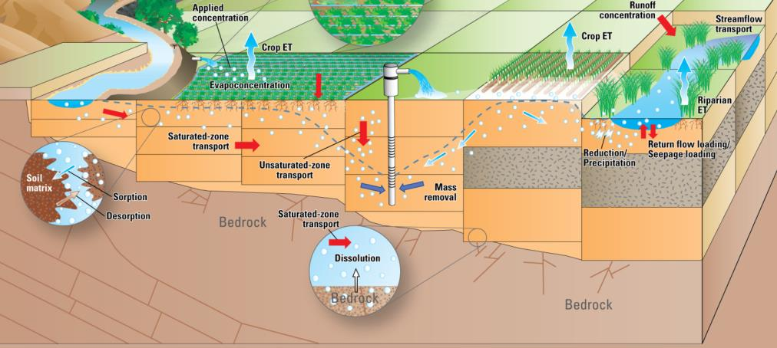
Salt Accumulation
Water and Land Degradation
Crop Yield Decline
Slide credit: Dr. Timothy Gates, Oct 24, 2023
Notes:
Water used and reused 7x in South Platte River Basin. Salts coming in from bedrock, also through treatment process in some municipalities, stormwater & deicing.
When used for irrigation, water evaporates, leaves salt in soil and they accumulate over time. Salts in groundwater – irrigate land, evaporate.
How will more efficient water use in ag impact salinity? Less water available for flushing salts from soil.
Some crops are less salt tolerant. Already can’t grow dry beans in NE CO due to salinity.

Slide 6
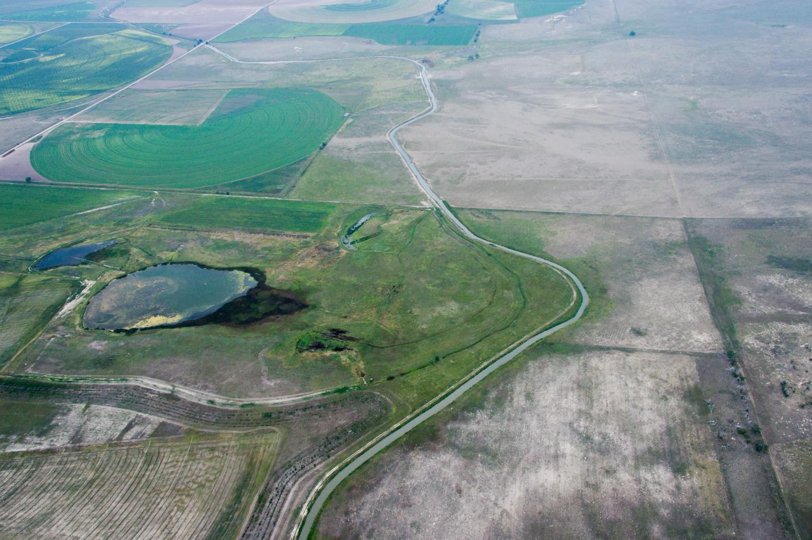
Growing Concern about Salinization of
Water and Land Resources in
the South Platte River Basin
Anecdotal Evidence
Intermittent and Limited Data
Notes:
Growing concern about salinization
Limited data
Sources, concentrations, loading, extent of problem and impacts

Slide 7
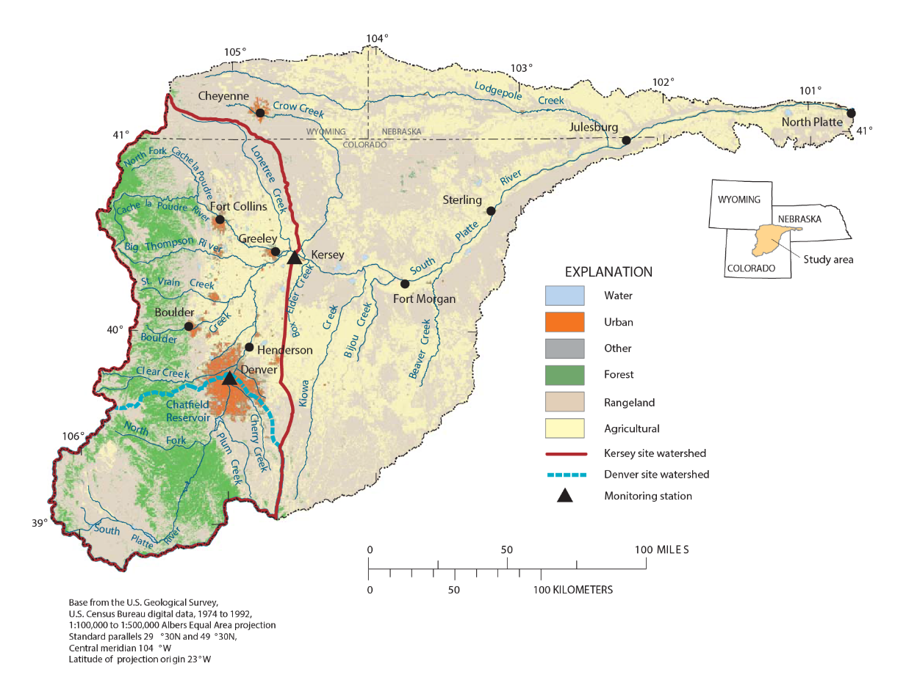
Background
South Platte Salinity Stakeholder Group formed in 2020
Recognized need for fostering collaboration and coordinated salinity research in the South Platte River Basin
Focus area: the South Platte River watershed from Waterton Canyon to the CO/NE state line (Julesburg)
Initially funded by a Colorado Water Conservation Board Water Supply Reserve Fund grant
Charter drafted in Dec. 2021
Roughly quarterly meetings
Facilitated by the Colorado Water Center with support from Northern Water staff
Image credit: https://www.usgs.gov/media/images/nawqa-south-platte-river-basin-study-area
1
Notes:
Image credit:
U.S. Geological Survey map of the South Platte River watershed that shows land use, urban centers, and key flow monitoring stations (triangles). Yellow stars added to show Waterton Canyon and Julesburg focus for stakeholder group

Slide 8



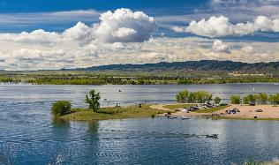
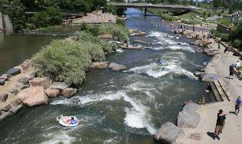
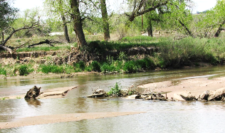
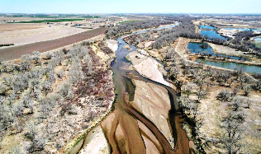
Goals
Bring together diverse stakeholders to discuss South Platte salinity concerns and needs
Guide ongoing and future South Platte salinity research based on stakeholder needs
Develop collaborative solutions
2
Notes:
Photo credits:
Chatfield State Park: https://www.outtherecolorado.com/category/6-things/chatfield-state-park-6-things-to-know-before-your-visit/article_5e0d86cd-c978-58d0-a961-7ffec9f2e1c7.html
Tubing in Denver: https://www.uncovercolorado.com/river-tubing-kayaking/south-platte-river/
South Platte near Evans: https://www.watereducationcolorado.org/fresh-water-news/is-the-south-platte-river-too-salty-new-study-to-examine-toxicity/
Fort Morgan: https://www.usnews.com/news/us/articles/2022-05-18/colorado-nebraska-jostle-over-water-rights-amid-drought

Slide 9
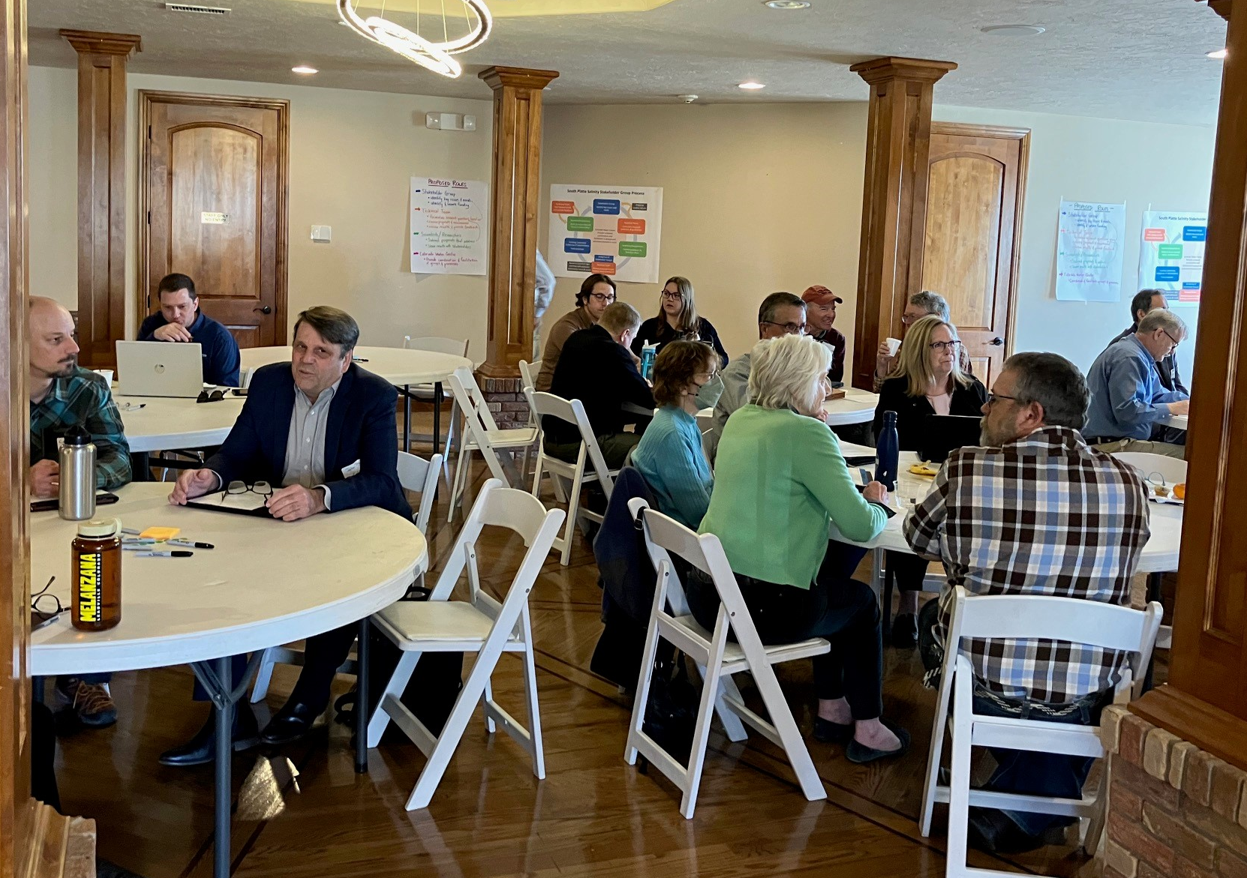
Stakeholders to date
Municipal
City of Aurora
City of Loveland
Denver Water
Metro Wastewater Reclamation District
Roxborough Water & San. District
South Metro Water Supply Authority
City of Thornton
Water Conservancy & Conservation Districts
Northern Water Conservancy District
Central Colorado Water Conservancy District
Lower South Platte Water Conservancy District
St. Vrain and Left Hand Water Conservancy District
Agriculture
Colorado Corn
Larimer and Weld Irrigation
New Cache Ditch Co.
North Sterling Irrigation District
Colorado Ag Water Alliance
Brink Inc.
Government
CDPHE
NRCS
CO Dept. of Ag.
DWR
USGS
Research
Colorado Geological Society
Colorado State University
NEIRBO Hydrogeology
Nonprofit
Colorado Watershed Assembly
Ducks Unlimited
(as of Jan 2024)
3

Slide 10
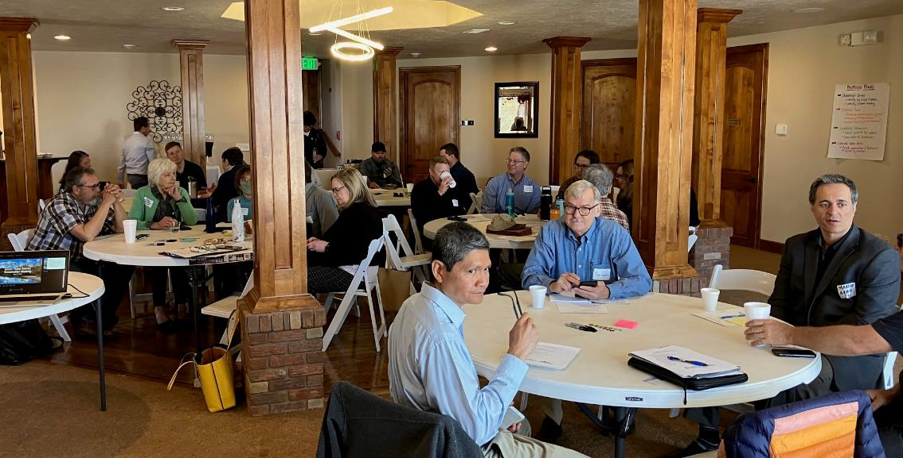
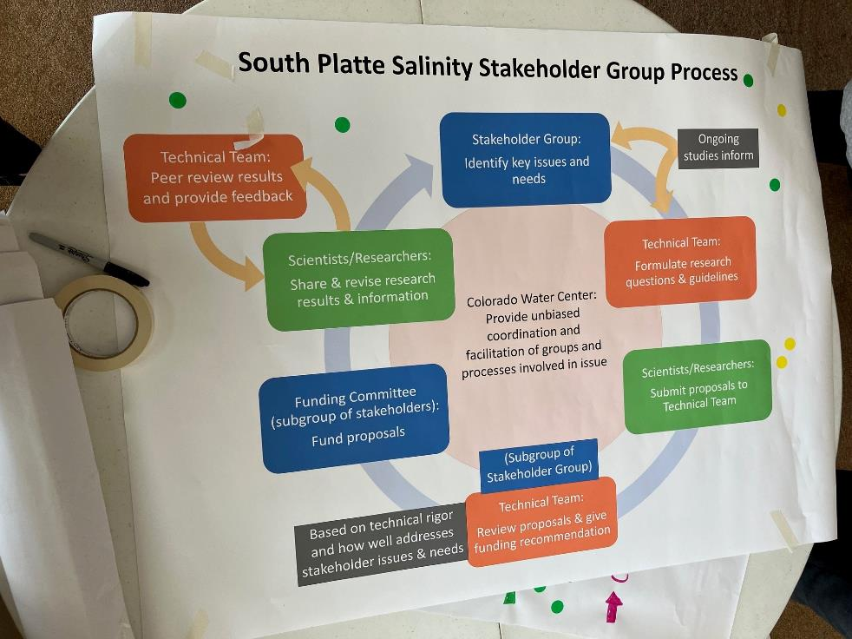
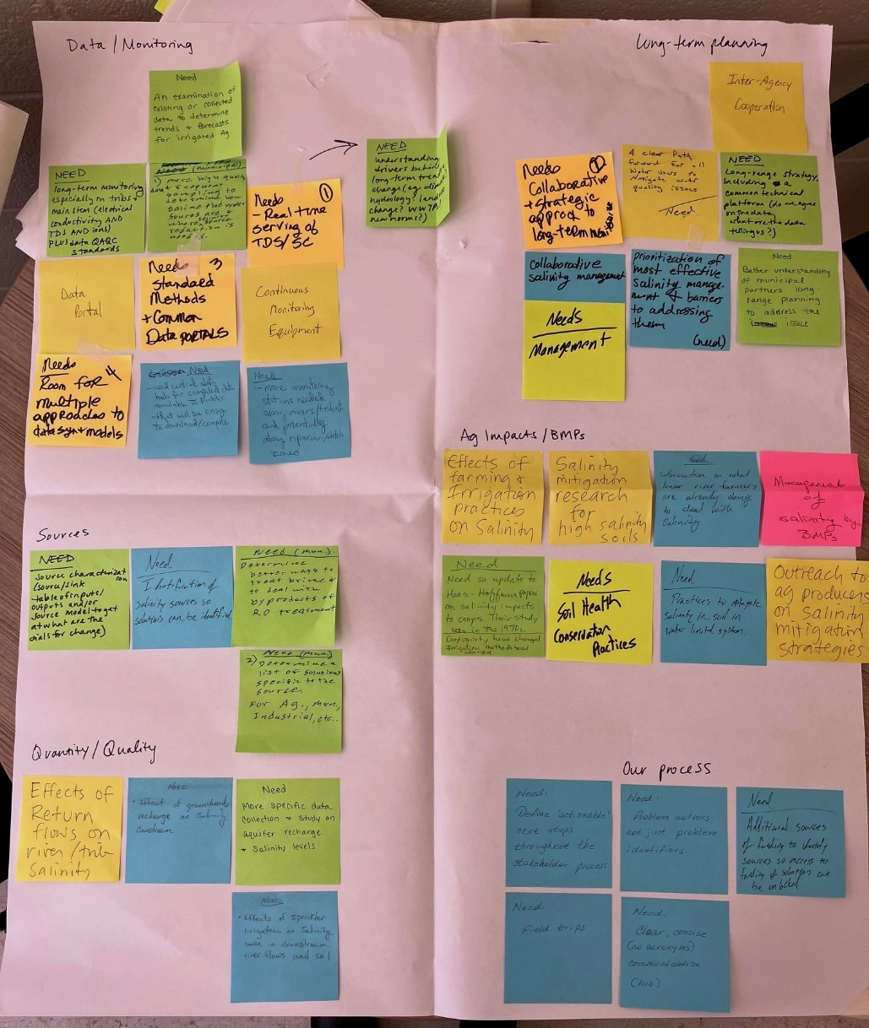
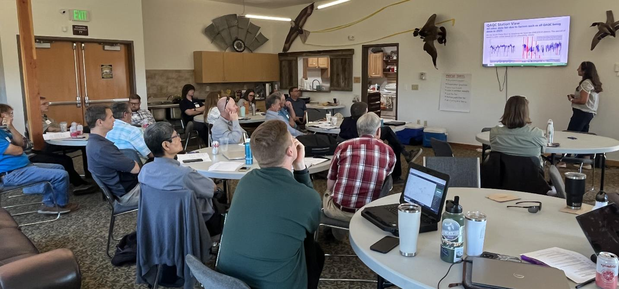
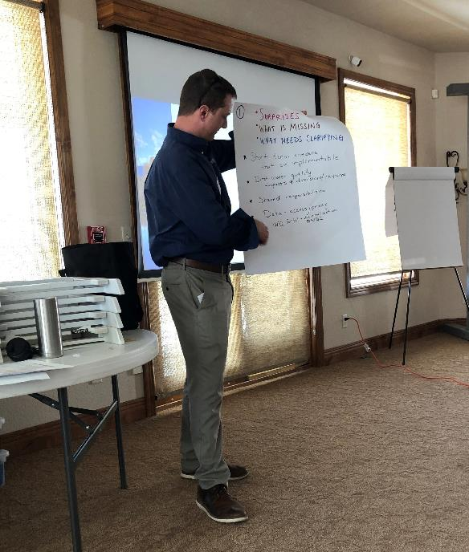
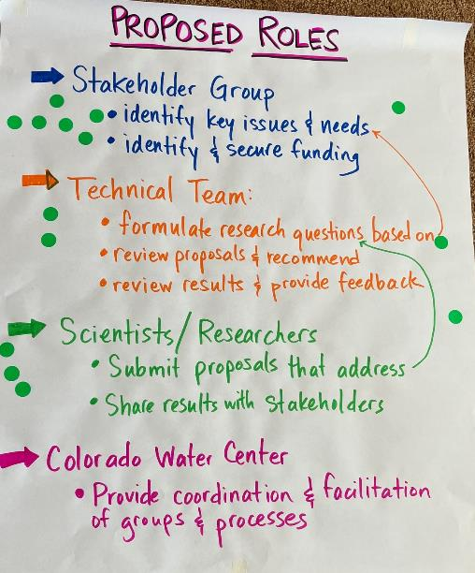
Notes:
Focused on shared and transparent process and set stakeholder roles and expectations.
Identified stakeholder concerns and needs, those turned into research questions.
These research questions will guide proposals and proposal funding in the future.
Will support research that is relevant to the stakeholders and going to address their concerns and needs.
With additional research on characterization of the salinity issues, will be able to then identify effective mitigation strategies based on the source and trends.
Current proposed research: additional data collection on sources, sinks, loads. Proposal for salinity modeling in basin to assess interaction of land and water management with salinity.
Also municipalities are considering different water treatment options – reverse osmosis as well as ion exchange based advanced treatment process (less brine produced, costly).

Slide 11

South Platte Salinity
Stakeholder Group Process
Stakeholder Group:
Identify key issues and needs
Technical Team:
Formulate research questions & guidelines
Scientists/Researchers:
Submit proposals to Technical Team
Technical Team:
Review proposals & give funding recommendation
Funding Committee (subgroup of stakeholders):
Fund proposals
Scientists/Researchers:
Share & revise research results & information
Ongoing studies inform
Technical Team:
Peer review results and provide feedback
Colorado Water Center:
Provide unbiased coordination and facilitation of groups and processes involved in issue
(Subgroup of Stakeholder Group)
Based on technical rigor and how well addresses stakeholder issues & needs
Notes:
Process agreed upon by stakeholders spring 2023
It is iterative – continue to identify new issues and next steps as results come in.

Slide 12
South Platte Salinity Concerns & Needs
Pressures
Impacts
Needs
Policy
Salinity is non-regulated, external water demands (NE)
Physical
Soil/plant health, aquatic life, taste & odor, corrosion, groundwater quality, complexity of treatment
Process
Broad engagement, resolving conflict, getting beyond special interests, problem definition
Hydrology
Surface water/groundwater, spatio-temporal variation in source water
Water rights
Quantity prioritized over quality
Economic
Crop and forage yield
Cost of treatment
Data/Monitoring
Transparency, consistency, data quality, long-term plan, continuous
Problem characterization
Source studies; extent and severity of salinity-related issues
Future
Climate change, water projects, increasing water demand
Social-Cultural
Ag community, Public concern with drinking water quality, Public education, hearsay/perception
Modeling
Identify levers for change
Solutions
Mitigation strategies: ag BMPs, cost-effective treatment
Notes:
Overview of stakeholder concerns & needs activities – won’t go into all of the detail on this.
Technical team turned these into research questions

Slide 13
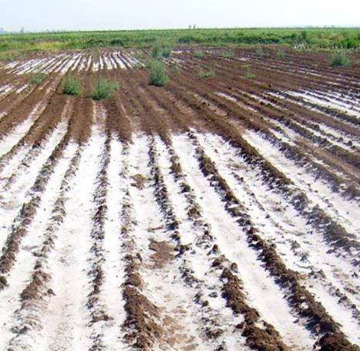
Question 1: Sinks, Sources, and Distribution
Research Questions
What are the sources of salinity and what are the concentrations/loads in the watershed (Waterton Canyon to the state line): spatial, temporal, amounts, constituents?
1a. Where are the hydrologic inputs and outputs of the watershed?
1b. How does salt accumulate over time and where does it go (load & trends)?
This Photo by Unknown author is licensed under CC BY-NC.

Slide 14
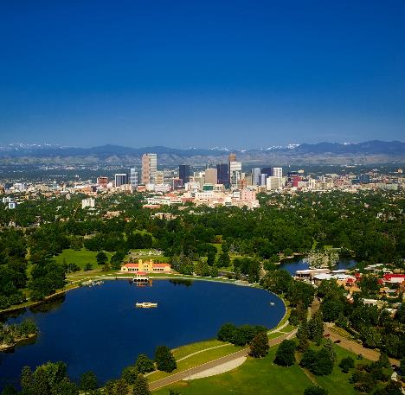
Question 2: Effects of water and land management
Research Questions
What is the interaction of water and land management with sources and concentrations/loads?
2a. What are the effects of agriculture and irrigation practices on salinity?
2b. What are the effects of municipal and industrial water use & treatment on salinity?

Slide 15
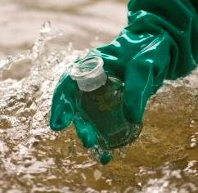
Question 3: Quantifying Impacts
Research Questions
What are the impacts of salinity?
3a. Is salinity currently a problem and for whom? (municipal, agriculture, ecosystem (microbiome, aquatic invertebrates))? Where?
3b. Will salinity be a problem in the future and for whom? Where and when?
3c. What are the short-term and long-term salinity implications for species, groundwater, agriculture, municipalities, other states?
This Photo by Unknown author is licensed under CC BY-SA-NC.

Slide 16
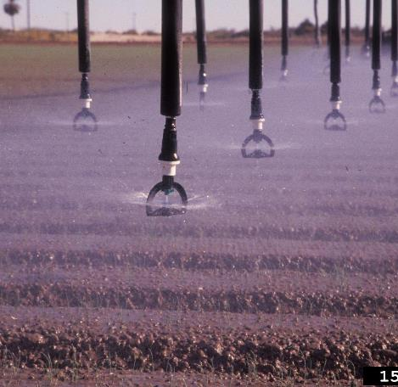
Question 4: Identifying Mitigation Strategies
Research Questions
By source, what are feasible and effective mitigation and management strategies to address salinity?
This Photo by Unknown author is licensed under CC BY-NC.

