Slide 1
Efficiency in Irrigated Agriculture
Does It Save Water?
April 27, 2023
Joel P. Schneekloth
Regional Water Resources Specialist
Colorado Water Center and Extension

Slide 2
Agriculture in the South Platte Basin
Agriculture uses approximately 86% of the water in the South Platte Basin.
5 of the top 10 counties are within the South Platte Basin ($3.5 billion)
854,000 irrigated acres
80% of Colorado’s population
South Platte is net water short
Can increase efficiency help solve the problem?

Slide 3
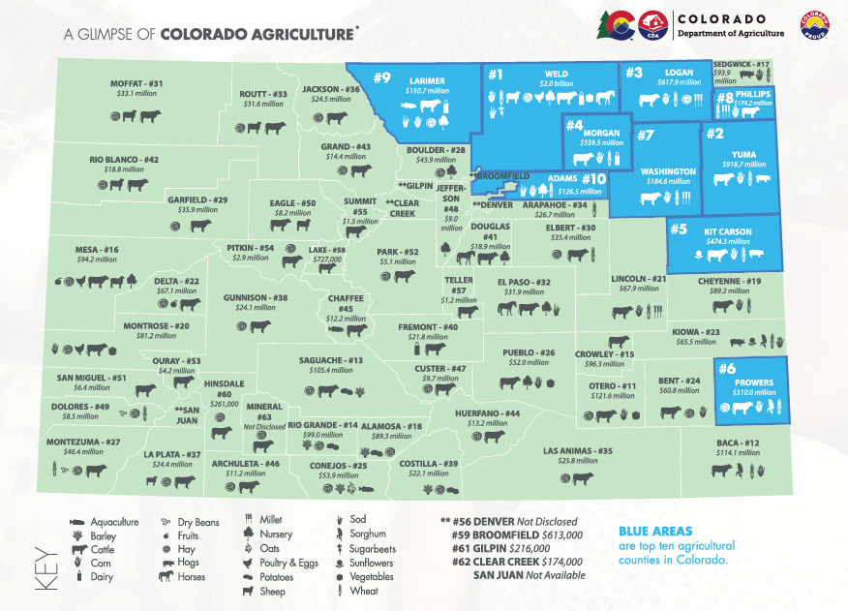
Of the top 20 counties in Colorado
15 – Eastern Plains
3 – San Luis Valley
2 – Western Slope

Slide 4
South Platte River
Prior to development
Raging river from snow melt
Dry during summer due to lack of snow melt
Beginning of development
Development of irrigation
Near river as well as ditches farther from the river
River began to flow more consistently in summer in regions
Leads to more irrigation development
Increased Storage in the Alluvial Aquifer
Rivers are a drainage system for the basin

Slide 5
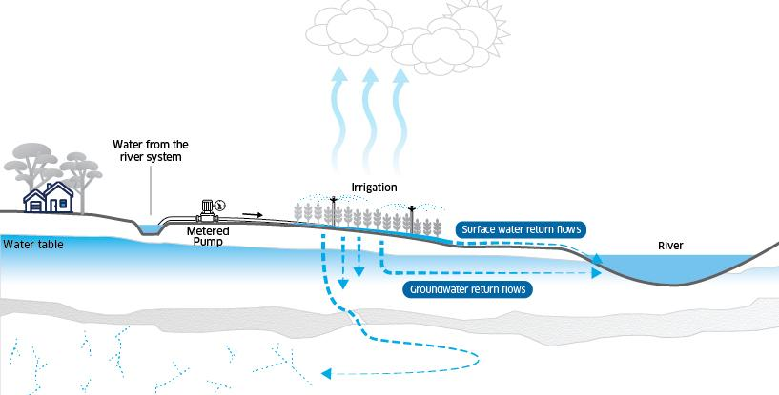
Source: Murry-Darling Basin

Slide 6
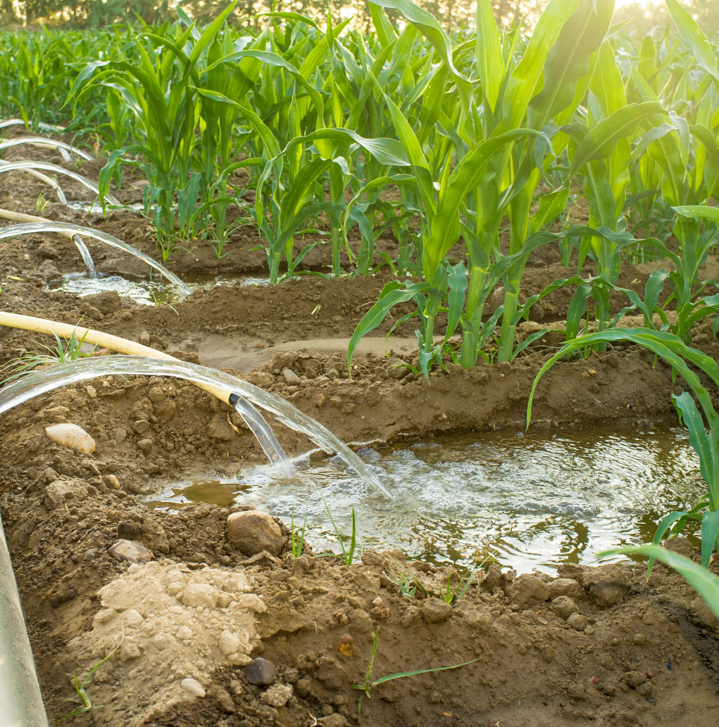
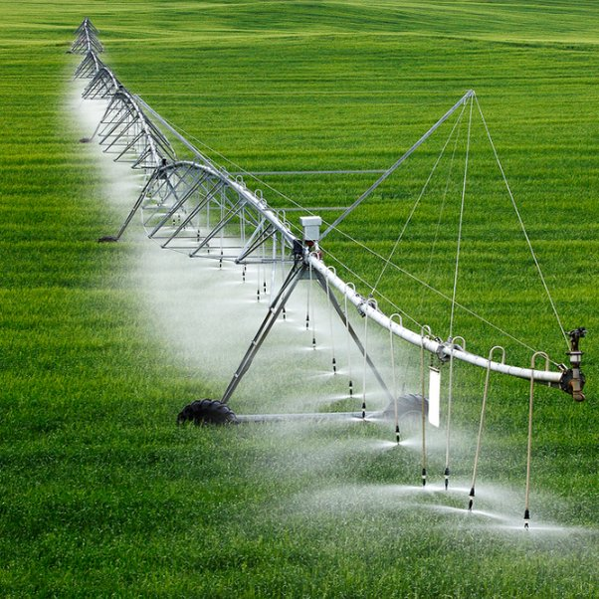
Furrow Irrigation Center Pivot

Slide 7
Water Use in a Water Short Environment
Water Conservation Irrigation Efficiency Actual Consumptive Water Use How does efficiency impact stream flows?

Slide 8
How the river works
20 cfs 15 cfs 10 cfs 5 cfs
5 cfs 5 cfs 5 cfs
10 cfs 5 cfs 0 cfs 0 cfs
5 cfs 5 cfs ? cfs
Senior water rights – shut off junior rights to get his water

Slide 9
How the river works
10 cfs 8 cfs 6 cfs 4 cfs
5 cfs 5 cfs 5 cfs
3 cfs return
3 cfs return
3 cfs return
10 cfs 7 cfs 4 cfs 1 cfs
3 cfs 3 cfs 3 cfs

Slide 10
How the river works
Low Efficiency
20 cfs 18 cfs 16 cfs 14 cfs
5 cfs 5 cfs 5 cfs
3 cfs return
3 cfs return
3 cfs return
High Efficiency
20 cfs 17 cfs 14 cfs 11 cfs
3 cfs 3 cfs 3 cfs

Slide 11
Return Flows
Return flows are what built irrigation within the basin
Stabilized flows during the summer when flows were low
Retiming of water to low flow times
Water Supply
1.4 million acre-ft of native water supplies
0.4 million acre-ft of trans basin diversion
Annual diversions on South Platte
4 million acre-ft

Slide 12
Efficiency – On Farm vs Basin
On Farm Efficiency has many benefits
Greater yields
Reduced leaching of nutrients
Labor savings vs furrow irrigation
Downfall
Reduced return flows into system
Need for greater storage
Expensive
Greater issues with salinity
As changes to greater efficiency happen, changes to the system will need to be made
Storage

Slide 13
The Consumptive Use Conundrum: Economics vs Water Savings
Questions?

