Slide 1
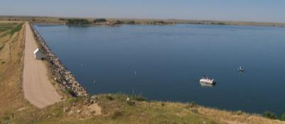
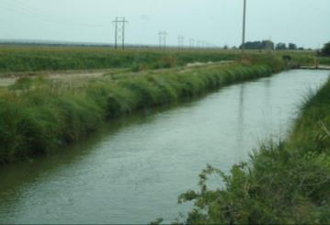
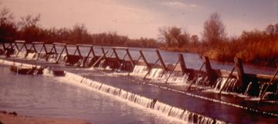
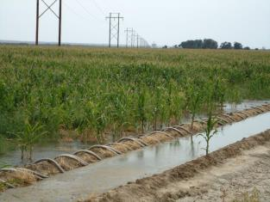
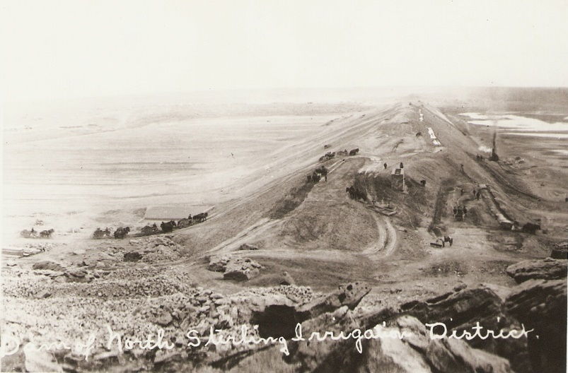
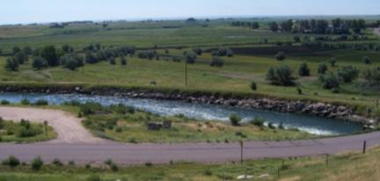
Water Literate Leaders
Overview of Ag in the South Platte
Jim Yahn
January 10, 2024

Slide 2
South Platte River

Slide 3
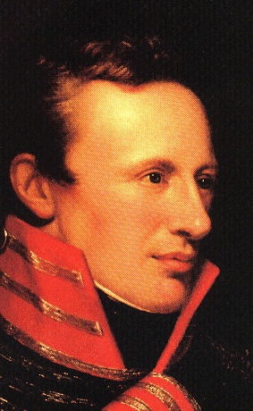
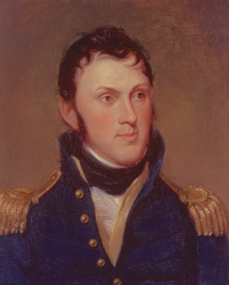
Lt. Zebullon Pike
Major Stephen Long
“these vast plains of the western hemisphere may become in time equally celebrated with the sandy deserts of Africa.” - 1806
“a barren region unfit for the habitation of civilized man.” - 1820
Notes:
Another explorer, Major Stephen Long explored this area around 1820. Major Stephen H. Long of the U.S. Army Engineers was the leader of the first scientific exploration up the Platte River. His party included several scientists who studied the geography and natural resources of the area. Eventually, Long became one of the most prolific explorers covering 26,000 miles in five expeditions.
Long called this area “a barren region unfit for the habitation of civilized man.” In his report of the 1820 expedition, Long wrote that the Plains from Nebraska to Oklahoma were "unfit for cultivation and of course uninhabitable by a people depending upon agriculture."

Slide 5
South Platte River Agricultural Development
Direct Ditch Systems
Reservoir Systems
Transbasin Diversion Projects
Well Development
Augmentation Plans

Slide 6
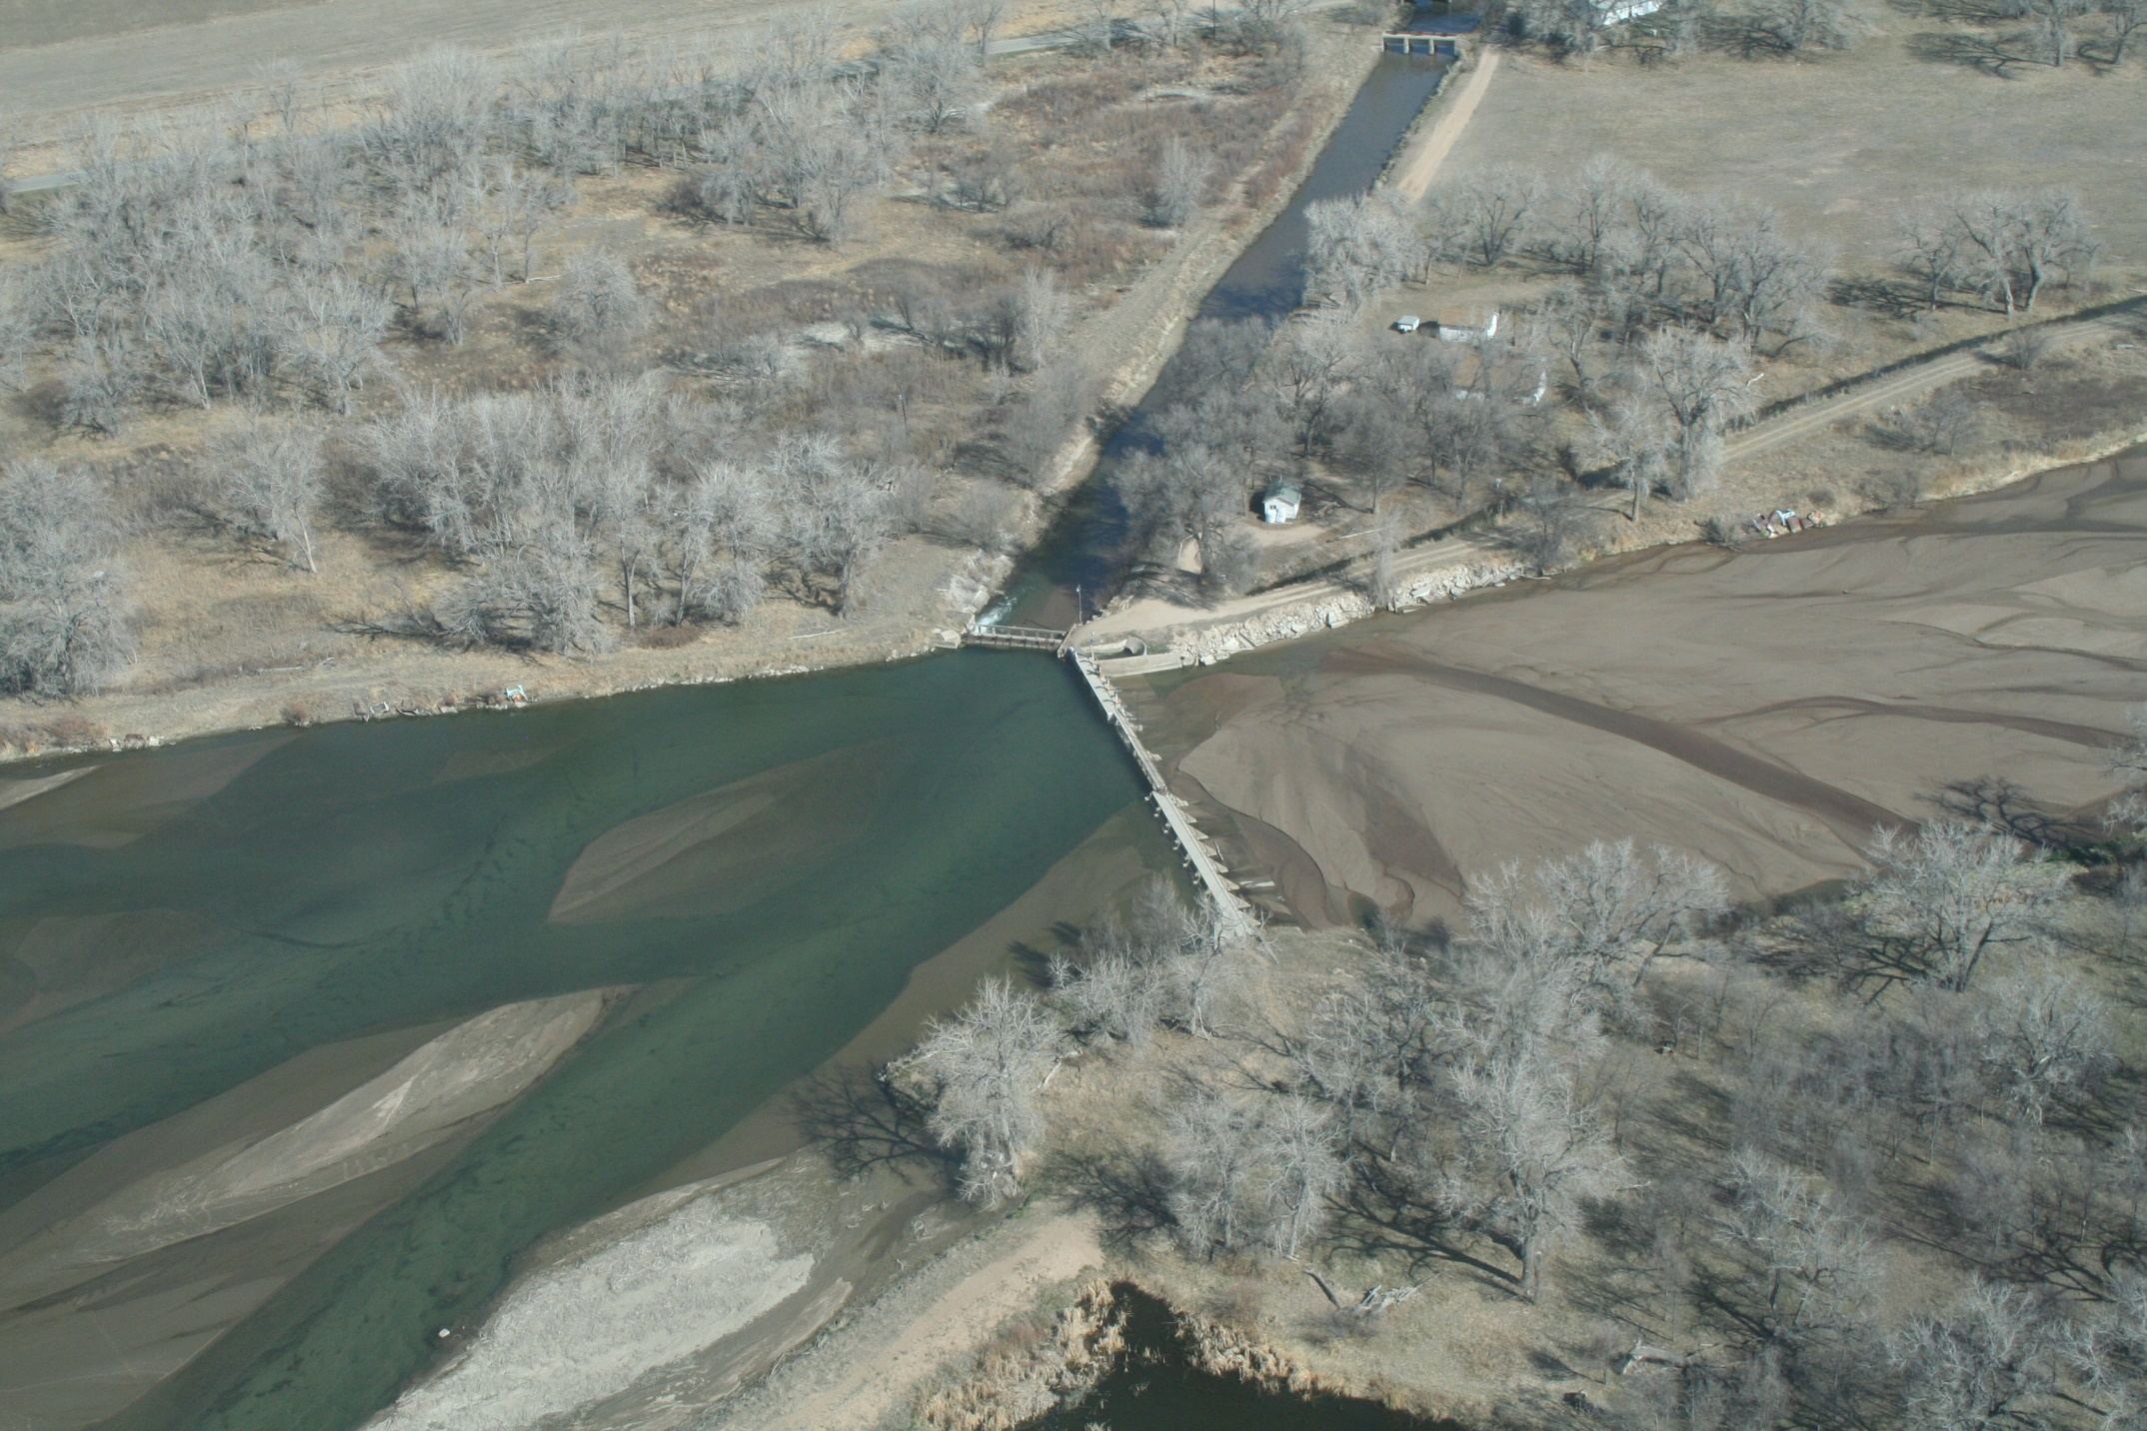

Slide 7
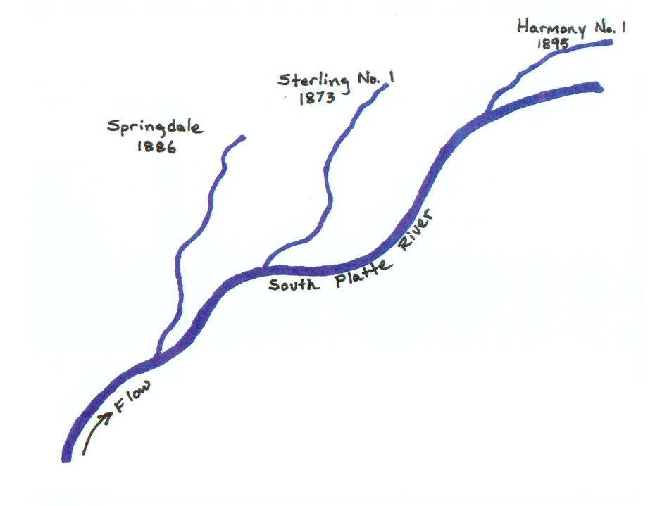
Ditch Development
and Administration

Slide 8
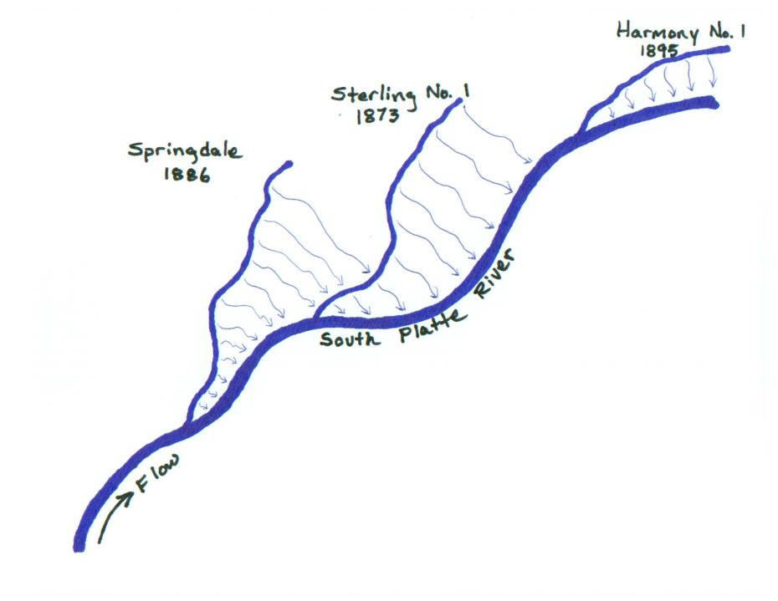
Historic Return Flows

Slide 9
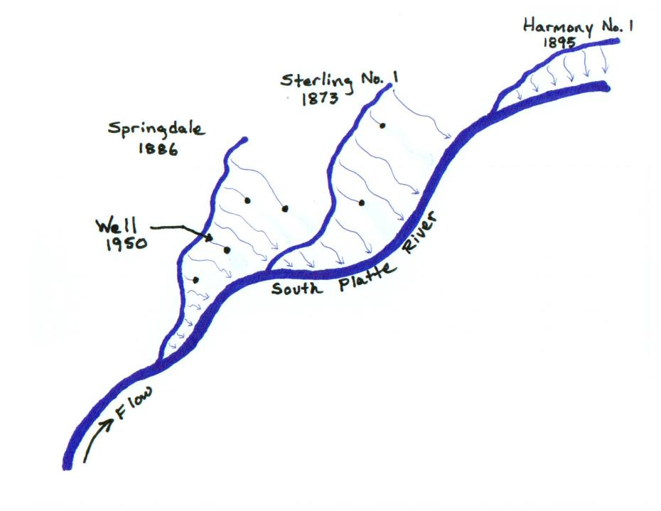
Intercepted Return Flows

Slide 10
Return Flows and Accretions
Ditch/Field Seepage
Return Flow
(Accretion)
Stream
Alluvial Aquifer
Ditch, Reservoir and on-farm seepage fill up the aquifer which slowly makes its way back to river.
The volume released to the river is the “return flow ”.

Slide 11
Pumping and Depletions
Depletion
Stream
Well
Alluvial Aquifer
An alluvial well used, typically, for irrigation.
Pumping “depletes” or “intercepts return flows” which impacts river flow.

Slide 12
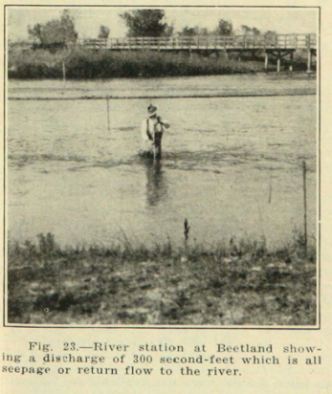
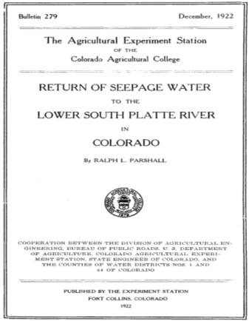
Ralph Parshall in 1922
Return of Seepage Water to the Lower South Platte River in Colorado
Ralph Parshall (Colorado Ag. College now Colorado State University) December, 1922.

Slide 13
Ralph Parshall in 1922
The Phenomenon of Return Waters
Return flows were increasing over time and continued to increase, mostly due to the general rise of the water-table over greater areas.
The water table has risen each year (since the early stages of irrigation development) as much as 100 feet in some areas.
Return flows varied from 2 to 8 ½ second-foot per mile and averaged 5 ¼ second-foot per mile.
The diversions from the river after the spring floods have subsided are practically all from seepage or return water, and only during summer floods or freshets is the river flow increased.

Slide 14
Nature of return flows in the South Platte
“The flow was excessive in May and June and disappeared entirely during the summer. The river frequently became dry for months of each year to points as far west as the present city of Fort Morgan.” – Prior to surface irrigation.
“The flow of return and seepage waters coming back to the river from irrigation of Colorado lands, has resulted in a constant supply at the interstate line.”
– After surface irrigation development.
“This flow is increasing and will soon be sufficient to care for the full demands of Nebraska as determined by the compact, while great quantities of water annually flow to waste across the interstate line, during the flood season and winter months…………………………….”
“ The once “disappearing” flood stream has been converted into one of constant flow making possible the development in both states.”
Delph Carpenter, 1925 letter to CO Governor

Slide 15
The Water Problem
Ralph Parshall’s address to Ft. Collins Rotary Club
August 29th, 1956
Several issues impacting the dwindling river and hydrologic conditions.
Return flows have been investigated since the early 1880s and these past records strongly indicated a steady increase in the return flow to the river.
In 1956 it was found that seepage return was practically nil.
Partly due in the fact, that between Kersey and Julesburg, more than 4000 irrigation wells pumped to deliver enough water to fill Horsetooth Reservoir four times during the season of 1955 (584,000 ac-ft).
Appeared obvious that we cannot continue depleting the underground reservoir at that rate.

Slide 16
 | 1950 |  | 1955 |  | 1960 |  | 1965 |  | 1970 |  | 1975 |  | 1980 |  | 1985 |  | 1990 |  | 1995 |  | 2000 |  | 2005
South Platte Conjunctive Use Administration
1969 Water Rights Determination Act
Operation of Large Temporary Replacement Plans
Operation of New
Permanent Decreed Replacement Plans
1957 Colorado Ground Water Law
1953 Underground Water Act
1967 Senate Bill 407
1974
Amendments to 1969 Act
1965 Colorado Ground Water Management Act
Early Decrees for Augmentation and Recharge
1968 Supreme Court Fellhauer Case
Empire Lodge Case Ruling 2002
House Bill 02-1414 and Senate Bill 03-73

Slide 17
Augmentation Plan
Service Areas

Slide 18
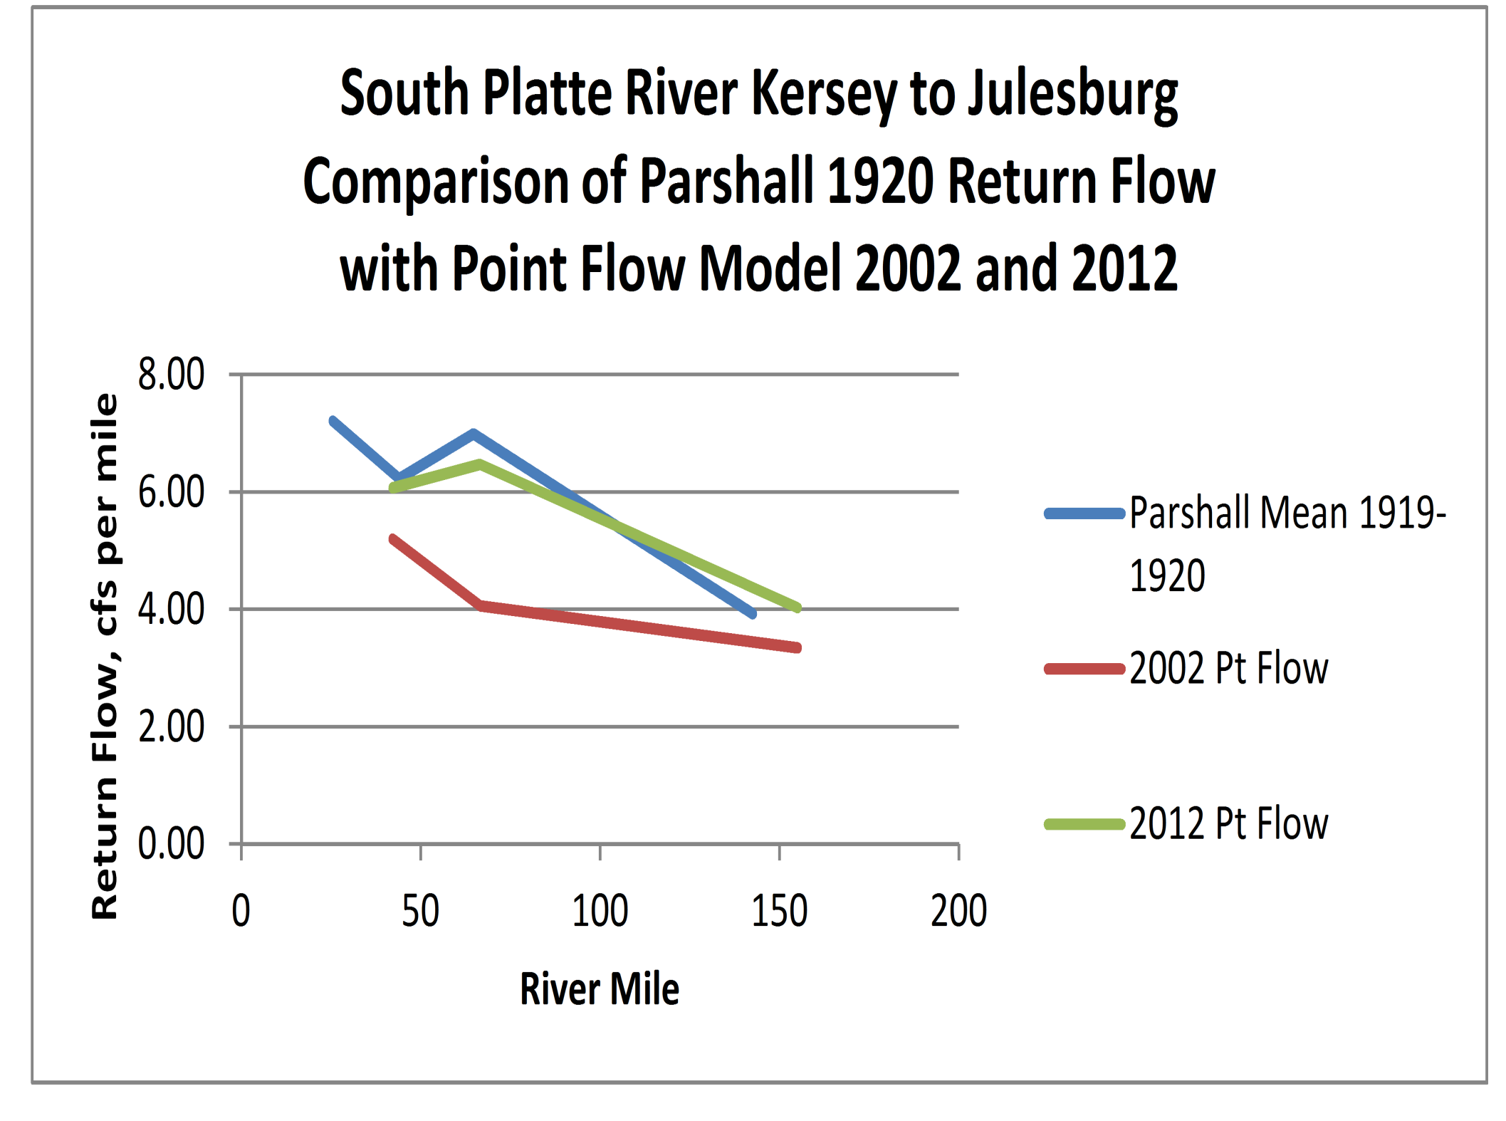

Slide 19
Average Supply
1.4 million AF annual native flow for total basin
400,000 AF generated from transbasin projects
30,000 AF Non-tributary groundwater
Average Diversions
500,000 AF tributary groundwater
4 MAF total annual surface water diversions
Average Outflow
300,000 AF to Nebraska
Notes:
Today the South Platte River Basin consists of a complex and diverse system of ditch and reservoir systems along with groundwater well pumping and augmentation efforts.
Top map - Each of the different color represents the service area of one particular ditch or reservoir system and the white (lighter) background colors represent lands irrigated in 2005.
Bottom Map – Decreed Augmentation Plans in the Lower South Platte as of June, 2007.

Slide 21
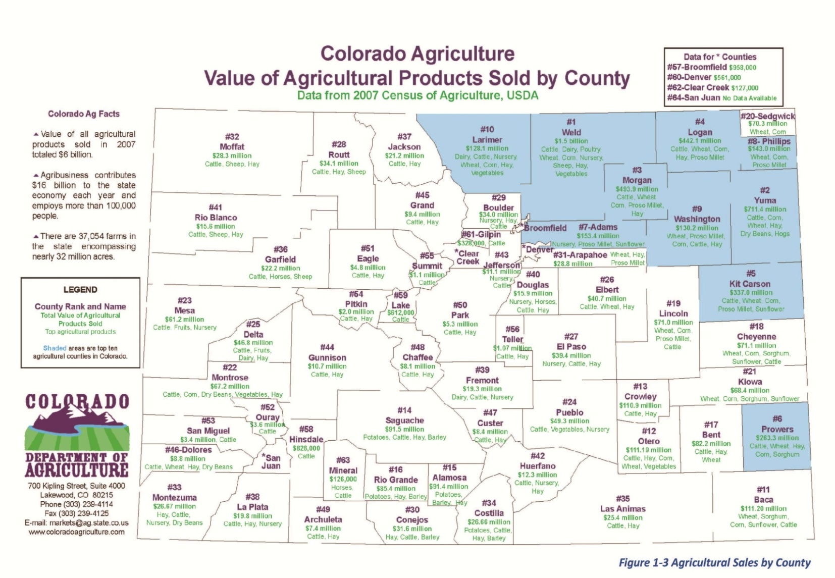
Irrigated Agriculture
South Platte Basin: Approx. 831,000 irrigated acres (SWSI 2010)
Republican Basin: Approx. 550,000 irrigated acres (SWSI 2010)
40% of Colorado’s Irrigated land
South Platte 379,000 AF Avg. Annual Ag. Gap (SWSI 2010)
Republican 200,000 AF Avg. Annual Ag. Gap (SWSI 2010)

Slide 22
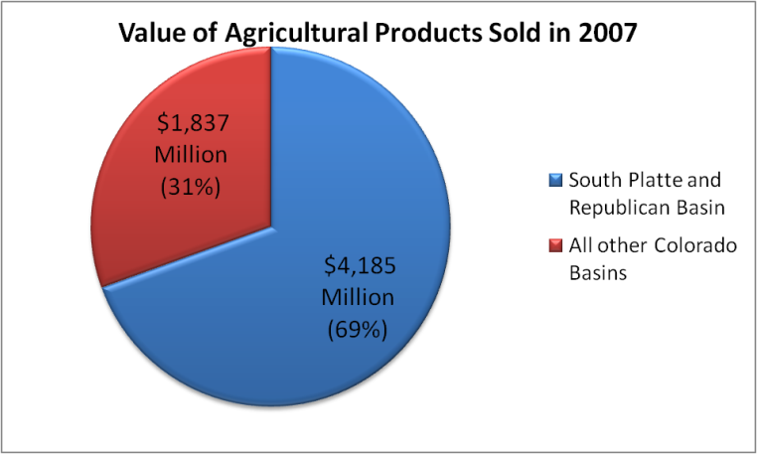
South Platte Basin Agricultural Production
Notes:
Todd

Slide 23
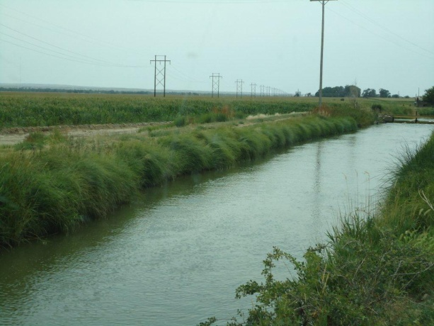
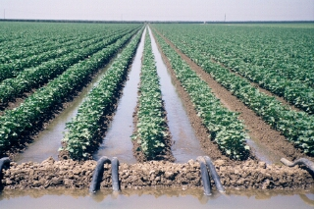
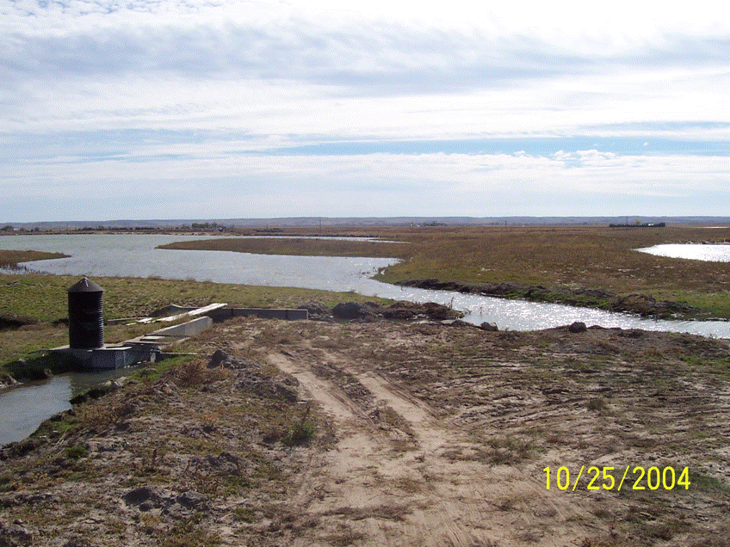
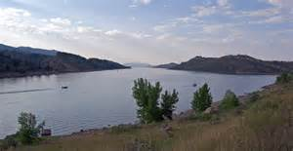
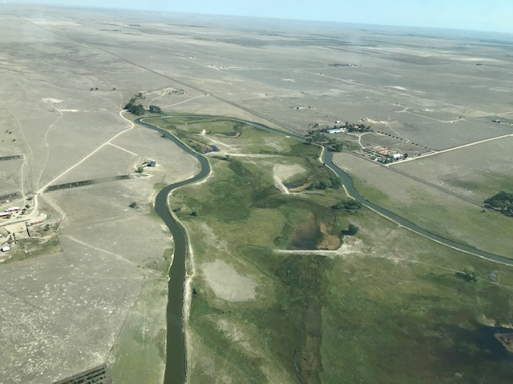
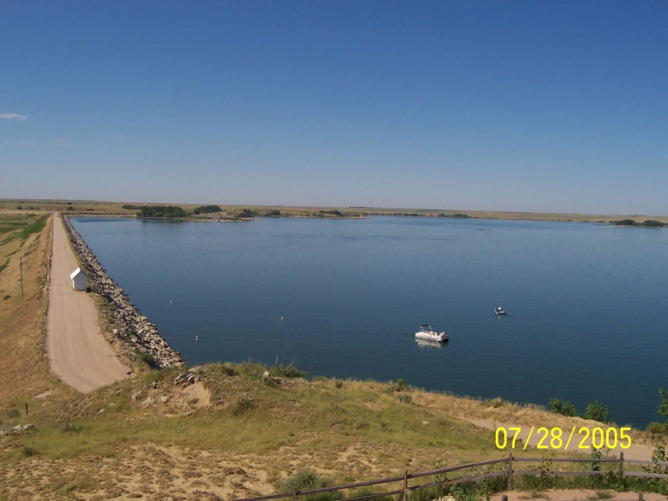
Benefits of Irrigated
Agriculture

Slide 24
Sections:
Upper
Lower (District 64)
Seasons:
Summer (April 1 – Oct. 15)
If flow at interstate station <120 c.f.s., then curtail rights in District 64 junior to June 14, 1897
Winter (Oct. 15 – April 1)
Colorado has full and uninterrupted use (except art. VI)

Slide 25
Article VI
1. Rights for Nebraska to construct, maintain and operate canal in CO.
2. Canal may divert net future flow
a. Colorado reserves the prior, preferred, and superior right to store 35,000 af
b. between Oct. 15 and April 1, Canal entitled to divert 500 c.f.s. under Dec. 17, 1921 appropriation date; no claim to water in Upper Section
3. No claim to water between April 1 and Oct. 15 other than surplus flows

Slide 27
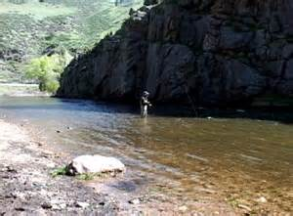
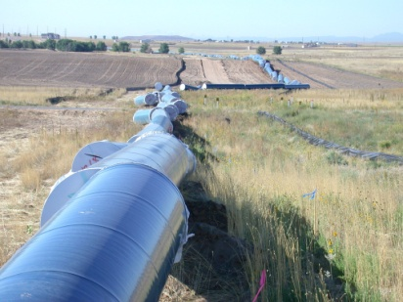
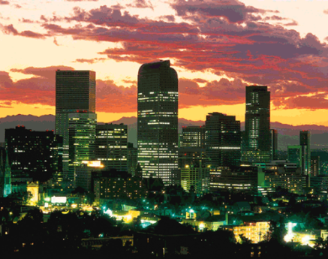
Questions?

Slide 28
Project Overview
Launched in 2019 between Parker Water & Sanitation District and the Lower South Platte Water Conservancy District.
An innovative, long-term water supply solution that will benefit both agricultural and municipal communities in the South Platte River Basin.
Notes:
Link to video: https://youtu.be/M5-mfpjwSyE.

Slide 29
Model for Future Water Development
Not just ‘do no harm’, but will provide benefits to our partners
We’re listening to our communities.
This is a true partnership with LSPWCD.
Setting policies to prevent activities that will harm the community
Consistent with practices outlined in the Colorado Water Plan
No buy and dry
Support from diverse stakeholders including agricultural, environmental, municipal, political, and Western Slope groups.
Notes:
Partnering with the Ag community – not just ‘no harm’ but provides a benefit. Give example (exchanging water from the Iliff reservoir up to our future forebay)
Supported by a very diverse stakeholder group (not sure its stakeholder is the right word). This includes ag, environmental, municipal, political, western slope, others? I think the quote from the Highlands Ranch author that comment on RWR and said DC has an opportunity to support a better solution would be impactful. Plus it introduces RWR in a passive way.

Slide 30
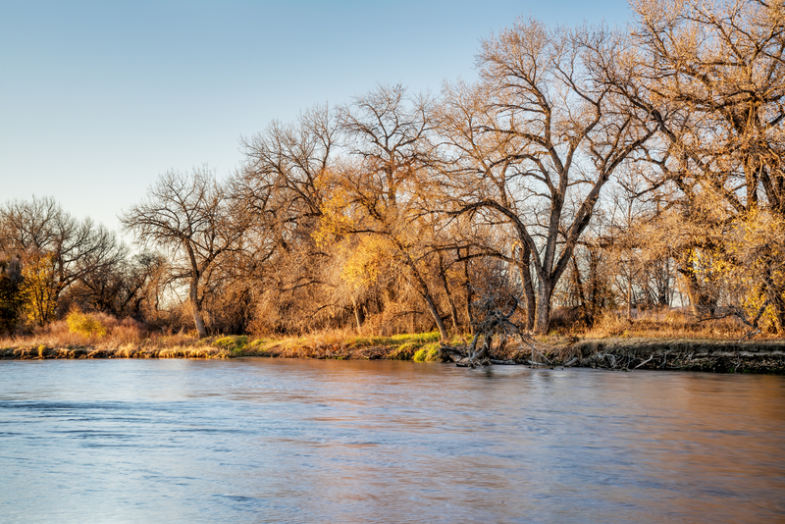
Support for the Plan
“This is an opportunity to keep water entitled to Colorado in Colorado to avoid future dry up of irrigated farms.” — Jerry Sonnenberg, Logan County Commissioner, former Colorado State Senator
“This is a win/win and shows how we can work together to meet water needs of ag and cities.” — Dan Kendrick, Morgan County Board Member of LSPWCD
“This is a monumental project. This is farmers working with cities for mutual benefits.” — Rod Mari, Logan Irrigation District Board
“I’ve been covering water for 40 years and this is one of the most exciting things I’ve seen.” — Jeff Rice, Sterling Journal-Advocate Reporter
“The citizens of Douglas County can choose to invest in a water future that cripples a rural community, or they can join Parker in leading the Front Range in a new direction — one that reflects the spirit of the Water Plan.” – Sarah Parmer, Director of Conservation for Colorado Open Lands
Notes:
Partnering with the Ag community – not just ‘no harm’ but provides a benefit. Give example (exchanging water from the Iliff reservoir up to our future forebay)
Supported by a very diverse stakeholder group (not sure its stakeholder is the right word). This includes ag, environmental, municipal, political, western slope, others? I think the quote from the Highlands Ranch author that comment on RWR and said DC has an opportunity to support a better solution would be impactful. Plus it introduces RWR in a passive way.

