Slide 1
Best Practices for Implementing Water Conservation and Demand Management Through Land Use Planning
Lindsay Rogers, Policy Manager for Municipal Conservation
Western Resource Advocates
February 14, 2024
Photo Courtesy of Resource Central

Slide 2
Western Resource Advocates
MT
WY
Federal & Regional Collaboration
NV
UT
State Legislatures
CO
State Agencies & Commissions
AZ
NM
Local Governments
Electric Utilities
Diverse Coalitions & Communities
WRA works across seven states in the Interior West to protect our climate, land, air, and water.
Notes:
WRA works across seven states in the Interior West to protect our climate, land, air, and water. Our offices serve as hubs for our dedicated team of policy experts, scientists, economists, engineers, and attorneys to leverage our organization’s unique strengths to drive solutions on a scale commensurate with the complex issues we face.
WRA recognized early on that we achieve the best results when we focus on the venues where decisions are made — at state legislatures, within state agencies and commissions, and working directly with utilities, local governments, and municipalities. By building policy solutions that address difficult conservation problems and collaborating with diverse coalitions, councils, and task forces across the region, we are tackling the West’s most pressing challenges. And we’re winning!
We are steadfast in our belief and in our commitment to a different future for the planet. When we have a smart plan, backed by science, a talented team, and dedicated supporters and partners, we can do big things.

Slide 3
AGENDA
Integrated Water & Land Use Planning
Introduction
Overview of strategies throughout the development process
Case studies
Questions

Slide 4
Why does municipal water use matter?
7% of total water use in Colorado
By 2050, 360,000 acre-feet/year projected M&I supply and demand gap
Population projected to be 7.5 million in 2050
Climate change & prolonged drought exacerbate supply challenges
~$93,000 - $98,000 per 1 AF of Colorado-Big Thompson project water
More demand can lead to buy-and-dry and increased pressure on rivers
Notes:
Muni sector is small % BUT we’re facing some very real challenges
By 2050, the CWP estimated our Municipal and Industrial sector will face a 360,000 AF supply and demand gap
To put that in perspective in 1 AF/year is about enough water for 2 CO households, so that’s about the equivalent of what 720,000 CO households use in a year
In this is largely because our population is growing so by 2050, Colorado is projected to grow by over 1.5M people
And that’s coupled with climate change and prolonged drought – or aridification in the region – straining our limited water resources
This increased demand on limited supplies means the price of new securing new supply is accelerating, here in Northern CO – the current price to secure 1 AF of C-BT water is reaching nearly $100,000
And it means or municipal demands are harming other water users like our farmers and ranchers through buy and dry and through increased pressure on our rivers and streams and the wildlife that depend on them
1 AF is enough for 2 Colorado households per year
(6 million today)
https://developmentwater.com/, https://www.sellingcoloradowater.com/buysellwater/, and personal email conversation with Brett Bovee, President, WestWater Research, LLC

Slide 5
Shift to Demand-side Water Management
Water Conservation = Encouraging water users to reduce their use
Water Efficiency = Requiring/encouraging the use of technology, building, or site design that uses less water
Water Reuse = Treating or converting gray and black water to replace/augment supplies
Notes:
This is why more and more of our communities are shifting to a demand-side water management approach where they’re investing in demand reduction solutions instead of a more traditional focus on acquiring new supplies.
3 main types of demand-side water management strategies –
When we talk about integrated water and land use planning, we’re talking about the integration of water conservation, efficiency and reuse strategies into all facets of land use planning

Slide 6
Decoupling Growth from Demand
Fort Collins grew by 6% from 2000 to 2015 and saw total water use reductions of 14%
Denver grew by 17% from 2000 to 2015 but saw total water use reductions of 28%
Colorado Springs has grown 92% since the mid-80s, but the City is using about the same amount of water today as it was 40 years ago
Notes:
When we shift to implementing these demand side solutions, we can actually start to decouple our population growth from our water demand meaning that even in the face of population growth and climate change, we can avoid or seriously downsize the need for new supplies
Significant investment in water conservation not only reduces per capita water demand, it also has the potential to reduce overall water demand even in the face of population growth and climate change, thus avoiding or greatly downsizing the need for additional water supplies and storage.

Slide 7
Reducing Outdoor Water Use
Nearly 50% of municipal water supplies in Colorado are used outdoors, mostly irrigating high water use turfgrass
Outdoor water use is consumptive
Replacing or limiting non-functional turfgrass is one our most impactful demand reduction opportunities

Slide 8
Why integrate water & land use planning?
Historically siloed, leading to inefficiencies
Significantly reduces water demand of new and redevelopment
Empowers communities to improve water efficiency within their own context
Increases resilience to drought and climate change
Align water supply and demands, even with population growth and declining supplies
“By 2025, 75% of Coloradoans would live in communities that have incorporated water saving actions into land use planning”
(CO Water Plan Goal, 2015)

Slide 9
Comprehensive Plans
Capital Improvement Plans
Water Efficiency Plans
Planning & Policy Making
Water adequacy requirements
Conservation-oriented tap fees
Pre-
Development
Zoning and subdivision regulations
Annexation policies
Planned development policies
Process incentives
Development Review
Building and plumbing codes
Landscape regulations
Water conservation rate structuring
Conservation incentives & education
Outdoor watering restrictions
Water budgets and auditing
Building & Construction
Post-
Occupancy

Slide 10
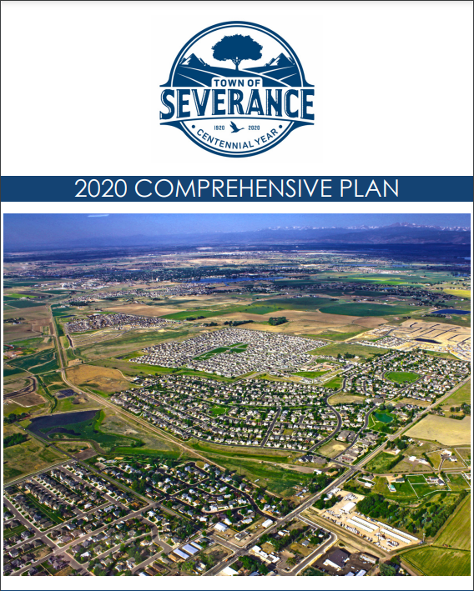
II. Planning & Policy- Making: Comprehensive Plans & Future Land Use Maps
Involved water staff, planners, electeds, and community members
Discrete water system and utilities chapter
Identified specific policies & strategies for securing new supplies & demand reduction
Aligned with HB20-1095: Local Governments Water Element in Master Plans (potential 2024 legislative update)
“Any proposal for changing land uses in or around Severance will be evaluated based on… Water resource availability and commitment to water efficient development practices.”

Slide 11
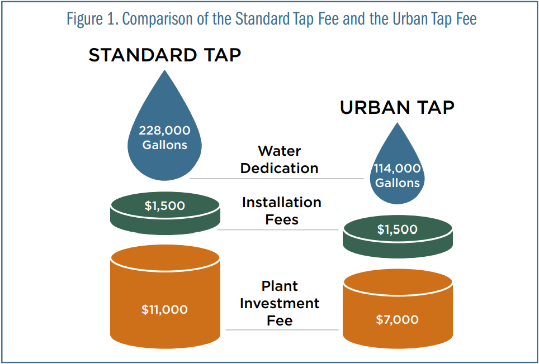
II. Pre-Development: Conservation-Oriented Tap Fees
Traditionally based on meter size
Conservation-oriented tap fees based on:
Lot size
Landscape area or materials
Number of bedrooms or bathrooms
Little Thompson Water District Example

Slide 12
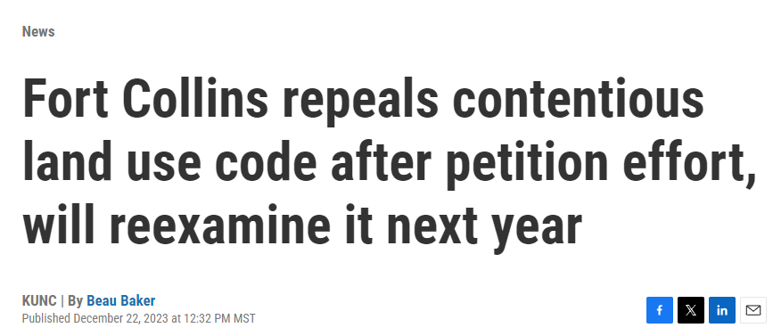
III. Development Review: Zoning Codes
Compact, infill development reduces water demand and infrastructure costs
Compared to a single-family home:
ADUs = 22% less water
Small Multi-Family Unit = 63% less
Large Multi-Family = 86% less
(Keystone Policy Center, 2018, Colorado Water & Growth Dialogue Final Report)
Zoning decisions intersects with other community values: Affordable housing, energy efficiency, transportation access, parking & traffic, sprawl & open space protection, neighborhood aesthetics
Notes:
Like many Front Range cities, Fort Collins is looking at ways to increase its affordable housing stock. The revised land use code sought to open up more options for builders in different zones of the city by allowing increased density. It also permitted ADUs, or Accessory Dwelling Units.
“Use by right” – not required.

Slide 13
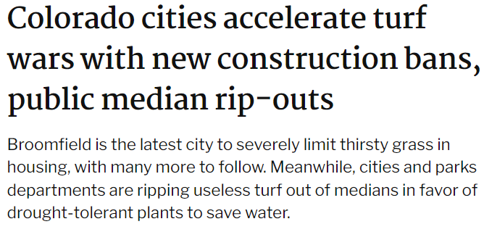
IV. Building & Construction: Landscape Regulations
Of CO’s 38 turf replacement programs, 18 (47%) of communities covered by these programs have a turf limit in their code
City & County of Broomfield Example:
Only 30% turfgrass allowed on all property types & must be drought-tolerant turf species
Maximum allowable water budget = 12 gal / sq ft
75% living plant material
Irrigation efficiency technology
Notes:
Thanks Laura, we’re going to shift gears for a few minutes to focus on some of the legislative efforts and other research and educational initiatives that are underway this year to advance Colorado’s landscape transformation goals.
This is by no means an exhaustive list of all the important work happening across the state but its a snapshot of some key initiatives to keep an eye on.

Slide 14
IV. Building & Construction: Landscape Regulations (cont’d)
SB24-005 Non-Functional Turf Limits Legislation
Sponsored by Senators Roberts & Simpson and Representatives McCormick & McLachlan
Prohibits installation of new non-functional turf on state facilities, commercial, industrial, and institutional properties, HOA common areas, parking lots, street rights of way, medians, and transportation corridors
Also prohibits new artificial turf and invasive plant species on these properties
Implementation date is Jan 1, 2026
Passed Senate, headed to House
Notes:
On the new development side, SB24-5 was introduced earlier this month and if passed it would limit the installation of new nonfunctional turf, artificial turf, and invasive plant species on applicable properties.
Those applicable properties include: state facilities, commercial, industrial and institutional properties, HOA common areas, street rights of way, medians, parking lots and transportation corridors. But it does not include residential properties.
The implementation deadline is Jan 1, 2026 for municipalities and counties to update their landscaping codes or standards, if needed.
The bill is sponsored by Senators Roberts and Simpson and Representatives McCormick and McLachlan, and as of earlier today it passed the Senate floor 28:5 and was headed to the House.
WRA has worked with the sponsors on some of the amendments to the bill, so we’d be happy to answer any question you have on bill language.

Slide 15
V. Post-Occupancy: Turf Replacement Incentives
38 turf replacement incentive programs; 9 in Northern CO (40% increase in 2023)
Residential & Commercial
Resource Central support
12.5 gal/ sq ft
median water savings
“Introduce a program to reduce the quantity of non-functional turf grass by 30% through replacement with drought- and climate-resilient landscaping...”
- CO River Basin MOU, Aug 2022
$1.69/ sq ft
median rebate
Notes:
This year we’re anticipating significant new funding for the state’s turf replacement program
In November, the CWCB board approved a $2M annual appropriation for inclusion in the State’s 2024 Projects Bill
And in September, CWCB also granted $1.5M to Resource Central to expand their turf replacement program support over the next 3 years, with an emphasis on new West Slope programs
And finally, the Colorado River Drought Taskforce released their recommendations last month, which included support for continued state funding of $5M annually
We’re not sure we’ll quite reach that $5M figure this year, but we’re excited to see the broad support for ongoing state funding for turf replacement across the water sector.
Northern CO = 9 entities : Greeley, Fort Collins, Longmont, Northern Water, Berthoud, Evans, Frederick, Loveland Water & Power, Little Thompson Water District,

Slide 16
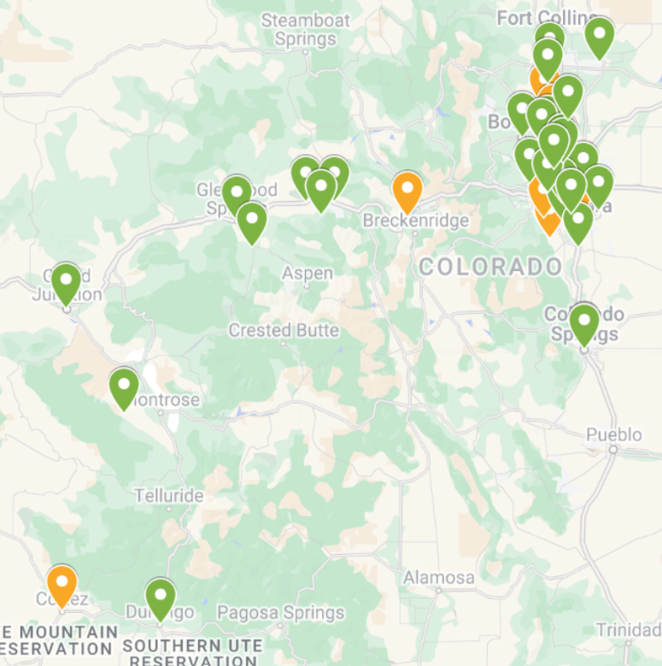
V. Post-Occupancy: Turf Replacement Incentives (cont’d)
State Turf Replacement Funding Program
HB22-1151 provided $2M initial appropriation
Funded 50 programs and projects
Up to $50,000 each
$1.5M additional grant provided to Resource Central in 2023
$2M requested in 2024 Projects Bill
CWCB map of funded & contracted entities.
Turf replacement program
Turf replacement project
Notes:
This year we’re anticipating significant new funding for the state’s turf replacement program
In November, the CWCB board approved a $2M annual appropriation for inclusion in the State’s 2024 Projects Bill
And in September, CWCB also granted $1.5M to Resource Central to expand their turf replacement program support over the next 3 years, with an emphasis on new West Slope programs
And finally, the Colorado River Drought Taskforce released their recommendations last month, which included support for continued state funding of $5M annually
We’re not sure we’ll quite reach that $5M figure this year, but we’re excited to see the broad support for ongoing state funding for turf replacement across the water sector.

Slide 17
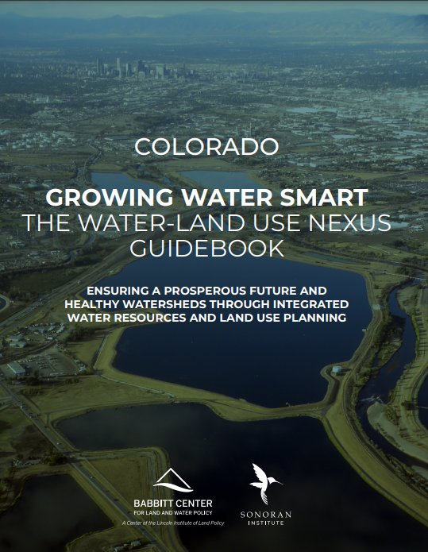
Want to learn more?
3-day workshop
Community teams of 5-7 planners, water managers & electeds
Develop 12-month action plan
Follow-up technical assistance
Next round: Fall 2024
sonoraninstitute.org/growingwatersmart/
Notes:
Anyone had a chance to participate in GWS?
Another round in Fall 2024

Slide 18
LINDSAY.ROGERS@WESTERNRESOURCES.ORG

