Slide 1
Finding Water for New Developments and it’s Impact on Housing Affordability
Water Literate Leaders
February 14th, 2024

Slide 2
Topics Discussed today
Pricing Trends
AREAS that require water to be Brought
Process to find / acquire water
Competition
Changing Marketplace
How Does the Price of water effect Affordable Housing

Slide 3
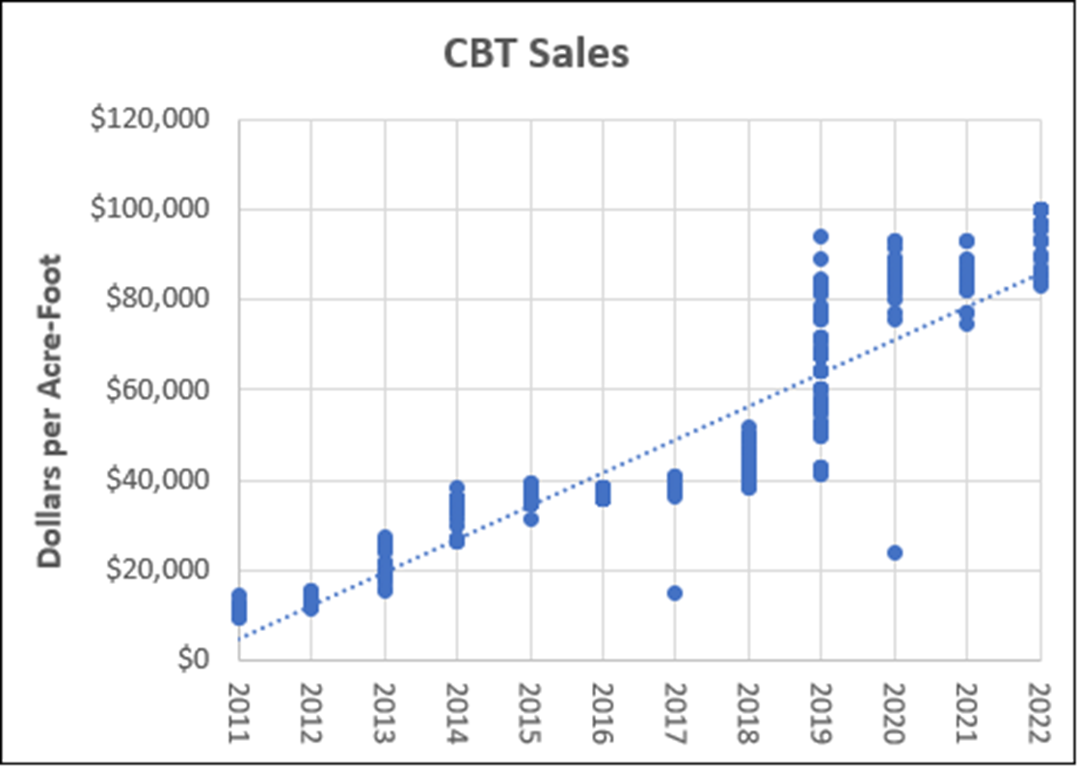
What is Driving developers to think differently?
Avg. $/Share = $60,000
Avg. Yield AF Pricing (.7AF) = $ 85,714
Firm Yield AF Pricing (.5AF) = $ 120,000
Average Price per Share
Source: WestWater Research, LLC

Slide 4
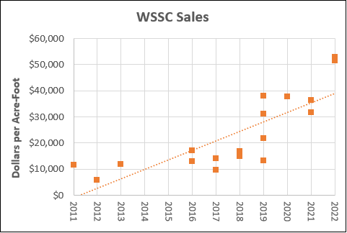
Historic Water supply and Storage Pricing
Avg. $/Share = $4,100,000
Avg. Yield AF Pricing (60 AF) = $68,333
Average Price per Acre Foot
Source: WestWater Research, LLC, November 2022

Slide 5
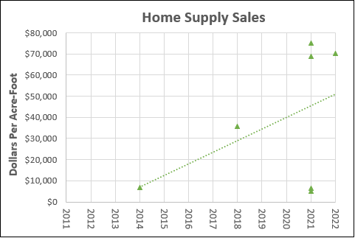
Historic Consolidated home Supply Pricing
Avg. $/Share = $635,000
Avg. Yield AF (Changed Share) Pricing (8 AF) = $79,375
Source: WestWater Research, LLC, November 2022

Slide 6
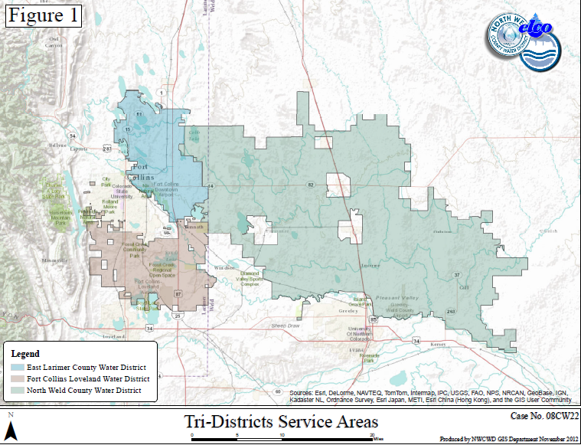
NOCO PROVIDERS requiring “Wet” water Dedication

Slide 7
PROCESS TO FIND AND AQUIRE WATER
Understand your Need
Indoor Use
Outdoor Use
Understand What Shares work within what systems
Different Water Providers accept different shares for dedication
This is a function of can they treat it or not
Familiarize yourself with the nuisances of the dedication policies of the provider you are dedicating too
What fees are associated with the dedication?
What is the timing of dedication?
Understand the Shares you are seeking to Buy
Not all shares are created equal
The same rights on different parts of the system will yield different results
What is the Historical Consumptive Use?
Is that changing over time?
Do I need to Dry-Up?
Enter the Market
Be prepared to buy quickly
Will not be able to wait for your project to get approved to buy
Be prepared to buy land
Be prepared for very short due diligence periods

Slide 8
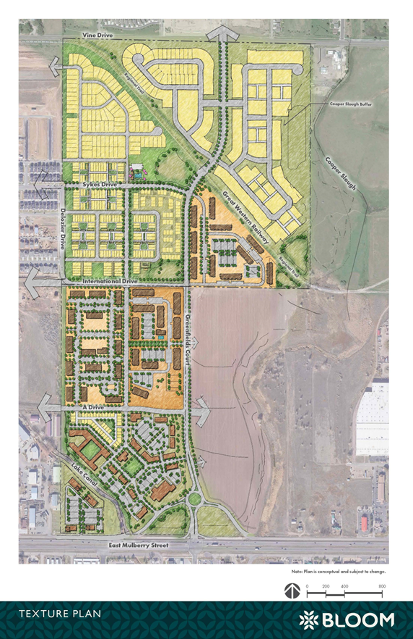
Example Cost “CBT” as a Function of Project
Bloom Community (East Mulberry - FC)
1,800 Total Units on 225 Acres
Cottages / Traditional Single Family / Condos / Affordable Apts. and Market Apts. / Commercial
Water Needs
1,800 Total Units at .22 AF/Unit = 396 AF Needed for Project
396 AF = 566 CBT Units (0.7 AF / Unit) at $60,000/Units
Acquisition Price of CBT = $33,960,000
$151,00 / Ac for Water vs. $44,000/Ac for Real Estate
Water is ~3.43X the price of the Real Estate!

Slide 9
Example Cost “AG Water” as a Function of Project
Bloom Community (East Mulberry - FC)
1,800 Total Units on 225 Acres
Cottages / Traditional Single Family / Condos / Affordable Apts. and Market Apts. / Commercial
Water Needs
~1,800 Total Units at .22 AF/Unit = 396 AF Needed for Project
396 AF = 7.33 WSSC Units (54 AF / Share) at $4,000,000/Share
540 Acres Ag. Ground at $7,000/AC. = $3,780,000
Acquisition Price of WSSC / Farm = $33,100,000
$147,000 / Ac for Water vs. $44,000/Ac for Real Estate
Ag. Water is ~3.34X the price of the Real Estate!

Slide 10
Example Cost COFC - Tapestry
Tapestry (SEC of 3rd and Buckingham - FC)
140 Total Condo Units
Indoor Water Needs
140 Total Units at .08 AF/Unit = 11.25 AF Needed for Project Indoor Use Only
11.25 AF at $68,200* = $767,705 or $5,483/Unit Indoor Use Only
Outdoor Water Needs
7.55 Acre Site with 30% as Irrigated Area or 2.265 Acres
Of Irrigated Area 75% is Turf and 25% is Shrub beds
4.7 Acre-Feet of Water
4.7 Acre-Feet $68,200* = $320,540 or $2,300/Unit Outdoor Use
Total Cost per Unit = $7,783 / Unit
* Indicated current Fort Collins CIL Cost
PROPOSED FC CIL COST = $179,500 per Acre Foot or $20,450!!!!

Slide 11
So you have the money……NOT SO FAST Changed MUNICIPAL Shares are Running Out - CBT – 310,000 Units 70% of system already in M&I, 20% likely to remain in Ag - Water Supply and Storage – 600 Shares 400 Shares Owned By Thornton - NPIC – 10,000 Shares 65% in Municipal ownership – 2009, Windsor Potable water Master Plan Competition is Still Stiff. With a slow up in building we have seen a recent moderation in price increases and in some cases a slight decrease. HOWEVER, Builders are Still competing with Local Municipalities, south Weld County Builders and Municipalities, and Metro Area Municipalities for the same Poudre River Rights.

Slide 12
Out of Region Competition
Source: Arapahoe County Water and Wastewater Authority 2015 Municipal Water Efficiency Plan Update

Slide 17
“Look ahead and plan for others as others have planned for you” - Greeley tribune, 1941

Slide 18
Thank You!

