Slide 1
“Impact of Buy and Dry”
Greg Peterson
Executive Director
coagwater@gmail.com
www.coagwater.org

Slide 2
What is Political Economy?

Slide 3
What is Political Economy?
How politics affects the economy and how the economy affects politics

Slide 4
What is Political Economy?
How politics affects the economy and how the economy affects politics
The different economic theories of a bunch of dead guys
How to best manage natural resources

Slide 5
How do we as countries, states, and communities manage natural resources?
Oil and natural gas
Precious minerals
Water

Slide 6
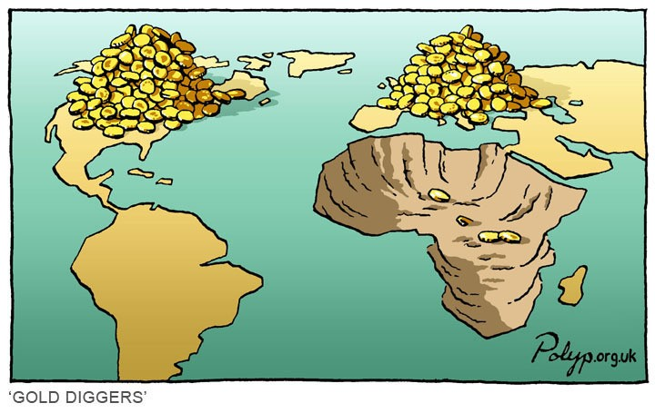

Slide 7
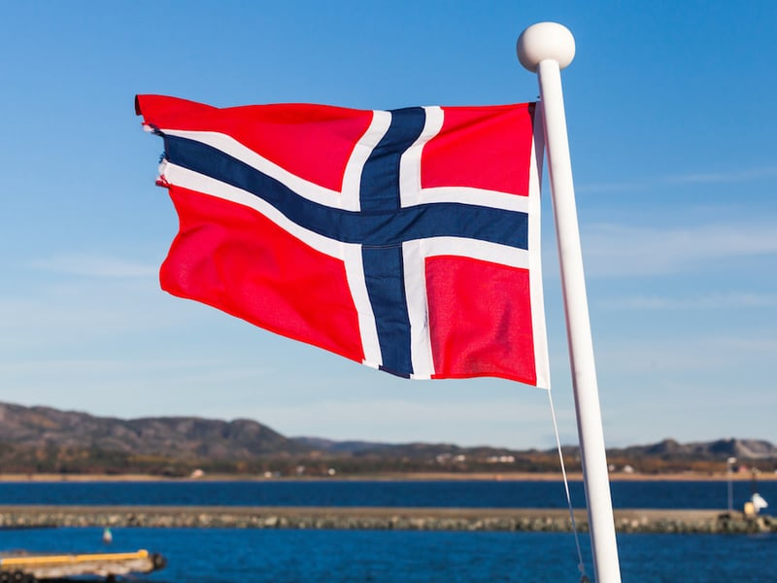
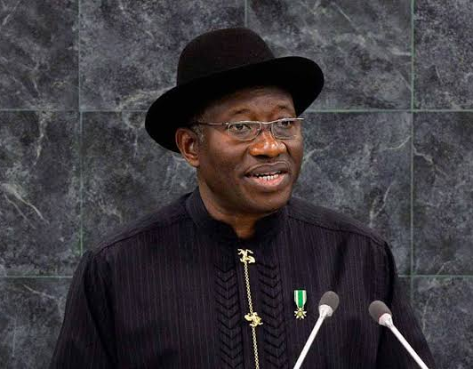

Slide 8
Water (like oil) is a resource that creates development and wealth What happens when a resource “leaves” the community?

Slide 9
Loss of primary economic industry
Loss of secondary businesses that rely on and support agriculture
Difficulty to pursue future development
Impact on county services
Value of irrigated ag lands: $6,000 per acre
Value of dried-up lands: $1,200 per acre

Slide 10
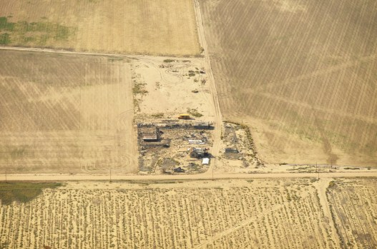

Slide 11
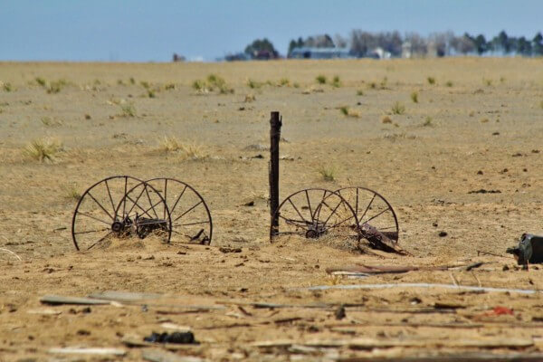

Slide 12
Revegetation isn’t easy
Dust storms
Tumbleweeds
Fuel for grassland fires

Slide 13
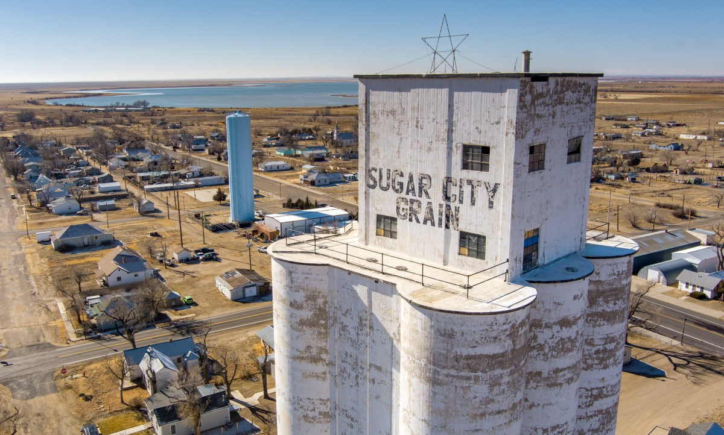
Revegetation isn’t easy
Dust storms
Tumbleweeds
Fuel for grassland fires

Slide 14
Crowley County
People living below poverty line: 24.9% (Colorado average is 9.6%)
Average household income: $37,870 (Colorado average is $80,184)
County Health Ranking: 57th
Largest employer: county prison system
Revegetation isn’t easy
Dust storms
Tumbleweeds
Fuel for grassland fires

Slide 15
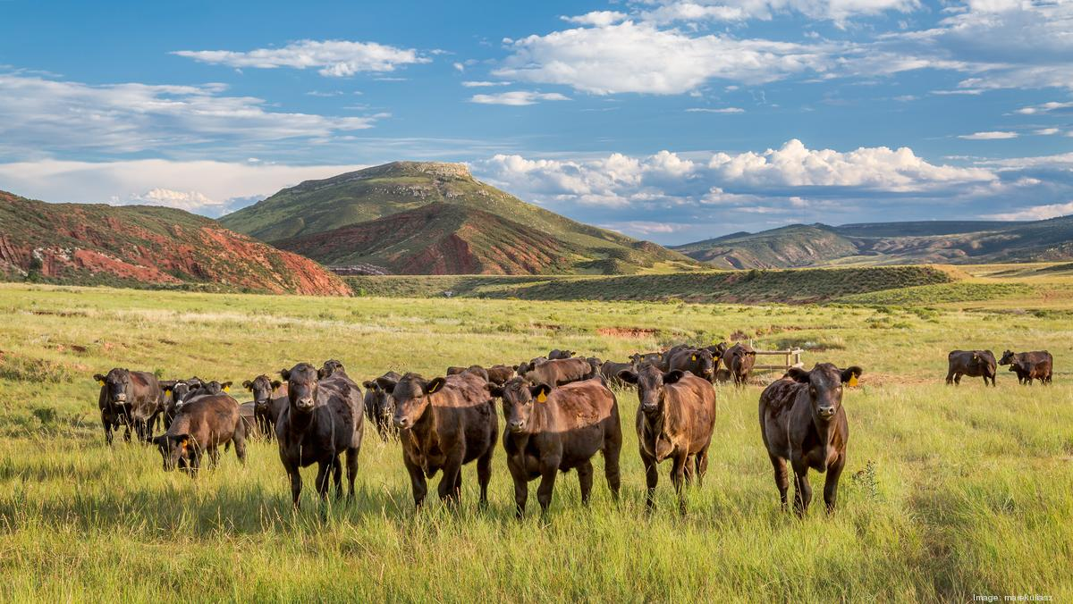
Revegetation isn’t easy
Dust storms
Tumbleweeds
Fuel for grassland fires

Slide 16
Drying up some of the most productive and efficient agricultural systems in the world
What is going to replace it?
Global GHG Emissions from livestock: 11% – 19% and going up
US Livestock GHG Emissions? 3-4% and trending down
New agriculture abroad = deforestation
Revegetation isn’t easy
Dust storms
Tumbleweeds
Fuel for grassland fires

Slide 17
How many cows does it take to produce the same amount of milk as one cow in the US?
Mexico?
India?
How many cows does it take to produce the same amount of finished beef as one cow in the US?
Brazil?
India?
Revegetation isn’t easy
Dust storms
Tumbleweeds
Fuel for grassland fires

Slide 18
How many cows does it take to produce the same amount of milk as one cow in the US?
Mexico? 3 dairy cows
India? 20 dairy cows
How many cows does it take to produce the same amount of finished beef as one cow in the US?
Brazil?
India?
Revegetation isn’t easy
Dust storms
Tumbleweeds
Fuel for grassland fires

Slide 19
How many cows does it take to produce the same amount of milk as one cow in the US?
Mexico? 3 dairy cows
India? 20 dairy cows
How many cows does it take to produce the same amount of finished beef as one cow in the US?
Brazil? 3 beef cows
India? 10 beef cows
Revegetation isn’t easy
Dust storms
Tumbleweeds
Fuel for grassland fires

Slide 20
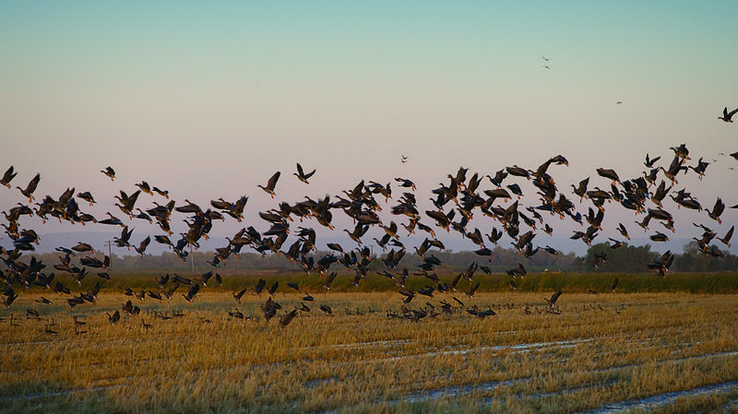
Revegetation isn’t easy
Dust storms
Tumbleweeds
Fuel for grassland fires

Slide 21
On the Front Range, irrigated agriculture and ditch system provide over 90% of riparian habitat in most counties
We’ve lost most of our natural wetlands to development in the 20th century.
Irrigated agriculture critical for migratory bird species
Revegetation isn’t easy
Dust storms
Tumbleweeds
Fuel for grassland fires

