Slide 1
Stakeholder Engagement in Northern Colorado Water & Beyond
February 14, 2024
Karen Schlatter, Associate Director
Colorado Water Center

Slide 2
Stakeholder Engagement, Collaboration and Water
What are our values for our water resources – how do we fulfill and sustain them into the future?
How do we balance diverse needs, complex administration, & changing climate & hydrology?
Who has a voice and a seat at the table in decision-making around water? Who doesn’t?
What are the challenges and opportunities for stakeholder engagement?
How do we encourage more inclusive and collaborative discussions around water in CO?

Slide 3
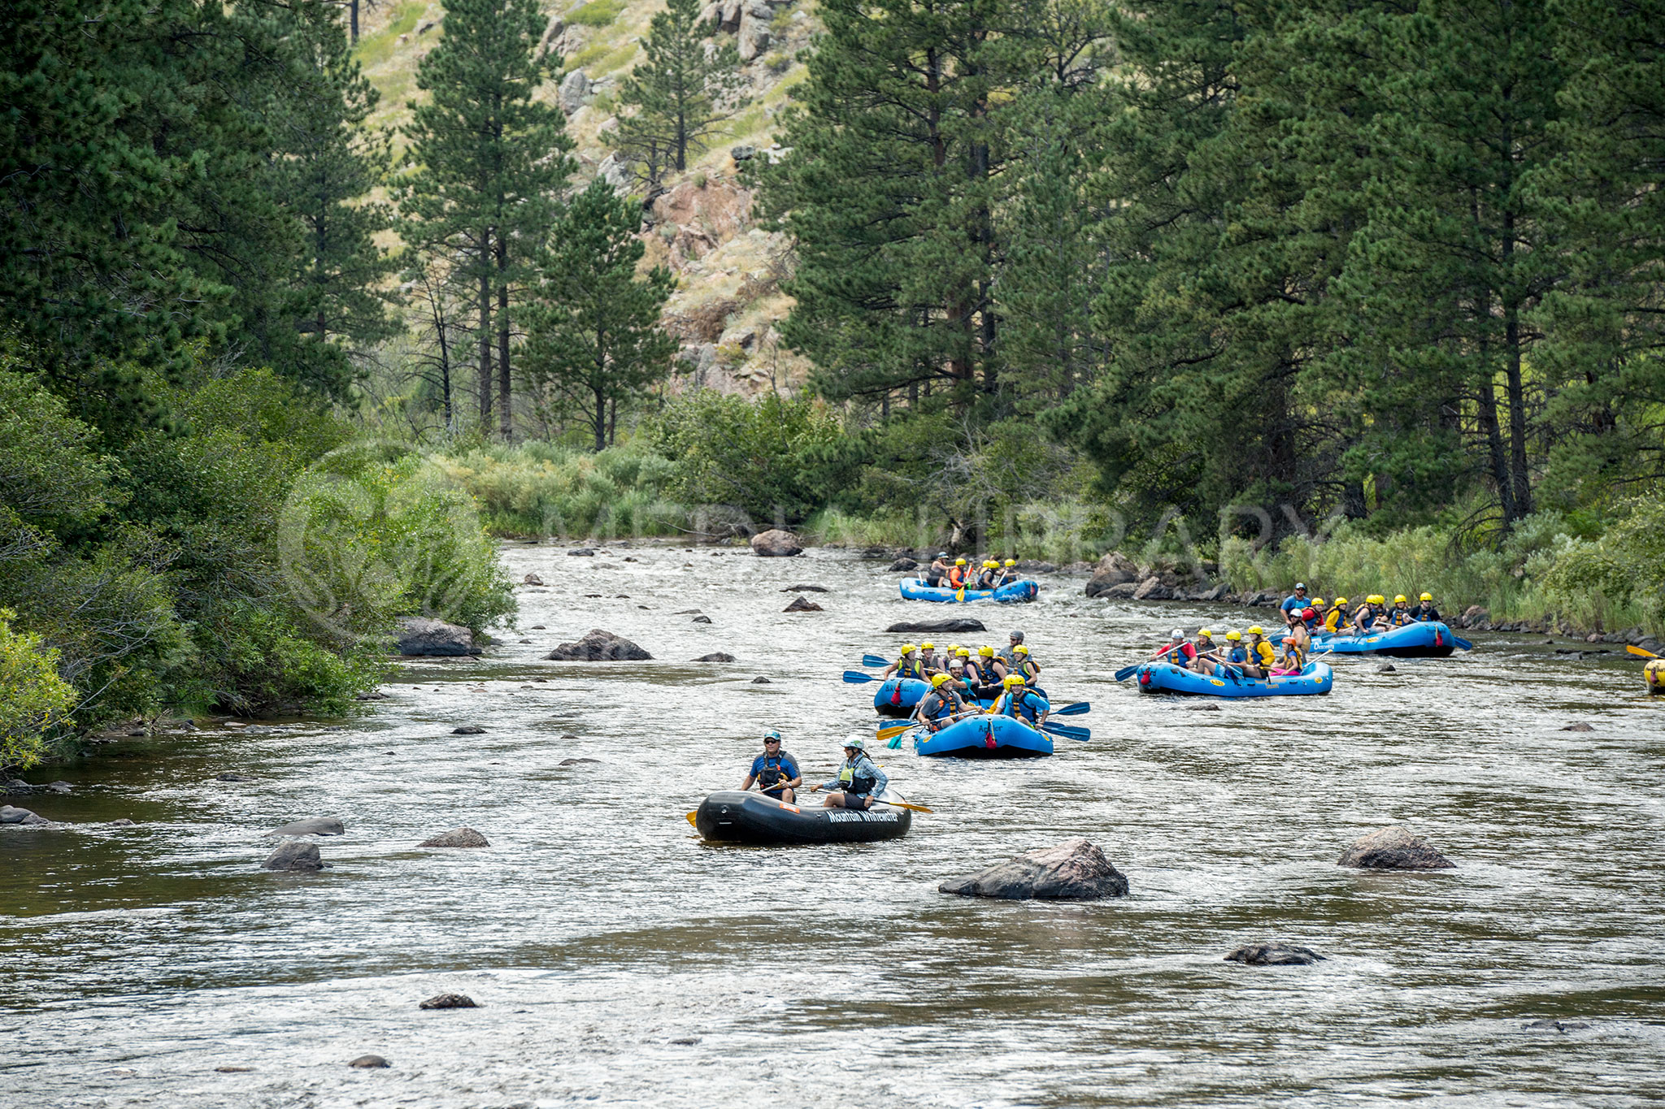
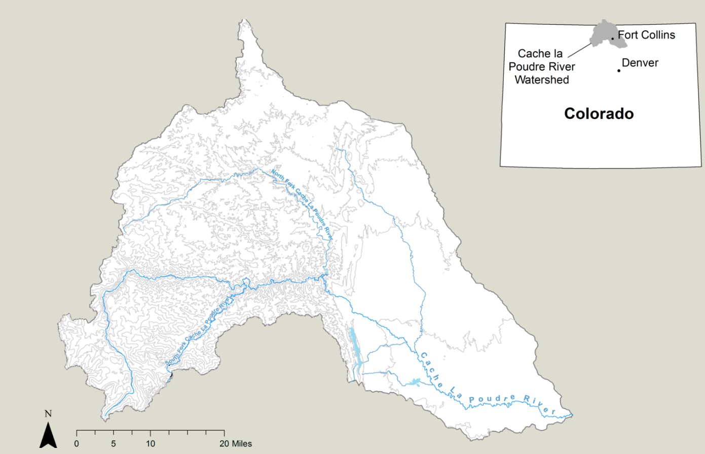
Cache la Poudre Watershed – A Case Study
Average water supply of 274,000 acre-feet/year
Source: https://www.poudrewatershed.org

Slide 4
Cache la Poudre - Uses
Municipal: Fort Collins, Greeley, Timnath, Windsor
Water supply for more than 400,000 residents
Agricultural: >151,000 acres of irrigated agricultural land
Industrial: Breweries; Oil & gas
Recreational
75 miles designated as part of National Wild and Scenic Rivers System
Fishing, rafting, kayaking, hiking/walking, camping, bicycling
Urban greenway – Poudre River Trail
Ecological: threatened and endangered fish, wildlife & plant species
Source: Coalition for the Poudre River Watershed

Slide 5
Cache la Poudre – Groups
Coalition for the Poudre River Watershed – To improve and maintain the ecological health of the Poudre River watershed through community collaboration
Save the Poudre – To protect and restore the Cache la Poudre River
Poudre Runs Through It – To make the Poudre River the world’s best example of a working river that’s also healthy
Cache la Poudre River National Heritage Area – To promote a variety of historical and cultural opportunities; engage people in the river corridor; and inspire learning, preservation, and stewardship

Slide 6
Northern Integrated Supply Project

Slide 7
Stakeholder Engagement Best Practices
Identify stakeholders – anyone with an interest in the issue
4I’s: Interested, Influential, Invested, Impacted
Ensure historically excluded and underserved communities have seat at table
Notes:
Going beyond permit approval to meaningful and successful stakeholder engagement and collaboration.
Will get range of engagement with stakeholders.
Some people will not ever collaborate.

Slide 8
Notes:
Going beyond permit approval to meaningful and successful stakeholder engagement and collaboration.
Will get range of engagement with stakeholders.
Some people will not ever collaborate.

Slide 9
Notes:
Going beyond permit approval to meaningful and successful stakeholder engagement and collaboration.
Will get range of engagement with stakeholders.
Some people will not ever collaborate.

Slide 10
Stakeholder Engagement Best Practices
Identify stakeholders – anyone with an interest in the issue
4I’s: Interested, Influential, Invested, Impacted
Ensure historically excluded and underserved communities have seat at table
Connect
Develop engagement and outreach strategies specific to different stakeholder types (consider type of communication, language, message, framing, incentives for participation)
Connect with community leaders and points of contact
Listen to understand perspectives and experiences
Conflict is ok and expected; create safe environment where sharing is valued
Recognize and understand your own interests and biases
Identify needs, interests, concerns
Notes:
Going beyond permit approval to meaningful and successful stakeholder engagement and collaboration.
Will get range of engagement with stakeholders.
Some people will not ever collaborate.

Slide 11
Stakeholder Engagement Best Practices
Identify power dynamics, strive to level playing field for engagement
Hire a good facilitator (or several)
Unbiased; leads group process, dialogue, negotiation, decision-making
Build relationships; build trust in people and process
Take into account past wrongs and/or relationship history
Transparent and iterative/adaptable process; equitable engagement
Informal spaces for conversation and networking
Co-develop goals and outcomes
Shared understanding of timelines, expectations, & roles/responsibilities
Robust discussion of tradeoffs, uncertainties
No one wins; goal is not to reach consensus but reach “I can live with this”
Notes:
Facilitators also design efficient meetings. Don’t waste peoples’ time.

Slide 12
Conclusions
Successful stakeholder engagement and collaboration take a lot of time and are usually very challenging
Collaboration builds more collaboration – creation of long-lasting relationships and learned skills
Stakeholder engagement & collaboration are imperative for ever-evolving management of socio-environmental issues (“solving” the problem is not realistic)

Slide 13
Questions?

Slide 14
Stakeholder Identification & Mapping Exercise
Form groups of 3
Select a water issue – ideally from someone’s work or something you’ve heard over the course of WLL
To your best ability, identify stakeholders involved and map them out
Share out your discussion & map with the full group

