Slide 1
A Land Made From Water – Appropriation and the Evolution of Colorado’s Landscape, Ditches, and Water Institutions
By Robert R. Crifasi
Reviewed by Deb DeBoutez and Laura Quattrini

Slide 2
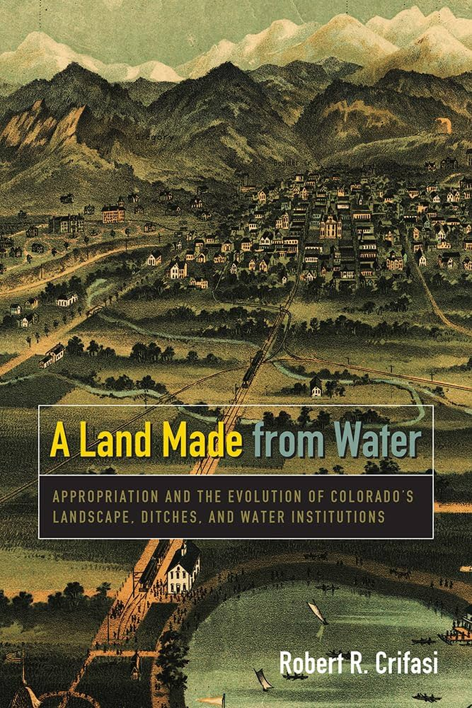
Brief Synopsis & Important Takeaway
Chronicles the settlement of pioneers in Colorado’s Front Range with specific focus on Boulder Valley
Native and Spanish influence → Pioneers → Agricultural colonies → Growing cities → Modern Era
Tracks the development of and commodifying(?) water: Management institutions
Water for the people → Water for profit → Water to be governed
Showcases the complex interaction of people and the environment over time
Mining
Beaver trapping / buffalo extirpation
Water movement
Wetland creation; riparian expansion

Slide 3
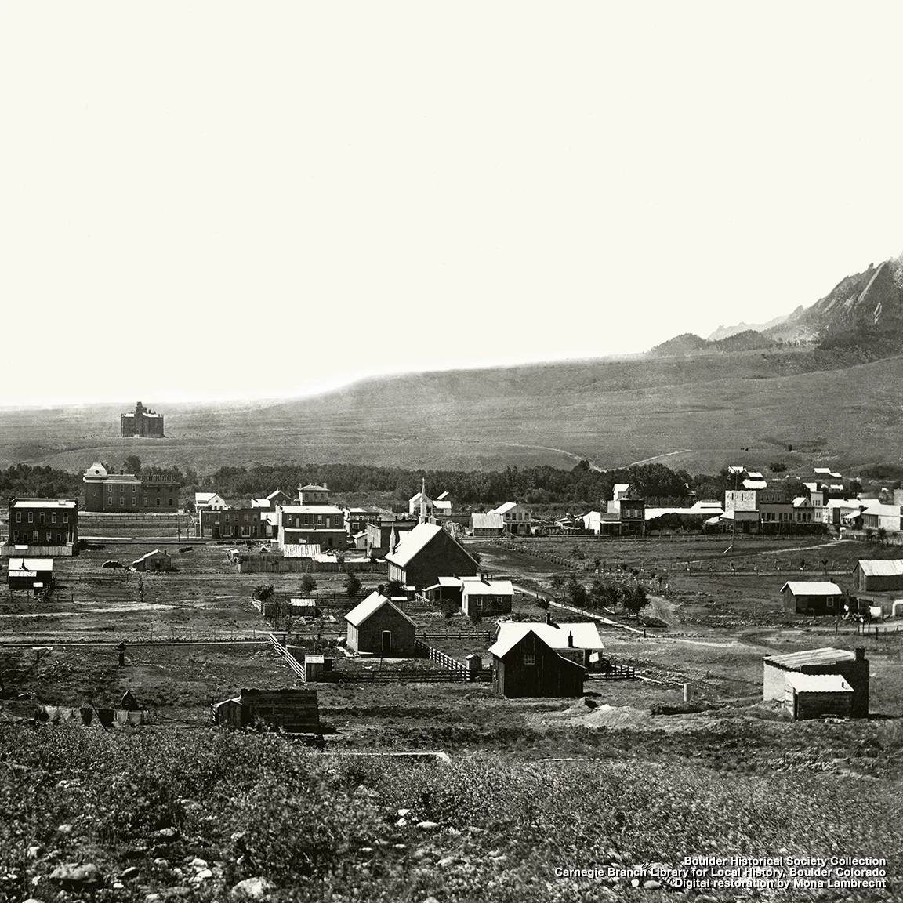
Strengths of the Book: What we liked
Perspective of human impact on ecosystem:
“The one constant is change itself”
Romanticized what it was like to be a pioneer
Detailed the process of digging a ditch
“Taking” of Colorado from Native Americans
Matter-of-fact
Comprehensive: Good for history aficionados – especially those more interested in Boulder
Notes:
1. Last chapter – philosophical: about how the environment is ever changing, never a precious time before man came; nature was destroying and building itself repeatedly; we are part of the process; settlements did help CO (natural viability)
3. doesn’t vilify or condone what we did, it happened for good or bad

Slide 4
Challenges: What we least liked
Dull: Too many irrelevant details – could have been shorter

Slide 5
Would we recommend and why?

